Slide 1
CERN PS impedance localization update
N. Biancacci
Transverse impedance localization method
Application to the PS
Conclusion and Outlook
MSWG 15-03-2013

Slide 2
Acknowledgement
PS operators,
G.Arduini, R.Calaga, H. Damerau,
R. De Maria, S.Gilardoni, M.Giovannozzi,
C.Hernalsteens, M.Migliorati, E.Métral,
N.Mounet, G.Rumolo, B.Salvant, G.Sterbini,
S.Persichelli, R.Wasef

Slide 3
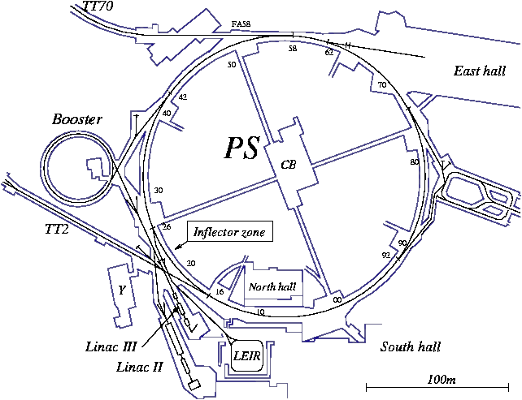
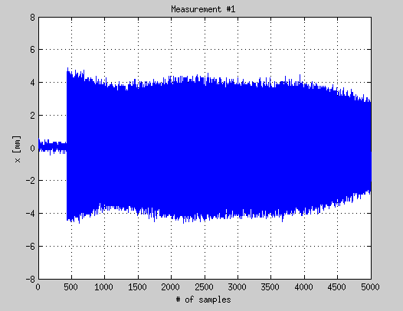

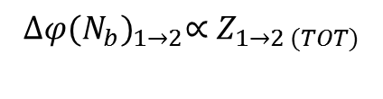
Transverse Impedance Localization Method
The method for local measurements was proposed and applied by G. Arduini et al. in 2004 and 2009 in SPS [1,2] and benchmarked with HEADTAIL.
Local measurements: variation of phase advance between BPMs with intensity.
$${∆φ\text{(}N_{b}\text{)}}_{1→2}∝Z_{1→2 (TOT)}$$
Global measurements:
variation of tune frequency with intensity.
$∆\text{Q}\text{(}N_{b}$)$∝Z_{⊥ (TOT)}$
[1] "Localizing impedance sources from betatron-phase beating in the CERN SPS", G. Arduini, C. Carli , F. Zimmermann EPAC'04.
[2] “Transverse Impedance Localization Using dependent Optics” R.Calaga et al., PAC’09.

Slide 4
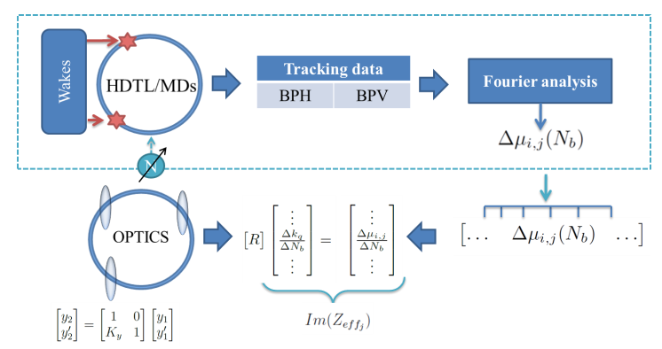
Transverse Impedance Localization Method
The aim of the measurement is: correlating the phase advance beating variation with intensity with a local source of impedance.
In “optical” terms, an impedance would behave as a (de)focusing intensity dependent quadrupole.

Slide 5
Impedance Budget Flowchart
RECONSTRUCTION
Theory
Impedance budget
Measurements
Estimations
Global impedance
Local impedance
Machine
Measurement accuracy

Slide 6
Impedance Budget Flowchart
RECONSTRUCTION
Theory
Impedance budget
Measurements
Estimations
Global impedance
Local impedance
Machine
Measurement accuracy

Slide 7
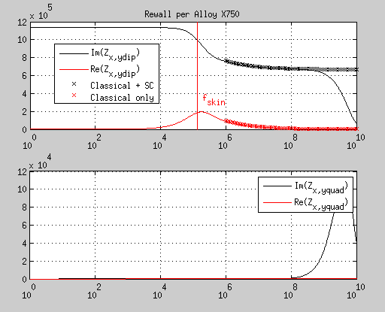
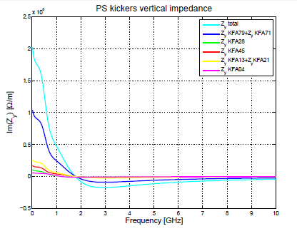
Impedance budget
A PS impedance database is being constructed @ 2 GeV.
Rewall+SC
Kickers
SC
dipolar
S.Persichelli
quadrupolar
Mounet-Métral code

Slide 8
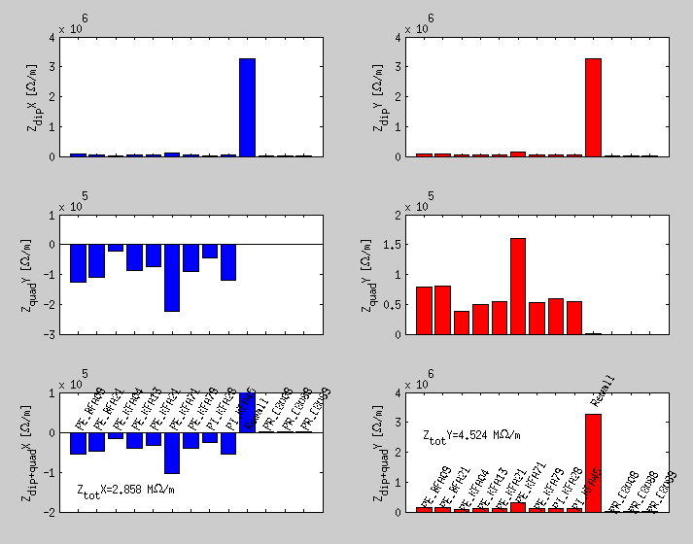
Global PS impedance estimations
+SC
We estimated a partial impedance budget at injection:
Resistive wall + Indirect space charge;
Kickers (Tsutsui)
Cavities 80MHz (negligible)
Ver. plane: 4.5 MOhm/m.
Hor.plane= 2.8 MOhm/m.

Slide 9
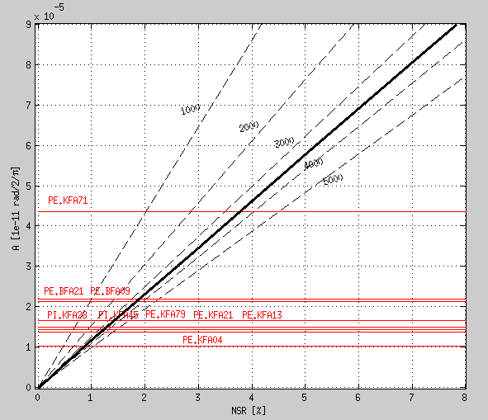

Local PS impedance estimations
Case M=100, X=[1e11->1e12]
The impedance-induced beating can be calculated and compared with the accuracy expected or required from measurement:
$$σ_{\frac{∆φ}{∆N}}∝\frac{NSR}{σ_{X}\sqrt{N}\sqrt{M}}$$
N=
N=
N=
Impedance-induced beating amplitude from theory (Sacherer)

Slide 10
Impedance Budget Flowchart
RECONSTRUCTION
Theory
Impedance budget
Measurements
Estimations
Global impedance
Local impedance
Machine
Measurement accuracy

Slide 11
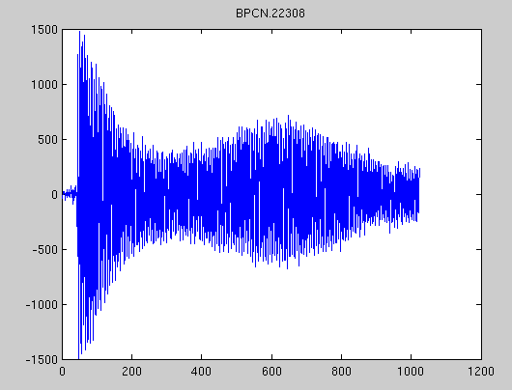
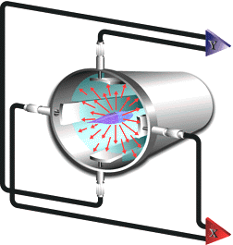
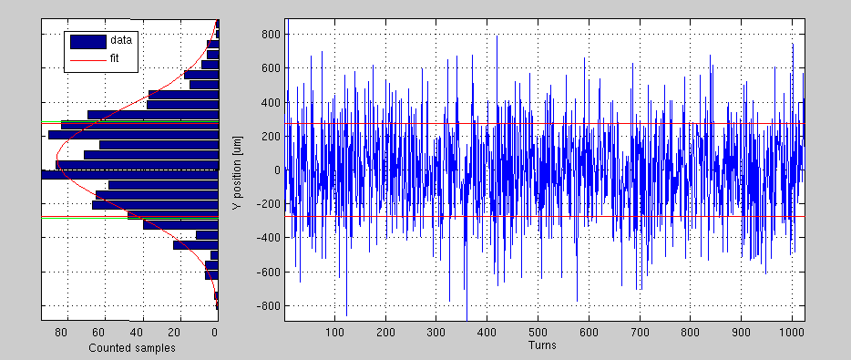
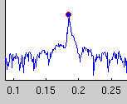





Machine
The uncertainty chain:
$$σ_{n}$$
$$NSR=\frac{σ_{n}}{A}$$
FFT
A
Noise Signal Ratio
BPM system
$$σ_{∆φ}$$
$$σ_{\frac{∆φ}{∆N}}$$
Phase advance accuracy
Phase advance slope accuracy

Slide 12
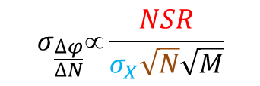
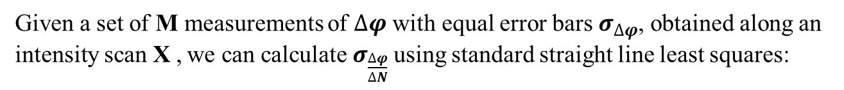
Accuracy of phase advance measurements
Given a set of M measurements of $∆φ$ with equal error bars $σ_{∆φ}$, obtained along an intensity scan X , we can calculate $σ_{\frac{∆φ}{∆N}}$using standard straight line least squares:
To be reduced
(noise level, kicker strength, BPMs gain, BPM transfer function)
$$σ_{\frac{∆φ}{∆N}}∝\frac{NSR}{σ_{X}\sqrt{N}\sqrt{M}}$$
To be increased: M= number of measurements. Usually a 100 points it’s the case.
To be increased: It is the width of the scan of intensity. Upper threshold can be TMCI. Lower is BPM sensitivity.
To be increased: N=Number of turns. Depends on ability on hardware and data trasmission from BPM to storage.
This quantity has to be compared with the impedance-induced phase beating amplitude!

Slide 13
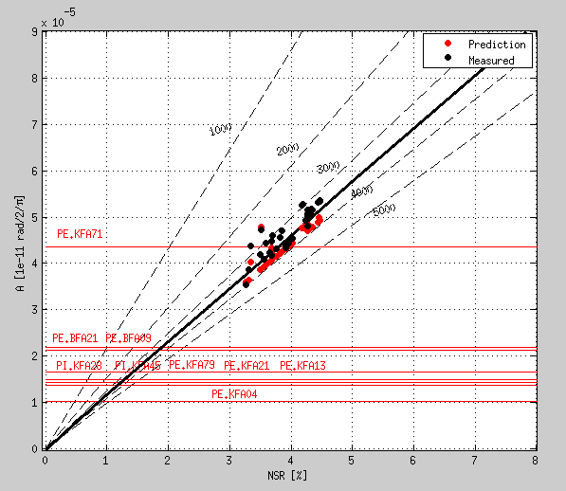
Local PS impedance estimations
MD on 05-02-2013_#2
The impedance-induced beating appears to be small with respect to the measurement accuracy usually achieved (NSR~5%) during MDs.
Only big impedance source are expected to be localized.

Slide 14
Impedance Budget Flowchart
RECONSTRUCTION
Theory
Impedance budget
Measurements
Estimations
Global impedance
Local impedance
Machine
Measurement accuracy

Slide 15
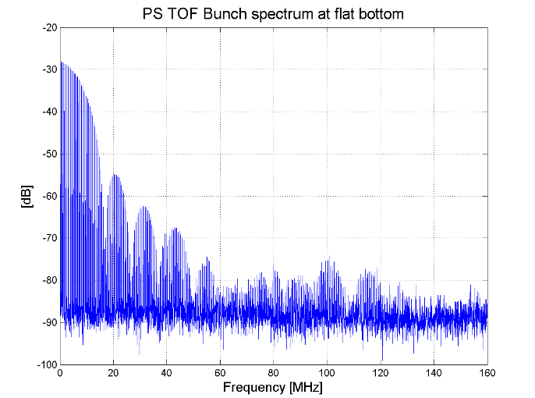
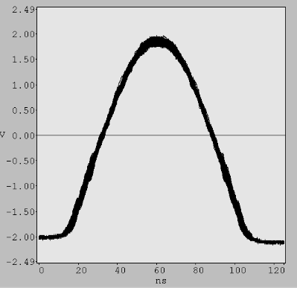
Measurements
The measurement were done with single bunch at injection energy 2GeV, with a TOF beam.
Intensity scan is usually from ~1e11 to ~1e12 ppb.
TFB was used as vertical kicker.
The smallest bunch length is 90ns (4σ) with 200kV on 10MHz cavities.
H.Damerau, S.Persichelli

Slide 16
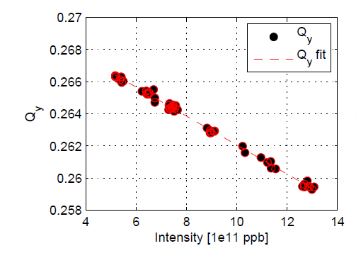
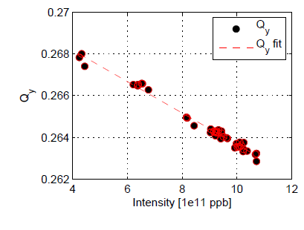
Measurements
PS-05-02-2013_#2
Bunch length~90ns (rf@200kV)
Ztot~6.5 MOhm/m (from tune shift)
PS-05-02-2013_#3
Bunch length~107ns (rf@100kV)
Ztot~6.3 MOhm/m (from tune shift)

Slide 17
RECONSTRUCTION
Theory
Impedance budget
Measurements
Estimations
Global impedance
Local impedance
Machine
Measurement accuracy

Slide 18
Reconstruction
Before reconstruction:
For the moment we chose the reconstruction points as everything in the machine except monitors, vacuum port and magnets. So:
  Cavities;
  Kickers;
  Wirescanners;
  TFB;
  Septa;
  Wall current;
Response matrix size: 49 reconstructors x 40 BPMs.
After reconstruction:
Check how the measured and reconstructed slope overlap;
Do stress-test to check the stability of the solution:
Y
Keep corrector sequence
Choose shorter sequences
Switch off
corrector
residual norm
increase > 30%?
N

Slide 19
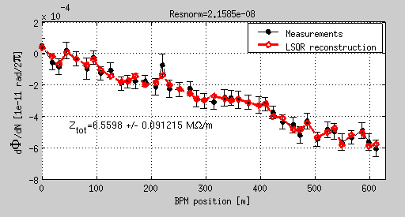
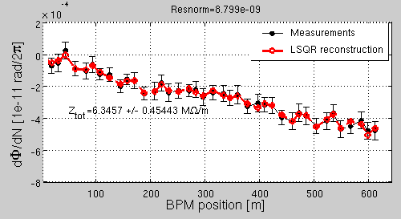
Measurements
PS-05-02-2013_#2
Bunch length~90ns (rf@200kV)
Ztot~6.5 MOhm/m (from tune shift)
PS-05-02-2013_#3
Bunch length~107ns (rf@100kV)
Ztot~6.3 MOhm/m (from tune shift)

Slide 20
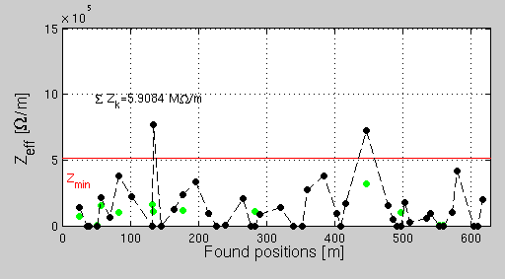
Reconstruction
Low bound from accuracy estimation
reconstructed
Theory

Slide 21
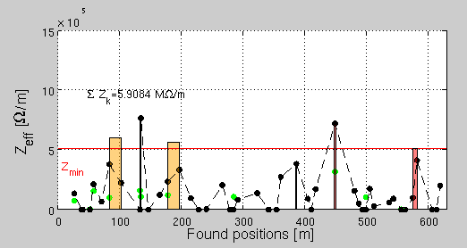
Reconstruction
After stress-test:

Slide 22
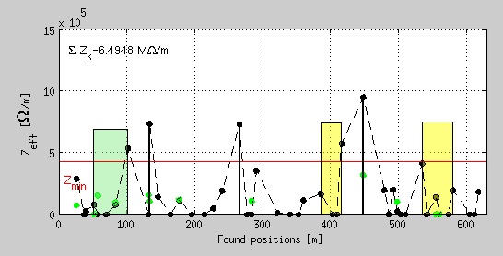
PS-05-02-2013_#2
Bunch length~90ns (rf@200kV)
Ztot~6.5 MOhm/m (from tune shift)
Ztot~6.4 MOhm/m (from recons.)
PS-05-02-2013_#3
Bunch length~107ns (rf@100kV)
Ztot~6.3 MOhm/m (from tune shift)
Ztot~5.9 MOhm/m (from recons.)

Slide 23
PS-05-02-2013_#2
Bunch length~90ns (rf@200kV)
Ztot~6.5 MOhm/m (from tune shift)
Ztot~6.4 MOhm/m (from recons.)
BFA21+KFA21
KFA71
PS-05-02-2013_#3
Bunch length~107ns (rf@100kV)
Ztot~6.3 MOhm/m (from tune shift)
Ztot~5.9 MOhm/m (from recons.)

Slide 24
Conclusion and Outlook
Conclusion:
Understood the role of noise in the measurement.
Transverse impedance model is going to be built.
At least 5 good localization measurements collected in 2012/2013 MD time.
Two probable impedance locations localized in KFA71 and BFA21(S+P)+KFA21.
Outlook:
Analyze remaining measurements and crosscheck localization results.
Improve stress test on the solution (vary residual norm threshold, etc…)
Crosscheck with simulations,
…

Slide 25
Backup

Slide 26
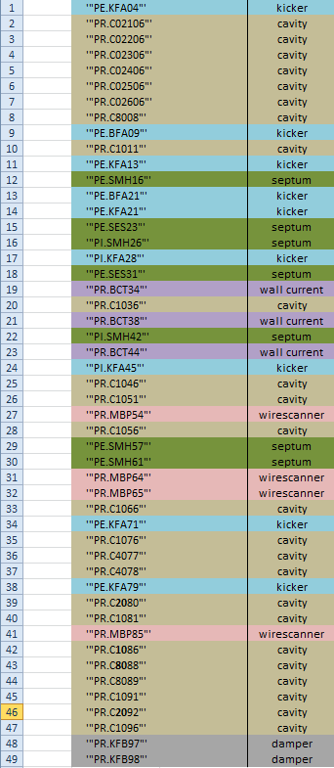
Reconstruction points

