Slide 1
CLIC CDR
D. Schulte for the CLIC collaboration

Slide 2
The CLIC CDR documents
In addition a shorter overview document was submitted as input to the European Strategy update, available at:
http://arxiv.org/pdf/1208.1402v1

Slide 3
Contents of Volume 1
Introduction
The CLIC concept: key issues and feasibility
Accelerator physics descriptions of the main beam complex
  E.g. sources, damping rings, beam delivery system, …
Accelerator physics descriptions of the drive beam complex
Technical description of the accelerator
  E.g. accelerating structures, modules, …
Civil engineering and technical services
CLIC technologies demonstrated at CTF3
Energy scanning
Staged construction
Appendices, e.g. Parameters
Total 813 pages

Slide 4
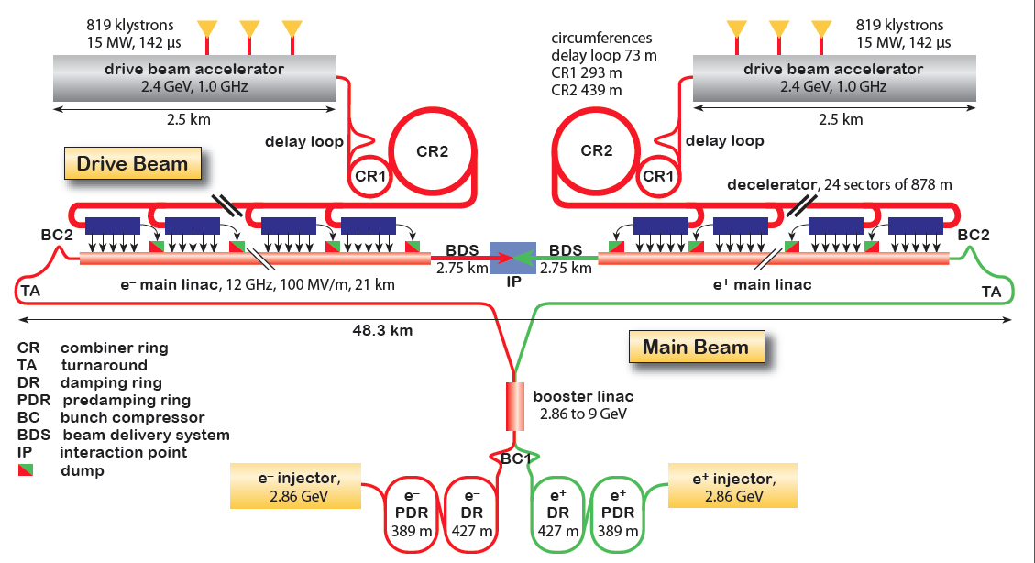
CLIC Layout at 3 TeV
Goal: Lepton energy frontier
Drive Beam Generation Complex
Drive beam time structure - initial
Drive beam time structure - final
240 ns
240 ns
5.8 μs
140 μs train length - 24 × 24 sub-pulses
4.2 A - 2.4 GeV – 60 cm between bunches
Main Beam Generation Complex
24 pulses – 101 A – 2.5 cm between bunches

Slide 5
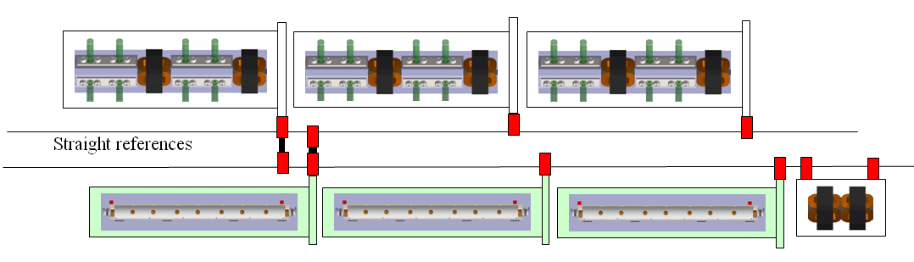
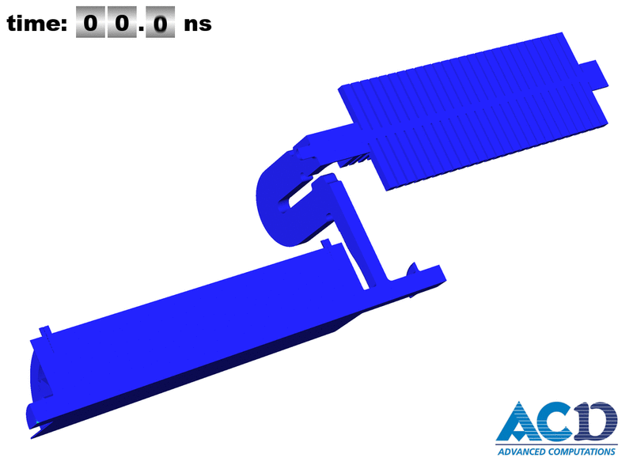
CLIC Two-beam Concept
Magnets guide the beams
100A drive beam
1.2A main beam
2m
Total instantaneous power of O(10TW)
1.2A main beam
A. Candel
100A drive beam

Slide 6
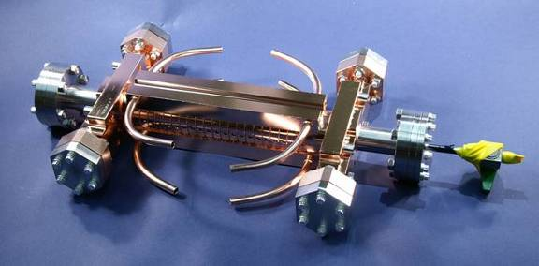
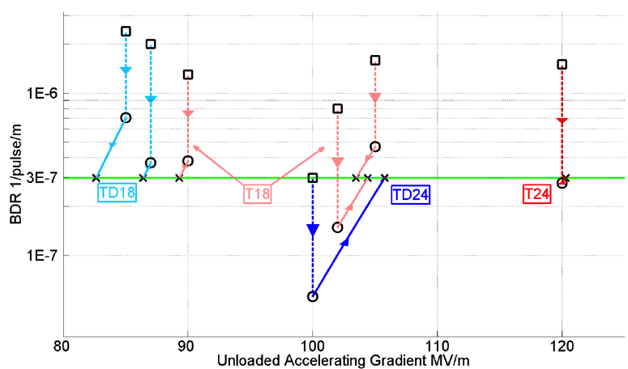
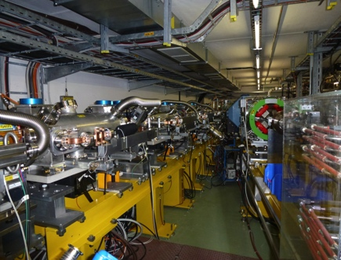
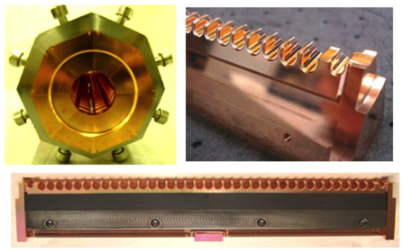
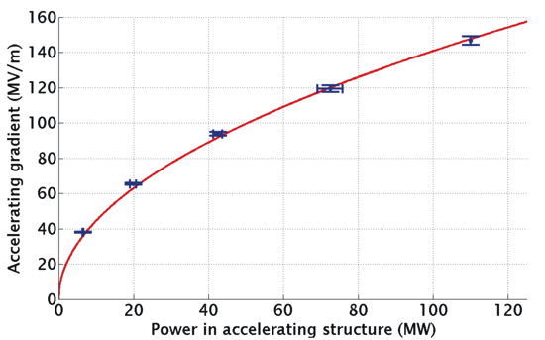
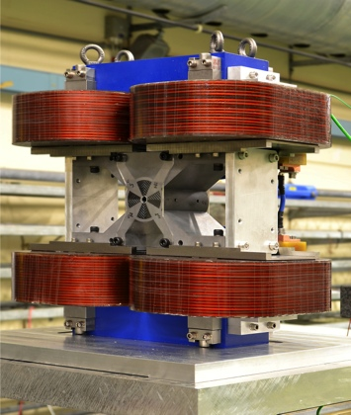
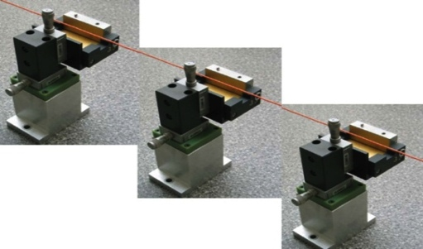
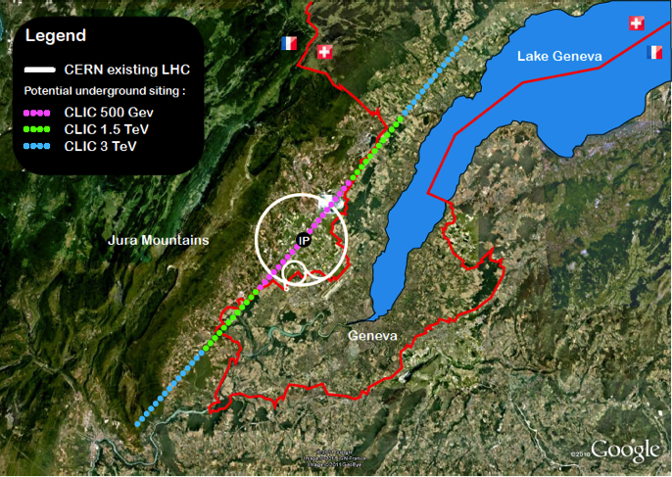
Conclusion of the Accelerator CDR Studies
Main linac gradient
Ongoing test close to or on target
Uncertainty from beam loading being tested
Drive beam scheme
Generation tested, used to accelerate test beam above specifications, deceleration as expected
Improvements on operation, reliability, losses, more deceleration studies underway
TD24 baseline: Unloaded 106 MV/m
Expected with beam loading 0-16% less
CLIC Nominal, unloaded
CLIC Nominal, loaded
Luminosity
Damping ring like an ambitious light source, no show stopper
Alignment system principle demonstrated
Stabilisation system developed, benchmarked, better system in pipeline
Simulations on or close to the target
Operation &
Machine Protection
Start-up sequence and low energy operation defined
Most critical failure studied and first reliability studies
Implementation
Consistent staged implementation scenario defined
Schedules, cost and power developed and presented
Site and CE studies documented

Slide 7
Contents of Volume 2
Executive Summary
CLIC Physics Potential
CLIC Experimental Conditions and Detector Requirements
CLIC Detector Concepts
Vertex Detectors
CLIC Tracking System
Calorimetry
Detector Magnet System
Muon System at CLIC
Very Forward Calorimeters
Readout Electronics and Data Acquisition System
CLIC Interaction Region and Detector Integration
Physics Performance
Future Plans and R&D Prospects
Summary
Appendices
Total 257 pages

Slide 8
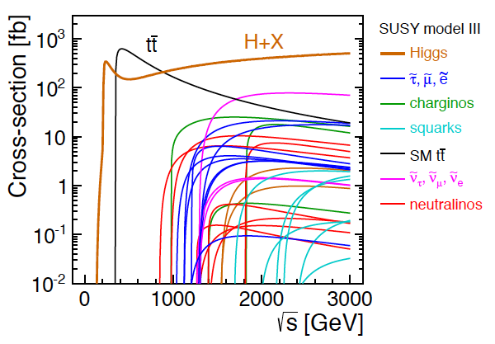
CLIC Physics Potential
LHC complementarity at the energy frontier:
How do we build the optimal machine given a physics scenario (partly seen at LHC ?)
Examples highlighted in the CDR:
Higgs physics (SM and non-SM)
Top
SUSY
Higgs strong interactions
New Z’ sector
Contact interactions
Extra dimensions
Detailed studies at 350, 500, 1400,
1500 and 3000 GeV for these processes
Operation at lower than nominal energy
Stage 1: ~500 (350) GeV => Higgs and top physics
Stage 2: ~1.5 TeV => ttH, ννHH + New Physics (lower mass scale)
Stage 3: ~3 TeV => New Physics (higher mass scale)

Slide 9
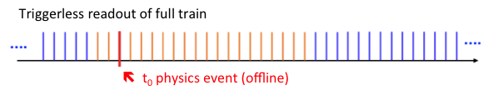
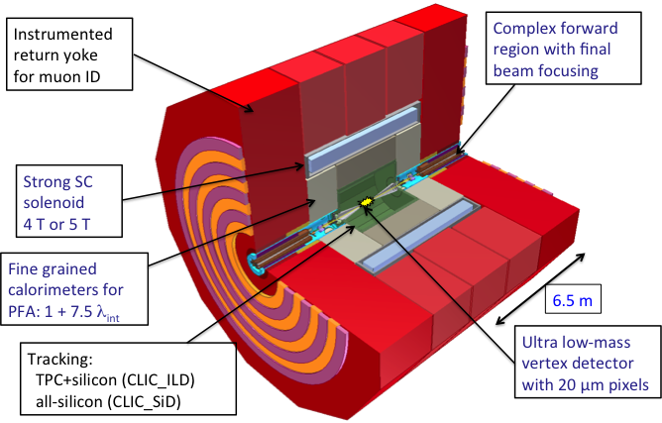
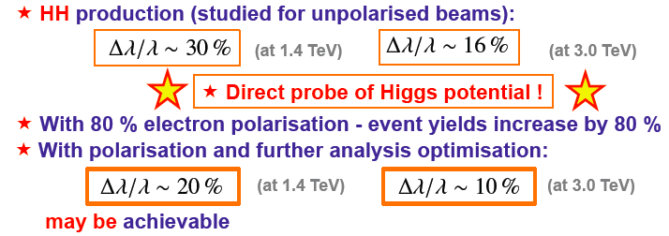
CLIC Physics and Detector studies
tCluster
Detailed GEANT 4 simulation
  Consider in particular pair background and γγ-processes
Studied using full reconstruction with background
  Make full use of timing and fine granularity to reconstruct the physics objects with very high precision
Have verified that the CLIC bunch and timing structures are fully compatible with high precession e+e- physics
Studies at a range of CM energies from 350 to 3000 GeV (SM, Higgs, BSM), see: https://indico.cern.ch/getFile.py/access?contribId=18&sessionId=0&resId=0&materialId=slides&confId=204269
Further work on completing picture of Higgs prospects at ~350 GeV, ~1.4 TeV, ~3 TeV, example:

Slide 10
Contents of Volume 3
Introduction
Physics overview
CLIC accelerator technology
CLIC detector concepts
CLIC project implementation
CLIC physics potential
Strategy and objective for the CLIC programme
Total 84 pages

Slide 11
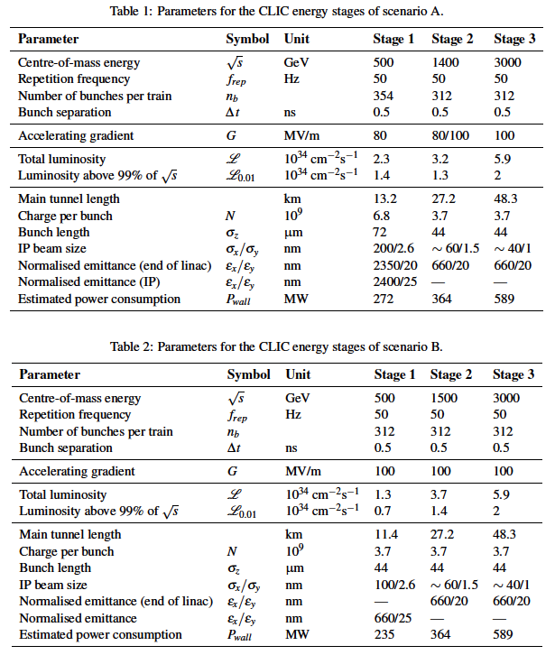
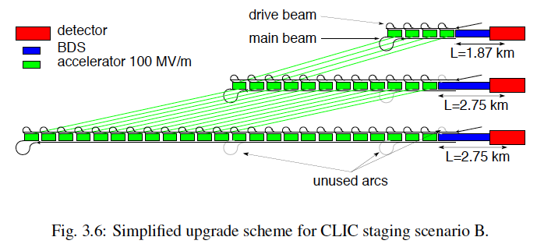
Possible CLIC stages studied
Key features:
High gradient (energy/length)
Small beams (luminosity)
Repetition rates and bunch spacing (experimental conditions)

Slide 12
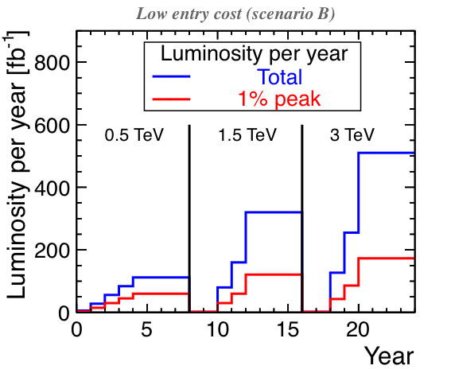
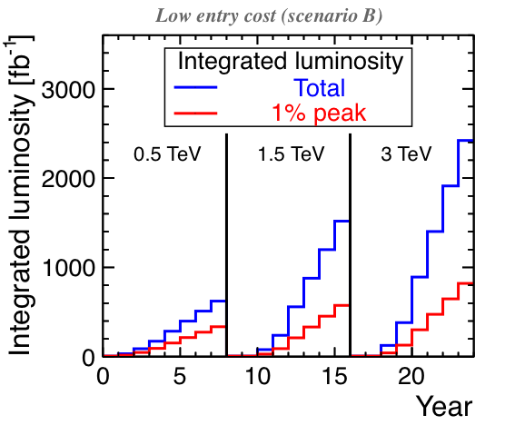
Example Operation Scenario
Assume 200 days/year, 50% efficiency, i.e. 8.64x10⁶ s/year
E_{cms} | Int(L)
0.5 TeV | 500 fb⁻¹
1.4/1.5 TeV | 1500 fb⁻¹
3 TeV | 2000 fb⁻¹
Stage | Year 1 | Year 2 | Year 3 | Year 4 | Year 5
1 | 5% | 25% | 50% | 75% | 100%
2 and 3 | 25% | 50% | 100% | 100% | 100%
Scenario A delivery twice the luminosity in the first stage

Slide 13
Power Consumption 500GeV (A)
Based on detailed estimates for components in each area

Slide 14
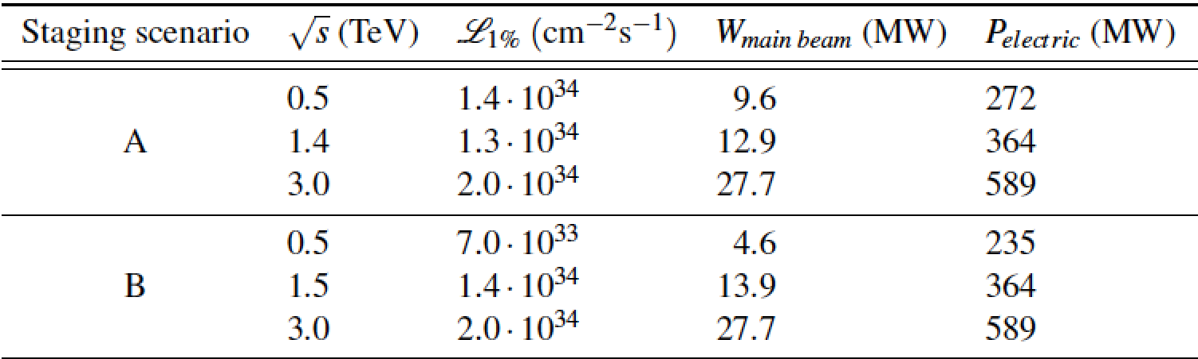
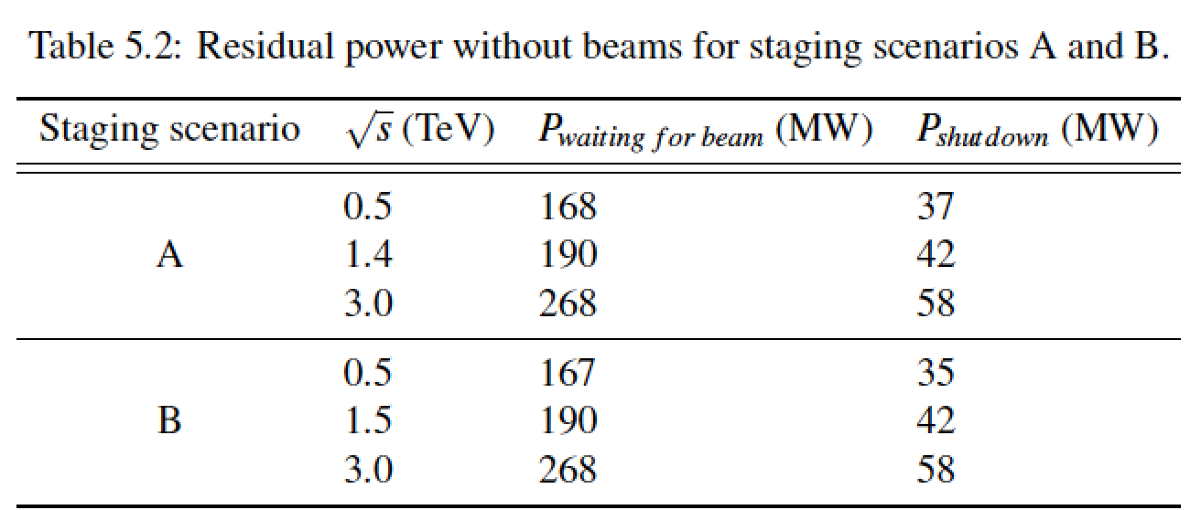
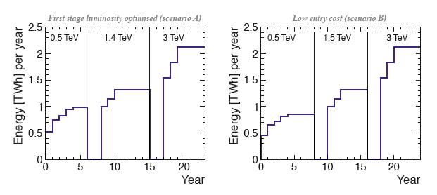
Power/Energy Consumption
Considering 150 days per year of normal operation at nominal power and a luminosity ramp-up in the early years at each stage of collision energy, the development of yearly energy consumption can be sketched.
Re-optimize parts
  Reduced current density in normal-conducting magnets
  Reduction of heat loads to HVAC
  Re-optimization of accelerating gradient with different objective function
Efficiency
  Grid-to-RF power conversion
  Permanent or super-ferric superconducting magnets
Energy management
  Low-power configurations in case of beam interruption
  Modulation of scheduled operation to match electricity demand: Seasonal and Daily
  Power quality specifications
Waste heat recovery
  Possibilities of heat rejection at higher temperature
  Waste heat valorization by concomitant needs, e.g. residential heating, absorption cooling
Beyond:
Scale with inst. luminosity – i.e. running at the very end of the project lifetime might be power limited and require more time.
CERN energy consumption 2012: 1.35 TWh

Slide 15
Cost of the 500GeV Stage
Swiss francs of December 2010
Incremental cost for B:
4MCHF/GeV
-> Step to 1.5TeV is less than first stage

Slide 16
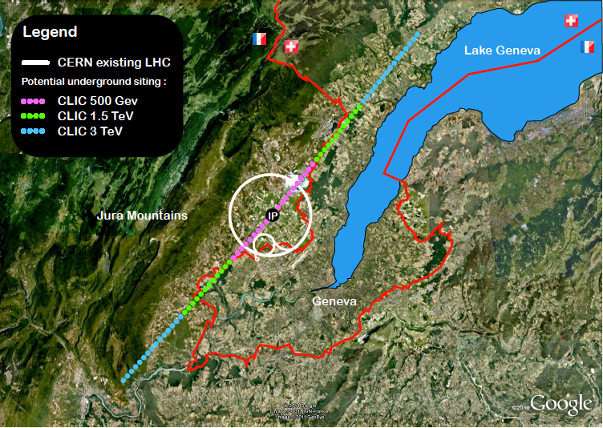
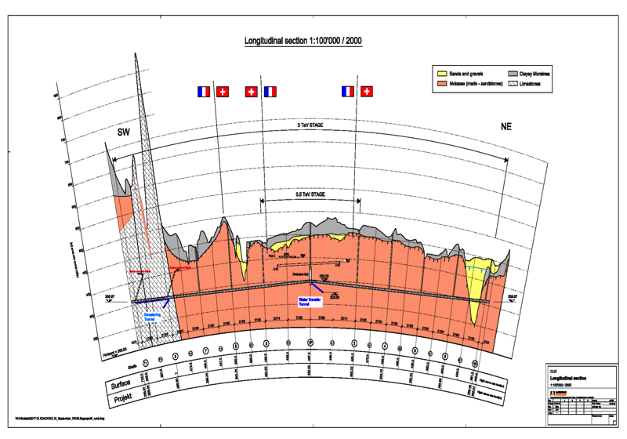
CLIC Near CERN

Slide 17
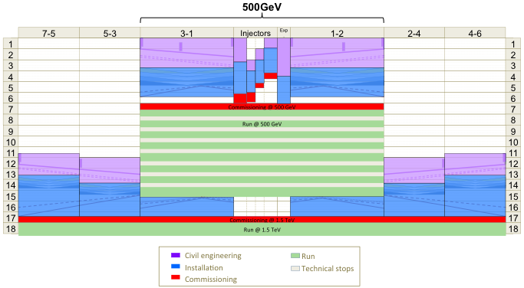
Example Construction Schedule

Slide 18
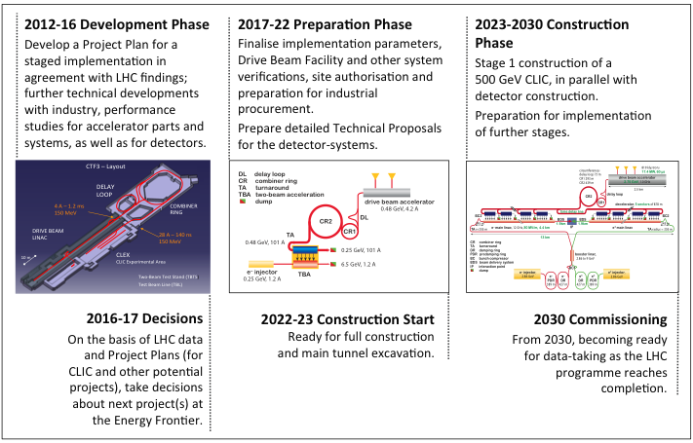
Timeline

Slide 19
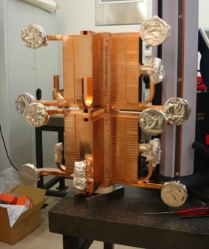
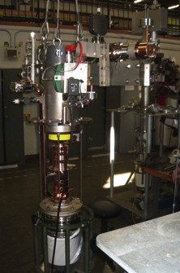
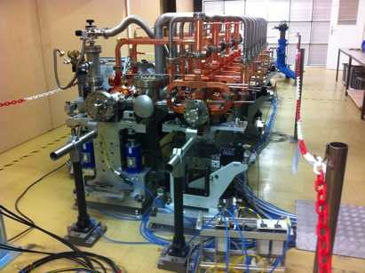
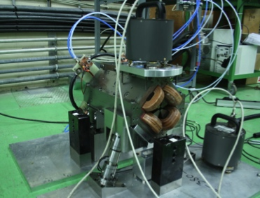
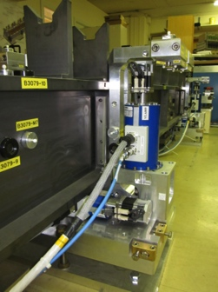
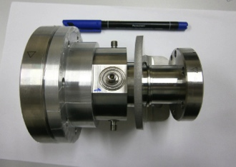
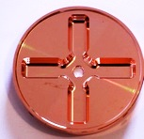
Project Implementation Plan 2012-16
Key words for 2013:
rebaseling
power reduction studies
systemtests
structure testing capacity
drive beam power unit
common work with light source community

Slide 20


























Current CLIC Collaboration
CLIC multi-lateral collaboration - 48 Institutes from 25 countries
Over the last months increased to 48 institutes from 25 countries adding Jerusalem, Belgrade, Alba and Tartu to the list – linked to 2012-2016 work-programme
On-going discussions with 5 more groups …
Detector and Physics Studies for CLIC being organized in a similar manner, but with less formal agreements – yet allowing a collaboration like structure to organize the work, elections and making decisions about priorities and policies
ACAS (Australia)
Aarhus University (Denmark)
Ankara University (Turkey)
Argonne National Laboratory (USA)
Athens University (Greece)
BINP (Russia)
CERN
CIEMAT (Spain)
Cockcroft Institute (UK)
ETH Zurich (Switzerland)
FNAL (USA)
Gazi Universities (Turkey)
Helsinki Institute of Physics (Finland)
IAP (Russia)
IAP NASU (Ukraine)
IHEP (China)
INFN / LNF (Italy)
Instituto de Fisica Corpuscular (Spain)
IRFU / Saclay (France)
Jefferson Lab (USA)
John Adams Institute/Oxford (UK)
Joint Institute for Power and Nuclear Research SOSNY /Minsk (Belarus)
John Adams Institute/RHUL (UK)
JINR
Karlsruhe University (Germany)
KEK (Japan)
LAL / Orsay (France)
LAPP / ESIA (France)
NIKHEF/Amsterdam (Netherland)
NCP (Pakistan)
North-West. Univ. Illinois (USA)
Patras University (Greece)
Polytech. Univ. of Catalonia (Spain)
PSI (Switzerland)
RAL (UK)
RRCAT / Indore (India)
SLAC (USA)
Sincrotrone Trieste/ELETTRA (Italy)
Thrace University (Greece)
Tsinghua University (China)
University of Oslo (Norway)
University of Vigo (Spain)
Uppsala University (Sweden)
UCSC SCIPP (USA)

Slide 21

Organisation of CLIC Detector and Physics Study
Pre-collaboration structure, based on a “Memorandum on Cooperation”
http://lcd.web.cern.ch/LCD/Home/MoC.html
Light-weight collaborative structure => partners join on “best effort” basis
Organisation resembling most particle physics experiments
Central body is the Institute Board

Slide 22
CLIC Organisation (during CDR)
Representatives of collaborating institutes
Study leader appointed by CERN management
-> appointed area leaders
Collaboration board elects chair and spokes person

Slide 23
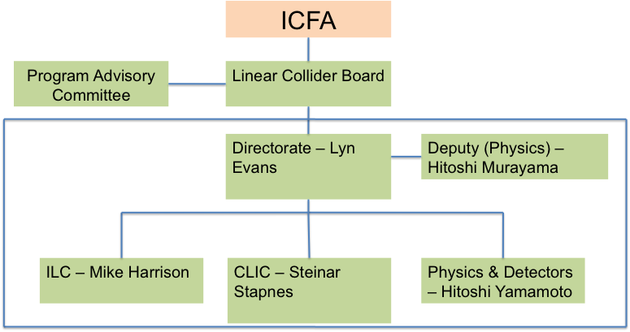
The LCC Organisation and CLIC
Issues for CLIC:
Improve common work with ILC (optimize resources) – see below
Keep strong CLIC physics and detector activities as identifiable part of overall P&D box (we have common CLIC steering group and very direct weekly contacts)
Understand machine committee organization
  In addition common working groups on: Cost and Schedule, Civil Engineering and Conventional Facilities, Technical systems – and a General Issues Working Group

Slide 24
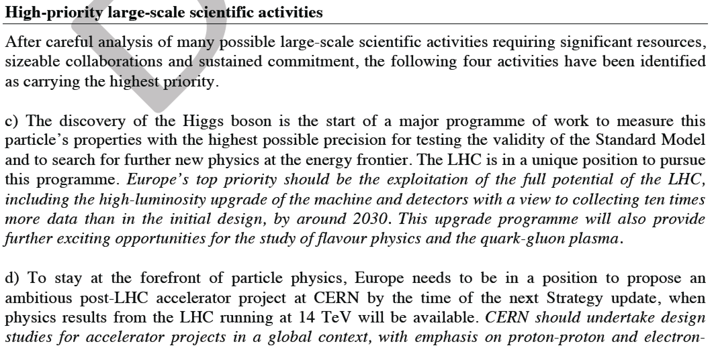
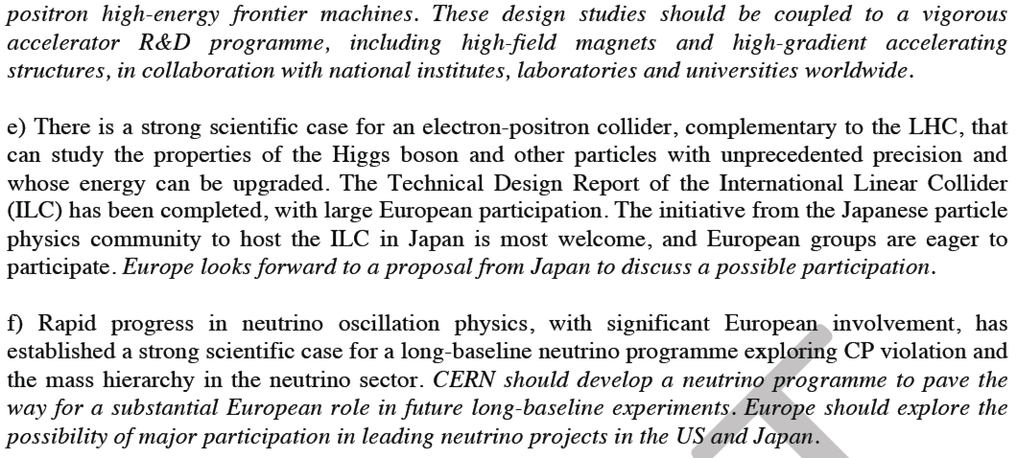
ENERGY FRONTIER PROJECTS AT CERN AFTER LHC – THE CONTEXT OF THE CLIC ACTIVITIES
Open Session during the CLIC workshop end January:
Common session with main other alternatives for energy frontier projects at CERN after LHC (LHC energy upgrades), including presentations of what we can expect from LHC and a potential Higgs-factory
Status and very first focus on potential common or co-ordinated activities in the coming years (2013-2017)

Slide 25
Conclusion
The CDR required several years and contains
  CLIC concept and key issues/feasibility
  Detailed description of the machine
  Technical description of the key components
  Project considerations: cost, power consumption, schedule, site, strategy and plans
  The (potential) physics case
  A detailed detector description
  A detailed analysis of the detector performance
Essential prerequisites
  Dedication of collaborators
  Advisory committee

Slide 26
Reserve

Slide 27
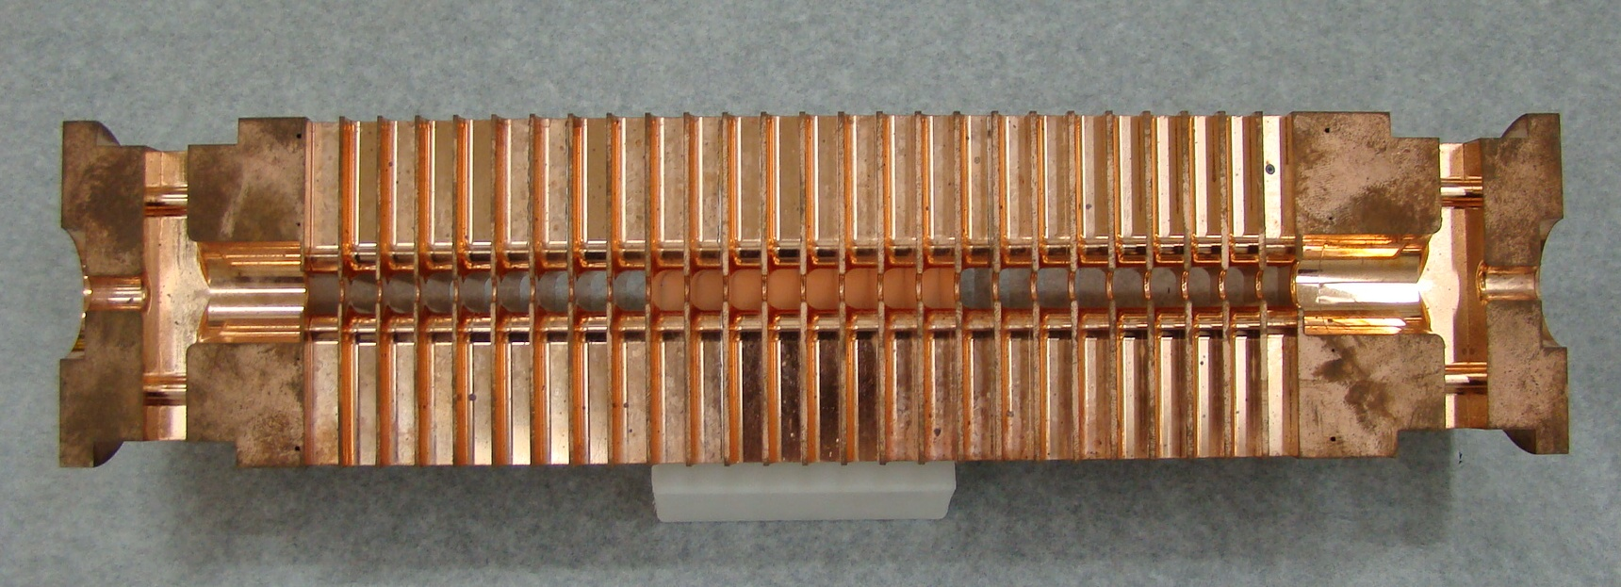
CLIC Accelerating Structure
Loaded gradient 100MV/m
Require (soft) breakdown probability p≤3x10⁻⁷m⁻¹pulse⁻¹
Structure design based on empirical constraints, not first principle
Experiments are essential to confirm the structure performance

Slide 28
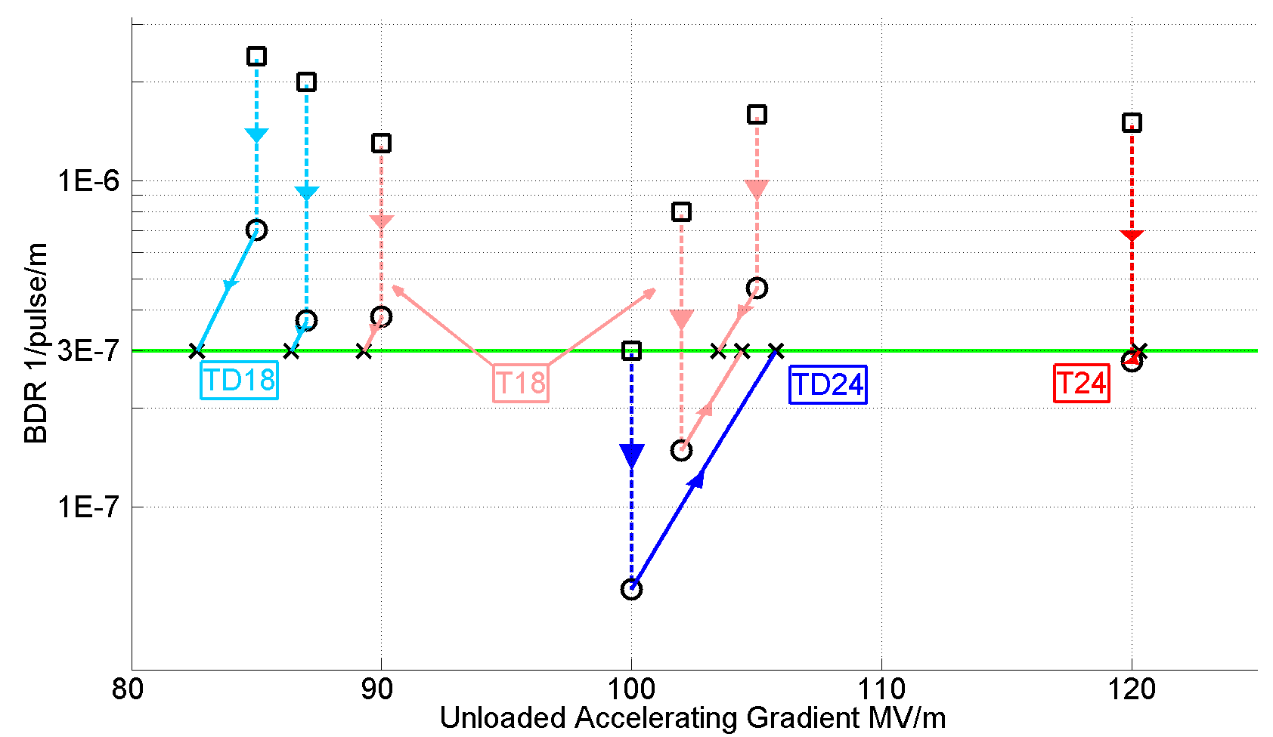
Achieved Gradient for CLIC
Tests at KEK and SLAC
Measurements scaled according to
Unloaded 106MV/m
With loading 0-16% less
 | Simple early design to get started | More efficient fully optimised structure
No damping waveguides | T18 | T24
Damping waveguides | TD18 | TD24 = CLIC goal

Slide 29
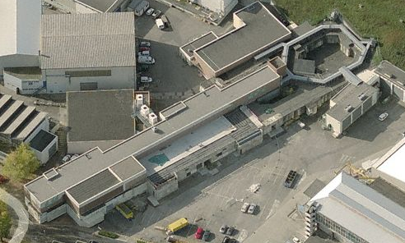
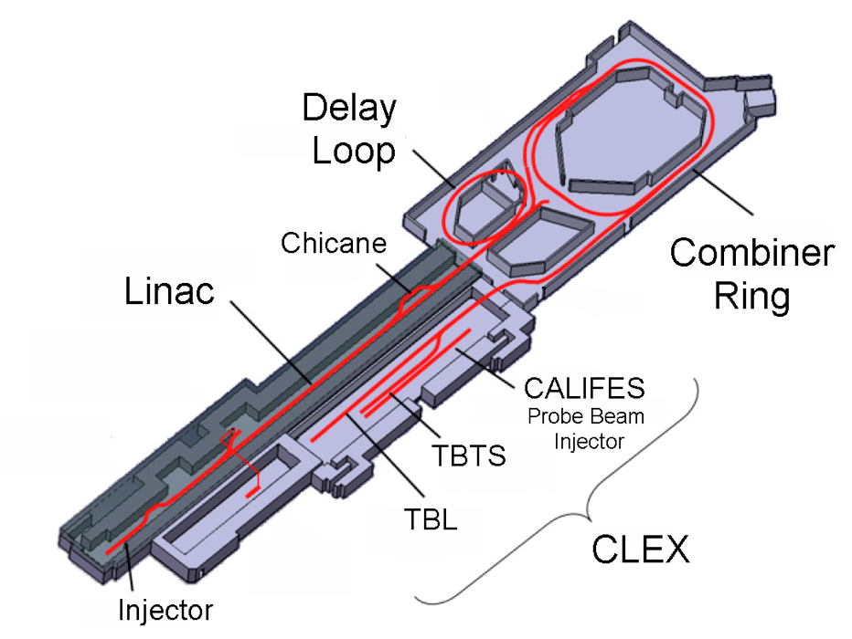
CLIC Test Facility (CTF3)
4 A, 1.4us
120 MeV
30 A, 140 ns
120 MeV
30 A, 140 ns
60 MeV

Slide 30
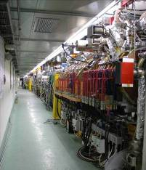
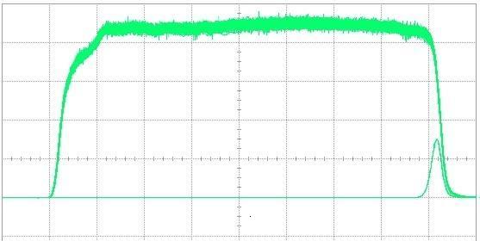
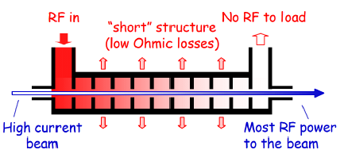
Drive Beam Linac
10 m
Power
Pulse current measurement
95.3% RF to beam efficiency
No instabilities
Phase switch works OK

Slide 31
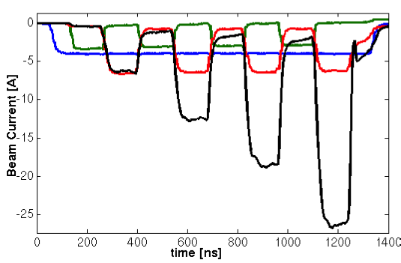
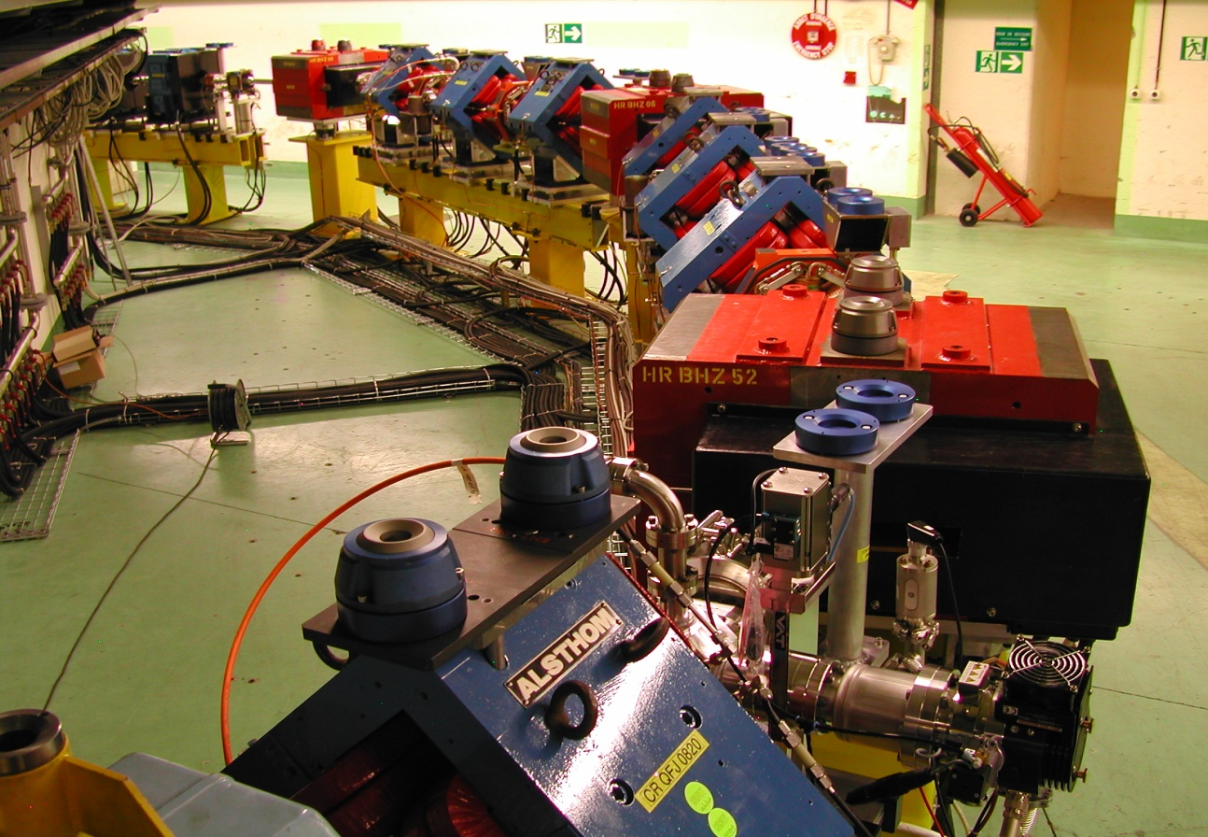
Drive Beam Combination in CTF3
In combiner ring
After delay loop
Delay loop
End of linac
29 A reached, routinely 25A
DL
CR
30A

Slide 32
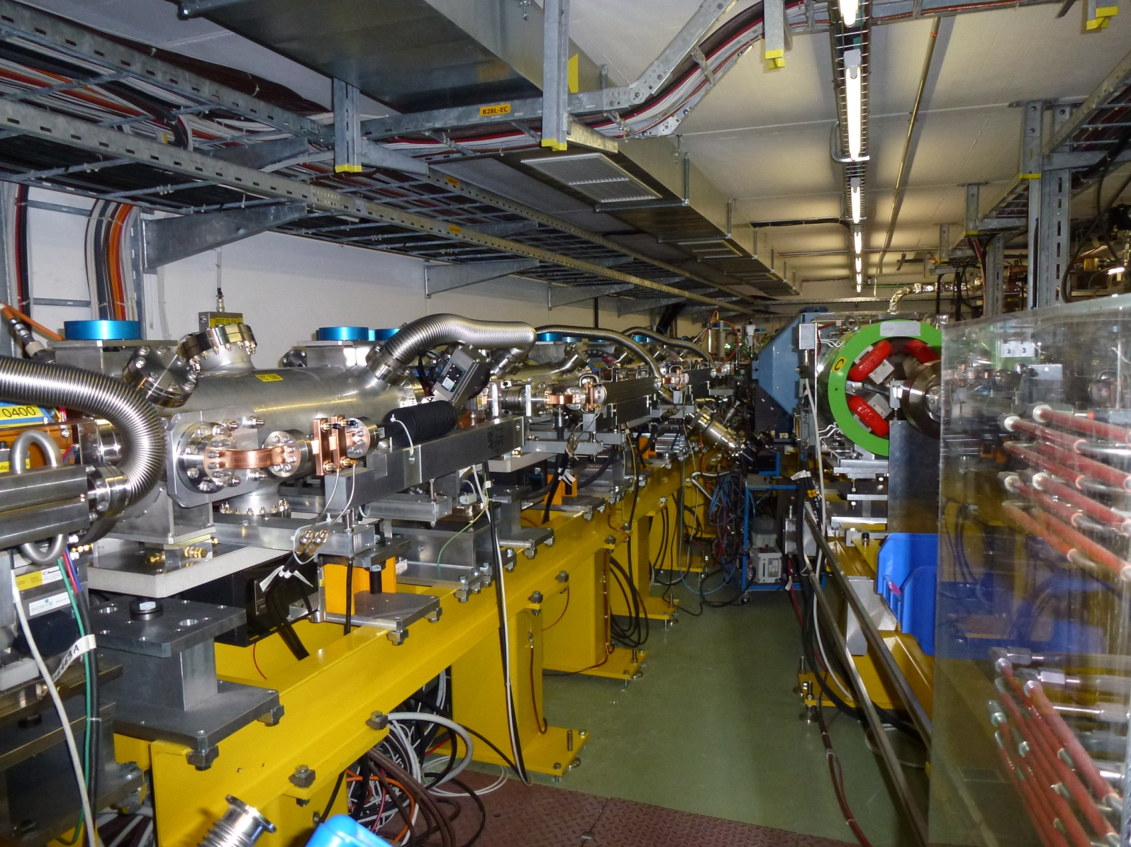
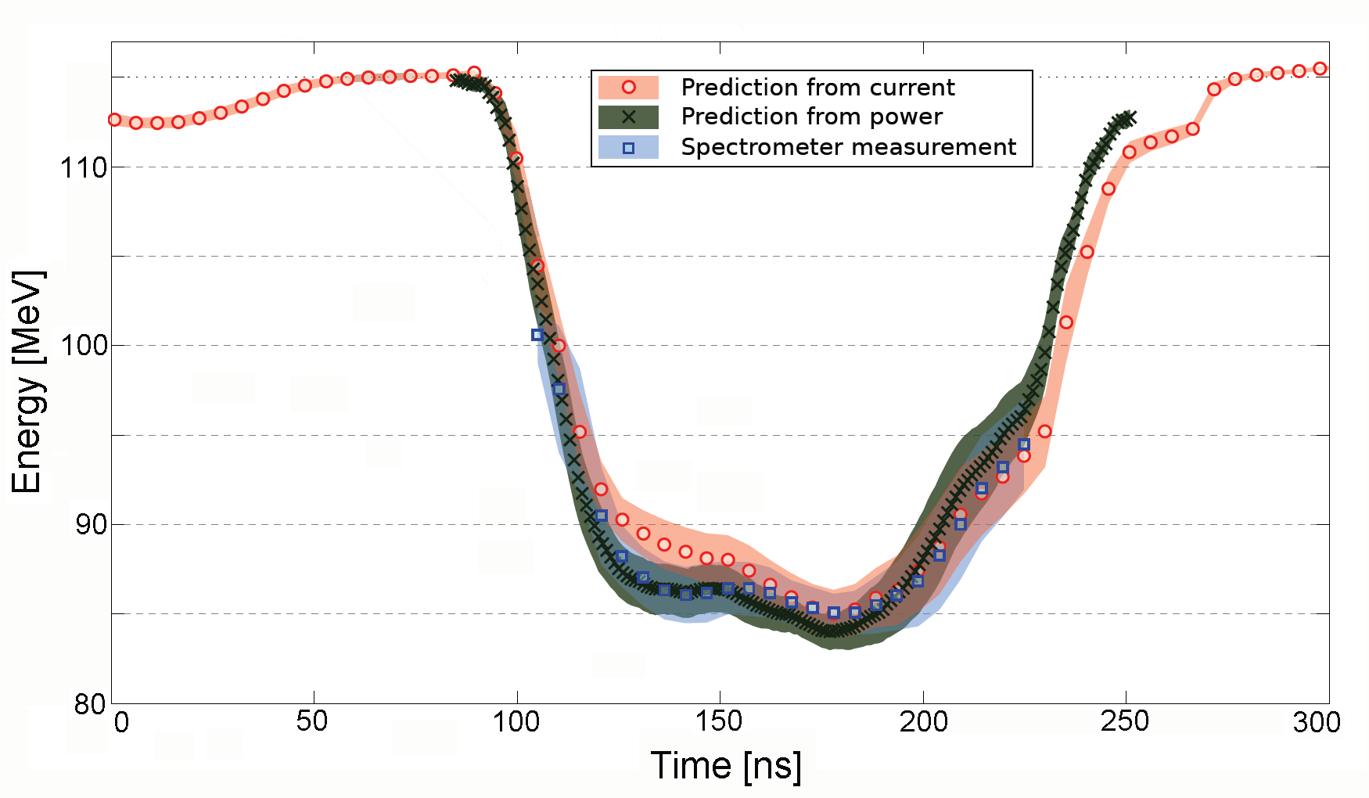
TBL: Drive Beam Deceleration
With 9 PETS, 21 A
~26% deceleration
Now 13 PETS are installed
Final goal is 50% deceleration
Measured in TBL:
Up to 21A current
optics understood
no losses in TBL
On-off mechanism verified
Good agreement
power production in PETS
beam current
beam deceleration
~ 30 MeV
26%
Notes:
Show power extraction in PETS

Slide 33
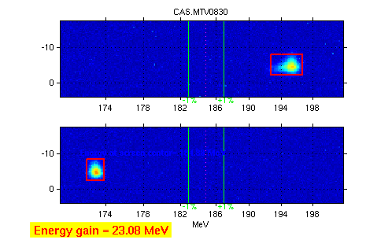
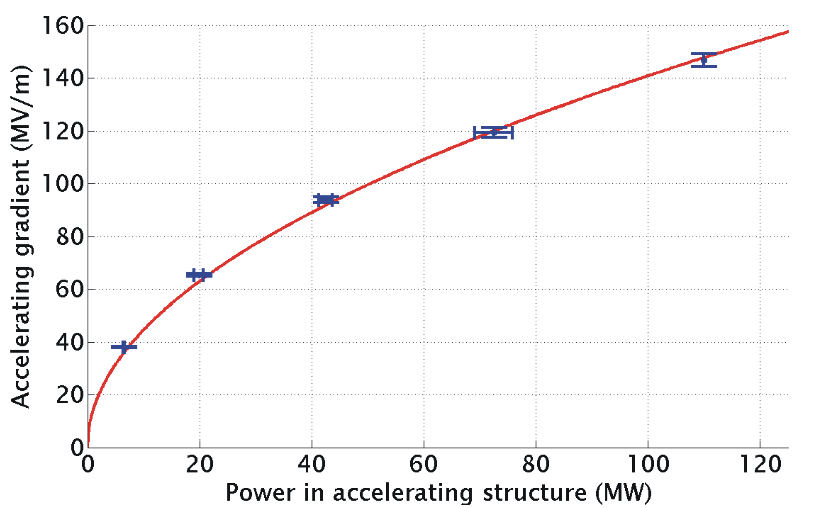
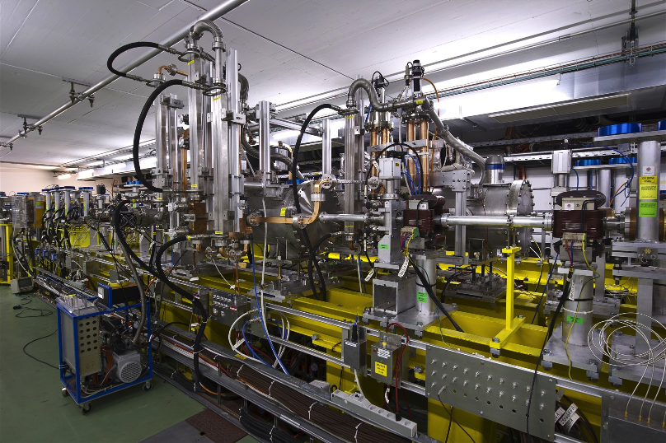
TBTS: Two Beam Acceleration
Measured accelerating gradient
Maximum gradient 145 MV/m
Consistency between
produced power
drive beam current
test beam acceleration

Slide 34


Emittance Generation
Many design issues addressed:
lattice design
dynamic aperture
tolerances
intra-beam scattering
space charge
wigglers
RF system
vacuum
electron cloud
kickers
In addition: wiggler and kicker developments
Damping ring design is consistent with target performance
CLIC @3 TeV would achieve 1/3 of luminosity with ATF performance
(3800nm/15nm@4e9)

Slide 35


Active Stabilisation Results
Luminosity achieved/lost [%]
 | B10
No stab. | 53%/68%
Current stab. | 108%/13%
Future stab. | 118%/3%
Code
Machine model
Beam-based feedback
Close to/better than target

Slide 36

Staging Scenario B
4 sectors equal 500GeV
12 sectors equal 1.5TeV
24 sectors equal 3TeV
Energy choices made with Physics Group
Need to be reviewed when more
LHC results become available
They are only an example

Slide 37

Scenario A
Scenario is chosen for luminosity at 500GeV, L=2.3x10³⁴m⁻²s⁻¹
Special structure for 500GeV leads to
N=6.8x10⁹ vs. 3.7 x10⁹, G=80MV/m vs. 100MV/m, L=2.3x10³⁴m⁻²s⁻¹ vs. L=1.3x10³⁴m⁻²s⁻¹
Main beam RF pulse lengths are the same and power is comparable
=> can use the same drive beam generation complex
Main beam injector at stage 1 needs some additional RF power
Can use 80MV/m structure with the train for CLIC_G (the nominal 3TeV structure)
=> lose a bit of energy for stage 2

Slide 38




Possible Luminosity Examples
Based on 200 days/year at 50% efficiency (accelerator + data taking combined)
Target figures: >500 fb⁻¹ at first stage, 1.5 ab⁻¹ at second stage, 2 ab⁻¹ at third stage

