Slide 1
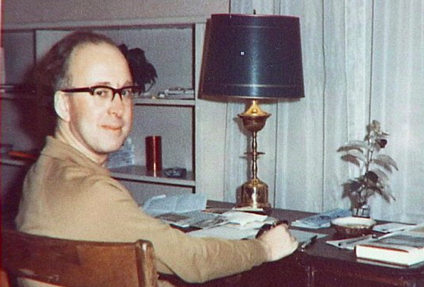
Physics Overview
John Ellis
King’s College London
(& CERN)
4th TLEP workshop (EuCARD-AccNet)

Slide 2
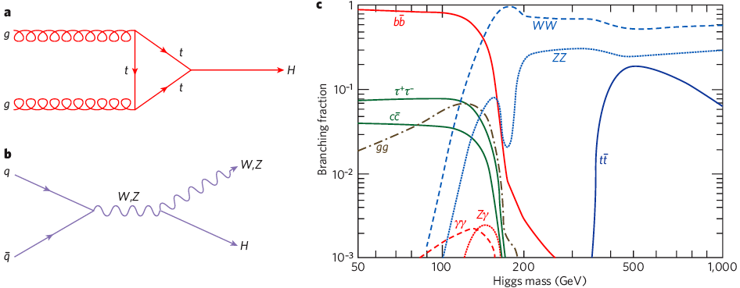
Higgs Decay Branching Ratios
Couplings proportional to masses (?)
Important couplings through loops:
  gluon + gluon → Higgs → γγ
Many decay modes measurable if M_{h} ~ 125 GeV

Slide 3
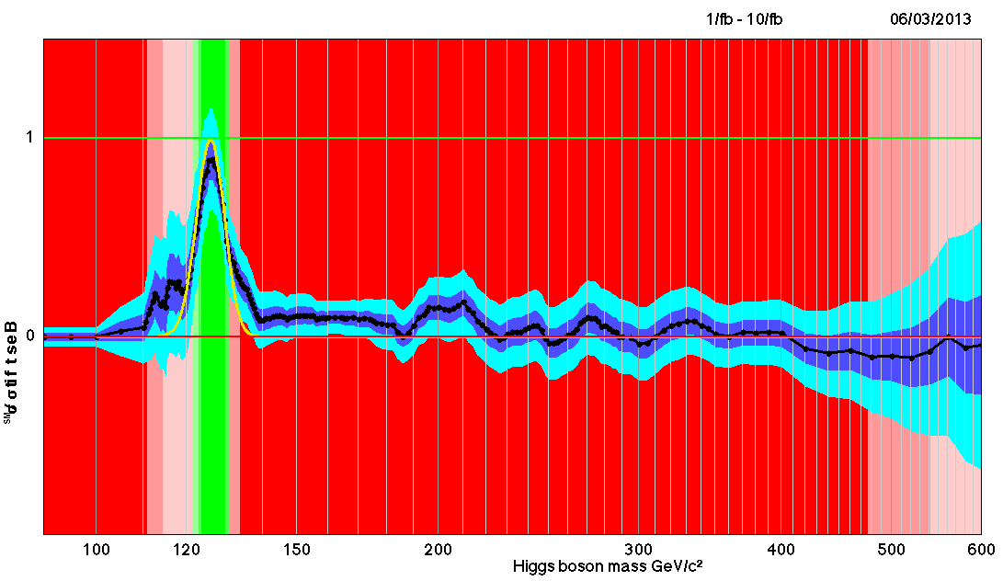

Unofficial Combination of Higgs Search Data from March 6th
Is this the
Higgs Boson?
No Higgs here!
No
Higgs
here!

Slide 4
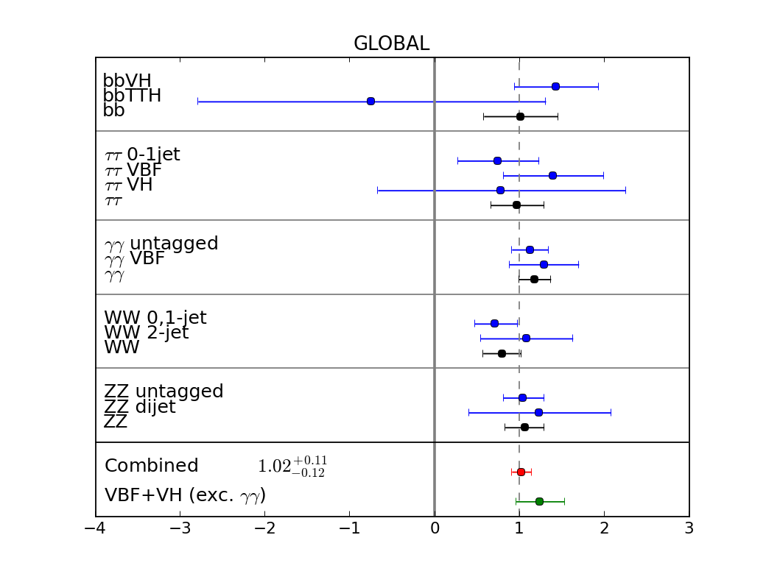
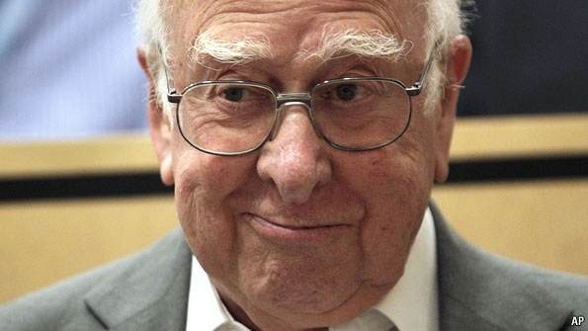
Couplings resemble Higgs of Standard Model
No indication of any significant deviation from the Standard Model predictions
JE & Tevong You, arXiv:1303.3879

Slide 5
Some Questions
What is it?
  Higgs or …?
What else is there?
  Supersymmetry or …?
What next?
  A Higgs factory or …?

Slide 6
What is it ?
Does it have spin 0 or 2?
Is it scalar or pseudoscalar?
Is it elementary or composite?
Does it couple to particle masses?
Quantum (loop) corrections?
What are its self-couplings?

Slide 7
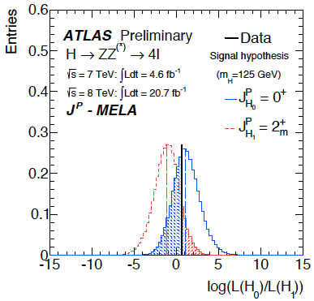
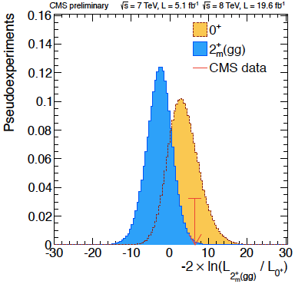
The ‘Higgs’ Spin is probably 0
Graviton-like spin-2 disfavoured at 98.5% CL

Slide 8
What is it ?
Does it have spin 0 or 2?
  Spin 2 very unlikely
Is it scalar or pseudoscalar?
Is it elementary or composite?
Does it couple to particle masses?
Quantum (loop) corrections?
What are its self-couplings?

Slide 9
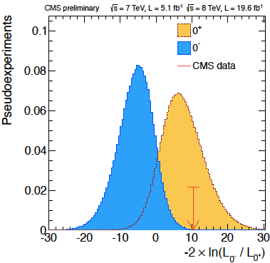
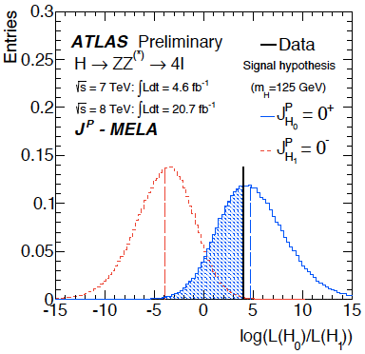
The ‘Higgs’ is probably a scalar
Pseudoscalar 0⁻ disfavoured at > 99% CL

Slide 10
What is it ?
Does it have spin 0 or 2?
  Spin 2 seems unlikely, but needs experimental checks
Is it scalar or pseudoscalar?
  Pseudoscalar disfavoured by experiment
Is it elementary or composite?
Does it couple to particle masses?
Quantum (loop) corrections?
What are its self-couplings?

Slide 11
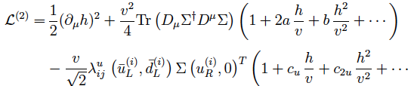
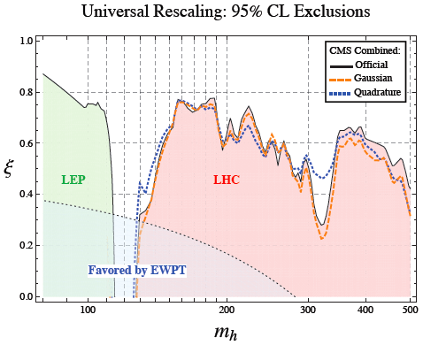
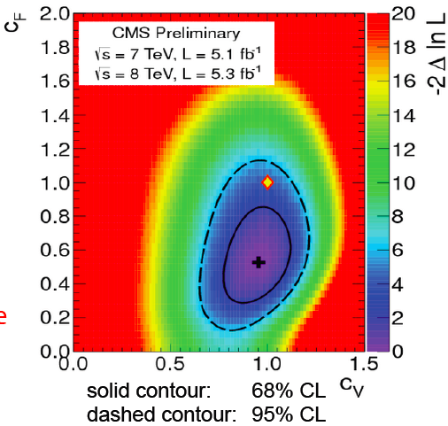

General Analysis of ‘unHiggs’ Models
Parametrization of effective Lagrangian:
Fits
c
a ≠ c
CMS fit assuming c > 0
a
Azatov, Contino, Galloway: arXiv:1202.3415

Slide 12
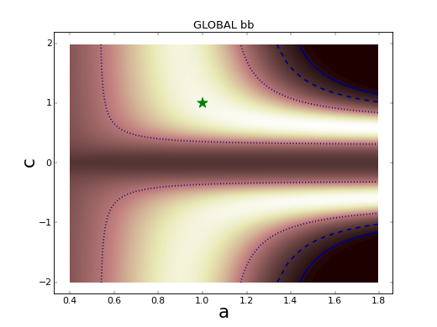
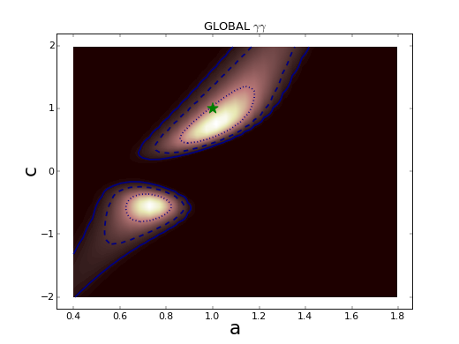
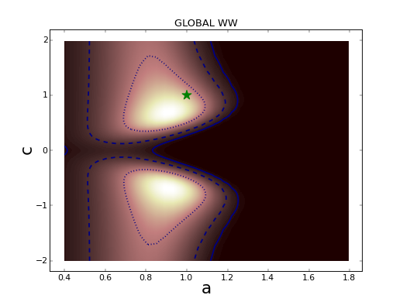
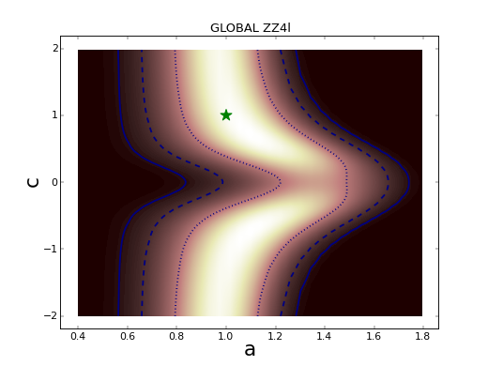
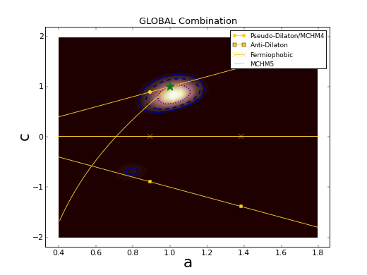
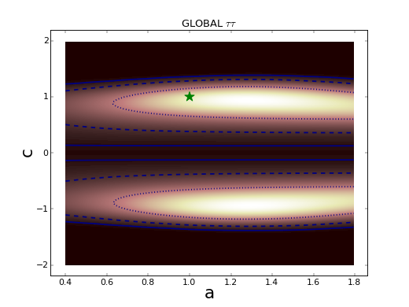
Global Analysis of Higgs-like Models
Rescale couplings: to bosons by a, to fermions by c
Standard Model: a = c = 1
W W
Global
b bbar
τ τ
γ γ
Z Z
JE & Tevong You, arXiv:1303.3879

Slide 13
What is it ?
Does it have spin 0 or 2?
  Spin 2 seems unlikely, but needs experimental checks
Is it scalar or pseudoscalar?
  Pseudoscalar disfavoured by experiment
Is it elementary or composite?
  No significant deviations from Standard Model
Does it couple to particle masses?
Quantum (loop) corrections?
What are its self-couplings?

Slide 14
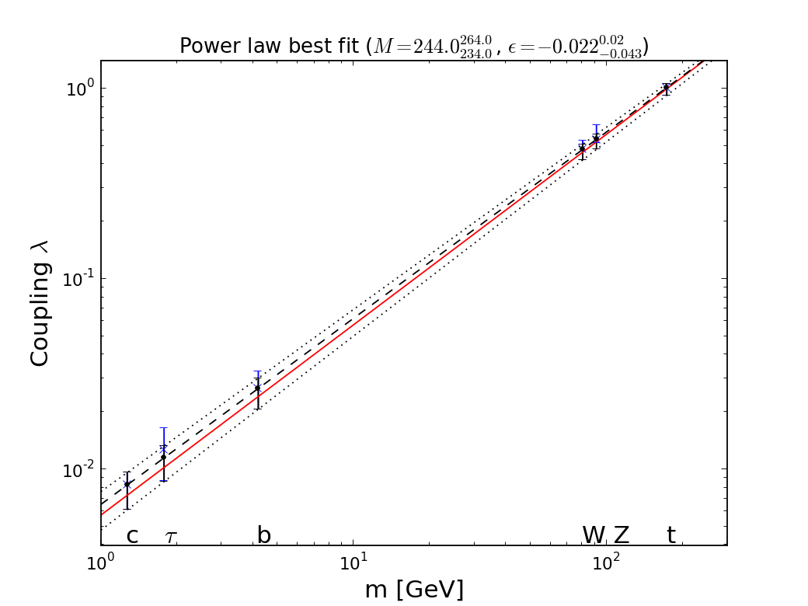


It Walks and Quacks like a Higgs
Do couplings scale ~ mass? With scale = v?
Red line = SM, dashed line = best fit
Global
fit
JE & Tevong You, arXiv:1303.3879

Slide 15
What is it ?
Does it have spin 0 or 2?
  Spin 2 seems unlikely, but needs experimental checks
Is it scalar or pseudoscalar?
  Pseudoscalar disfavoured by experiment
Is it elementary or composite?
  No significant deviations from Standard Model
Does it couple to particle masses?
  Some prima facie evidence that it does
Quantum (loop) corrections?
What are its self-couplings?

Slide 16
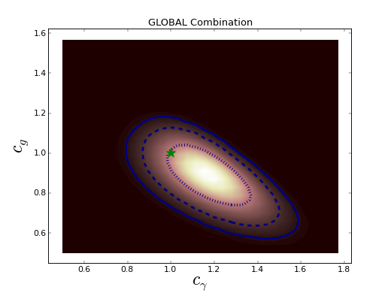
Loop Corrections ?
ATLAS sees excess in γγ, CMS sees deficit
Loop diagrams ~ Standard Model?
JE & Tevong You, arXiv:1303.3879

Slide 17
What is it ?
Does it have spin 0 or 2?
  Spin 2 seems unlikely, but needs experimental checks
Is it scalar or pseudoscalar?
  Pseudoscalar disfavoured by experiment
Is it elementary or composite?
  No significant deviations from Standard Model
Does it couple to particle masses?
  Some prima facie evidence that it does
Quantum (loop) corrections?
  γγ coupling > Standard Model?
What are its self-couplings?

Slide 18
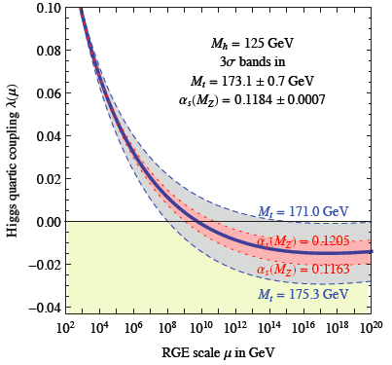
Theoretical Constraints on Higgs Mass
Large M_{h} → large self-coupling → blow up at low-energy scale Λ due to
renormalization
Small: renormalization
due to t quark drives
quartic coupling < 0
at some scale Λ
→ vacuum unstable
Vacuum could be stabilized by Supersymmetry
Degrassi, Di Vita, Elias-Miro, Giudice, Isodori & Strumia, arXiv:1205.6497

Slide 19
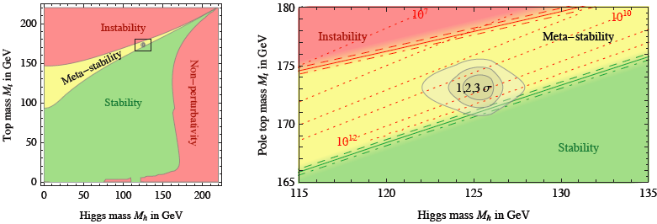
Vacuum Instability in the Standard Model
Very sensitive to m_{t} as well as M_{H}
Present vacuum probably metastable with lifetime >> age of the Universe
Degrassi, Di Vita, Elias-Miro, Giudice, Isodori & Strumia, arXiv:1205.6497

Slide 20
What else is there?
Supersymmetry
LHC may reveal new physics when it restarts at higher energy
Do not mortgage future of HEP before we know
Gluino mass
CMSSM
Successful prediction for Higgs mass
  Should be < 130 GeV in simple models
Successful predictions for couplings
  Should be within few % of SM values
Buchmueller, JE et al: arXiv:1207.3715

Slide 21
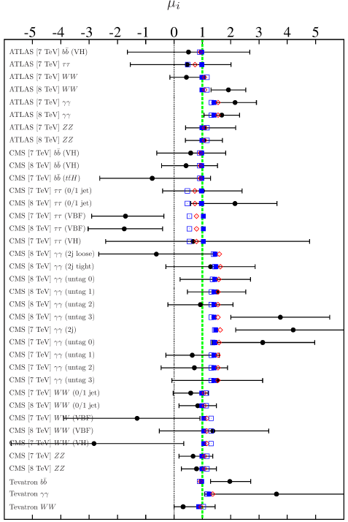
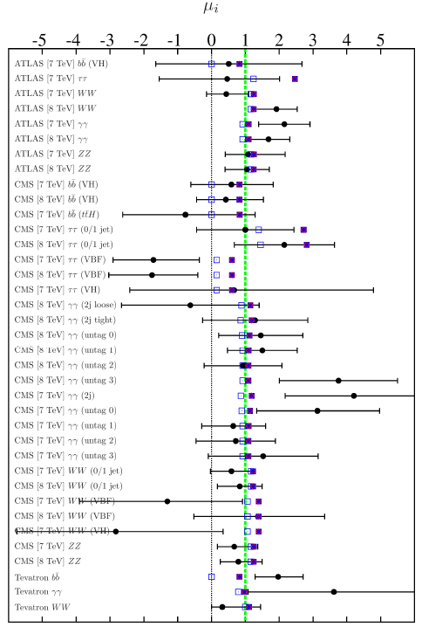
Maybe it is a Supersymmetric Duck?
Bechtle et al., arXiv:1211.1955
Fits with lighter/heavier scalar Higgs at 125 GeV
Lighter
Heavier

Slide 22
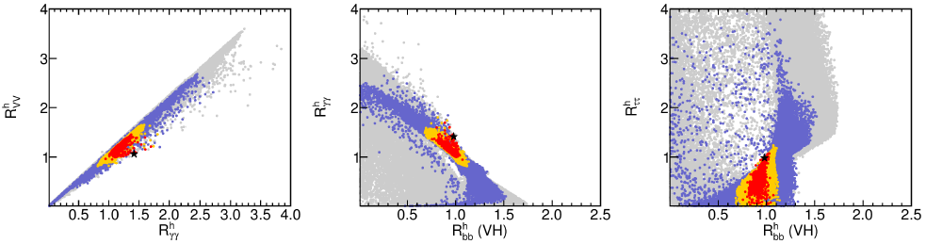
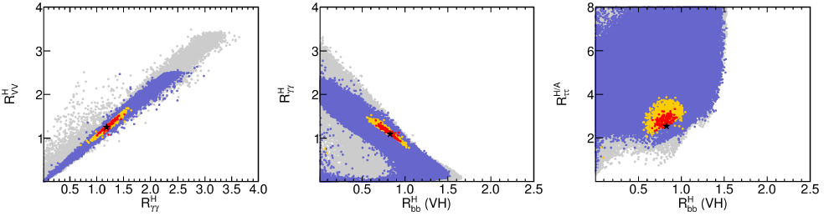
Maybe it is a Supersymmetric Duck?
Bechtle et al., arXiv:1211.1955
Fits with lighter/heavier scalar Higgs at 125 GeV
Lighter
Heavier

Slide 23
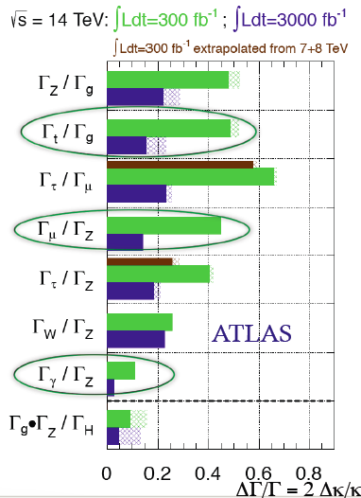
What Next: A Higgs Factory?
To study the ‘Higgs’ in detail:
The LHC
  Rethink LHC upgrades in this perspective?
A linear collider?
  ILC up to 500 GeV
  CLIC up to 3 TeV
    (Larger cross section at higher energies)
A circular e+e- collider: TLEP, …
  A photon-photon collider: SAPPHiRE
A muon collider

Slide 24
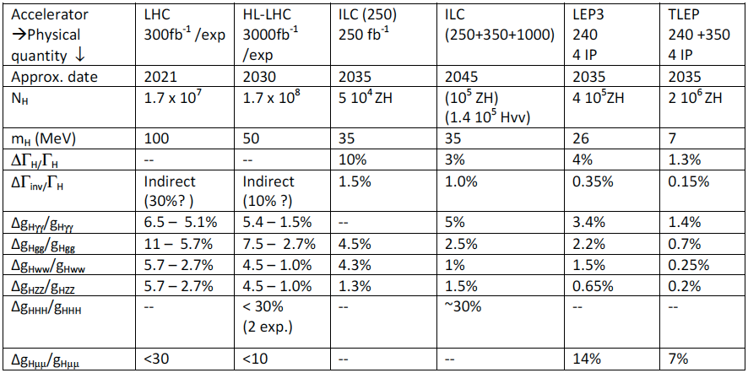
Higgs Factory Summary
Best
precision
ICFA Higgs Factory Workshop
Fermilab, Nov. 2012

Slide 25
Impact of Higgs Factory?
Predictions of current best fits in simple models
Current uncertainties in SM calculations [LHC Higgs WG] (important correlations)
Comparisons with
  LHC
  HL-LHC
  ILC
  TLEP

Slide 26
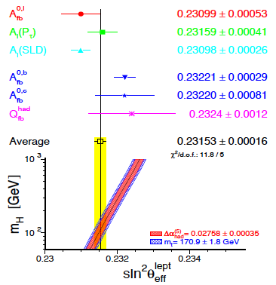
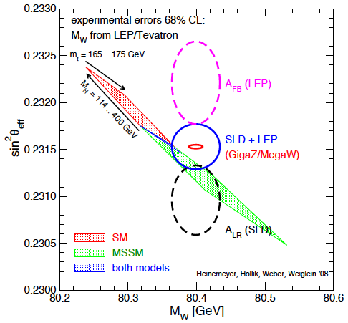
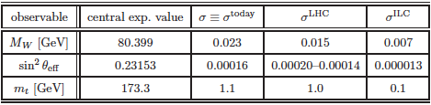

Impact of TeraZ
& GigaW
No serious studies yet: refer back to GigaZ studies
Issues in LEP/SLC data at Z peak
Big improvement possible at GigaZ
BUT δα_{em}, δM_{Z}, higher-order EW … …
Heinemeyer & Weiglein, arXiv:1007.5232

Slide 27
Precision at TeraZ/GigaW?
Estimates using M_{H}, M_{Z}, α_{em}, m_{t}, α_{s}:
M_{W} = 80.361 ± 0.006 ± 0.004 GeV
(parametric) (higher-order EW)
sin²θ_{eff} = 0.23152 ± 0.00005 ± 0.00005
(parametric) (higher-order EW)
GigaZ/MegaW aim at
δM_{W} = 7 MeV, δsin²θ_{eff} = 10⁻⁵
What can be done with TeraZ/GigaW?
Much theoretical work also needed!
Ferroglia & Sirlin, arXiv:1211.1864

Slide 28
Summary
Beyond any reasonable doubt, the LHC has discovered a (the) Higgs boson
The LHC may discover physics beyond the SM when it restarts at ~ 13 TeV
If it does, priority will be to study it
If it does not, natural to focus on the Higgs
In this case, TLEP offers the best prospects
  and also other high-precision physics
A severe test also for theoretical physics

