Slide 1
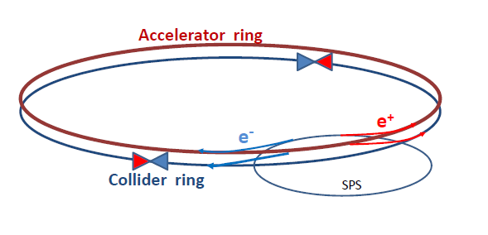
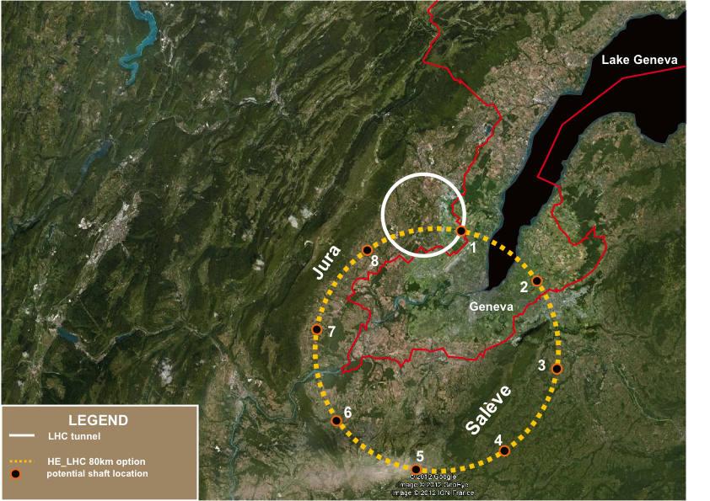
Precision Measurements : Higgs and Top
TLEP : A first step in a long-term vision for particle physics
  In the context of a global project
  See Design Study Proposal at
    http://tlep.web.cern.ch/
      And sign-up the web form to express your interest !

Slide 2
Bibliography
[1] G. Gomez-Ceballos, “Study of SMS Production in bosonic decay channels with CMS”, talk given at the Rencontres de Moriond (Mar. 2013)
[2] F. Hubaut, “Study of SMS production in bosonic decay channels with ATLAS”, talk given at the Rencontres de Moriond (Mar. 2013)
[3] B. Mansoulié, “Combination of SMS results with ATLAS”, talk given at the Rencontres de Moriond (Mar. 2013)
[4] K. Monig, “ATLAS and CMS Physics Prospects at the HL-LHC”, talk given at the CLIC Workshop (Jan. 2013)
[5] R. Kogler, „The EW fit after the SMS discovery at LHC”, , talk given at the Rencontres de Moriond (Mar. 2013)
[6] LHCb, “First evidence for the decay B_{s}⁰ → μ⁺μ⁻”, Phys.Rev.Lett. 110 (2013) 021801
[7] P. Janot and G. Ganis, “The HZHA Generator” in Physics at LEP2, CERN Report 96/01 (Vol.2) 309
[8] S. Dittmaier et al., “Handbook of LHC Higgs cross sections: inclusive observables”, CERN-2011-002 (Vol.1) 76
[9] R.S. Gupta, H. Rzehak, J.D. Wells, “How well do we need to measure Higgs boson couplings?”, arXiv:1206.3560 (2012)
[10] H. Baer et al., “Physics at the International Linear Collider”, in preparation, see http://lcsim.org/papers/DBDPhysics.pdf
[11] CMS, “CMS at the High-Energy Frontier”, ESPP Contribution #177
[12] ATLAS, “Physics at a High-Luminosity LHC with ATLAS”, ATL-PHYS-PUB-2012-004 (2012), ESPP Contribution #174
[13] M. Zanetti, talk given at the 2nd LEP3 day (Oct. 2012)
[14] H. Stoeck et al., “ILD Letter of Intent”, arXiv:1006.3396 (2010)
[15] P. Azzi et al., “Prospective studies for LEP3 with the CMS detector”, arXiv 1208.1662 (2012)
[16] J.E. Brau et al., “The physics case for an e⁺e⁻ linear collider”, ESPP Contribution #69
[17] C.F. Duerig, “Determination of the Higgs Decay Width at the ILC”, talk given at the LCWS12 (Oct. 2012)
[18] P. Janot, “Higgs beyond the LHC”, talk given at the HF2012 ICFA Workshop (Nov. 2012)
[19] M. Peskin, “Ultimate Higgs Measurements at ILC, LEP3 and TLEP”, talk given at the 3rd TLEP3 day (Jan. 2013)
[20] A. Blondel et al., Report of the ICFA Beam Dynamics Workshop,“Accelerators =for a Higgs Factory: Linear vs. Circular”, HF2012 (2013)
[21] M. Martinez and R. Miquel, “Multi-parameter fits to the tt threshold observables at a future e+e- linear collider”, Eur. Phys. Jour.C27 (2003) 49.
[22] Electroweak fits run by M. Gruenewald (private communication, Nov. 2012)
[23] P. Janot, “Physics Landscape and TLEP/LEP3 motivation”, talk given at the 1st TLEP3 day (Jun. 2012)
[24] A. Blondel, “Possibilities and conditions for very high precision electroweak measurements”, talk given at the 3rd TLEP3 day (Jan. 2013)
[25] M.L. Mangano et al., “Higgs cross sections in pp collisions at very high energy”, ESPP Contribution #176
[26] T. Price, “Measurement of the top Yukawa coupling at the ILC”, talk given at the LCWS12 (Oct. 2012)
[27] J. Tian, “Higgs self-coupling study at ILC”, talk given at the LCWS12 (Oct. 2012)
[28] T. Laštovička and J. Strube , “Higgs self-coupling study at CLIC”, talk given at the LCWS12 (Oct. 2012)
[29] E. Meschi, “Detectors for SHE-LHC and TLEP”, talk given at the 3rd TLEP3 day (Jan. 2013)

Slide 3
Introduction : Mis-conceptions about TLEP
A compendium of mis-conceptions about TLEP
  TLEP is more expensive than the ILC
  TLEP parameters are stretched by many-order-of-magnitude extrapolations
  TLEP will come later than ILC
  TLEP is superfluous once ILC is approved and starts construction
  TLEP will delay VHE-LHC
  TLEP required electrical power is unacceptable
  TLEP physics case is the same as that of ILC (at low energy)
  TLEP can only do Higgs couplings / TLEP does not cover the physics case
    We need a machine upgradeable beyond 350 GeV to make discoveries beyond LHC
  TLEP precision is an overkill
    Higgs couplings do not need to be measured so precisely
All are wrong
  With the upgrade path to a 100 TeV machine (unique to TLEP)
    TLEP is the first step in a long-term vision for particle physics
      And might be the only way to secure high-energy physics in Europe
This talk

Slide 4
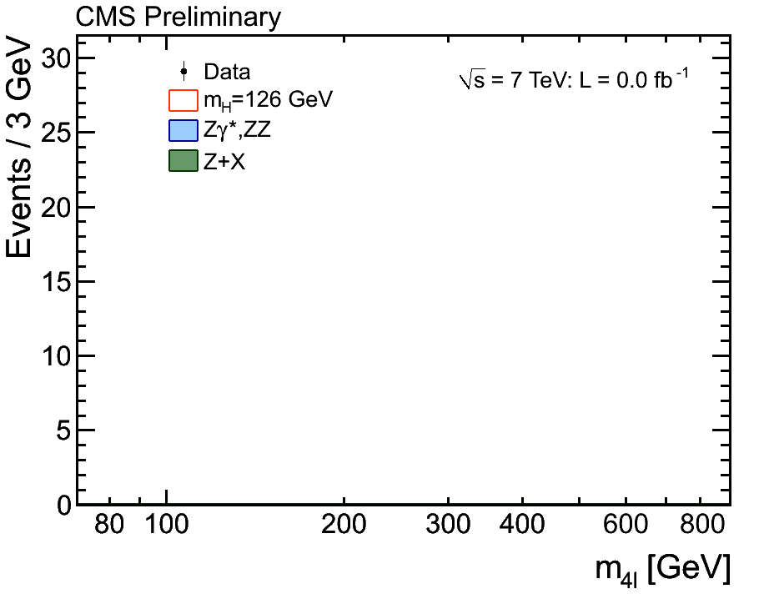

Main Motivation for TLEP
A new boson with mass ~ 126 GeV, and with SMS properties
  Example : H(126) → ZZ → 4 leptons in CMS and ATLAS
    H(126) couples to the Z boson (important for e⁺e⁻ colliders)
    All couplings compatible with those of the Standard Model Scalar
    Scalar hypothesis favoured over pseudo-scalar or spin-2 particle
    m_{H} known to ~ 400 MeV
    A factor 100 luminosity will bring the statistical uncertainty on μ to a couple %.
[1,2,3]

Slide 5
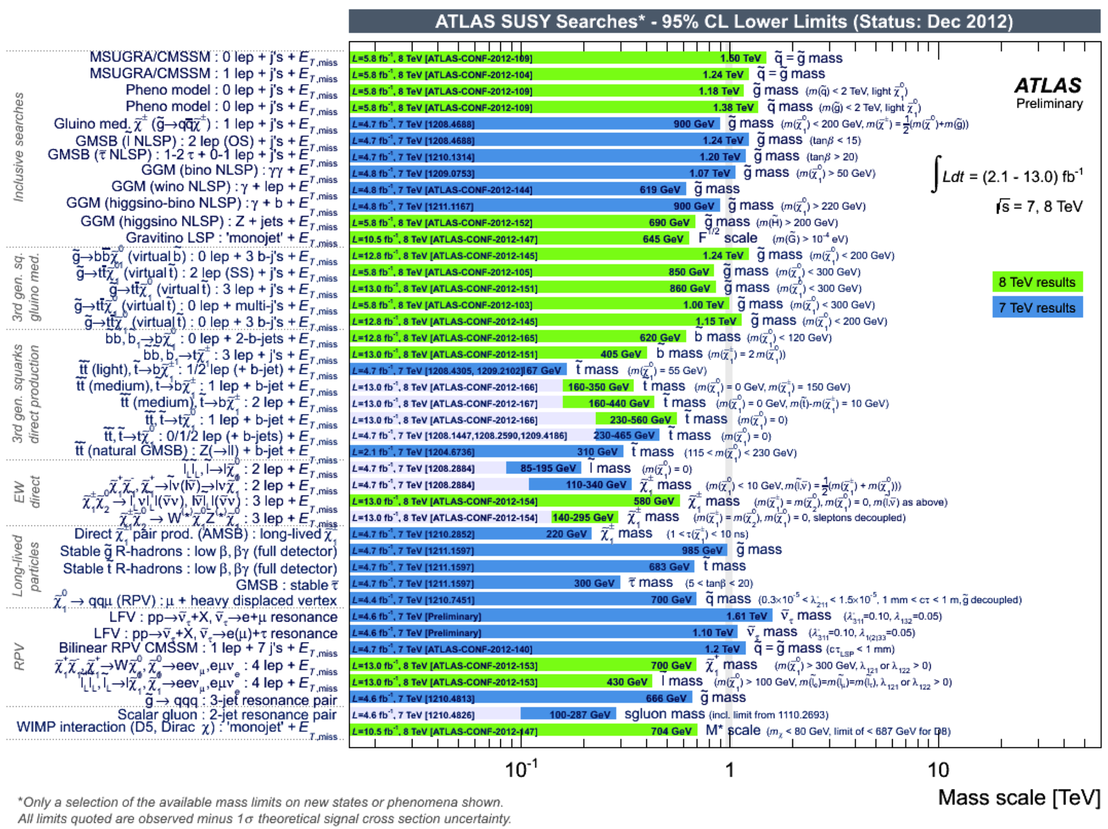
“We need a machine upgradeable beyond 350 GeV” (1)
No sign of new physics below a scale of several 100’s GeV
  Supersymmetry (ATLAS) Exotics (CMS)
  Data at higher √s will extend the mass reach to ~500 GeV for SUSY
    Will know more after the next LHC run at 14 TeV (2015-2017)
      Air is getting very thin for e⁺e⁻ colliders with √s = 500 GeV (and even 1 TeV)
[4]

Slide 6
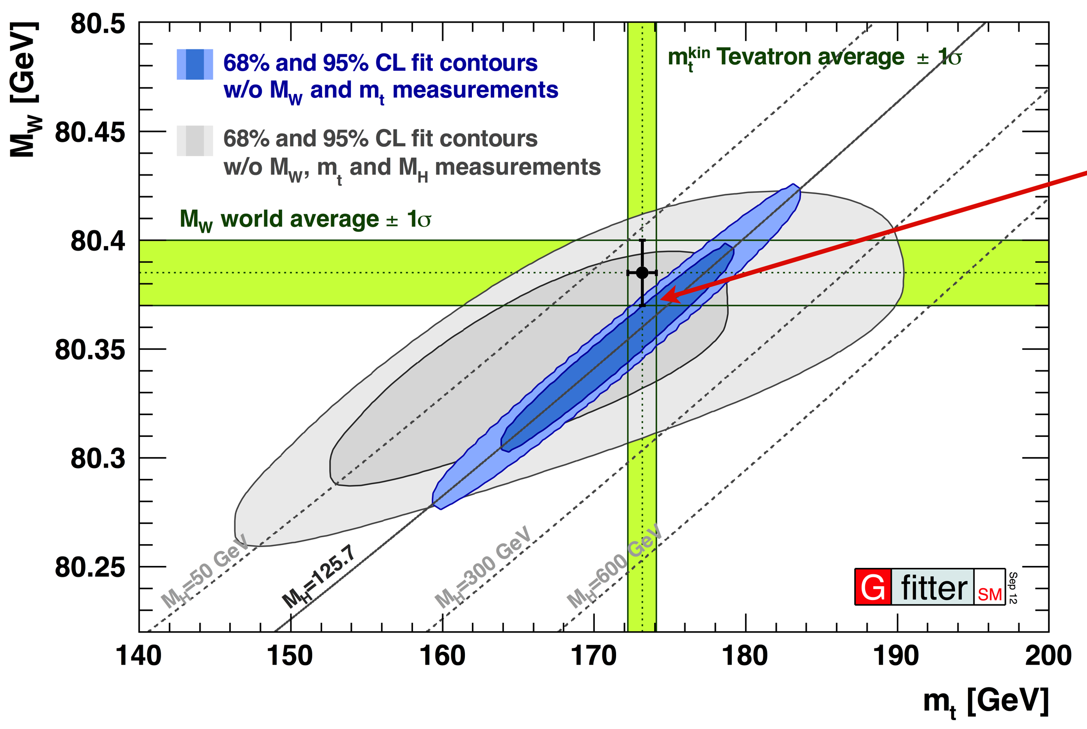
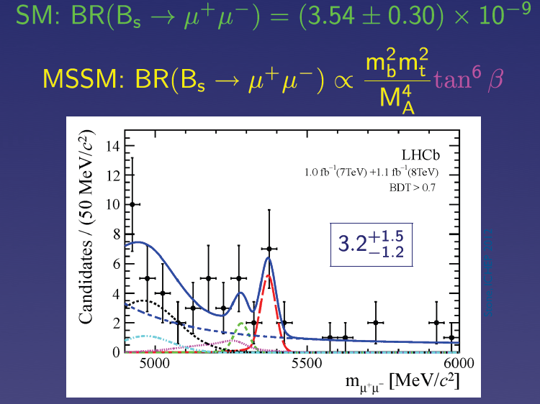
“TLEP Precision is an overkill”
If no new physics is found, what next ?
  Once m_{H} is known, the standard model has nowhere to go !
    Very strong incentive to revisit and improve all precision measurements
      Z pole, WW threshold
      Higgs couplings
      Top quark properties
      Rare decays (B_{s} → μμ, etc.)
    … and find indirect effects of new physics at larger scales
[5,6]
→ Programme unique to TLEP, see Alain’s talk
This presentation
→ Also at the Z pole, unique to TLEP

Slide 7
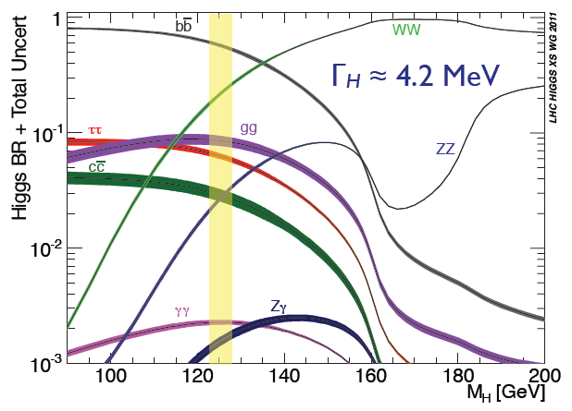
“Higgs couplings do not need to be measured so precisely” (1)
Precision needed for Higgs measurements ?
  Does H(126)
    Couple to fermions ?
    Account for fermion masses ?
    Fully account for EWSB ?
    Has SM coupling to gauge bosons ?
    Decay to new, visible, particles ?
    Decay to invisible particles ?
    Have the “proper” mass and width ?
    Show any sign of new physics ?
  What is the precision needed to answer all these questions in a useful manner ?
    Simple answer : predict and measure as precisely as possible
      Not very informative, especially for the last question
[7,8]
57.9 ± 1.7 %
21.6 ± 0.6 %
6.4 ± 0.4 %
8.2 ± 0.8 %
2.8 ± 0.3 %
2.6 ± 0.1 %
0.27 ± 0.02 %

Slide 8
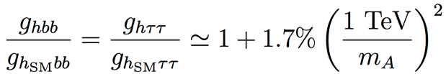
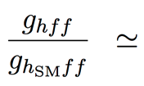
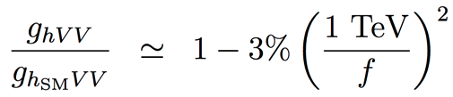
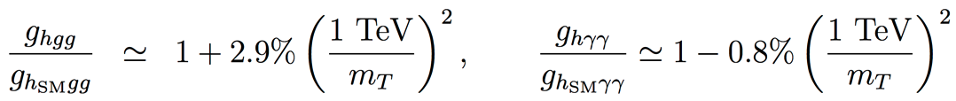
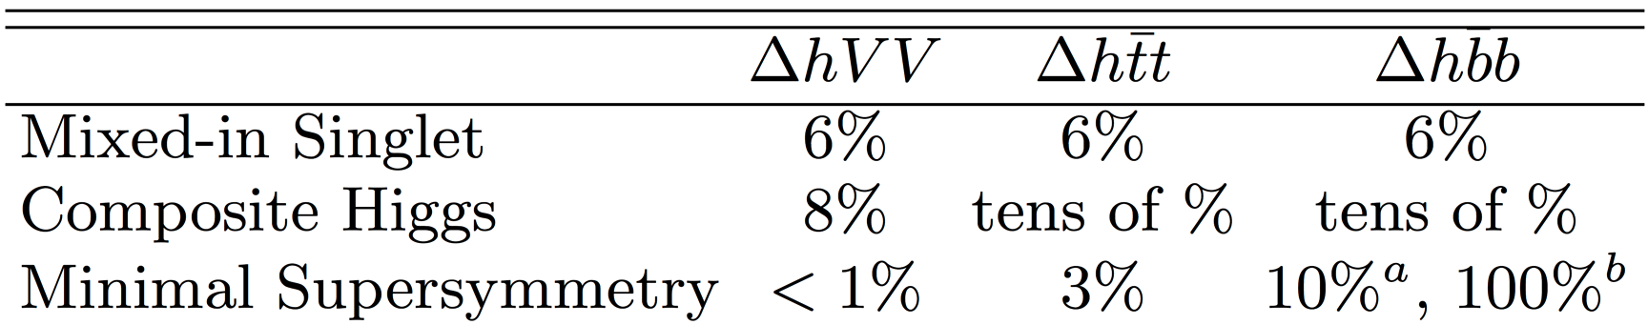
“Higgs couplings do not need to be measured so precisely” (2)
Example : Precision for Higgs couplings
  Maximal deviations with respect to SM couplings, as a function of new physics scale
    SUSY , for tanβ = 5
    Composite Higgs
    Top partners
    Other models may give up to 5% deviations with respect to the Standard Model
  Maximal deviations for the new physics scale still allowed by LHC results
Strongly influences the strategy for Higgs factory projects
  Need at least a per-cent accuracy on couplings for a 5σ “observation”
    And sub-percent precision if new physics is at the (multi-)TeV scale
[9,10]

Slide 9
Precision at existing colliders : (HL-)LHC (1)
Executive summary
Approved LHC, 300 fb⁻¹ at 14 TeV :
  Higgs mass at 100 MeV
  Disentangle Spin 0 vs Spin 2 and main CP component in γγ/ZZ*
  Coupling precision / Experiment
    ZZ, WW, 5-6%
    bb, ττ 10-15%
    tt, μμ 3-2 σ effect
    γγ , gg 5-11%
HL-LHC, 3000 fb⁻¹ at 14 TeV:
  Higgs mass at 50 MeV
  More precise studies of Higgs CP sector
  Coupling precision / Experiment
    ZZ, ZW, 1-5%
    bb, ττ, tt, μμ 3-10%
    γγ and gg 2-7%
    HH >3 σ (2 Expts)
Assuming sizeable reduction of theory errors
[11,12]

Slide 10
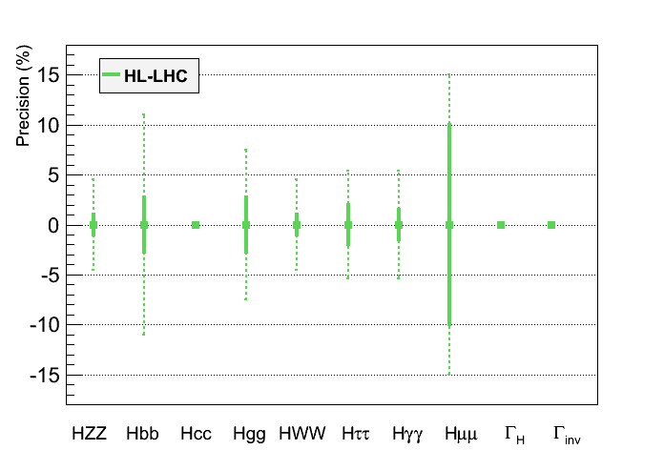
Precision at existing colliders : HL-LHC (2)
Graphic representation of HL-LHC projected performance
  Much better than originally expected before LHC started
    Will need vigorous upgrade of CMS and ATLAS detectors
      Per-cent to sub-percent precision will require new collider(s)
Assumptions :
No new decay
Γ_{H} fixed in the fit
(or fixed BR(cc) )
?
?
?
In bold, theory uncertainty are assumed to be divided by a factor 2,
experimental uncertainties are assumed to scale with 1/√L,
and analysis performance are assumed to be identical as today
ATLAS upper limit at 65%
(Moriond EW 2013)
[11]

Slide 11
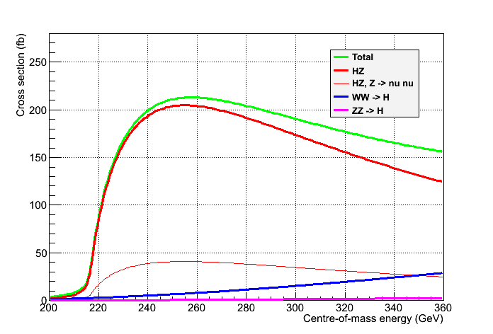
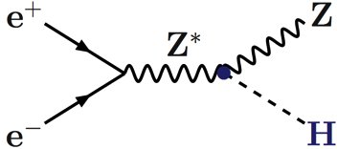
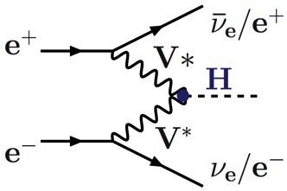
“TLEP Physics is the same as ILC Physics” (1)
Physics case not driven by the fact that the collider is linear or circular
  Scan of the HZ threshold : √s = 210-240 GeV Spin
  Maximum of the HZ cross section : √s = 240-250 GeV Mass, BRs, Width, Decays
  Just below the tt threshold : √s ~ 340-350 GeV Width, CP
Unpolarized cross sections
Need 100’s fb⁻¹
Z → All
Z → νν
[7]

Slide 12
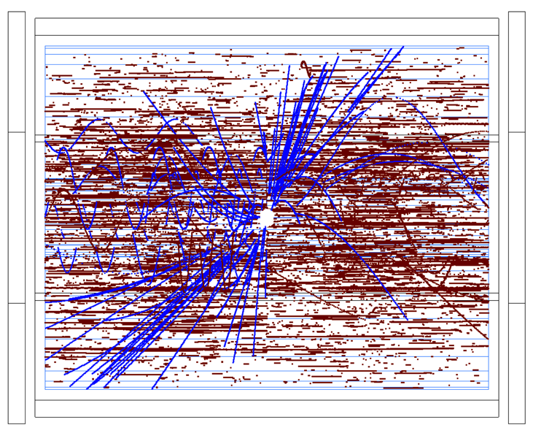
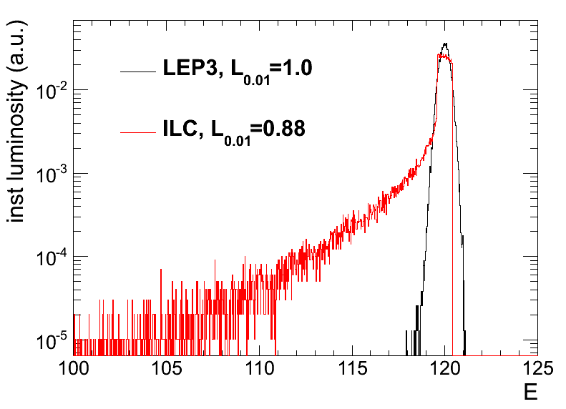
“TLEP Physics is the same as ILC Physics” (2)
A few specificities, though :
  e⁻ (e⁺) beam polarization is easy at the source (possible) for a linear collider.
    Not critical for Higgs studies.
  No beam disruption from Beamstrahlung for a circular collider (σ_{y} ~ 300 nm vs. 5 nm @ ILC)
    No EM backgrounds in the detector (photons, e+e- pairs);
    No beam energy smearing – energy spectrum perfectly known (lumi measurement)
    Negligible pile-up from γγ interactions
      No drastic requirements for the detector and the background simulation
  Possibility of operating several IP’s simultaneously in circular collider
    vs. only one IP in linear collider
ILD TPC at 500 GeV
[13,14]

Slide 13
“TLEP Physics is the same as ILC Physics” (3)
Number of Higgs bosons produced at √s = 240-250 GeV
  LEP3 : 4-8 times more luminosity and 3-6 times more Higgs bosons than ILC
  TLEP : 20-40 times more luminosity and 15-30 times more Higgs bosons than ILC
    In a given amount of time, Higgs coupling precisions scale like
      2.5% for ILC : 1.3% for LEP3 : 0.4% for TLEP
      One year of TLEP = five years of LEP3 = 15-30 years of ILC (at 240 GeV)
No Hubner factor
included !
 | ILC-250 | LEP3-240 | TLEP-240
Lumi / IP / 5 years | 250 fb⁻¹ | 500 fb⁻¹ | 2.5 ab⁻¹
# IP | 1 | 2 - 4 | 2 - 4
Lumi / 5 years | 250 fb⁻¹ | 1 - 2 ab⁻¹ | 5 - 10 ab⁻¹
Beam Polarization | 80%, 30% | – | –
L_{0.01} (beamstrahlung) | 86% | 100% | 100%
Number of Higgs | 70,000 | 400,000 | 2,000,000
Upgradeable to | ILC 1TeV CLIC 3 TeV | HE-LHC 33 TeV | VHE-LHC 100 TeV

Slide 14
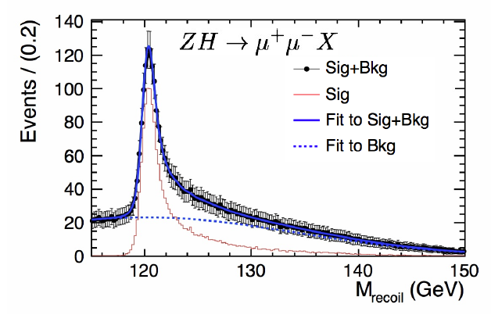
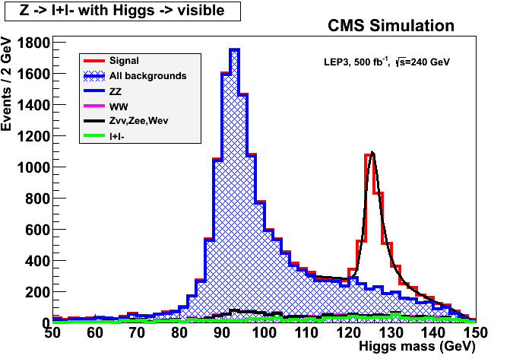
Higgs measurements at √s ~ 240 GeV (1)
With e⁺e⁻ → ZH → e⁺e⁻X and μ⁺μ⁻X events
  Measure HZ cross section in a model independent way
    Find m_{H} peak from the leptons and E,p conservation
    Determine spin with three-point threshold scan
      10 fb⁻¹ / point suffice
    Determine σ_{HZ} and g_{HZZ} coupling at 240 GeV
      3% (1.5%) precision on σ_{HZ} (g_{HZZ})with 250 fb⁻¹
    Good tracker needed, but details mildly depend on the actual performance
      Plots below with ILD@ILC and CMS@LEP3
e⁻
H
Z*
e⁺
    g_{HZZ}
Z
e⁻, μ⁻
e⁺, μ⁺
[9,10,11]
e⁺e⁻ → ZH → e⁺e⁻X and μ⁺μ⁻X
e⁺e⁻ → ZH → μ⁺μ⁻X
e⁺e⁻ → ZH → μ⁺μ⁻X
Δp/p ~ 0.2%
Δp/p ~ 2%
[15,16]

Slide 15
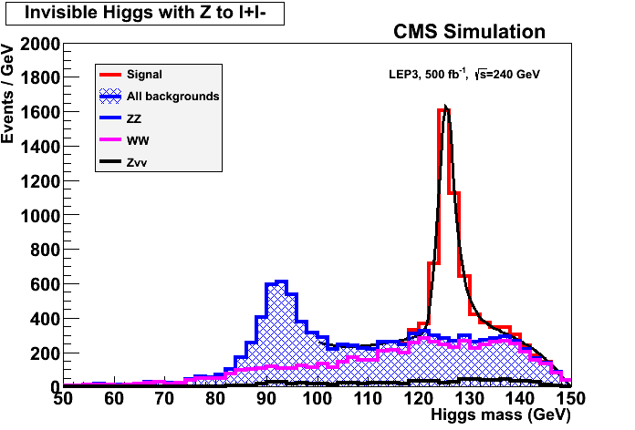
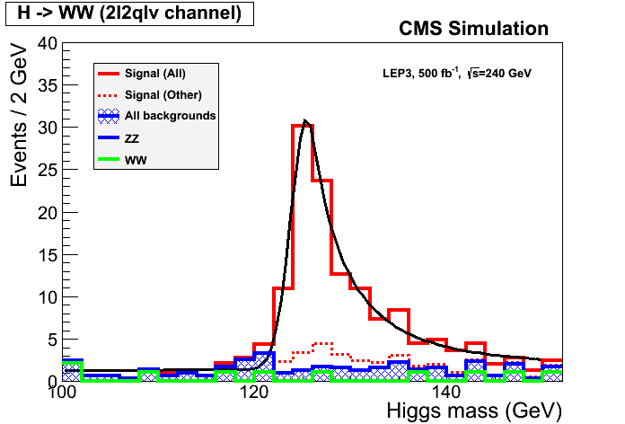
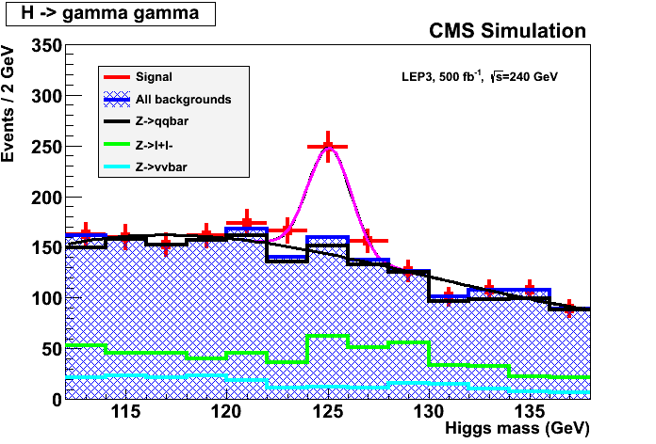
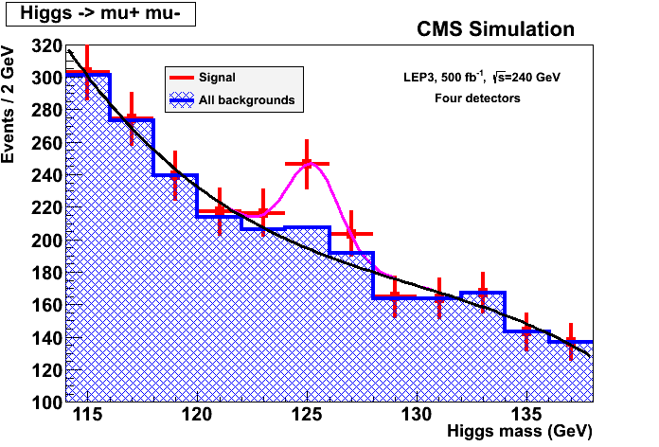
Higgs measurements at √s ~ 240 GeV (2)
With ZH → e⁺e⁻X and μ⁺μ⁻X events (cont’d)
  Measure invisible decay branching ratio (X = nothing)
    Precision on BR_{INV} ~ 1% with 250 fb⁻¹
    Or exclude BR_{INV} > ~2% at 95% C.L.
Measure other σ_{HZ}×BR(H→ ff,VV)
  With exclusive selections of Z and H decays
    Precision of 1.5% to 8% with 250 fb⁻¹ for the copious decays (bb, WW, gg, ττ, cc)
    Need more luminosity for rare decays (γγ, Zγ, μμ)
      Particle flow, b and c tagging, lepton and photon capabilities needed
ZH→ qqbb, 250 fb⁻¹ ZH→ llWW→ lllνqq, 500 fb⁻¹ ZH→ Xγγ, 500 fb⁻¹ ZH→ Xμμ, 2 ab⁻¹
[10,15,16]

Slide 16
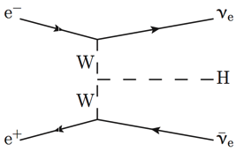
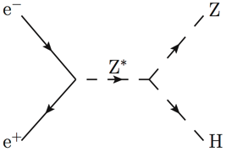
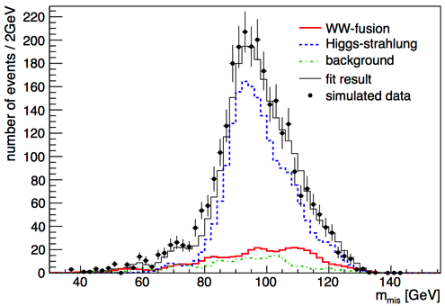
Higgs measurements at √s ~ 240 GeV (3)
Higgs width from the Hνν final state
  From σ_{WW→H} and BR(H→ WW)
    σ_{WW→H} ~ g²_{HWW}
    BR(H→ WW) = Γ_{H→WW} / Γ_{H} ~ g²_{HWW} / Γ_{H}
      Γ_{H} ~ σ_{WW→H} / BR(H→ WW)
  Contribution to Hνν from HZ ~ 40 pb
    Known from ZH → e⁺e⁻X and μ⁺μ⁻X
  Contribution from WW fusion ~ 6 pb
    To be measured
  Select ννbb events from ZH and WW fusion
    Needs adequate b tagging and particle flow
  Fit the missing mass distribution for N_{WW→H→bb}
    σ_{HZ} x BR(H→ bb) known to ~1.5% or better
    σ_{WW→H} = N_{WW→H→bb} / BR(H→ bb)
      Precision on σ_{WW→H} ~ 14% with 250 fb⁻¹
      Γ_{H} ~ σ_{WW→H} / BR(H→ WW), measured up to 15% precision with 250 fb⁻¹
    g_{HWW}
[17]

Slide 17
Higgs measurements at √s ~ 240 GeV (4)
Z
Higgs width from the ZZZ final state
  Number of ZZZ events ~ σ_{HZ} × BR(H→ ZZ)
    σ_{HZ} ~ g²_{HZZ}
    BR(H→ZZ) = Γ_{H→ZZ}/Γ_{H} ~ g²_{HZZ} / Γ_{H}
      Number of ZZZ events ~ g⁴_{HZZ} / Γ_{H}
  Select l⁺l⁻ l^{’+}l^{’−} X events ( ~ background and H →WW free)
    Number of events in 250 fb⁻¹ @ 240 GeV :
      250 fb⁻¹ × 200 fb × BR(H→ZZ) × BR(Z→ll)² × 3
        → About 40 events, of which ~25 selected
  Hence measure the total width Γ_{H} with a precision of 21%
    Reduced to 12% in combination with WW fusion measurement
      Could be further reduced with other Z decays
        (Need full simulation and WW/ZZ simultaneous fit)
  Note : Precision of a few % can be reached on Γ_{H} if one assumes no exotic Higgs decays
e⁻
Z∗
H
Z
e⁺
Known to 6%
from l⁺l⁻X events
with 250 fb-1
Z∗

Slide 18
“TLEP does not cover the Physics Case” (1)
Precision on H(125) branching fractions, width, mass, … after 5 years
  LEP3 numbers obtained from a CMS simulation x 4, except (*) extrapolated from ILC
    Need a refined vertex detector for gg and cc BR accurate measurements
  TLEP numbers extrapolated from LEP3 column – ILC numbers with super-duper ILC detector
 | ILC | LEP3 (4) | TLEP (4)
σ_{HZ} | 2.5% | 1.3% | 0.4%
σ_{HZ} ✕BR(H→bb) | 1.0% | 0.5% | 0.1%
σ_{HZ} ✕BR(H→cc) | 6.9% | 4% (*) | 1.3%
σ_{HZ} ✕BR(H→gg) | 8.5% | 4.5% (*) | 1.4%
σ_{HZ} ✕BR(H→WW*) | 8.0% | 3.0% | 0.9%
σ_{HZ} ✕BR(H→ττ) | 5.0% | 3.0% | 0.9%
σ_{HZ} ✕BR(H→ZZ*) | 28% | 7.1% | 3.1%
σ_{HZ} ✕BR(H→γγ) | 27% | 6.8% | 3.0%
σ_{HZ} ✕BR(H→μμ) | – | 28% | 13%
σ_{WW→H} | 12% | 5% (*) | 2.2%
Γ_{H} , Γ_{INV} | 10% , < 1.5% | 4% , < 0.7% | 1.8% , < 0.3%
m_{H} | 40 MeV | 26 MeV | 8 MeV
[10,15,16]

Slide 19
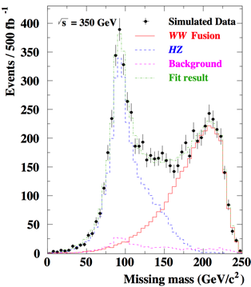
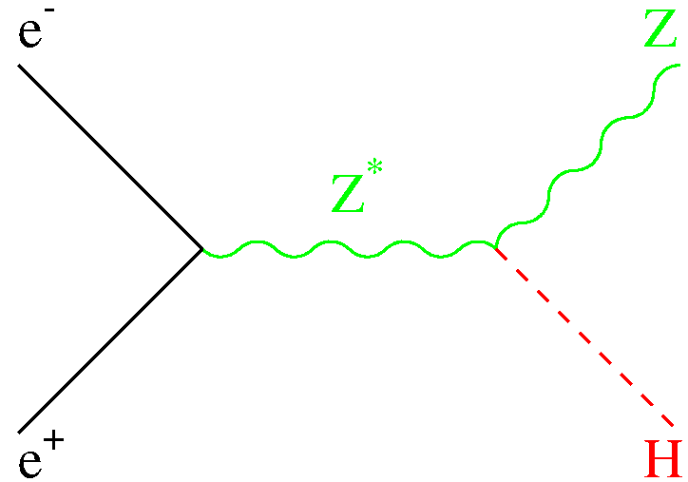
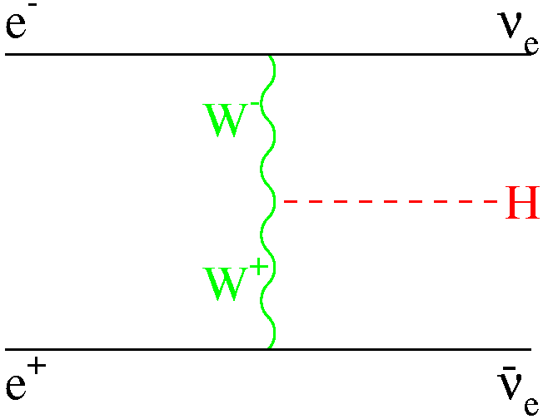
Higgs Measurements at √s ~ 350 GeV
Luminosity similar for ILC and TLEP
  At each IP : 350 fb⁻¹ over 5 years
    With possibly 4 detectors at TLEP
  More study of the Hνν final state with H→bb
    Contribution from HZ : ~ 25 fb
    Contribution from WW→H : ~ 25 fb
      Improves precision on Γ_{H} and HWW coupling
      Smaller improvement of other σ✕BR measurements
 | ILC (250+350) | TLEP (240+350)
σ_{WW→H} | 12% → 4% | 2.2% → 1.5%
Γ_{H} | 10% → 5.5% | 1.8% → 1.3%
[10,17]

Slide 20
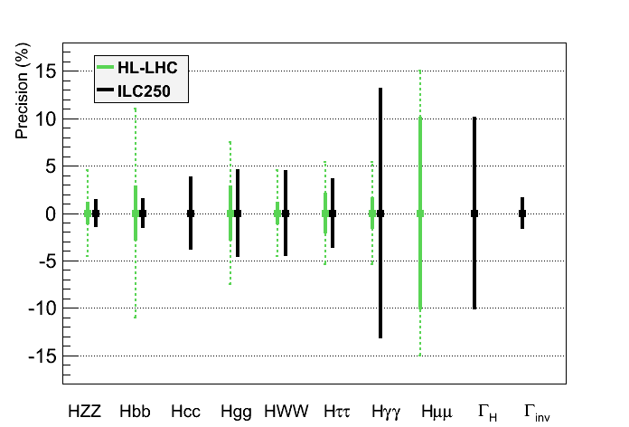
“TLEP does not cover the Physics Case” (2)
Same assumptions as for HL-LHC for a sound comparison
  No exotic decay, fixed decay width
      ILC250 would complement LHC (esp. for Γ_{H} , Γ_{inv} , g_{Hcc} , g_{Hbb})
[11,16]

Slide 21
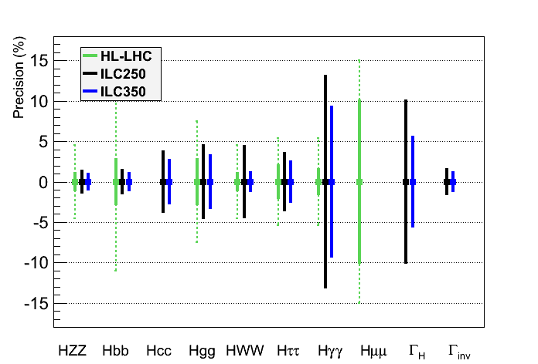
“TLEP does not cover the Physics Case” (3)
Same assumptions as for HL-LHC for a sound comparison
  No exotic decay, fixed decay width
      ILC250/350 would further complement LHC, but does not cover the physics case
[11,16]

Slide 22
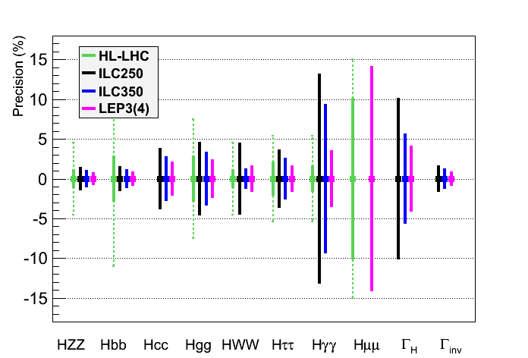
“TLEP does not cover the Physics Case” (4)
Same assumptions as for HL-LHC for a sound comparison
  No exotic decay, fixed decay width
      LEP3 would be an advantageous back-up : larger lumi, several IPs, smaller cost
[11,16,18]

Slide 23
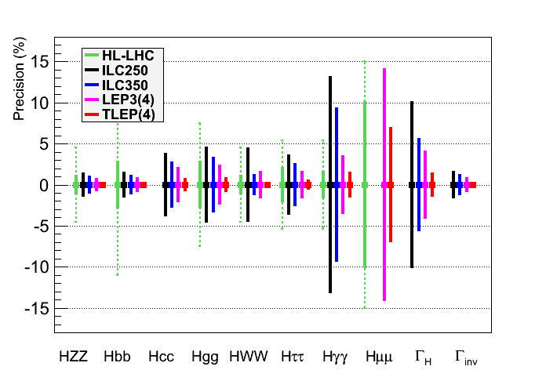
“TLEP does not cover the Physics Case” (5)
Same assumptions as for HL-LHC for a sound comparison
  No exotic decay, fixed decay width
      TLEP would be a superior option (see zoom next page)
See zoom
Next page
[11,16,18]

Slide 24
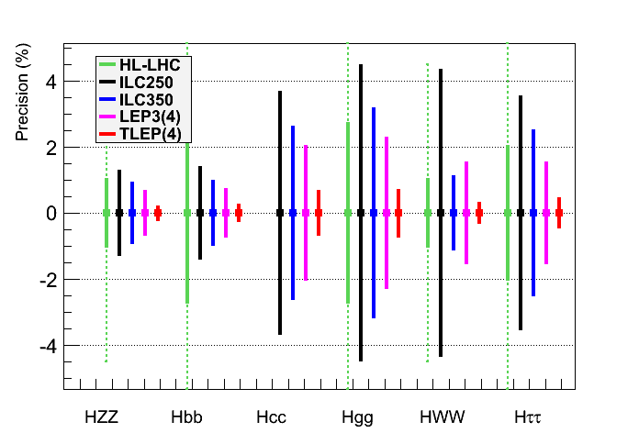
“TLEP does not cover the Physics Case” (6)
Same assumptions as for HL-LHC for a sound comparison
  No exotic decay, fixed decay width
      TLEP : sub-percent precision, needed for (multi)-TeV New Physics sensitivity
[11,16,18]

Slide 25
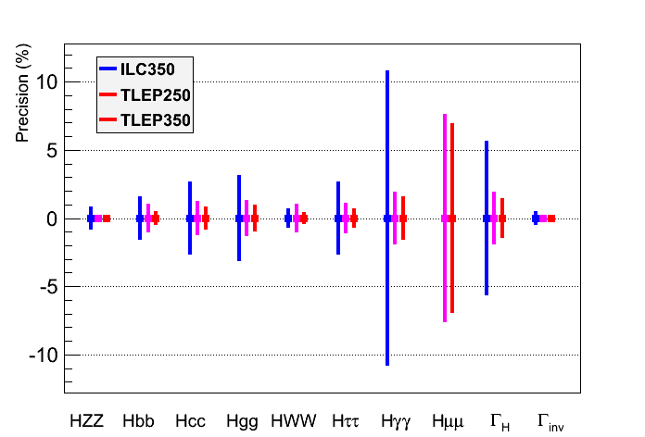
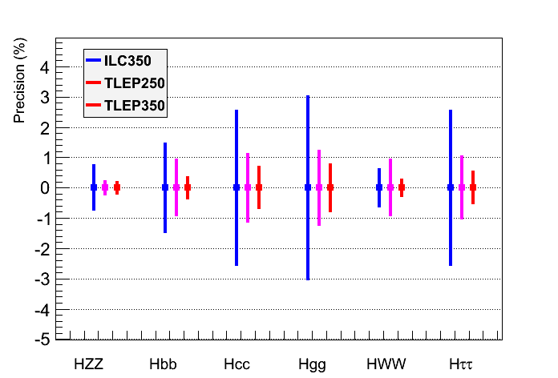
“TLEP does not cover the Physics Case” (7)
Same conclusion when Γ_{H} is a free parameter in the fit
  Plot shown only for ILC350 and TLEP, with an accurate width measurement
      TLEP : sub-percent precision, adequate for NP sensitivity beyond 1 TeV
[19]

Slide 26
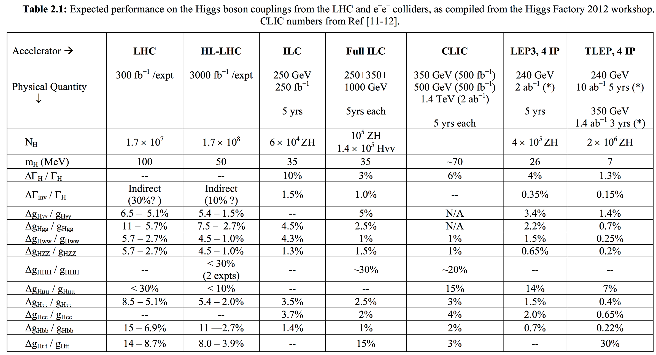
“TLEP does not cover the Physics Case” (8)
[20]

Slide 27
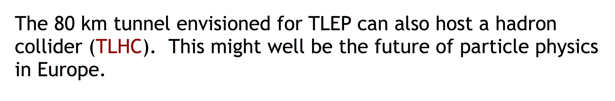
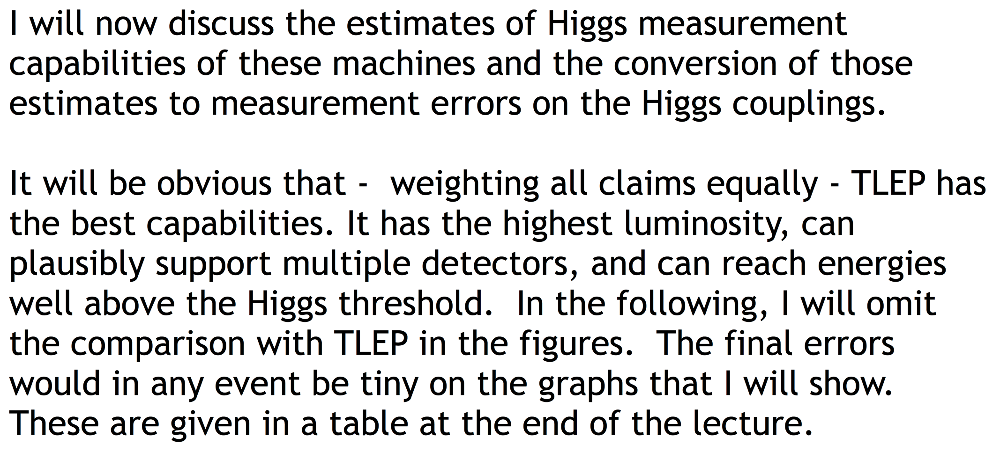
“TLEP does not cover the Physics Case” (9)
A slide from M. Peskin at the 3rd TLEP/LEP3 Worskshop (10-Jan-2013)
[19]

Slide 28
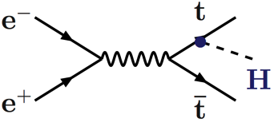
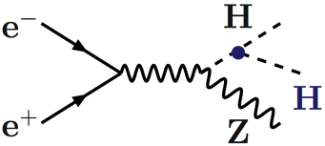
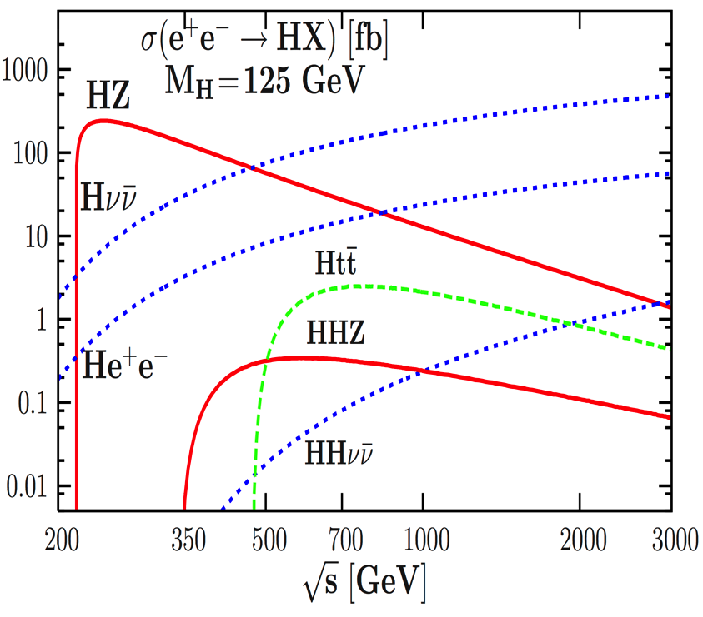
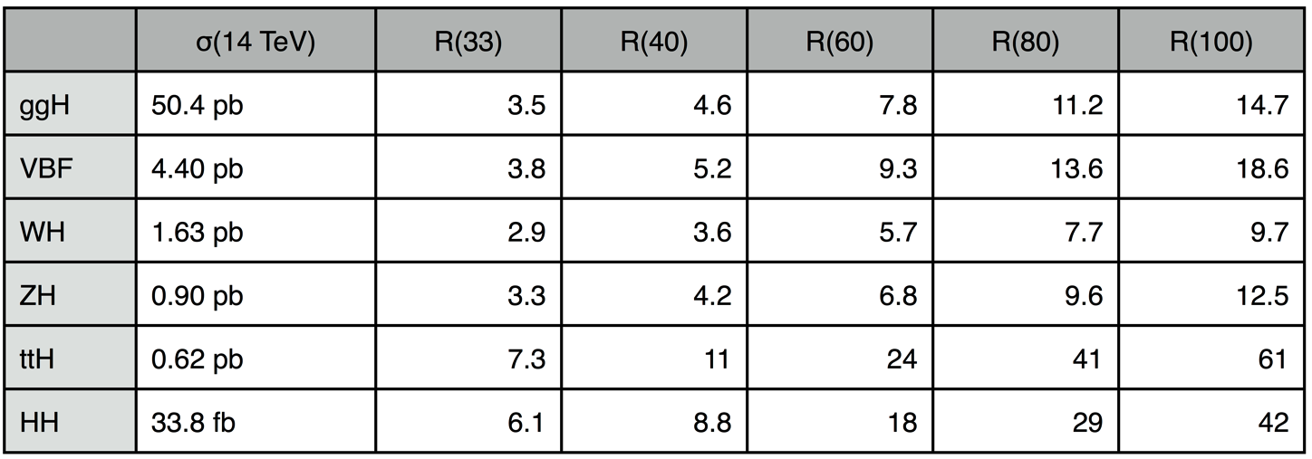
“We need a machine upgradeable beyond 350 GeV” (2)
All existing proposals have access to larger √s
  To discover New Physics in a direct manner
  To measure more difficult Higgs couplings : g_{Htt} and g_{HHH}
    ILC350 can be upgraded to ILC500/ILC1TeV, or even to CLIC (3 TeV) [600 MW!]
    LEP3 can be upgraded to (or preceded by) HE-LHC (33 TeV)
    TLEP can be upgraded to VHE-LHC (100 TeV)
[25]
Cross sections in e⁺e⁻ collisions
H
H
Cross sections in pp collisions

Slide 29
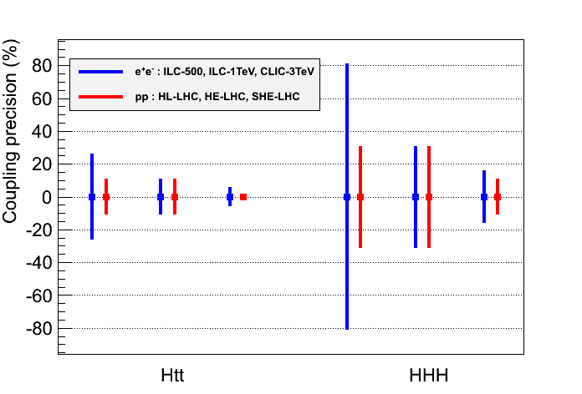
“We need a machine upgradeable beyond 350 GeV” (3)
Summary for Htt and HHH couplings
  Other Higgs couplings benefit only marginally from high energy
    For similar/larger new physics reach, ttH/HHH precision with pp better than e⁺e⁻
      ILC500 does not cover the (new) physics case – ILC1TeV vastly insufficient
[11,12,26,27,28]
√s, NP
√s, NP
ILC500, HL-LHC ILC1TeV, HE-LHC CLIC3TeV, VHE-LHC

Slide 30
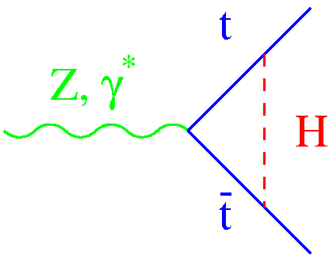
Top Measurements at √s ~ 350 GeV (1)
Scan of the tt threshold
  Observables σ_{tt}, A_{FB} and <p_{t}^{max}> sensitive to m_{top} , Γ_{top} , and λ_{top} (ttH Yukawa coupling)
    Experimental precision (for ILC)
      No beamstrahlung at TLEP is a advantage
    Sensitivity with 300 fb⁻¹ for ILC (expected to be better for TLEP)
    Studies of rare top decays
m_{top} = 175 GeV
σ_{tt}
p_{t}^{max}
A_{FB}
Δm_{top} | ΔΓ_{top} | Δλ_{top}/λ_{top}
30 MeV (0.02%) | 35 MeV (3%) | 30%
[21]

Slide 31
Top Measurements at √s ~ 350 GeV (2)
Examples of sensitivities (for ILC-like beamstrahlung)
Cross section
Cross section
Cross section
ΔΓ_{t} = 200 MeV
Δλ_{t}/λ_{t} = 0.25
Δm_{t} = 100 MeV
A_{FB}
ΔΓ_{t} = 200 MeV
<p_{t}^{max}>
ΔΓ_{t} = 200 MeV
(m_{top} = 175 GeV)
[21]

Slide 32
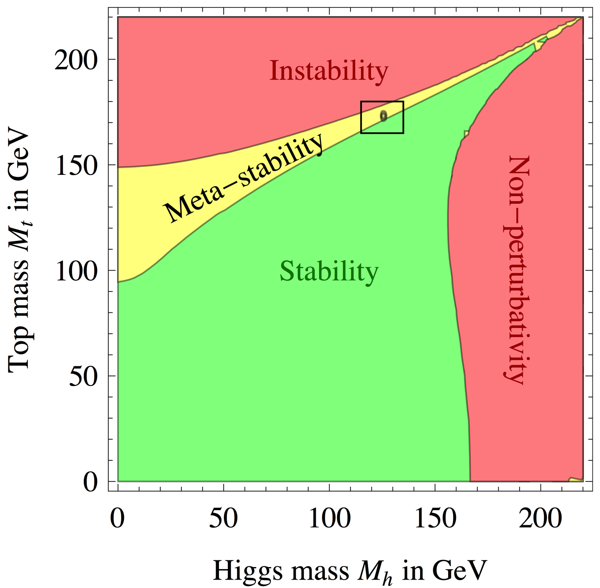
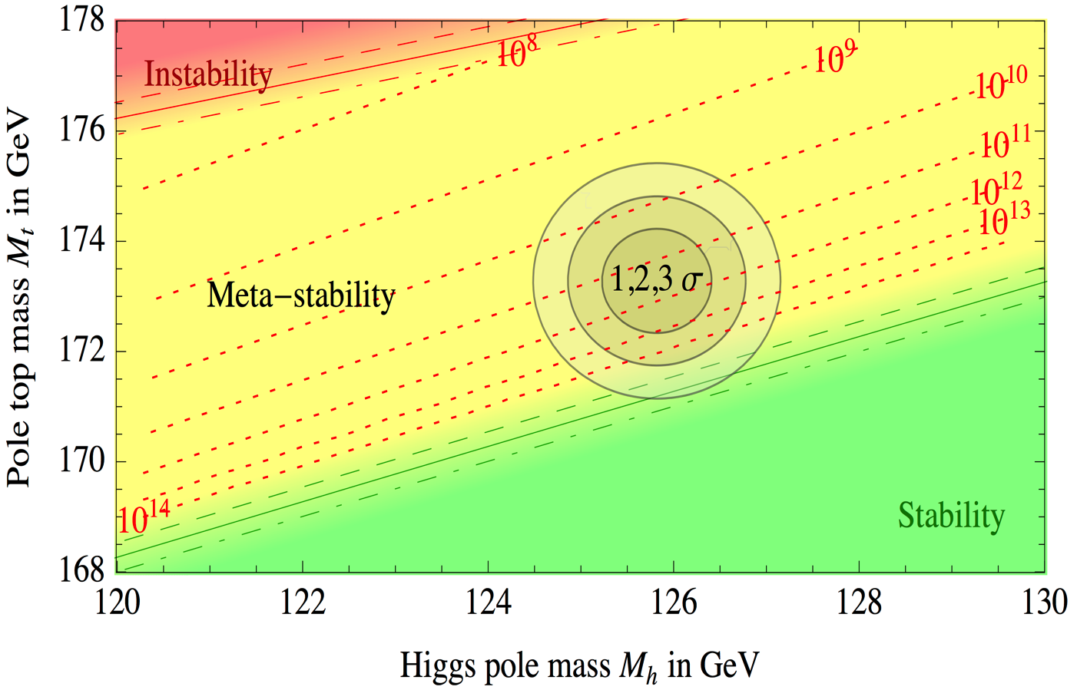
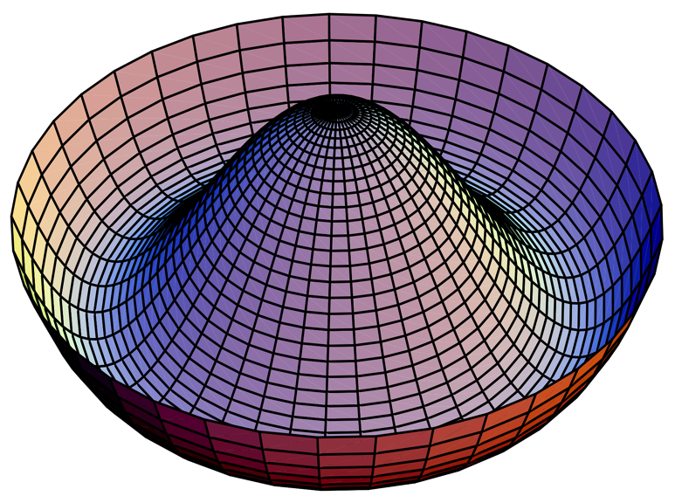
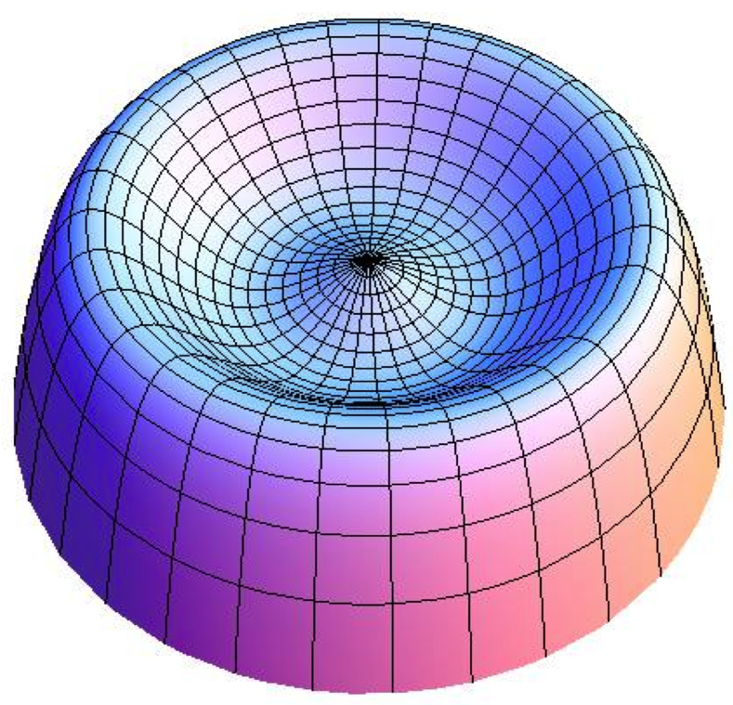

Top Measurements at √s ~ 350 GeV (3)
Measurement of m_{top} perhaps more important than originally thought
Meta-stability favoured at 2σ : need to know m_{top} from e⁺e⁻
→
→

Slide 33
Design Study : 2013 – 2018 (1)
Long list of things to do (not exhaustive)
  Propose a sound detector design
    With performance between those of CMS and a ILC detector
      Suited for Z, W, H and top studies (with feedback from physics analyses)
    Particle-Flow friendly
    Able to take data at the Z pole (30 kHz of Z, 120 kHz of Bhabha)
      Forward region, luminosity measurement, …
      Work out the offline and online computing challenges
    Upgradeable for VHE-LHC
  Develop a parametric, a fast, and a full (?) simulation of this detector
    And an event reconstruction for the fast (and full) simulations
      Can use CMS or ATLAS for a while, but then need to move on
  Develop a common analysis framework
  Understand experimental environment: beam backgrounds, machine/detector interface
    e.g., Beamstrahlung, …
    e.g., By-passes for the accelerator ring

Slide 34
Design Study : 2013 – 2018 (2)
Long list of things to do (not exhaustive, cont’d)
  Repeat and improve Higgs properties measurements, develop missing ones
    σ_{HZ}, σ_{HZ} x BR, σ_{WW→H ,} σ_{WW→H} x BR, invisble decays, total width, mass, …
    Investigate ttH and HHH coupling in pp collisions at 100 TeV
    Make a global fit towards coupling determination
  Develop analyses for the top properties measurements
    Cross section, AFB, momentum distribution, exclusive decays, other ?
    Global fit towards mass, width, Yukawa coupling, α_{s}, …
  Assess the precision of EW measurements at the Z pole and WW threshold
    See Alain’s talk
  Global fit of all centre-of-mass energies outcome
  Improve the theoretical SM predictions to match expected experimental precisions
    Higgs branching fractions
    Electroweak observables
    Develop accurate Monte Carlo generators accordingly
  Evaluate the effect of new physics, in a few benchmark models
    Assess the overall sensitivity of TLEP

Slide 35

Design Study : 2013 – 2017

