Slide 1
Ibex and AI HOWTO
Vítor Gouveia,
vitor.gouveia@cern.ch
IT-PES-PS

Slide 2
Agenda
Recap: AI components
Cloud Infrastructure: Ibex
Ibex and beyond
Support Lines
Migrate Quattor-managed machines to AI
Questions??

Slide 3
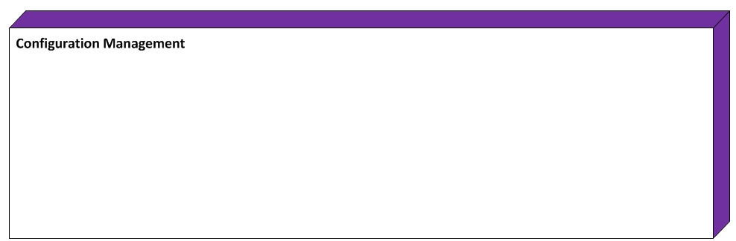
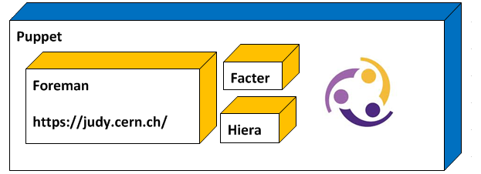
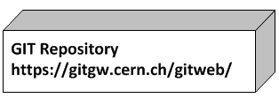

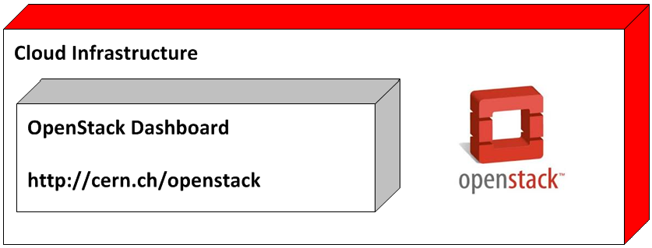
Recap: AI Components

Slide 4
Cloud Infrastructure: Ibex
Ibex: Based OpenStack Folsom
  Pre-production service for users, project admins and IaaS admins
In your personal project you have resources for 10 VMs
User support via SNOW tickets
Increased stability and improved state handling
Current user documentation:
http://information-technology.web.cern.ch/book/cern-private-cloud-user-guide

Slide 5
Cloud Infrastructure: Ibex
Suitable for implementing the “Cattle” use case
  machines that may die without impact in service (Ex: lxplus, lxbatch)
  Can include puppet-managed nodes in load-balanced aliases
  The new nodes to be behind lxplus6.cern.ch are hosted and configured within the CERN IT Agile Infrastructure project

Slide 6
Ibex and beyond
Volume service will be added to Ibex in the coming weeks
Ibex EOL: May 31st 2013
  will be destroyed, and replaced by a Grizzly based service
  the Grizzly service will upgraded to Havana in 6 months

Slide 7
AI Support Lines
Two support lines were created:
Cloud Infrastructure support lines:
https://cern.service-now.com/service-portal/function.do?name=cloud-infrastructure&s=cloud
Configuration Management support lines:
https://cern.service-now.com/service-portal/function.do?name=Configuration-Management

Slide 8
Current status
Although, we have support lines and the cloud service is getting close to production status.
…everything is still a pre-production service
things can change…!!!

Slide 9
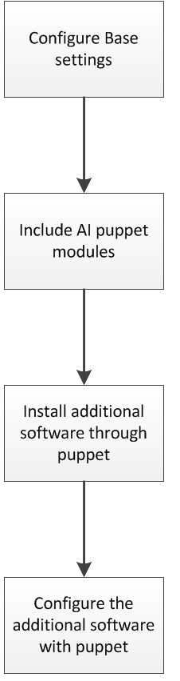
Migrate Quattor-managed machines to AI
There is no automated way to convert a Quattor-managed machine into a Puppet-managed machine. Essentially, the migration is an execution of the following steps:
Configure base settings (Ex: users, firewall)
Include AI puppet modules that install and configure common services (Ex: afs, Apache, MySQL)
Install additional software (Custom or specific applications/services needed by the machine) [rpms (dependencies are resolved automatically), extra repositories, etc…]
Configure additional software with puppet
(If the configuration of additional software is used in several hostgroups you should create a AI puppet module)

Slide 10
Demo
Let’s see a live demo of the AI project….

Slide 11

???????????????????????

