Slide 1
ARDENT –ESR3
Silvia Puddu – 14/10/2013

Slide 2
Summary
About me
Experimental activity
  n_TOF
  CERF
  Radioactive waste
Conferences & Presentations
Publications
Training
Outreach

Slide 3
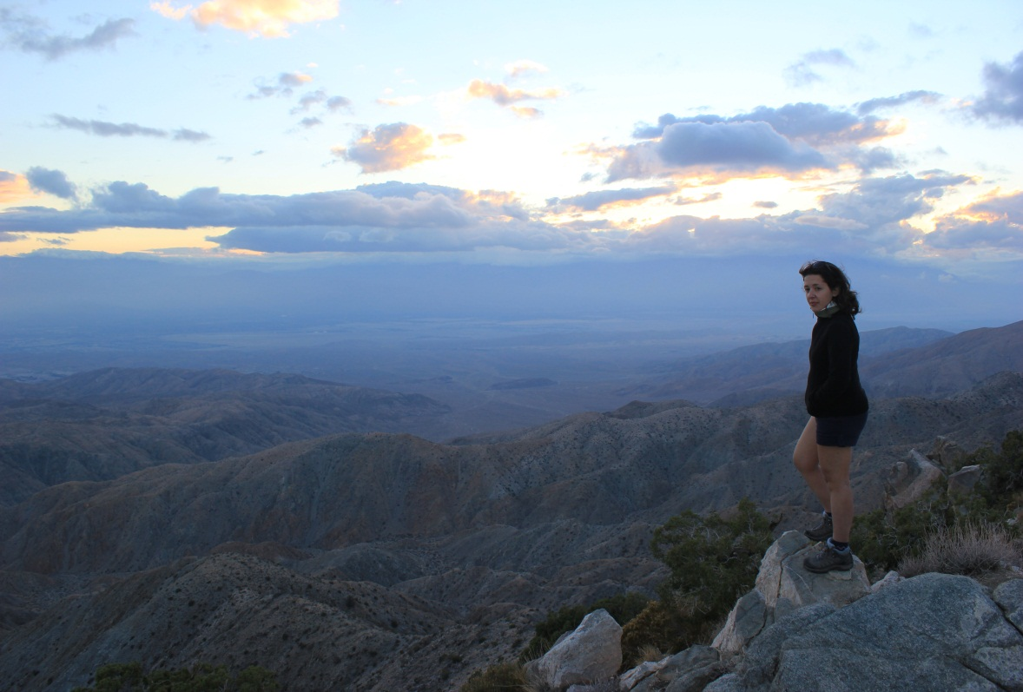

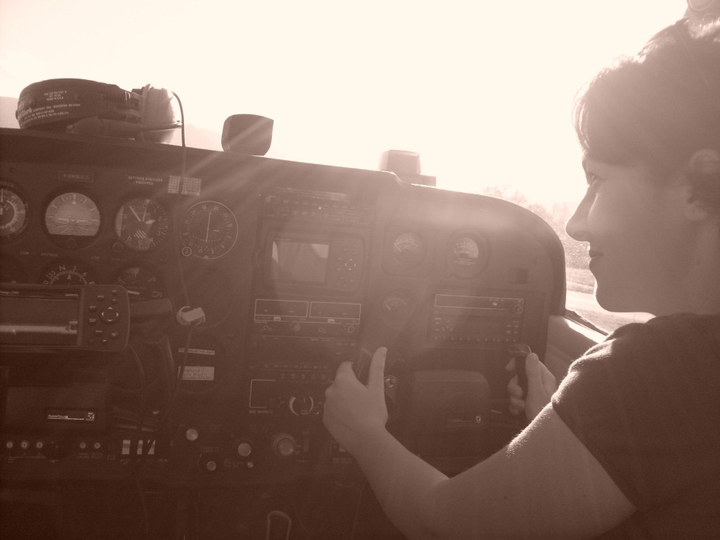

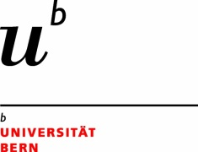
About me
Born in Cagliari-Sardinia Italy
ARDENT Project: ESR3
Affiliation: CERN
PhD affiliation:
Bern University
Supervisors: M. Silari, F. Murtas

Slide 4
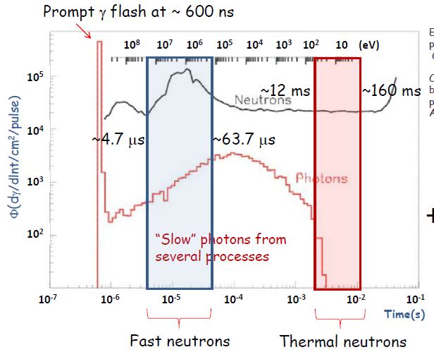
Experimental activity: n_TOF
n_TOF facility: neutron production from spallation reactions; a 183 m path define neutron energy from TOF.
Two activities with GEM:
  Beam imaging with fast neutron detector
  Beam imaging with thermal neutron detector
Neutrons interact with a converter and the generated charged particles are detected by GEM
Neutron energy is selected by delaying the trigger of the GEM

Slide 5
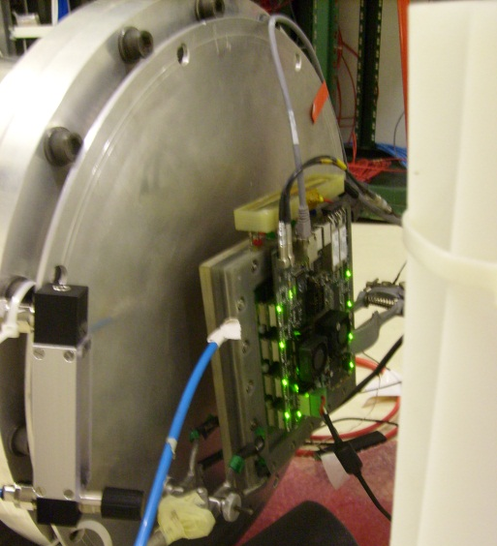
Experimental activity: n_TOF
n_TOF facility: neutron production from spallation reactions; a 183 m path define neutron energy from TOF.
Two activities with GEM:
  Beam imaging with fast neutron detector
  Beam imaging with thermal neutron detector
Neutrons interact with a converter and the generated charged particles are detected by GEM
Neutron energy is selected by delaying the trigger of the GEM

Slide 6
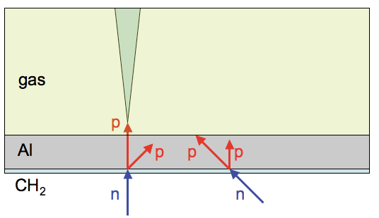
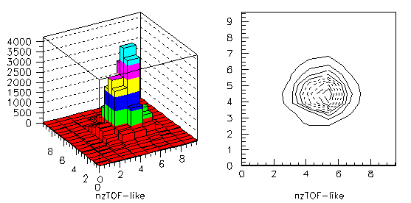
Experimental activity: n_TOF
Fast neutrons:
Head on detector
Converter: PE+Al
Delay: 2000 ns
Low sensitivity to γ background at chosen WP
Constant: 3640 ± 40
Mean1: 5.9 ± 1.8 cm
Mean2: 5.5 ± 1.8 cm

Slide 7
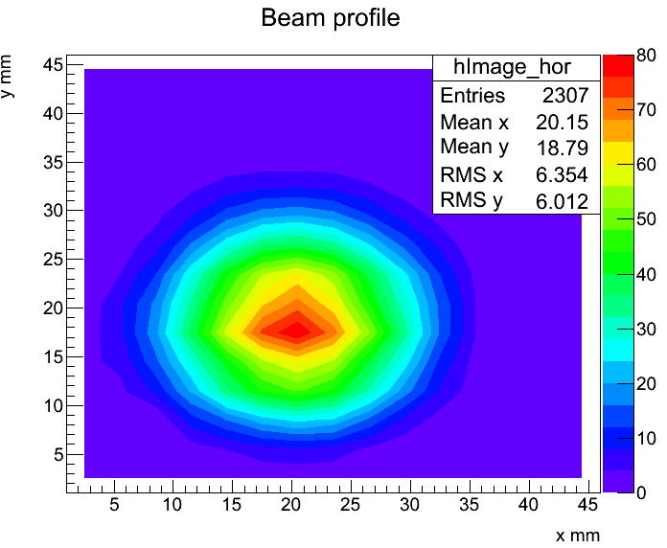
Experimental activity: n_TOF
Side-On detector
Thermal neutrons
Alphas
Thermal neutrons:
Converter: series of slices of ¹⁰Bo
Delay: 12 ms
Low sensitivity to γ background at chosen WP
Beam image reconstructed from several step position
Data analysis performed by E. Aza
Writing paper
IEEE-NSS 2013, Seoul - Talk

Slide 8
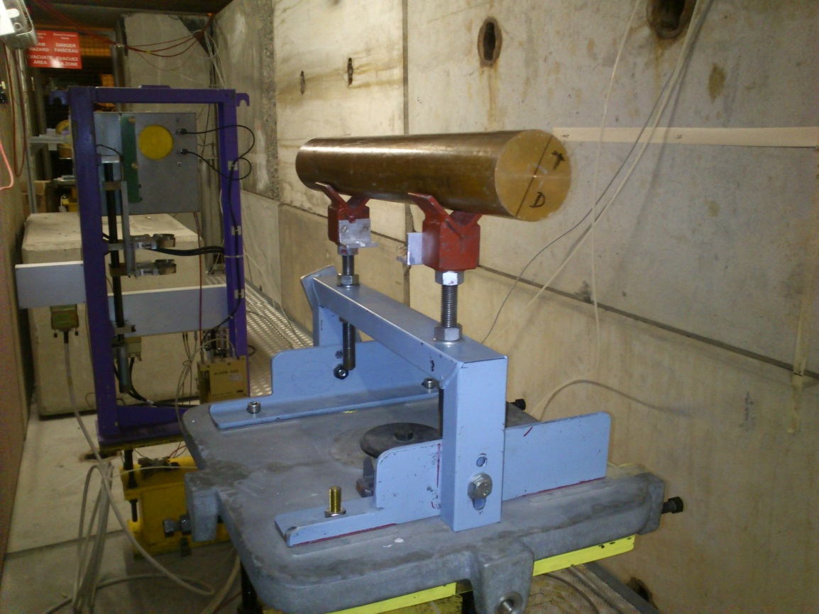
Experimental activity: CERF
CERF facility: neutron production from spallation reaction.
  On the roof, neutron spectrum is similar to aircraft neutron spectrum.
Activity with GEM:
  beam monitoring
  measuremets of several radiation components

Slide 9
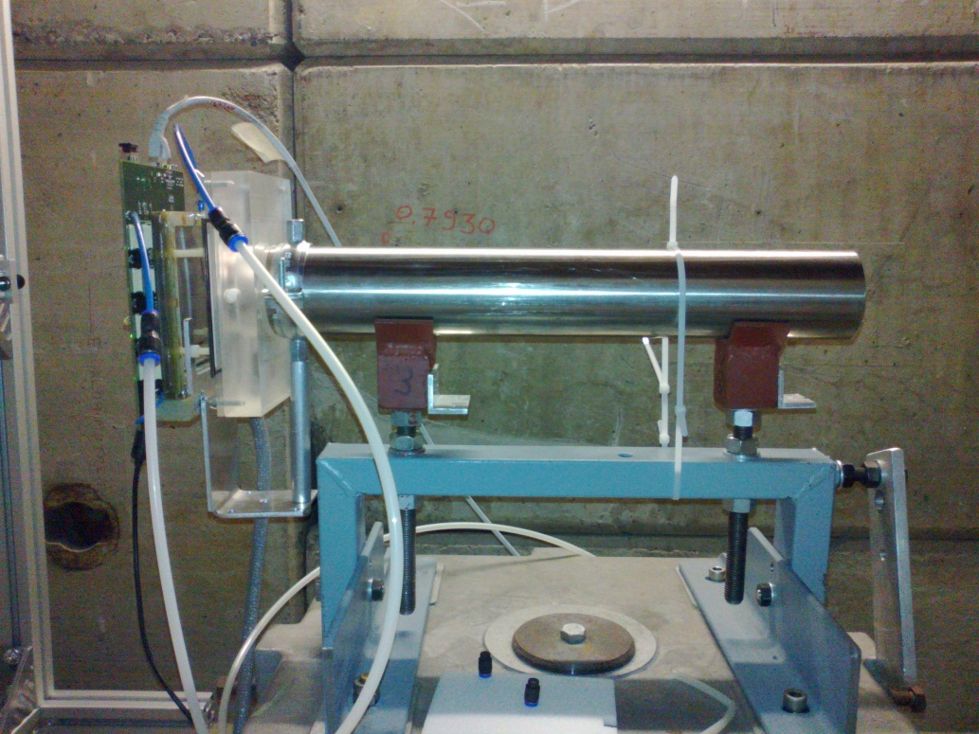
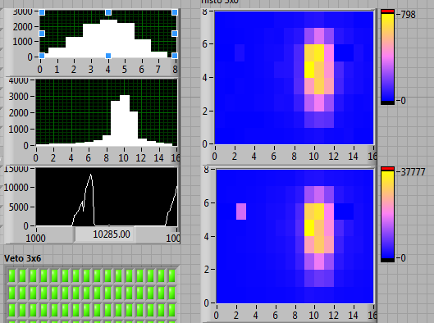
Experimental activity: CERF
GEM for beam monitoring
beam shape
beam alignment
beam intensity
Giura
down
up
Saleve

Slide 10
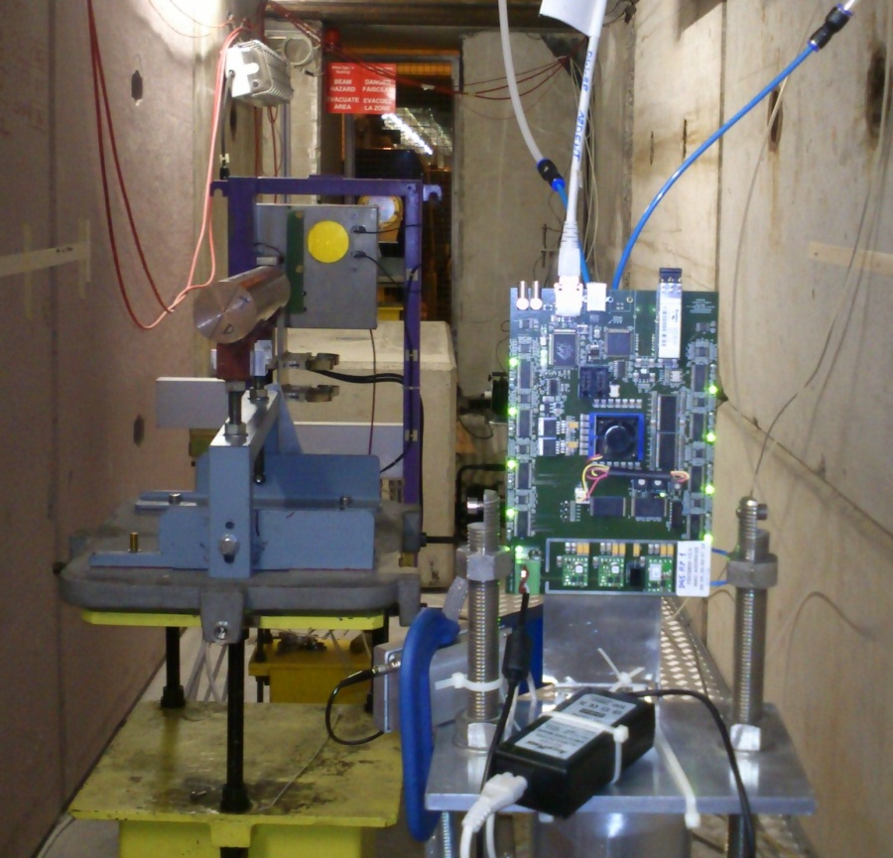
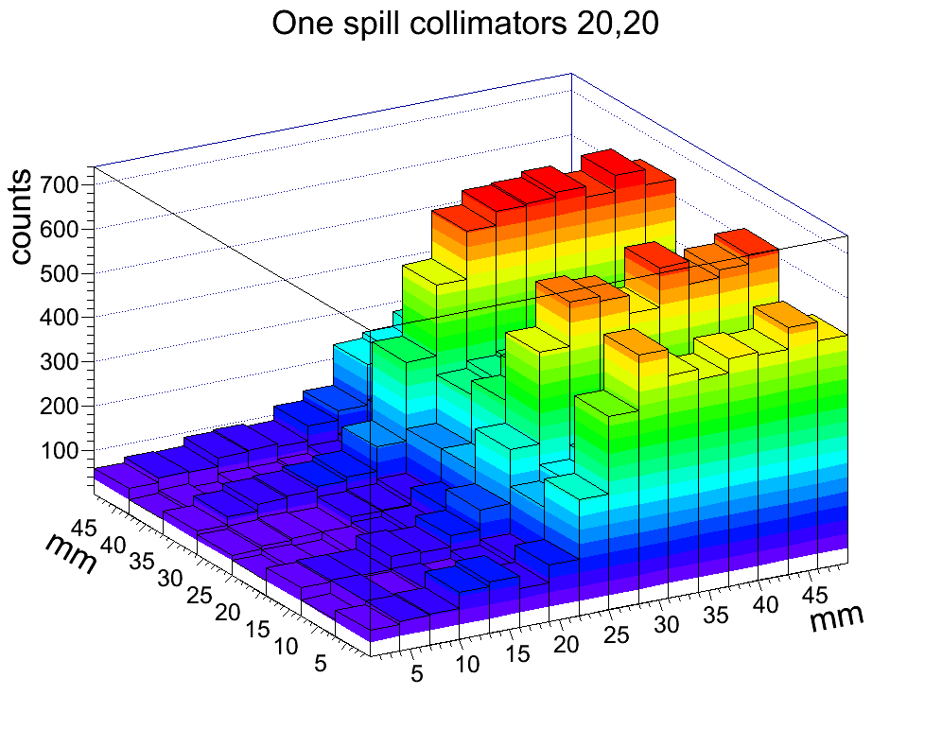
Experimental activity: CERF
GEM for dosimetry
On December 2012
  position at the side of the target
  charged component
  thermal neutron component
  Analysis performed by E. Aza

Slide 11
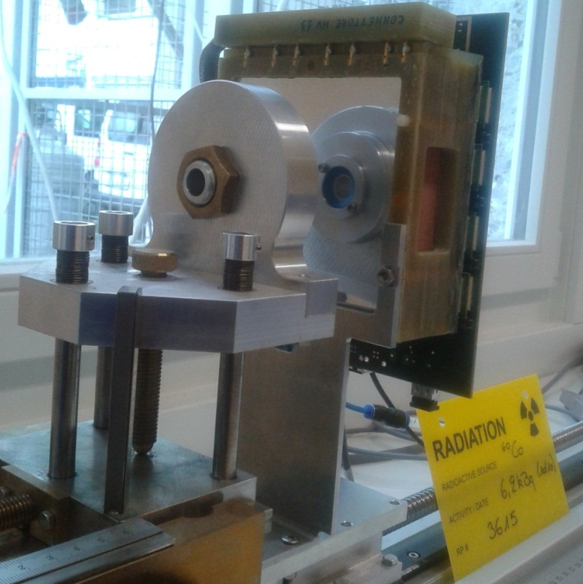
Experimental activity: radioactive waste
Motivation:
materials in accelerator environment are activated by radiations
in order to treat this materials after the decommissioning, it is necessary a characterization to know the nuclide population
gamma emitters are easily recognised by γ spectrometry
the challenge is to measure the ⁵⁵Fe amount
a detector with high efficiency to ⁵⁵Fe and high γ rejection to is needed

Slide 12
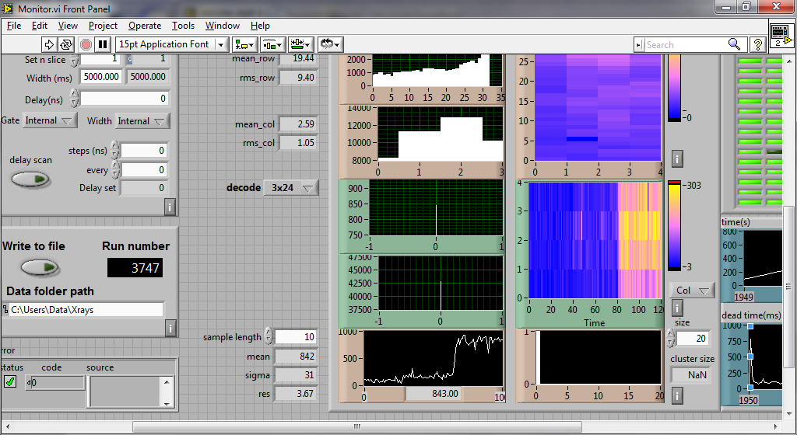
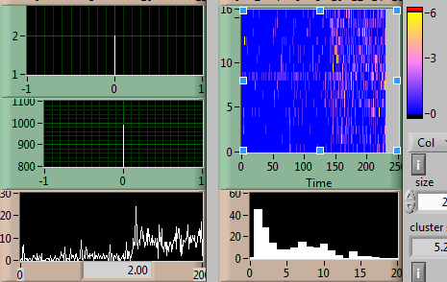
Experimental activity: radioactive waste
Detectors characterization with sources:
  3 mm drift detector
  40 mm drift detector:
    higher efficiency to ⁵⁵Fe
    higher γ rejection
Measurements with samples:
  Fully characterised samples with high presence of ⁶⁰Co
bck
52
62
bck
52
62
bck
52
62
bck
52
62

Slide 13
Conferences & Presentations
31th October 2012: nss-ieee Anaheim “Performance test of triple GEM detector at CERN n_TOF facility”
2nd November 2012: nss-ieee Anaheim “Investigation on Thermal Neutron Detectors Based on the Gas Electron Multiplier Technology” (on behalf of F. Murtas)
29th November 2012: n_TOF annual meeting “Triple GEM detector at CERN n_TOF facility”
3 abstract submitted for next nss-ieee:
  The Triple GEM detector as beam monitor at the CERF facility (co-author) – Accepted as Poster
  Neutron beam profile measurements with a triple GEM for thermal neutrons at the CERN n_TOF facility (Reference author) – Accepted as talk
  ⁵⁵Fe Measurements in Radioactive Waste with a Triple GEM Detector (Reference author) – Accepted as talk

Slide 14
Publications
G. Claps, G. Croci, F. Murtas, A. Pietropaolo, S. Puddu , C. T. Severino, M. Silari, "Performance Test of a Triple GEM Detector at CERN n_TOF Facility", published in conference proceeding IEEE-NSS Anaheim 29 Oct - 3 Nov 2012: ARDENT-CONF-2012-001.
O. Sauter, B.P. Duval, L. Federspiel, F. Felici, T.P. Goodman A. Karpushov, S. Puddu, J. Rossel and TCV team, "Effects of ECH/ECCD on tearing modes in TCV and link to rotation profile", EPFL-CONF-153089(2010).
B. Esposito, F. Murtas, R.Villari, M. Angelone, D. Marocco, P. Pillon and S. Puddu, "Design of a GEM-based detector for the measurement of fast neutrons", Nuclear Instruments and Methods, doi :10.16/j.nima.2009.06.101(2009) .

Slide 15
Training
2012 Q3
  Summer English course (CERN)
  Advanced FLUKA course (Vancouver)
2012 Q4
  Training on GEM detector (Frascati)
  Labview for beginner (CERN)
  Radiation detection and measurements (Anaheim)
  ARDENT workshop (Wien)
2013 Q2
  Training on FLUKA for ntuple generation (Dresden)
  Preparation of Mid-Term review (CERN)
2013 Q3
  Management of Radioactive Waste in Nuclear Power Plant
  Course for written English (started now-CERN)
  First Aid course (programmed-CERN)

Slide 16
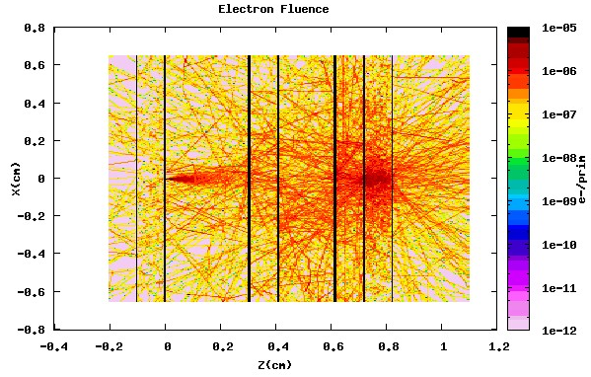
Training
In April 2013 I spent a week in Dresden at HZDR to develop a tool for FLUKA in order to generate ntuple. The aim of this activity is to characterize the phenomena into the detector, event by event, to optimize it

Slide 17
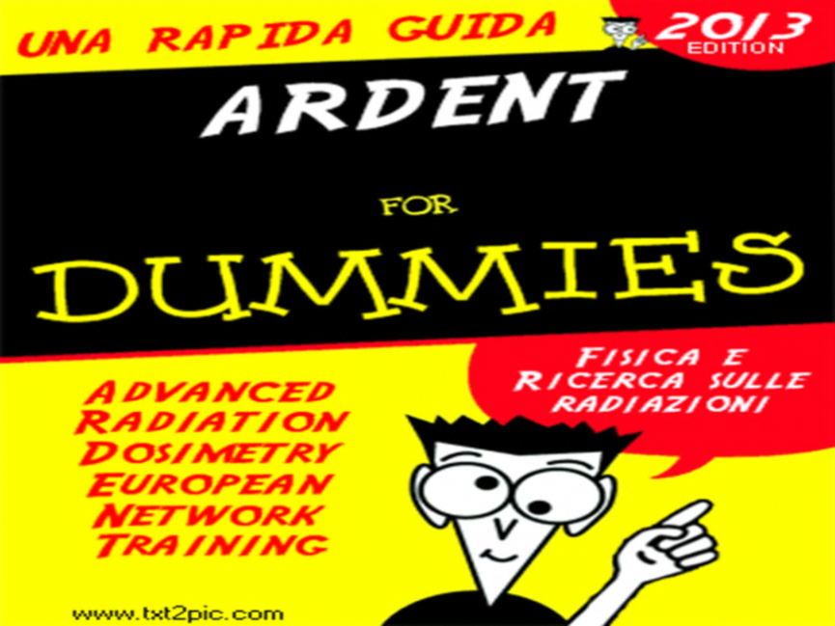
Outreach
May 2013 Cagliari-Sardinia, three high schools: “ARDENT for Dummies”
  http://youtu.be/3wtUr3iVVIw?t=1m04s (video about CERN)
  Why doing research?
  Radioactivity
  Interaction between radiation and material
  ARDENT
    Dosimetry
      Detector for neutrons dosimetry
    Hadronherapy
      Beam monitoring
All seminars were about 1h30 for ~70. Students were
really interested and some of them is thinking about
Physics for University study. This seminar is going to
be repeated in a shorter version for the Outreach Event
in Milan for the 150 anniversary of the Politecnico.
27th of October 2013: “Origin 2013 – European Researcher’s Night Event”. I have taken part on the speed dating (short meeting face to face)
28th of October 2013: “CERN Open Days”. I have been involved in the RP stand as a guide, I have explained to the public about radiation, natural background, detectors, safety. I have prepared the presentation “Radiation protection for Dummies” for the RP group

Slide 18
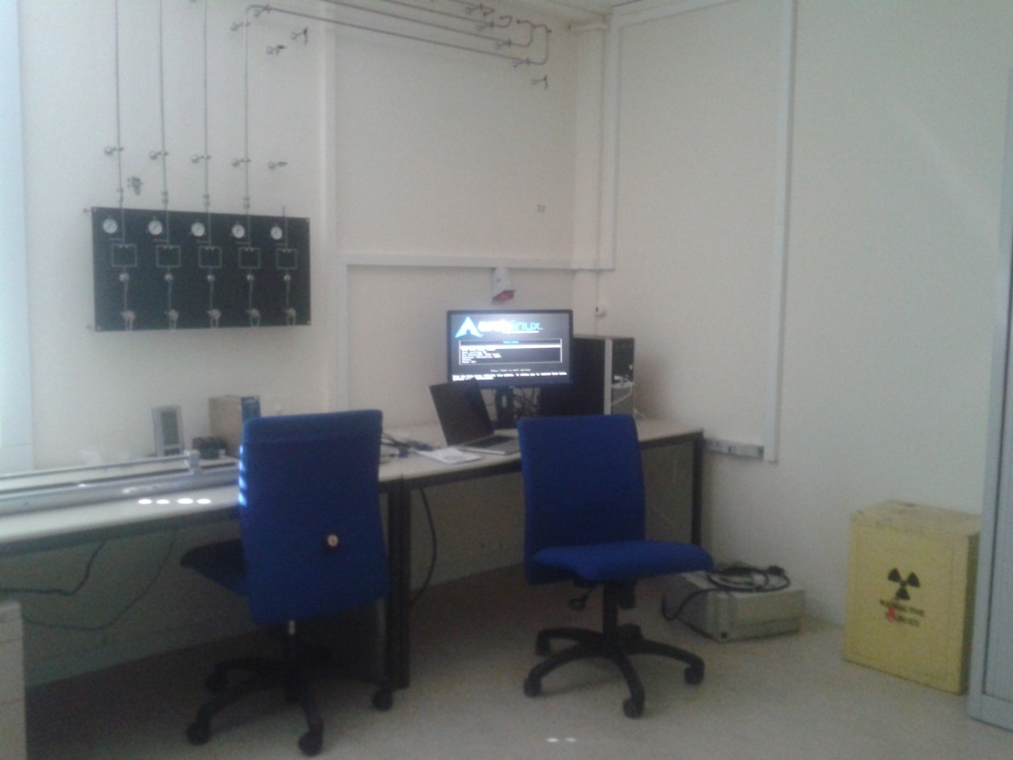
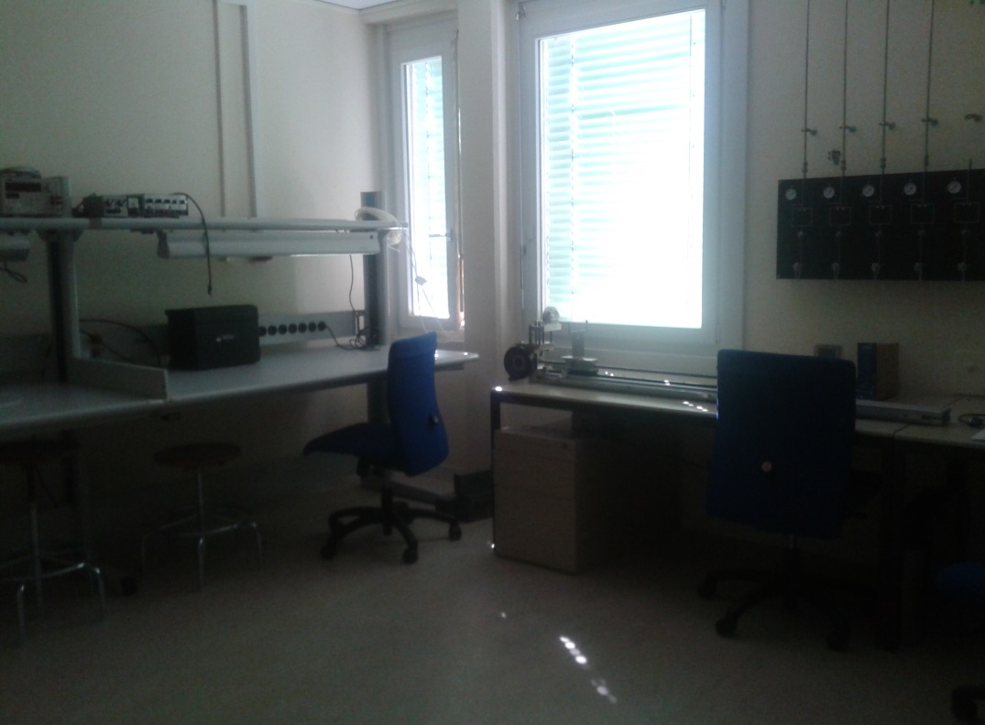
Miscellaneous...
From January to May 2013: as IEEE student member, I did a review for a paper of IEEE journal
2013: I managed the work for a new laboratory for our section, RP-SP at CERN

Slide 19
Thanks!!!

