Slide 1

Dosepix – a detector for quality assurance in Medical Imaging
Francesca Bisello
Midterm Review Meeting
ARDENT Project
October 14th, Milan

Slide 2
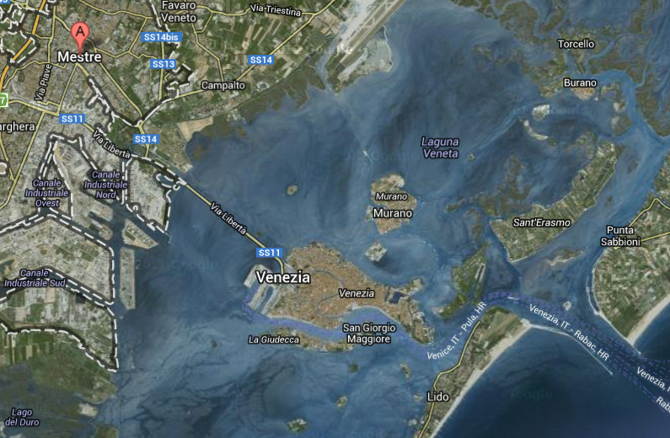
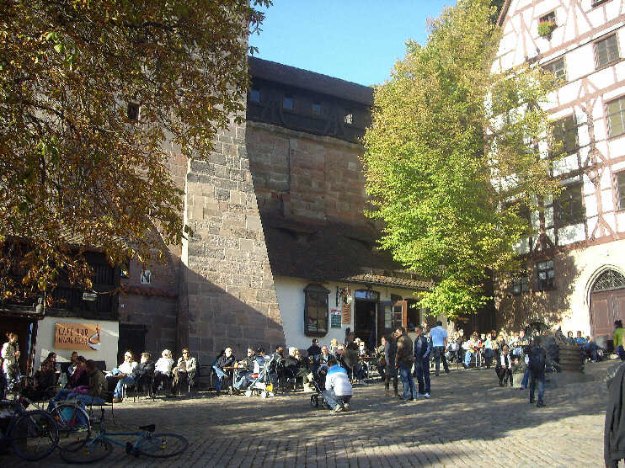
About myself
ARDENT Project
Research work
Training & Conferences
About Myself
Venice (Italy)
Nürnberg (Germany)

Slide 3
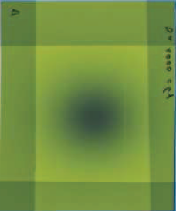
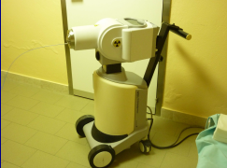
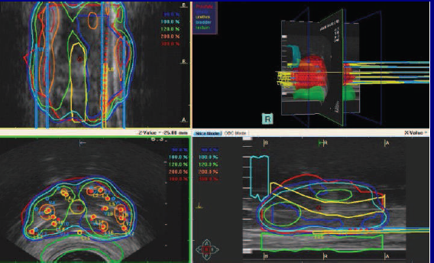
About myself
ARDENT Project
Research work
Training & Conferences
University Education
University of Padua: Bachelor Degree
Erasmus at Ludwig Maximilians Universität München
University of Bologna : Master Degree in Applied Physics
Master Thesis: „Characterization of a radiochromic film Gafchromic EBT2 in relation to a Ir-192 source“, Sant´Orsola-Malpighi
hospital,Bologna

Slide 4
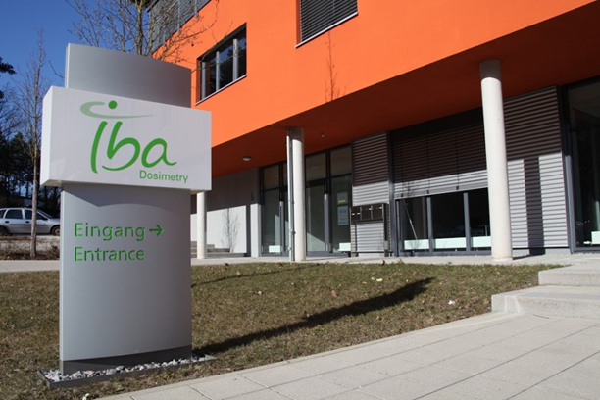
About myself
ARDENT Project
Research work
Training & Conferences
ARDENT Project
Physics and Innovation Group
IBA Dosimetry
Schwarzenbruck, Germany

Slide 5
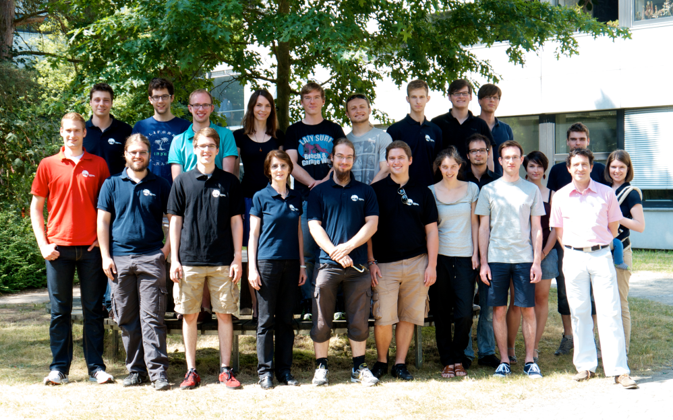
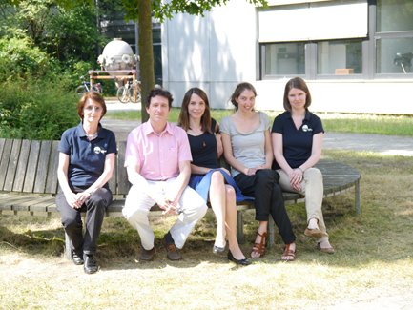
About myself
ARDENT Project
Research work
Training & Conferences
ARDENT Project
ECAP, Radiation Physics Group
FAU University Erlangen
Dosepix Group
FAU University Erlangen

Slide 6
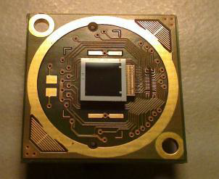
About myself
ARDENT Project
Research work
Training & Conferences
ARDENT Project
ARDENT ESR 10
Goal
Development of a Dosepix based Quality Assurance detector for different X-rays modalities in Medical Imaging

Slide 7
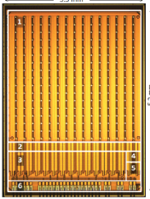
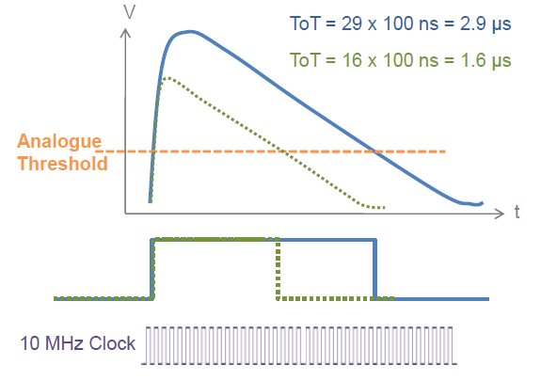
About myself
ARDENT Project
Research work
Training & Conferences
Dosepix
Hybrid Silicon Detector
Matrix: 16x16 Pixels
Single Photon counting : Time-Over-Threshold method

Slide 8
About myself
ARDENT Project
Research work
Training & Conferences
Dosepix
Hybrid Silicon Detector
Matrix: 16x16 Pixels
Single Photon counting : Time-Over-Threshold method
128 bit Register
Periphery DAC Register

Slide 9
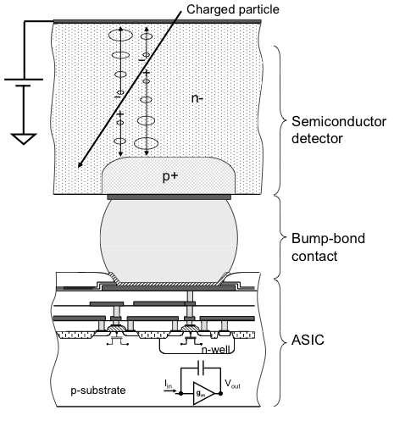
About myself
ARDENT Project
Research work
Training & Conferences
Dosepix
Hybrid Silicon Detector
Matrix: 16x16 Pixels
Single Photon counting : Time-Over-Threshold method

Slide 10
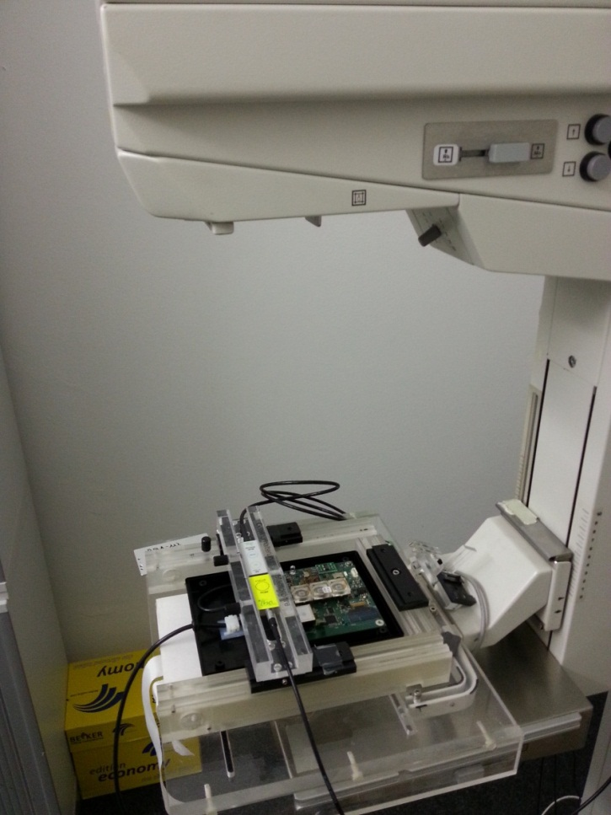
About myself
ARDENT Project
Research work
Training & Conferences
Research Activities
Diagnostic Quality Assurance Device for Mammography:
Mammo Tube
IBA Dosimetry, Schwarzenbruck

Slide 11
About myself
ARDENT Project
Research work
Training & Conferences
Research Activities
Diagnostic Quality Assurance Device for Mammography:
Mammo Tube
IBA Dosimetry, Schwarzenbruck
February 2013 – October 2013
Preliminary studies:
Working Modes, DAC, Spectrum measurements, calibartions
Future:
  Simulation of monoenergetic response functions
  Reconstruction of impinging spectra and dose calculation
  Determination of the Range of Work
Improving Energy Calibration

Slide 12
About myself
ARDENT Project
Research work
Training & Conferences
Research Activities
Features :
Simulations
Future Activity:
Monte-Carlo Simulation of response and comparison to measurement (small and big pixels)
Reconstruction
Future Activity:
Deconvolution to reconstruct impinging spectra (small and big pixels)
Dose Calculation
Range of Work
Future Activity:
Experimental Activity with different set-up and different DAC settings

Slide 13
About myself
ARDENT Project
Research work
Training & Conferences
Research Activities
Energy Calibration
Based on the use of Fluorescence lines from different materials
Comparison between Energy Calibration and Analog Test Pulse Calibration
Bremsstrahlung X-ray Spectra – kVp deduction

Slide 14
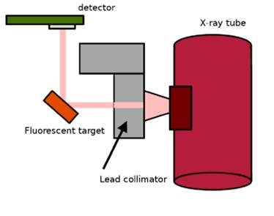
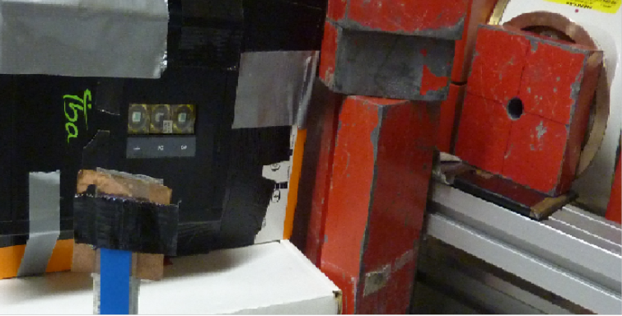
About myself
ARDENT Project
Research work
Training & Conferences
Research Activities
Energy Calibration of the detector: Experimental Set-up
Xray Tube
ECAP, FAU University Erlangen

Slide 15
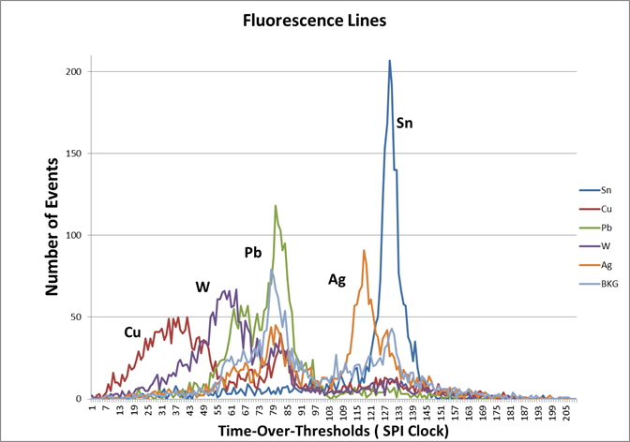
About myself
ARDENT Project
Research work
Training & Conferences
Completed Research Activity
Energy Calibration of the detector: Response of a single pixel to the
fluorescence lines of different materials
Xray Tube
ECAP, FAU University Erlangne

Slide 16
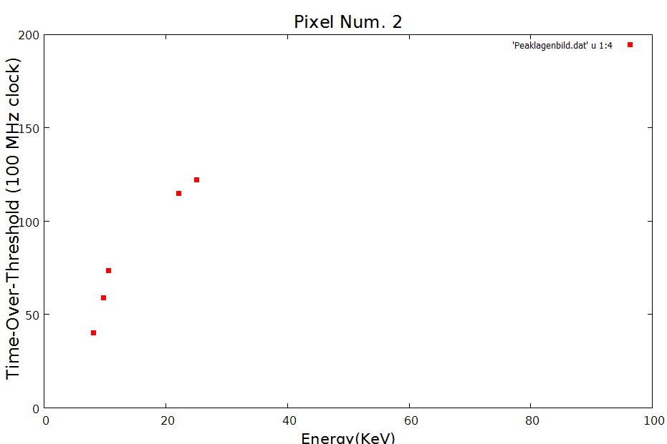
About myself
ARDENT Project
Research work
Training & Conferences
Completed Research Activity
Energy Calibration of the detector: Interpolation and Fitting of the peaks
Xray Tube
ECAP, FAU University Erlangne

Slide 17
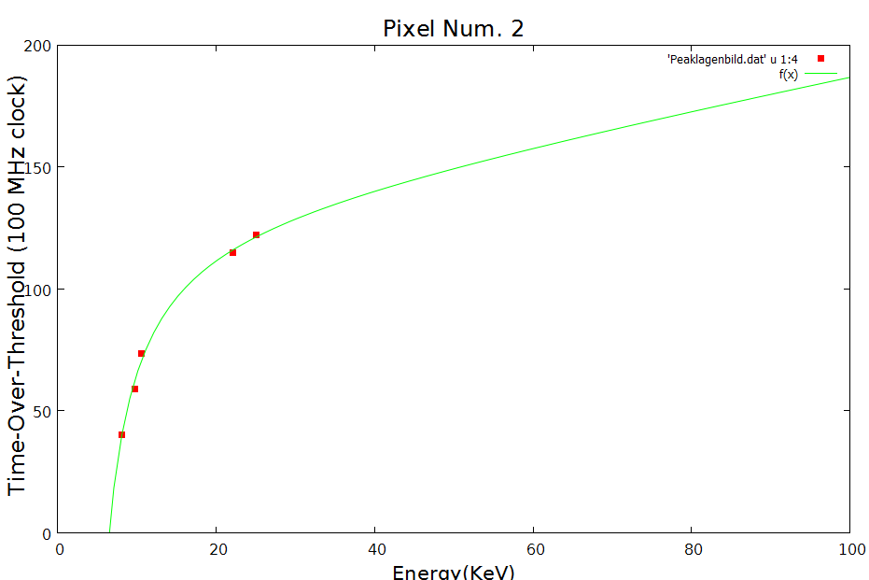

About myself
ARDENT Project
Research work
Training & Conferences
Completed Research Activity
Energy Calibration of the detector: Interpolation and Fitting of the peaks
Xray Tube
ECAP, FAU University Erlangne
$$f\left(x\right)=a+b∗x+\frac{c}{(x−t)}$$

Slide 18
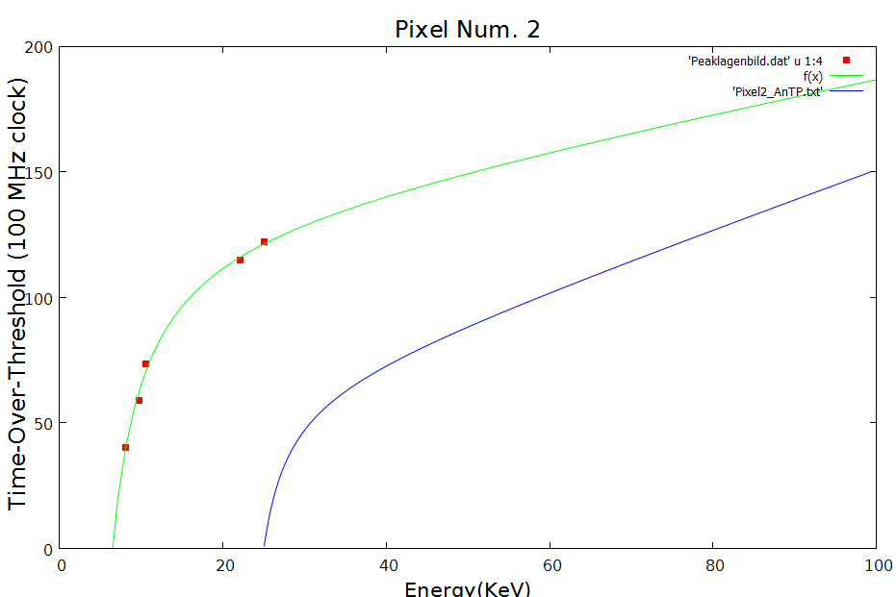

About myself
ARDENT Project
Research work
Training & Conferences
Completed Research Activity
Energy Calibration of the detector: Comparison between Analogue Test Pulse Calibration and XRF
Xray Tube
ECAP, FAU University Erlangne
$$f\left(x\right)=a+b∗x+\frac{c}{(x−t)}$$
$$f\left(x\right)=a+b∗x+\frac{c}{(x−t)}$$

Slide 19
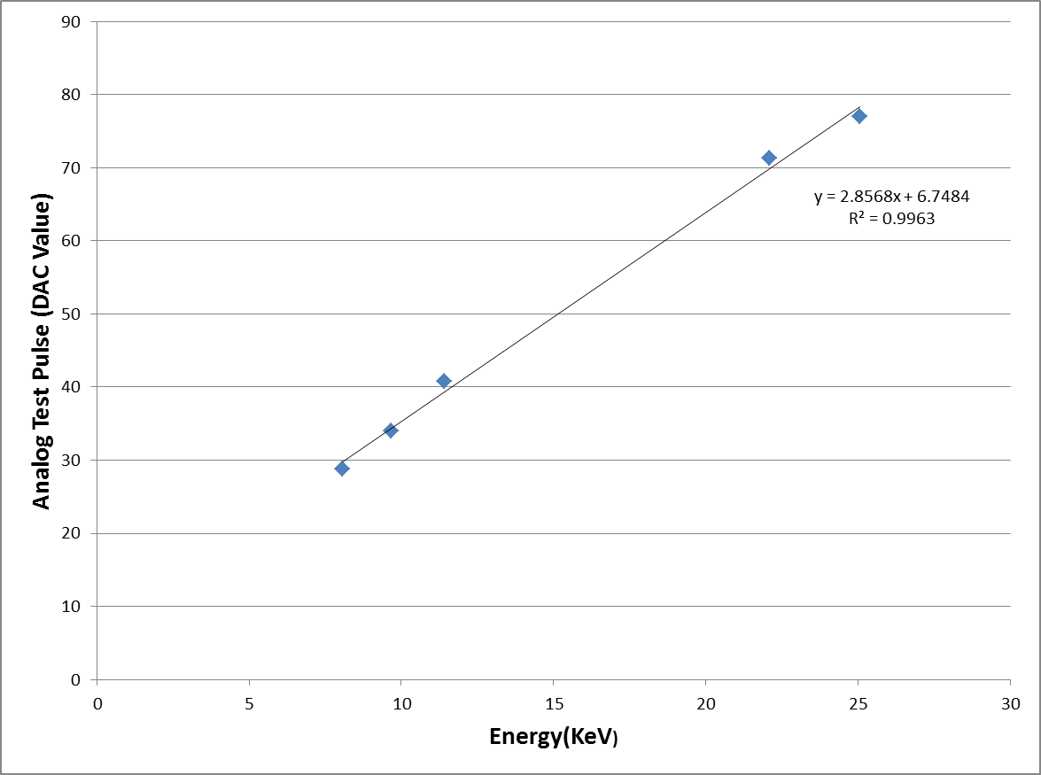
About myself
ARDENT Project
Research work
Training & Conferences
Completed Research Activity
Energy Calibration of the detector: Comparison between Analogue Test Pulse Calibration and XRF
Xray Tube
ECAP, FAU University Erlangne
$$f\left(x\right)=a+b∗x+\frac{c}{(x−t)}$$
$$f\left(x\right)=a+b∗x+\frac{c}{(x−t)}$$
“Characterization of a new Photon counting Detector with XRF “,
F. Bisello , I. Ritter, F. Tennert, T. Gabor, M. Campbell, W.S. Wong, S. Wölfel, G.Anton, N.Michel and T. Michel, IEEE 2013, Seoul

Slide 20
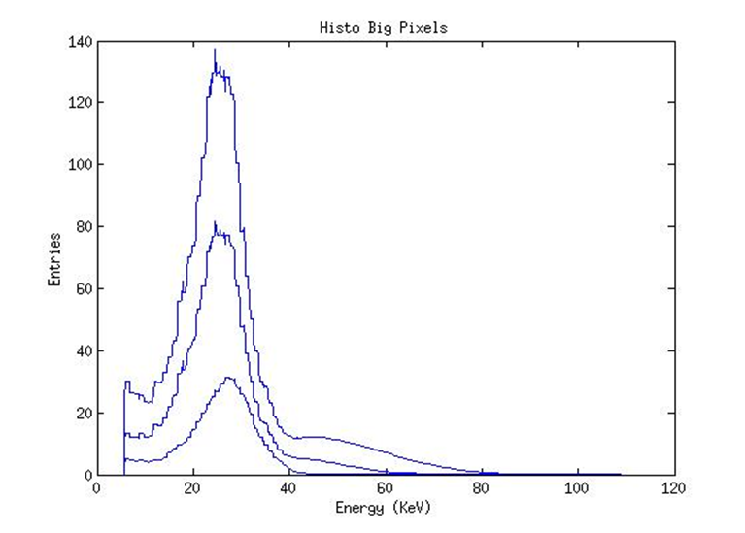
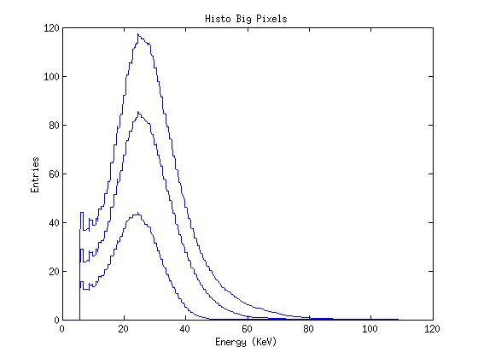
About myself
ARDENT Project
Research work
Training & Conferences
Completed Research Activity
Energy Calibrated Bremsstrahlung spectra from ECAP X-ray device:
Sn Filter
PMMA Filter

Slide 21
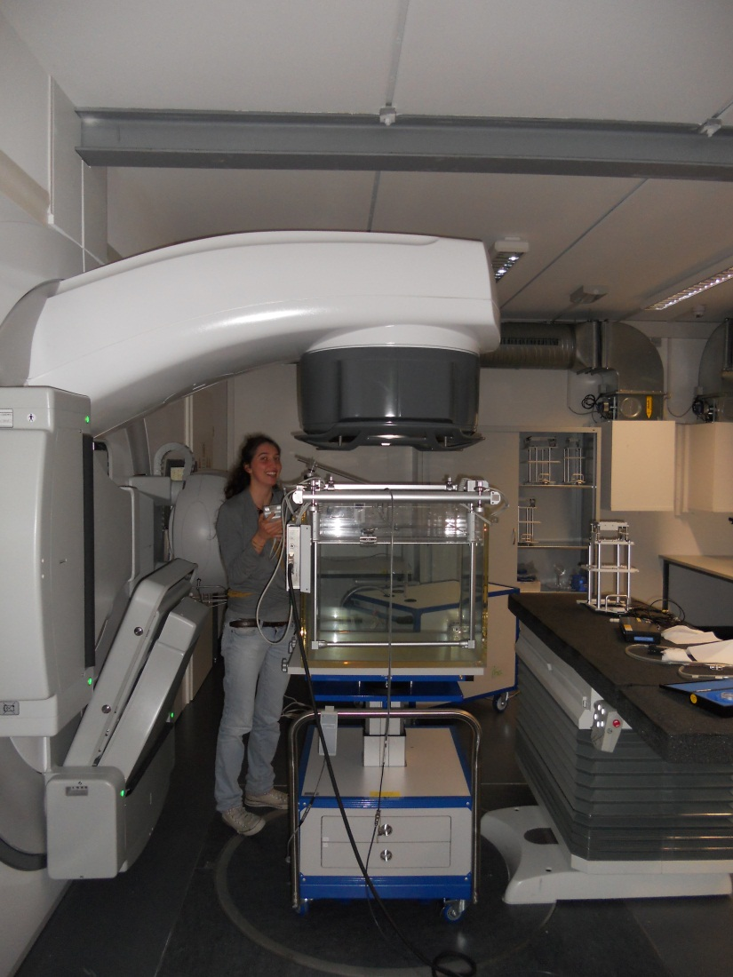
About myself
Dosepix
Training & Conferences
Research Activity
Trainings, Schools and Conferences
IBA Dosimetry Training
  Absolute and Relative Dosimetry
  Xray facilities Training
  Radiation Safety
  Monte Carlo simulation with EGS
  Company Data Protection
  Introduction to QM System
  Introduction into Working safety
Training at Neumarkt hospital
  Daily Quality Assurance at Radiotherapy Unit

Slide 22
About myself
ARDENT Project
Research work
Training & Conferences
Trainings, Schools and Conferences
Attended Schools
  V Nation School, INFN Padova (Italy) : „Electronics and Detector for High Energy Physics, Astrophysics, Space Application and Medical Physics“
    Radiation damage in Semiconductor Detector
    Front-end Electronics
    Medical Application ( Silicon photomultiplier, Proton Therapy)
Conferences
  IEEE Seoul 2013, Workshop „New Detector thecnologies in Radiation Dosimetry and ist Application“, October 27- November 3
      Characterization of a new Photon counting Detector with XRF
      F. Bisello^{1,2}, I. Ritter², F. Tennert², T. Gabor^{2,5}, M. Campbell³,
      W.S. Wong³, S. Wölfel¹, G.Anton², N.Michel⁴ and T. Michel²
1- IBA Dosimetry GmbH, Bahnhofstraße 5, 90592 Schwarzenbruck, Germany
2-Erlangen Centre for Astroparticle Physics, Radiation and Detector Physics, Erwin- Rommel-Str. 1, 91058 Erlangen, Germany
3- Medipix Team, Microelectronics Group, CERN, 1211 Geneva, Switzerland
4- Customized Microelectronic Solutions, Bruckwiesenstr. 3,91220 Schnaittach,Germany
5- Fraunhofer Institute for Solar Energy Systems ISE, Heidenhofstraße 2, 79110 Freiburg im Breisgau , Germany

Slide 23
About myself
ARDENT Project
Research work
Training & Conferences
Trainings, Schools and Conferences
Programmed Events
  National Congress of Medical Physics, AIFM Torino 16-19 November 2013
  ICTR-PHE 2014, Geneve February 10-14 2014

Slide 24
Thank you for your attention

