Slide 1
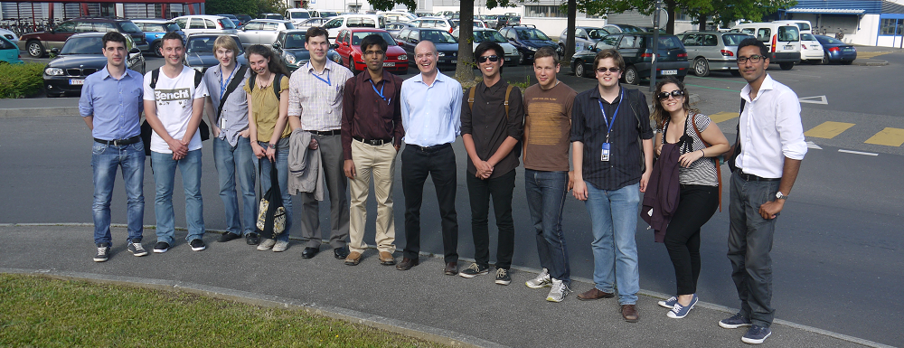



2D Ionization Chambers
Array for Clinical Applications
MICHELE TOGNO – ESR11

Slide 2

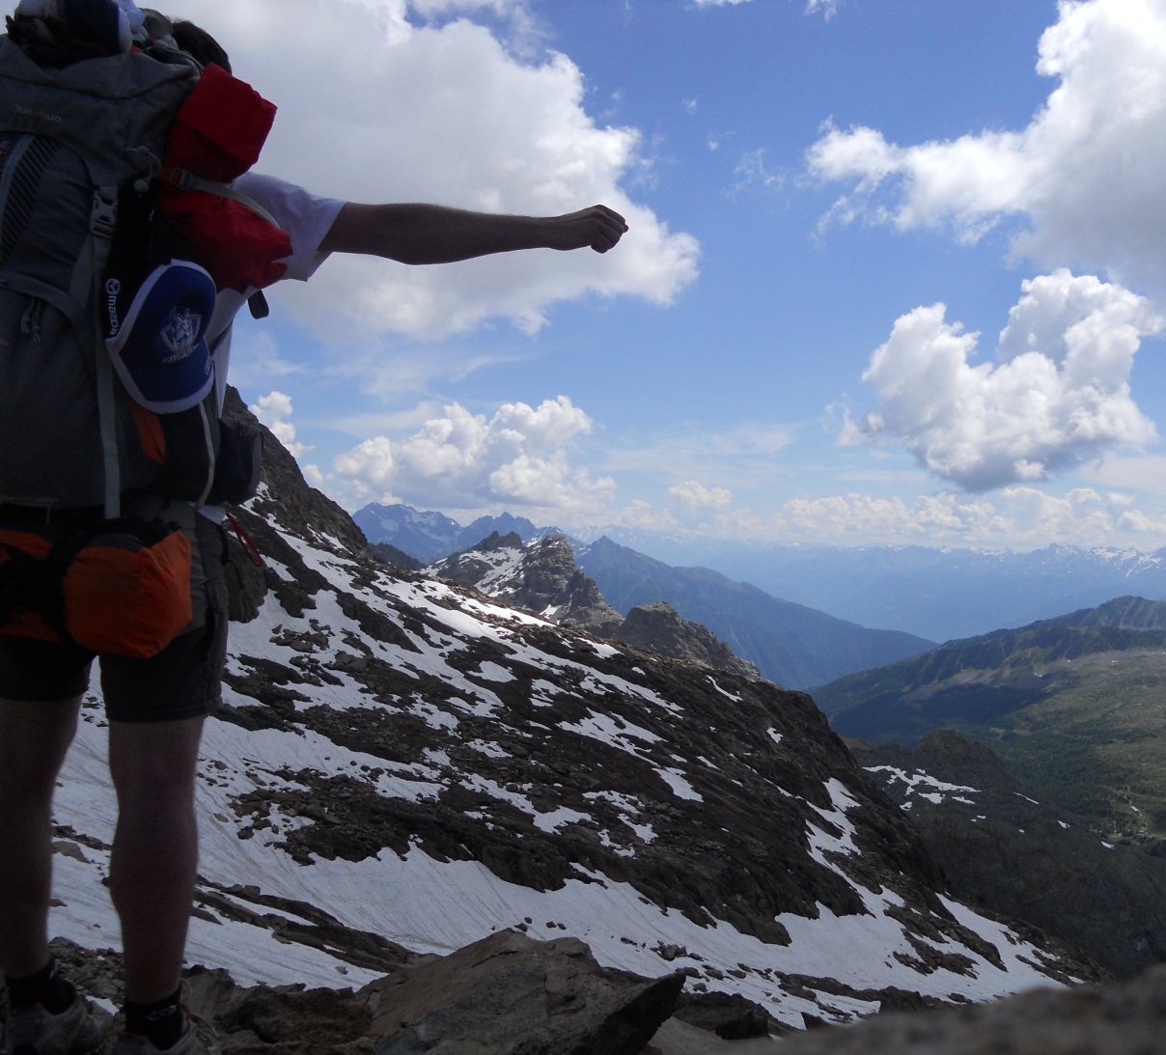

What about me…
Valtellina

Slide 3
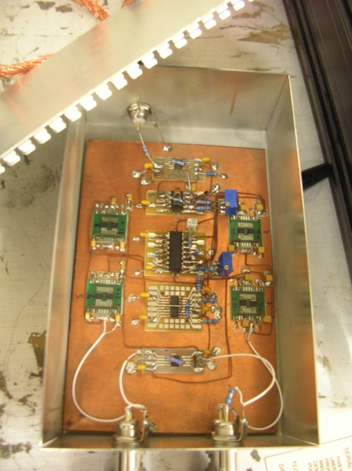
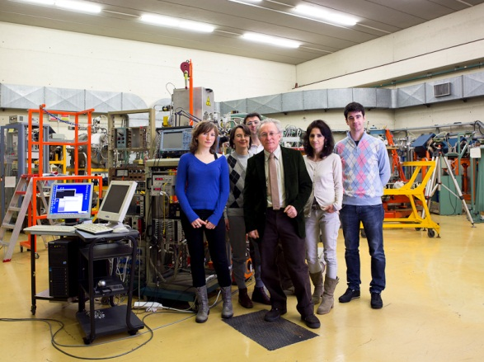
…and my career so far
Bachelor Degree in Physical Engineering (Polytechnic of Milan): “Superconductivity and Isotopic Effect”
  Master Degree in Nuclear Engineering (Polytechnic of Milan): “Study of a Logarithmic Compression Amplifier for Microdosimetry”
National Institute of Nuclear Physics in Legnaro (Padova): here I carried out part of my thesis work and I became more familiar with gas detectors (especially with TEPC for microdosimetry)

Slide 4
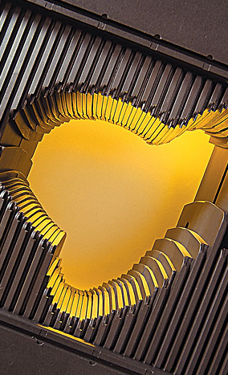
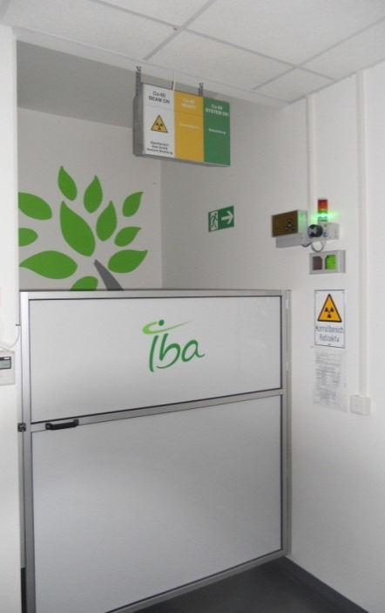
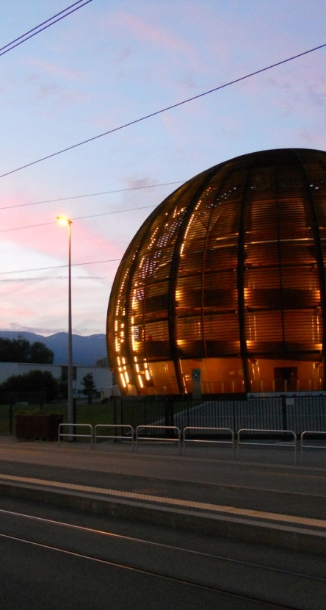
Outline
Conferences, trainings…
Overview on the project
Experimental activity

Slide 5
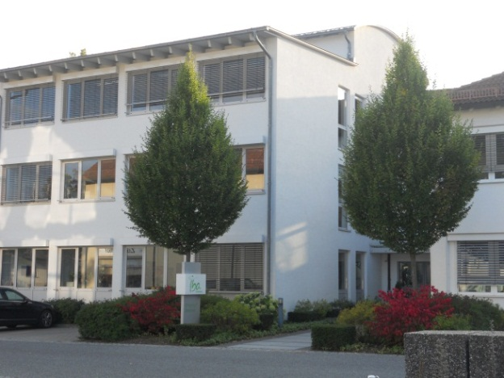
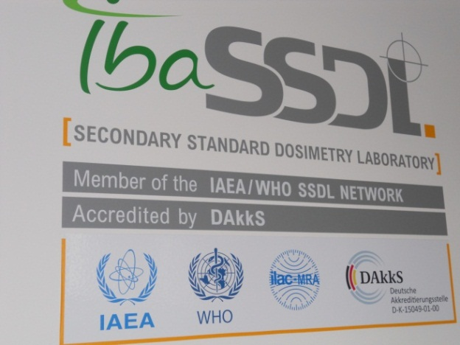
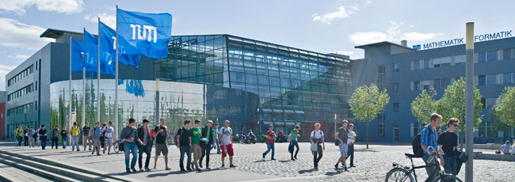
My ARDENT: overview on the project
Hosting Organization and partner institute
QA of equipment for radiotherapy and X-ray diagnostic
SSDL, 5 facilities (⁶⁰Co, KV X-ray, MV X-ray, mammo) where carry out tests on devices
Application of detector technology in clinical environment
Introduction into Medical Physics group scheduled on October, 21th

Slide 6
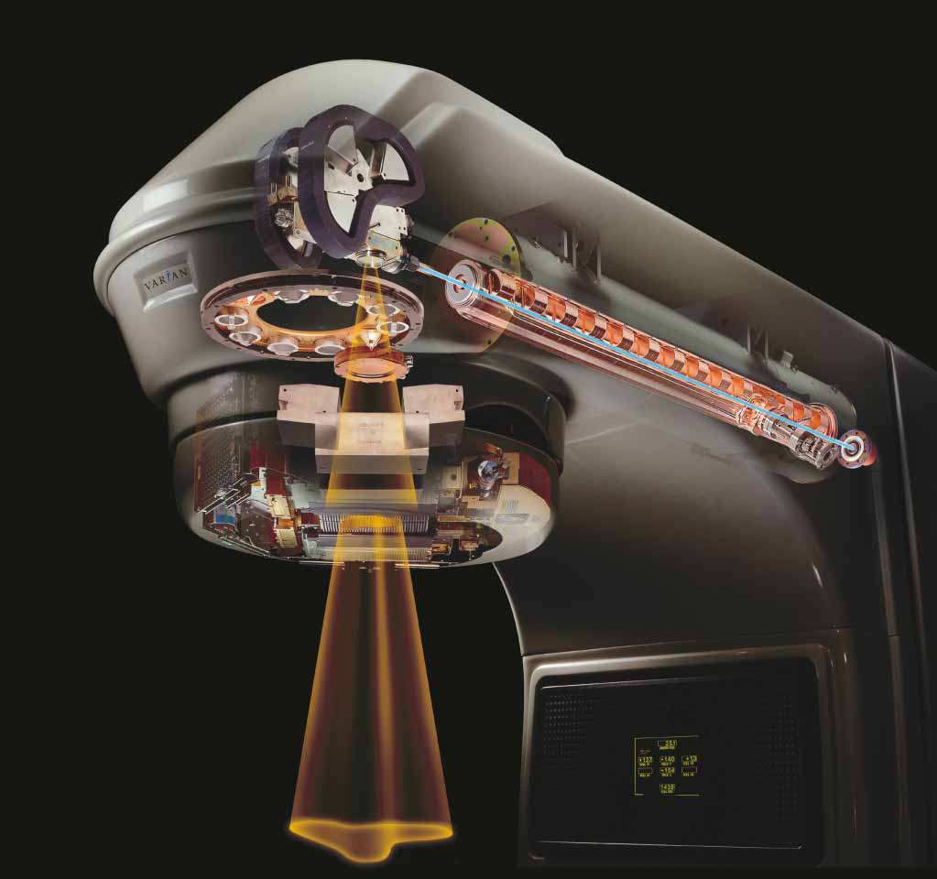
My ARDENT: overview on the project
Needs in Clinical Application
Before starting daily patient treatments, it is important to perform QA measurements in order to check critical LINAC parameters such as penumbra, symmetry, flatness and field size
Bending magnet
Target
Collimators
Again, do a verification of absorbed dose vs planned dose is essential to validate a radiotherapy treatment

Slide 7
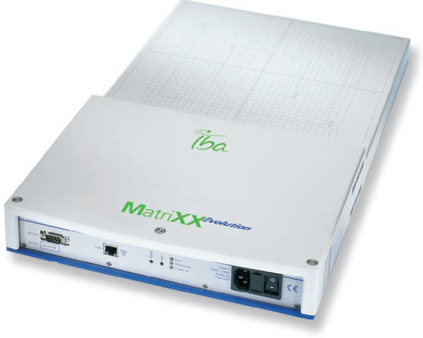
My ARDENT: overview on the project
2D Ionization Chambers Array for Clinical Applications
Project objective: development and characterization of a new generation of high performances ionization chambers arrays for radiotherapy
…we need a detector suitable to perform:
fast and accurate field profiling
measurements of absorbed dose in photon, electron and proton beams
measurements within a water phantom
Starting point: IBA experience (MatriXX detector family, developed in collaboration with INFN Turin)
Notes:
Foto matrix

Slide 8

My ARDENT: overview on the project
2D Ionization Chambers Array for Clinical Applications
Physics specifications: outperform existing devices in terms of
improved stability of the detector
better spatial resolution
high charge collection efficiency at high dose rates (X-ray and p⁺)
lower production cost, better yield and less security concerns
Design, geometry and materials represent a strategic know-how for the company, in future this technology will be protected by a patent

Slide 9
Conferences, trainings…
Overview on the project
Experimental activity

Slide 10
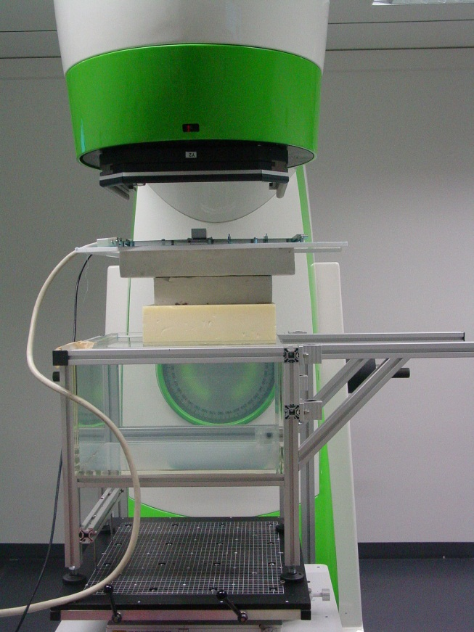
Experimental activity
Measurements at IBA facilities
Characterization of prototype I (developed at IBA before the beginning of this project), which includes several arrays with different shapes and geometries
Two type of investigation:
dynamic response of individual pixel
measurement of 1D dose distribution
Main problem to be solved
small chamber volume and reduced sensitivity:
read-out electronics noise
high sensitivity to parasitic signals

Slide 11
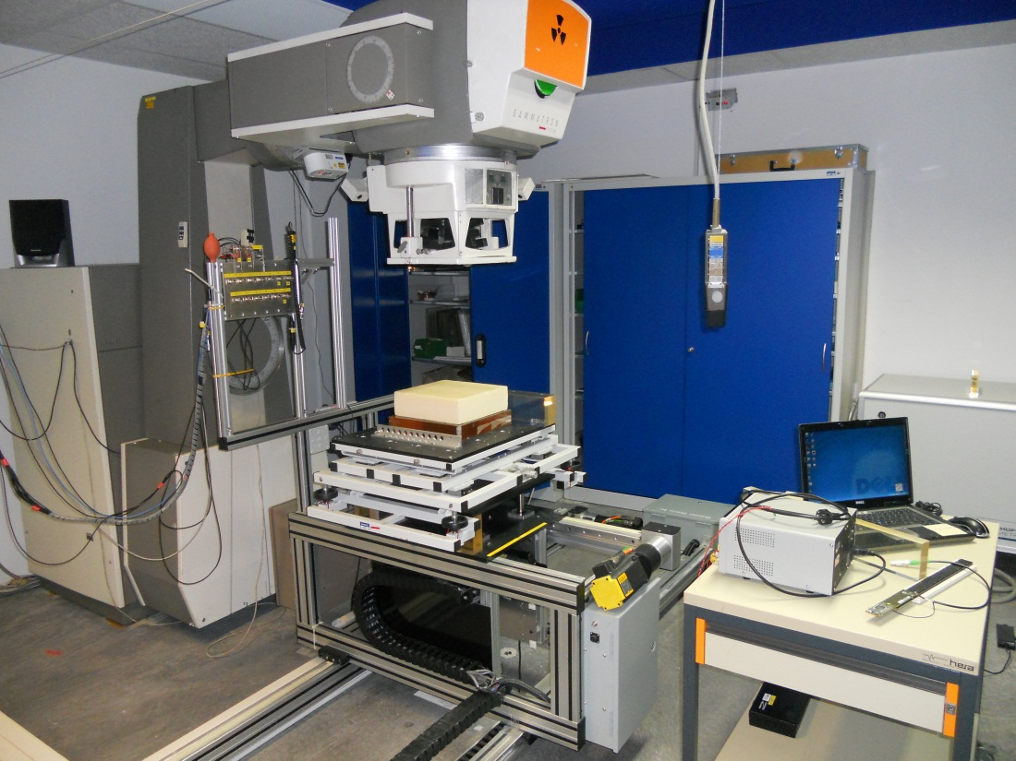
Experimental activity
First results/1
First results in ⁶⁰Co beam profiling was very satisfactory
Comparison between reference amorphous Silicon Flat Panel and IC array shows a good agreement

Slide 12
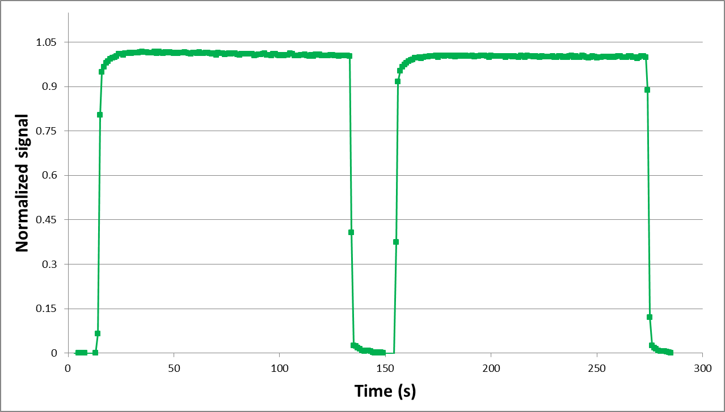
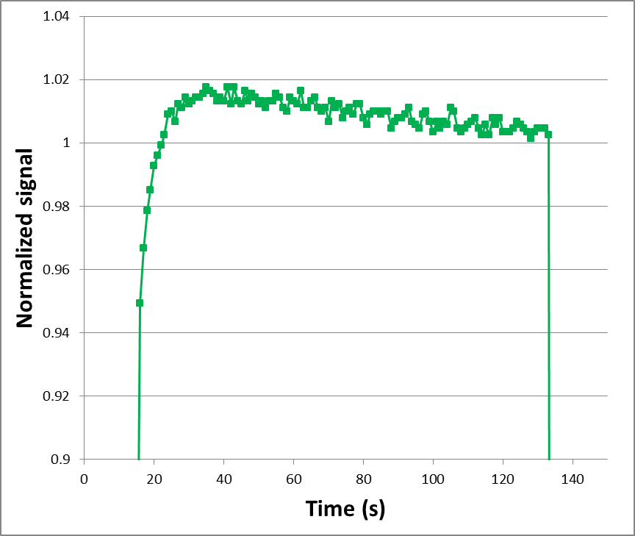
Experimental activity
First results/2
Spurious component,
signal drift
Increasing bias voltage, these undesired effects increase
⁶⁰Co source, 100V bias
Single chamber readout with reference class electrometer (KETHLEY)

Slide 13
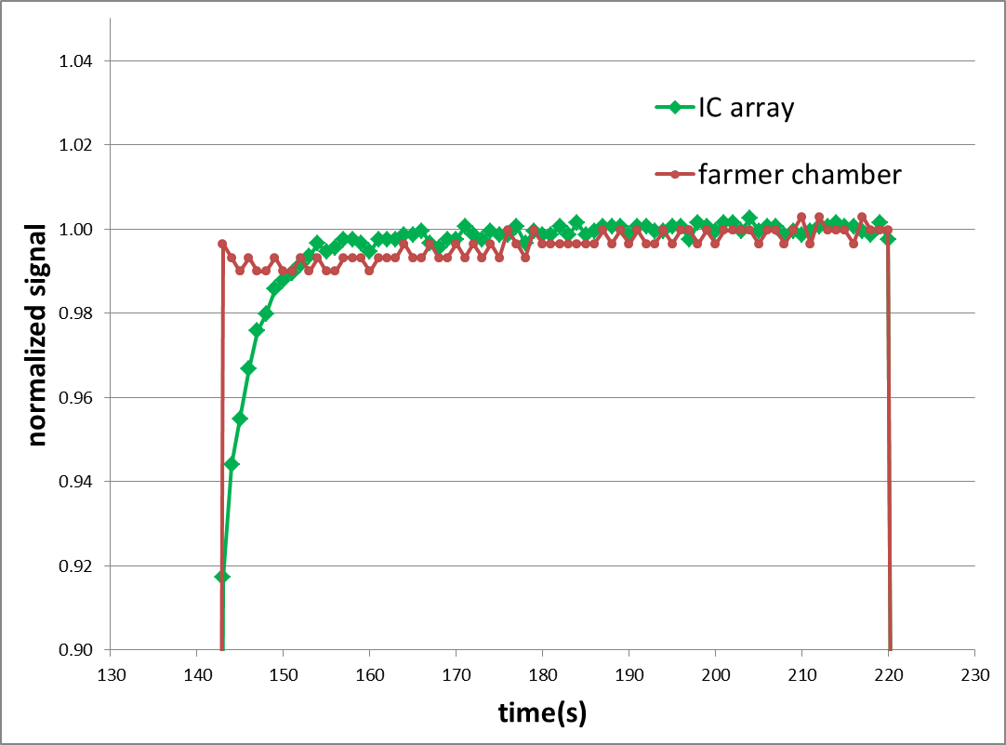
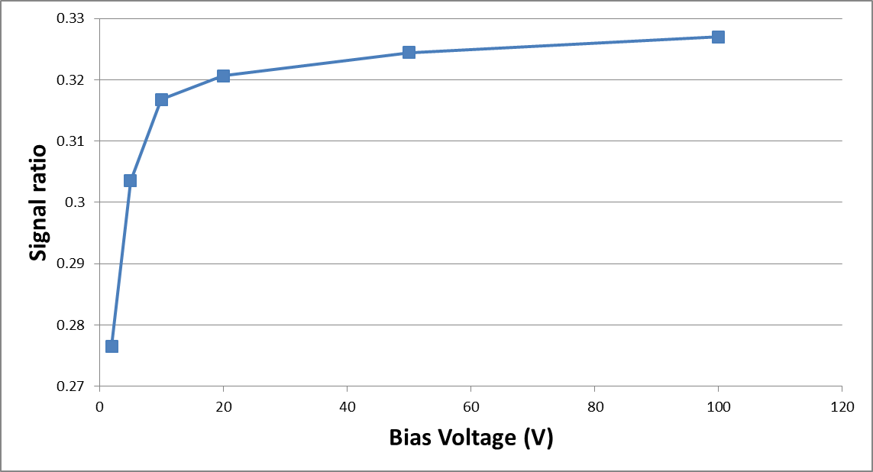
Experimental activity
First results/3
The same behavior was found for device response under MV X-ray beam
Difficult to identify full charge collection efficiency
Single chamber readout
Comparison between reference ionization chamber and IC array

Slide 14
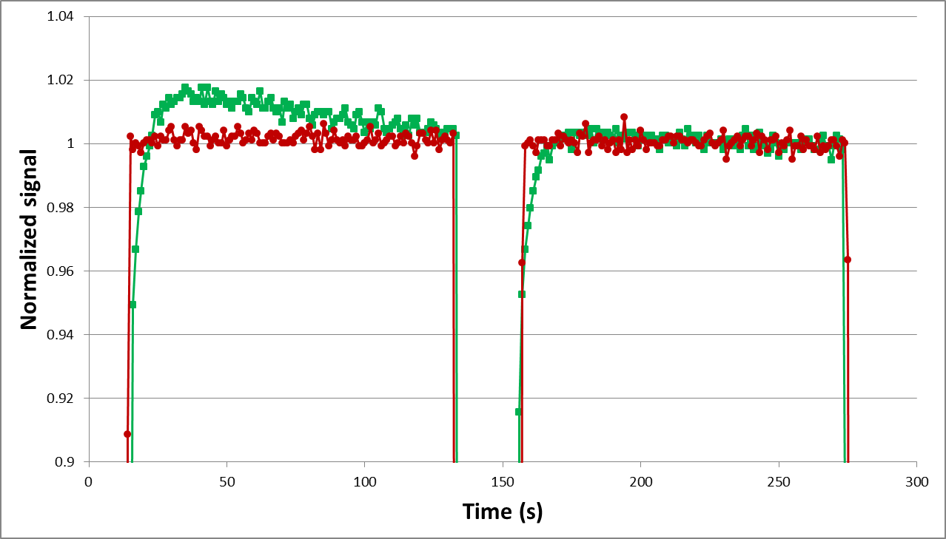
Experimental activity
First results/4
After improvement in:
guarding of device
signal routing
⁶⁰Co, 100V bias
Better signal stability in time!
Notes:
Risistemare, indicare Co

Slide 15
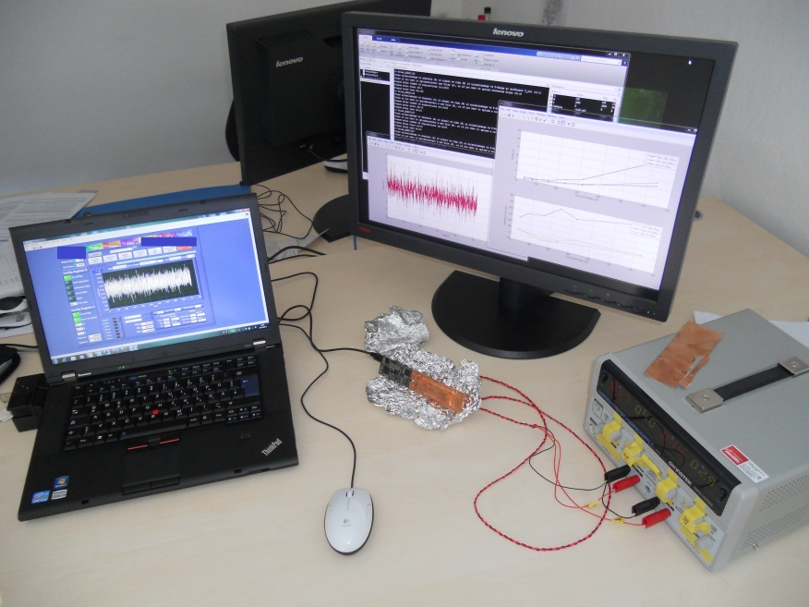
Development of prototype II
Upgraded detector: prototype II
Designed according to lessons learned with Prototype I
Other goals:
reach a high signal stability
consolidate results obtained with Prototype I
produce a device suitable for independent tests at clinics
+ introduction of a new multi-channel / low noise / front-end electronics
Prototype II is now ready for the first tests!

Slide 16
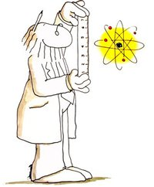
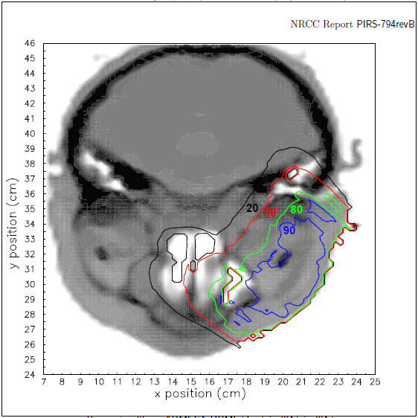
Monte Carlo simulations
Upgrading detector: Monte Carlo simulations
Simulations of the array has been started using Monte Carlo code EGSnrc, specifically suited to model the transport of photons and electrons through matter
Goals:
understand the physics of chambers
Support the improvement of design and material choice

Slide 17

Work in progress
and planned activities
Experimental characterization of Prototype II
Going ahead with Monte Carlo simulations:
  comparison with experimental results obtained with tests on Prototype II
  possibility to strengthen the collaboration with Medical Physics Department of S.Bortolo Hospital
Starting activities at TUM (next week), drawing a plan for secondments activities
Other secondments to be evaluated…

Slide 18
Conferences, trainings…
Overview on the project
Experimental activity

Slide 19
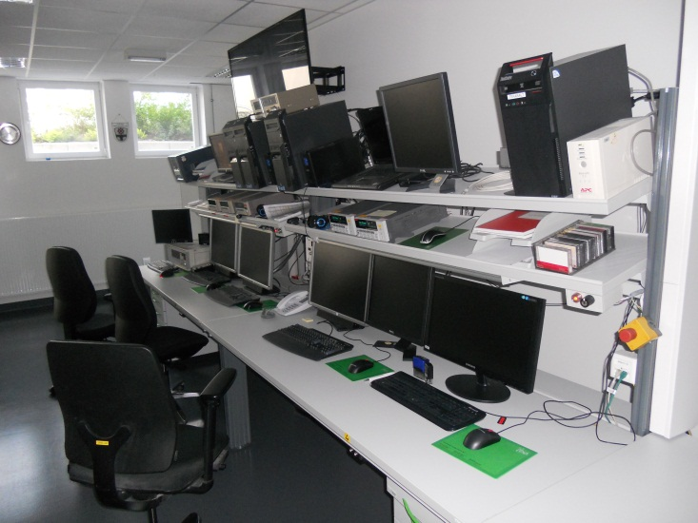
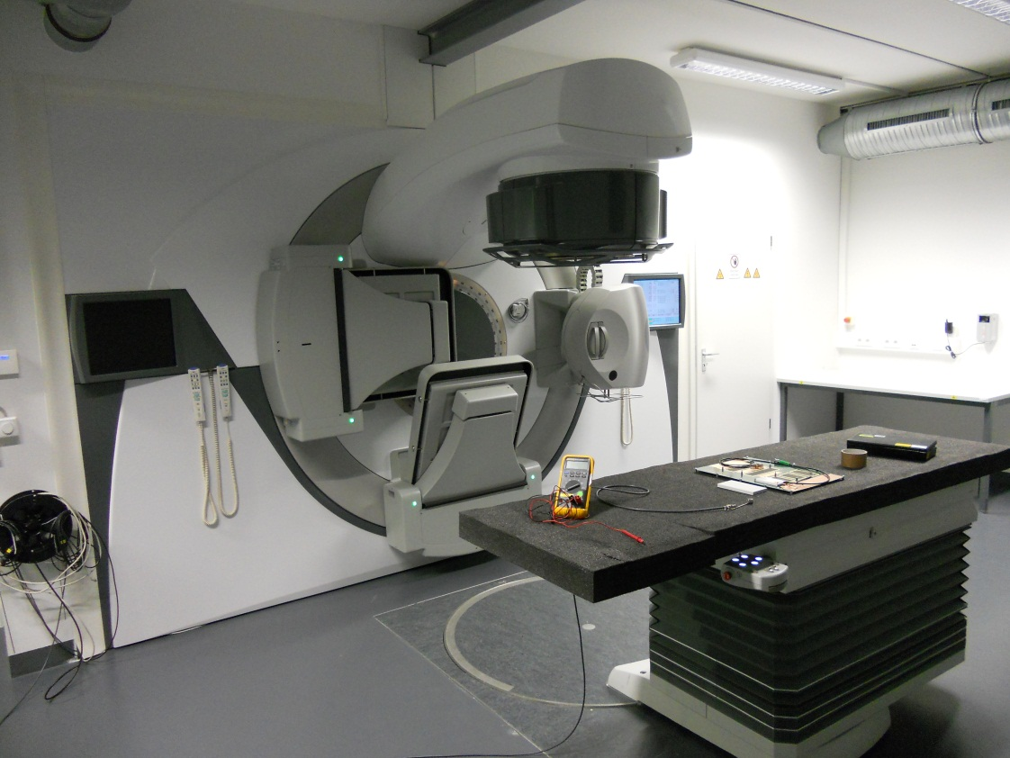
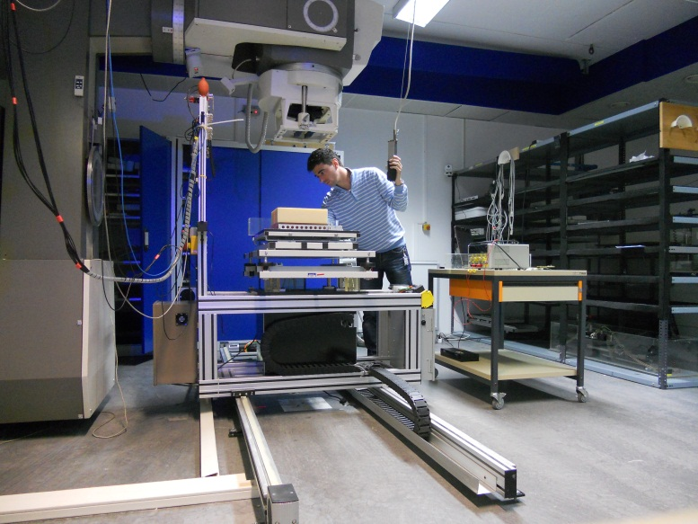
Trainings & conferences
Trainings in using radiation facilities
⁶⁰Co sources:
  Terabalt: 249.1TBq
  Gammatron: 85.5TBq
Linac, MV X-ray

Slide 20
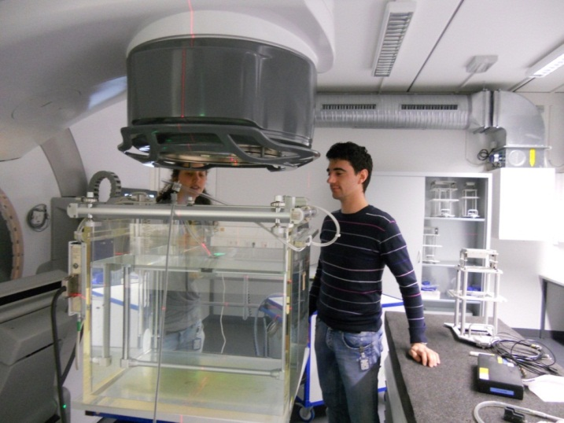
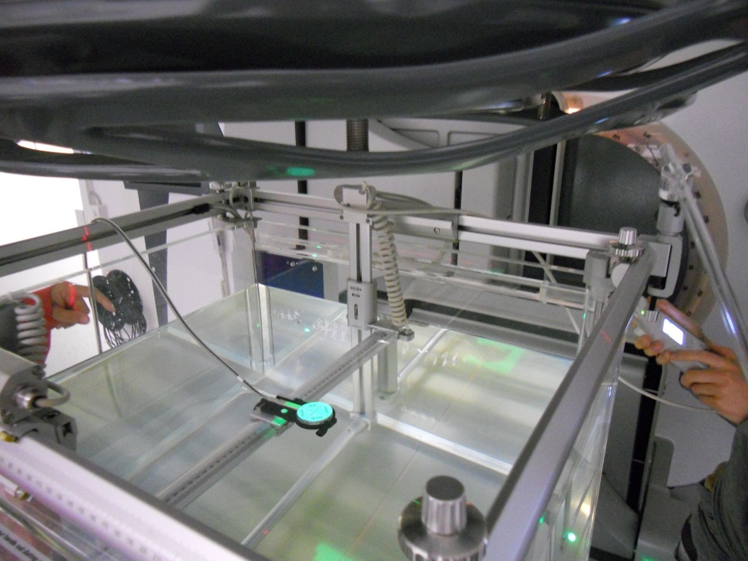
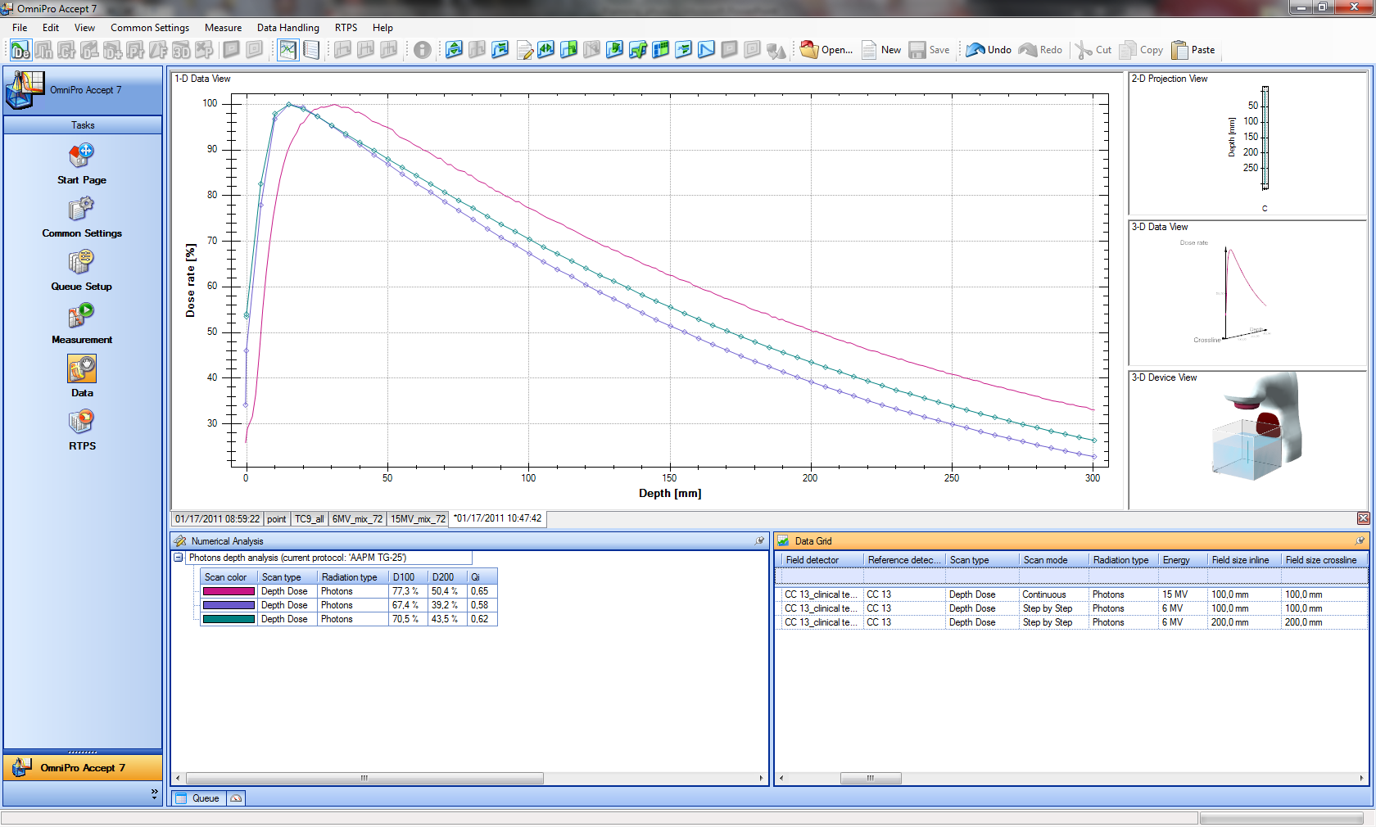
Trainings & conferences
Relative and absolute dosimetry
measurement with LINAC facility: how to measure a PDD profile, beam profile and output factors of a medical linear accelerator, perform a beam calibration
SSD=100cm
Relative dose [%]
15MV, 10x10
6MV, 10x10
6MV, 20x20

Slide 21
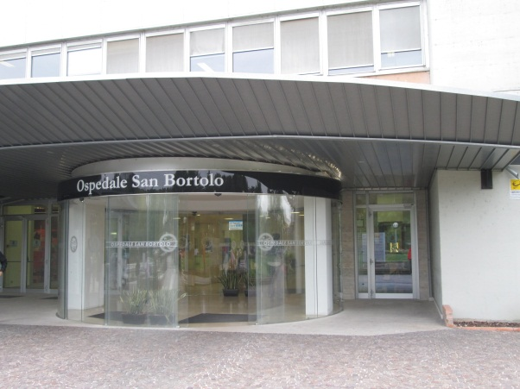
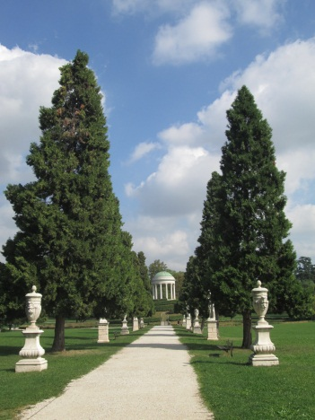
Trainings & conferences
Monte Carlo EGSnrc:
  First training @ IBA
    Second training: Paolo Francescon, Department of Medical Physics, S.Bortolo Hospital, Vicenza
“V National School in Detector and Electronics for High Energy Physics, Astrophysics, Space Applications and Medical Physics, INFN Padova (Italy)”:
  radiation damage in detectors
  front-end electronics
  medical application of radiation
German language course
Trainings delivered by company : introduction to working safety, introduction to QM system, radiation safety, company data protection

Slide 22
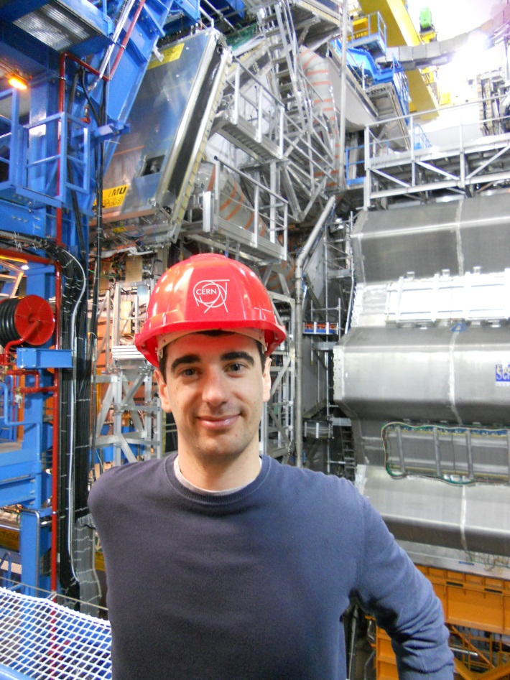
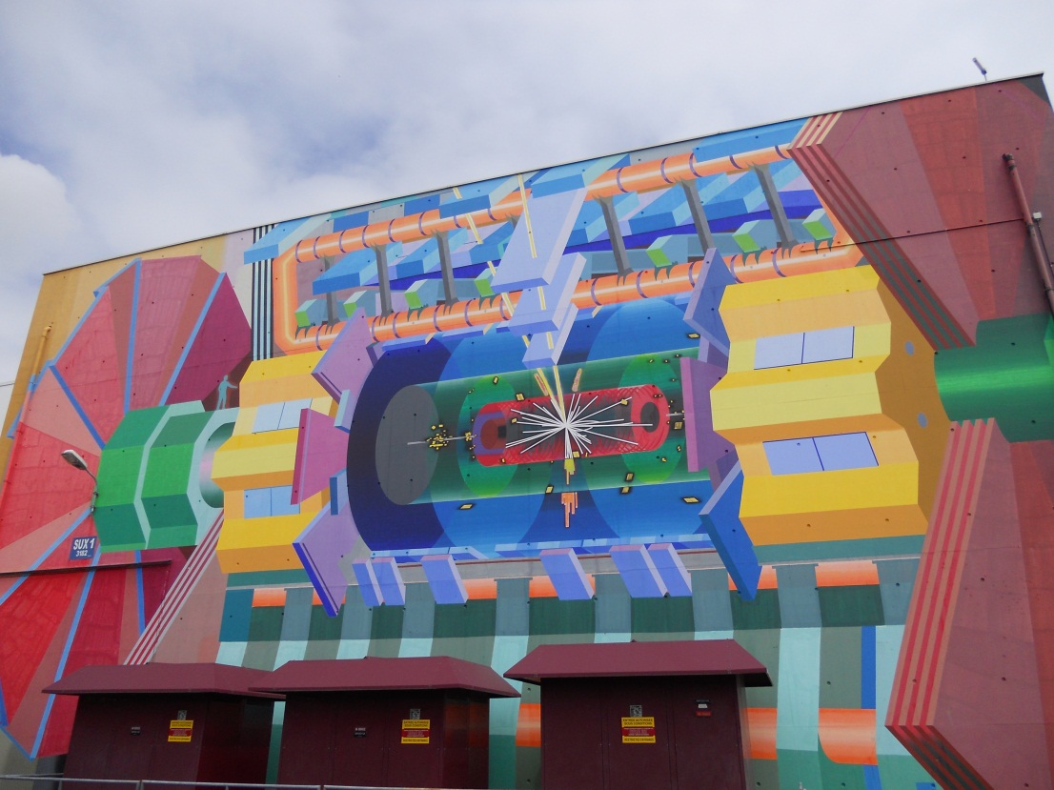
Trainings & conferences
ARDENT Mid-Term Review Meeting, CERN
Confirmed attendance at IEEE, NSS-MIC, Seoul
Under evaluation: attendance to AIFM (Turin), ICTR-PHE (Geneva)

Slide 23
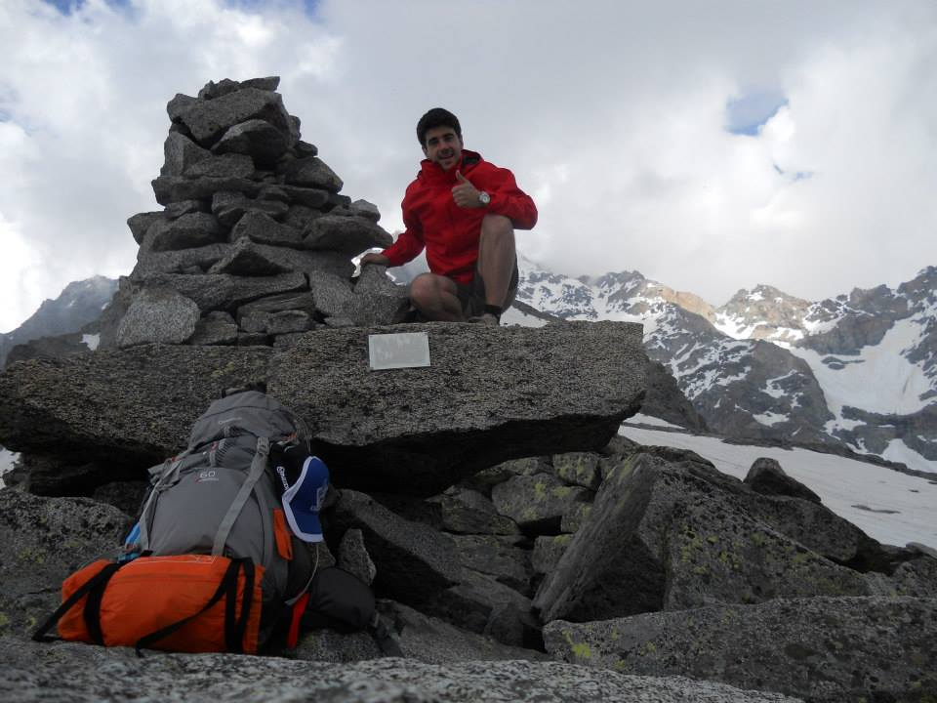
Thank you!

