Slide 1















Overview of ITN
Advanced Radiation Dosimetry European Network Training initiative
(ARDENT)
Mid-Term review
Marco Silari (CERN)
on behalf of the ARDENT consortium

Slide 2








ARDENT
February 2012 – January 2016
Advanced Radiation Dosimetry European Network Training initiative
Marie Curie Initial Training Network under EU FP7 – 4 M€
(7 ->) 8 Full Partners and (5->) 6 Associate Partners
Coordinator: CERN, Scientist-in-Charge: Dr. M. Silari
CERN (coordinator), Switzerland
AIT Vienna, Austria
CTU - IAEP Prague, Czech Republic
IBA Dosimetry, Schwarzenbruck, Germany
Jablotron, Jablonec nad Nisou, Czech Republic
MI.AM, Piacenza, Italy
Politecnico of Milano, Italy
Seibersdorf Laboratories, Austria
INFN Legnaro National Laboratories, Italy
ST Microelectronics, Italy
University of Erlangen, Germany
University of Houston, USA
University of Ontario, Canada
University of Wollongong, Australia

Slide 3
ARDENT
8 full partners: 3 research institutions, 2 academic, 3 industry
6 associate partners: 1 research institution, 4 academic, 1 industry
Originally 12 partners (7 full and 5 associate)
Development of radiation sensors and dosimeters moved from AIT to Seibersdorf Laboratories (SL) after ARDENT starting date
AIT group split between AIT and SL, SL joined as 8th full partner
One ESR with AIT and one ESR with SL
Revised Grant Agreement entered into force on 1st January 2013 (retroactive)
On 1st January 2013 LNL-INFN joined ARDENT as 6th associate partner because of its expertise in microdosimetry

Slide 4
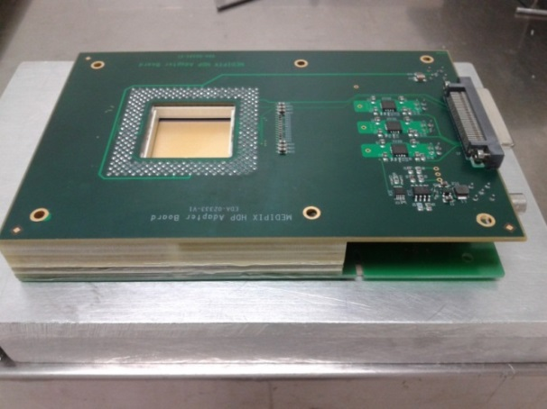
Development of advanced instrumentation for radiation monitoring
Three technologies
gas detectors [gas electron multipliers (GEM), tissue equivalent proportional counters (TEPC), ionization chambers]
solid state detectors [Medipix, silicon micro-dosimeters]
track detector techniques [CR-39]
Main objectives
  Radiation dosimetry
  Micro- (and maybe sub-micro-) dosimetry
  Neutron spectrometry
Applications
  Characterization of radiation fields at particle accelerators
  Characterization of radiation fields on-board aircrafts and in space
  Assessment of secondary dose to RT patient
  Measurement of properties of clinical hadron beams

Slide 5
Recruitment
15 Early Stage Researchers (ESR)
  4 at CERN, Geneva
  1 ait AIT, Vienna
  3 at CTU, Prague
  2 at IBA Dosimetry, Schwarzenbruck
  1 at Jablotron, Jablonec nad Nisou (100 km from Prague)
  1 at MI.AM, Fabiano di Rivergaro (near Piacenza)
  2 at the Politecnico, Milano
  1 at Seibersdorf Laboratories, Seibersdorf
All ESRs are enrolled in a PhD program

Slide 6
Recruitment
All positions advertised network-wide (ARDENT website, CERN’s e-recruitment system, Euraxess, LinkedIn, Facebook, Twitter, the Institute of Physics and the Institute of Engineering and Technology, local advertisement)
All ESR applications handled via the CERN ERT tool
87 applications received, of which 74 were eligible for consideration for recruitment with at least one of the beneficiaries
Publication started in February 2012 for 6 weeks initially, positions left open on CERN’s e-recruitment system until June
Applications re-opened for a few weeks in November 2012

Slide 7
Recruitment
Almost 28% of the candidates were from females, with nearly 27% (4/15) females appointed
Selection of candidates done by the respective institutes
  Selection process documented
  Researchers recruited under employment contract
Applications not limited to the EU countries (mobility criteria), selected candidates are:
  9 European
    Germany, Greece (2), Italy (3), Slovakia, Sweden, U.K.
    6 non-European
      Australia (2), Colombia, India (2), Mauritius

Slide 8
Recruitment
All contracts started within the first 12 months, except 2 (SL, CTU)
SL and CTU plan to use the remaining man-month funding for these positions (6 and 8 man-months, respectively) for short-term contracts on ESR5- and ESR7-related subjects
No major problems with the other positions, only some delays due to administrative / VISA issues for some of the non-EU ESRs

Slide 9
Work Packages
Seven Work Packages
  WP1: gas detectors
  WP2: solid state detectors
  WP3: track detectors
  WP4: instrument inter-comparison
  WP5: training
    Individual training programs
    Network-wide training
  WP6: dissemination and outreach
  WP7: ITN management

Slide 10
Work Packages
ESR | Individual Research project | Link with WPs | Host Institute | Fellow months
ESR 1 | Development of compact neutron spectrometer | 1, 2, 4, 5, 6 | CERN | 36
ESR 2 | Dosimetry in mixed fields with Medipix and RP training | 2, 4, 5, 6 | CERN | 36
ESR 3 | Dosimetry in mixed fields with GEM and TEPC | 1, 4, 5, 6 | CERN | 36
ESR 4 | Medical applications of Si detectors | 2, 4, 5, 6 | CERN | 36
ESR 5 | Characterisation of TEPC for space and medical applications | 1, 4, 5, 6 | SL | 36
ESR 6 | Evaluation of advanced detectors for dosimetry in phantoms | 2, 4, 5, 6 | AIT | 36
ESR 7 | Development of radiation-hard radiation field monitor | 2, 4, 5, 6 | CTU | 36
ESR 8 | Application of Medipix detectors for medicine and radiation safety | 2, 4, 5, 6 | CTU | 36
ESR 9 | Optimization of mixed-field data evaluation | 2, 4, 5, 6 | CTU | 36
ESR 10 | Development of detector system for medical Quality Assurance | 2, 4, 5, 6 | IBA | 36
ESR 11 | 2D Ionization chamber array for clinical applications | 1, 4, 5, 6 | IBA | 36
ESR 12 | Development of Medipix-based radiation monitoring system | 2, 4, 5, 6 | Jablotron | 36
ESR 13 | Neutron dosimetry and spectrometry with CR-39 | 3, 4, 5, 6 | MI.AM | 36
ESR 14 | Solid state microdosimetry, low-pressure TEPCs | 2, 4, 5, 6 | POLIMI | 36
ESR 15 | CR-39 and active detector for pulsed neutron fields | 1, 3, 4, 5, 6 | POLIMI | 36

Slide 11
ARDENT management structure
Supervisory Board (SB)
Administrative support unit (CERN)
ITN Management Office
Scientist in Charge
Selection Committees
Technical Training Board
(Leaders WP 1-4)
Training Board
(WP 5)
Dissemination and Outreach Board (WP 6)
Technical WPs
  WP1: gas detectors
  WP2: solid state detectors
  WP3: track detectors
  WP4: instrument inter-comparison
Each board meets 4 times/year
three vidyo conferences
one in-person at the workshops
agenda / minutes

Slide 12
ARDENT management structure
Supervisory Board: representatives from each partner and ESRs
Technical Training Board: four technical WP leaders
  monitors the progress of the technical WPs (milestones/deliverables)
Training Board: one representative from each full partner
  checks that each ESR follows his/her training programme
Dissemination and Outreach Board: 7 members
  promotes and monitors the dissemination and outreach activities
ITN Management Office: scientist-in-charge + chairs of the TTB, TB and DOB
  reports to the Supervisory Board, in charge of the overall management of the network programme

Slide 13
Website
On-line since 1st February 2012 (thanks to AIT!), mostly public:
• the project scope and organizational structure
• the ESRs personal pages
• the outreach and dissemination results
• the program of the various workshops and training courses; all documentation including slides of the lectures is freely accessible worldwide
• information on the involvement and collaboration with other projects
• a list of the international conferences and courses of interest to ARDENT activities

Slide 14
Website
Password-protected member area for official documents
(needs CERN external account):
Grant Agreement and its annexes
Consortium Agreement
Documents related to the project deliverables
Minutes of the board meetings and of other relevant meetings
Some documents of confidential nature
(e.g. containing proprietary information of private partners)

Slide 15
Communication
Mailing lists
General ARDENT mailing list
SB mailing list
ITN MO mailing list
TB mailing list
TTB mailing list
DOB mailing list
ESRs mailing list (networking!)

Slide 16

Training
Individual PhD-specific training program
Hands-on / experimental work
ARDENT training courses within the annual workshops
Courses and schools
Conferences
Complementary training (e.g. language, business and administration)
International conferences (many!) – just one example:
  Workshop “New Detector Technologies in Radiation Dosimetry and its Applications”, IEEE NSS/MIC conference, Seoul, Korea, October 2013 / Chairs M. Silari and A. Rosenfeld

Slide 17
Training - tracking
CDP review by the Training Board
  Scientific goals / training / complementary training / outreach
Activity table (coordinator)
  Training (achieved and planned)
  Experimental activities
  Conferences and workshops attended
  Presentations at conferences/workshops/scientific meetings
  Outreach activities
  Scientific publications
  Secondments (achieved and planned)
Web site

Slide 18
Network-wide events (so far)
Project kick-off meeting, CERN, 8 May 2012
ARDENT-CNAO workshop, Pavia, 19 October 2012
1st annual ARDENT workshop, Vienna, November 2012
  training course on radiation dosimetry
  visit to MedAustron
Mid-Term review preparatory meeting , CERN, 13 June 2013,
  visit to ATLAS and to the 600 MeV synchrocyclotron
2nd annual ARDENT workshop, Politecnico of Milan, October 2013
  training course on experimental microdosimetry
  full-day outreach event (POLIMI 150° anniversary)

Slide 19
Annual workshops
Lead institution / location | Objectives | Deliverables | Participants | Month
AIT/Vienna | Training course on dosimetry Visit to MedAustron | 1st Workshop and training course | All | 10
POLIMI/ Milano | Training course on experimental microdosimetry Mid-Term review | 2nd Workshop and training course | All | 22
IBA/ Schwarzenbruck | Topic of the course to be decided | 3rd Workshop and training course | All | 34
CTU/Prague | Topic of the course to be decided | 4th Workshop and training course | All | 46
Kickoff meeting held at CERN on month 3

Slide 20
Deliverables / Milestones
No significant deviations in the work program as compared to Annex I
All deliverables “delivered”
All milestones met, except slight delay in:
M5 - comparison of detector technologies (WP1)
M6 - choice of detector technology (WP1, WP2)
WP1: Description of work - GEM detector technology for neutron spectrometry, dosimetry and microdosimetry; TEPC to determine absorbed dose and dose equivalent in complex radiation fields; miniaturized version of a TEPC for use in cancer radiation therapy; neutron detectors based on proportional counters for operation in mixed and pulsed radiation fields; novel ionization chamber detector array for the measurement of absorbed dose from photon, electron and proton radiation
WP2: Description of work - Medipix technology for neutron spectrometry, dosimetry and for characterising therapeutic ion beams; universal portable mixed-field radiation detector for environmental monitoring based on Medipix; Medipix/Timepix based hand-held public security radiation detector; single photon detection system for QA of radiological imaging systems; silicon detectors and instrumentation for microdosimetry; Medipix technology in medical imaging for cancer treatment planning

Slide 21
Deliverables / Milestones
Slight modifications or extensions in the work plans of some ESRs
ESR1: expanded to include extensive hands-on training on neutron spectrometry
ESR4: enlarged to include dosimetry and microdosimetry with Medipix / GEMPIX
ESR5: added radiation effects to electronics
ESR6: includes evaluation of advanced detectors in a moving phantom for dose validation in radiation therapy (revised Annex I)
ESR7: more accent on data analysis and on further radiation hardness studies
ESR12: expanded to include the development of a GM counter-based prototype
ESR14: extended to design and construction of low-pressure TEPC

Slide 22
WP4 activities
Organisation of transnational, network-wide experimental activities involving more than one ESR
Measurements planned at:
LNL-INFN, Legnaro, Italy
LNS-INFN, Catania, Italy
CNAO, Pavia, Italy
PSI, Villigen, Switzerland
Maybe HIT, Heidelberg, Germany
Maybe HIMAC, Chiba, Japan

Slide 23
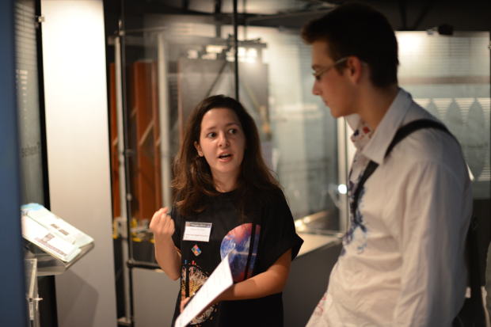
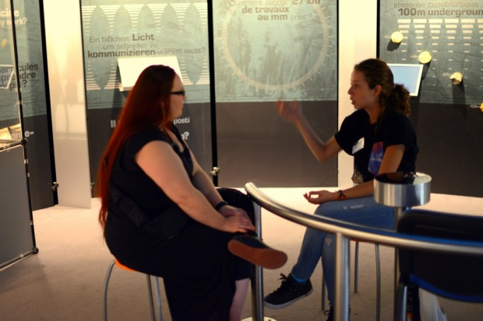
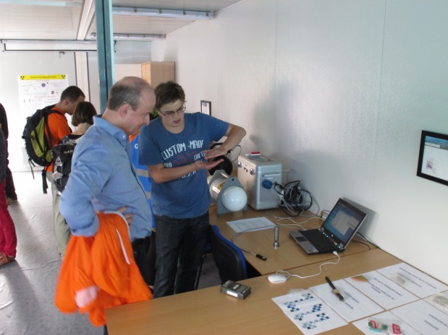
Outreach activities
A documentary on ARDENT activities with the participation of all ESRs is in preparation
Two ESRs participated in the Researchers’ night on 27 September at CERN
Three ESRs gave a demonstration of some ARDENT activities during the CERN Open Days on 28 and 29 September
ESR13, ESR14 and ESR15 are involved in a project organized with an Italian high school, giving introductory lectures on radioactivity and radiation protection and a practical demonstration of radon measurements with track detectors

Slide 24
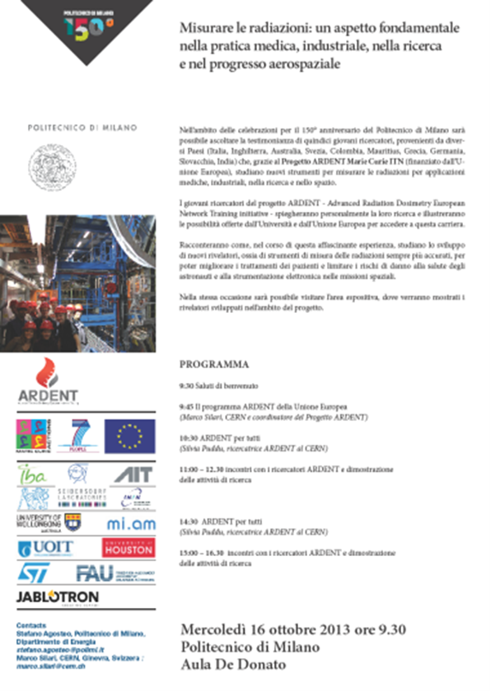
Outreach activities
And of course…
POLIMI Outreach Day
16 October 2013

Slide 25
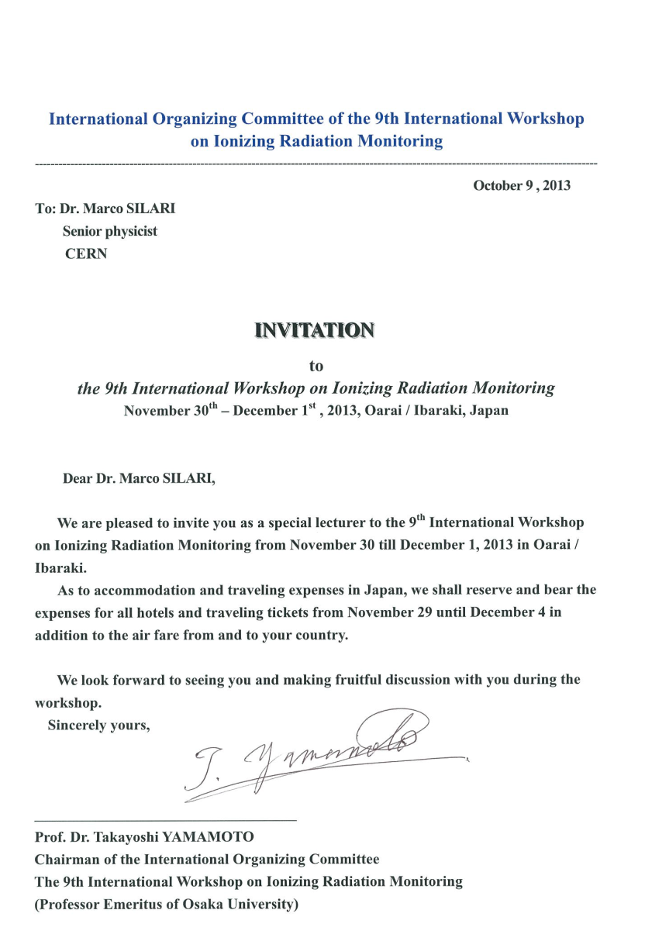

Dissemination
Invited lecture at the 9th International Workshop on Ionizing Radiation Monitoring
November 30th - December 1st, 2013, Oarai I Ibaraki, Japan
Highlights from the Advanced Radiation Dosimetry European Network Training initiative (ARDENT)
BioQuaRT Satellite Workshop at the 12th NEUDOS Conference, 7th June 2013, Aix-en-Provence

Slide 26
Category 3 budget status
Institute | N. of ESRs | Months | ESR-months 1 Feb 2012 - 30 Sept 2013 | % expenditure over total 1 Feb 2012 - 31 Jan 2016 | % at Mid-term –> 30 Sept 2013
CERN | 4 | 144 | 57.0 | 45% | 114%
AIT | 1 | 36 | 9.5 | 23% | 89%
CTU | 3 | 108 | 19.5 | 20% | 110%
IBA | 2 | 72 | 15.5 | 21% | 96%
Jablotron | 1 | 36 | 12.0 | 26% | 77%
MI.AM | 1 | 36 | 9.5 | 34% | 129%
POLIMI | 2 | 72 | 25.0 | 21% | 60%
SL | 1 | 36 | 2.0 | 2% | 41%
Total | 15 | 540 | 150 | 27% | 98%
Category 3: 1800 € per researcher/month

Slide 27

Sponsorships and partnerships
Support to “local” PhD students
Participation in training course at the 1st (Vienna) and 2nd (Milano) annual ARDENT workshops open to outside students (14 extra-ARDENT students attending the training course on experimental microdosimetry on 17-18 October 2013)
Biologically weighted quantities in radiotherapy

Slide 28
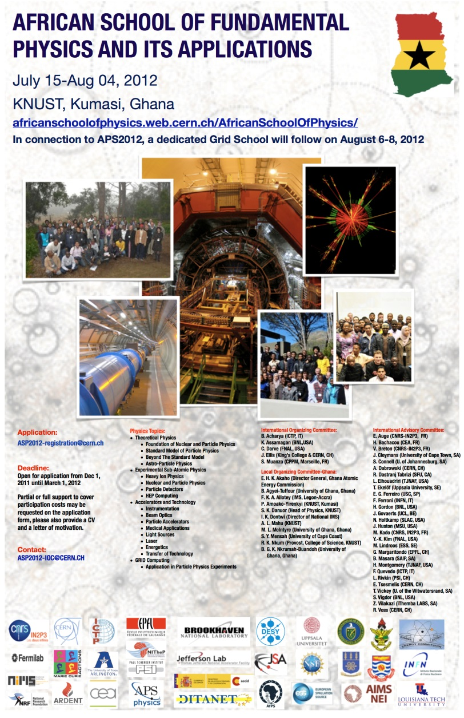
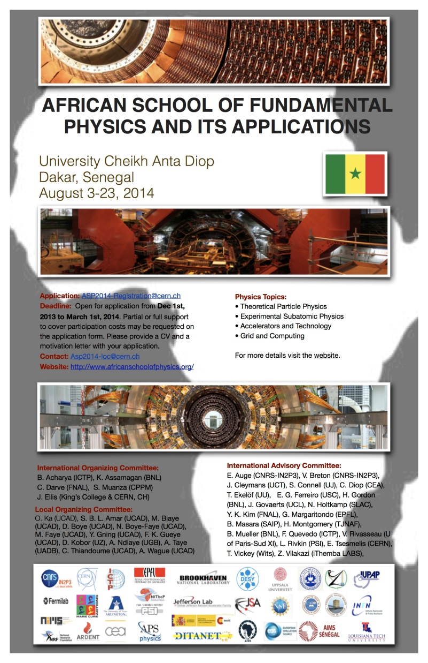
Sponsorships and partnerships
African School of Physics
Stellenbosch (SA) –August 2010
African School of Physics 2012
Kumasi, Ghana – July 2012
African School of Physics 2014
Dakar, Senegal, August 2014
ARDENT

Slide 29
Acknowledgements
Thank you to:
REA and the Project Officers (Sergio Mastropierro and Mika Levonen) who have worked with us on ARDENT and helped us to get this far
The colleagues (supervisors and experts) of the Full and Associated partners
All ESRs for their enthusiasm, commitment and hard work

