Slide 1
session 1: introduction & overview
welcome & program – Ilan Ben-Zvi
crab history & motivation – Robert Palmer
LHC crab scheme – Rama Calaga
SBIR phase-1 for 800 MHz prototype
– Mike Cole

Slide 2
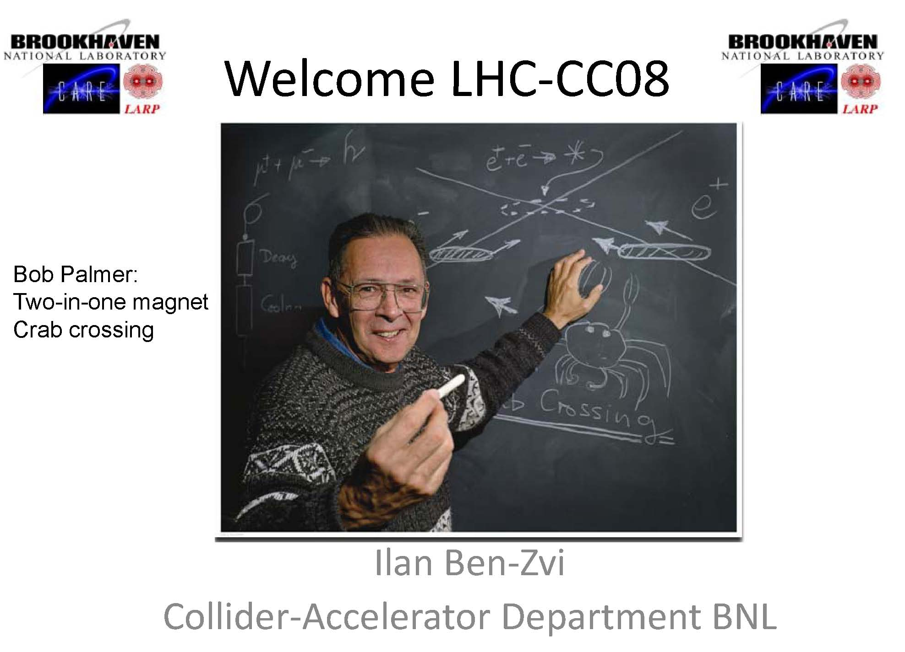

Slide 3
goals (Ilan)
learn from KEKB
roadmap for LHC crab cavities
time line, time scales
work packages + distribution of tasks
decisions
global or local?, optics, small-angle strawman? requirements for local scheme?
exotic cavities?, choice of rf frequency,
D1 magnet parameters?, engneering challenges, R&D plan, AES cavity
how do we get started? installation in IR4?

Slide 4
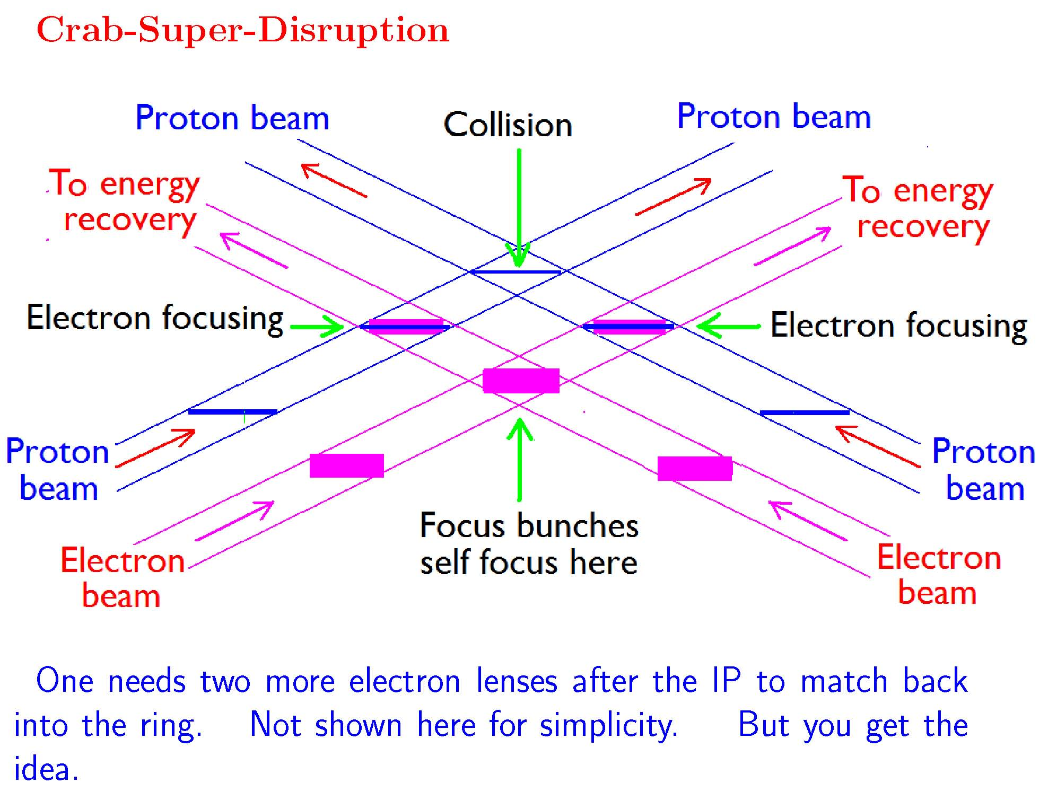
R. Palmer

Slide 5
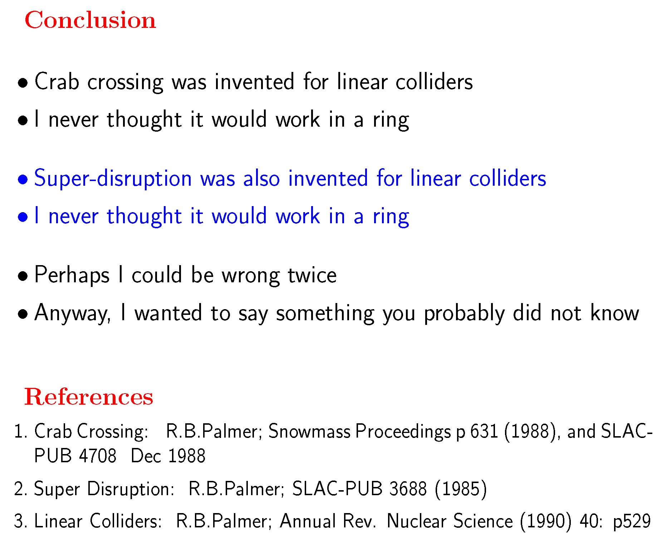
R. Palmer

Slide 6
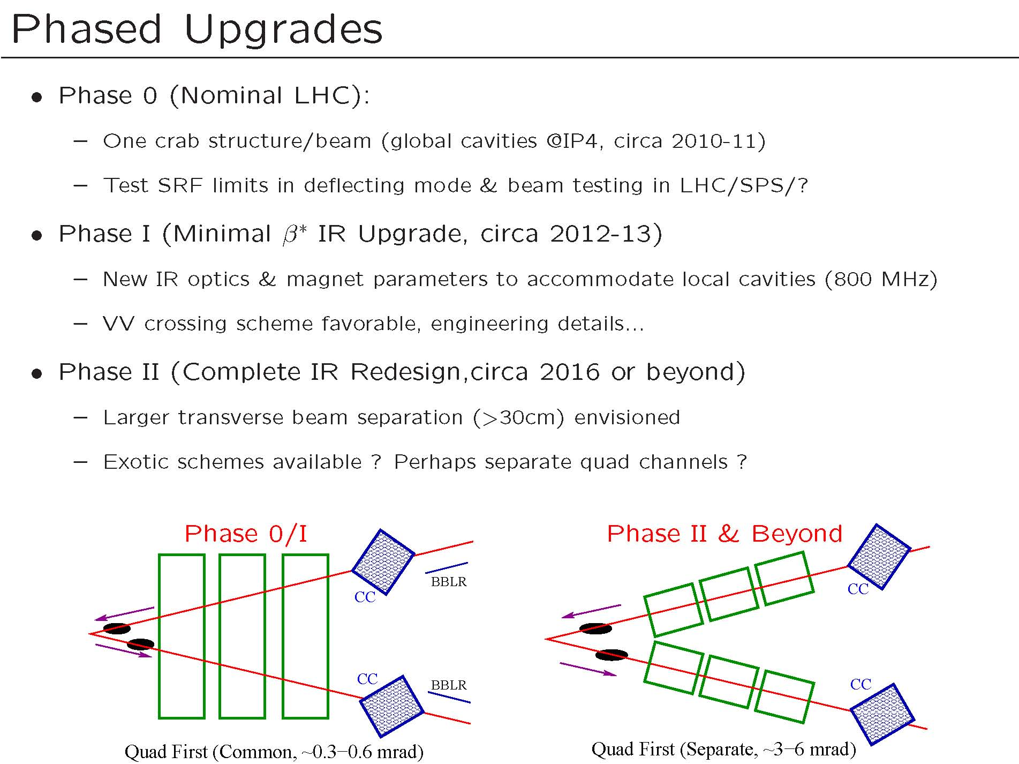
R. Calaga

Slide 7
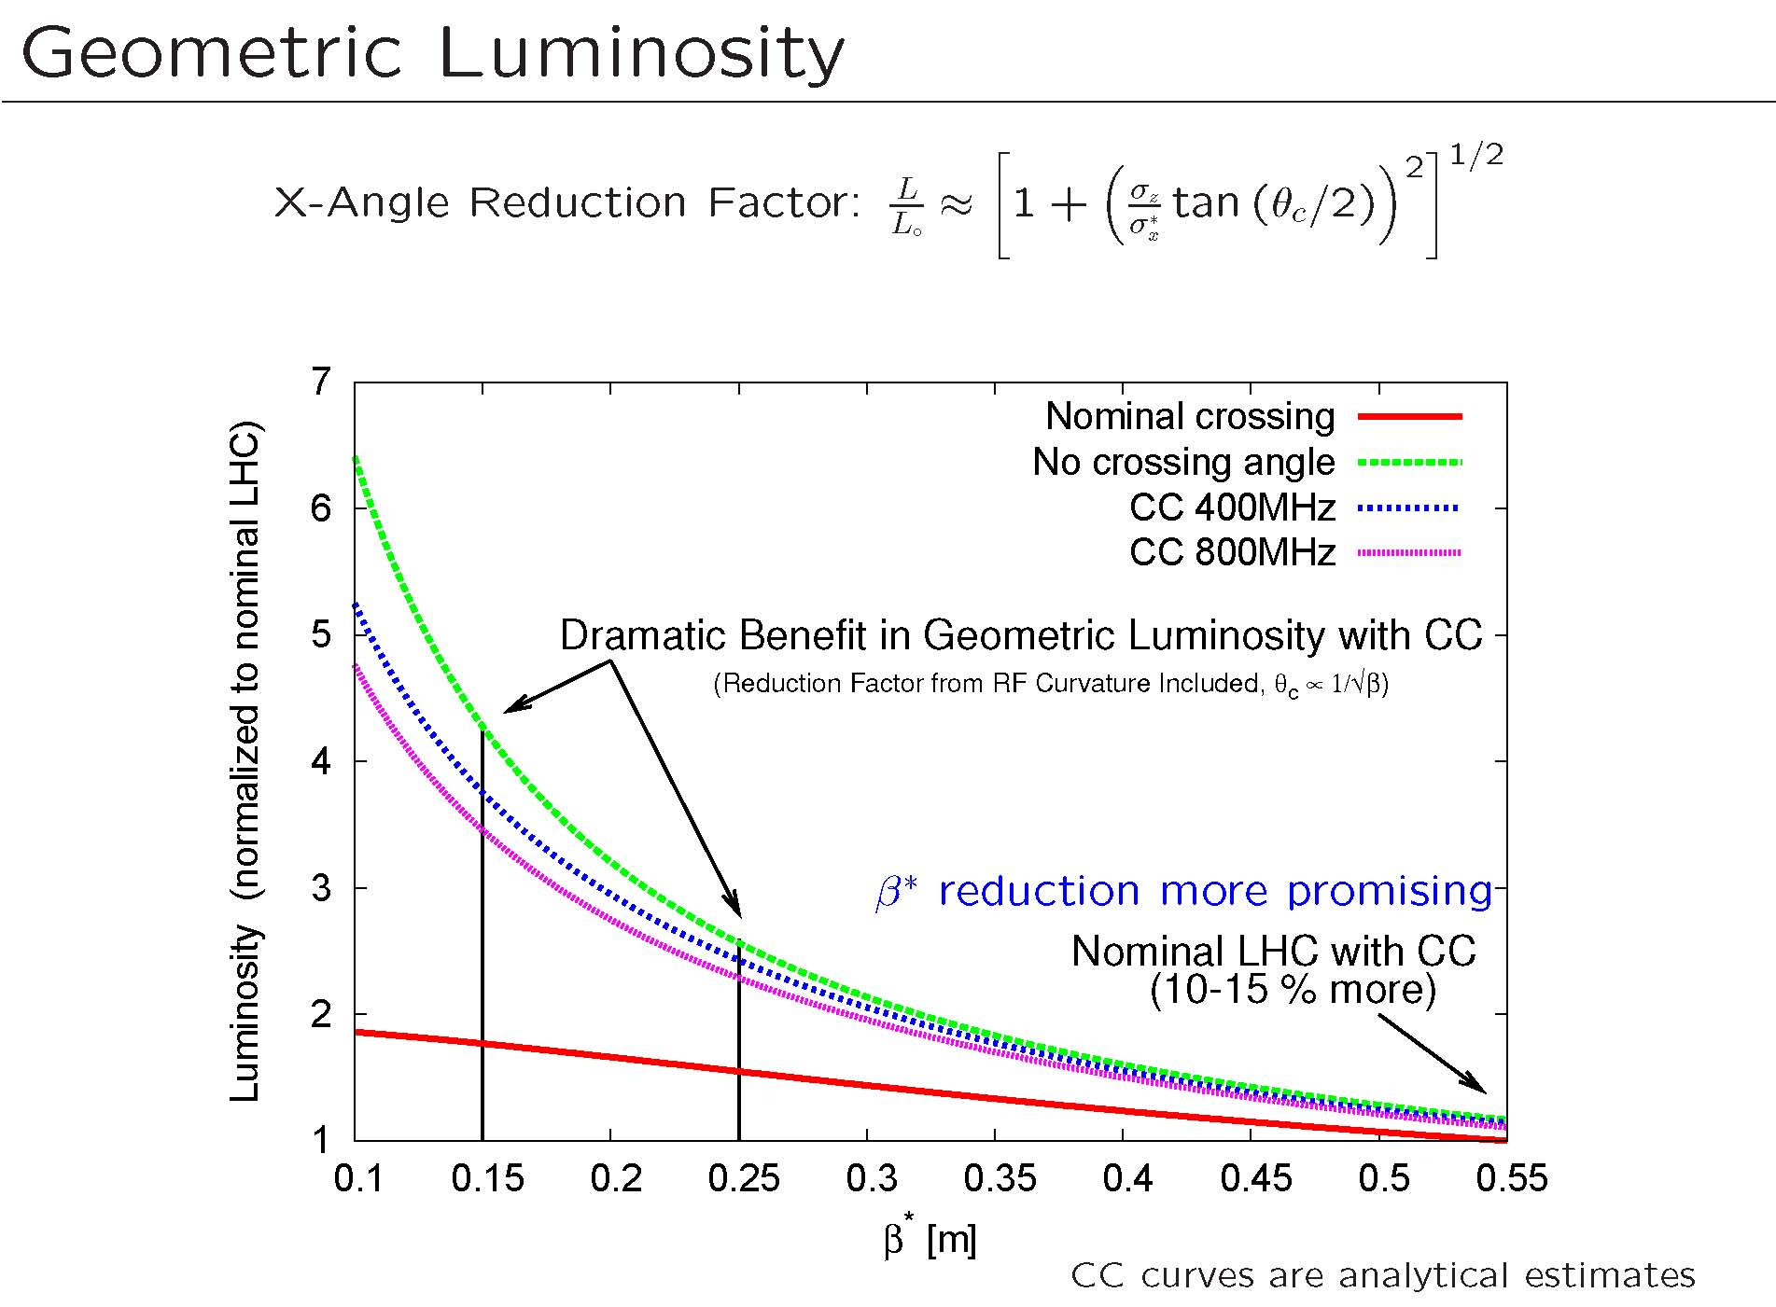
R. Calaga
factor 2-3 gain in luminosity

Slide 8
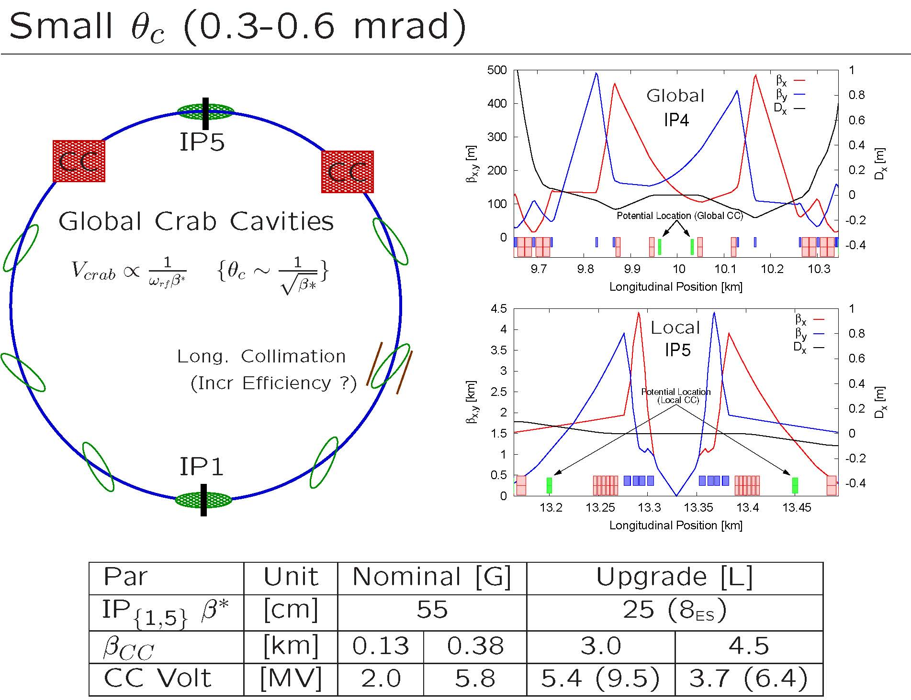
R. Calaga

Slide 9
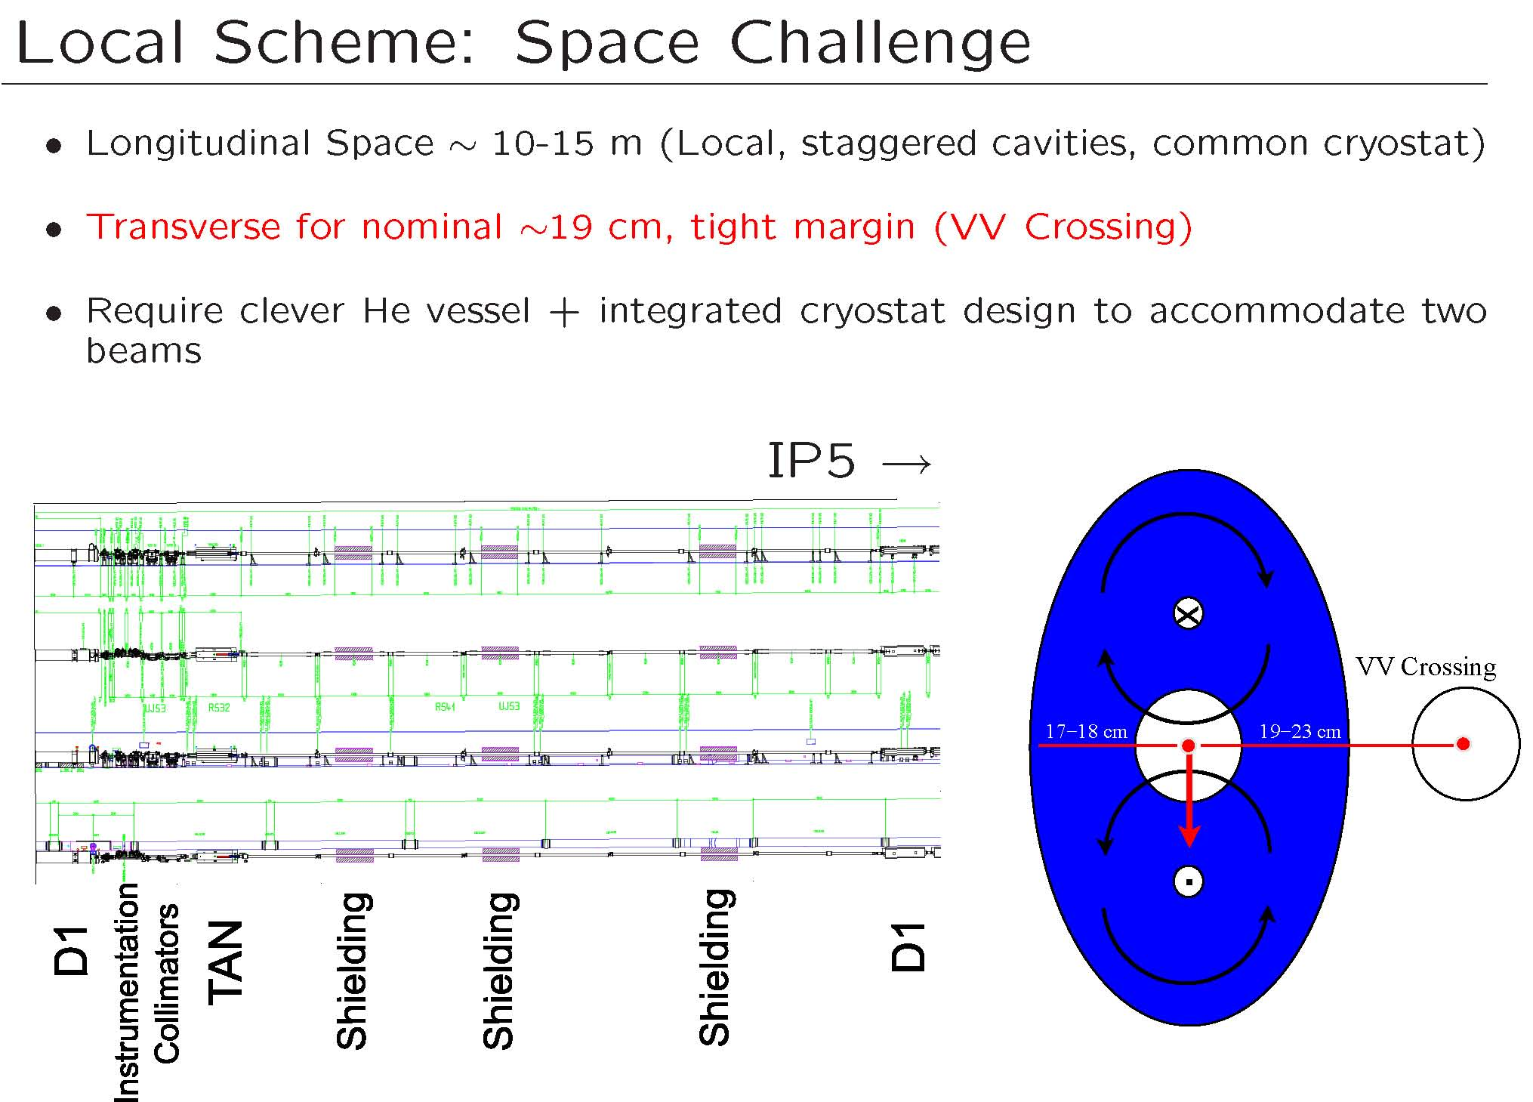
R. Calaga
VV crossing only option for local scheme

Slide 10
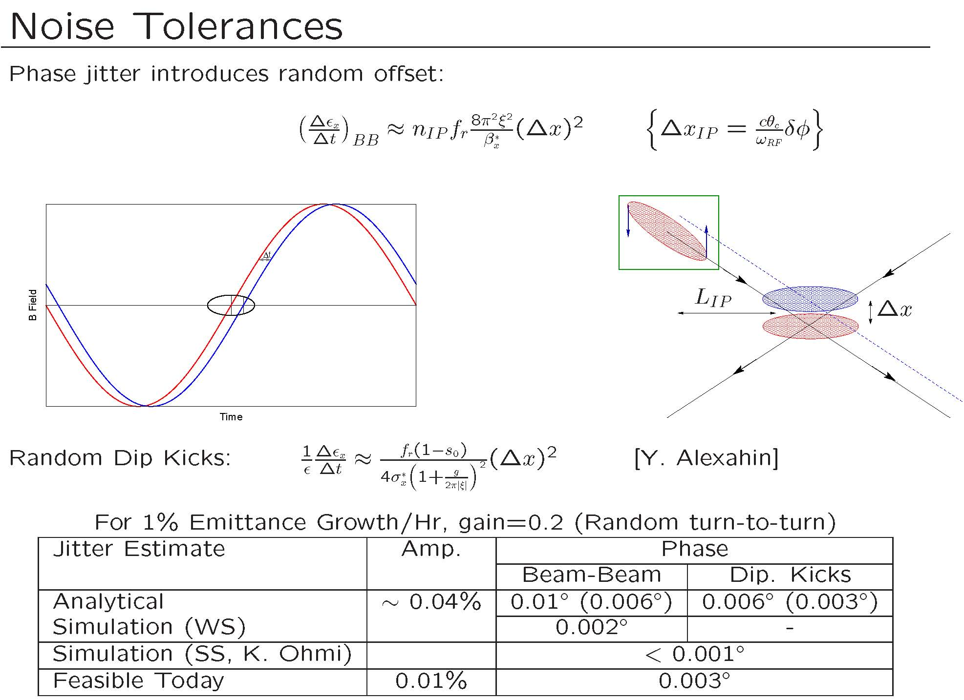
R. Calaga
tolerances tight but within reach

Slide 11
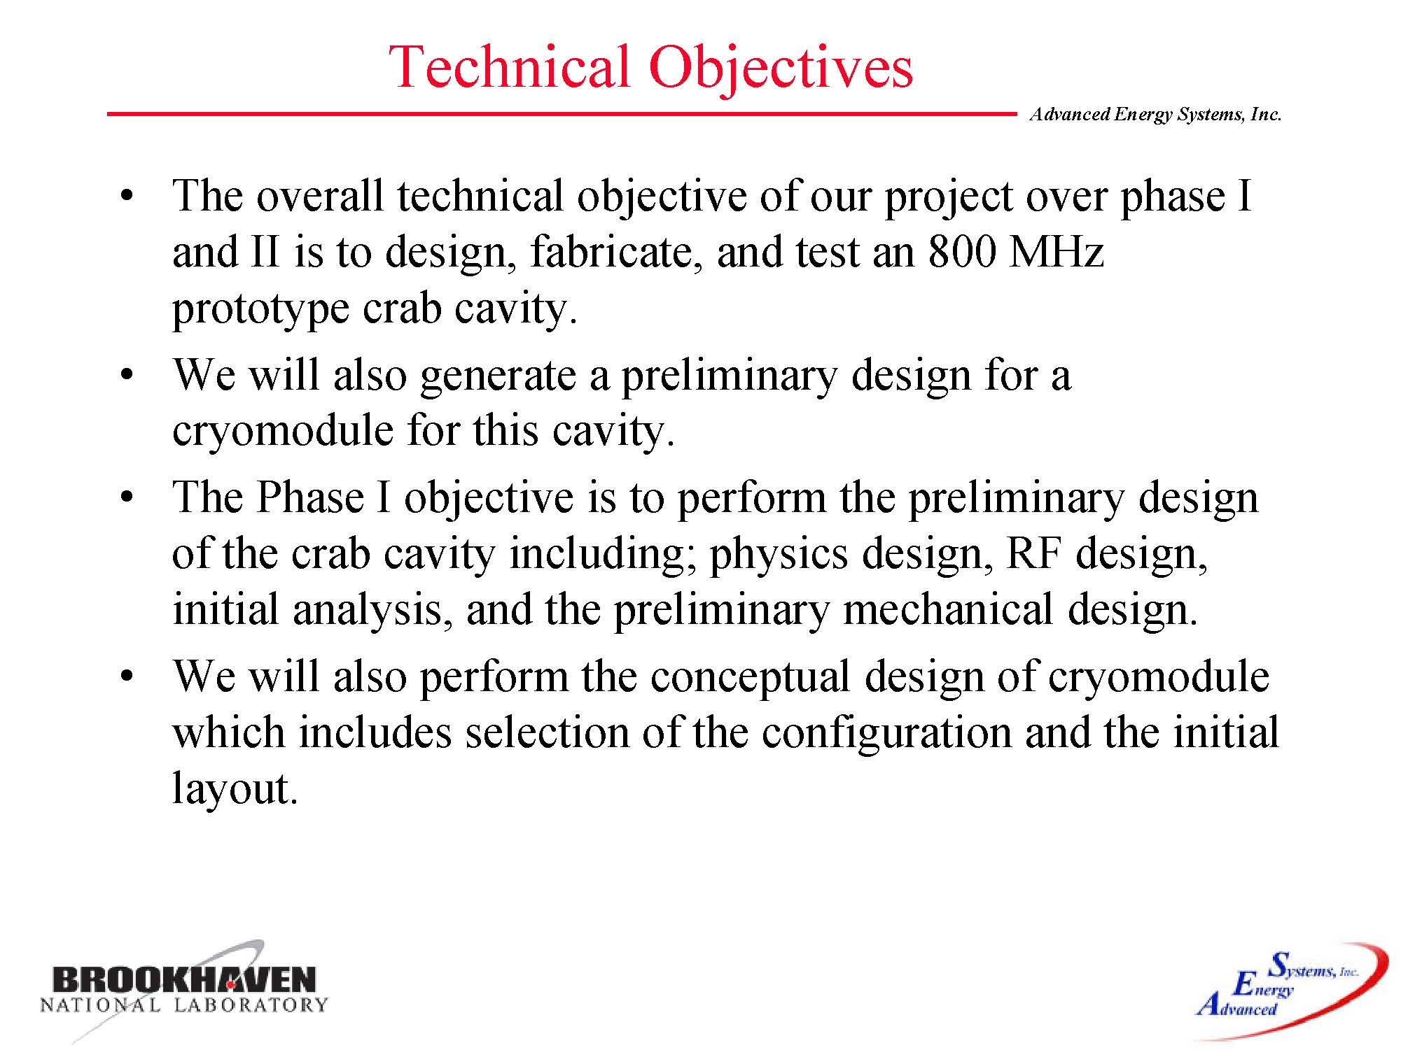
M. Cole
phased SBIR program over 2.5 years, BNL-AES collaboration

Slide 12
discussion
phase-0 benefit for both IPs? (Ralph); sqrt(2) higher voltage & 45/135deg phase advance can be used to crab in both IPs (with same crossing plane) – Katsunobu Oide
crab-cavity wake fields → “banana effects” – Bob Palmer, H.P.
collimator wake fields for global scheme wake fields excited by tilted bunches passing through collimators → self-consistent calculation needed – H. Padamsee, F. Z.
crab-cavity parameters similar for local & global scheme
noise issues possibly relaxed for local scheme – H.P., F.Z.
crab super disruption – could it be applied to LHeC?
dispersion at rf cavity instead of crab cavity? - John Byrd
passive operation for crab cavity test? – John Byrd
separate cooling for easier exchange? – Joachim, Hassan,…

