Slide 1



Higgs Physics at CMS
Albert De Roeck
CERN, Geneva, Switzerland
Antwerp University Belgium
UC-Davis California USA
24 June 2013

Slide 2
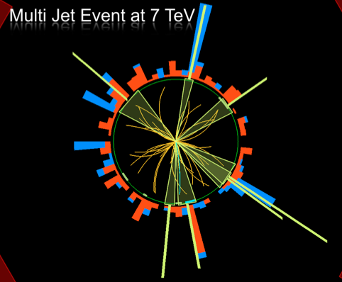


Outline
Introduction & Performance
Higgs searches
Overview of the results
including updates
Studies of Higgs properties
Summary
OR: The year after!!
Melbourne 4th of July

Slide 3
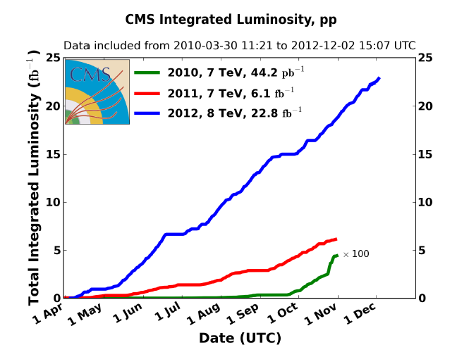
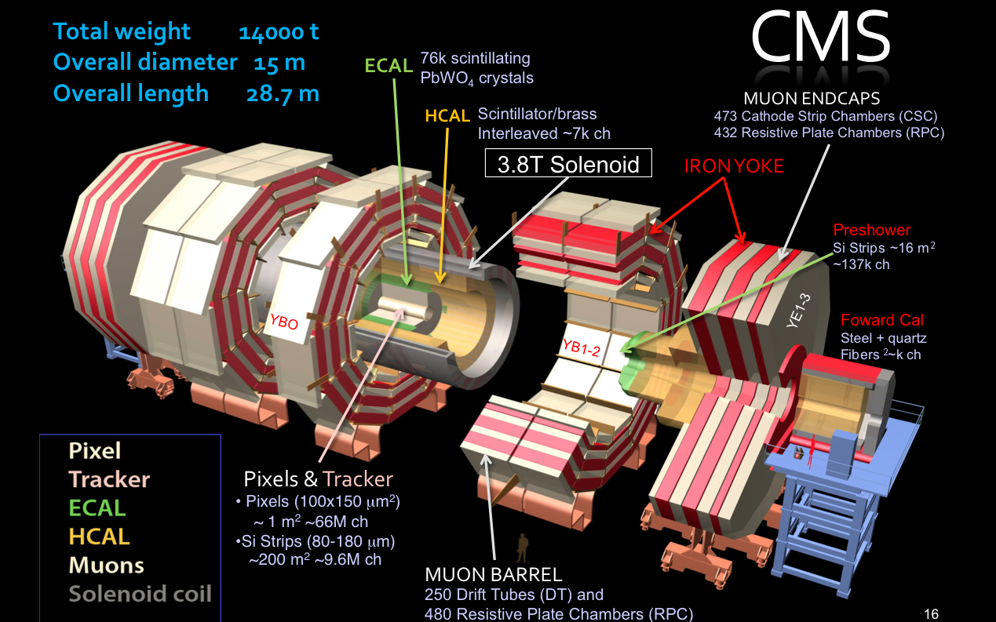
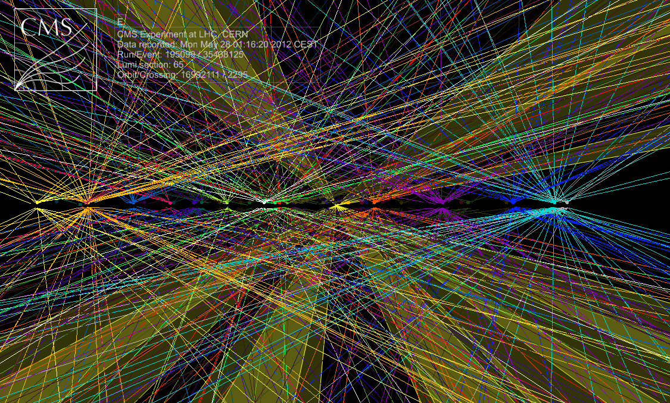
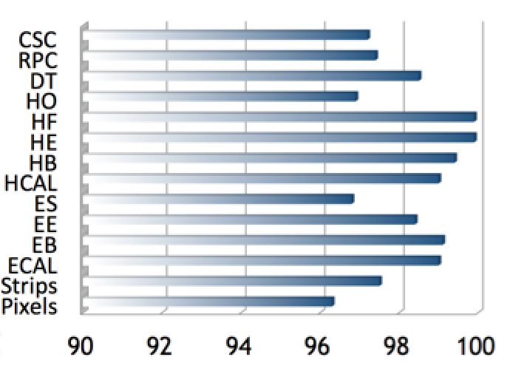
The CMS Detector
8 TeV
7 TeV
Detector Performance End 2012
~ 25 events on average per BX

Slide 4
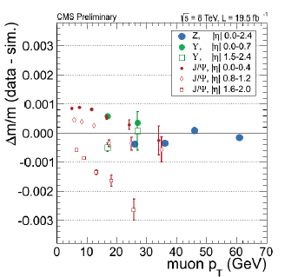
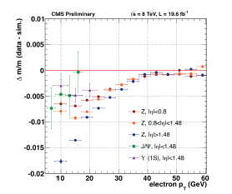
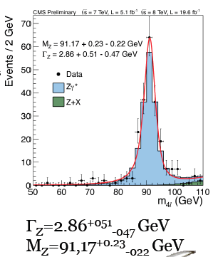
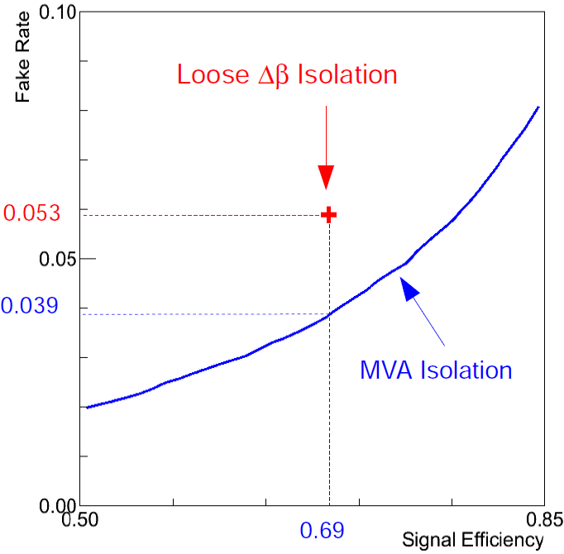
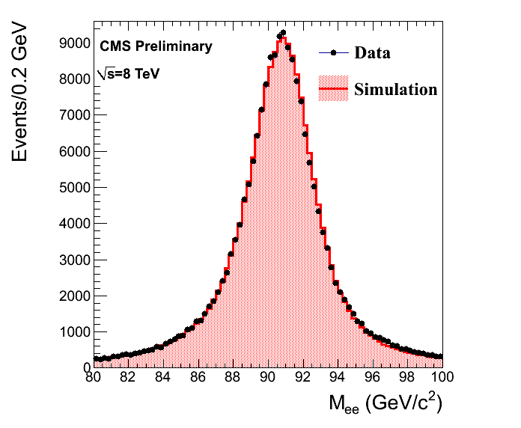
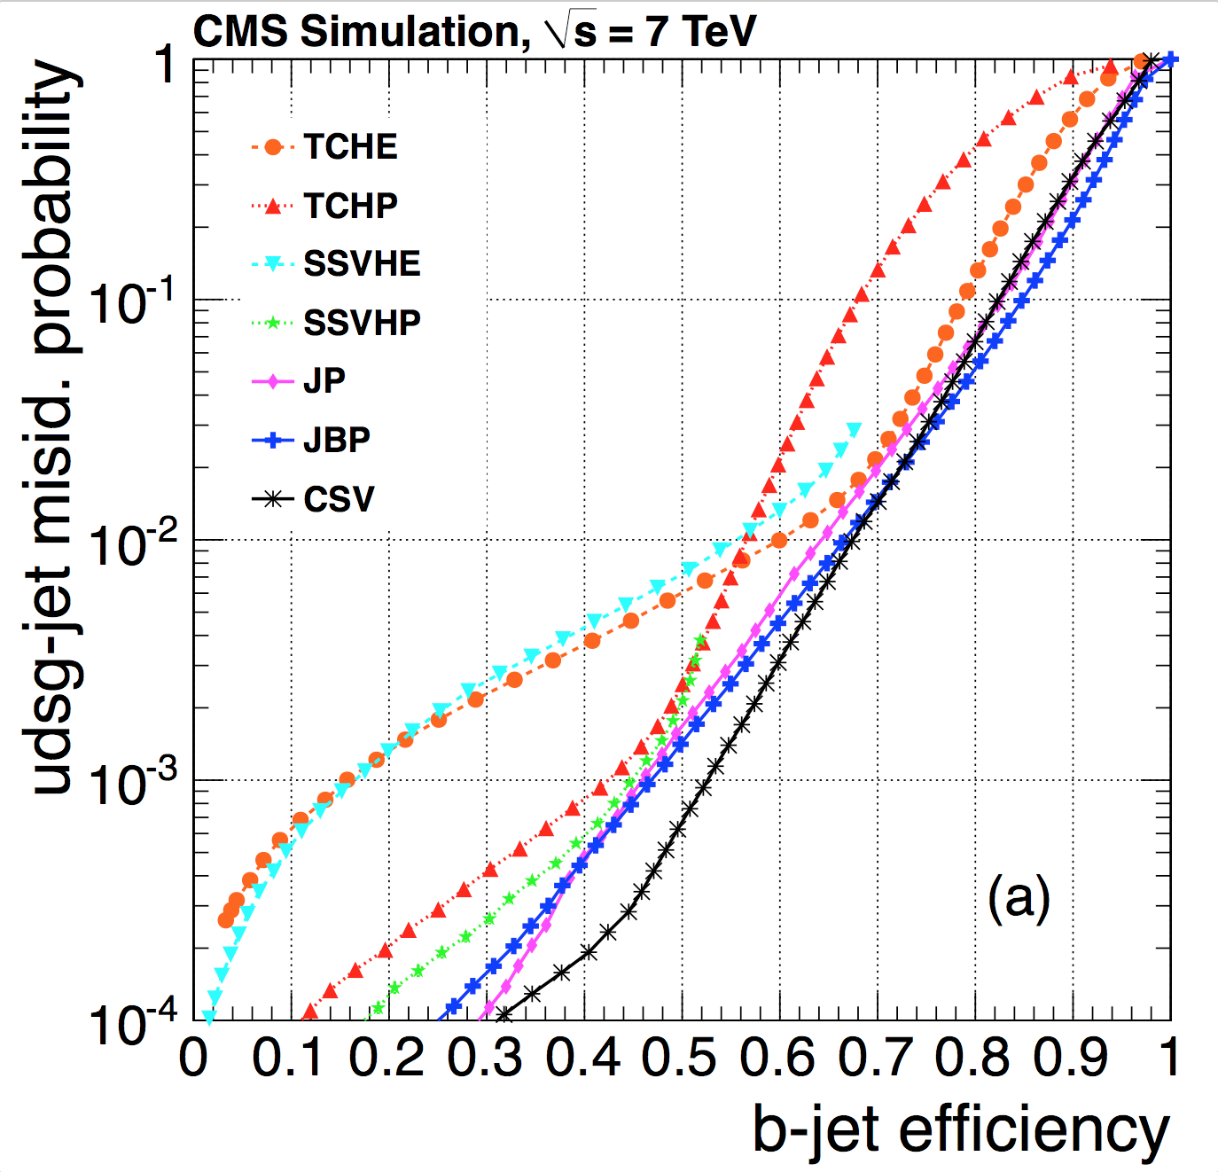
CMS Ready for the Higgs Hunt
Muon momentum scale ~0.1%
Electron momentum scale ~ 0.2%
for p_{T}>35 GeV, else down to 1.5%
Muons at the Z-peak
~4%
~70%
b-jet tagging
Tau efficiency
EM-Calo energy scale for γγ

Slide 5
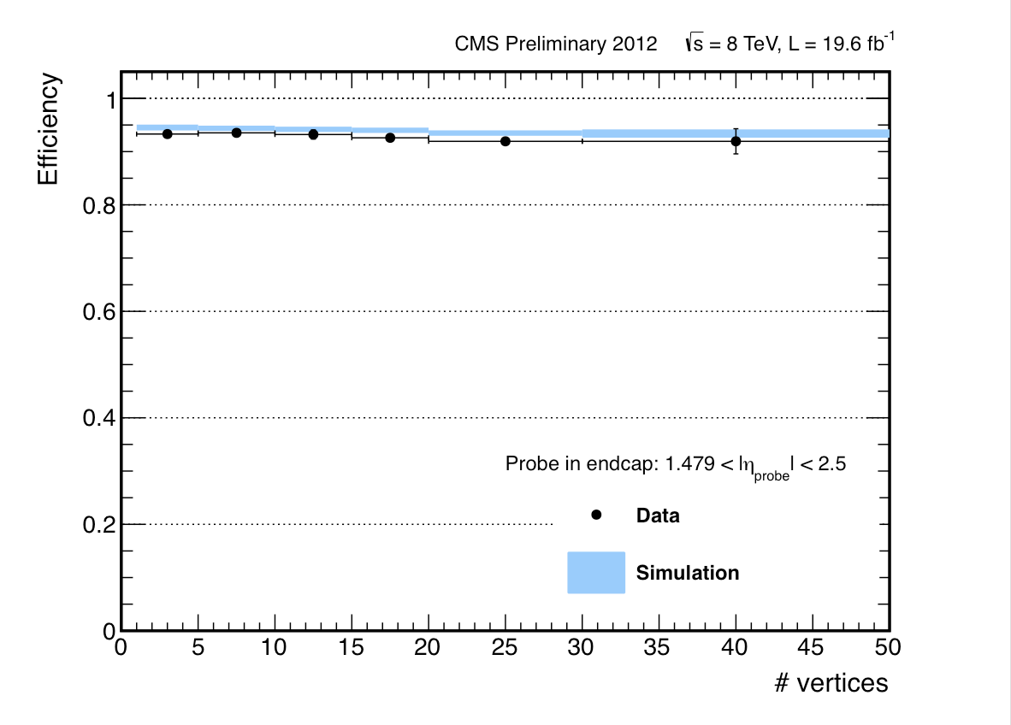
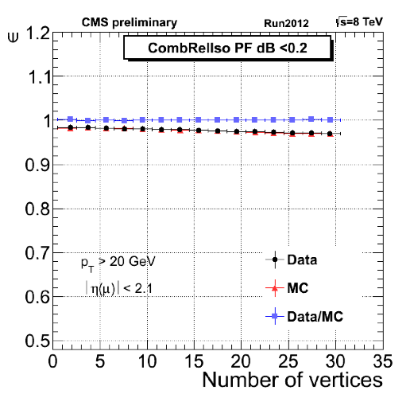
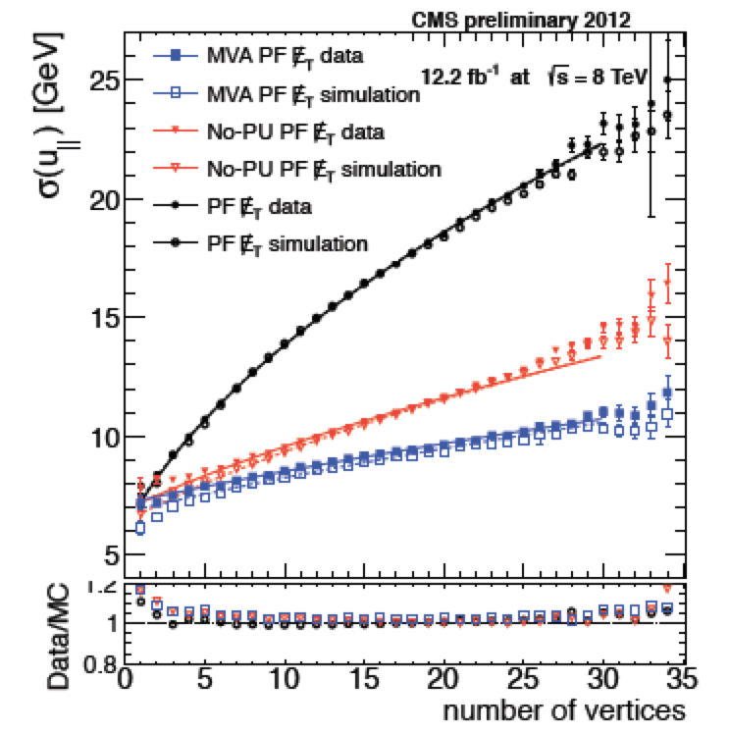
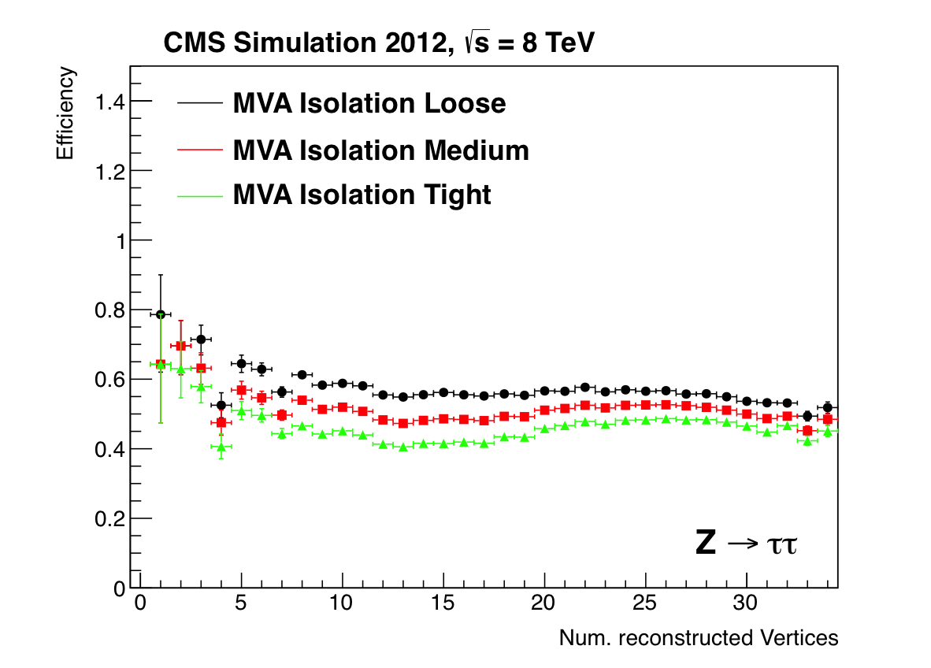
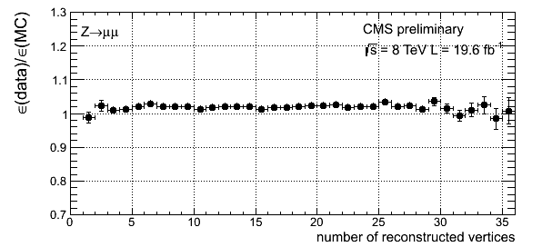
Detector Performance: Pile-Up
Object performance
as a function of the
pile-up: ie the number
of reconstructed
vertices
Electron ID+ isolation eff.
(Endcaps)
Muon ID
# vertices
Vertex reco efficiency (for γγ)
MET resolution
Tau reco efficiency
Data/MC ratio using Z→μμ
with muon tracks removed
# vertices
Notes:
DO WE HAVE SOMETHING FOR THE PHOTONS?
PUT IT ON HGG SLIDE?

Slide 6
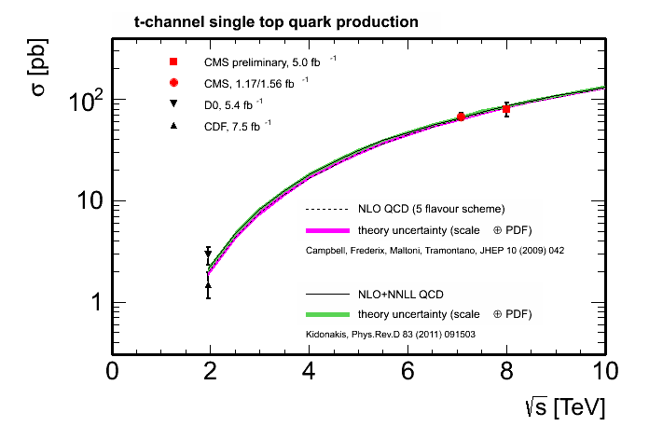
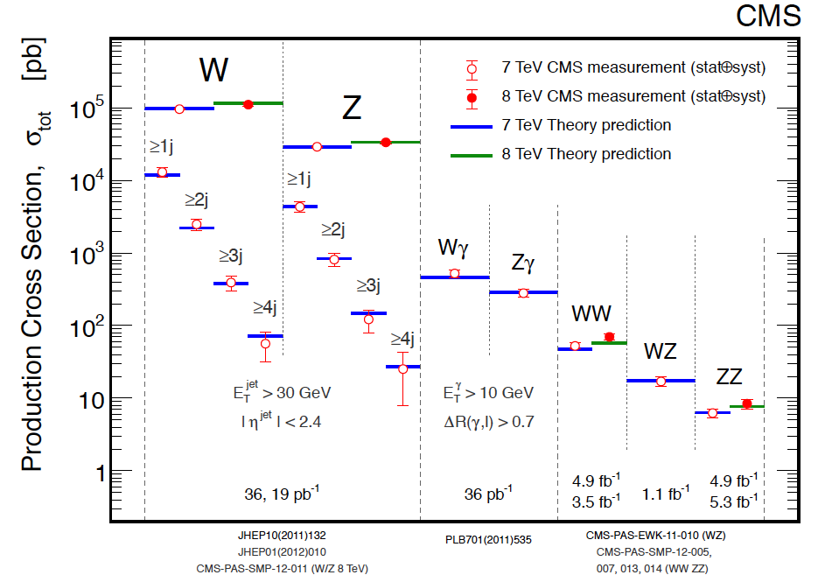
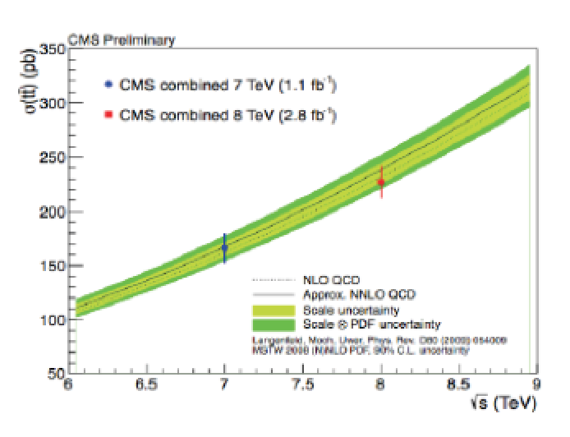
Standard Model Measurements
Electroweak Measurements
Top Quark Cross Sections
Single top
Top pairs
More later during LP2013
Good understanding of the detector + accurate theory predictions
Precise measurements of the SM processes in a large range
Good knowledge of the backgrounds to the Higgs analyses

Slide 7
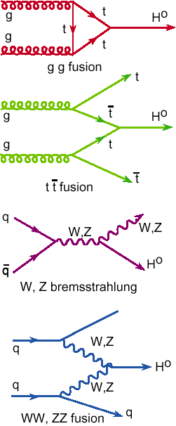
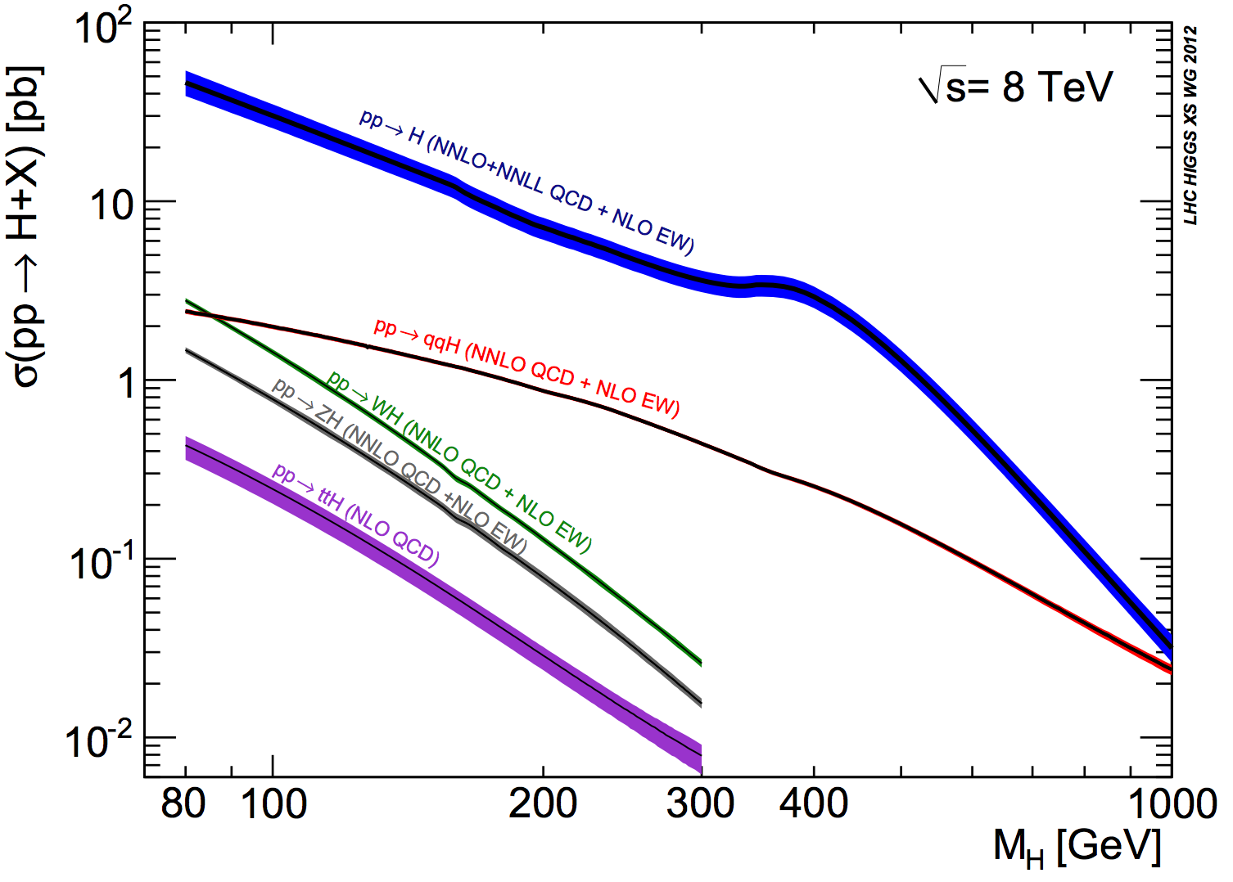
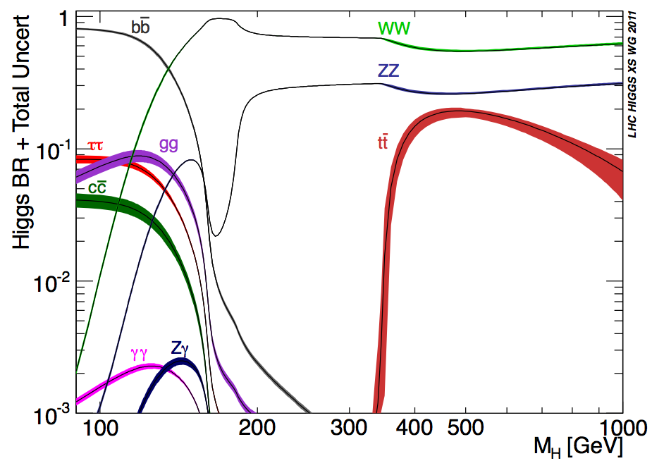
Higgs Production & Decay
Processes
•Gluon fusion
•Vector Boson Fusion
•W/Z associated prod.
•Top associated prod.
Numbers taken from the
LHC Higgs Cross Section WG
See yellow reports:
YR1: Inclusive cross sections
YR2: Differential cross sections
YR3: Properties (to appear)

Slide 8


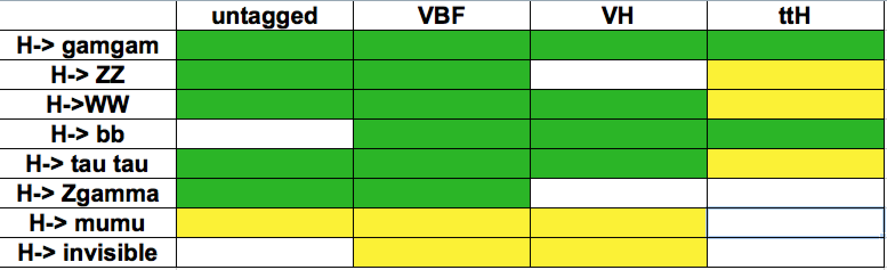
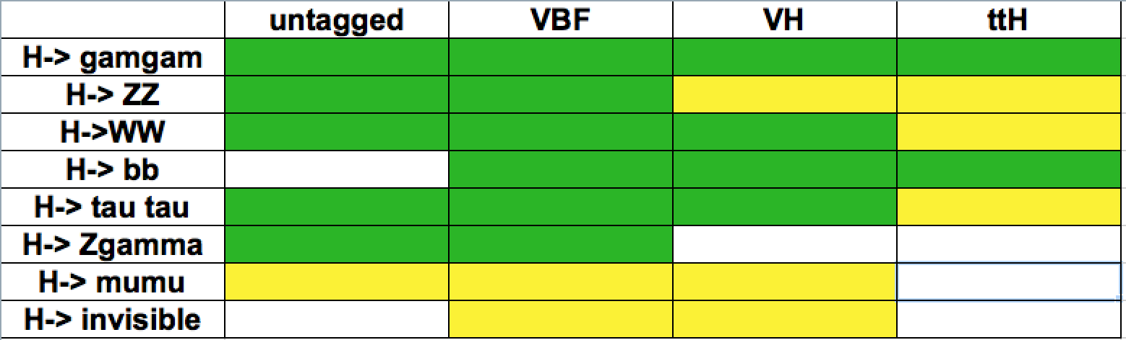
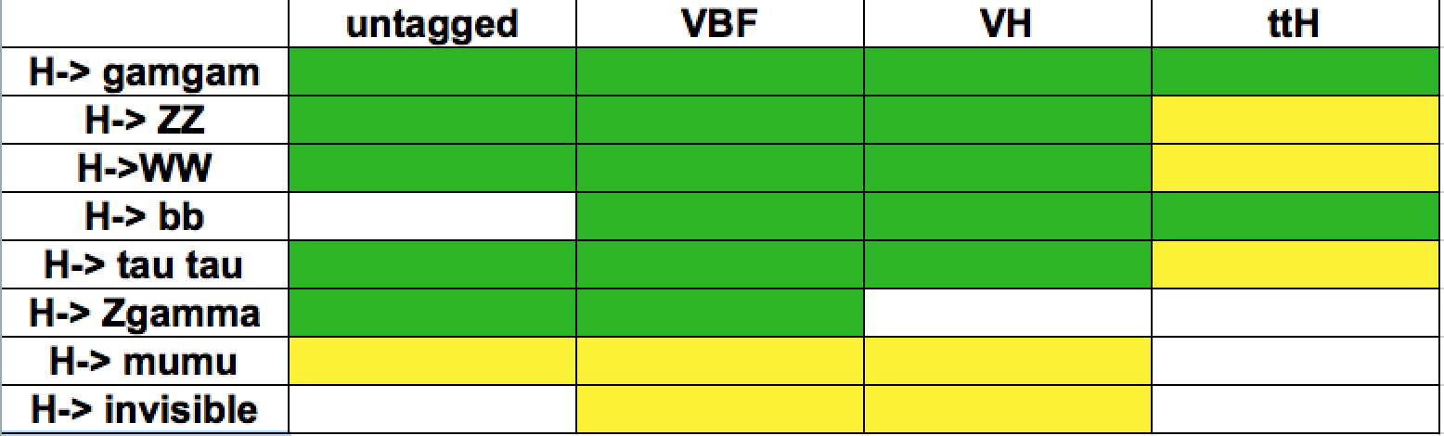
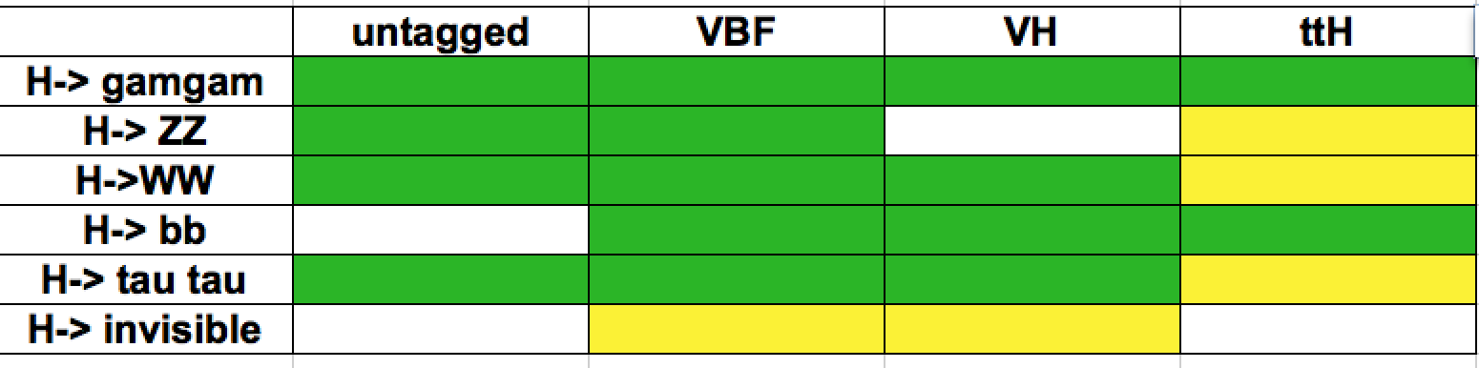
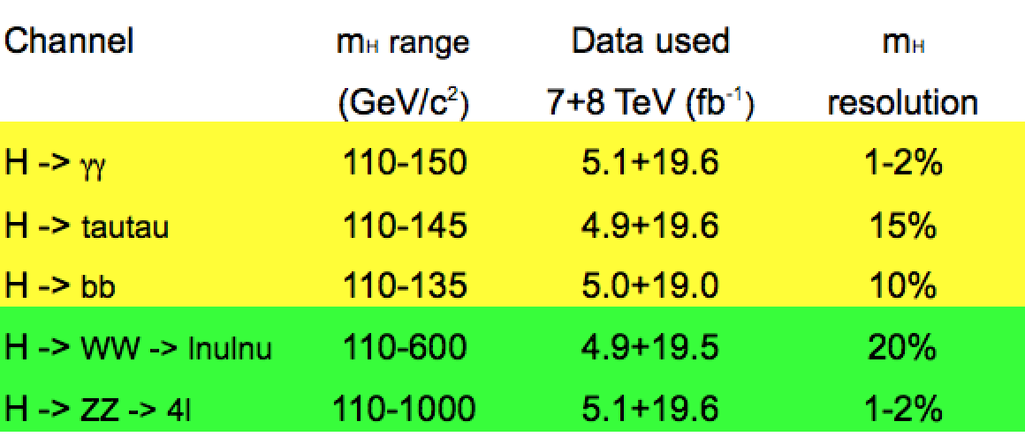
Higgs Hunting in CMS
Processes/decays studied:
Results released In progress
Γ_{BSM} = 0
Main decay channel characteristics:
+ more exotic channels

Slide 9
Higgs Decay into Bosons

Slide 10
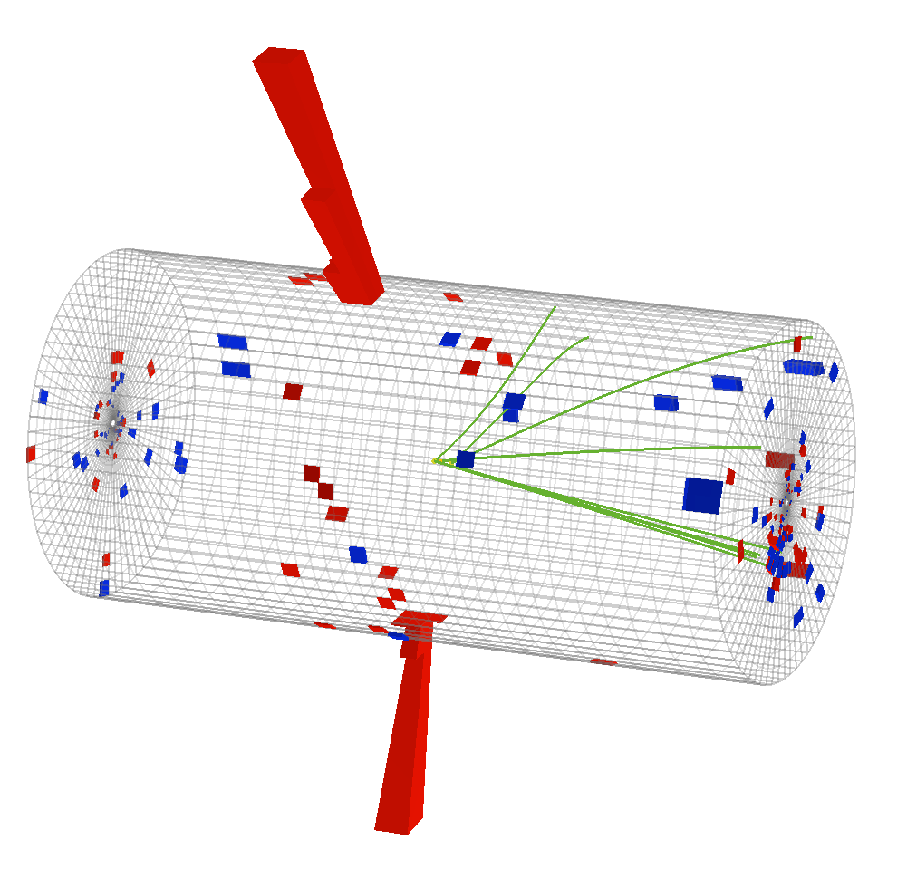
The Decay H→ γγ
Analysis
  •Two high momentum photons
  •Low mass Higgs is narrow
  •Two photon resolution is excellent
  •Looking for a narrow peak
  •Large irreducible background from direct two photons
  •Smaller fake photon background
  Key analysis features
  •Energy resolution (calibration)
  •Fake photon rejection
  •Optimize use of kinematics
86 GeV
56 GeV
CMS-PAS-HIG-13-001

Slide 11
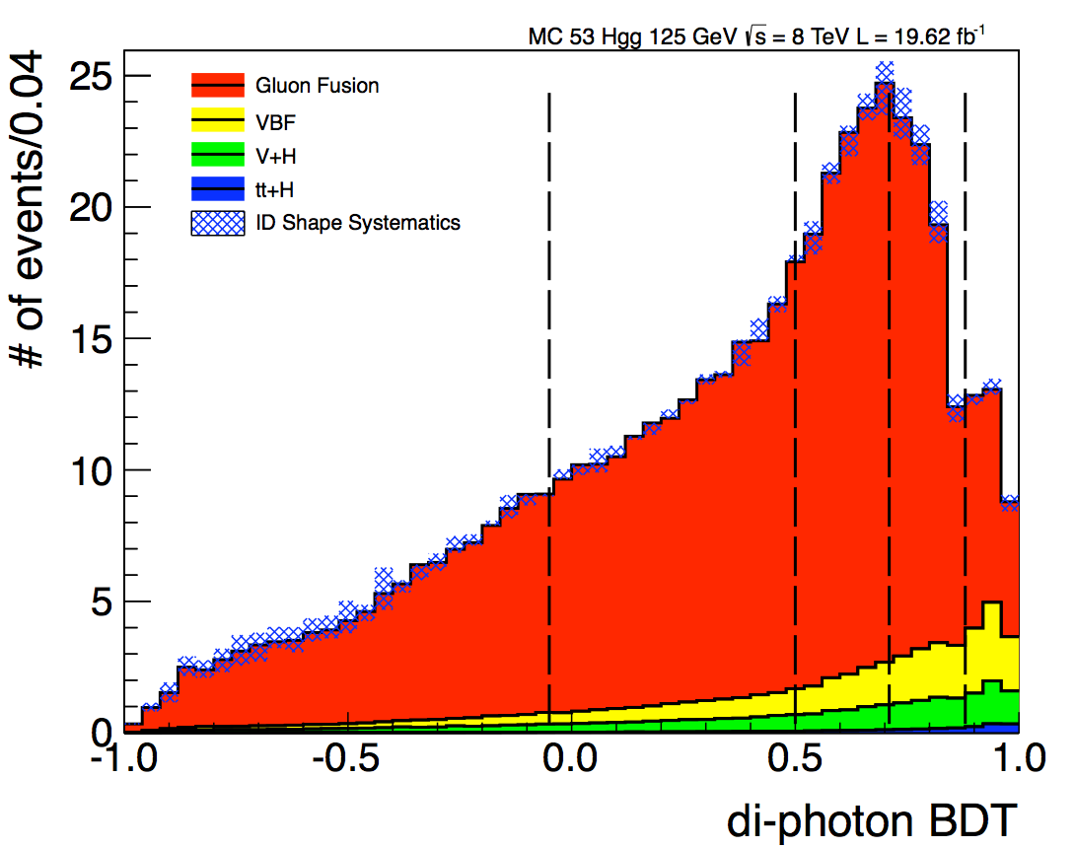
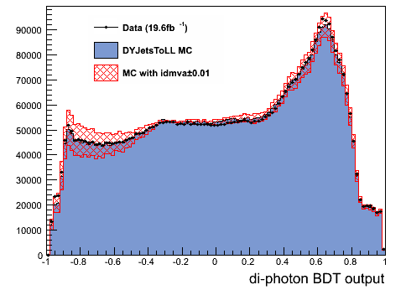
The Decay H→ γγ
Two inclusive analyses:
• MVA: photons selected with an MVA. Variable in the MVA: photon kinematics, photon ID MVA score (shower shape, isolation), di-photon mass resolution. 4 MVA categories with different S/B
  • Cut-based: photons selected with cuts. 4 categories based on: γ in Barrel/Endcap, (un)converted γ. Each category has different mass resolution and S/B
3 VH channels (e, μ and MET tag) + VBF (2 dijet categories)
PRIMARY
CROSS-CHECK
Output of the MVA validated using Z→ee
(where e are reconstructed as γ)
Cut
MVA Event categories

Slide 12
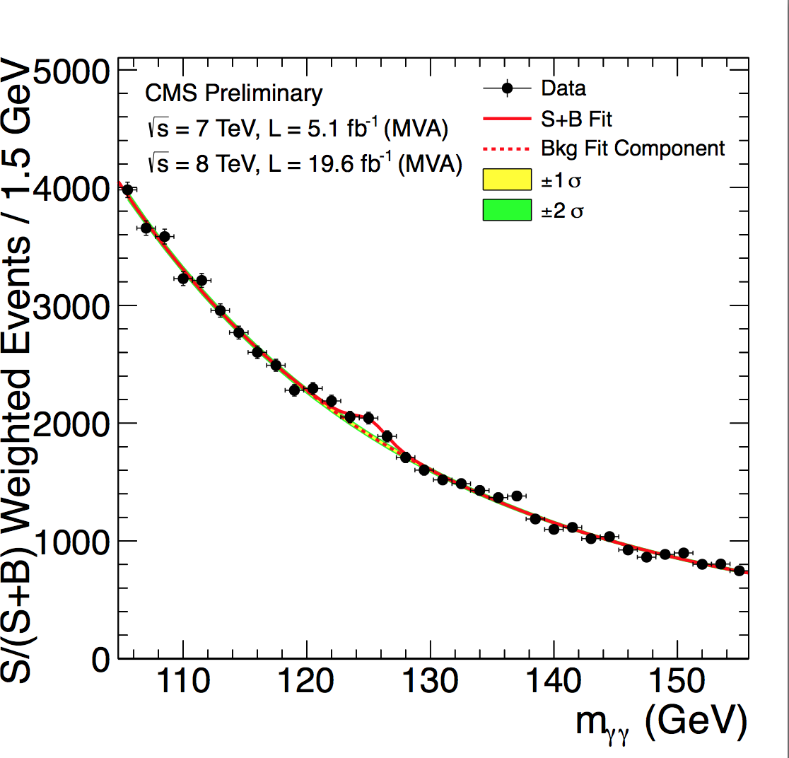
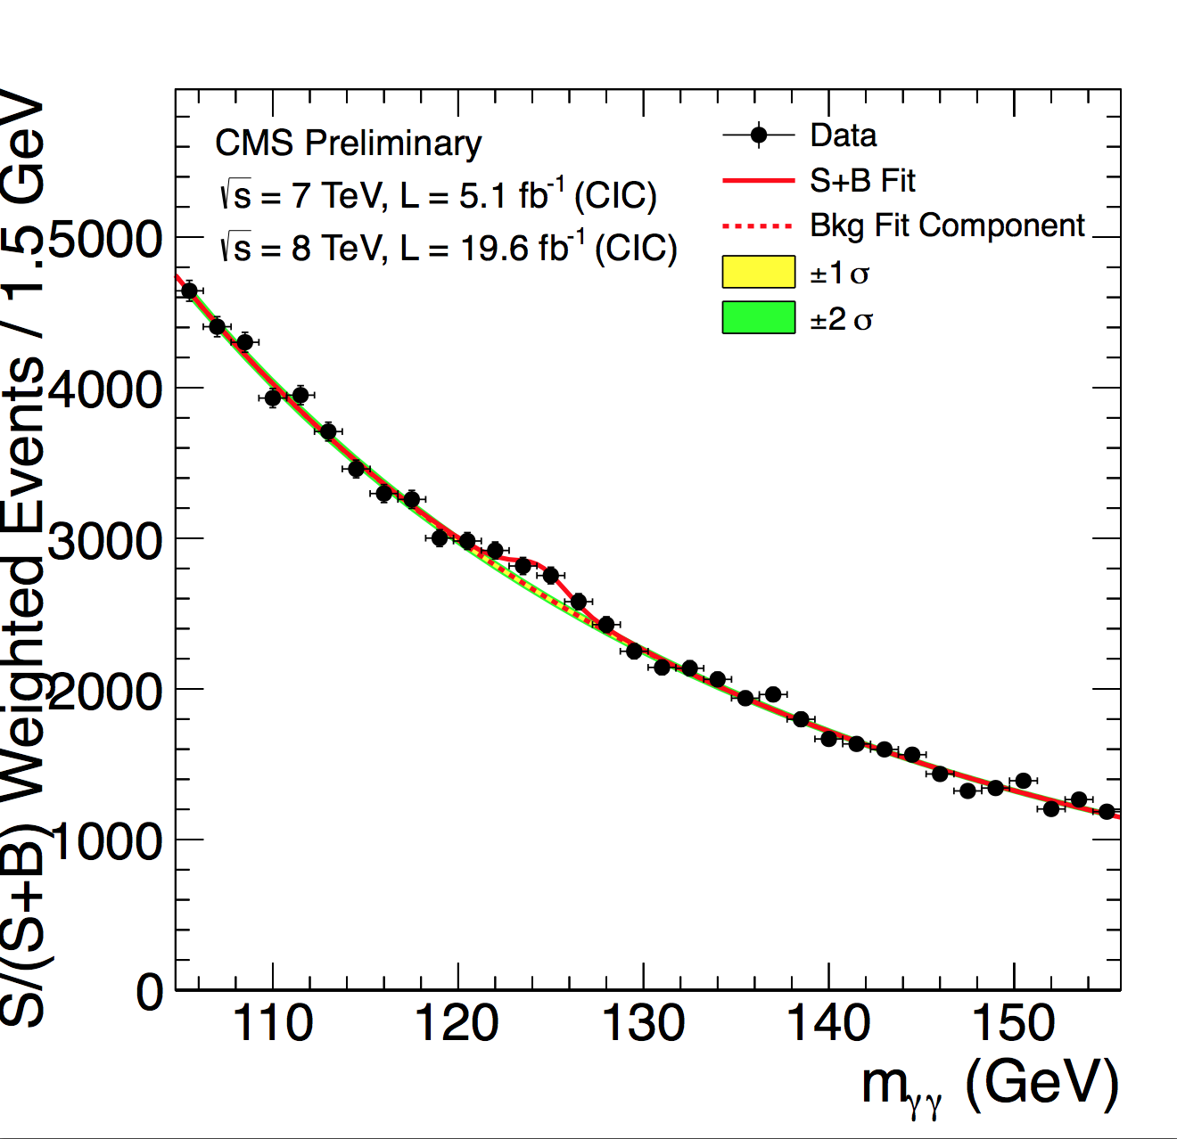
The Decay H→ γγ
MVA mass-factorized
Cut-based
Each event category is weighted by its S/(S+B)
only for visualization purposes

Slide 13
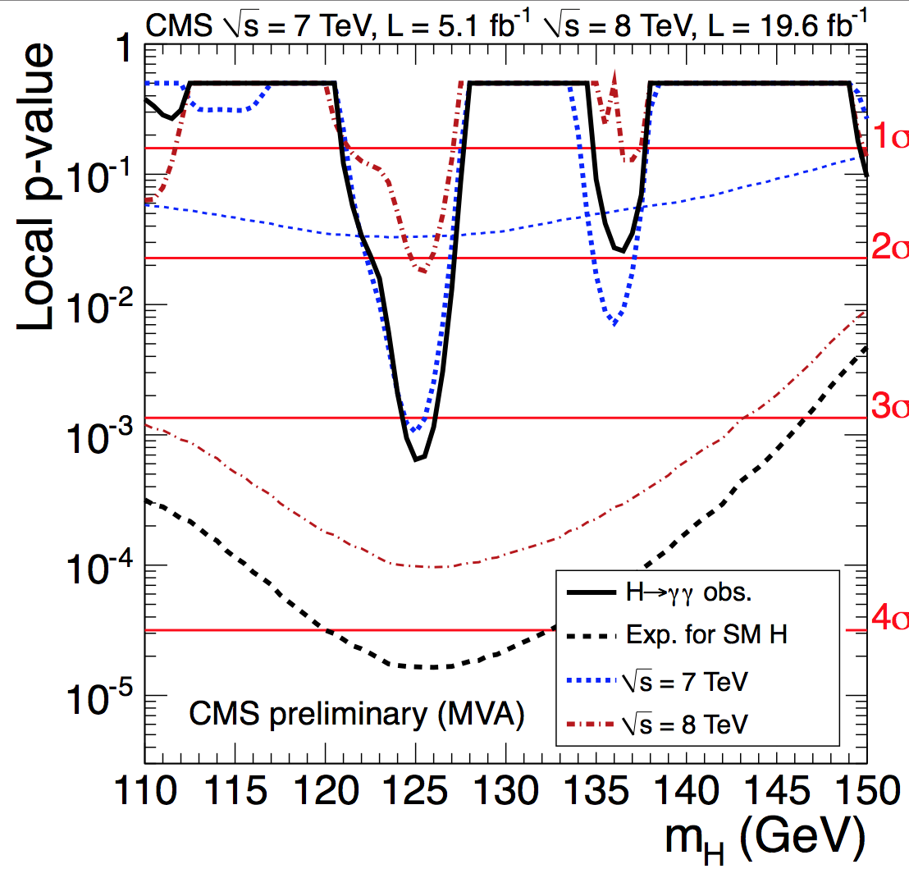
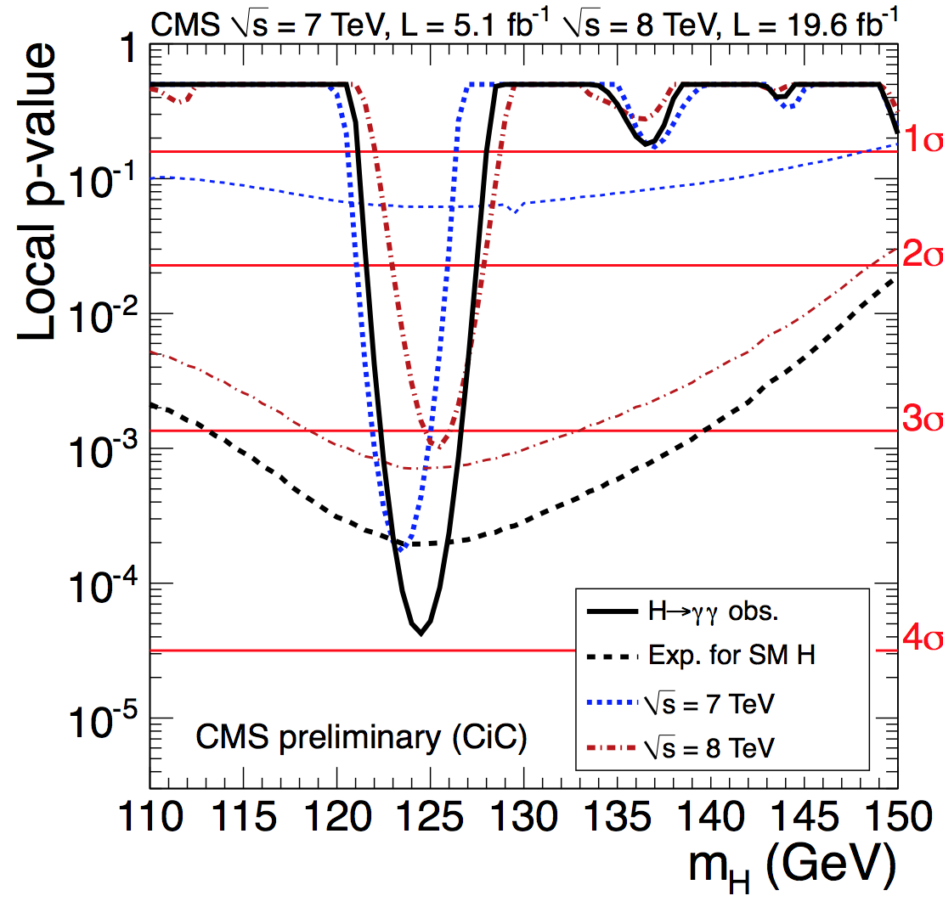
The Decay H→ γγ
MVA mass-factorized
Cut-based

Slide 14
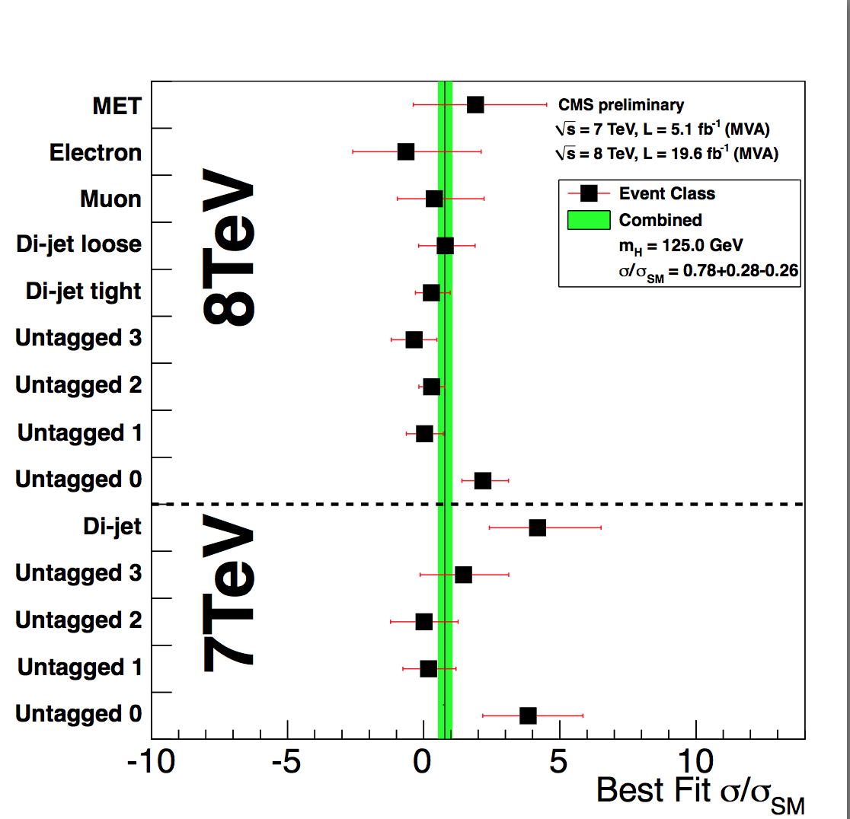
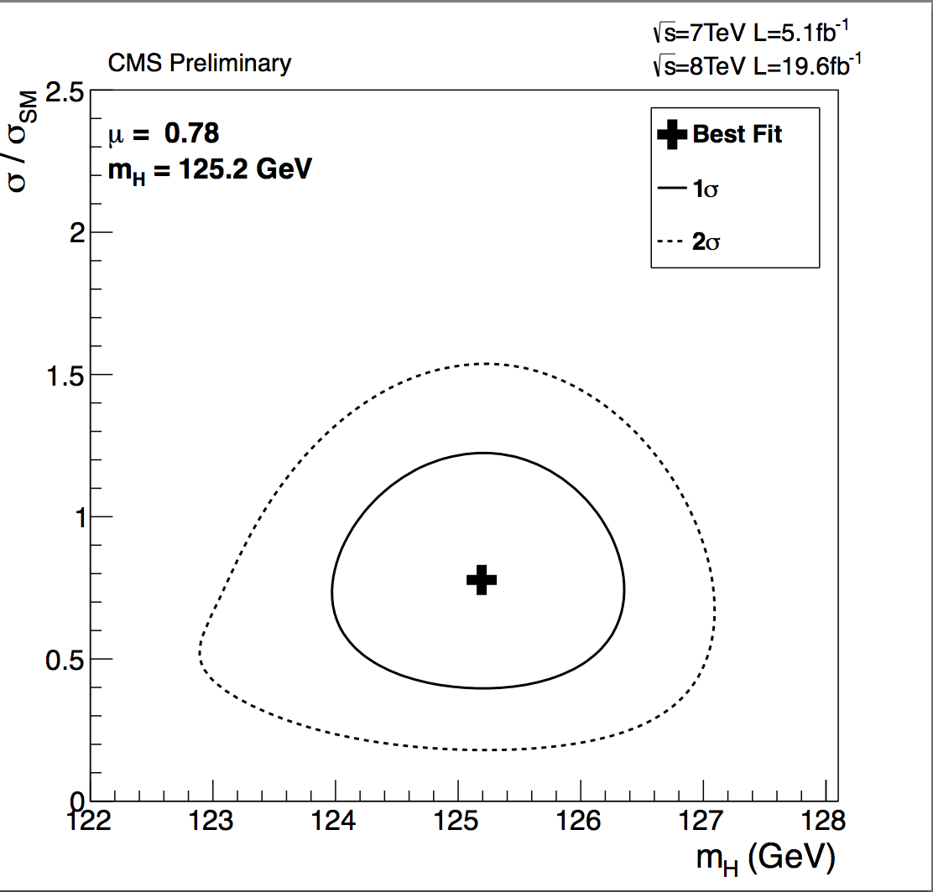
The Decay H→ γγ
MVA mass-factorized
M_{H}=125.4 ± 0.5(stat.) ± 0.6(syst.)
7+8 TeV: σ/σ_{SM} for a mass of 125.0 GeV = 0.78 ^{+0.28}_{-0.26}

Slide 15
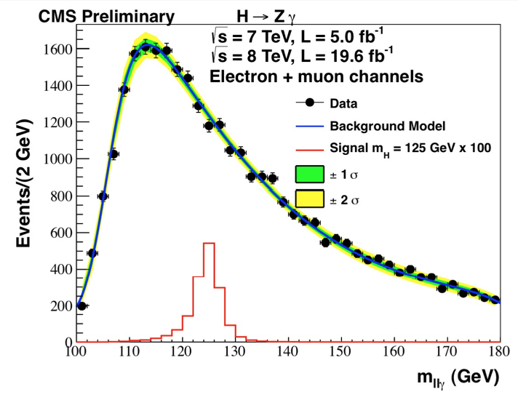
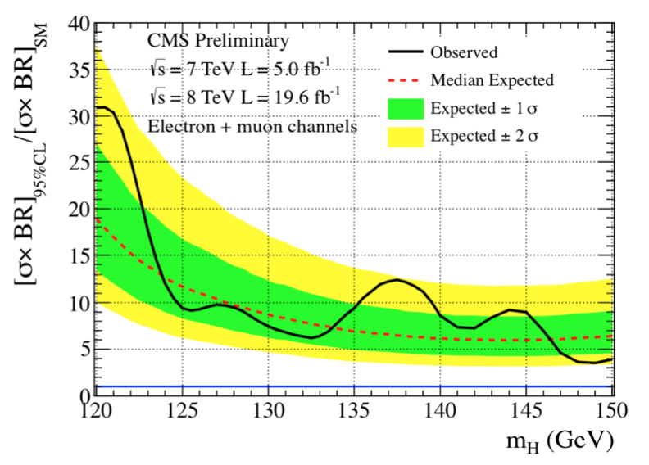
The Decay H→ Zγ
CMS-PAS-HIG-13-006
•Z decays into 2 charged leptons. The BR (H → Z γ) is comparable to
BR(Η → γγ) , but BR (Z → ll) reduces sensitivity (factor 15)
•Search for a narrow llγ peak on top of a falling background, as for H → γγ
•No significant excess seen over the entire search region
In certain models this channel could be largely enhanced

Slide 16
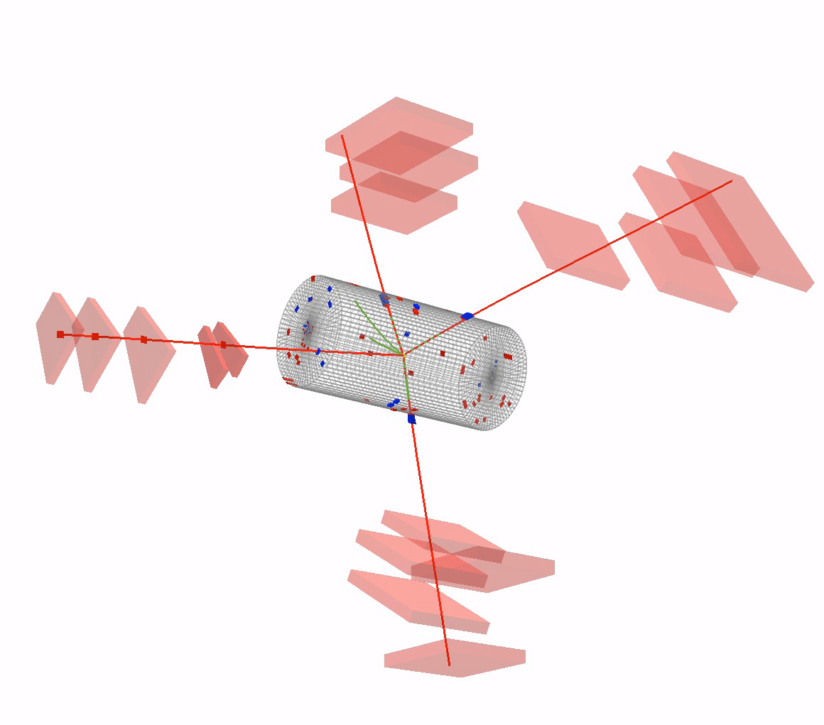
The Decay H → ZZ → 4l
Analysis
  •4 isolated high p_{T} leptons
  consistent with Z decays
  from same vertex
  •Use a di-jet tagged and untagged category, and
  kinematics
  •Clear mass peak
  •Little background, main comes from non-resonant ZZ production, also Zbb and top (2l2ν2b), fakes
CMS-PAS-HIG-13-002
Analysis procedure rather stable since ICHEP2012

Slide 17
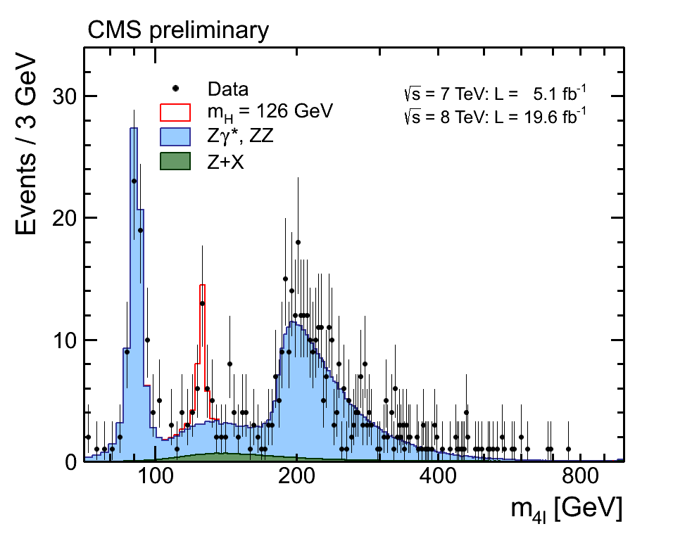
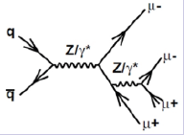
The Decay H → ZZ → 4l
Very good control of the dominant ZZ background
M(4l)>160 GeV
Data 380 evts
MC 364.5 evts
Clean signal peak at ~126 GeV
σ(pp →ZZ, 8TeV) = 8.4±1.0 (stat.) ± 0.7 (syst.) ± 0.4(lum.) pb
σ_{SM}(th) = 7.8 ± 0.6 pb

Slide 18
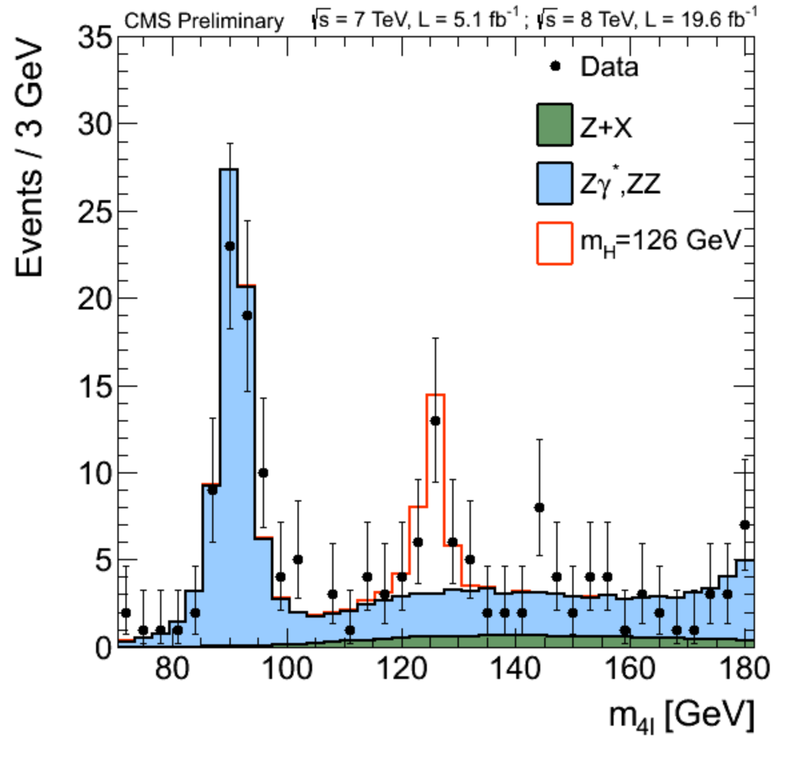
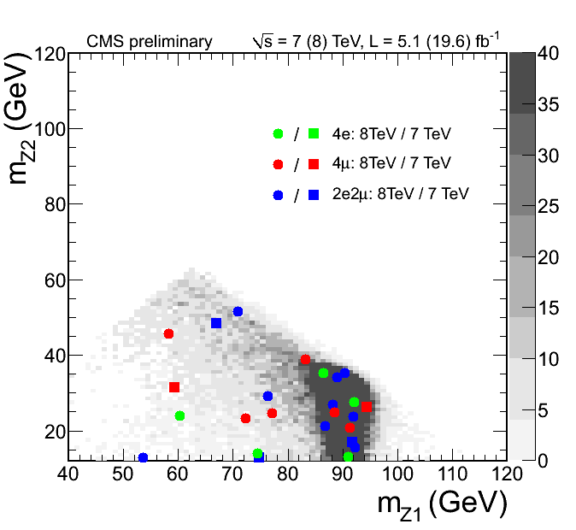
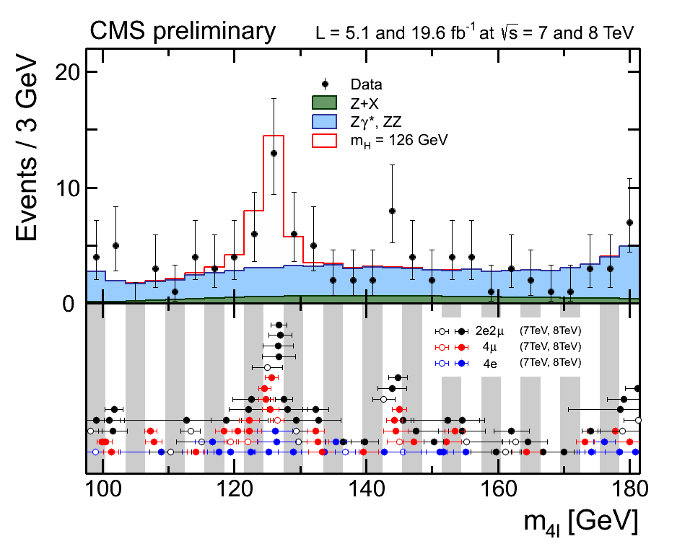
The Decay H → ZZ → 4l
m_{Z1} versus m_{Z2}
121.5 < M(4l) < 130.5 GeV

Slide 19
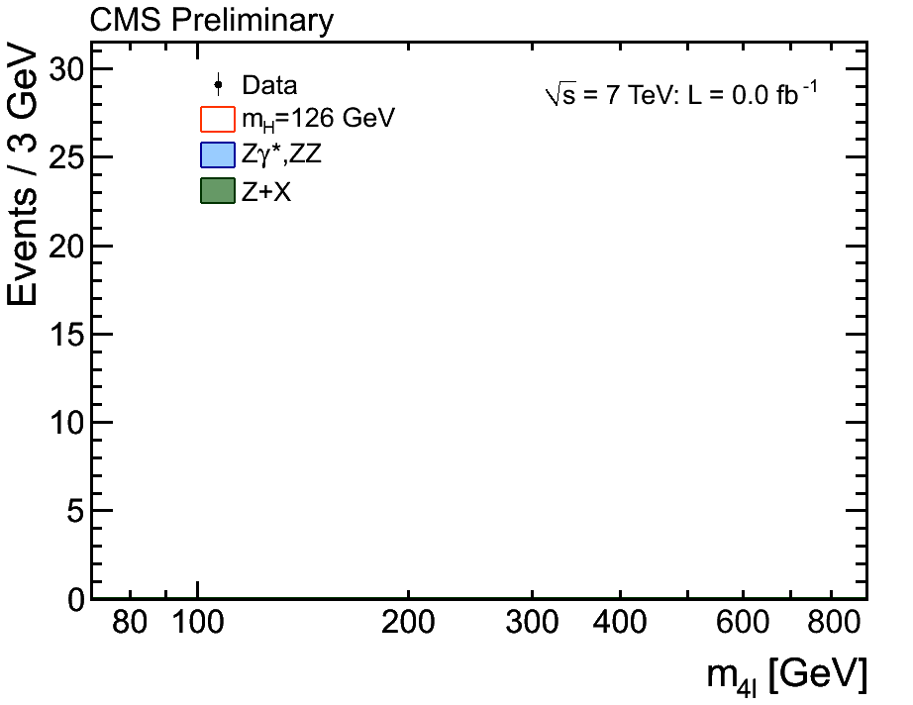
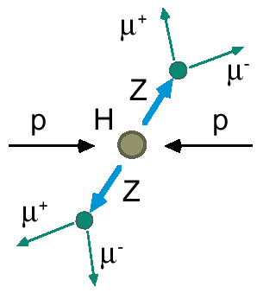
The Birth of a Particle
“History” of the data
accumulation during
the last two years
ZZ with Z→ee or μμ

Slide 20
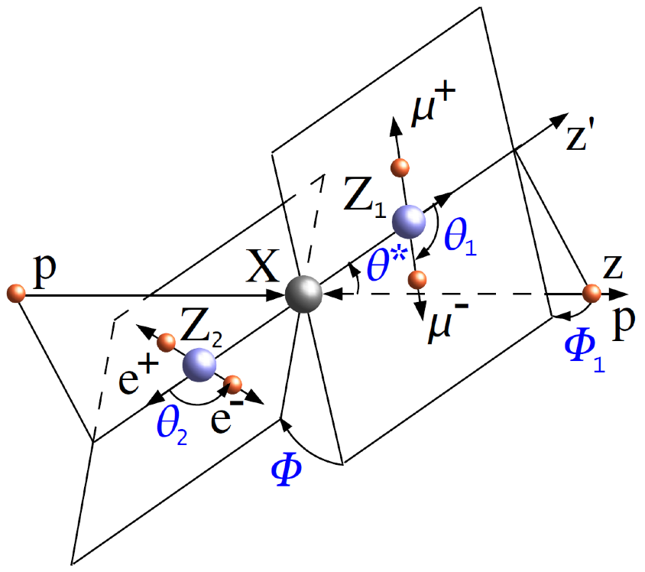
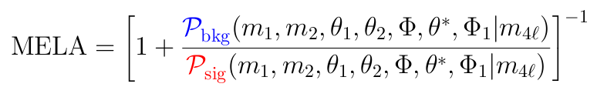
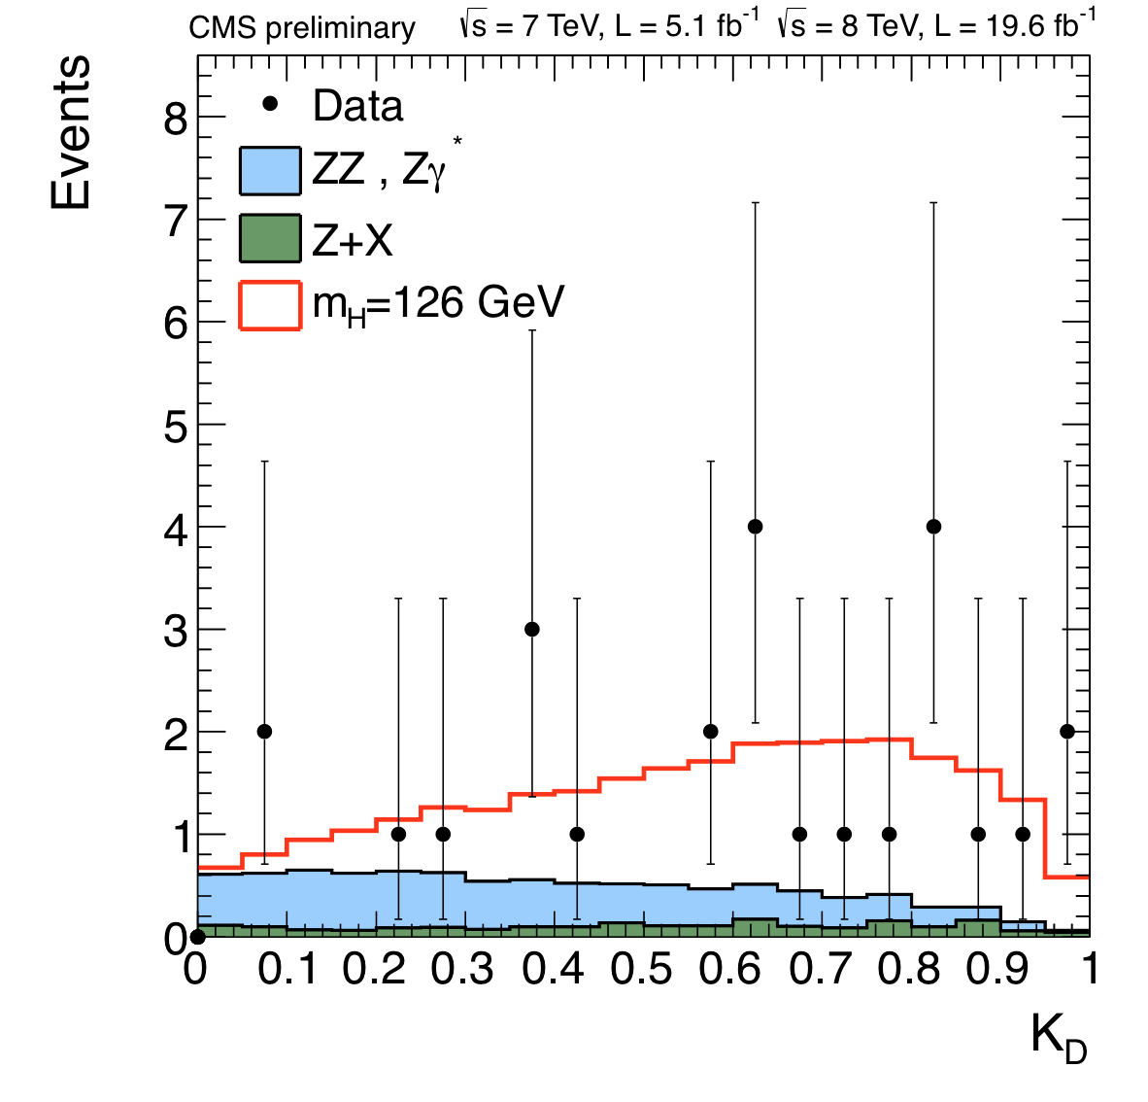
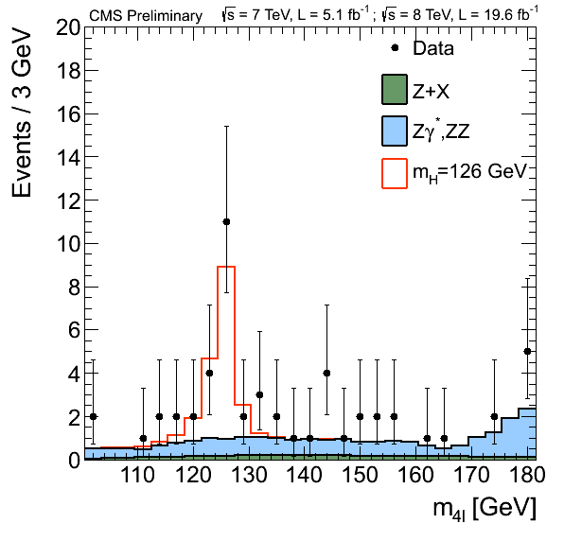


The Decay H → ZZ → 4l
Matrix Element Likelihood Analysis:
uses kinematic inputs to build a kinematic discriminant (K_{D}) for signal to background discrimination using {m₁,m₂,θ₁,θ₂,θ*,Φ,Φ₁}
SIGNAL
BACKGROUND
K_{D}> 0.5
m(4l) (GeV)

Slide 21


The Decay H → ZZ → 4l
p-value: Expected: 7.1σ
Observed: 6.7σ
σ/σ_{SM} at 125.7 GeV = 0.92 ± 0.28
Significance is well over 6 standard deviations in this channel

Slide 22



The Decay H → ZZ → 4l
Coupling scale factors to
vector bosons and fermions
Mass Measurements
M_{H}= 125.8 ± 0.5(stat.) ± 0.2(syst.) GeV.

Slide 23


The Decay H → WW → 2l 2ν
CMS-PAS-HIG-13-004
Analysis
  •Two opposite charged leptons (leptons only e, μ)
  •Two neutrinos == missing transverse energy (MET)
  •No Higgs mass peak
  •Counting & 2D shape analyses
  •Enhance sensitivity by subdividing into + (0,1,2) jets categories
Analysis challenges
  •Understand backgrounds WW, W+jets, top, Drell-Yan
  •Determined from control regions
μ: 32 GeV
e: 34 GeV
MET:
47 GeV
Scalar decay and V-A structure
of W decay lead to a small
opening angle between leptons

Slide 24



The Decay H → WW → 2l 2ν
•Analysis on the full data set for WW+0 jets and +1 jets categories
The W+2jets (VBF) channel is in progress
•Use a cut based analysis for same flavour lepton events and 2-dimensional
M_{T}-M_{ll} analysis for different flavour events
2D analysis

Slide 25


The Decay H → WW → 2l 2ν
Events with 0 jets and different flavour leptons (7+8 TeV Data)
A significant excess is observed…

Slide 26


The Decay H → WW → 2l 2ν
Standard Analysis
Using m_{H} = 125 GeV as a “background”
•Exclusion at 95% in the mass range 128-600 GeV
•Large excess in the low mass region
•When including M_{H}=125 GeV as part of the background, no significant
excess is seen over the entire mass range

Slide 27


The Decay H → WW → 2l 2ν
A 4.0σ (5.1σ) observed (expected)
significance at m_{H} ~ 125 GeV
σ/σ_{SM} signal strength: 0.76 ± 0.21

Slide 28


Associated Production VH H →WW
WH → WWW → 3l 3ν
VH → VWW→2l 2ν + V→jj
CMS-PAS-HIG-13-009
CMS-PAS-HIG-12-017
NEW
•Three high p_{T} leptons with moderate
missing transverse momentum
• WW analysis cuts plus two central
jets
Limited Standard Model Higgs sensitivity (~ 3.5-4•SM at 125 GeV)

Slide 29
Higgs Decay into Fermions

Slide 30



The Decay H →ττ
Topologies studied
CMS-PAS-HIG-13-004
Analysis
•Tau decays to e, μ, τ_{had}
used to reconstruct a tau
•Reconstruct corrected ττ
invariant mass
•Use many categories
to increase the sensitivity
jet
Inclusive
0-jets
Boosted
1-jet
VBF
2-jets
jets with p_{T} > 30 GeV
reconstructed tau p_{T}
0-jets, low p_{T}
0-jets, low p_{T}
1-jets, low p_{T}
0-jets, high p_{T}
1-jets, high p_{T}
1-jets, high p_{T}

Slide 31

The Decay H →ττ
Z→ττ Embedding: Z→μμ data, replace μ with simulated τ decay
Normalization from Z→μμ data
Syst: 5%
W+jets
Shape from simulation
Normalization from control region
Syst: 10-20%
QCD
SS lepton data, corrected for SS/OS lepton ratio
Syst: 10%
•Select isolated, well-identified leptons, τ_{h}
•Topological cuts (e.g. m_{T} in lτ_{h}) to suppress backgrounds
•Categorize events based on number of jets, τ-p_{T}
•Template fit to m_{ττ} shape

Slide 32
The Decay H →ττ
…plus all other tau
decay modes: eτ_{h},
eμ, μμ, τ_{h}τ_{h}
Combine the sensitive categories of all channels with a S/B weight

Slide 33


Associated Production VH → Vττ
•Study topologies of 3 and 4 lepton final states
•Use tau decay channels into electrons muons and hadronic final states
CMS-PAS-HIG-12-053
Upper limits of 2.9 to 4.6 times the predicted Standard Model value
for σ•BR at 95% CL.

Slide 34


The Decay H →ττ
Results include also the VH channels
Significance:
2.93σ for m_{H} = 120 GeV
2.85σ for m_{H} = 125 GeV
Signal strength
μ = 1.1 ± 0.4
Mass: all ττ channels combined
m_{H} = 120⁺⁹₋₇ (stat+syst) GeV
Excess building up in the region 120-130 GeV

Slide 35



The Decay H→bb
CMS-PAS-HIG-13-012
Analysis
  •By far largest number of Higgs decays
  •But lots of QCD background (jets)
  •Trigger based on leptons and missing E_{T}
  •b-jets identified through displaced tracks
  •Go to high p_{T} where Higgs is enhanced
  •Main background W/Z+jets and top

Slide 36


The Decay H→bb
M_{bb} for all categories and 7+8 TeV

Slide 37



The Decay H→bb
CMS-PAS-HIG-13-011
For 125 GeV:
•Significance = 2.1σ (2.1σ expected)
•Signal strength μ = 1.0± 0.5
Mild excess observed in data.

Slide 38



VBF Process with H→bb
bb event + ≥ 2 non-b jets at large Δη
At 125 GeV the upper limit
on σ•BR = 3.6•SM (3.0 exp.)

Slide 39


H→bb Channel Combination
Combine the results of the VBF and VH processes for H→bb
NEW
•95% CL limit observed (expected) at 125 GeV: 1.79 (0.89)
•Significance observed (expected) at 125 GeV : 2.1σ (2.2σ)
•Signal strength at 125 GeV: μ= 0.97± 0.48

Slide 40





Higgs Associated with Top Production
Study of the channel
H → bb
•Analyses for di-lepton and
lepton+jets ttbar decays
•Neural net technique
•Analysis optimized for H→bb
CMS-PAS-HIG-12-035
Publ. JHEP05 145 (2013)
5/fb at 7 TeV +
5/fb at 8 TeV
S/B →
All channels
Data compatible with background expectations
Limit on σ•BR: Exp:5.2 Obs:5.8 for m_{H}=125 GeV

Slide 41







Higgs Associated with Top Production
•Study of the channel
H → γγ
•Perform analyses for leptonic and hadronic ttbar decays
•Sensitivity σ.BR ~ 5.3.SM
for 125 GeV
CMS-HIG-13-015
limits
hadronic
leptonic
hadronic

Slide 42


ttH Combination
Combination of the ttH->2 photons with ttH->bb result
NEW
The expected 95% CL upper
limits on the signal strength
parameter μ = σ/ σ_{SM} as a
function of Higgs mass for the
combination of channels
Observed limit at 125 GeV: 3.3
Expected limit at 125 GeV: 3.1
(95% CL)
Sensitivity to 1-2•SM within reach
with full data set/all channels!

Slide 43




High Mass Higgs Searches
High mass Higgs searches with SM channels WW, ZZ updated with 2012
Statistics
Sensitivity reaches now up to ~ 1 TeV
Interpretation of the data in eg EW-singlet models; Benchmark models proposed by the LHC XS WG:
See CMS-PAS-13-008
CMS-PAS-13-014
ZZ→2l2ν
WW→2l2ν
ZZ→4l
WW→lν jet

Slide 44

Channel Combination & Higgs Properties
Since fall 2012 we have been especially concentrating on measurements
of properties of the new particle

Slide 45


Summary of the Five Main Channels
For a mass of m_{H} = 125.7 GeV
CMS-PAS-HIG-13-005
3.4 σ combined!
bb: includes VH and VBF
WW: includes ggF, VH, VBF

Slide 46


Mass of the New Particle
H →ZZ→4l: m_{H} = 125.8 ± 0.5 (stat.) ±0.2 (syst.) GeV
H →γγ: m_{H} = 125.4 ± 0.5 (stat.) ±0.6 (syst.) GeV
Signal strength
versus mass
m_{H} = 125.7 ± 0.3^{(stat)} ± 0.3^{(syst)} GeV
= 125.7 ± 0.4 GeV

Slide 47


Consistency with SM Hypothesis
p-value= 0.65 w.r.t. μ=1
p-value= 0.52 w.r.t. μ=1
Combined signal strength: μ=0.80±0.14
Here and further: bb results based on 12 fb⁻¹ at 8 TeV and 5 fb⁻¹ at 7 TeV

Slide 48

Consistency with SM Hypothesis
2-dimensional view: test production modes in the various decay modes
Vector Boson
Couplings
Fermion
Couplings

Slide 49



Signal Strength for Different Modes
Likelihood scans versus the different μ values, using all decay modes
Gluon Gluon Fusion
Vector Boson Fusion
Associated production
Data in good agreement with the expectation
Approximately a 2σsignificance for the VBF channel

Slide 50



Couplings to Fermions and Bosons
For m_{H} = 125.7 GeV
Γ(H→ γγ) ~ |α κ_{V} + β κ_{f}|²
α/β = − 0.2, Γ_{BSM} = 0
Contributions from all decay channels
Overall result
Results within 1σ of the Standard Model Prediction

Slide 51


Custodial Symmetry Test
Modify the SM Higgs boson couplings to the W and Z bosons introducing two
scaling factors κ_{W} and κ_{Z} and perform combinations to assess if
λ_{WZ} = κ_{W}/κ_{Z} = 1 for m_{H} = 125.7 GeV
95% CL interval for λ_{WZ} : [0.62,1.19]

Slide 52


Summary of the Couplings Test
Summary of the fits for deviations in the couplings
for a LHC XS WG benchmark model parametrisation (arXiv:1209.0040)
for a generic five parameter model (no eff. loop couplings)
Γ_{BSM} = 0
The best fit values of the most interesting parameters are shown, with the corresponding 68% and 95% CL intervals, and the overall p-value p_{SM} of the SM Higgs hypothesis is given.

Slide 53




Higgs Properties from H→γγ
CMS-PAS-HIG-13-016
Upper limit on the Higgs width
•Dominated by experimental resolution
•Breit-Wigner + Gaussian fit
•Observed (exp) upper limit = 6.9 (5.9) GeV 95% CL
Additional Higgs-like states:
•Take SM 125 GeV as part of the background
•Search for additional Higgses
•Largest excess: 136.5 GeV with 2.9σ(<2σ after LEE)
Search for near mass degenerate states
•Two signals with
relative strength x
mass difference Δm
•Perform a 2D scan
•No signal at 95% CL
for Δm> 4 GeV
Expectation
Data

Slide 54





Spin/Parity Hypothesis Tests
Spin/parity hypothesis tests: H → ZZ → 4l channel
Kinematic discriminant built to describe the kinematics of production and decay of different J^{P} state of a "Higgs"
0⁺ vs 0⁻
CL_{s}=0.16%
More J^{P} hypotheses have been tested in a similar way →

Slide 55


Spin Combination for 0⁺/2⁺_{mgg} Test
Combining results from WW and ZZ channel
Expected results with μ=1
ZZ WW Comb
6.8% 1.4% 0.2%
Observed results at measured μ
ZZ WW Comb
1.4% 14% 0.6%
The observation is very compatible with the SM Higgs expectations of 0⁺. The data disfavours the 2⁺_{m}(gg) hypothesis with a CLs value of 0.6%
CMS-PAS-HIG-12-016
NEW
Use the γγ events to distinguish 0⁺/2⁺_{mgg}
The present γγ data does not have the
power for a significant hypothesis test

Slide 56
Conclusions
The discovery of the new particle last summer has been confirmed with more added collisions. Moving on now to measuring properties.
The spin/parity is compatible with a 0⁺ state and not with (simple) 0⁻ or spin 2 states
The mass is getting measured better with time, the present value by CMS is 125.7 ± 0.4 GeV
Signs of decays into fermion decay channels. The significance of the combined τ+b channels is >3σ
Hunt for rare decays & processes is going on…
The couplings to bosons and fermions are consistent with SM predictions, but these are tested so far up to ~20-30% precision only; Surprises still possible!!

Slide 57



14 March 2013

Slide 58
Backup

Slide 59

Summary of the Couplings Test
For the fermions, the values of the fitted yukawa couplings are shown, while for vector bosons the square-root of the coupling for the hVV vertex divided by twice the vacuum expectation value of the Higgs boson field.

Slide 60

Comparisons based on pre-LP2013 data released by ATLAS and CMS

Slide 61

Comparisons based on pre-LP2013 data released by ATLAS and CMS

Slide 62

Comparisons based on pre-LP2013 data released by ATLAS and CMS

