Slide 1
SPS kick response measurements
H. Bartosik, S. Cettour Cave, B. Salvant
Acknowledgements: J. Wenninger
MSWG, 26. March 2013

Slide 2
Introduction
Measurement of the orbit response to individual corrector kicks
  ±25μrad for each orbit corrector (COD)
    Two consecutive cycles
    The orbit difference between positive and negative kick is the orbit response
  In practice
    Injection on well corrected orbit
    Then all CODs set to zero and finally the COD of interest is powered
    This is done using YASP

Slide 3







Orbit response analysis
SVD analysis of orbit response data
  Relation between beam position u_{i} for corrector kicks θ_{j} is given by Response matrix R_{ij}
  Analysis principle
    Difference vector between measurement and MADX model to minimize
    Sensitivity matrix S for BPM calibration factors and COD calibration factors c_{i}
    Solving linear equation
    Perform Singular Value Decomposition on S and compute correction for calibration factors
  Reference: J. Wenninger, Orbit Response Measurements at the SPS, CERN-AB-2004-009
μ: phase advance
β: beta function
Q: tune
… only R^{mod} depends on calibration factors!

Slide 4
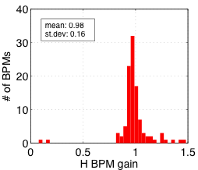
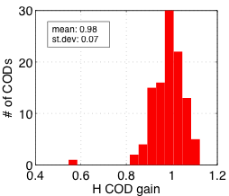
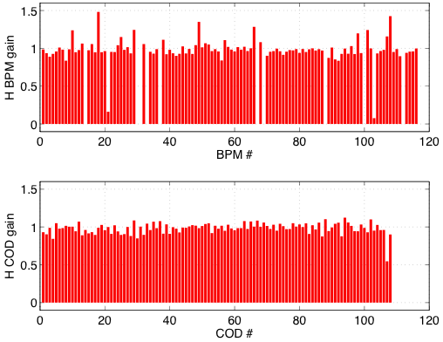
Calibration results - Horizontal

Slide 5
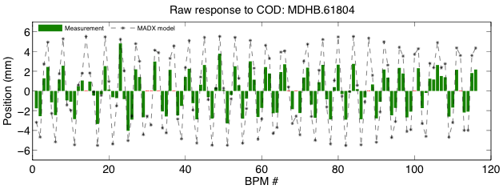
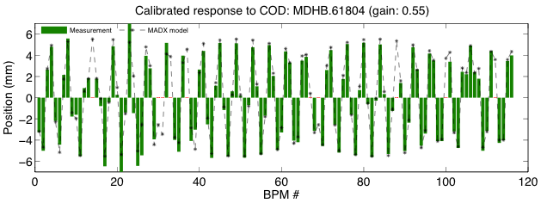
Orbit response: MDHB.61804
COD of special type …
Problem with magnet or calibration issue?

Slide 6
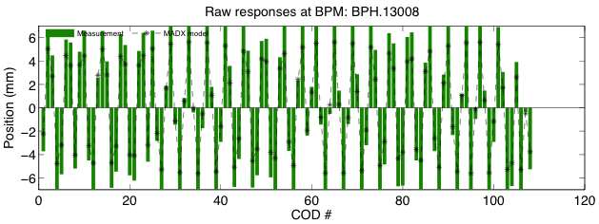
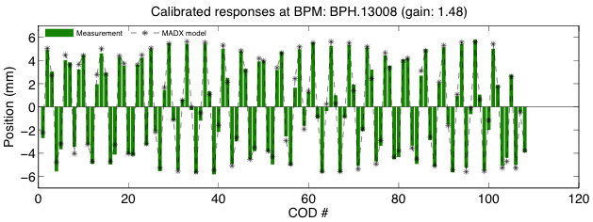
Orbit responses at: BPH.13008
Largely wrong calibration!
Error too large to be caused by beta-beat …

Slide 7
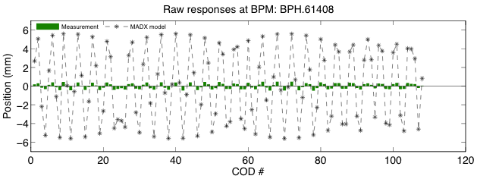
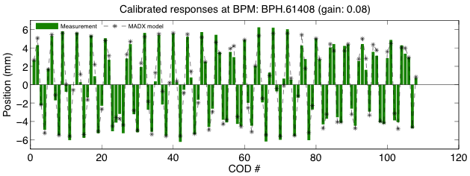
Orbit responses at: BPH.61408
The sensitivity of this BPM is less than 10% of the expected value!

Slide 8
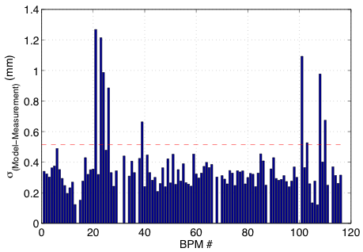
Calibrated measurement vs. model - Horizontal
Standard deviation of difference between model and calibrated measurements
  Typical standard deviation of about 0.3mm
  A few BPMs with large standard deviations, due to
    Small calibration value and thus reduced resolution
    Large measurement noise
    Spurious readings for some measurements
  Acceptable limit arbitrarily set to ~0.5mm for horizontal BPMs

Slide 9
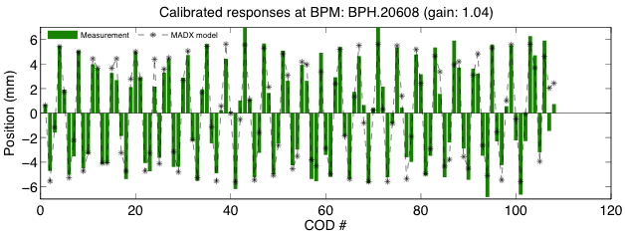
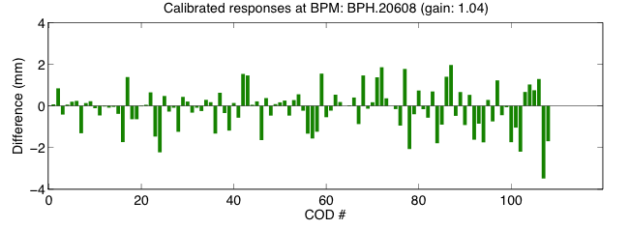
Orbit responses at: BPH.20608
Orbit response cannot be fitted consistently at this BPM → large difference between model and measurements even after “calibration”

Slide 10
Results - Horizontal
  This COD is having significantly “reduced strength”
    MDHB.61804 (gain=0.55)
  These BPMs are not working:
    BPH.12408, BPA.21706, BPA.21805, BPH.22208, BPH.23008, BPCE.41705, BPCE.41931, BPH.52008, BPH.60808, BPH.62808;
  These BPMs have large calibration errors:
    BPD.11906 (gain=1.24)
    BPH.13008 (gain=1.48)
    BPH.13608 (gain=0.16)
    BPA.21605 (gain=1.24)
    BPH.31808 (gain=1.35)
    BPH.41608 (gain=1.28)
    BPH.60408 (gain=1.20)
    BPH.61008 (gain=1.24)
    BPH.61408 (gain=0.08)
    BPH.62008 (gain=1.43)
  These BPMs have large standard deviation after “calibration” with respect to the model:
    BPH.20408, BPH.20608, BPH.21008, BPH.23408, BPH.62408;

Slide 11
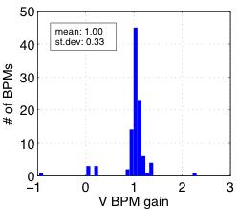
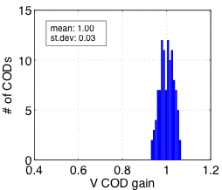
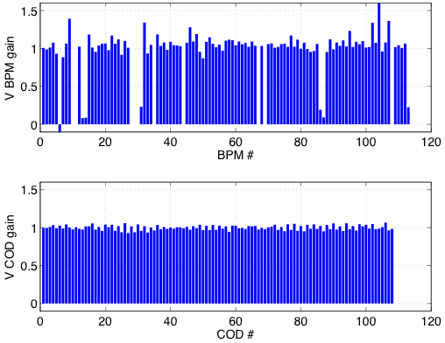
Calibration results - Vertical

Slide 12
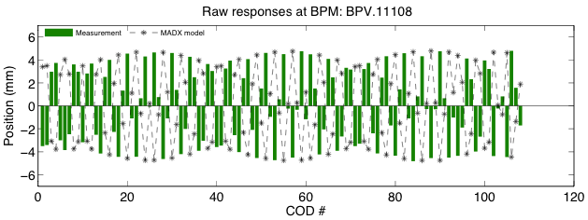
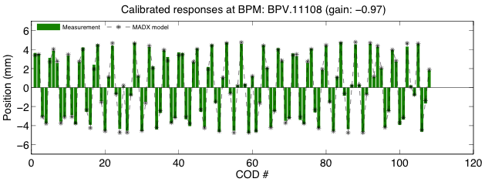
Orbit responses at: BPV.11108
This BPM is simply inverted …

Slide 13
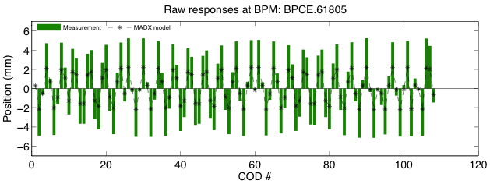
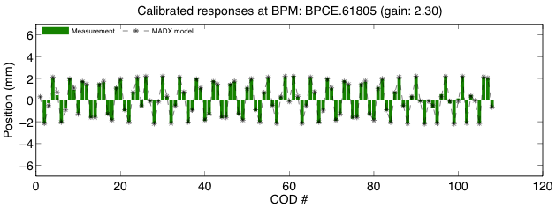
Orbit responses at: BPCE.61805
Largely wrong calibration!
Error too large to be caused by beta-beat …

Slide 14
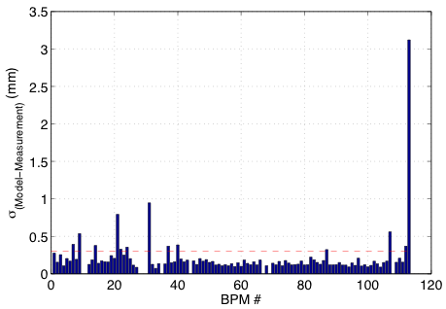
Calibrated measurement vs. model - Vertical
BPV.63508
Standard deviation of difference between model and calibrated measurements
  Typical standard deviation of less than 0.2mm
  A few BPMs with large standard deviations, due to
    Small calibration value and thus reduced resolution
    Large measurement noise
    Spurious readings for some measurements
  Acceptable limit arbitrarily set to ~0.3mm for horizontal BPMs

Slide 15
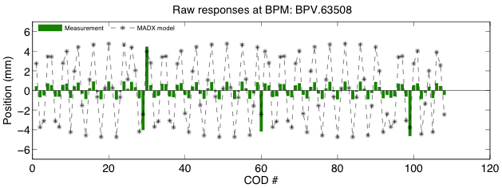
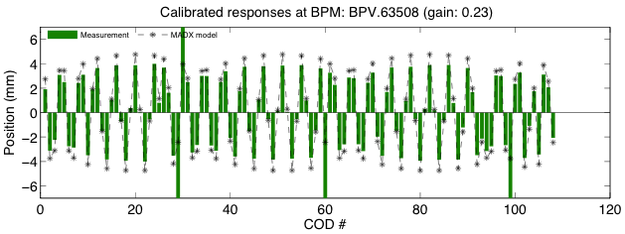
Orbit responses at: BPV.63508
Looks like BPM has very little sensitivity – but in 4 cases it gives even larger values than expected ???

Slide 16
Results - Vertical
  These BPMs are not working:
    BPD.11833, BPD.11906, BPA.21605, BPA.21706, BPA.21805, BPCN.22708, BPV.30908, BPCE.41801, BPV.42108, BPV.62508;
  These BPMs have large calibration errors:
    BPV.11108 (gain=-0.97)
    BPV.11706 (gain=1.39)
    BPCN.12308 (gain=0.08)
    BPCN.12508 (gain=0.09)
    BPA.21931 (gain=0.23)
    BPV.22108 (gain=1.34)
    BPV.31308 (gain=1.28)
    BPV.51908 (gain=0.19)
    BPV.52108 (gain=0.09)
    BPV.60108 (gain=1.23)
    BPV.61508 (gain=1.34)
    BPCE.61805 (gain=2.30)
    BPV.62308 (gain=1.36)
    BPV.63508 (gain=0.23)
  These BPMs have large standard deviation after “calibration” with respect to the model:
    BPV.11308, BPV.20308, BPV.20508, BPV.20908, BPV.23108, BPV.30108, BPV.63308;

Slide 17
Summary and Conclusions
Horizontal BPMs
  10 BPMs are not working at all (some of them in hot zones)
  10 BPMs seem to have grossly wrong calibration (some of them are special type)
  5 BPMs have large spread around expected readings (after “calibration”) → should be investigated
Vertical BPMs
  10 BPMs are not working at all (some of them in hot zones)
  14 BPMs seem to have grossly wrong calibration (some of them are special type)
  7 BPMs have large spread around expected readings (after “calibration”) → should be investigated
Horizontal closed orbit correctors
  Identified 1 closed orbit corrector with reduced kick strength (is it hardware or simply calibration problem?)
  Average fitted kick strength is 0.98±0.07
Vertical closed orbit correctors
  Work properly
  Average fitted kick strength is 1.00±0.03

