Slide 1
SPS aperture measurements
MSWG
26/03/2013
Stéphane Cettour Cavé

Slide 2
Outline
Method used to search the aperture restrictions
Method used to measure the aperture
Presentation of the results
Summary

Slide 3
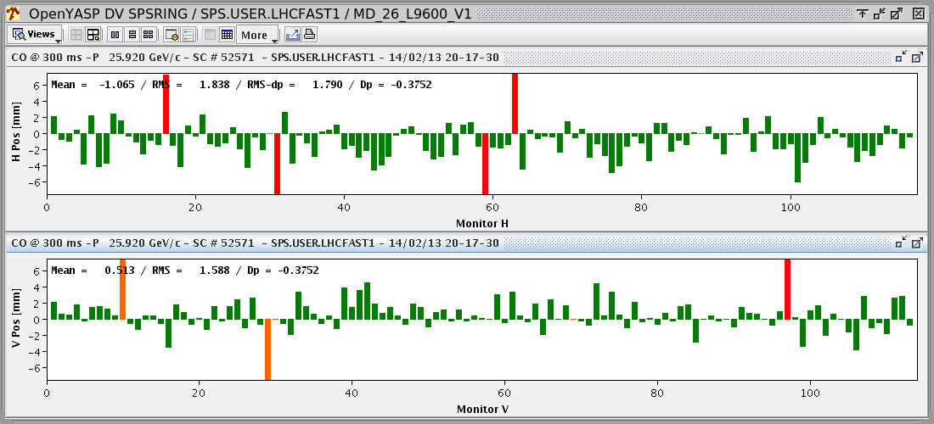
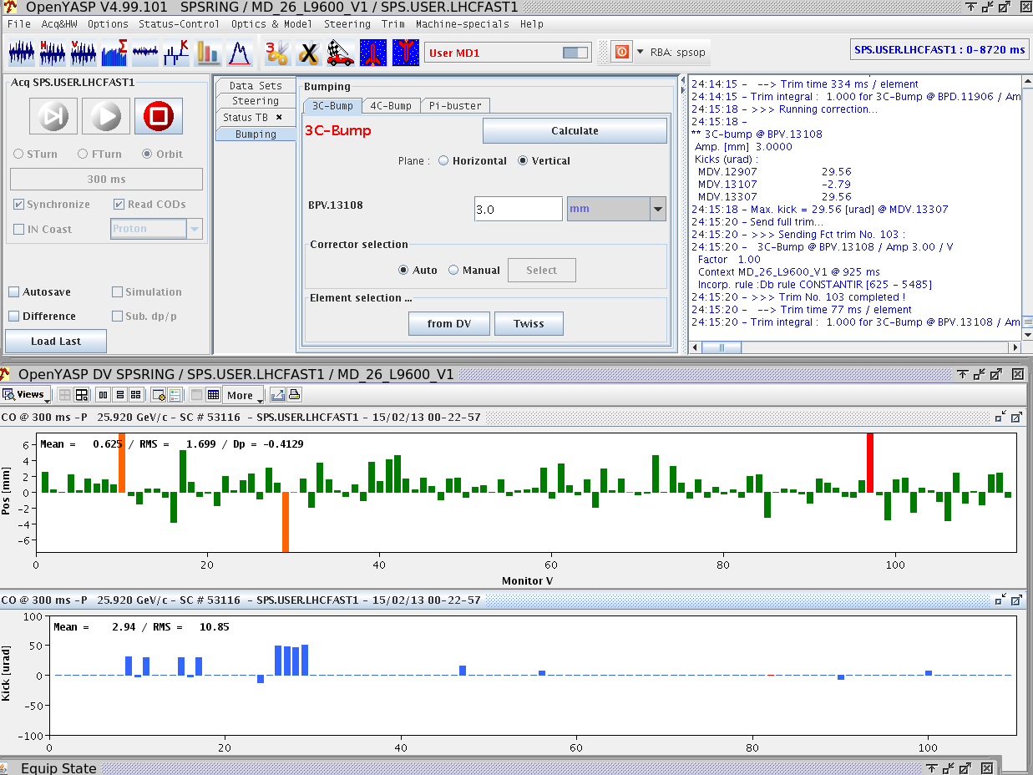
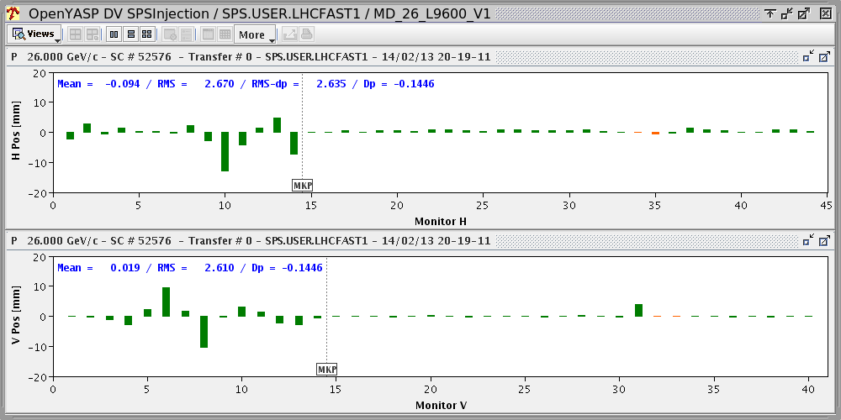
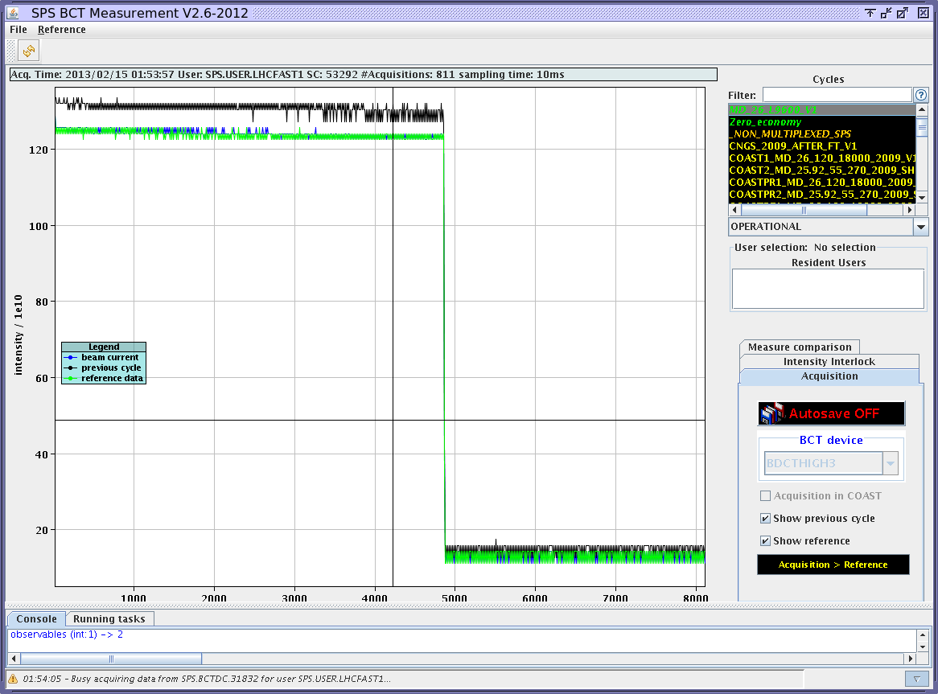
Method used to search the aperture restrictions
Preparation of the machine
Corrected orbit
Removed 3 and 4 correctors bump
Few correctors to improve orbit
Corrected injection oscillations
Beam intensity about: 1.2 E12 p
All the measurements were made at flat bottom (low energy 26GeV or 14 GeV)

Slide 4
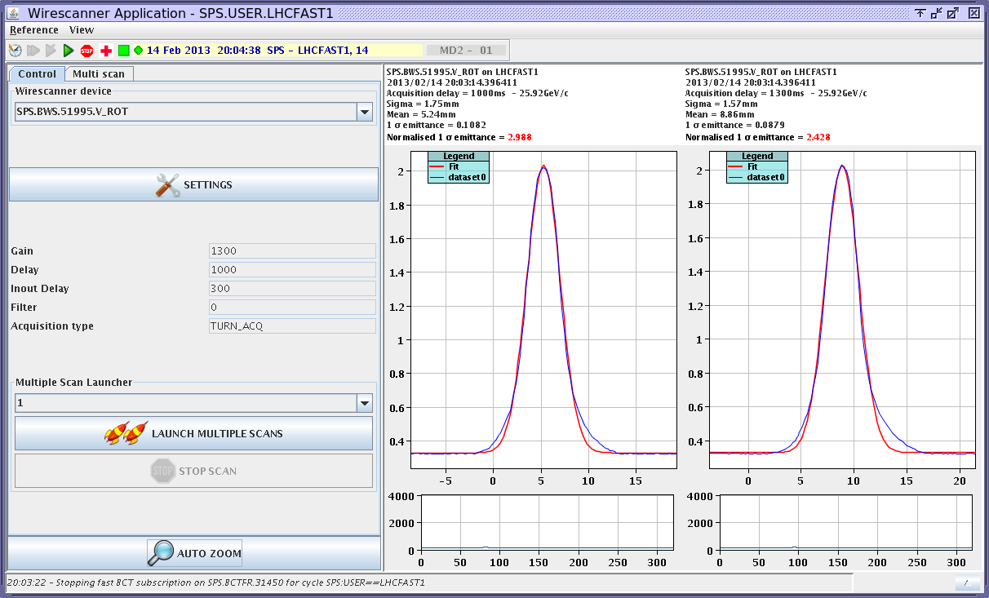
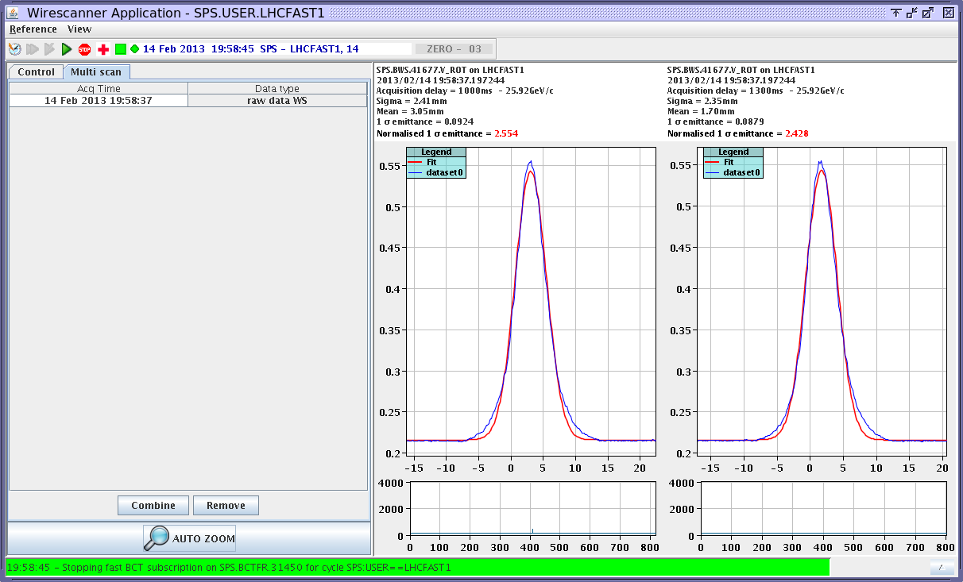
Method used to search the aperture restrictions
Beam profile measurements with the wire scan (41677 and 51995) on Vertical plane (Beam without blow up)
Wire scan Vertical plane
Position: 51995
Beta Vertical: 28.15
Beam characteristics
Sigma: 1.75 mm
Emittance: 2.99 µm
Wire scan Vertical plane
Position: 41677
Beta Vertical: 62.96
Beam characteristics
Sigma: 2.34 mm
Emittance: 2.55 µm

Slide 5
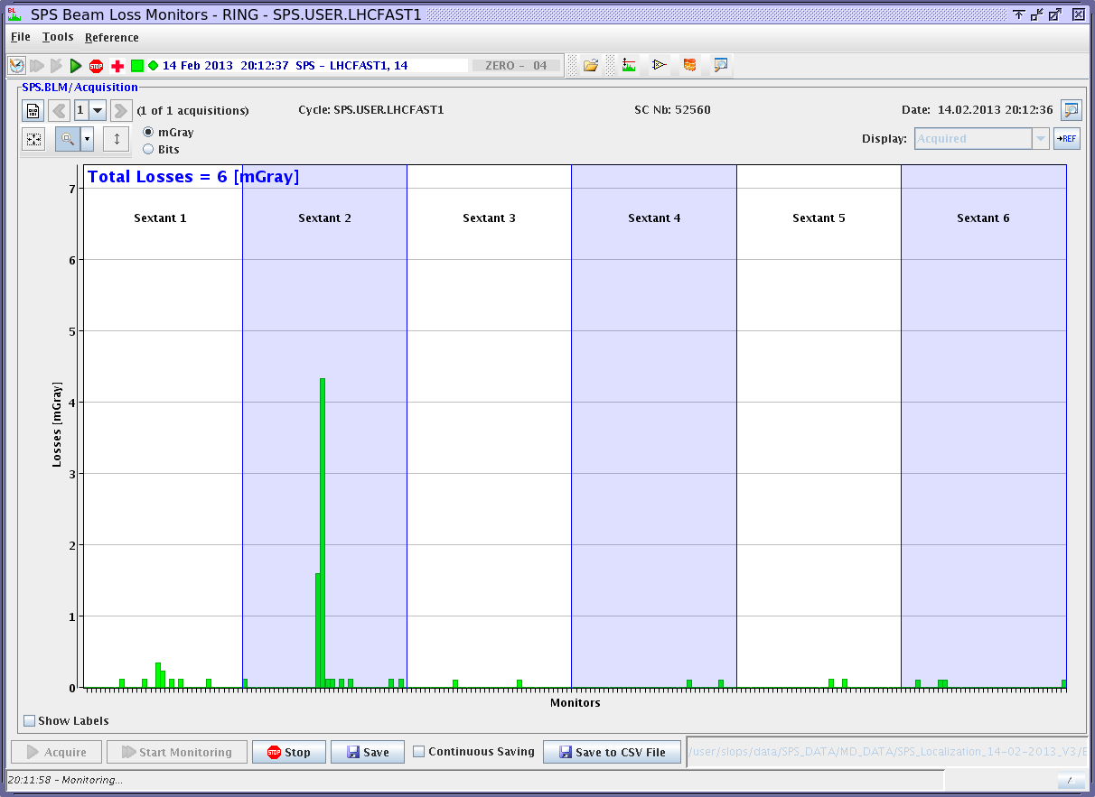
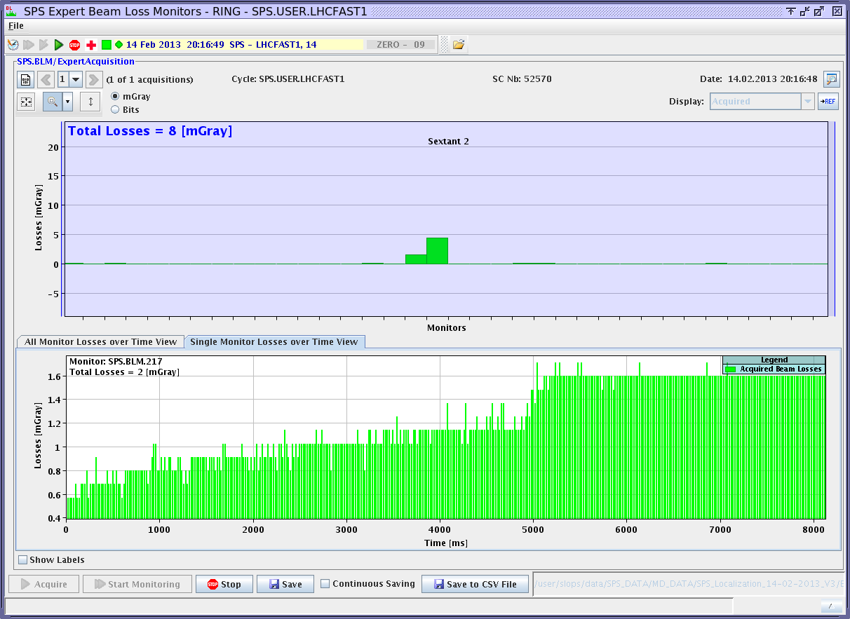
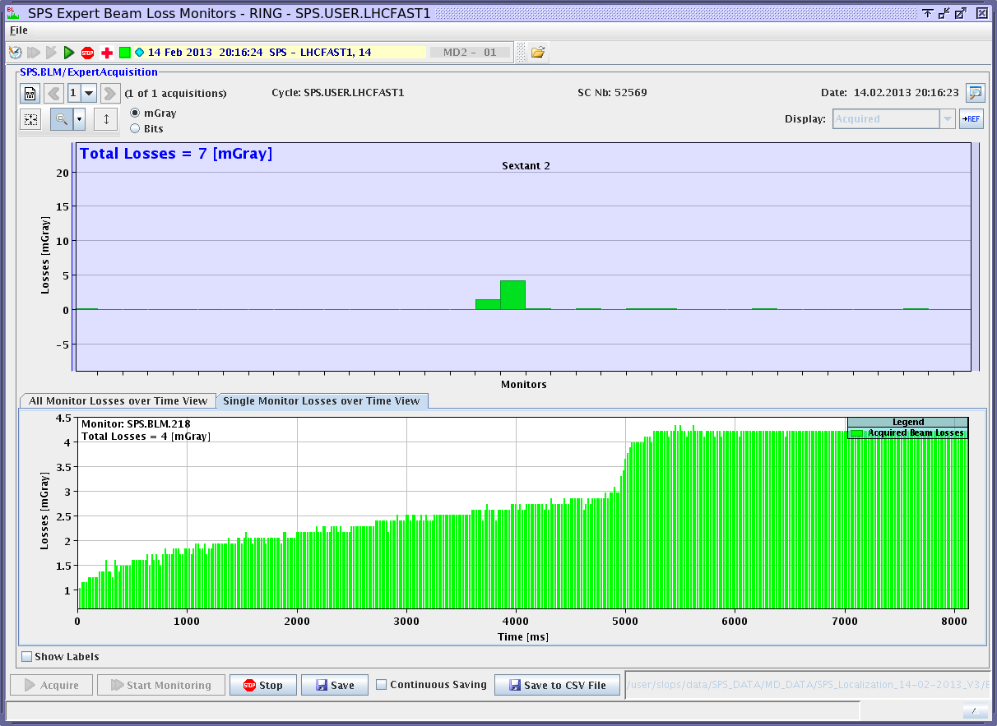
Method used to search the aperture restrictions
Search the losses in the ring without blowing up beam
We can see the main losses
BLM 217 ~2 mGray
BLM 218 ~4 mGray
Aperture restriction around half cells 217 and 218
Integrated losses
BLM 217
The losses are present from injection
Integrated losses
BLM 218
The losses are present from injection

Slide 6
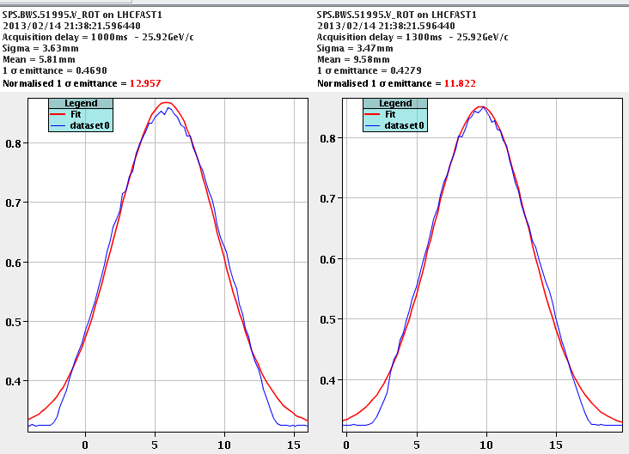
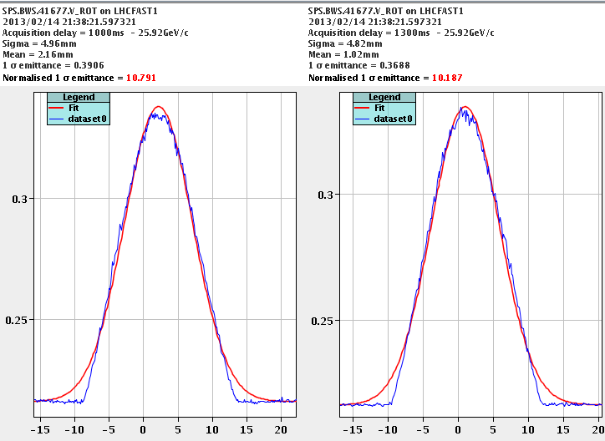
Method used to search the aperture restrictions
Blow up the beam in using the BTV screens in TT10
Beam profile measurements with the wire scan (41677 and 51995) on Vertical plane (with blow up)
BTV screens in beam
Position 1001, 1003 screen 1
Position 1018, 1024 screen Al
The beam is cut by the aperture restriction
Wire scan Vertical plane
Position: 51995
Beta Vertical: 28.15
Beam characteristic
Sigma: 3.63 mm
Emittance: 12.96 µm
Vertical aperture of the SPS measured with wire scan 51995
~ 16.5 mm
Wire scan Vertical plane
Position: 41677
Beta Vertical: 62.96
Beam characteristic
Sigma: 4.96 mm
Emittance: 10.79 µm
Vertical aperture of the SPS measured with wire scan 41677
~ 23 mm

Slide 7
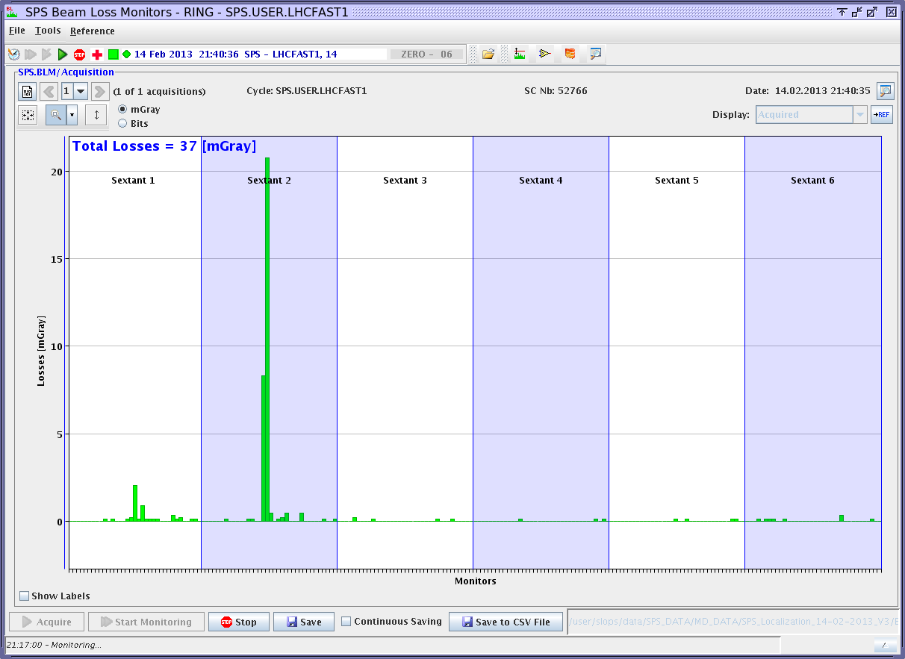
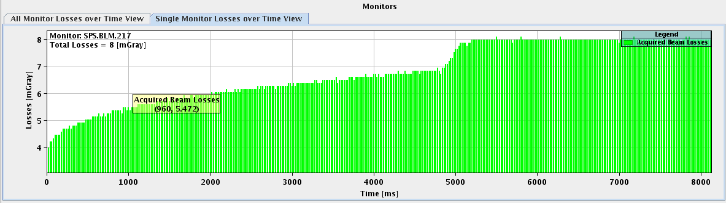
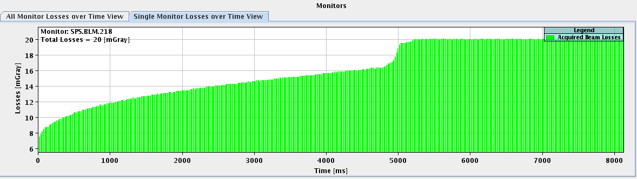
Method used to search the aperture restrictions
Search the losses in the ring with blown up beam
Main losses
BLM 217 ~8 mGray
BLM 218 ~20 mGray
This confirms an aperture restriction around half cells 217 and 218
Integrated losses
BLM 217
The losses are present from injection
Integrated losses
BLM 218
The losses are present from injection

Slide 8
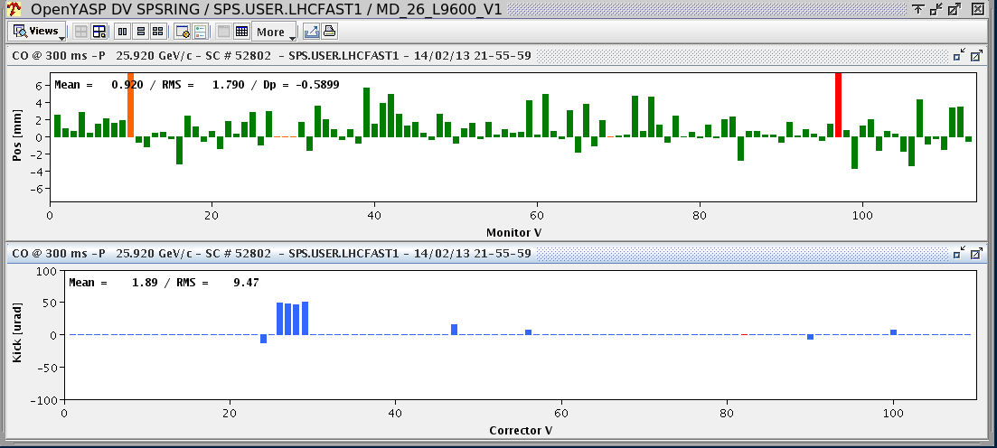
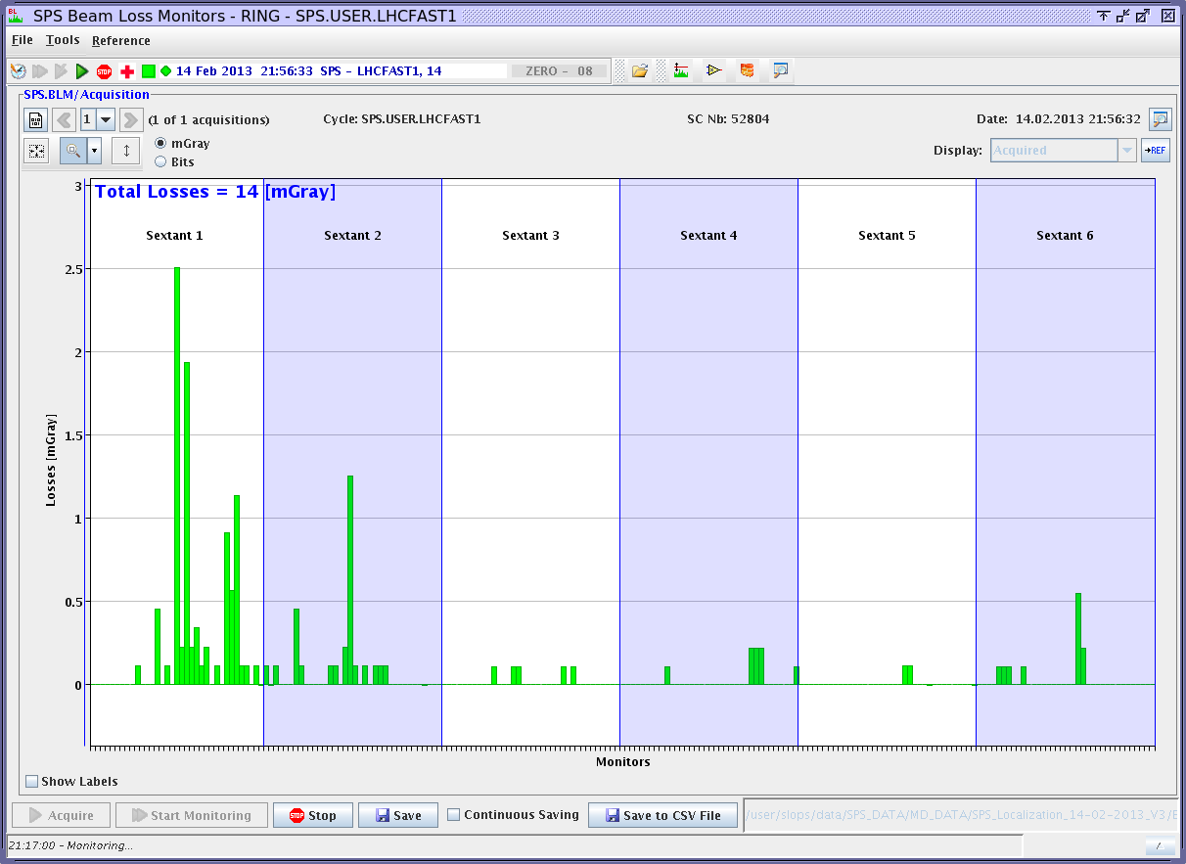
Method used to search the aperture restrictions
Establish a closed bump centred on 217 to eliminate this restriction
Other aperture restrictions on the beam losses
4 corrector bump centred on 217
Amplitude: 5 mm
During the entire flat bottom
Losses in 119 ( TIDVG)
First theoretical restriction of the SPS (42mm)
Losses in 131
Investigation ??
Losses in 621
Investigation: probably due to tunnel subsidence ??

Slide 9
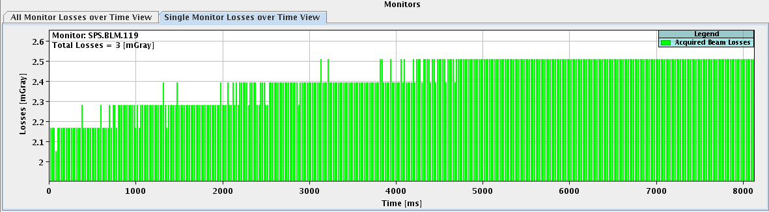
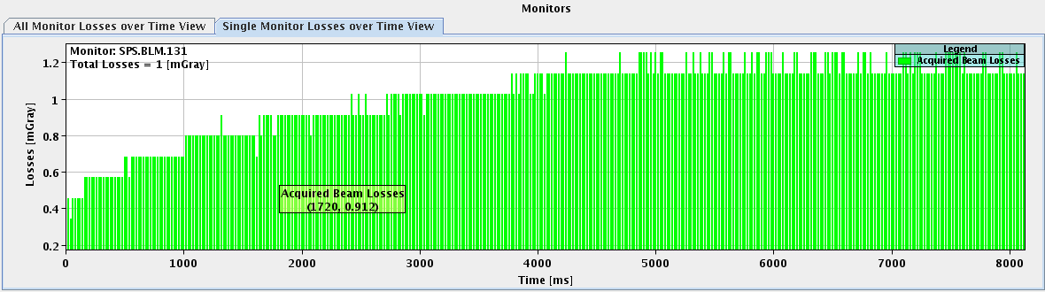
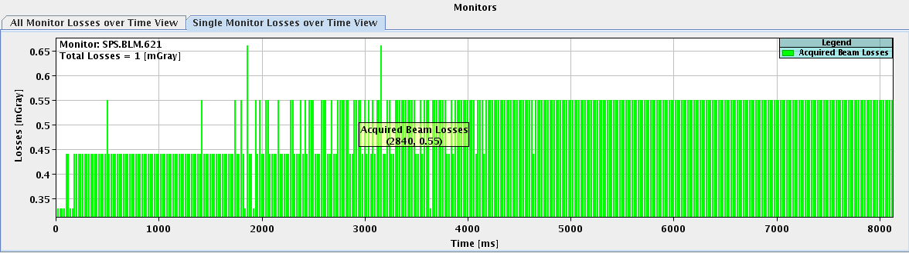
Method used to search the aperture restrictions
Integrated losses in the restrictions found
Integrated losses
BLM 119
The loss are present from injection
Integrated losses
BLM 131
The loss are present from injection
Integrated losses
BLM 621
The loss are present from injection
We found several points giving a possible aperture restriction
  119, 131, 217, 621

Slide 10
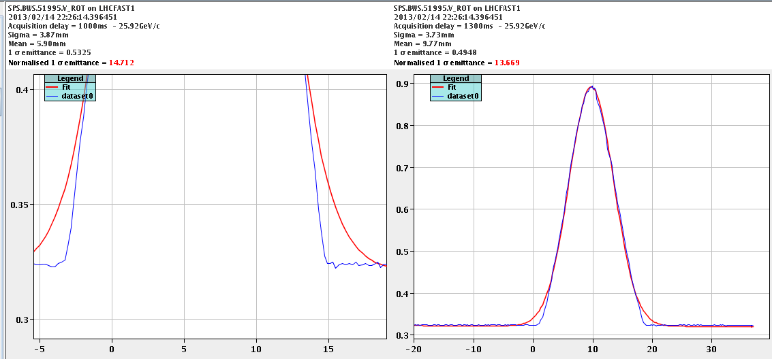
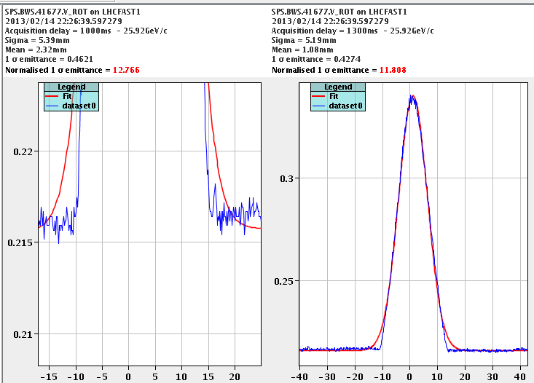
Method used to search the aperture restrictions
Measurements of beam profile with the wire scan (41677 and 51995) on Vertical plane (with blow up) and with the 4 corrector bump centred in 217
With the 5mm bump centred on 217 we increased the aperture to 16 mm from 18 mm
Wire scan Vertical plane
Position: 51995
Beta Vertical: 28.15
Beam characteristic
Sigma: 3.87 mm
Emittance: 14.71 µm
Vertical aperture of the SPS measured with wire scan 51995 ~ 18 mm
With the 5mm bump centred on 217 we increased the aperture to 23 mm from 25 mm
Wire scan Vertical plane
Position: 41677
Beta Vertical: 62.96
Beam characteristic
Sigma: 5.39 mm
Emittance: 12.77 µm
Vertical aperture of the SPS measured with wire scan 41677 ~ 25 mm

Slide 11
Method used to measure the aperture
Aperture measurements in the restrictions (beam without blow up)
  Implementation of a bump centred on restriction ( positive bump and negative bump)
  These bumps are created with the special incorporation rules (not in the skeleton point)
  The purpose of these bumps are to create losses over 10% on the BLM at the restriction (or the following BLM)
  In these conditions we store data from the DC BCT
  Perform a plot, Horizontal axis bump amplitude in millimeters, Vertical axis relative beam losses from BCTDC
  Calculate the aperture at ± 2 sigma with BCTDC losses of 10%
    Aperture=ABS(Positive bump at 10% losses) +ABS(Negative bump at 10% losses)+4 x sigma
  Calculate the aperture at ± 3 sigma with BCTDC losses of 2%
    Aperture=ABS(Positive bump at 2% losses) +ABS(Negative bump at 2% losses)+6 x sigma
Losses 10% or 2%
Negative bump
4 or 6 sigma
Positive bump
Losses 10% or 2%

Slide 12
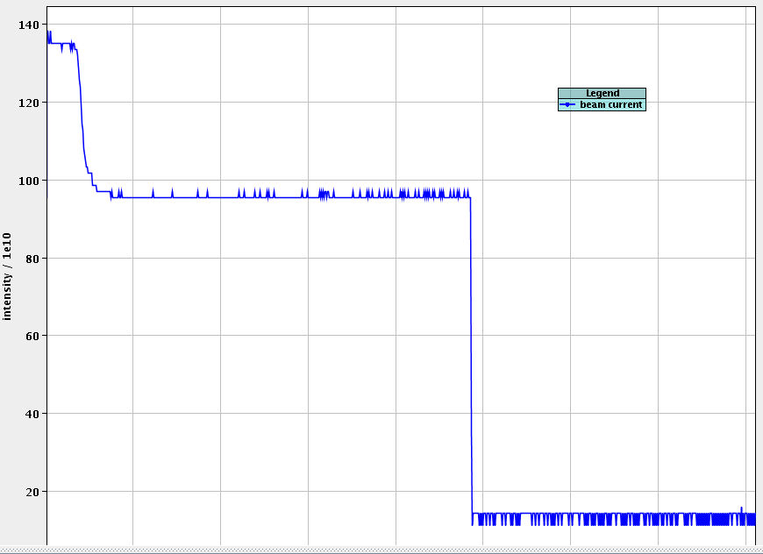
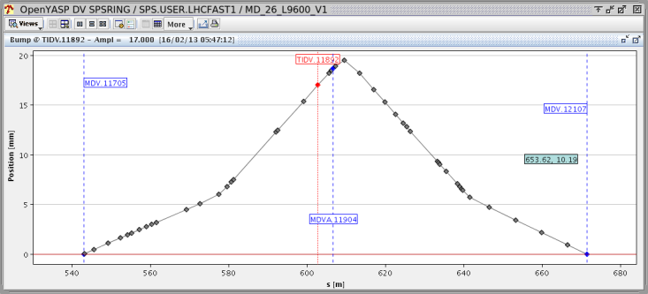
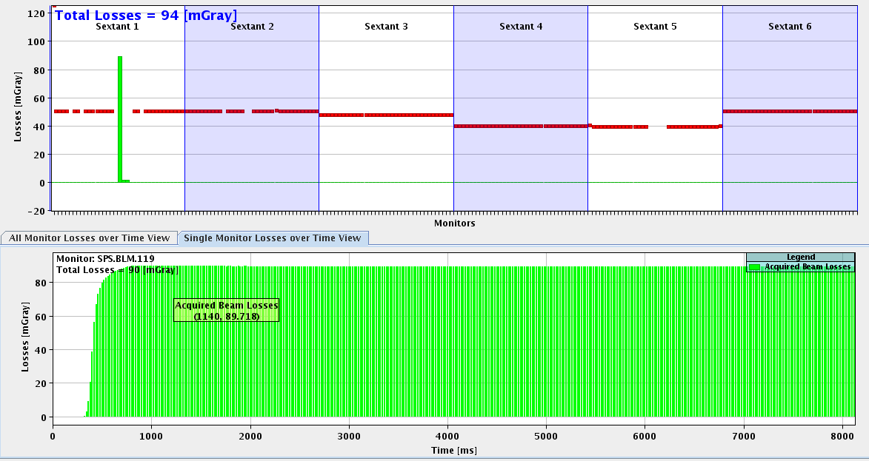
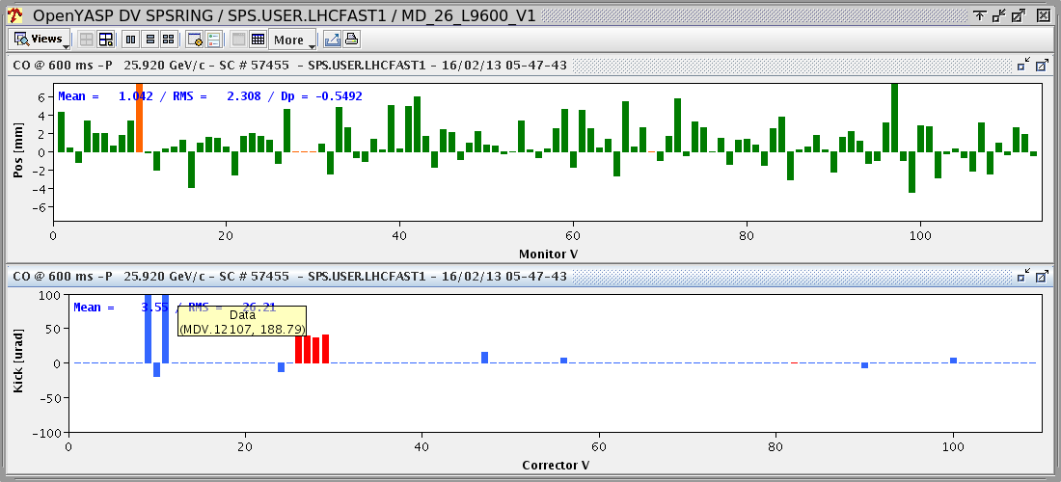
Method used to measure the aperture
Aperture measurements in the TIDVG 118 internal dump (beam without blow up)
  Removed the BTV screens in TT10
  Implementation of a 17mm bump centred on TIDVG 118
  The purpose of this bump is to create losses of over 10% on BLM 119
  In these conditions we store data from the DC BCT
  The same measurements were done with a negative bump of -10 mm
  All these measurements have been done for 217, 131
BCT DC
Theoretical bump
Beam losses 119
Bump 17mm

Slide 13
Presentation of measurement results
Aperture measurements in the TIDVG 118 (internal dump)
Plot: Relative losses from BCT 10%
Theoretical vertical aperture in the TIDVG: 42mm
Aperture at ± 2 sigma, data from wire scan 41677: 39.3mm
Aperture at ± 2 sigma, data from wire scan 51995: 40.5mm

Slide 14
Presentation of measurement results
Aperture measurements in the TIDVG 118 (internal dump)
Plot: Relative losses from BCT 2%
Theoretical vertical aperture in the TIDVG: 42 mm
Aperture at ± 3 sigma, data from wire scan 41677: 36.1 mm
Aperture at ± 3 sigma, data from wire scan 51995: 38 mm
The difference between the approximation at ± 2 and ± 3 sigma comes from the beam tails

Slide 15
Presentation of measurement results
Aperture measurements in the 217 (north extraction)
Plot: Relative losses from BCT 10%
Theoretical vertical aperture in the ZS: 46mm
Aperture at ± 2 sigma, data from wire scan 41677: 37 mm
Aperture at ± 2 sigma, data from wire scan 51995: 38.4mm
Aperture restriction on the bottom
(we put usually positive bump to increase beam transmission)

Slide 16
Presentation of measurement results
Aperture measurements in the 217 (north extraction)
Plot: Relative losses from BCT 2%
Theoretical vertical aperture in the ZS: 46 mm
Aperture at ± 3 sigma, data from wire scan 41677: 35.4 mm
Aperture at ± 3 sigma, data from wire scan 51995: 37.5 mm

Slide 17
Presentation of measurement results
Aperture measurements in the 131
Plot: Relative losses from BCT 10%
Theoretical vertical aperture in the MDV: 83 mm
MBB: 48.5 mm
MBA: 34.5 mm
Aperture at ± 2 sigma, data from wire scan 41677: 42.6 mm
Aperture at ± 2 sigma, data from wire scan 51995: 44.1mm

Slide 18
Presentation of measurement results
Aperture measurements in the 131
Plot: Relative losses from BCT 2%
Theoretical vertical aperture in the MDV: 83mm
MBB: 48.5 mm
MBA: 34.5 mm
Aperture at ± 3 sigma, data from wire scan 41677: 40.3 mm
Aperture at ± 3 sigma, data from wire scan 51995: 42.4 mm

Slide 19
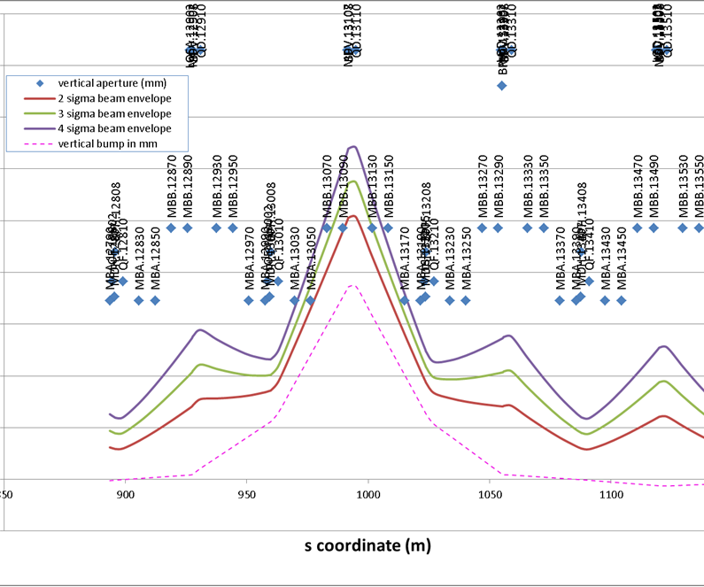
Presentation of measurement results
Explanation for the lack of aperture on MDV 13107
3 corrector bump centred on MDV 13107
2 sigma beam envelope goes to the aperture limit on MBA and MBB before MDV 13107
Courtesy
B.Salvant, H. Bartosik

Slide 20
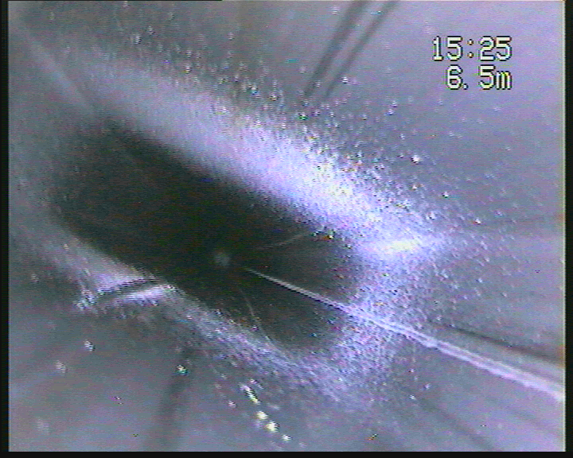
Measurement results
Synthesis restrictions aperture
Position | aperture restriction [mm] | Investigation LS1 | Radiation [µS]
13107 | 44.1 | MDV endoscopie upstream | 900
21695 | 38.4 | TCE | 3600
1732 | 38.4 | MPNH | 2350
21758 | 38.4 | BBSH | 380
21759 | 38.4 | TPSN | 4300
21773 | 38.4 | BBSH | 6750
21773 | 38.4 | BBSV | 6750
21774 | 38.4 | MST | 6750
21804 | 38.4 | MDHA | 9200
62130 |  | Probably LSS6 alignement | 525
Magnet MBB 62130 beam hit
Found 2009
Magnet removed

Slide 21
Many Thanks:
B. Salvant, H. Bartosik, K. Cornelis
Thank you for your attention

