Slide 1

Electron Cloud Studies for the PS
G. Iadarola, H.Bartosik, H. Damerau,
S. Rioja Fuentelsaz, M. Pivi, G. Rumolo, G. Sterbini
Many thanks to:
S. Hancock, S. Gilardoni, D. Schoerling, C. Yin Vallgren
and all the SPS Operator crew
MSWG - 9/4/2013

Slide 2
Outline
  Introduction
  Beam observation
    Emittance along the train
    Instability on a “stored beam”
  Simulation work
    Code development
    First results
  Measurements with e-cloud setup in SS98
    Shielded pickup measurements
    Mitigation strategy test

Slide 3
Outline
  Introduction
  Beam observation
    Emittance along the train
    Instability on a “stored beam”
  Simulation work
    Code development
    First results
  Measurements with e-cloud setup in SS98
    Shielded pickup measurements
    Mitigation strategy test

Slide 4
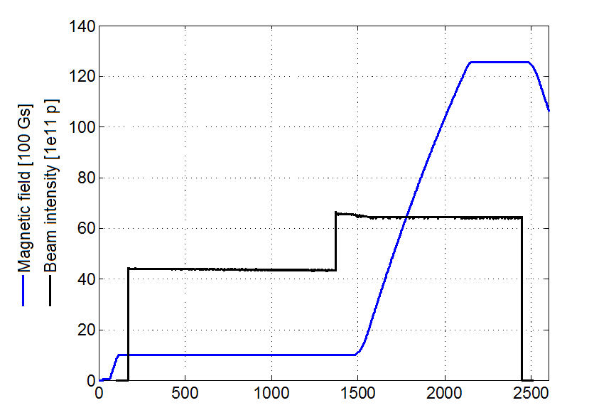
25ns LHC type beams in the PS
h=42
b.sp.=50 ns (36 b.)
h=7
b. sp. ≈ 330 ns (4 - 6 b.)
h=21
b. sp.≈100 ns (18 b.)
h=84
b.sp.=25 ns (72 b.)
Triple
splitting
Double splitting
Double splitting
Bunch shortening

Slide 5
25ns LHC type beams in the PS
h=42
b.sp.=50 ns (36 b.)
h=7
b. sp. ≈ 330 ns (4 - 6 b.)
h=21
b. sp.≈100 ns (18 b.)
h=84
b.sp.=25 ns (72 b.)
Before the last bunch splitting
e-cloud not expected nor observed
Triple
splitting
Double splitting
Double splitting
Bunch shortening

Slide 6
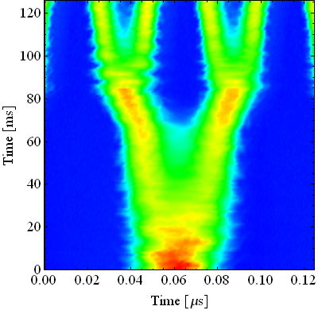
25ns LHC type beams in the PS
h=42
b.sp. = 50 ns (36 b.)
h=84
b.sp. = 25 ns (72 b.)
h=7
b. sp. ≈ 330 ns (4 - 6 b.)
h=21
b. sp.≈100 ns (18 b.)
300
4 ns
Double splitting
250
200
40 MHz RF Voltage [kV]
Bunch rotation
150
100
11 ns
50
b.l.≈14 ns
Adiabatic shortening
0
10
20
30
40
50
60
Triple
splitting
Double splitting
Double splitting
Bunch shortening
Time [ms]

Slide 7
25ns LHC type beams in the PS
h=42
b.sp. = 50 ns (36 b.)
h=84
b.sp. = 25 ns (72 b.)
h=7
b. sp. ≈ 330 ns (4 - 6 b.)
h=21
b. sp.≈100 ns (18 b.)
4 ns
300
E-cloud expected and observed
Double splitting
250
200
40 MHz RF Voltage [kV]
Bunch rotation
150
100
11 ns
50
b.l.≈14 ns
Adiabatic shortening
0
10
20
30
40
50
60
Triple
splitting
Double splitting
Double splitting
Bunch shortening
Time [ms]

Slide 8
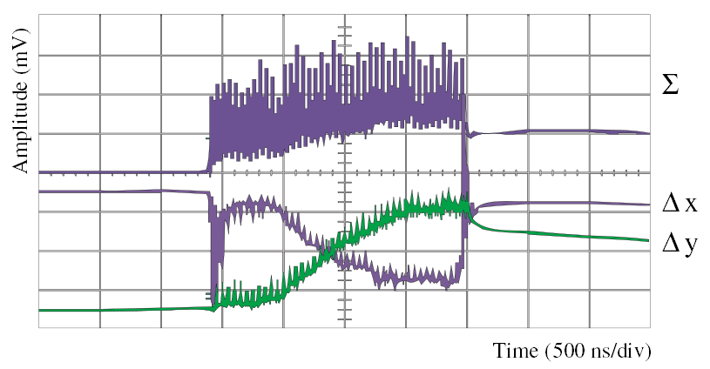
Introduction
  First observations of e-cloud in the PS date back to the early 2000s⁽¹⁾: baseline distortion on pickup signals (PS ring and TT2)
  In 2007 an e-cloud test setup with two shielded pickups was installed in SS98⁽²⁾ Measurements confirmed e-cloud formation in this chamber during last stages of LHC beam production cycle
⁽¹⁾R. Cappi, M. Giovannozzi, E. Metral, G. Métral, G. Rumolo and F. Zimmermann, "Electron cloud buildup and related instability in the CERN Proton Synchrotron." Physical Review Special Topics-Accelerators and Beams 5.9 (2002): 094401.
⁽²⁾E. Mahner, T. Kroyer and F. Caspers. "Electron cloud detection and characterization in the CERN Proton Synchrotron." Physical Review Special Topics-Accelerators and Beams 11.9 (2008): 094401.

Slide 9
Introduction
  First observations of e-cloud in the PS date back to the early 2000s⁽¹⁾: baseline distortion on pickup signals (PS ring and TT2)
  In 2007 an e-cloud test setup with two shielded pickups was installed in SS98⁽²⁾ Measurements confirmed e-cloud formation in this chamber during last stages of LHC beam production cycle
  Quite likely e-cloud is developing also in the main magnets → No direct confirm since no diagnostics available up to now (to be installed during LS1, see Christina’s talk)
⁽¹⁾R. Cappi, M. Giovannozzi, E. Metral, G. Métral, G. Rumolo and F. Zimmermann, "Electron cloud buildup and related instability in the CERN Proton Synchrotron." Physical Review Special Topics-Accelerators and Beams 5.9 (2002): 094401.
⁽²⁾E. Mahner, T. Kroyer and F. Caspers. "Electron cloud detection and characterization in the CERN Proton Synchrotron." Physical Review Special Topics-Accelerators and Beams 11.9 (2008): 094401.

Slide 10
Outline
  Introduction
  Beam observation
    Emittance along the train
    Instability on a “stored beam”
  Simulation work
    Code development
    First results
  Measurements with e-cloud setup in SS98
    Shielded pickup measurements
    Mitigation strategy test

Slide 11
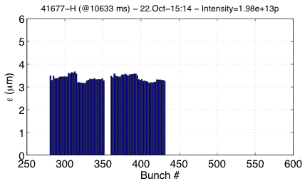
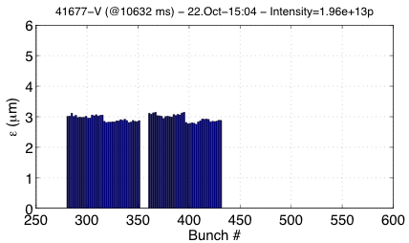
Beam observations: emittances
  Up to now e-cloud in the PS has never been a limitation for the production of the 25 ns LHC type beams
    In 2012, bunch by bunch emittance measurements performed in the SPS (intensities up to 1.45e11 ppb) never revealed any e-cloud signature on the emittance pattern coming from the PS
Horizontal
Vertical
  Measurements done on the SPS flat top with 1.45e11 ppb injected into the SPS

Slide 12
Beam observations: tr. instabilities on “stored” beam
  A possible reason of the absence of any visible degradation could be that the beam does not interact with the cloud for a sufficiently long time
300
4 ns
250
200
40 MHz RF Voltage [kV]
150
100
11 ns
50
b.l.≈14 ns
0
10
20
30
40
50
60
70
80
90
100
Time [ms]
R. Cappi, M. Giovannozzi, E. Metral, G. Métral, G. Rumolo and F. Zimmermann, "Electron cloud buildup and related instability in the CERN Proton Synchrotron." Physical Review Special Topics-Accelerators and Beams 5.9 (2002): 094401.

Slide 13
Beam observations: tr. instabilities on “stored” beam
  A possible reason of the absence of any visible degradation could be that the beam does not interact with the cloud for a sufficiently long time
    To check this possibility in 2001 test were made by storing for about 100 ms a 25ns beam with b.len.=11 ns
300
4 ns
250
200
40 MHz RF Voltage [kV]
150
100
11 ns
50
b.l.≈14 ns
0
10
20
30
40
50
60
70
80
90
100
Time [ms]
R. Cappi, M. Giovannozzi, E. Metral, G. Métral, G. Rumolo and F. Zimmermann, "Electron cloud buildup and related instability in the CERN Proton Synchrotron." Physical Review Special Topics-Accelerators and Beams 5.9 (2002): 094401.

Slide 14
Beam observations: tr. instabilities on “stored” beam
  A possible reason of the absence of any visible degradation could be that the beam does not interact with the cloud for a sufficiently long time
    To check this possibility in 2001 test were made by storing for about 100 ms a 25ns beam with b.len.=11 ns
300
250
200
40 MHz RF Voltage [kV]
150
100
b.l.≈ 11 ns
50
b.l.≈14 ns
0
10
20
30
40
50
60
70
80
90
100
Time [ms]
R. Cappi, M. Giovannozzi, E. Metral, G. Métral, G. Rumolo and F. Zimmermann, "Electron cloud buildup and related instability in the CERN Proton Synchrotron." Physical Review Special Topics-Accelerators and Beams 5.9 (2002): 094401.

Slide 15
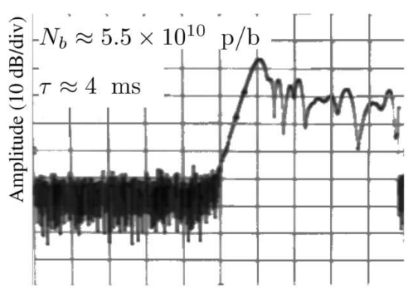

Beam observations: tr. instabilities on “stored” beam
  A possible reason of the absence of any visible degradation could be that the beam does not interact with the cloud for a sufficiently long time
    To check this possibility in 2001 test were made by storing for about 100 ms a 25ns beam with b.len.=11 ns → transverse instabilities were observed
H pickup signal – 357 kHz component
300
250
200
40 MHz RF Voltage [kV]
150
100
b.l.≈ 11 ns
50
b.l.≈14 ns
0
10
20
30
40
50
60
70
80
90
100
Time [ms]
R. Cappi, M. Giovannozzi, E. Metral, G. Métral, G. Rumolo and F. Zimmermann, "Electron cloud buildup and related instability in the CERN Proton Synchrotron." Physical Review Special Topics-Accelerators and Beams 5.9 (2002): 094401.

Slide 16
Beam observations: tr. instabilities on “stored” beam
  A possible reason of the absence of any visible degradation could be that the beam does not interact with the cloud for a sufficiently long time
    To check this possibility in 2001 test were made by storing for about 100 ms a 25ns beam with b.len.=11 ns → transverse instabilities were observed
    In 2012 we decided to continue this kind of experiments with the main goal of investigating if e-cloud could be a possible source of this instability
      Bunch by bunch position data were acquired (at first 120 turns using OASIS, then ~30000 turns using local scope on transverse feedback PU)

Slide 17
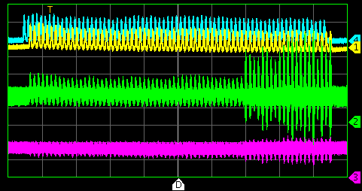
Beam observations: tr. instabilities on “stored” beam
    From the first acquisitions over 120 turns (fast PU in SS94, OASIS) we could observe:
    Instability observed even for quite low intensity (6e10 ppb)
    Strong oscillation mainly in the horizontal plane
-- Wall current monitor -- Sum -- Horizontal -- Vertical

Slide 18
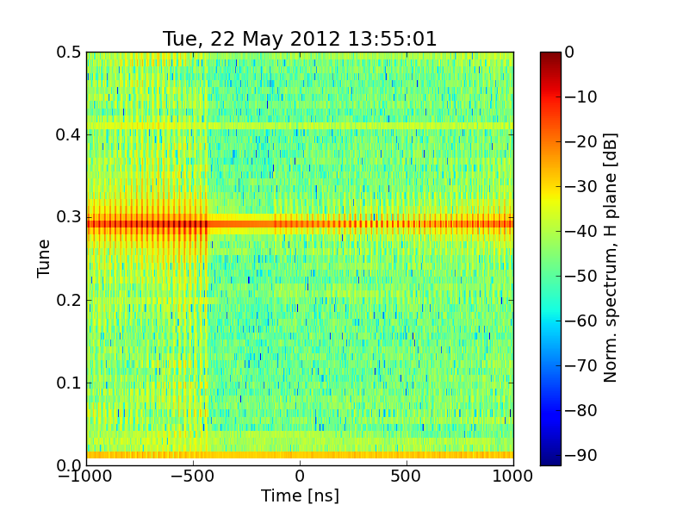
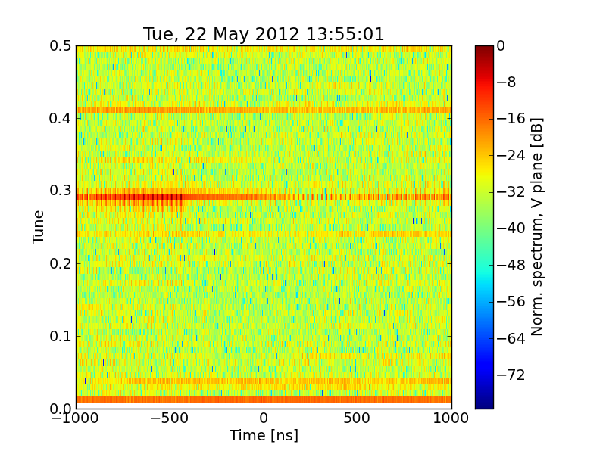
Beam observations: tr. instabilities on “stored” beam
    From the first acquisitions over 120 turns (fast PU in SS94, OASIS) we could observe:
    Instability observed even for quite low intensity (6e10 ppb)
    Strong oscillation mainly in the horizontal plane
    Oscillation in the vertical plane likely coming from coupling
H tune
gap
gap

Slide 19
Beam observations: tr. instabilities on “stored” beam
    Towards the end of 2012 it was possible to acquire many more turns (up to 40000) thanks to the oscilloscope and PUs used for the transverse feedback. These measurements show:
    First bunches of the train are stable, instability rise time then decreases along the train and saturates towards the tail

Slide 20
Beam observations: tr. instabilities on “stored” beam
    Towards the end of 2012 it was possible to acquire many more turns (up to 40000) thanks to the oscilloscope and PUs used for the transverse feedback. These measurements show:
    First bunches of the train are stable, instability rise time then decreases along the train and saturates towards the tail

Slide 21
Beam observations: tr. instabilities on “stored” beam
    Towards the end of 2012 it was possible to acquire many more turns (up to 40000) thanks to the oscilloscope and PUs used for the transverse feedback. These measurements show:
    First bunches of the train are stable, instability rise time then decreases along the train and saturates towards the tail

Slide 22
Beam observations: tr. instabilities on “stored” beam
    Towards the end of 2012 it was possible to acquire many more turns (up to 40000) thanks to the oscilloscope and PUs used for the transverse feedback. These measurements show:
    First bunches of the train are stable, instability rise time then decreases along the train and saturates towards the tail

Slide 23
Beam observations: tr. instabilities on “stored” beam
    Towards the end of 2012 it was possible to acquire many more turns (up to 40000) thanks to the oscilloscope and PUs used for the transverse feedback. These measurements show:
    First bunches of the train are stable, instability rise time then decreases along the train and saturates towards the tail

Slide 24
Beam observations: tr. instabilities on “stored” beam
    Towards the end of 2012 it was possible to acquire many more turns (up to 40000) thanks to the oscilloscope and PUs used for the transverse feedback. These measurements show:
    First bunches of the train are stable, instability rise time then decreases along the train and saturates towards the tail

Slide 25
Beam observations: tr. instabilities on “stored” beam
    Towards the end of 2012 it was possible to acquire many more turns (up to 40000) thanks to the oscilloscope and PUs used for the transverse feedback. These measurements show:
    First bunches of the train are stable, instability rise time then decreases along the train and saturates towards the tail

Slide 26
Beam observations: tr. instabilities on “stored” beam
    Towards the end of 2012 it was possible to acquire many more turns (up to 40000) thanks to the oscilloscope and PUs used for the transverse feedback. These measurements show:
    First bunches of the train are stable, instability rise time then decreases along the train and saturates towards the tail

Slide 27
Beam observations: tr. instabilities on “stored” beam
    Towards the end of 2012 it was possible to acquire many more turns (up to 40000) thanks to the oscilloscope and PUs used for the transverse feedback. These measurements show:
    First bunches of the train are stable, instability rise time then decreases along the train and saturates towards the tail

Slide 28
Beam observations: tr. instabilities on “stored” beam
    Towards the end of 2012 it was possible to acquire many more turns (up to 40000) thanks to the oscilloscope and PUs used for the transverse feedback. These measurements show:
    First bunches of the train are stable, instability rise time then decreases along the train and saturates towards the tail

Slide 29
Beam observations: tr. instabilities on “stored” beam
    Towards the end of 2012 it was possible to acquire many more turns (up to 40000) thanks to the oscilloscope and PUs used for the transverse feedback. These measurements show:
    First bunches of the train are stable, instability rise time then decreases along the train and saturates towards the tail

Slide 30
Beam observations: tr. instabilities on “stored” beam
    Towards the end of 2012 it was possible to acquire many more turns (up to 40000) thanks to the oscilloscope and PUs used for the transverse feedback. These measurements show:
    First bunches of the train are stable, instability rise time then decreases along the train and saturates towards the tail

Slide 31
Beam observations: tr. instabilities on “stored” beam
    Towards the end of 2012 it was possible to acquire many more turns (up to 40000) thanks to the oscilloscope and PUs used for the transverse feedback. These measurements show:
    First bunches of the train are stable, instability rise time then decreases along the train and saturates towards the tail

Slide 32
Beam observations: tr. instabilities on “stored” beam
    Towards the end of 2012 it was possible to acquire many more turns (up to 40000) thanks to the oscilloscope and PUs used for the transverse feedback. These measurements show:
    First bunches of the train are stable, instability rise time then decreases along the train and saturates towards the tail

Slide 33
Beam observations: tr. instabilities on “stored” beam
    Towards the end of 2012 it was possible to acquire many more turns (up to 40000) thanks to the oscilloscope and PUs used for the transverse feedback. These measurements show:
    First bunches of the train are stable, instability rise time then decreases along the train and saturates towards the tail

Slide 34
Beam observations: tr. instabilities on “stored” beam
    Towards the end of 2012 it was possible to acquire many more turns (up to 40000) thanks to the oscilloscope and PUs used for the transverse feedback. These measurements show:
    First bunches of the train are stable, instability rise time then decreases along the train and saturates towards the tail

Slide 35
Beam observations: tr. instabilities on “stored” beam
    Towards the end of 2012 it was possible to acquire many more turns (up to 40000) thanks to the oscilloscope and PUs used for the transverse feedback. These measurements show:
    First bunches of the train are stable, instability rise time then decreases along the train and saturates towards the tail

Slide 36
Beam observations: tr. instabilities on “stored” beam
    Towards the end of 2012 it was possible to acquire many more turns (up to 40000) thanks to the oscilloscope and PUs used for the transverse feedback. These measurements show:
    First bunches of the train are stable, instability rise time then decreases along the train and saturates towards the tail

Slide 37
Beam observations: tr. instabilities on “stored” beam
    Towards the end of 2012 it was possible to acquire many more turns (up to 40000) thanks to the oscilloscope and PUs used for the transverse feedback. These measurements show:
    First bunches of the train are stable, instability rise time then decreases along the train and saturates towards the tail

Slide 38
Beam observations: tr. instabilities on “stored” beam
    Towards the end of 2012 it was possible to acquire many more turns (up to 40000) thanks to the oscilloscope and PUs used for the transverse feedback. These measurements show:
    First bunches of the train are stable, instability rise time then decreases along the train and saturates towards the tail

Slide 39
Beam observations: tr. instabilities on “stored” beam
    Towards the end of 2012 it was possible to acquire many more turns (up to 40000) thanks to the oscilloscope and PUs used for the transverse feedback. These measurements show:
    First bunches of the train are stable, instability rise time then decreases along the train and saturates towards the tail

Slide 40
Beam observations: tr. instabilities on “stored” beam
    Towards the end of 2012 it was possible to acquire many more turns (up to 40000) thanks to the oscilloscope and PUs used for the transverse feedback. These measurements show:
    First bunches of the train are stable, instability rise time then decreases along the train and saturates towards the tail

Slide 41
Beam observations: tr. instabilities on “stored” beam
    Towards the end of 2012 it was possible to acquire many more turns (up to 40000) thanks to the oscilloscope and PUs used for the transverse feedback. These measurements show:
    First bunches of the train are stable, instability rise time then decreases along the train and saturates towards the tail

Slide 42
Beam observations: tr. instabilities on “stored” beam
    Towards the end of 2012 it was possible to acquire many more turns (up to 40000) thanks to the oscilloscope and PUs used for the transverse feedback. These measurements show:
    First bunches of the train are stable, instability rise time then decreases along the train and saturates towards the tail

Slide 43
Beam observations: tr. instabilities on “stored” beam
    Towards the end of 2012 it was possible to acquire many more turns (up to 40000) thanks to the oscilloscope and PUs used for the transverse feedback. These measurements show:
    First bunches of the train are stable, instability rise time then decreases along the train and saturates towards the tail
    Coupled bunch motion clearly visible

Slide 44
Beam observations: tr. instabilities on “stored” beam
    Towards the end of 2012 it was possible to acquire many more turns (up to 40000) thanks to the oscilloscope and PUs used for the transverse feedback. These measurements show:
    First bunches of the train are stable, instability rise time then decreases along the train and saturates towards the tail
    Coupled bunch motion clearly visible

Slide 45
Beam observations: tr. instabilities on “stored” beam
    Towards the end of 2012 it was possible to acquire many more turns (up to 40000) thanks to the oscilloscope and PUs used for the transverse feedback. These measurements show:
    First bunches of the train are stable, instability rise time then decreases along the train and saturates towards the tail
    Coupled bunch motion clearly visible

Slide 46
Beam observations: tr. instabilities on “stored” beam
    Towards the end of 2012 it was possible to acquire many more turns (up to 40000) thanks to the oscilloscope and PUs used for the transverse feedback. These measurements show:
    First bunches of the train are stable, instability rise time then decreases along the train and saturates towards the tail
    Coupled bunch motion clearly visible

Slide 47
Beam observations: tr. instabilities on “stored” beam
    Towards the end of 2012 it was possible to acquire many more turns (up to 40000) thanks to the oscilloscope and PUs used for the transverse feedback. These measurements show:
    First bunches of the train are stable, instability rise time then decreases along the train and saturates towards the tail
    Coupled bunch motion clearly visible

Slide 48
Beam observations: tr. instabilities on “stored” beam
    Towards the end of 2012 it was possible to acquire many more turns (up to 40000) thanks to the oscilloscope and PUs used for the transverse feedback. These measurements show:
    First bunches of the train are stable, instability rise time then decreases along the train and saturates towards the tail
    Coupled bunch motion clearly visible

Slide 49
Beam observations: tr. instabilities on “stored” beam
    Towards the end of 2012 it was possible to acquire many more turns (up to 40000) thanks to the oscilloscope and PUs used for the transverse feedback. These measurements show:
    First bunches of the train are stable, instability rise time then decreases along the train and saturates towards the tail
    Coupled bunch motion clearly visible

Slide 50
Beam observations: tr. instabilities on “stored” beam
    Towards the end of 2012 it was possible to acquire many more turns (up to 40000) thanks to the oscilloscope and PUs used for the transverse feedback. These measurements show:
    First bunches of the train are stable, instability rise time then decreases along the train and saturates towards the tail
    Coupled bunch motion clearly visible

Slide 51
Beam observations: tr. instabilities on “stored” beam
    Towards the end of 2012 it was possible to acquire many more turns (up to 40000) thanks to the oscilloscope and PUs used for the transverse feedback. These measurements show:
    First bunches of the train are stable, instability rise time then decreases along the train and saturates towards the tail
    Coupled bunch motion clearly visible

Slide 52
Beam observations: tr. instabilities on “stored” beam
    Towards the end of 2012 it was possible to acquire many more turns (up to 40000) thanks to the oscilloscope and PUs used for the transverse feedback. These measurements show:
    First bunches of the train are stable, instability rise time then decreases along the train and saturates towards the tail
    Coupled bunch motion clearly visible

Slide 53
Beam observations: tr. instabilities on “stored” beam
    Towards the end of 2012 it was possible to acquire many more turns (up to 40000) thanks to the oscilloscope and PUs used for the transverse feedback. These measurements show:
    First bunches of the train are stable, instability rise time then decreases along the train and saturates towards the tail
    Coupled bunch motion clearly visible

Slide 54
Beam observations: tr. instabilities on “stored” beam
    Towards the end of 2012 it was possible to acquire many more turns (up to 40000) thanks to the oscilloscope and PUs used for the transverse feedback. These measurements show:
    First bunches of the train are stable, instability rise time then decreases along the train and saturates towards the tail
    Coupled bunch motion clearly visible

Slide 55
Beam observations: tr. instabilities on “stored” beam
    Towards the end of 2012 it was possible to acquire many more turns (up to 40000) thanks to the oscilloscope and PUs used for the transverse feedback. These measurements show:
    First bunches of the train are stable, instability rise time then decreases along the train and saturates towards the tail
    Coupled bunch motion clearly visible

Slide 56
Beam observations: tr. instabilities on “stored” beam
    Towards the end of 2012 it was possible to acquire many more turns (up to 40000) thanks to the oscilloscope and PUs used for the transverse feedback. These measurements show:
    First bunches of the train are stable, instability rise time then decreases along the train and saturates towards the tail
    Coupled bunch motion clearly visible

Slide 57
Beam observations: tr. instabilities on “stored” beam
    Towards the end of 2012 it was possible to acquire many more turns (up to 40000) thanks to the oscilloscope and PUs used for the transverse feedback. These measurements show:
    First bunches of the train are stable, instability rise time then decreases along the train and saturates towards the tail
    Coupled bunch motion clearly visible

Slide 58
Beam observations: tr. instabilities on “stored” beam
    Towards the end of 2012 it was possible to acquire many more turns (up to 40000) thanks to the oscilloscope and PUs used for the transverse feedback. These measurements show:
    First bunches of the train are stable, instability rise time then decreases along the train and saturates towards the tail
    Coupled bunch motion clearly visible

Slide 59
Beam observations: tr. instabilities on “stored” beam
    Towards the end of 2012 it was possible to acquire many more turns (up to 40000) thanks to the oscilloscope and PUs used for the transverse feedback. These measurements show:
    First bunches of the train are stable, instability rise time then decreases along the train and saturates towards the tail
    Coupled bunch motion clearly visible

Slide 60
Beam observations: tr. instabilities on “stored” beam
    Towards the end of 2012 it was possible to acquire many more turns (up to 40000) thanks to the oscilloscope and PUs used for the transverse feedback. These measurements show:
    First bunches of the train are stable, instability rise time then decreases along the train and saturates towards the tail
    Coupled bunch motion clearly visible

Slide 61
Beam observations: tr. instabilities on “stored” beam
    Towards the end of 2012 it was possible to acquire many more turns (up to 40000) thanks to the oscilloscope and PUs used for the transverse feedback. These measurements show:
    First bunches of the train are stable, instability rise time then decreases along the train and saturates towards the tail
    Coupled bunch motion clearly visible

Slide 62
Beam observations: tr. instabilities on “stored” beam
    Towards the end of 2012 it was possible to acquire many more turns (up to 40000) thanks to the oscilloscope and PUs used for the transverse feedback. These measurements show:
    First bunches of the train are stable, instability rise time then decreases along the train and saturates towards the tail
    Coupled bunch motion clearly visible

Slide 63
Beam observations: tr. instabilities on “stored” beam
    Towards the end of 2012 it was possible to acquire many more turns (up to 40000) thanks to the oscilloscope and PUs used for the transverse feedback. These measurements show:
    First bunches of the train are stable, instability rise time then decreases along the train and saturates towards the tail
    Coupled bunch motion clearly visible
    3.3"

Slide 64
Beam observations: tr. instabilities on “stored” beam
    Towards the end of 2012 it was possible to acquire many more turns (up to 40000) thanks to the oscilloscope and PUs used for the transverse feedback. These measurements show:
    First bunches of the train are stable, instability rise time then decreases along the train and saturates towards the tail
    Coupled bunch motion clearly visible

Slide 65
Beam observations: tr. instabilities on “stored” beam
    Towards the end of 2012 it was possible to acquire many more turns (up to 40000) thanks to the oscilloscope and PUs used for the transverse feedback. These measurements show:
    First bunches of the train are stable, instability rise time then decreases along the train and saturates towards the tail
    Coupled bunch motion clearly visible

Slide 66
Beam observations: tr. instabilities on “stored” beam
    Towards the end of 2012 it was possible to acquire many more turns (up to 40000) thanks to the oscilloscope and PUs used for the transverse feedback. These measurements show:
    First bunches of the train are stable, instability rise time then decreases along the train and saturates towards the tail
    Coupled bunch motion clearly visible

Slide 67
Beam observations: tr. instabilities on “stored” beam
    Towards the end of 2012 it was possible to acquire many more turns (up to 40000) thanks to the oscilloscope and PUs used for the transverse feedback. These measurements show:
    First bunches of the train are stable, instability rise time then decreases along the train and saturates towards the tail
    Coupled bunch motion clearly visible

Slide 68
Beam observations: tr. instabilities on “stored” beam
    Towards the end of 2012 it was possible to acquire many more turns (up to 40000) thanks to the oscilloscope and PUs used for the transverse feedback. These measurements show:
    First bunches of the train are stable, instability rise time then decreases along the train and saturates towards the tail
    Coupled bunch motion clearly visible

Slide 69
Beam observations: tr. instabilities on “stored” beam
    Towards the end of 2012 it was possible to acquire many more turns (up to 40000) thanks to the oscilloscope and PUs used for the transverse feedback. These measurements show:
    First bunches of the train are stable, instability rise time then decreases along the train and saturates towards the tail
    Coupled bunch motion clearly visible

Slide 70
Beam observations: tr. instabilities on “stored” beam
    Towards the end of 2012 it was possible to acquire many more turns (up to 40000) thanks to the oscilloscope and PUs used for the transverse feedback. These measurements show:
    First bunches of the train are stable, instability rise time then decreases along the train and saturates towards the tail
    Coupled bunch motion clearly visible

Slide 71
Beam observations: tr. instabilities on “stored” beam
    Towards the end of 2012 it was possible to acquire many more turns (up to 40000) thanks to the oscilloscope and PUs used for the transverse feedback. These measurements show:
    First bunches of the train are stable, instability rise time then decreases along the train and saturates towards the tail
    Coupled bunch motion clearly visible

Slide 72
Beam observations: tr. instabilities on “stored” beam
    Towards the end of 2012 it was possible to acquire many more turns (up to 40000) thanks to the oscilloscope and PUs used for the transverse feedback. These measurements show:
    First bunches of the train are stable, instability rise time then decreases along the train and saturates towards the tail
    Coupled bunch motion clearly visible

Slide 73
Beam observations: tr. instabilities on “stored” beam
    Towards the end of 2012 it was possible to acquire many more turns (up to 40000) thanks to the oscilloscope and PUs used for the transverse feedback. These measurements show:
    First bunches of the train are stable, instability rise time then decreases along the train and saturates towards the tail
    Coupled bunch motion clearly visible

Slide 74
Beam observations: tr. instabilities on “stored” beam
    Towards the end of 2012 it was possible to acquire many more turns (up to 40000) thanks to the oscilloscope and PUs used for the transverse feedback. These measurements show:
    First bunches of the train are stable, instability rise time then decreases along the train and saturates towards the tail
    Coupled bunch motion clearly visible

Slide 75
Beam observations: tr. instabilities on “stored” beam
    Towards the end of 2012 it was possible to acquire many more turns (up to 40000) thanks to the oscilloscope and PUs used for the transverse feedback. These measurements show:
    First bunches of the train are stable, instability rise time then decreases along the train and saturates towards the tail
    Coupled bunch motion clearly visible

Slide 76
Beam observations: tr. instabilities on “stored” beam
    Towards the end of 2012 it was possible to acquire many more turns (up to 40000) thanks to the oscilloscope and PUs used for the transverse feedback. These measurements show:
    First bunches of the train are stable, instability rise time then decreases along the train and saturates towards the tail
    Coupled bunch motion clearly visible

Slide 77
Beam observations: tr. instabilities on “stored” beam
    Towards the end of 2012 it was possible to acquire many more turns (up to 40000) thanks to the oscilloscope and PUs used for the transverse feedback. These measurements show:
    First bunches of the train are stable, instability rise time then decreases along the train and saturates towards the tail
    Coupled bunch motion clearly visible

Slide 78
Beam observations: tr. instabilities on “stored” beam
    Towards the end of 2012 it was possible to acquire many more turns (up to 40000) thanks to the oscilloscope and PUs used for the transverse feedback. These measurements show:
    First bunches of the train are stable, instability rise time then decreases along the train and saturates towards the tail
    Coupled bunch motion clearly visible

Slide 79
Beam observations: tr. instabilities on “stored” beam
    Towards the end of 2012 it was possible to acquire many more turns (up to 40000) thanks to the oscilloscope and PUs used for the transverse feedback. These measurements show:
    First bunches of the train are stable, instability rise time then decreases along the train and saturates towards the tail
    Coupled bunch motion clearly visible

Slide 80
Beam observations: tr. instabilities on “stored” beam
    Towards the end of 2012 it was possible to acquire many more turns (up to 40000) thanks to the oscilloscope and PUs used for the transverse feedback. These measurements show:
    First bunches of the train are stable, instability rise time then decreases along the train and saturates towards the tail
    Coupled bunch motion clearly visible

Slide 81
Beam observations: tr. instabilities on “stored” beam
    Towards the end of 2012 it was possible to acquire many more turns (up to 40000) thanks to the oscilloscope and PUs used for the transverse feedback. These measurements show:
    First bunches of the train are stable, instability rise time then decreases along the train and saturates towards the tail
    Coupled bunch motion clearly visible

Slide 82
Beam observations: tr. instabilities on “stored” beam
    Towards the end of 2012 it was possible to acquire many more turns (up to 40000) thanks to the oscilloscope and PUs used for the transverse feedback. These measurements show:
    First bunches of the train are stable, instability rise time then decreases along the train and saturates towards the tail
    Coupled bunch motion clearly visible
These features look compatible with an e-cloud driven instability

Slide 83
Beam observations: tr. instabilities on “stored” beam
    Towards the end of 2012 it was possible to acquire many more turns (up to 40000) thanks to the oscilloscope and PUs used for the transverse feedback.
    Applying Fourier analysis on the data:
    A slightly negative tune shift can be noticed on the unstable bunches

Slide 84
Beam observations: tr. instabilities on “stored” beam
    Towards the end of 2012 it was possible to acquire many more turns (up to 40000) thanks to the oscilloscope and PUs used for the transverse feedback.
    Applying Fourier analysis on the data:
    A slightly negative tune shift can be noticed on the unstable bunches

Slide 85
Beam observations: tr. instabilities on “stored” beam
    Towards the end of 2012 it was possible to acquire many more turns (up to 40000) thanks to the oscilloscope and PUs used for the transverse feedback.
    Applying Fourier analysis on the data:
    A slightly negative tune shift can be noticed on the unstable bunches

Slide 86
Beam observations: tr. instabilities on “stored” beam
    Towards the end of 2012 it was possible to acquire many more turns (up to 40000) thanks to the oscilloscope and PUs used for the transverse feedback.
    Applying Fourier analysis on the data:
    A slightly negative tune shift can be noticed on the unstable bunches

Slide 87
Beam observations: tr. instabilities on “stored” beam
    Towards the end of 2012 it was possible to acquire many more turns (up to 40000) thanks to the oscilloscope and PUs used for the transverse feedback.
    Applying Fourier analysis on the data:
    A slightly negative tune shift can be noticed on the unstable bunches

Slide 88
Beam observations: tr. instabilities on “stored” beam
    Towards the end of 2012 it was possible to acquire many more turns (up to 40000) thanks to the oscilloscope and PUs used for the transverse feedback.
    Applying Fourier analysis on the data:
    A slightly negative tune shift can be noticed on the unstable bunches
    Phase shift pattern along the train → Coupled bunch motion

Slide 89
Beam observations: tr. instabilities on “stored” beam
Good news:
the new transverse feedback can delay this instability!
10 ms
    G. Sterbini

Slide 90


Beam observations: tr. instabilities on “stored” beam
Good news:
the new transverse feedback can delay this instability!
    G. Sterbini
    G. Sterbini

Slide 91
What will happen for future beams?
    What will happen for the high intensity and high brightness beams foreseen by the LIU project?
    Can this instability or any other e-cloud related detrimental effect degrade the beams on the time scale of the production cycle?
    To estimate the e-cloud formation for the future PS scenarios, we are setting up the simulation model for the PS main magnets
    In 2011-2012, we have use the e-cloud facility in SS98 to acquire several measurements with different beam conditions

Slide 92
Outline
  Introduction
  Beam observation
    Emittance along the train
    Instability on a “stored beam”
  Simulation work
    Code development
    First results
  Measurements with e-cloud setup in SS98
    Shielded pickup measurements
    Mitigation strategy test

Slide 93
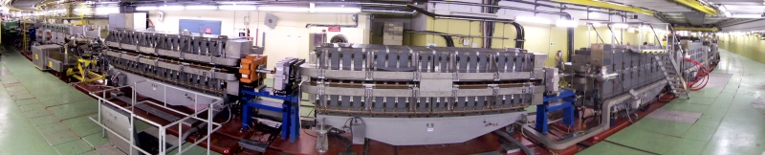
Simulation work
    In the PS, combined function magnets are used both for bending and focusing the beam
    Many thanks to D. Schoerling

Slide 94
Simulation work
    In the last months we introduced in the buildup code PyECLOUD the features to simulate the e-cloud build-up:
    Arbitrary shaped chamber
    Arbitrary magnetic field map

Slide 95
Simulation work
    In the last months we introduced in the buildup code PyECLOUD the features to simulate the e-cloud build-up:
    Arbitrary shaped chamber
    Arbitrary magnetic field map
    The electric field of the beam is calculated using Finite Difference Method

Slide 96
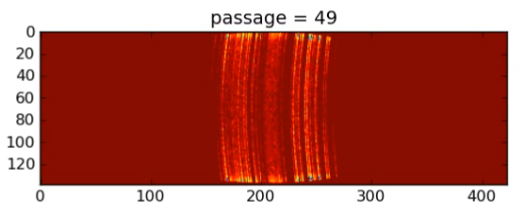
Simulation work
    In the last months we introduced in the buildup code PyECLOUD the features to simulate the e-cloud build-up:
    Arbitrary shaped chamber
    Arbitrary magnetic field map
    The electron tracker interpolates a B field map provided by the user

Slide 97
First simulation results
    The e-cloud flux in the main magnets if the PS is strongly dependent on the bunch length
300
4 ns
250
200
40 MHz RF Voltage [kV]
150
100
11 ns
50
b.l.≈14 ns
0
10
20
30
40
50
60
Time [ms]

Slide 98
First simulation results
    The dependence on bunch intensity is very weak for short bunches but becomes stronger for relatively larger bunch lengths
300
4 ns
250
200
40 MHz RF Voltage [kV]
150
100
11 ns
50
b.l.≈14 ns
0
10
20
30
40
50
60
Time [ms]

Slide 99
First simulation results
    The dependence on bunch intensity is very weak for short bunches but becomes stronger for relatively larger bunch lengths
300
4 ns
250
200
40 MHz RF Voltage [kV]
150
100
11 ns
50
b.l.≈14 ns
0
10
20
30
40
50
60
Time [ms]

Slide 100
First simulation results
    The dependence on bunch intensity is very weak for short bunches but becomes stronger for relatively larger bunch lengths
300
4 ns
250
200
40 MHz RF Voltage [kV]
150
100
11 ns
50
b.l.≈14 ns
0
10
20
30
40
50
60
Time [ms]

Slide 101
Outline
  Introduction
  Beam observation
    Emittance along the train
    Instability on a “stored beam”
  Simulation work
    Code development
    First results
  Measurements with e-cloud setup in SS98
    Shielded pickup measurements
    Mitigation strategy tests

Slide 102
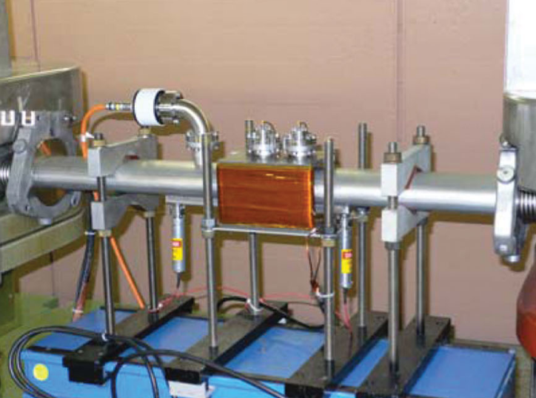
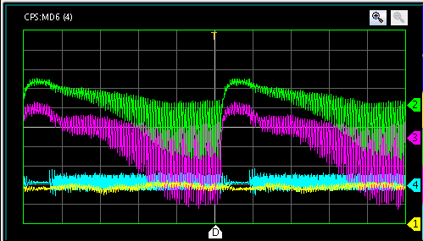
“Direct” e-cloud measurements
  A setup for e-cloud experiments is installed in SS98. It includes:
  Two shielded pickup for e-cloud detection
  A pressure gauge
  Clearing electrode
  Small dipole magnet (not used this year)
  Since 2012 it is possible to control the device from the CCC and acquire the signals using OASIS.
E. Mahner, T. Kroyer and F. Caspers. "Electron cloud detection and characterization in the CERN Proton Synchrotron." Physical Review Special Topics-Accelerators and Beams 11.9 (2008): 094401.

Slide 103
“Direct” e-cloud measurements
  Warning: the signal on this device does not describe the e-cloud in the main magnets, even dependence on beam parameters can be strongly different!
Test setup
Main magnet
PyECLOUD simulations for 4 ns bunch length

Slide 104
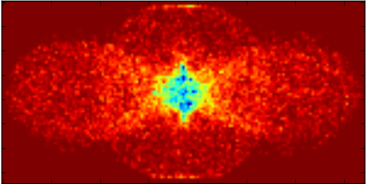
“Direct” e-cloud measurements
  Warning: the signal on this device does not describe the e-cloud in the main magnets, even dependence on beam parameters can be strongly different!
Test setup
Main magnet
PyECLOUD simulations for 4 ns bunch length

Slide 105
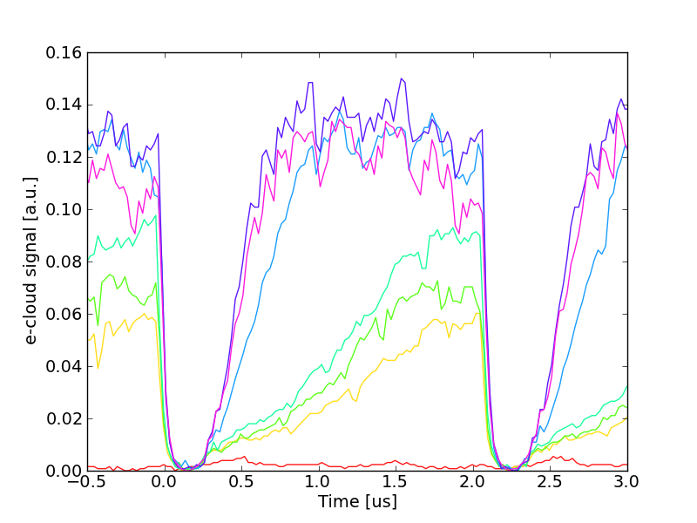
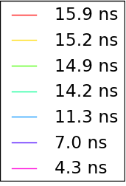
Parametric scans
  Is 2011-12 several measurement with different beam conditions were acquired in order to crosscheck our models and simulation codes.

Slide 106
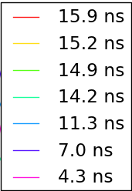
Parametric scans
  Is 2011-12 several measurement with different beam conditions were acquired in order to crosscheck our models and simulation codes.
  First attempts do not look so bad….
PyECLOUD sim.
Measurement

Slide 107
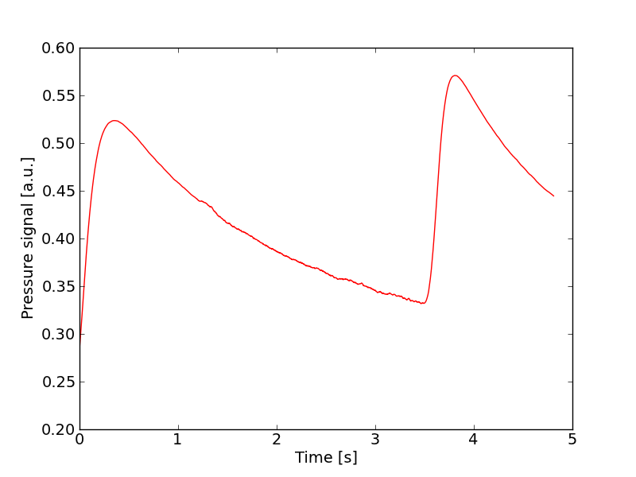
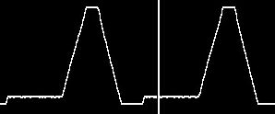
Possible mitigation strategies: RF voltage program
  The signal from the pressure gauge at SS98, can be used as an “time integrated” e-cloud indicator along the cycle (actually along the last ~60ms before extraction)

Slide 108
Possible mitigation strategies: RF voltage program
  The signal from the pressure gauge at SS98, can be used as an “integrated” e-cloud indicator along the cycle (actually along the last ~60ms before extraction)
  Together with the RF experts, we tried to optimize the 40MHz voltage program in order to mitigate this effect avoiding significant beam degradations

Slide 109
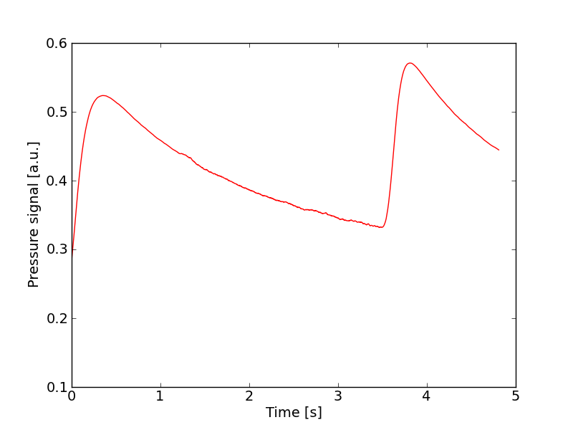
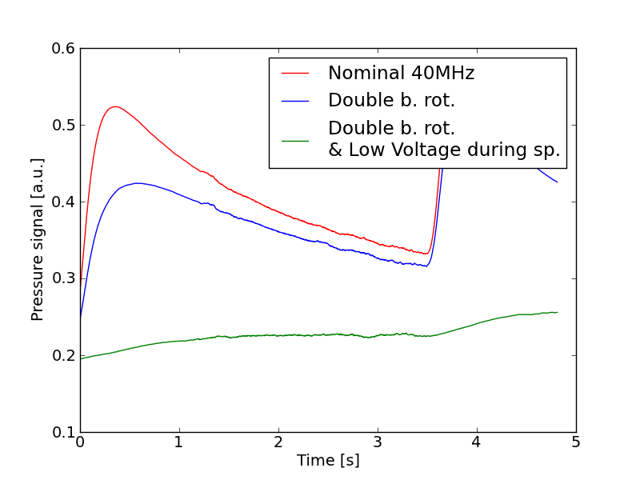
Possible mitigation strategies: RF voltage program
  Together with the RF experts, we tried to optimize the 40MHz voltage program in order to mitigate this effect avoiding significant beam degradations
4 ns
300
Double splitting
250
200
40 MHz RF Voltage [kV]
150
100
11 ns
50
b.l.≈14 ns
1.25e11 ppb
0
10
20
30
40
50
60
Time [ms]

Slide 110
Possible mitigation strategies: RF voltage program
  Together with the RF experts, we tried to optimize the 40MHz voltage program in order to mitigate this effect avoiding significant beam degradations
4 ns
300
Double splitting
250
200
40 MHz RF Voltage [kV]
150
100
50
b.l.≈14 ns
1.25e11 ppb
0
10
20
30
40
50
60
Time [ms]

Slide 111
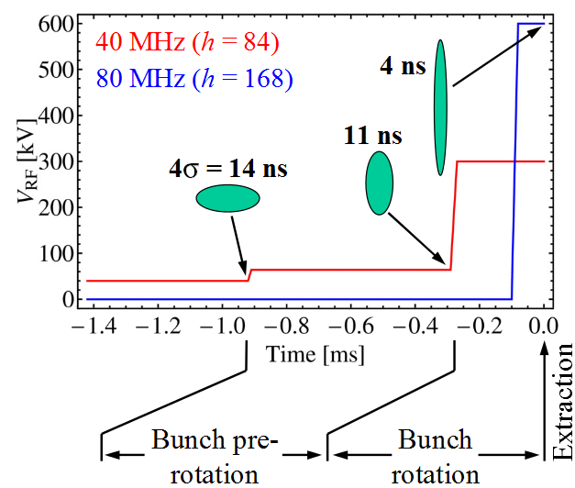
Possible mitigation strategies: RF voltage program
  Together with the RF experts, we tried to optimize the 40MHz voltage program in order to mitigate this effect avoiding significant beam degradations
Double bunch rotation
4 ns
300
Double splitting
250
200
40 MHz RF Voltage [kV]
150
100
50
b.l.≈14 ns
Tested in 2008 with encouraging results on e-cloud signals
0
10
20
30
40
50
60
Time [ms]
H. Damerau, S. Hancock, T. Kroyer, E. Mahner and M. Schokker, Electron Cloud Mitigation by Fast Bunch Compression in the CERN PS (No. CERN-AB-2008-050).

Slide 112
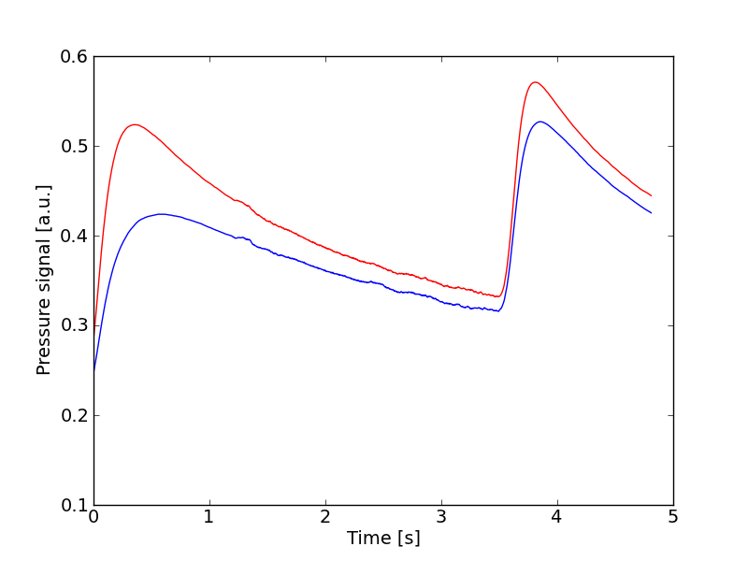
Possible mitigation strategies: RF voltage program
  Together with the RF experts, we tried to optimize the 40MHz voltage program in order to mitigate this effect avoiding significant beam degradations
4 ns
300
Double splitting
250
200
40 MHz RF Voltage [kV]
150
100
50
b.l.≈14 ns
1.25e11 ppb
0
10
20
30
40
50
60
Time [ms]
  A certain improvement can be obtained replacing the adiabatic bunch shortening with a “double bunch rotation”

Slide 113
Possible mitigation strategies: RF voltage program
  Together with the RF experts, we tried to optimize the 40MHz voltage program in order to mitigate this effect avoiding significant beam degradations
4 ns
300
Double splitting
250
200
40 MHz RF Voltage [kV]
150
100
40 kV
50
b.l.≈14 ns
1.25e11 ppb
0
10
20
30
40
50
60
Time [ms]

Slide 114
Possible mitigation strategies: RF voltage program
  Together with the RF experts, we tried to optimize the 40MHz voltage program in order to mitigate this effect avoiding significant beam degradations
4 ns
300
Double splitting
250
200
40 MHz RF Voltage [kV]
150
100
36 kV
50
1.25e11 ppb
0
10
20
30
40
50
60
Time [ms]

Slide 115
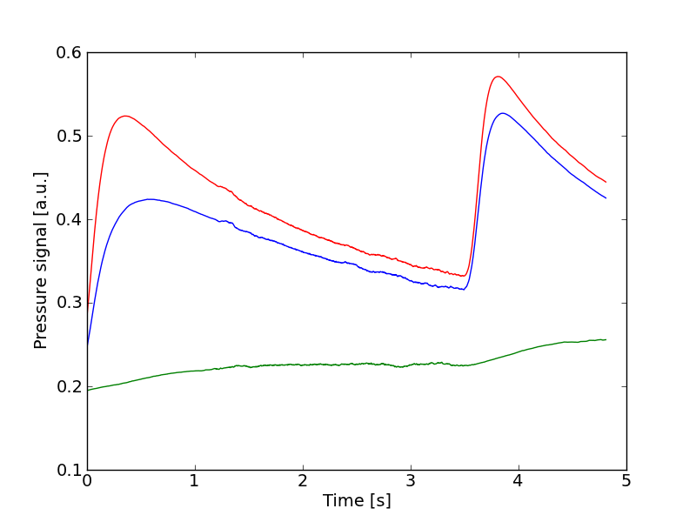
Possible mitigation strategies: RF voltage program
  Together with the RF experts, we tried to optimize the 40MHz voltage program in order to mitigate this effect avoiding significant beam degradations
4 ns
300
Double splitting
250
200
40 MHz RF Voltage [kV]
150
100
36 kV
50
1.25e11 ppb
0
10
20
30
40
50
60
Time [ms]
  A strong decrease of the pressure rise was observed reducing by 10% the 40 MHz RF voltage during last double splitting (no important degradation was observed)

Slide 116
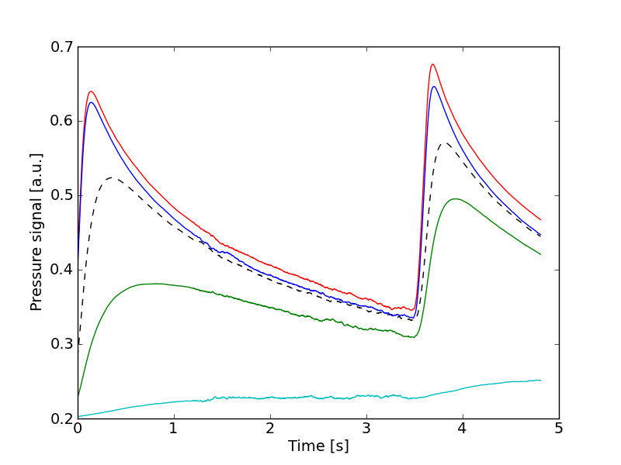
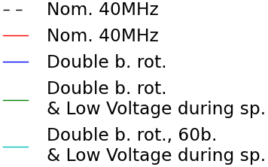
Possible mitigation strategies: RF voltage program
  As expected for the test setup, the situation gets worse when bunch intensity is increased
1.25e11 ppb
1.45e11 ppb

Slide 117
Summary
  Up to now e-cloud in the PS has never been a limitation for the production of the 25 ns LHC type beams but tranverse instabilities are observed when “storing” 25 ns beams at 26 GeV
  To predict the e-cloud behavior at higher intensities PyECLOUD modules have been developed for the simulation of combined function magnets
  For benchmarking against simulations, several e-cloud measurements with different beam conditions have been collected using the setup in SS98
  Double bunch rotation and 10% less voltage during the last bunch splitting give a significant reduction on the e-cloud in the test setup

Slide 118
Thanks for your attention!

