Slide 2
Proposals of new electron cloud monitor in the PS
Christina Yin Vallgren, TE-VSC
P. Chiggiato, S. Gilardoni, J. A. Ferreira Somoza, J. Hansen
G. Iadarola, G. Rumolo, G. Sterbini, M. Taborelli
Christina Yin Vallgren, MSWGmeeting 2013/04/09

Slide 3
Outline
WHY? Introduction
HOW?
  Proposal 1
  Proposal 2
  Present status
Summary

Slide 4
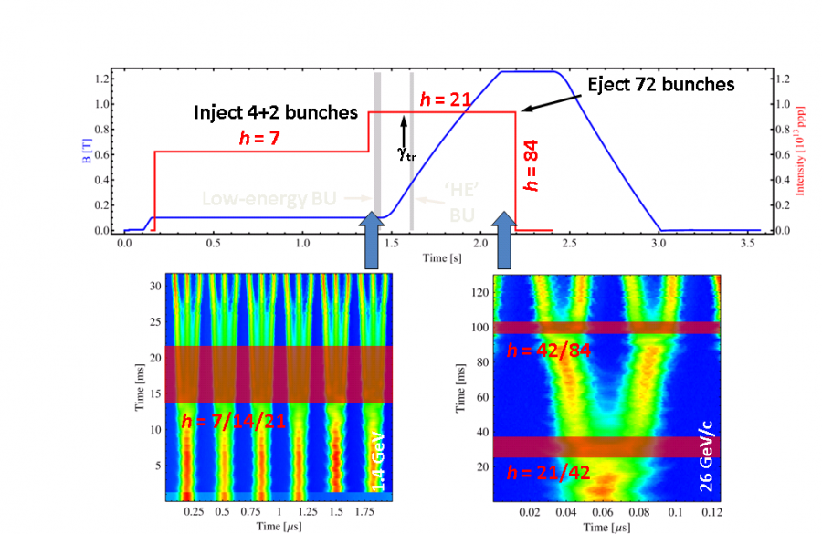
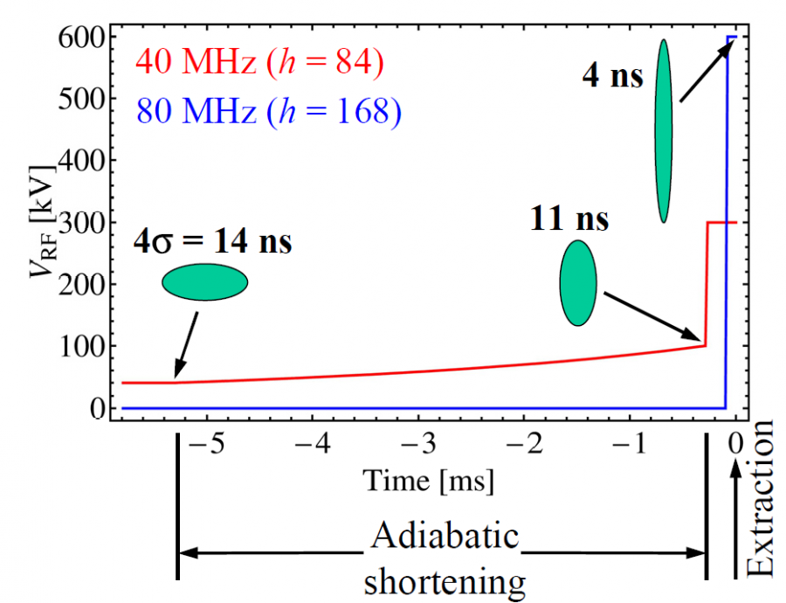
Introduction: Electron cloud build-up in the PS
Electron cloud is expected to occur shortly before extraction, when the bunches are short.
Bunch evolution during the last milliseconds in the PS cycle
(LHC beam of 25 ns)
Operation | Time before ejection | Number of bunches | Bunch spacing | Bunch length
2nd bunch splitting | 57 ms | 36 | 50 ns
3rd bunch splitting | 27 – 5 ms | 72 | 25 ns | 14 ns
Adiabatic bunch compression | 5 – 0.3 ms | 72 | 25 ns | 11 ns
Bunch rotation | 0.3 – 0.0 ms | 72 | 25 ns | 4 ns
Earlier studies confirmed that the electron cloud develops during 40-50ms before ejection (right after 2nd bunch splitting).

Slide 5
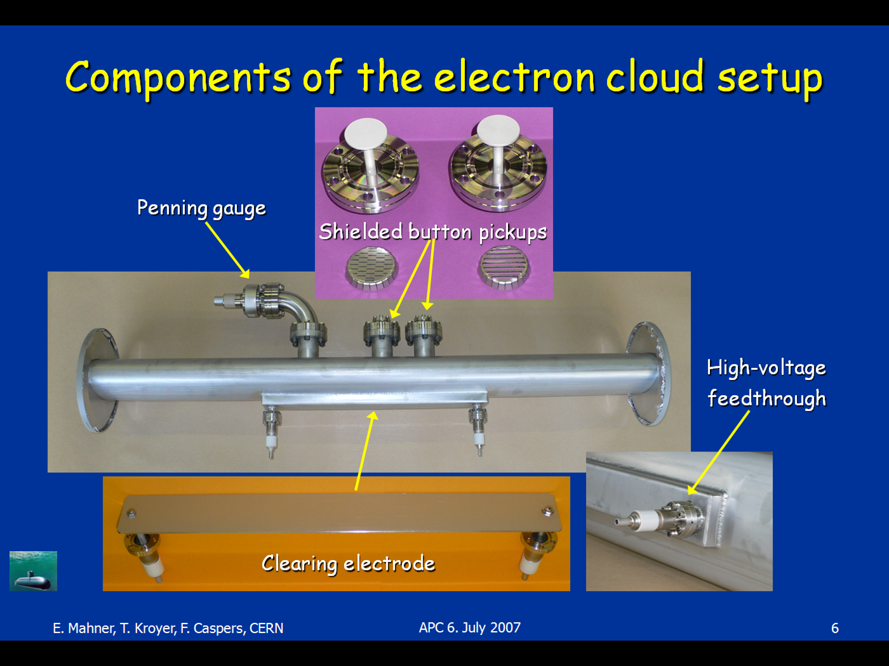
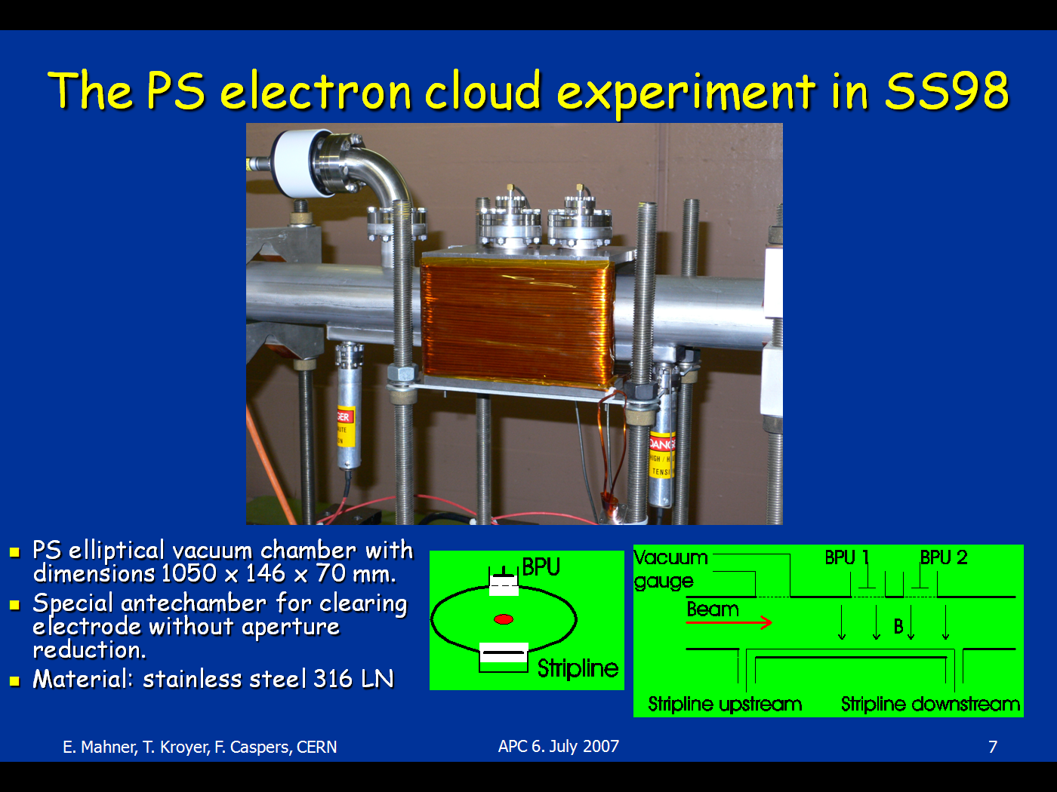
Experimental set-up of electron cloud detector
F. Caspers, T. Kroyer, E. Mahner
First electron cloud set-up in PS straight section 98, 2007
(bare st.st. vacuum chamber)
Second set-up in PS SS84, 2008
(a-C coated st.st. vacuum chamber)

Slide 6
Plan for the PS-LIU electron cloud studies
So far, we only have electron cloud monitor in the straight section, no direct diagnostics in any magnet.
  A dipole in straight section does not represent the real situation in a magnet: no high magnetic field and no ramp.
Plan to implement diagnostics tools in one of the PS magnets.
Measurements of electron cloud in a real magnet, will provide:
  Prediction of the EC build-up distribution in the PS magnets for higher intensity beams in the frame of the upgrade program.
  Validation of the EC simulation models and codes.

Slide 7
Existing electron cloud measurement methods
EC detection
Local EC measurements
Button-type pickups
Strip detectors
Integrated EC over a long section
Microwave transmission
Stable phase shift vs total beam intensity
New proposal
(photon detection)
  Simple, fast
  Used in the PS and the SPS straight sections
Simple, fast, position
Used in the SPS straight sections
Cannot be used in the PS: high outgassing of kapton foil and aperture limitation in the PS vacuum chambers.
Implemented in the SPS dipole
[S. Federmann & F. Casper & E. Mahner]
Measured in the LHC [Rumolo et.al.]

Slide 8
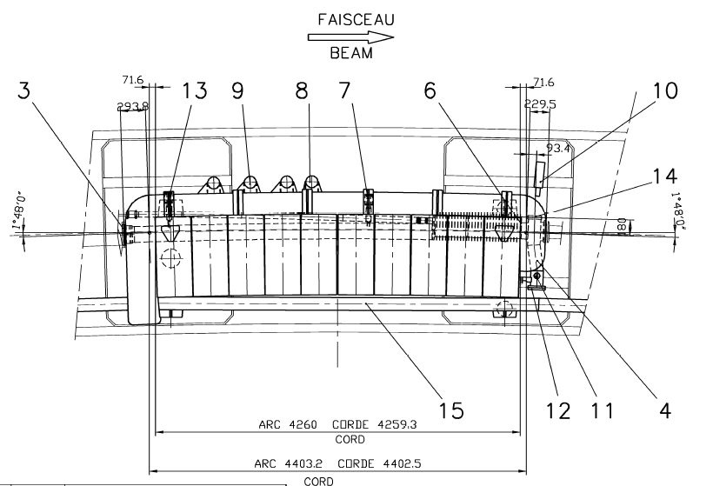
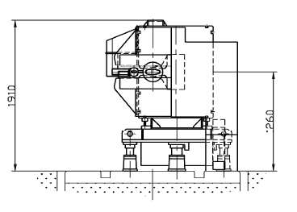
Proposal 1: pick up in magnet
Ideal location for a pick-up:
on the top/bottom of vacuum chamber due to magnetic field.
But Not possible: space limitation!

Slide 9
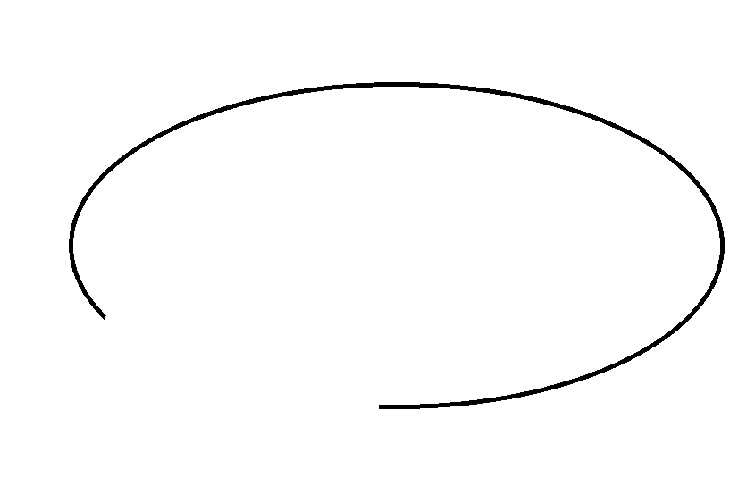
Proposal 1: pick up in magnet
PS magnet vacuum chamber
Different types of PS beam
Stainless steel plate
coated by Ag
Shield
The vacuum chamber with max length of 10cm with a shielded pick up can be manufactured independently.
Use an existing PS magnet vacuum chamber, cut and then weld the chamber where the vacuum chamber with the pickup will be installed.

Slide 10
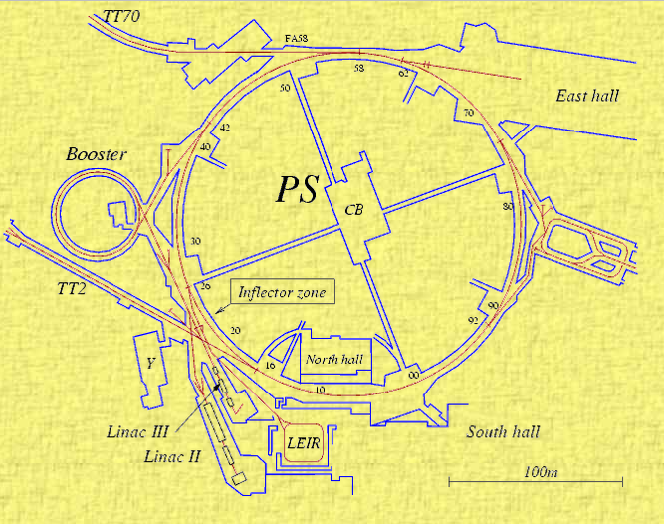
Proposal 1: pick up in magnet
Possible magnet:
  Several magnets are planned to be replaced during LS1 (MU14,55,57,75). => Good moment to benefit the opportunity
  Our preferable MU is in Sector 9: radiation cool.
  MU98: next to existing EC monitor in SS98
    Standard stainless steel vacuum chamber.
    Never refurbished.
    Cabling to 355/R-017: <50m.
    Benefit the existing electronics.
    Radial steering: beam can be moved towards
    the pick-up by 30mm.
MU55
EC monitor
SS98
355/R-017

Slide 11
Proposal 2: EC measurement via electron-photon emission
Electron-photon emission:
The emission of photons from metals bombarded by low-energy electrons
PS magnet vacuum chamber
Photomultiplier
hν
hν
hν
hν
LHC types beam
B
e-
e-
hν
hν
hν
Optical window
Electrons in EC has a relatively low energy (~300eV).
Expected photon wavelength with 300eV electrons: 200nm (UV) – 700nm (visible).
Expected photon energies: 2eV – 5eV.
Expected radiation yield: 10⁶ photons/sec.nm.mm².A

Slide 12
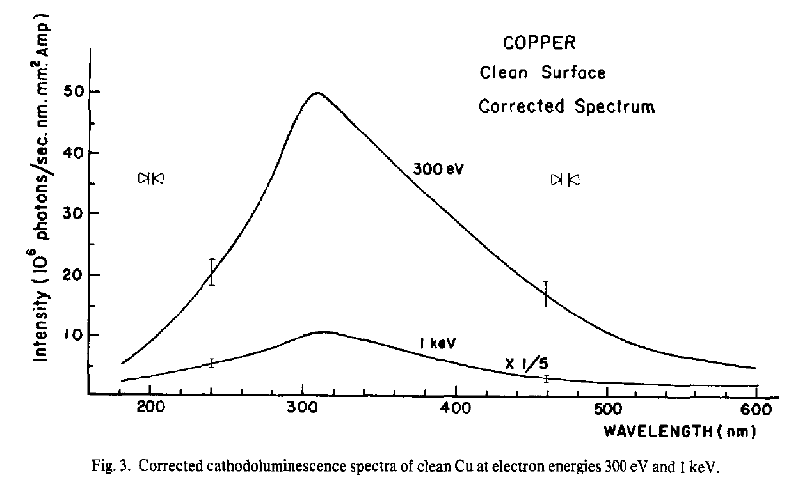
Proposal 2: EC measurement via electron-photon emission
J. Phys. Chem. Solids, 1976, Vol. 37, pp. 403-409
The measured luminescence intensity is expressed in:
number of photons/mm2 per sec per nm per Ampere of incident electron beam at a distance of 30 cm from the target.

Slide 13
Proposal 2: EC measurement via electron-photon emission
EC energy
Experiments in the lab
Radiation yield on Stainless steel
Implementation in the PS magnet vacuum chamber
Drawing of vacuum chamber
EC density
Spectral distribution of emission intensity
Simulation of EC
Beam profile
Beam envelop
Methods to move the beam
Electronics for the pick-up and photodetection.
PS magnet choice
EC position
E- gun with BaO cathode
Low light emitter (1150K)
Thanks to G. Iadarola and G. Sterbini
Ion gauge
EC energy: Peak at 200-300 eV
EC density: 0.5-2 A/m2
EC position: 20-30 mm from the centre of beam pipe
Beam envelop: vertical limitation
Method to move the beam: radial steering
valve
Spectrometer
200-720nm
Collimating
lens
Quartz
window
Transfer rod with load lock
valve
Optical fiber
sample
Computer
turbo
pump

Slide 14
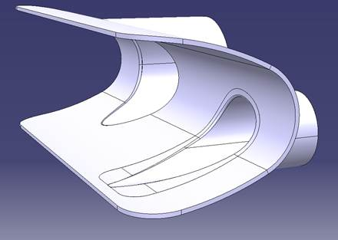
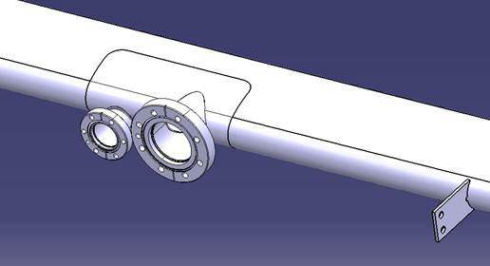
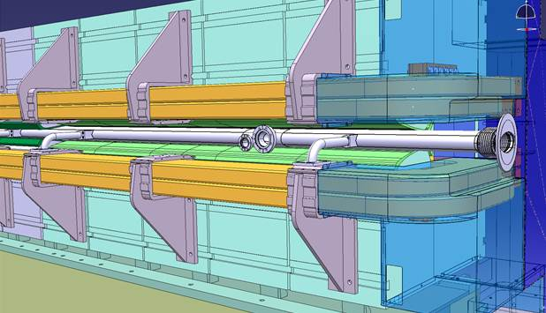
Implementation in the PS vacuum chamber
Modification of vacuum chamber: 1st version
DN63:
optical window
DN35:
shield pick-up
[By Teddy Capelli EN/MME]

Slide 15
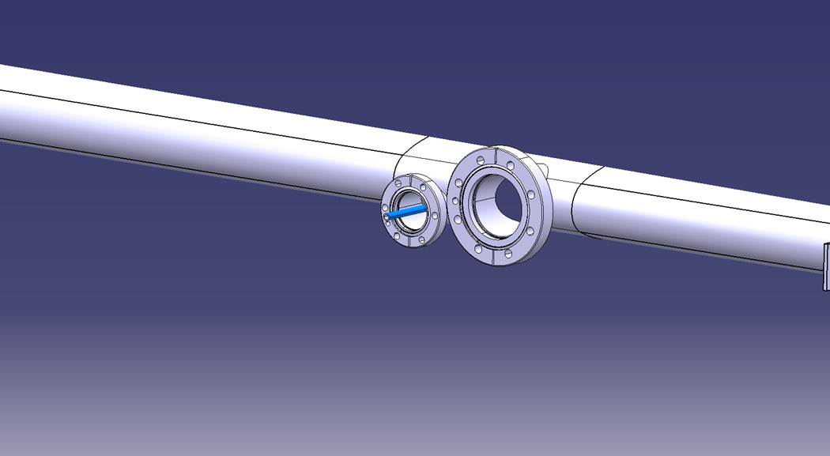
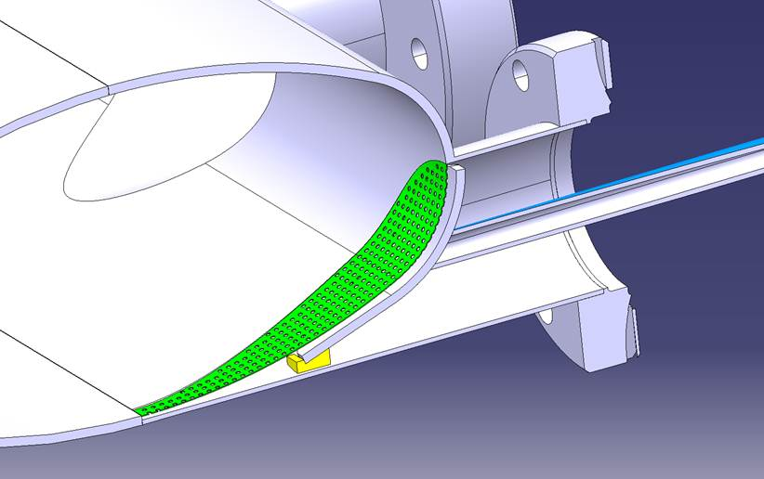
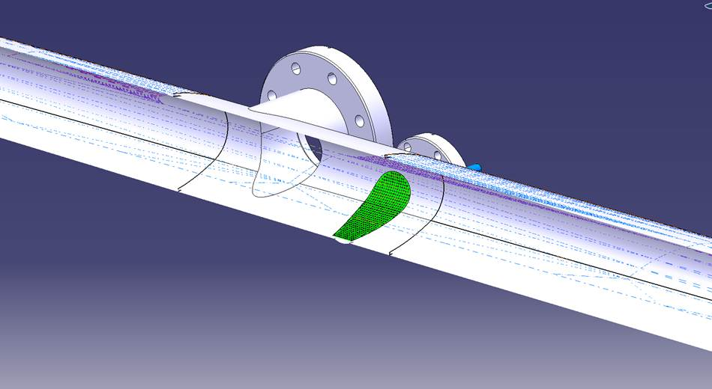
Implementation in the PS vacuum chamber
Modification of vacuum chamber: 1st version
Grid:
Prevent RF
Biased Electrode:
Measure current from EC
[By Teddy Capelli EN/MME]

Slide 16
Summary/To-do list
  Decision of which MU?
    To be confirmed by Dominique: final report on 15 April
  Photodetection experiments in the lab.
  Improve the design of electrode (closer to the beam pipe center).

