Slide 1
Radiation Survey Results 2013
Comparison 32h & 2months 2011-12 vs 2013
PS Complex
G. Dumont

Slide 2
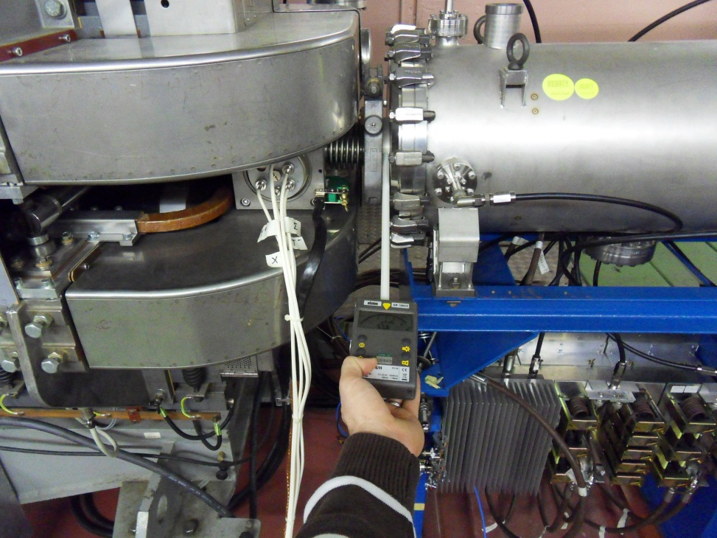
Radiation Survey method
Automess AD6
40cm « Gabarit »
Upstream – downstream of all the main elements
Values referenced with element names and relative position
Pictures for a better reproducibility
« RASU » system for data registering

Slide 3
PS Booster: Analysis of survey data
 | 22/11/2011 | 18/12/2012 |  | 20/01/2012 | 18/02/2013
Average dose rate [µSv/h] | 90 | 90 |  | 45 | 53
Median dose rate [µSv/h] | 30 | 31 |  | 13 | 19
Maximum level [µSv/h] | 2486 | 1900 |  | 945 | 1002
2nd max. point [µSv/h] | 1989 | 1898 |  | 614 | 380
3rd max. point [µSv/h] | 1193 | 732 |  | 382 | 352
Dose rate > 1000 µSv/h | 1% | 1% |  | 0% | 1%
500 < Dose rate < 1000 µSv/h | 2% | 3% |  | 1% | 0%
100 < Dose rate < 500 µSv/h | 18% | 22% |  | 10% | 14%
25 < Dose rate < 100 µSv/h | 29% | 31% |  | 26% | 30%
Dose rate < 25 µSv/h | 50% | 43% |  | 64% | 56%

Slide 16
PS Ring: Analysis of survey data
 | 17/11/2011 | 18/12/2012 |  | 17/01/2012 | 25/02/2013
Average dose rate [µSv/h] | 267 | 249 |  | 122 | 123
Median dose rate [µSv/h] | 70 | 63 |  | 30 | 30
Maximum level [µSv/h] | 3978 | 6627 |  | 1954 | 2881
2. point [µSv/h] | 3282 | 2529 |  | 1484 | 1369
3. point [µSv/h] | 3182 | 2320 |  | 1340 | 1309
Dose rate > 1000 µSv/h | 7% | 6% |  | 3% | 4%
500 < Dose rate < 1000 µSv/h | 7% | 6% |  | 5% | 3%
100 < Dose rate < 500 µSv/h | 21% | 24% |  | 14% | 15%
25 < Dose rate < 100 µSv/h | 50% | 48% |  | 36% | 35%
Dose rate < 25 µSv/h | 17% | 17% |  | 43% | 44%

Slide 25
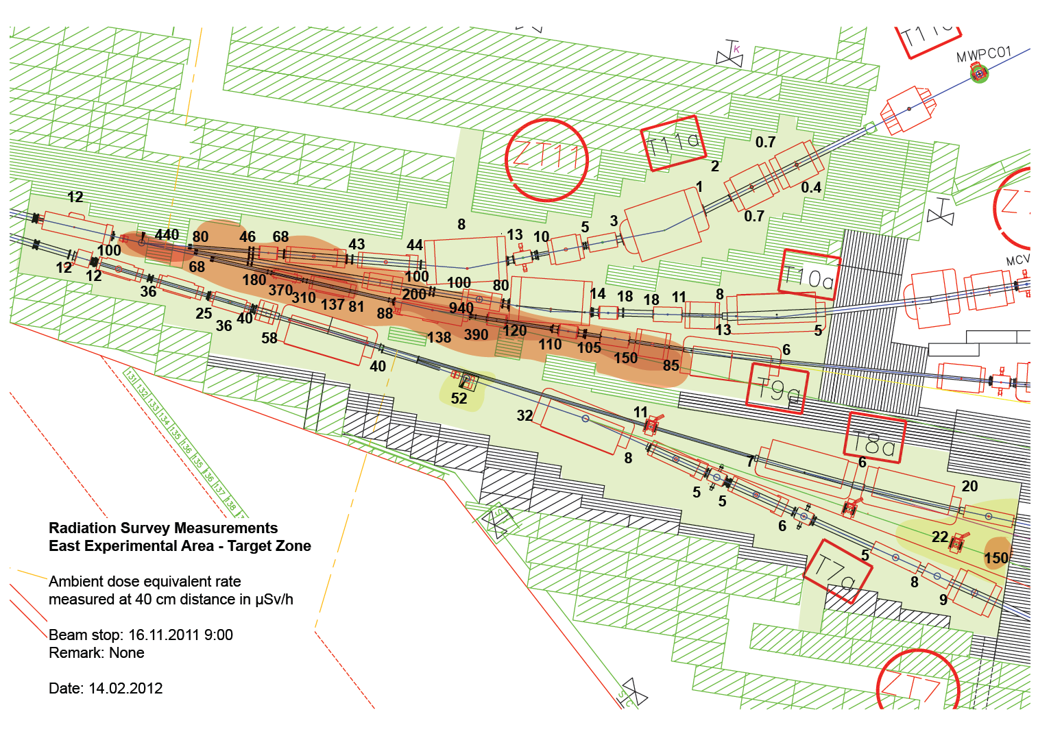

Slide 26
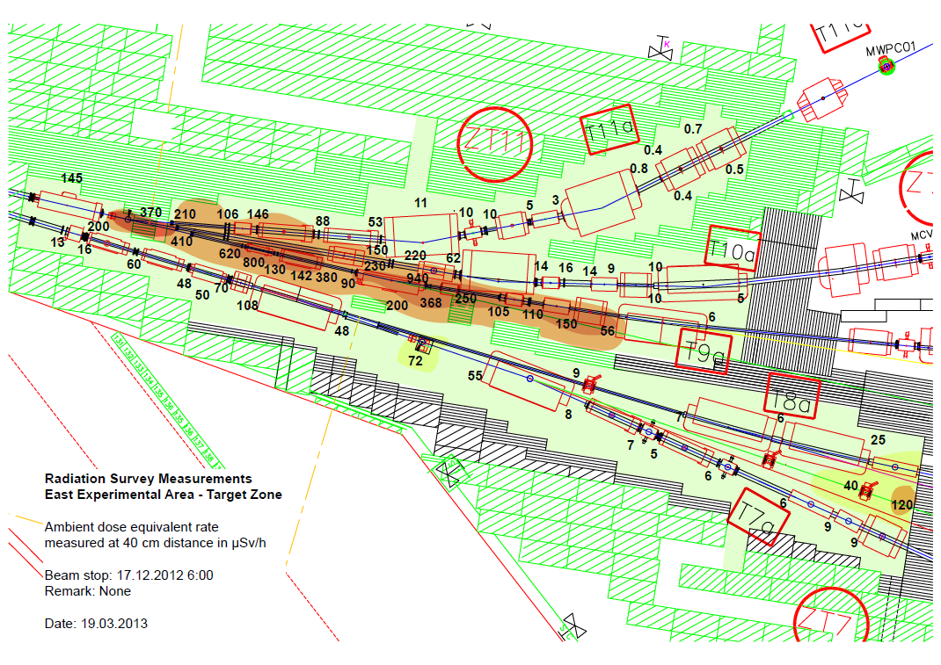
x 2 to 3

