Slide 1
LS1 schedule status
LHC
K. Foraz

Slide 2
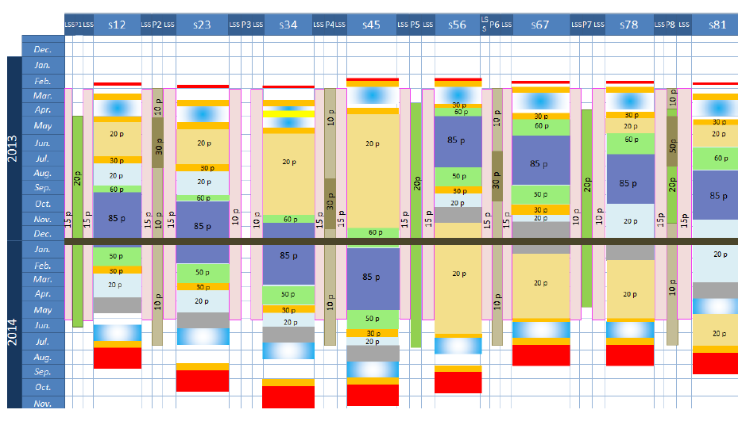
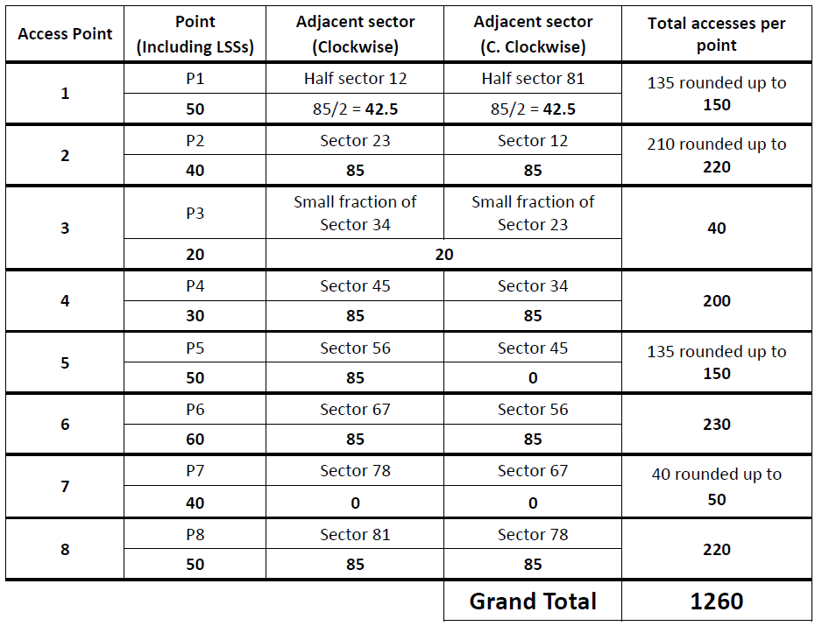
General information - maximum number of accesses
Courtesy: S. La Mendola (HSE)

Slide 3
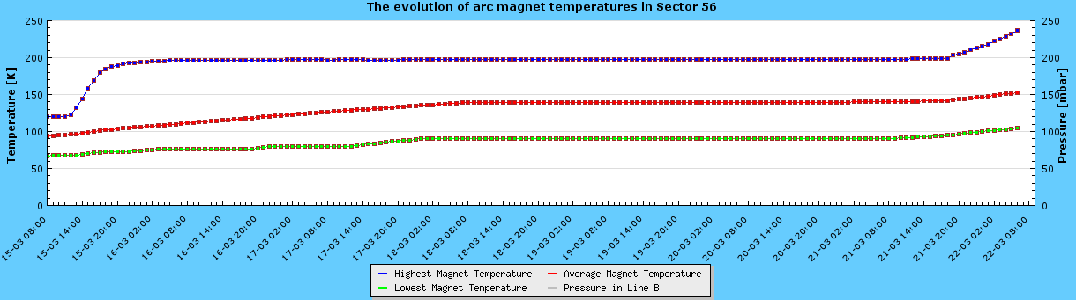
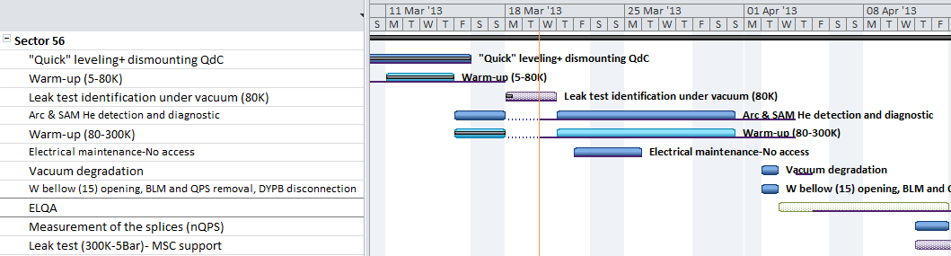
Progress
Warm-up in progress in sector 56
300K ~April 1st
End of
Survey fast leveling
Leak detection at cold

Slide 4
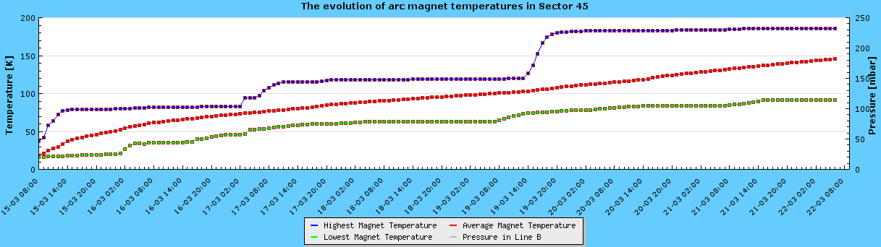
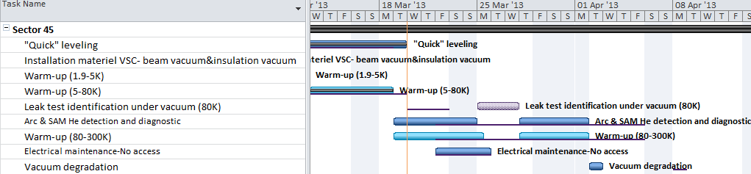
Progress
Warm-up in progress in sector 45
300K ~April 9th
End of
Survey fast leveling

Slide 5
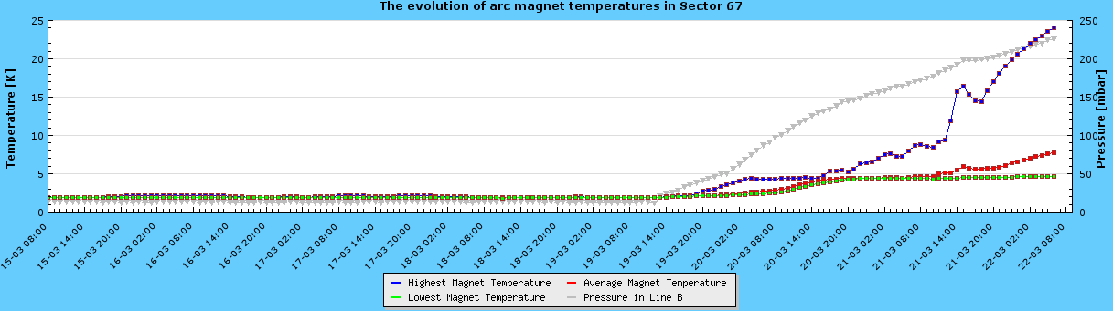
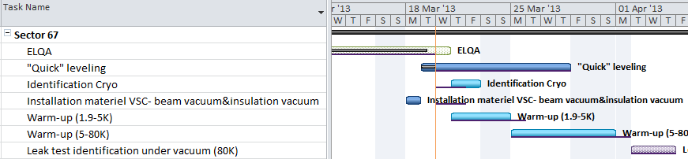
Progress
Warm-up in progress in sector 67
300K ~April 19th

Slide 6
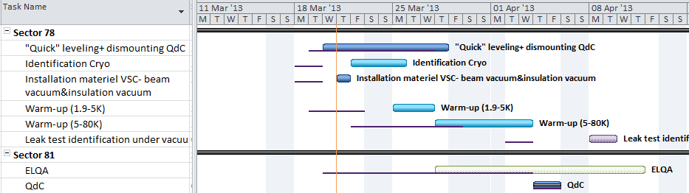
Progress
ELQA before warm-up is finished in sectors 56, 45, 67 & 78
In progress in sector 23 and 34

Slide 7
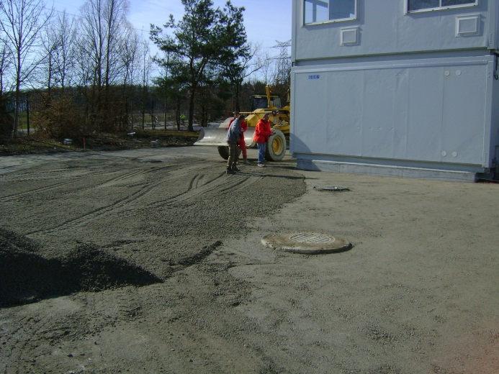
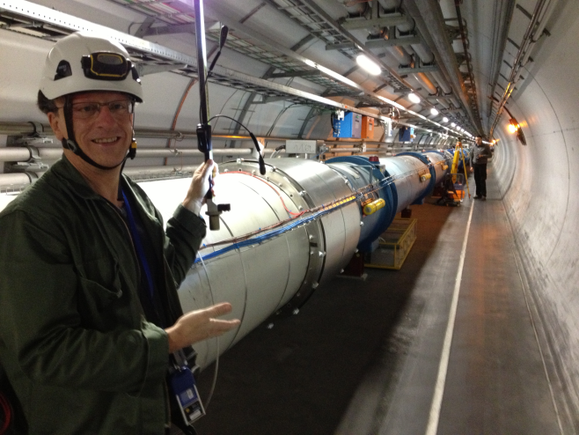
Progress
Installation of “bases de chantier”
Survey : Fast leveling & Deep reference
measurements
Installation of optical fiber’s ducts in pits
RF: Klystrons replacement and ADT
Base de chantier @ P6
Fast leveling in sector 23

Slide 8
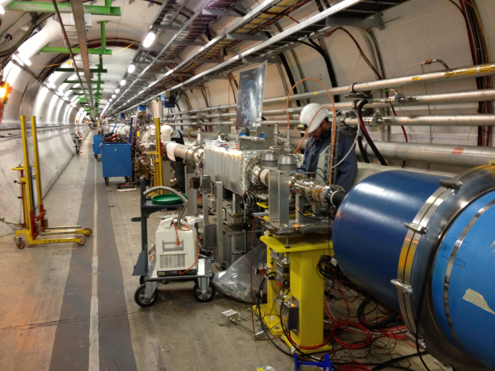
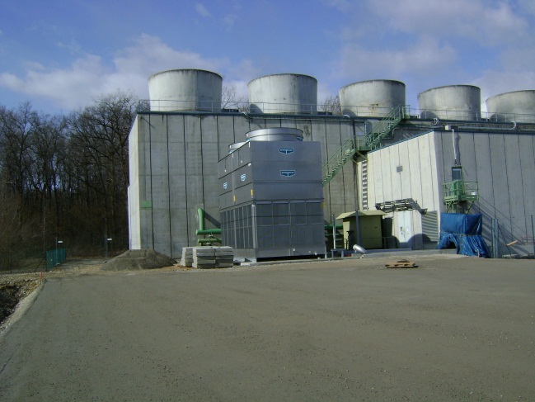
Progress
MKD-MKB: overhaul of generators
Beam vacuum in LSS (A5R2, A4L3, A5L5, A5R5, A6R5)
Maintenance, consolidation and new cooling-towers started
Inspection, check and tests of different equipment: collimators, ALPHA, BTVS, ACS, BQS, TCDQ,
Vacuum in LSS2L
New cooling tower @ P6

Slide 9
Global status
 | Powering Tests |  | ELQA Before warm-up |  | Fast leveling |  | Warm-up |  | SMACC Open |  | R2E
 | End |  | End |  |  |  | End |  | Start |  | Start
Sector 12 | 28/02 (+2d) |  | 10/04 (+8d) |  |  |  | 08/05 (+7d) |  | 17/07 (-)
Sector 23 | 28/02 (-) |  | 21/03 (+4d) |  |  |  | 09/05 (-5d) |  | 07/08 (-)
Sector 34 | 28/02 (-) |  | 05/04 (-7d) |  |  |  | 07/05 (- 8d) |  | 20/11 (-)
Sector 45 | 22/02 (+1d) |  | 08/03 (+2d) |  |  |  | 01/04 (-4d) |  | 06/01 (-)
 |  |  |  |  |  |  |  |  |  |  | 22/03 (-) But …
Sector 56 | 22/02 (+2d) |  | 06/03 (+2d) |  |  |  | 01/04 (-2d) |  | 16/04 (-3d)
Sector 67 | 25/02 (+2d) |  | 20/03 (+1d) |  |  |  | 18/04 (+1d) |  | 14/05 (-)
 |  |  |  |  |  |  |  |  |  |  | 13/05 (+3d)
Sector 78 | 27/02 (+2d) |  | 22/03 (+5d) |  |  |  | 22/04 (+3d) |  | 05/06 (-)
 |  |  |  |  |  |  |  |  |  |  | 04/04 (-) Small impact later
Sector 81 | 28/02 (+2d) |  | 12/04 (+8d) |  |  |  | 16/05 (+8d) |  | 26/06 (-)
 |  |  |  |  |  |  |  |  |  |  | 26/04 (-) (+8 days later)
Actual date (Δ/baseline)
Changes from last update

Slide 10
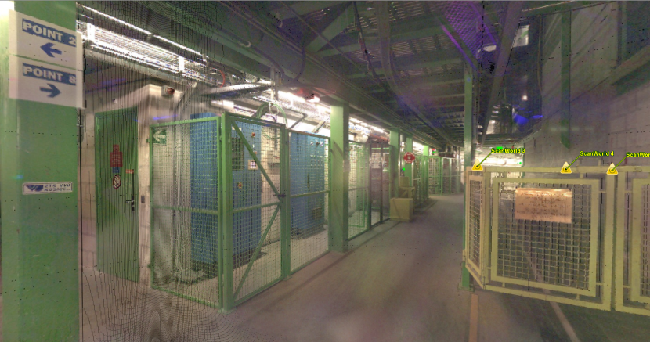
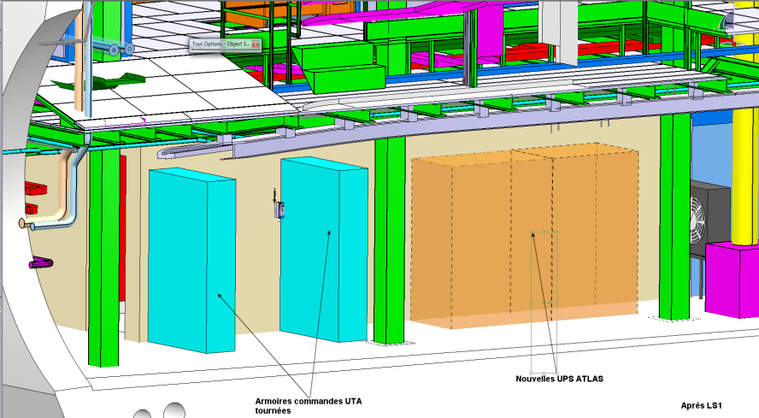
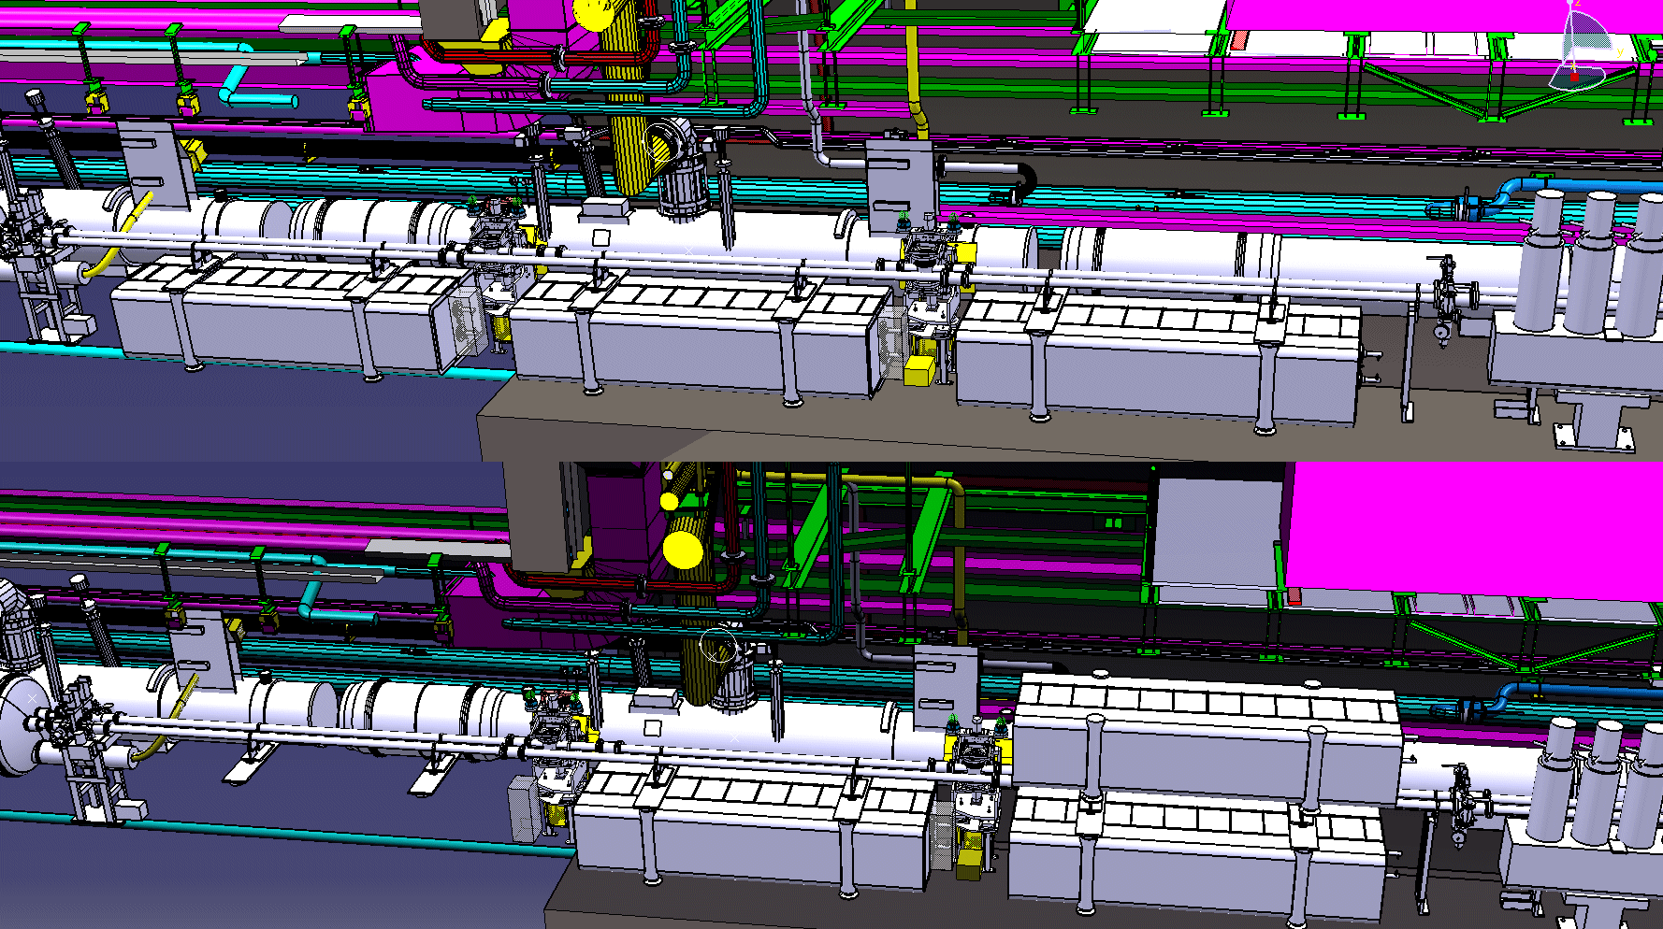
Warning & possible issues – being treated
US15 – UPS racks for ATLAS
  Machine space
  Integration in progress
  ECR must be written
ATLAS AFP – still no news
Totem Roman pot displacement @ P1
  Integration process just started
  As soon as work is defined, we will have to schedule it with the equipment groups (piping, vacuum…)

Slide 11
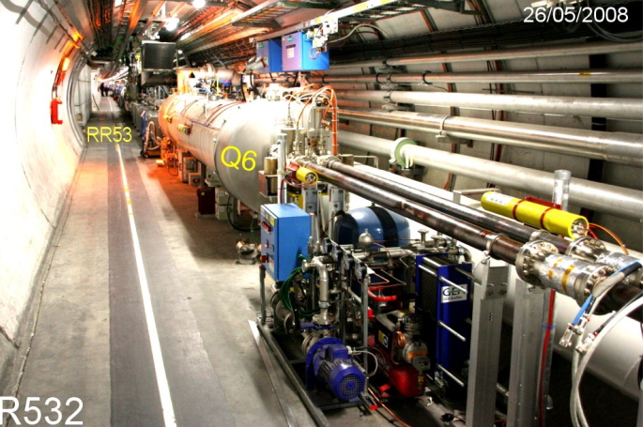
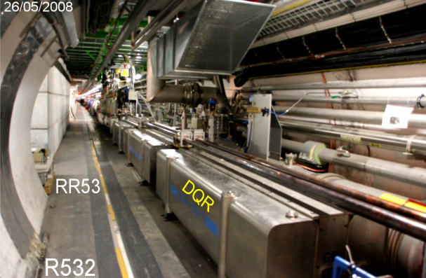
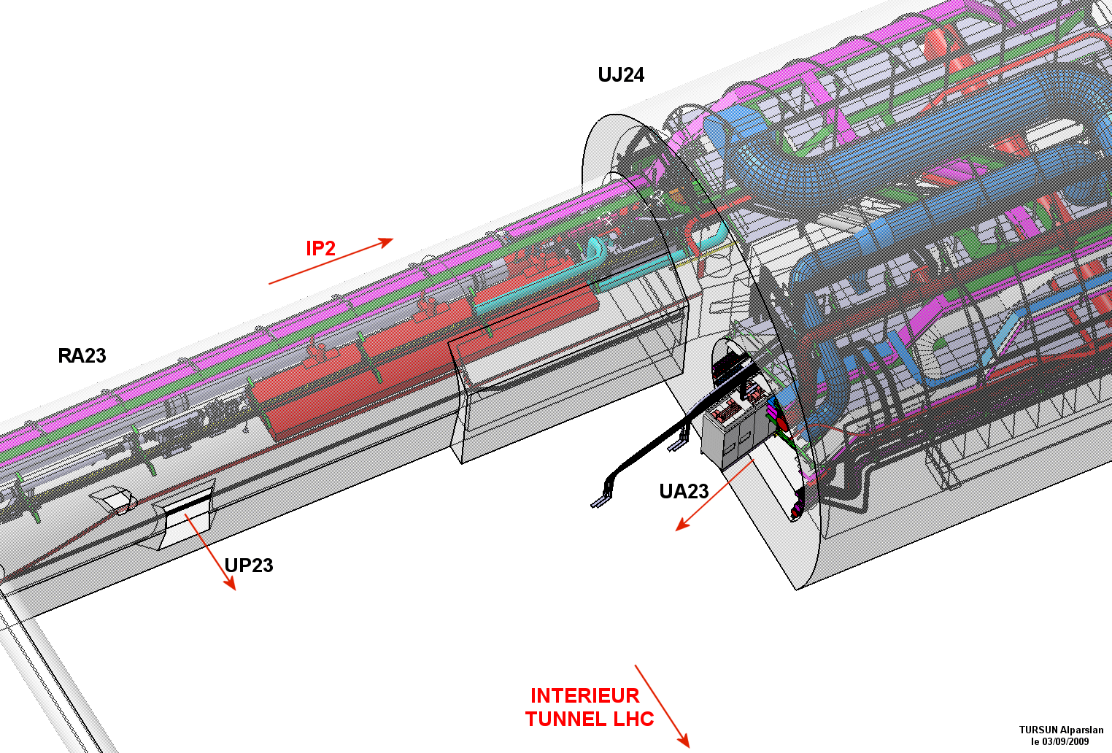
Warning & possible issues – being treated
TCL6 displacement at point 5
  Integration in progress (Roese to displace)
Inner Triplet DN300
  Integration in progress
  As a reminder the associated ECR is blocked, as well as the ECR concerning the Low Beta HLS System Validation Station
DFBX flowmeters
  Integration just finished
  But the late integration of these devices delayed the plan readiness for R2E
UP33 – ALARA cable tray
  Real transport volume is urgently needed !!
Inner Triplet DN300

Slide 12
Conclusions
«Base de chantier» in preparation
Schedule and Space …….tighter and tighter
Some few days more and less in the different sectors
  Very good spirit to try to recover the minor delays
  Thank you

