Slide 2
Safety Training for LS1
Prepared by Thomas Otto, Safety Officer, TE Dept.
In his absence:
Presented by John Pedersen, Safety Officer, EN Dept.

Slide 3
LS 1 Prevention Focus
Accident statistics and analysis indicates that the necessary technical prevention and protection is in place.
Work sites are prepared with the safety coordination ad documented in VIC reports
Rules and regulations in place provide in general a sufficient referential.

Slide 4
LS 1 Prevention Focus
What remains is training and awareness raising, as the safety problems are rather linked to the individuals.
This presentation is thus concentrating on the required safety training and awareness raising to access the sites during LS 1.

Slide 5
Basic Sensibilisation on SIR^{*)}
https://sir.cern.ch/
A specific e-learning ”Safety during LS-1” online.
To be taken with “CERN Safety Introduction”
The e-learning courses 1-3 and 4 (LHC machine) are waived
Other Level 4 courses (LHC experiments and injectors) remain in place
All personnel shall follow “e-learning LS-1” (approx. 30-45 minutes)
*) Safety Information Registration

Slide 6

Course for Underground Areas
Self-rescue mask is obligatory for underground areas (LHC and SPS)
Classroom training, approx. 2 hours

Slide 7
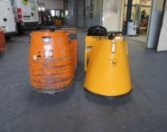
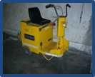
Driving Aptitude test PEFRA / RTL
Needed for CERN Personnel:
  Tractor with trailer
Needed for Contractors:
  Tractor with and without trailer
  Not needed with CACES 2 valid
Examinations every Monday afternoon
Inscription nominally :
Isabelle.Cusato@cern.ch
Safety.Training@cern.ch

Slide 8
Radiation Protection
For supervised radiation area (Annual dose< 6mSv):
  E-learning “RP Course for Supervised Radiation Areas” https://sir.cern.ch/
For controlled radiation areas: (Annual dose< 20mSv):
  1-day classroom training with exercises
  “Radiological Protection for Controlled Radiation Areas” https://cta.cern.ch
  For CERN personnel at CERN
  For contractors in Technoparc

Slide 9
Radiation Areas in Injectors
Supervised radiation area:
LEIR and most of the experimental areas
Controlled radiation areas:
SPS, PS, PSB, LINAC 3 and 2, AD Ring and Target,
Supervisor sends personnel to appropriate training, depending on their work area

Slide 10
Radiation Areas in LHC
Radiation areas in LHC are in general Supervised areas
The exceptions are:
Point 3: R34/R36/R37/R38 (collimators)
Controlled area
Point 6: TD62/UD62 et TD68/UD68 (dump caverns)
Limited stay area
  Point 7: R771, UJ76, R74/R76
  Limited stay area

Slide 11
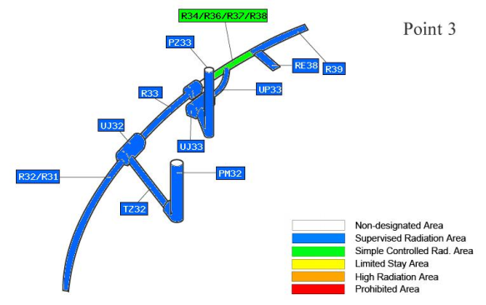
Radiation Areas in LHC
Point 3: R34/R36/R37/R38 (collimators)
  Passage permitted with “supervised areas course”
  Work requires “controlled areas course” and Work- and Dose Planning (WDP) associated to IMPACT

Slide 12
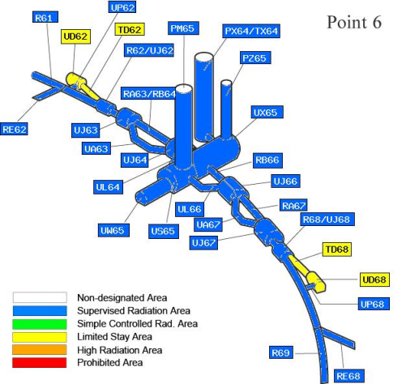
Controlled Radiation Areas in LHC
Point 6: TD62/UD62 et TD68/UD68 (dump caverns)
  Work requires “controlled areas course” and Work- and Dose Planning (WDP) associated to IMPACT

Slide 13
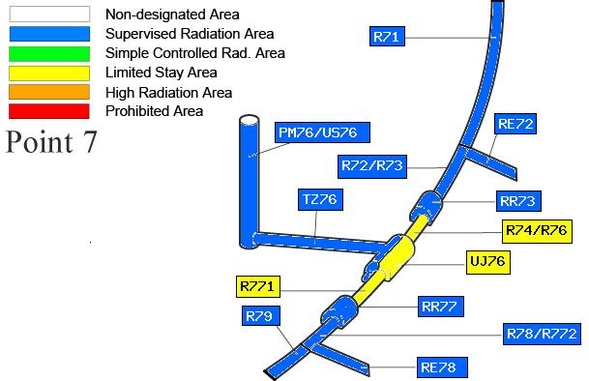
Controlled Radiation Areas in LHC
Point 7:
R771, UJ76, R74/R76
  Radiation veto until 1. 7. 2013
  Only exceptional passages afterwards
  Every access requires WDP associated to IMPACT

Slide 14
Electrical Safety Training
Access to LHC accelerator areas:
Non-electricians
  CERN Personnel: Electrical Safety Awareness, https://sir.cern.ch/
  Contractors: Electrical Habilitation H0B0 by employer after mandatory training
  Temporaires: Electrical Habilitation H0B0, may follow mandatory training at CERN, 1.5 days
Electricians, “travail d’ordre electrique”
  Electrical Habilitation according to needs, by employer (CERN: Group Leader) after mandatory training, 2-4 days
  CERN: https://cta.cern.ch

Slide 15
Where are the Safety Courses
Electronic platform SIR, self-learning:
  https://sir.cern.ch/
  CERN Safety Introduction
  E-learning LS1
  Level 4 for LHC Exp. and/or injectors
  Electrical Safety Awareness
  Radiation Protection
  (supervised areas)
Classroom courses (inscription required):
https://cta.cern.ch
  Self-Rescue Mask
  Electrical Habilitation Training
  Radiation Protection
  (controlled areas)
  PEFRA driving license
  Safety.training@cern.ch
  Isabelle.cusato@cern.ch

Slide 16
Summary Table
Work Area | CERN Safety Intro & Safety during LS1 | Accelerator Safety Level 4 | Electrical Safety Awareness | Self-Rescue Mask | RP Supervised | RP Controlled
LHC Tunnel | X |  | X(1)(2) | X | (3)
LHC Exp. | X | X | Recommended (1) | Recommended CMS: X | (3)
SPS | X |  | X(1)(2) | X |  | X
PS | X | X | X(1)(2) |  |  | X
other injectors | X | X | X(1)(2) |  | LEIR | AD, PSB LINACS
Experimental areas | X | ISOLDE N-TOF | (1) |  | (3)
Workshops | X |  | (1)
“Radioactive”Workshops | X |  | (1) |  | (3)
For “travaux d’ordre électrique”: electrical safety training and “habilitation électrique” by group leader or chef d’entreprise
Contractors need in any case at least a habilitation H0B0 by their chef d’entreprise
Mostly, but depending on local classification and /or dose equivalent rate

Slide 17




Don’t Forget your
Personal Protective Equipment
Accelerators, Experimental Halls
Underground Areas
PS Tunnel
EDMS 1223620

Slide 18
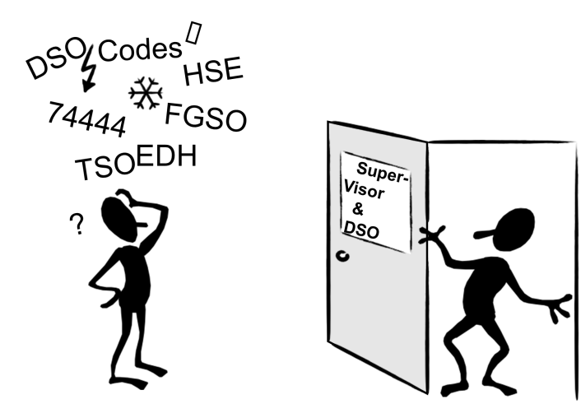
Questions ? Need Help ?

