Slide 1
Molasse/moraine interface tt20
GS/SE 21 March 2013

Slide 2
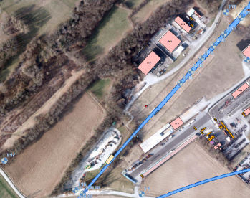
Borelogs Project Area
Sondage F16
  Molasse depth 425.95m asl (23.95m below ground)
Sondage F17
Molasse depth 413.73m asl (34.6m below ground)
Sondage F11
  Molasse depth 430.7m asl (20m below ground)
F11
F17
F16

Slide 3
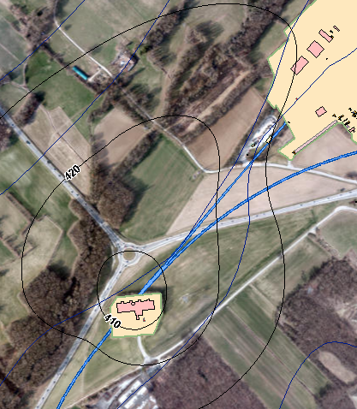
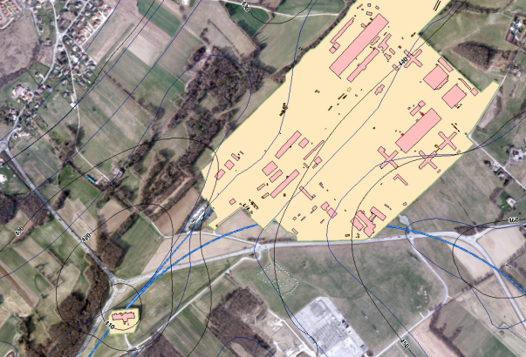
Molasse Depth Project Area
Isolines Molasse Depth
430
420
410

Slide 4
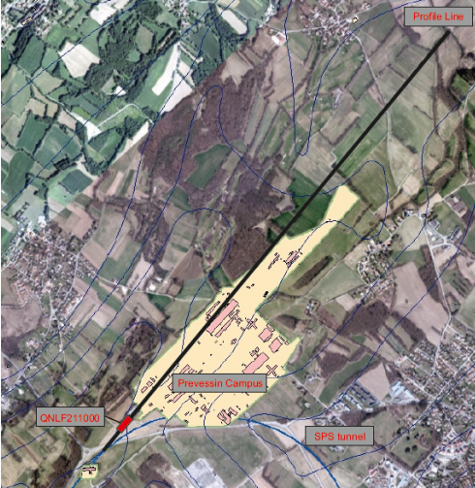
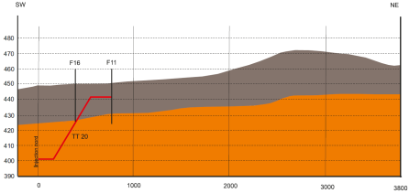
Molasse-Moraine Boundary TT20
Boundary at magnet QNLF 211000
SPS level = 401m asl

Slide 5
Junction Cavern Location
The Molasse – Moraine interface is near magnet QNFL 211000 (TT20).
However, some problems are expected for construction
  Marls in the Molasse are known to swell and cause instabilities, particularly in the regions
    QNLD 210700-210900 (maximal swelling)
    QNLF 210400 – QNLD 210500 (minor swelling)
    QNLD 210900 – QNLD 211300 (minor swelling)
  Water bearing units present
    in region QNLF210600 – QNLD 211100
These areas are preferably avoided.

Slide 6
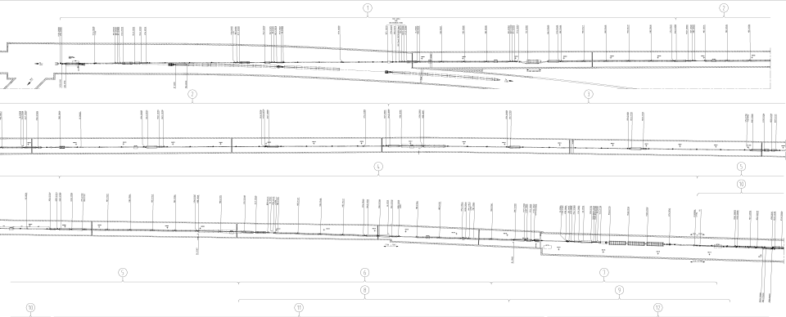
Junction cavern location
Upstream from QNLF 210400 is optimal location
  In Molasse
  Swelling clay – marl avoided
  Water units avoided
swelling
Water present
‘good’ rock
“good” rock
QNLF 210400
Molasse
Transition zone
Moraine
QNLF 211000

Slide 7
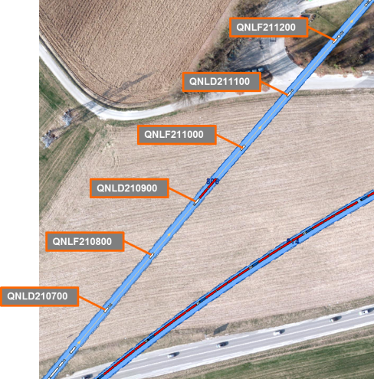
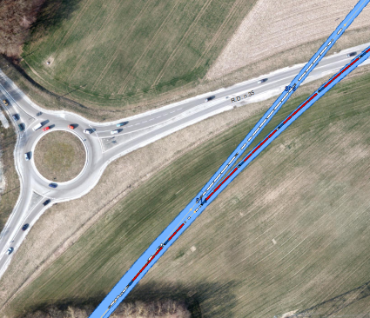
CENF Junction Cavern Location
QNLF210400
“challenging”
rock
“Good” rock

