Slide 1
LHC Physics Analysis and Databases or: “How to discover the Higgs Boson inside a database”
Maaike Limper

Slide 2
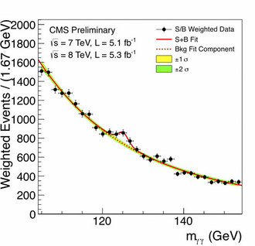
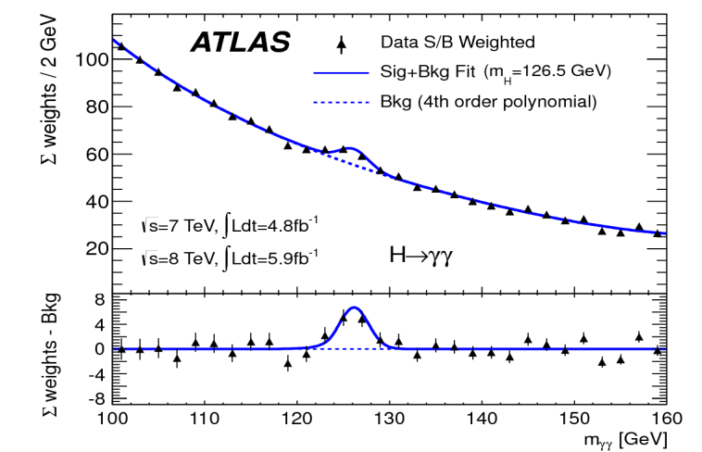
Introduction to LHC physics analysis
Plots of the invariant mass of photon-pairs produced at the LHC show a significant bump around 125 GeV
The discovery of a “Higgs boson-like” particle!
    http://www.bbc.co.uk/news/world-18702455
The work of thousands of people!
Operations of LHC and its experiments rely on databases for storing conditions data, log files etc.
… but the data-points in these plots did not came out of a database !

Slide 3
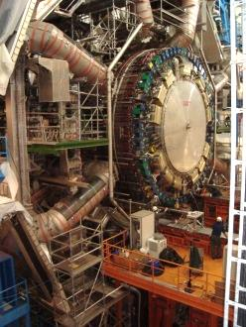
ATLAS reconstruction and analysis
data acquisition
event
data taking
analysis
event
analysis
reconstruction
analysis objects
(extracted per physics topic)
event
reconstruction
raw data
ntuple1
ntuple2
simulated raw data
generation→simulation→digitization
event
summary
data
ntupleN
event
simulation
interactive
physics analysis
(thousands of users!)
Global computing resources to store, distribute and analyse LHC data are provided by the Worldwide LHC Computing Grid (WLCG) which has more than 170 computing centres in 36 countries

Slide 4
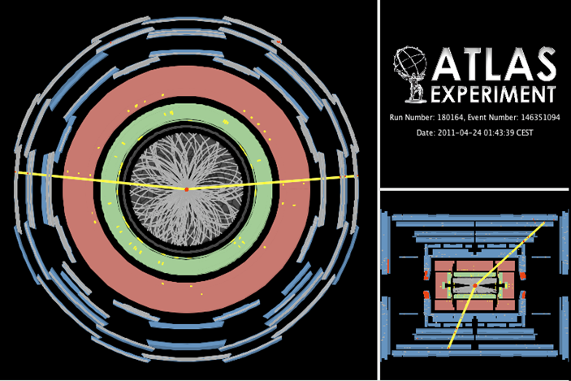
Analysis versus reconstruction
Event Reconstruction focuses on creating physics objects from the information measured in the detector (detectors hits → particle trajectory)
Event Analysis focuses on interpreting information from the reconstructed objects to determine what type of event took place
Z->μμ candidate, m_{μμ}=93.4 GeV

Slide 5

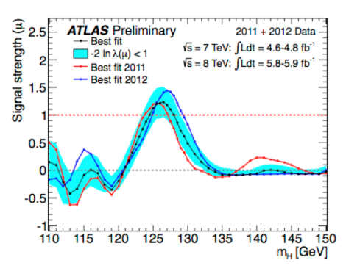
Data analysis in practice
LHC Physics Analysis is done with ROOT
Dedicated C++ framework developed by the High Energy Physics community, http://root.cern.ch
Provides tools for plotting/fitting/statistic analysis etc.
ROOT-ntuples are centrally produced by physics groups from previously reconstructed event summary data
Each physics group determines specific content of ntuple
Physics objects to include
Level of detail to be stored per physics object
Event filter and/or pre-analysis steps
ntuple1
event
summary
data
ntuple2
ntupleN
Ntuples=column-based storage: data is stored as “TTree” object, with a “TBranch” for each variable
Variables for each event in the form of scalar (number of muons), vectors (energy of each muon), vector-of-vectors (position of each detector hit for each muon)

Slide 6
Data analysis in practice
Analysis is typically I/O intensive and runs on many files
analysis
event
analysis
Small datasets→ copy data and run analysis locally
Large datasets:→use the LHC Computing Grid
Grid computing tools split the analysis job in multiple jobs each running on a subset of the data
Each sub-job is sent to Grid site where input files are available
Results produced by sub-jobs are summed
Bored waiting days for all grid-jobs to finish→
Filter data and produce private mini-ntuples
analysis objects
(extracted per physics topic)
ntuple1
ntuple2
ntupleN
interactive
physics analysis
(thousands of users!)
My Openlab Project: Can we replace the ntuple analysis with a model where data is analysed inside a centrally accessible Oracle database?

Slide 7
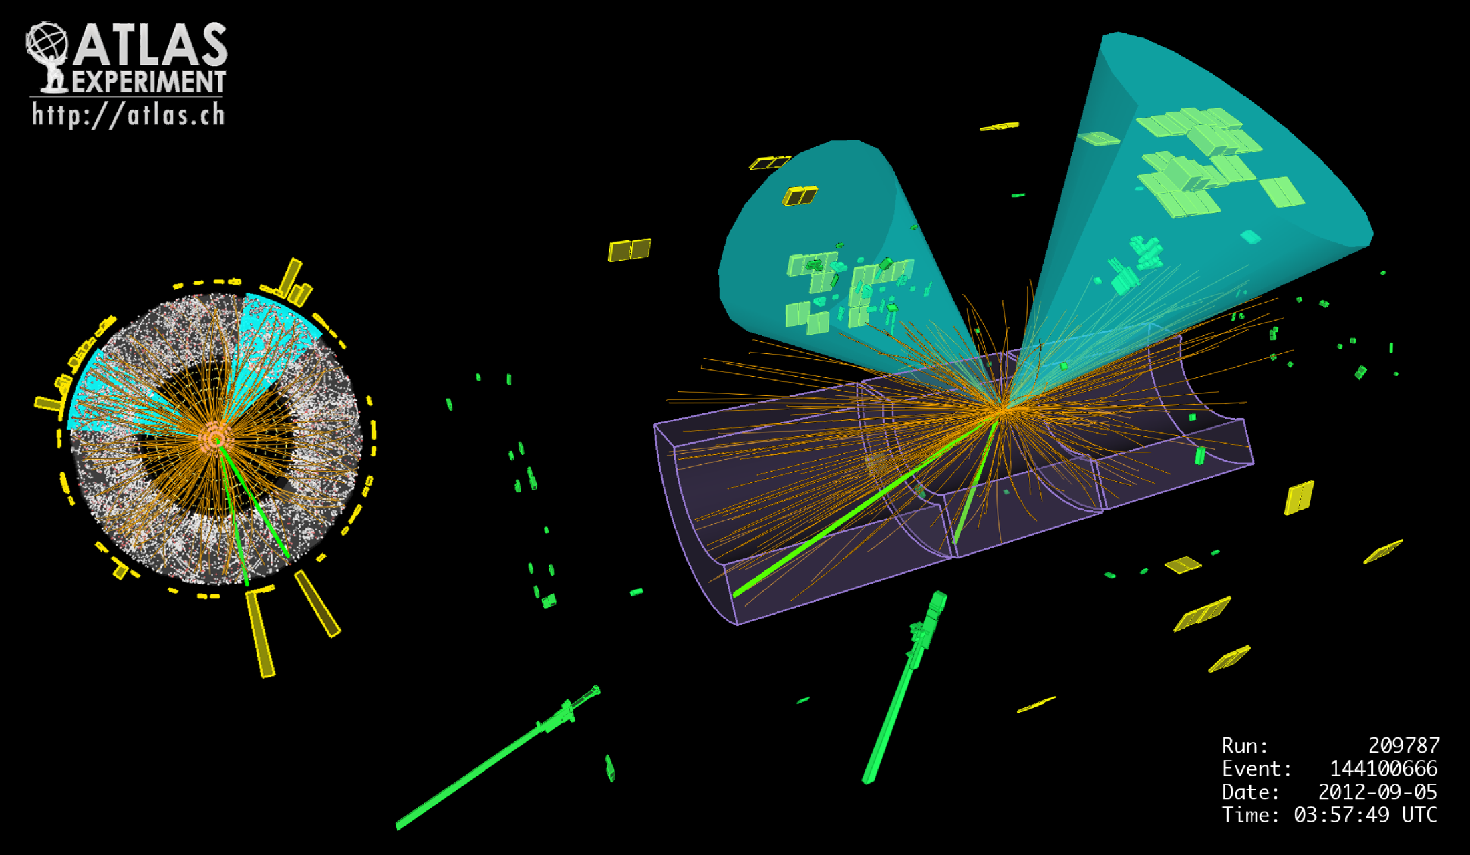
Physics Analysis Benchmark
My performance study for analysis inside the database used as benchmark:
“The search for a Higgs production in association with a Z boson”
Z+H candidate event observed in ATLAS
Higgs decays to two b-quarks, select good b-jets
Z boson decays to lepton-pair, select two good muons or two good electrons
Require specific Event Filter (EF) triggers to select events
Require “good lumi-blocks” from Event Data
Require Missing Transverse Energy (MET) less than 50 GeV to exclude top-pair events
Notes:
7

Slide 8
Database design
Oracle DB has row-based storage:
Separate tables for different physics objects, so users have to read only the object-tables relevant for their analysis
My test-sample “DATA12_8TEV” :
ATLAS experiment data taken in 2012 with collission energy of 8 Tev
7.2 million events
~ 0.5% of all collision events recorded by ATLAS in 2012
Corresponds to 127 ntuple-files
1366 variables, divided over 5 different tables
The (simplified) Z+H benchmakr analysis uses 40 of these variables
To run the analysis in the DB we need to transform a root-macro into a SQL-query

Slide 9
Physics Analysis C++
Root-analysis: Load relevant branches in ntuple-tree, loop over events, apply selection cuts and fill histograms:
vector<float> el_pt;
vector<float> el eta;
tree->getBranch(“el_pt”,&el_pt);
tree->getBranch(“el_eta”,&el_eta);
//etc.
for ( ievent = 0 ; ievent<nevents ; ievent++){
//find good electrons
tree->NextEvent();
for(i=0; i<nelectrons; i++){
if( el_pt[i] > 25. && fabs(el_eta[i])<2.5 etc.) ngoodelectron++;
}
//etc. for muon, jet, EF selections
//select events with 2 selected muons or 2 selected electrons and 2 good b-jets
….
//after passing selection cut reconstruct invariant mass, apply combined cuts etc.
…
// fill histograms
}
Notes:
9

Slide 10
Physics Analysis SQL
Single SQL-statement to reproduce physics analysis
Query starts by applying selection criteria via select-statements on relevant tables:
with sel_electron as
(select "electron_i","EventNo_RunNo",etc from "electron" where "pt" < 25. and abs("eta") <2.5 …etc. ),
sel_muon as
(select "muon_i","EventNo_RunNo",etc from "muon" where "pt" < 20. or abs("eta") < 2.4 .. etc. ),
sel_bjet as (
select "jet_i","EventNo_RunNo”,etc from "jet" where "pt">25. and abs("eta")<2.5and mv1("wIP3D","wSV1","wFCN",..)>0.6017),
Followed by JOINs to find events with two b-jets and two muons or two electrons in which the invariant-mass of the electron/muon-pair and the b-jet pair is calculated and other combined selections are applied
Calculations are done via PL/SQL functions except for one function for the b-jet selection that is called from C++-library
Finally a super-join where the calculated quantities, used to fill histograms, are returned:
select "EventNo_RunNo","EventNumber","RunNumber","DiMuonMass","DiElectronMass","DiJetMass" from sel_muon_events FULL OUTER JOIN sel_electron_events USING ("EventNo_RunNo") INNER JOIN sel_bjet_events USING ("EventNo_RunNo") INNER JOIN sel_MET_events USING ("EventNo_RunNo") INNER JOIN sel_EF_events USING("EventNo_RunNo") INNER JOIN sel_goodlbn_events USING("EventNo_RunNo")
Notes:
10

Slide 11
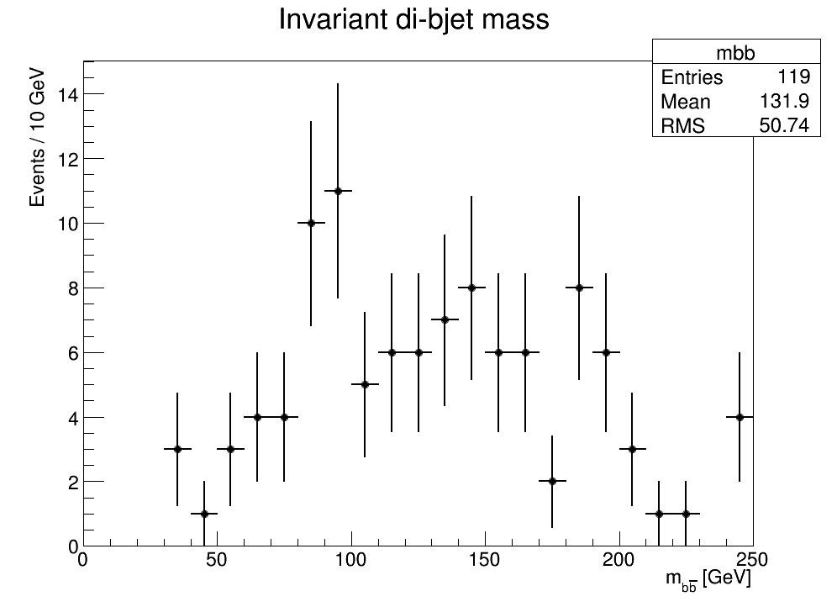
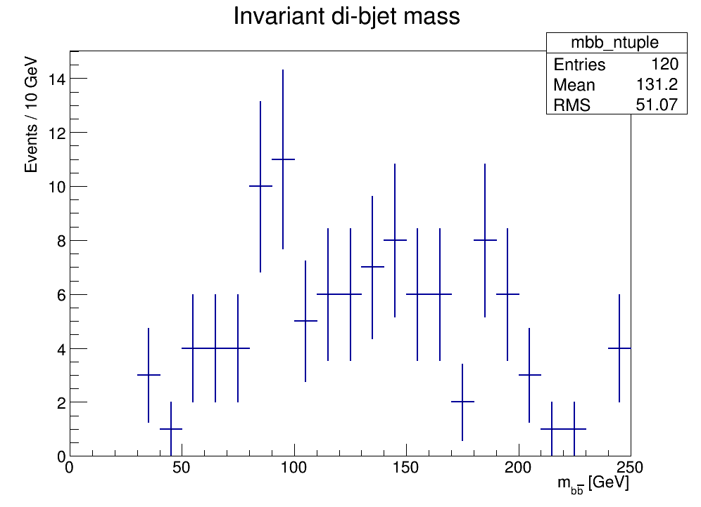
Ntuples vs DB performance
Both DB and ntuple analysis produce (almost) the same plot!
From Oracle Database
From root-ntuples
One double event in ntuple-analysis (due to overlapping trigger-streams)
Oracle DB does not contain double events due to unique constraint on EventNumber
Notes:
11

Slide 12
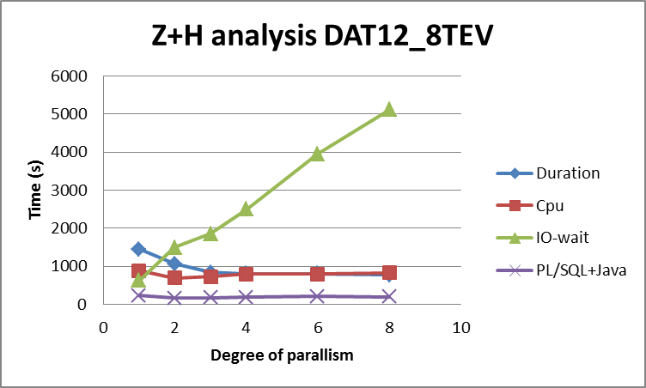
Ntuples vs DB performance
Analysis from Oracle database up to 4.5 times faster than standard ntuple analysis
Improvement of query time with parallel execution is limited by I/O wait time
Improvement of query time with parallel execution is limited by I/O wait time!
Notes:
12

Slide 13
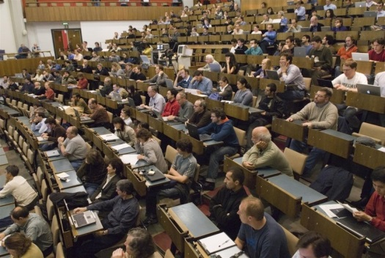
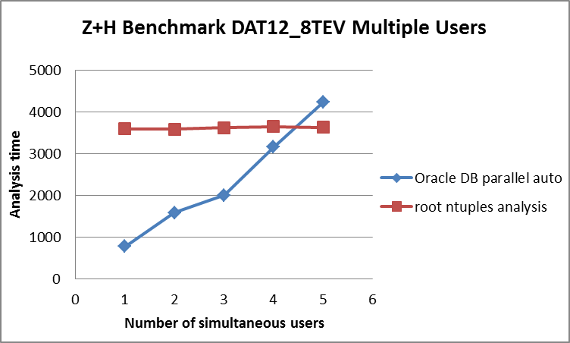
Many Physicists!
A real physics analysis database should be able to handle multiple users accessing the same data at the same time, with each user sending a unique analysis query corresponding to the signal they are looking for
The effect of parallelism and I/O bandwidth is similar to many users accessing the same data
Notes:
13

Slide 14

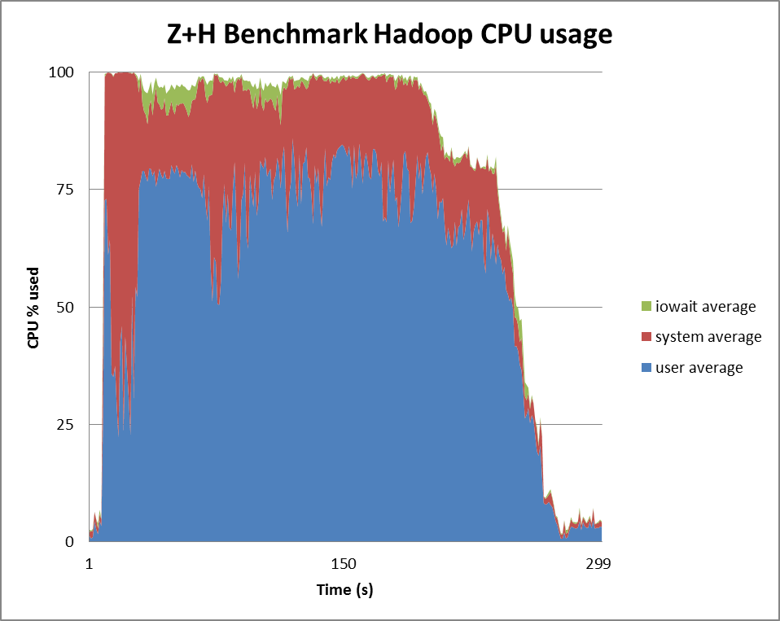
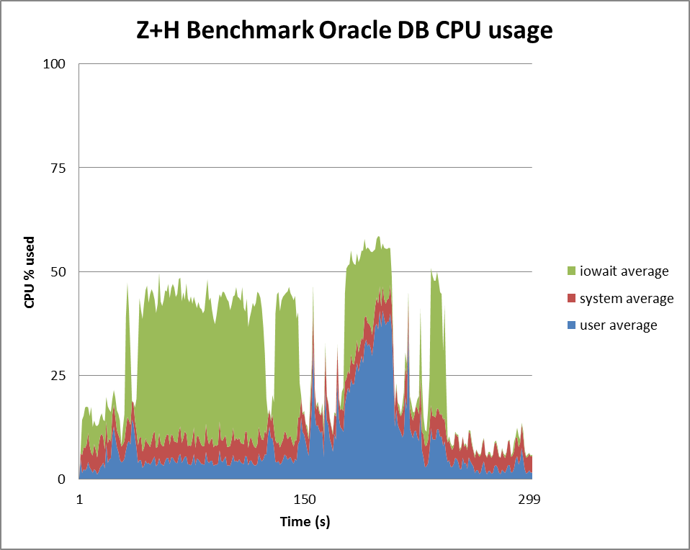
Hadoop vs Oracle
Compare the performance of the Oracle DB analysis with Hadoop!
Hadoop is supposed to have fast I/O by using data-locality, I prepared a basic test:
Physics-data stored as text-files in hadoop filesystem (hdfs)
Reproduce Z+H benchmark analysis with MapReduce-code (java!)
Mappers: one mappers per object to select muon, electron etc.
Reduce: select events with 2 good leptons and 2 b-jets, calculate invariant mass
Tests used a 5-machine cluster that could run either Hadoop or Oracle RAC
Hadoop: 299 seconds
(limited by CPU)
Oracle DB: 231 seconds
(limited by iowait)
Notes:
14

Slide 15
Conclusion/Outlook
LHC data analysis provides a real “big data” challenge
An unique benchmark to study the ability of the Oracle database to perform complex tasks on a large set of data
A central database running on a cluster of machines could provide a platform for physicists to perform analysis on data stored in the database
I/O is a bottleneck, especially with many users accessing the same data
Column-based data storage to be explored (some hints by Oracle this will be introduced in future 12c versions)
To be continued…
Notes:
15

