Slide 1
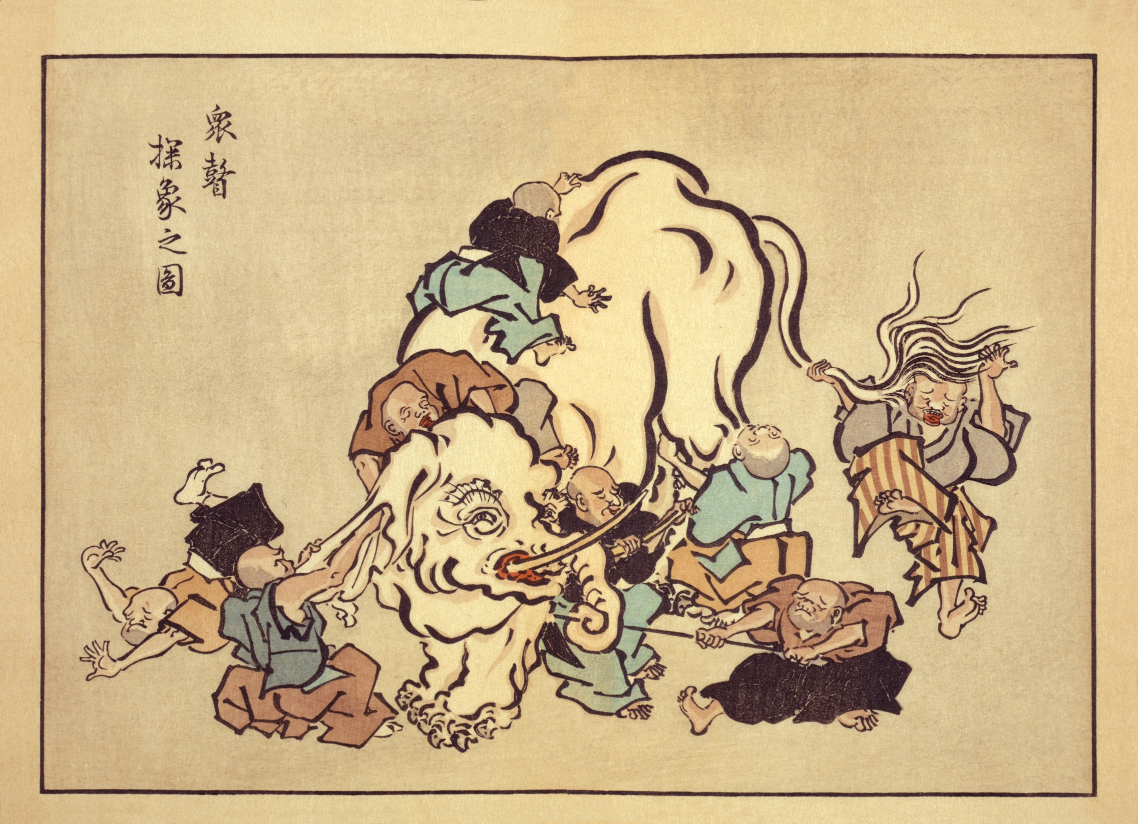

Slide 2
An approximate electromagnetic model for superconducting helically
wound cables and cable-in-conduit conductors
V. Zermeno, F. Grilli
Karlsruhe Institute of Technology
victor.zermeno@kit.edu

Slide 3
Content
Extension to CICC
Geometrical model for
3-phase cables
Electromagnetic model for coaxial
cables

Slide 4
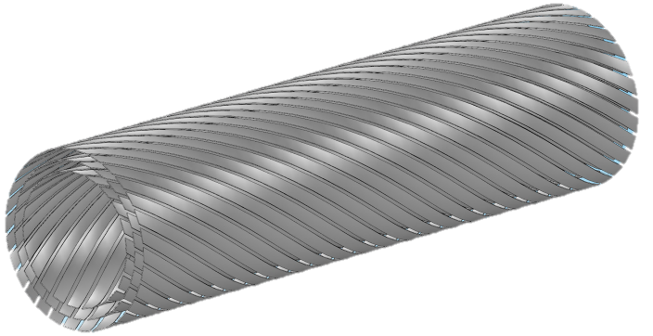
Content
Extension to CICC
Geometrical model for
3-phase cables
Electromagnetic model for coaxial
cables

Slide 5
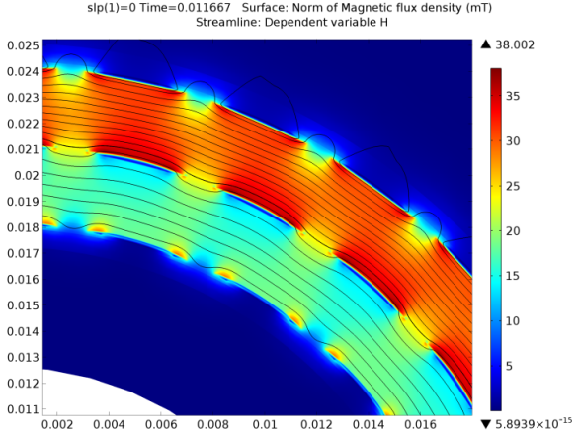
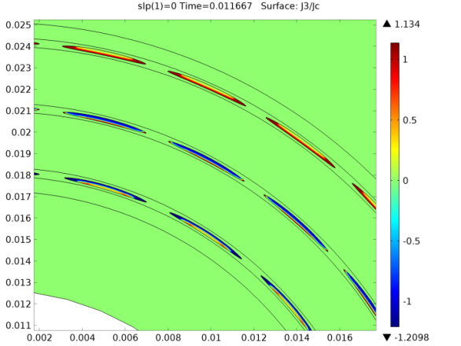
Content
Extension to CICC
Geometrical model for
3-phase cables
Electromagnetic model for coaxial
cables

Slide 6
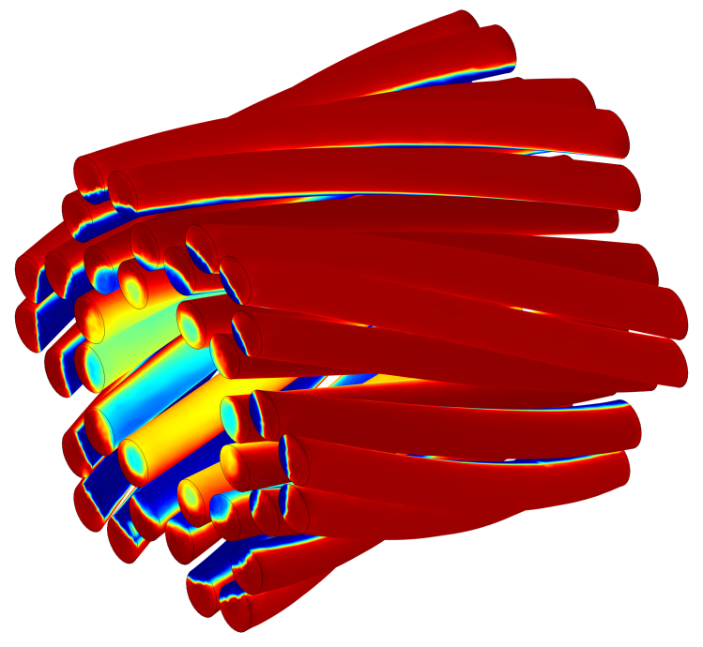
Content
Extension to CICC
Geometrical model for
3-phase cables
Electromagnetic model for coaxial
cables

Slide 7
The modeler’s dilemma
Real vs.
Possible
Feasible
Practical

Slide 8
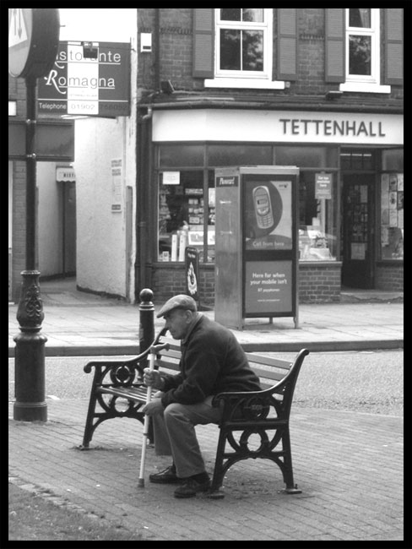
What is a model?

Slide 9

Exact Solution
Analytic Approximation

Slide 10
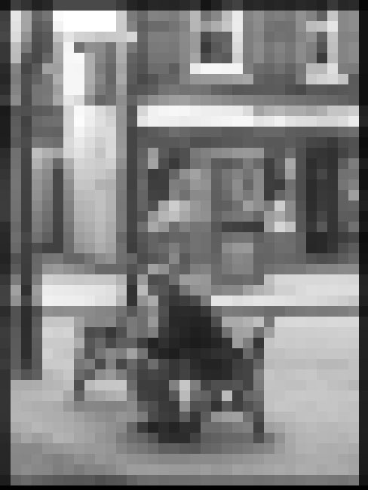
Exact Solution
Numeric Approximation 1

Slide 11

Exact Solution
Numeric Approximation 2

Slide 12

Exact Solution
Numeric Approximation 3

Slide 14
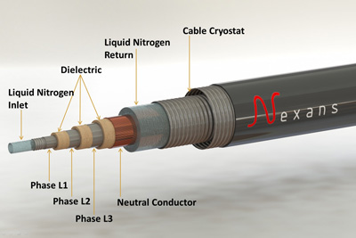

Ampacity project
Phase | # of tapes | radius | Pitch angle
A | 22 | 36.1 mm | 17.44°
B | 26 | 42.1 mm | 17.44°
C | 30 | 48.2 mm | 17.44°

Slide 15
How to model a 3-phase helically wound cable?

Slide 16

How to model a 3-phase helically wound cable?

Slide 17
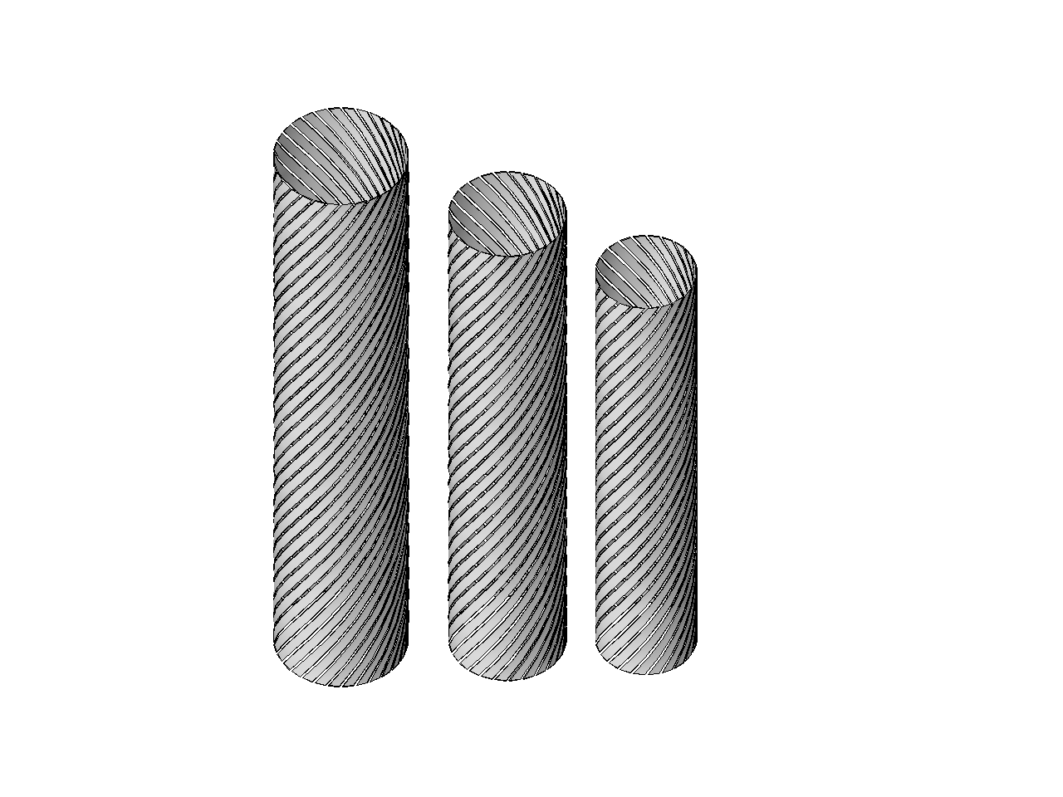

Original model design dissected
1 pitch length of each phase

Slide 18
1 phase

Slide 19
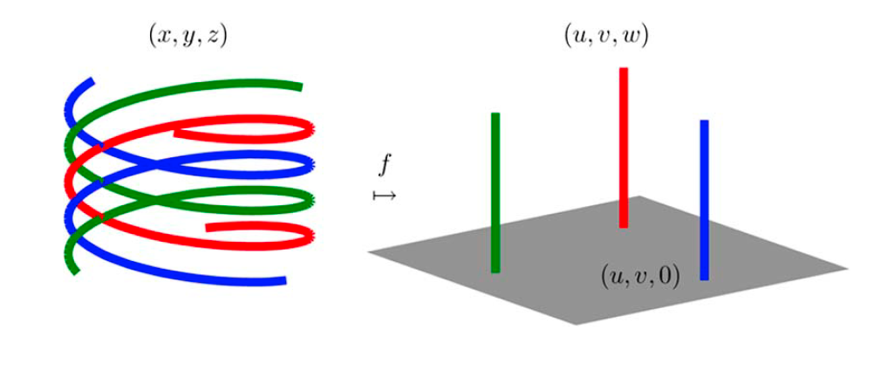
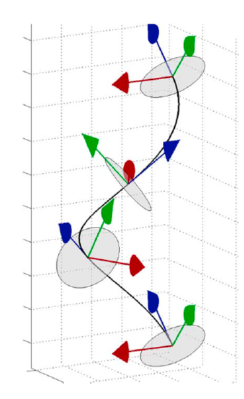
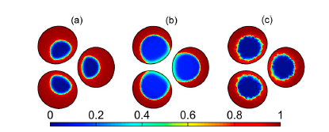
1 phase
Geometry can be modelled in 2D using helical coordinates
Stenvall, A. et al. IEEE TAS 23 -3 2013

Slide 20
2 phases

Slide 21
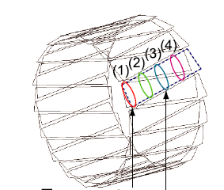
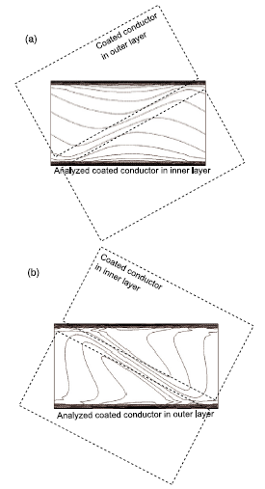
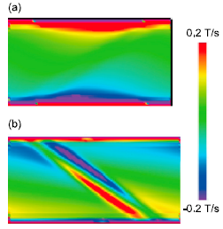
2 phases
Geometry must be modelled in a small 3D section
K Takeuchi et al Supercond. Sci. Technol. 24 (2011) 085014

Slide 22
3 phases
Geometry must be modelled in a large 3D section

Slide 23
3 phases
Geometry must be modelled in a large 3D section?

Slide 24
Model size
With constant pitch angle (17.44 deg), there are different pitch lengths for each phase:
  Phase 1 -> 361.013100007 mm
  Phase 2 -> 421.015277294 mm
  Phase 3 -> 482.017490868 mm

Slide 25
Model size
With constant pitch angle (17.44 deg), there are different pitch lengths for each phase:
  Phase 1 -> 361.013100007 mm
  Phase 2 -> 421.015277294 mm
  Phase 3 -> 482.017490868 mm
Lmc(361,421,482)=73254842… so, the spatial period is >73km ☹

Slide 26

Model size
With constant pitch angle (17.44 deg), there are different pitch lengths for each phase:
  Phase 1 -> 361.013100007 mm
  Phase 2 -> 421.015277294 mm
  Phase 3 -> 482.017490868 mm
Assume the tolerance is on our side and approximate the actual layout with something similar .

Slide 27
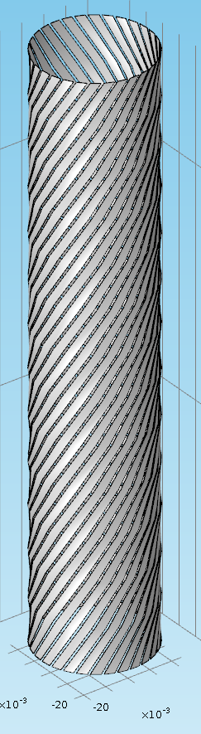
1-phase layout

Slide 28

1-phase layout

Slide 29
1-phase layout

Slide 30
1-phase layout

Slide 31
3-phase layout

Slide 32
3-phase layout

Slide 33
3-phase layout projected

Slide 34
3-phase layout projected

Slide 35
3-phase layout projected
Search for periodicity candidates

Slide 36
Search for periodicity candidates
radius=20 µm

Slide 37
Find minimum period per phase
30 26 22

Slide 38
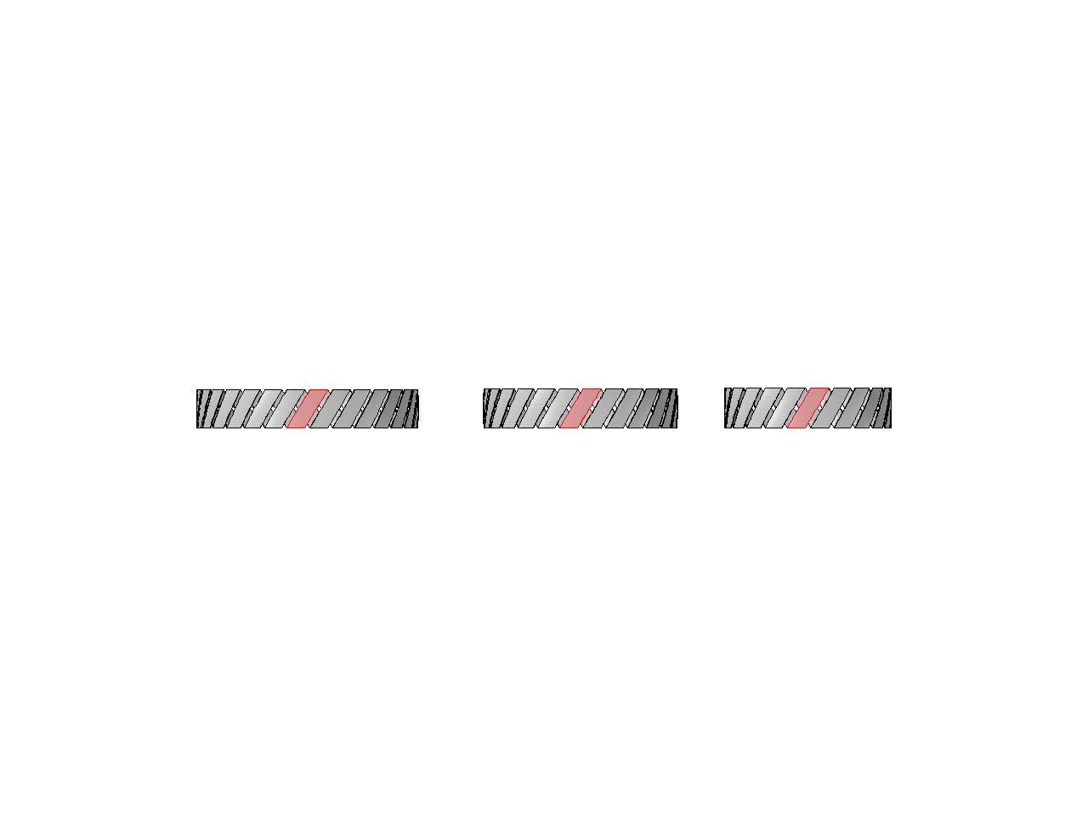
Find minimum period per phase
30 26 22

Slide 39
Find minimum period per phase
30 26 22

Slide 40
Search for candidate geometries
Use integer combinations of the minimum periods per phase
3
4
5

Slide 41
Search for candidate geometries
Use integer combinations of the minimum periods per phase
3
4
5

Slide 42
Search for candidate geometries
Use integer combinations of the minimum periods per phase
3
4
5
And test for the corresponding
pitch angles
16° 17.44° 18°

Slide 43
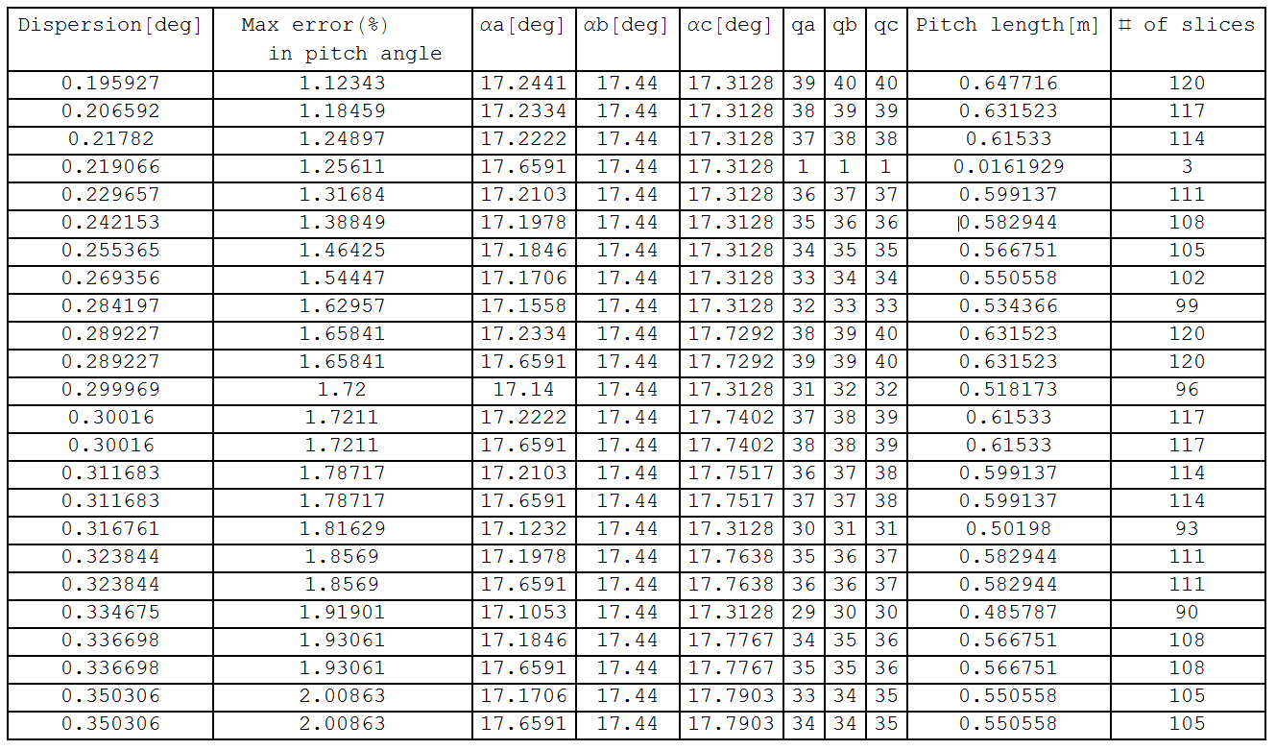
Approximate pitch length of the cable
Designs under 0.66 m

Slide 44
Approximate pitch length of the cable
Designs under 0.66 m

Slide 45
Approximate pitch length of the cable
Designs under 0.66 m

Slide 46
Approximate pitch length of the cable
Designs under 0.66 m

Slide 47
Approximate pitch length of the cable
Designs under 0.66 m

Slide 48
Approximate pitch length of the cable
Designs under 0.66 m

Slide 49
Approximate pitch length of the cable
Designs under 0.66 m

Slide 50
Approximate pitch length of the cable
Designs under 0.66 m

Slide 51
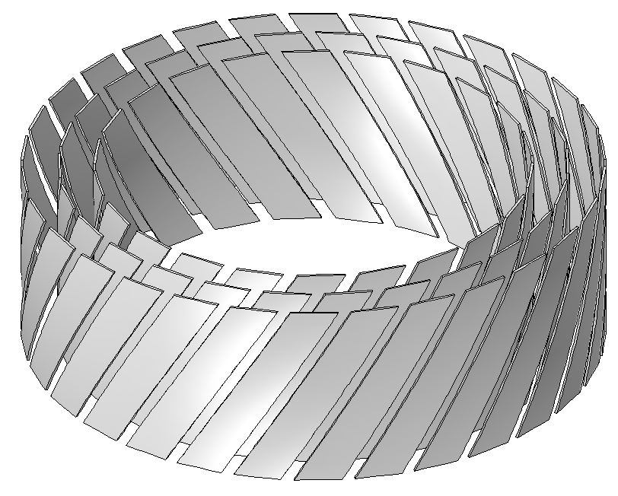
Approximate pitch length of the cable
Using an approximate pitch length of 16.193 mm for each phase:
  Phase 1 -> 17.659 deg (0.219 deg error)
  Phase 2 -> 17.44 deg (0 deg error)
  Phase 3 -> 17.313 deg (0.127 deg error)

Slide 52
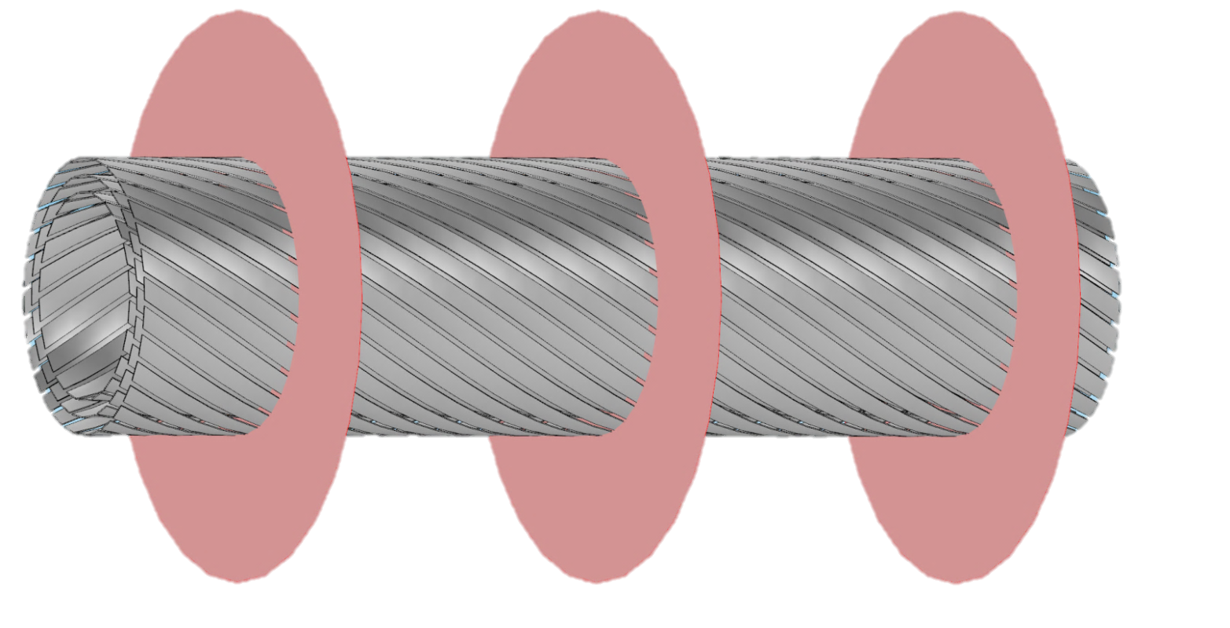
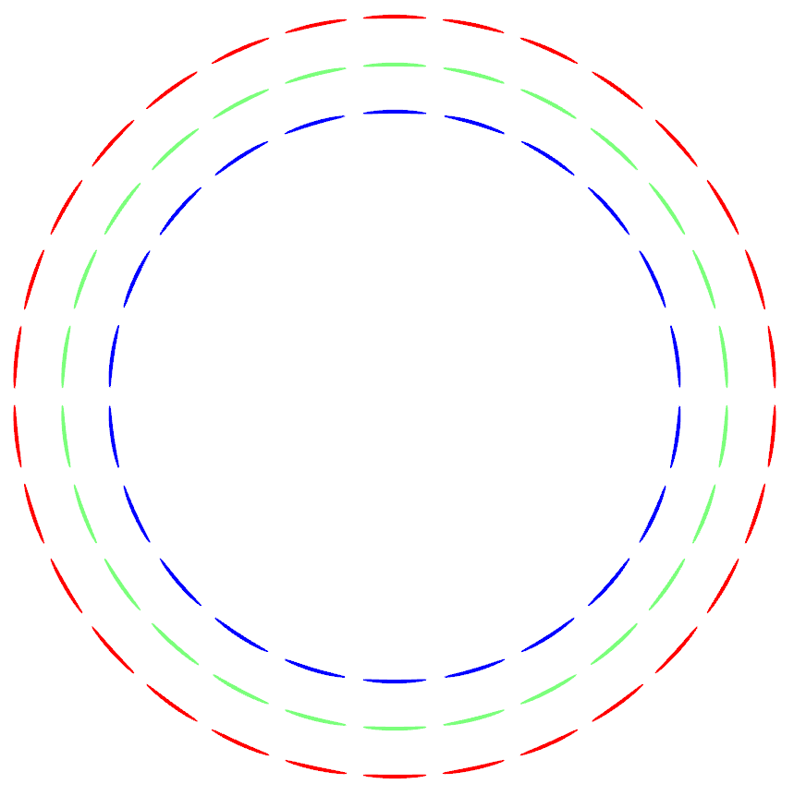
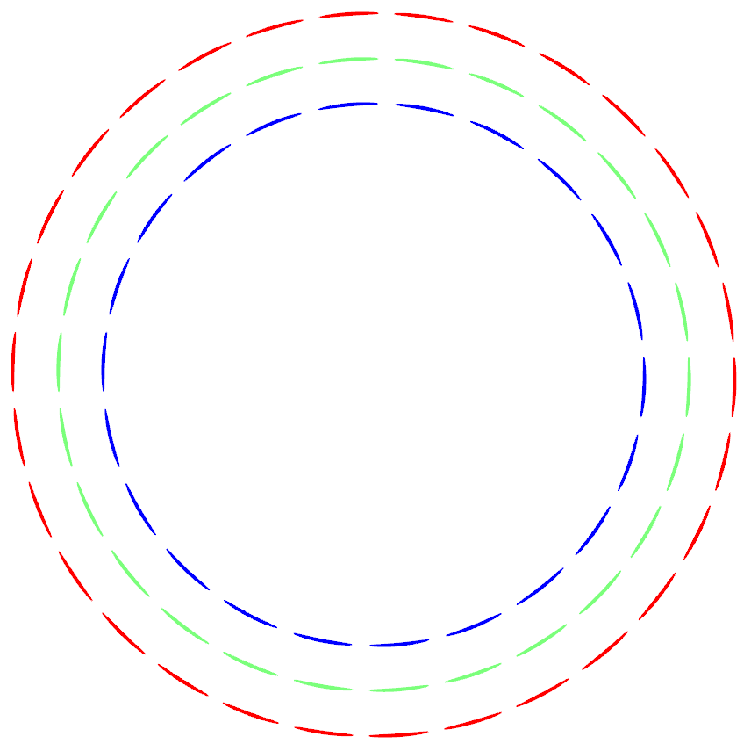
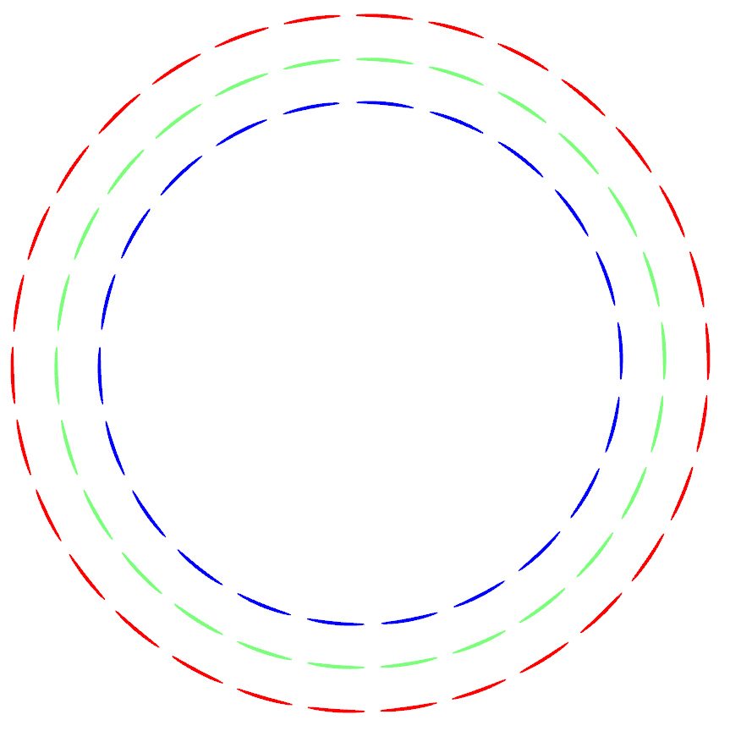
Model of cable by several 2D slices
a b c
a b c
a b c

Slide 53
Model of cable by several 2D slices
2.5-D
a b c
a b c
a b c

Slide 54
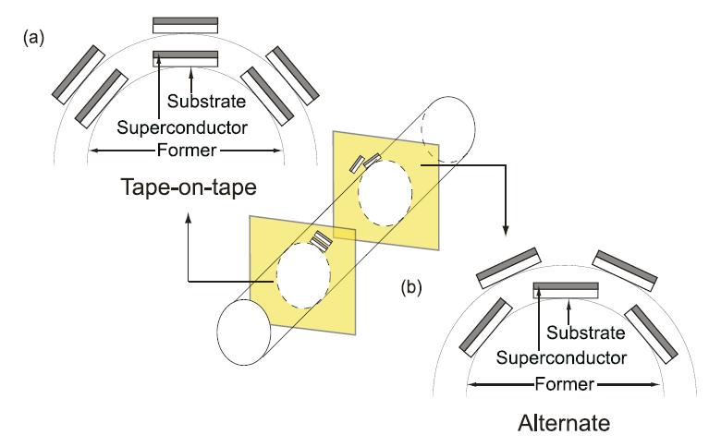
Model of cable by two 2-D slices
M Nakahata and N Amemiya Supercond. Sci. Technol. 21 (2008) 015007

Slide 55
Model of cable by subsequent 2D slices
Takes into account the different relative position of tapes along length (as a result of the pitch)
Good results expected for low pitch angles
Neglects axial field
Manageable computing time (per slice)

Slide 56
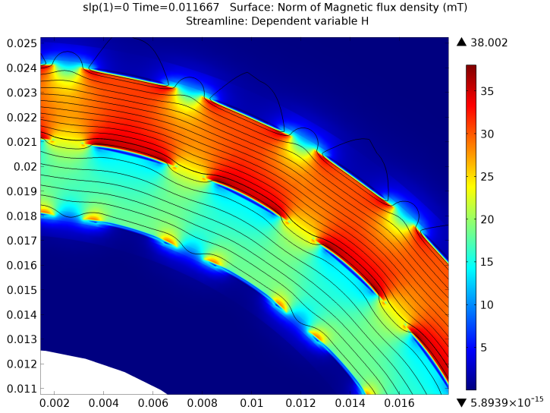

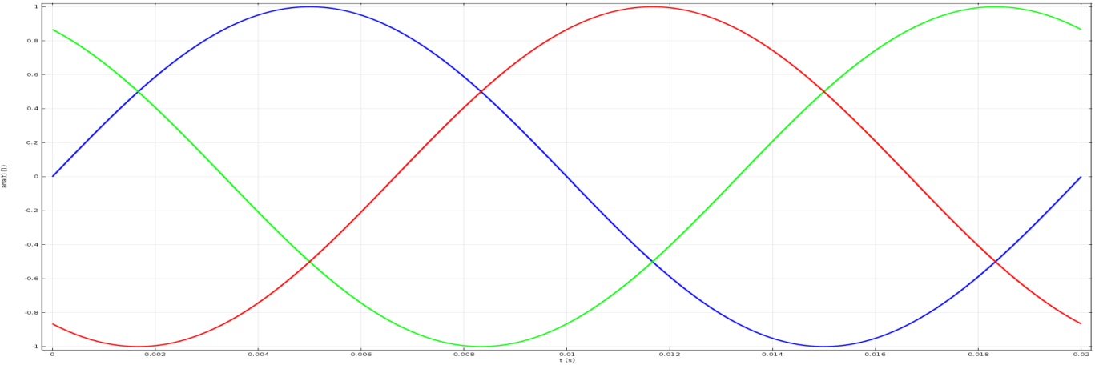
Magnetic flux density and
Normalized current density
Using H-formulation, Brambilla et al. SUST 20-1 (2007)

Slide 57
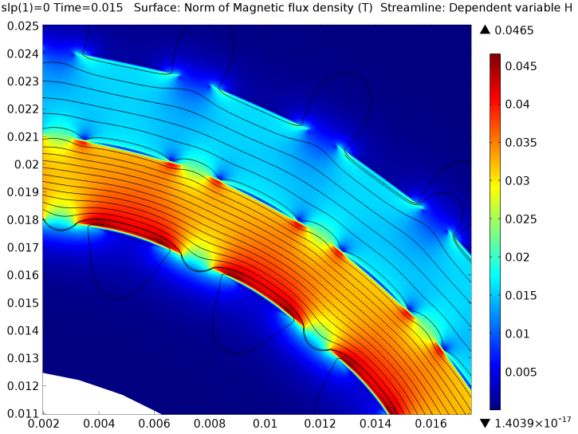
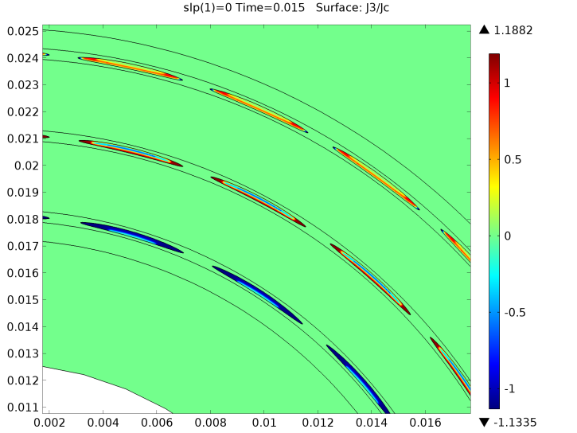
Magnetic flux density and
Normalized current density
Using H-formulation, Brambilla et al. SUST 20-1 (2007)

Slide 58
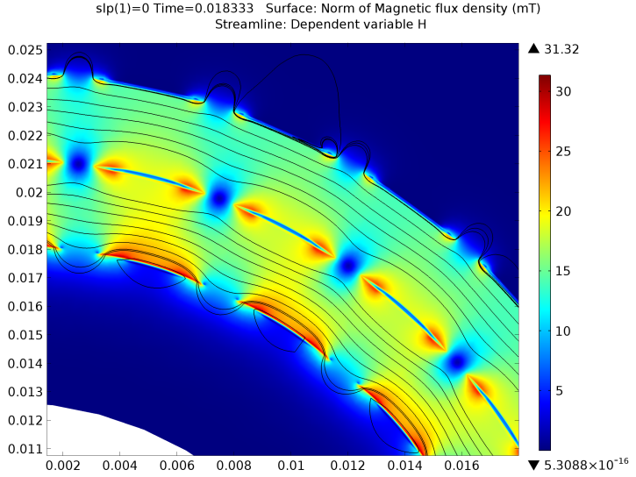
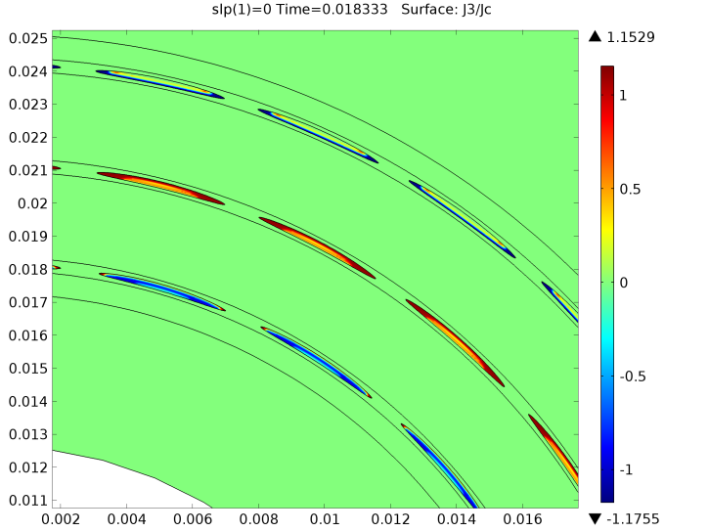
Magnetic flux density and
Normalized current density
Using H-formulation, Brambilla et al. SUST 20-1 (2007)

Slide 59
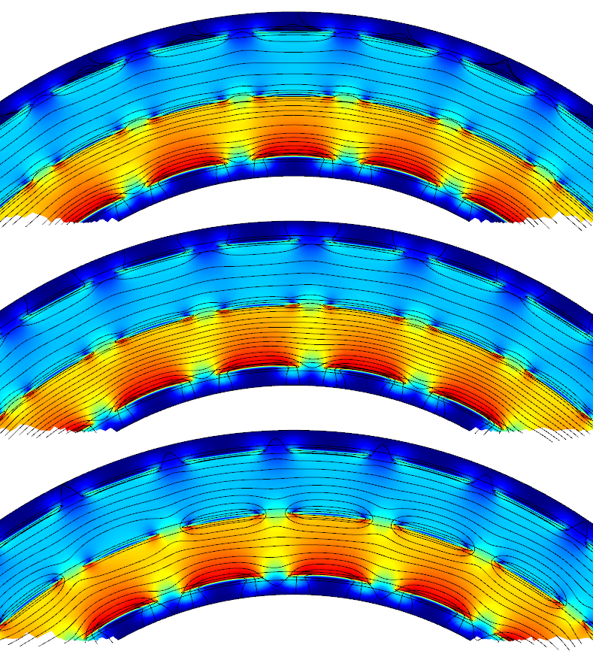
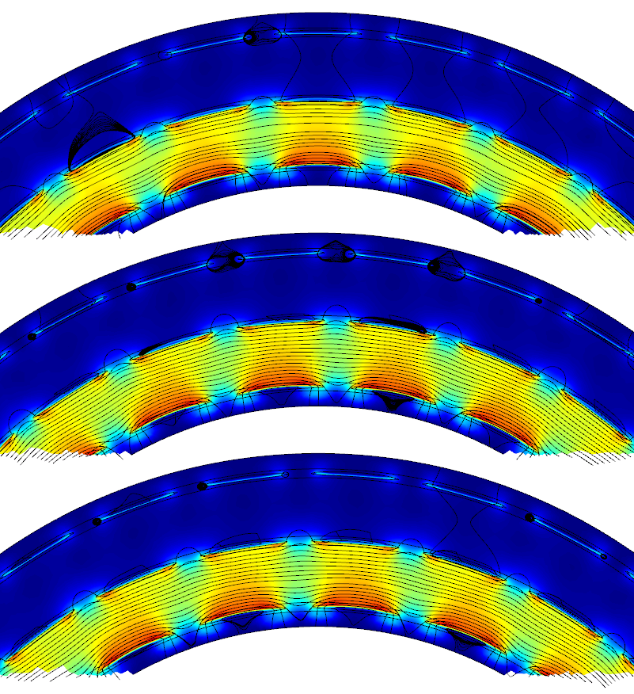
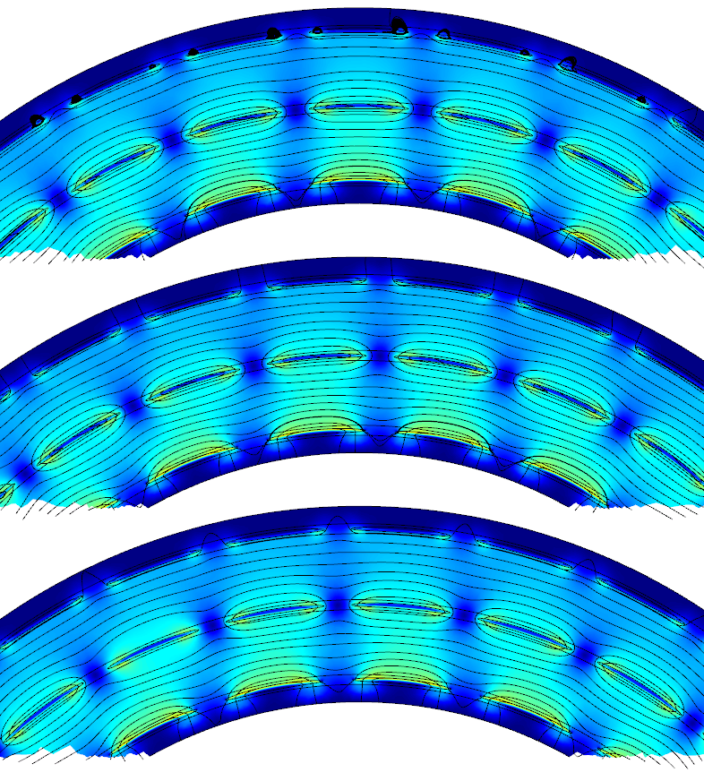
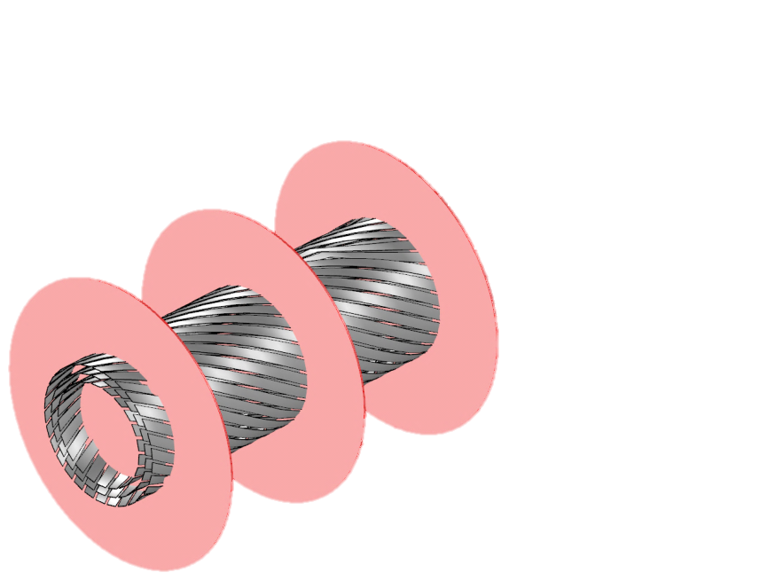
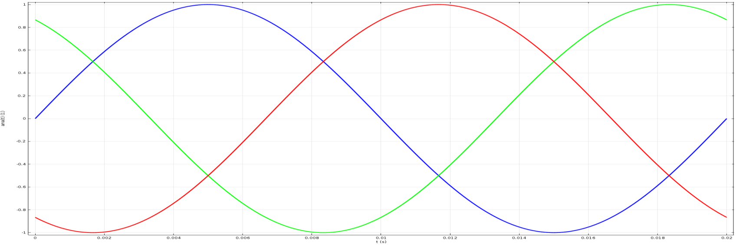
Magnetic field profile in different slices
Surface: |B| (mT) Streamlines: (B1,B2)

Slide 60
Assessing the need for several slices
Magnetic field is almost azimuthal in the inter-phase region:
  For several time steps and several slice positions

Slide 61
Assessing the need for several slices
Magnetic field is almost azimuthal in the inter-phase region:
  For several time steps and several slice positions
Computed AC losses using several slices (3-5) provided estimates with less than 0.5% variation.

Slide 62
Assessing the need for several slices
Magnetic field is almost azimuthal in the inter-phase region:
  For several time steps and several slice positions
Computed AC losses using several slices (3-5) provided estimates with less than 0.5% variation.
One slice can provide accurate estimates.
  Fast time to solution.

Slide 63
Original design: 1
If the Ic of all tapes is assumed to be equal to 170 A, then the corresponding Ic per phase is:
22 X 170 A = 3740 A
26 X 170 A = 4420 A
30 X 170 A = 5100 A
Total Ic 13260 A
Cable’s Ic is limited by the capacity of phase “a”.
1
22
26
30

Slide 64
Optional design: 2
If the Ic of each phase is assumed to be equal to that of phase “a” of the original design, then the Ic per phase is:
22 X 170 A = 3740 A
26 X 143.85 A = 3740 A
30 X 124.67 A = 3740 A
Total Ic 11220 A
15% less Ic than original design (cheaper design)
2
22
26
30

Slide 65
Optional design: 3
If the Ic of each phase is assumed to be equal to that of phase “b” of the original design, then the Ic per phase is:
22 X 201 A = 4420 A
26 X 170 A = 4420 A
30 X 147.3 A = 4420 A
Total Ic 13260 A
Same Ic as original design (similar price design)
3
22
26
30

Slide 66
AC loss in original design
75% Ic 90% Ic _
22 X 170 A
26 X 170 A
30 X 170 A
Design 1 (original) | Design 2 | Design 3
Design 1 (original) | Design 2 | Design 3

Slide 67
AC loss comparison for other designs
75% Ic 90% Ic _
Cheaper
(15 % less Ic)
27% more loss
Cheaper
(15 % less Ic)
23% more loss
22 X 170 A
26 X 143.85 A
30 X 124.67 A
Design 1 (original) | Design 2 | Design 3
Design 1 (original) | Design 2 | Design 3

Slide 68
AC loss comparison for other designs
75% Ic 90% Ic _
Similar price*
(same Ic)
11% less loss
22 X 201 A
26 X 170 A
30 X 147.3 A
Similar price*
(same Ic)
8% less loss
Design 1 (original) | Design 2 | Design 3
Design 1 (original) | Design 2 | Design 3

Slide 69
AC loss comparison for other designs
75% Ic 90% Ic _
Design 1 (original) | Design 2 | Design 3
Design 1 (original) | Design 2 | Design 3

Slide 70
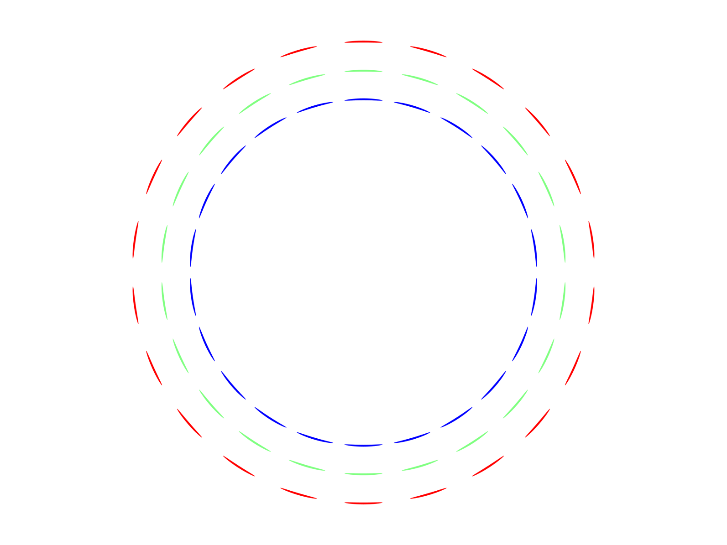
Optional design:4
If the Ic of all tapes is assumed to be equal to 170 A and 22 tapes are used in each phase, then the corresponding Ic per phase is:
22 X 170 A = 3740 A
22 X 170 A = 3740 A
22 X 170 A = 3740 A
Total Ic 11220 A
15% less Ic than original design (cheaper design)
4
22
22
22

Slide 71
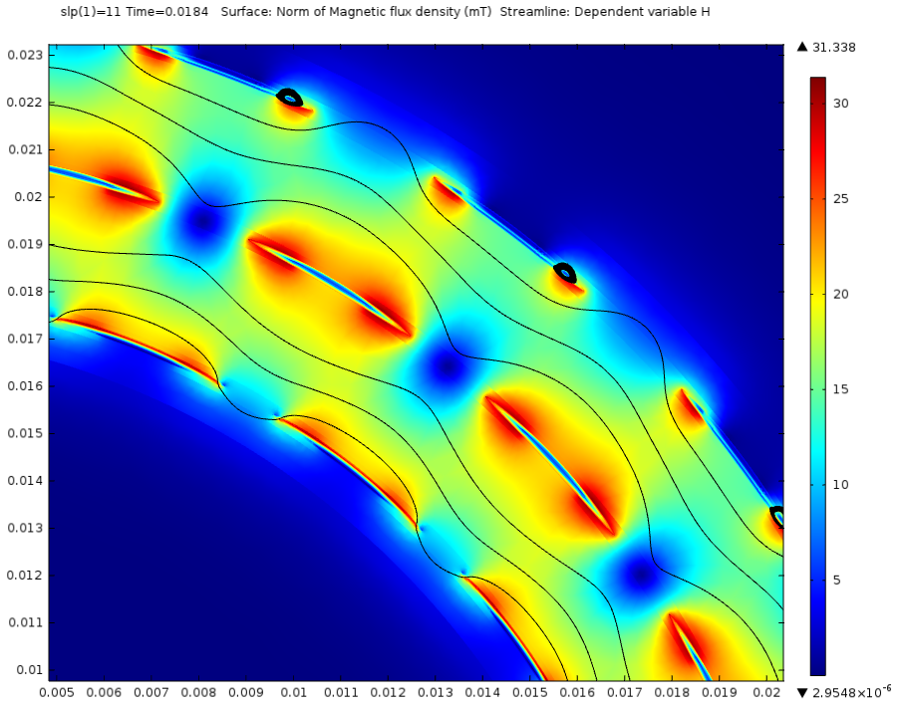
Original design:4

Slide 72
Original design:4
Field in the inter-phase regions is not azimuthal: Several slices needed

Slide 73
Cable with 22 tapes per phase
75% Ic 90% Ic _
Design 1 (original) | Design 4 (slice #1) | Design 4 (slice #12) | Design 4 (slice #21)
Design 1 (original) | Design 4 (slice #1) | Design 4 (slice #12) | Design 4 (slice #21)

Slide 74
Cable with 22 tapes per phase
75% Ic 90% Ic _
Design 2
Design 2
Design 1 (original) | Design 4 (slice #1) | Design 4 (slice #12) | Design 4 (slice #21)
Design 1 (original) | Design 4 (slice #1) | Design 4 (slice #12) | Design 4 (slice #21)

Slide 75
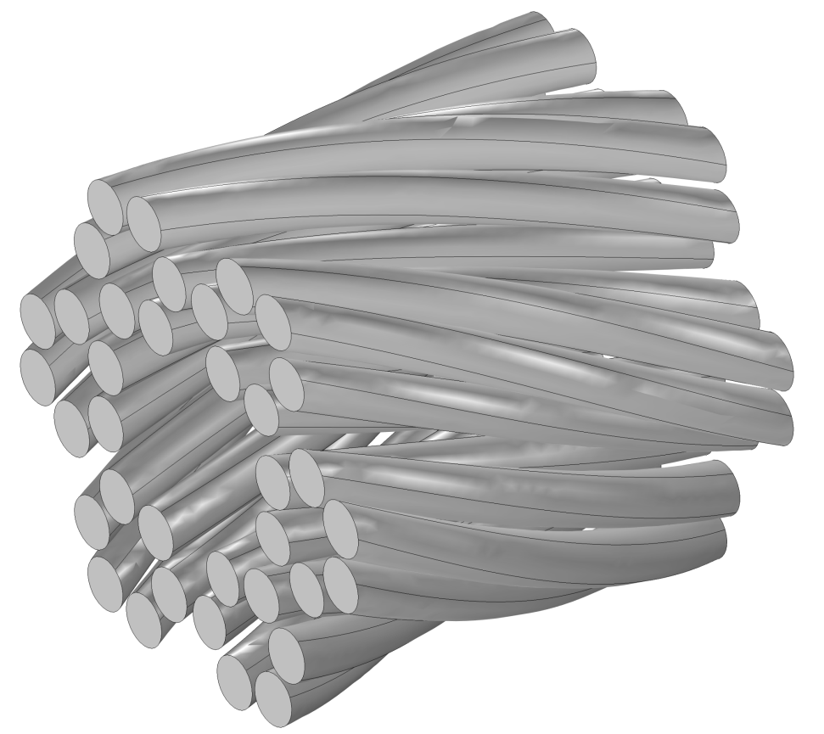
How about CICC?
Similar strategy can be followed:
  Pitch length now relates to wires and filaments rather than to layers.

Slide 76
In helically wound cables:
3
4
5

Slide 77
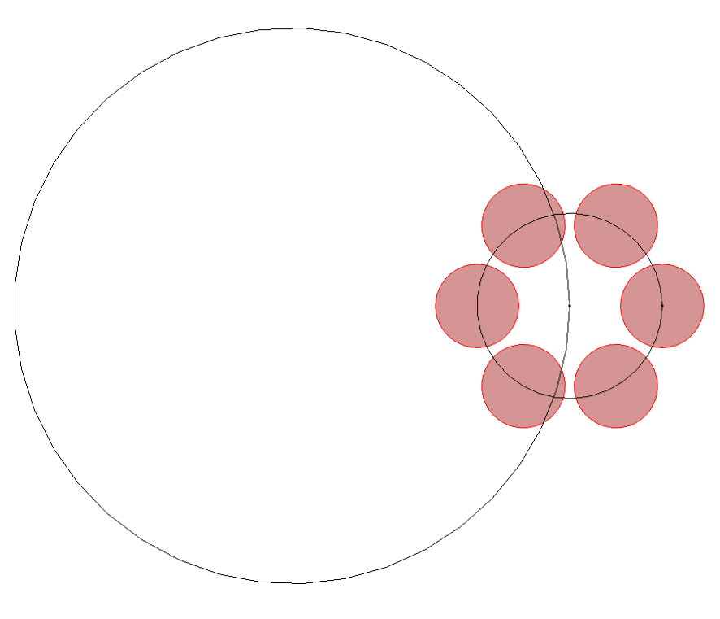
In CICC:
larger pitch length
# of bundles in wire
smaller pitch lentgh # of wires in bundle

Slide 78
In CICC:

Slide 79
In CICC:

Slide 80
In CICC:

Slide 81

Test design

Slide 82
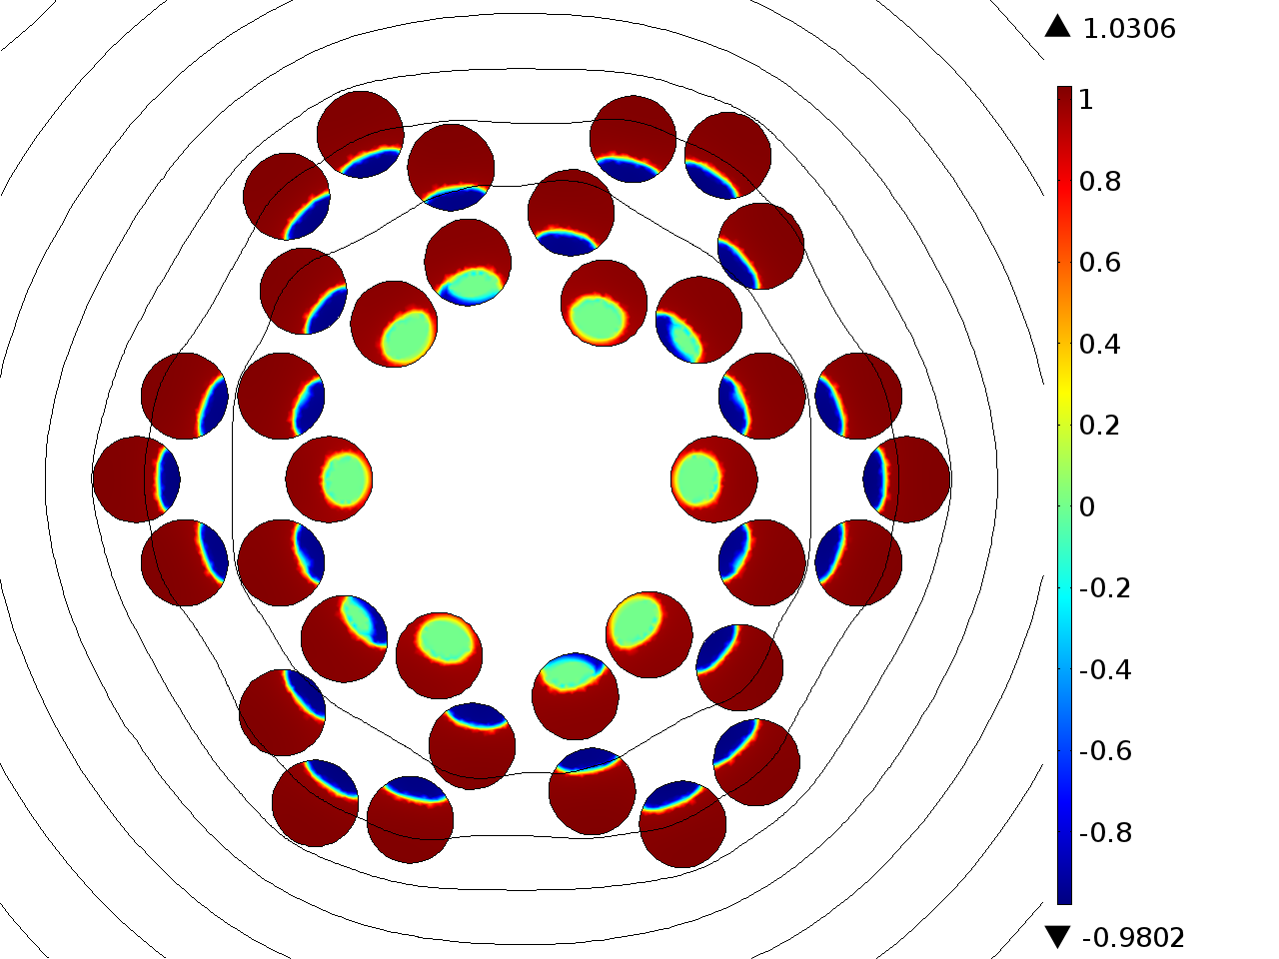
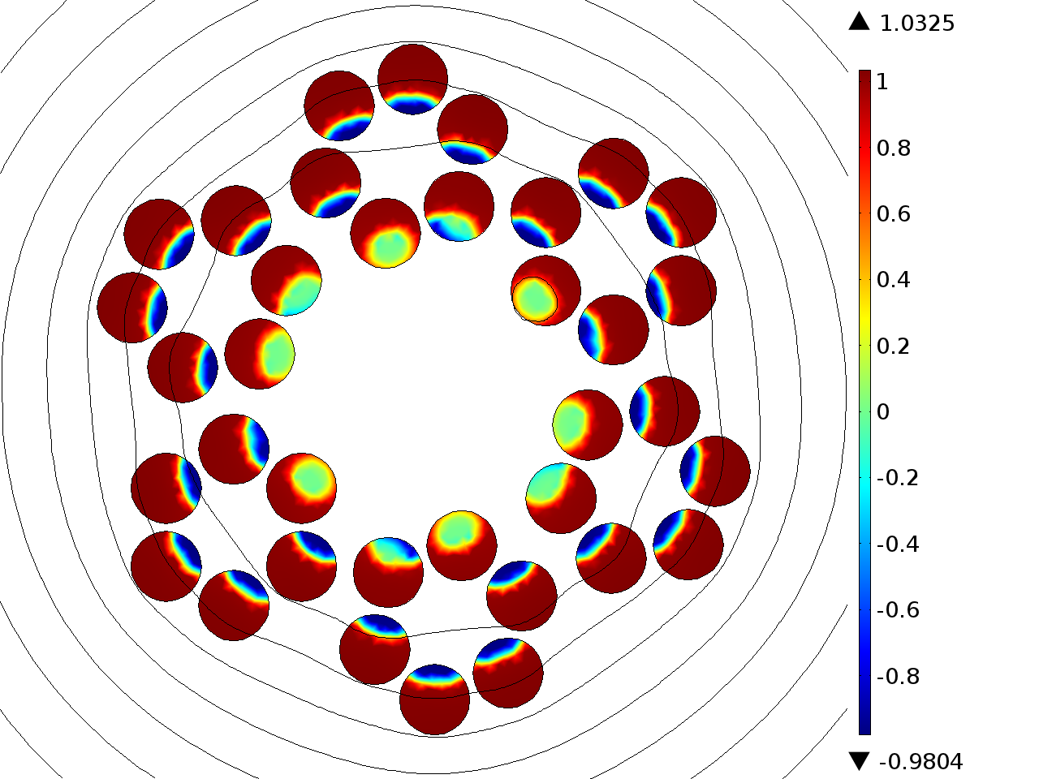
Test design (2.5-D)
Surface: |J/Jc| Streamlines: (B1,B2)
Use of several slices provided similar AC loss calculation (~1% difference)
Using H-formulation, Brambilla et al. SUST 20-1 (2007)

Slide 83

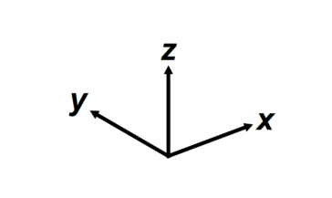
Test design (3-D)
J_{x}/J_{c}
Using CSM: Campbell, A. SUST 22-3 (2009)
(DOI: 10.1088/0953-2048/22/3/034005)

Slide 84
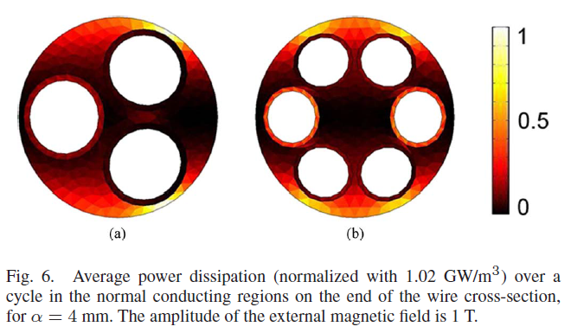
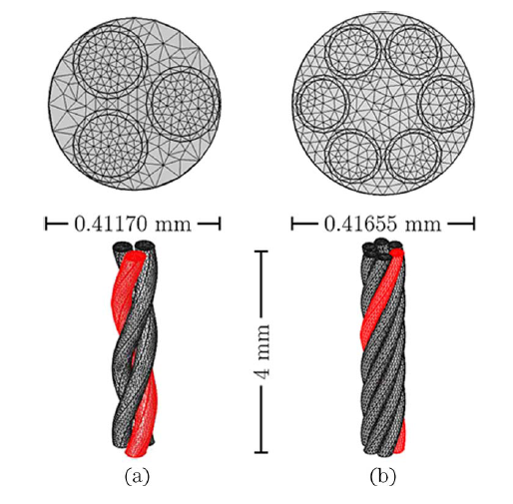
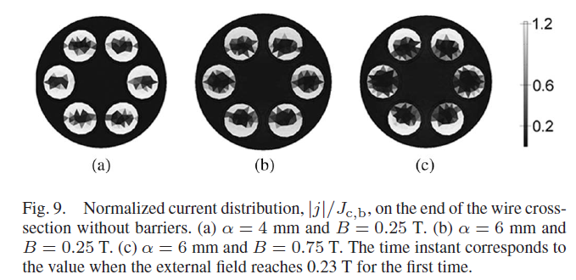
Using H-formulation 3-D
Lyly, M. et al. IEEE TAS 23-3 (2013)

Slide 85
Conclusions
An approximated geometrical model for 3-phase helically wound cables was developed.
  Actual layout of original cables is approximated within tolerance.

Slide 86
Conclusions
An approximated geometrical model for 3-phase helically wound cables was developed.
  Actual layout of original cables is approximated within tolerance.
AC losses were computed using a 2.5-D model consisting of a finite collection of slices.
  For the particular case of cables where Magnetic field is almost azimuthal in the inter-phase region one slice is sufficient.

Slide 87
Conclusions
An approximated geometrical model for 3-phase helically wound cables was developed.
  Actual layout of original cables is approximated within tolerance.
AC losses were computed using a 2.5-D model consisting of a finite collection of slices.
  For the particular case of cables where Magnetic field is almost azimuthal in the inter-phase region one slice is sufficient.
A similar methodology was used for CICC.
  Pitch length now relates to wires and filaments rather than to layers.

Slide 88
Conclusions
An approximated geometrical model for 3-phase helically wound cables was developed.
  Actual layout of original cables is approximated within tolerance.
AC losses were computed using a 2.5-D model consisting of a finite collection of slices.
  For the particular case of cables where Magnetic field is almost azimuthal in the inter-phase region one slice is sufficient.
A similar methodology was used for CICC.
  Pitch length now relates to wires and filaments rather than to layers.
The CICC geometrical model was used for simulating the electromagnetic transient response of the cables in transport conditions by means of FEM using H-formulation.

Slide 89
Conclusions
An approximated geometrical model for 3-phase helically wound cables was developed.
  Actual layout of original cables is approximated within tolerance.
AC losses were computed using a 2.5-D model consisting of a finite collection of slices.
  For the particular case of cables where Magnetic field is almost azimuthal in the inter-phase region one slice is sufficient.
A similar methodology was used for CICC.
  Pitch length now relates to wires and filaments rather than to layers.
The CICC geometrical model was used for simulating the electromagnetic transient response of the cables in transport conditions by means of FEM using H-formulation.
A 3-D model based in the CSM was implemented

