Slide 1

Influence of HTS Wire and Coil Configuration on Quench Propagation
Guillaume Escamez
Clement Lorin,
Denis Netter,
Philippe J. Masson.
University of Houston
Department of Mechanical Engineering
Texas Center for Superconductivity
October 10th, 2013

Slide 2
NASA’s Distributed Propulsion Aircraft

Slide 3
Distributed Propulsion – LH2 Cooling Network
LH2 can be used to cool-down superconducting components and power converters
Network dynamic simulation is used to determine the requirements of energy storage devices and reconfiguration
Turboshaft

Slide 4
Project Objectives
Develop a high fidelity sizing tool for fully superconducting rotating machines.
  Accurate 3D geometry represented
    Electromagnetics, mechanical and
    thermal
  Portable code in Python and C
Develop model for quench propagation
  Address detection and protection
Develop new model for AC losses
for superconducting stators
  Based on FEA simulations
Validate AC losses model experimentally

Slide 5
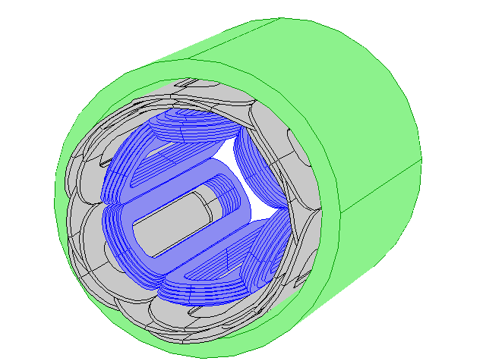
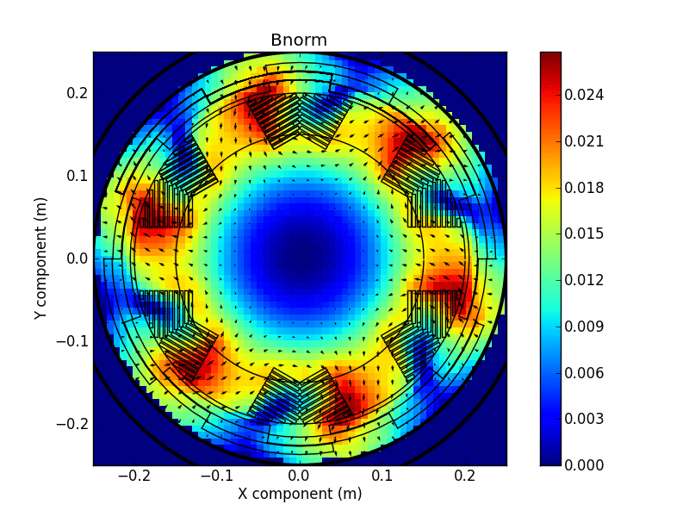
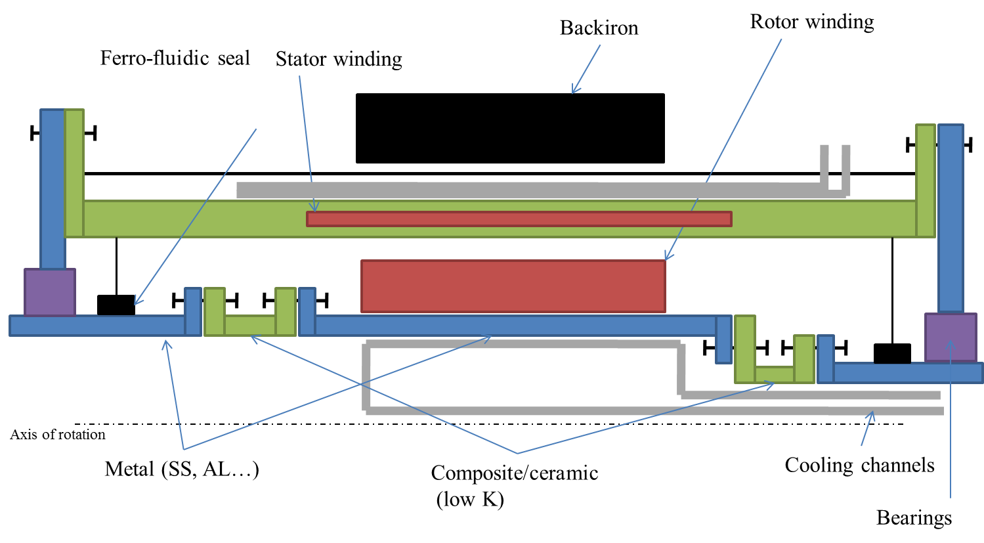
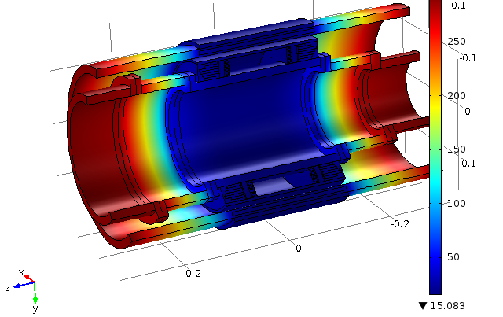
Sizing Model “Amber” Version 0.9
Zeroth order analytical sizing model (2D) used for preliminary optimization
Electromagnetic model
  Geometry accurately represented
  No mesh in air
  Based on integral methods (GFUN – Biot Savart)
Mechanical model
  Geometry accurately represented
  Steel and composite materials
  Thermal and force induced stress
Thermal model
  Total cryogenic heat load and temperature distribution estimated using finite differences
  Cryogenic system based on LH2 or Ghe and Reversed Turbo-Brayton cryocoolers

Slide 6
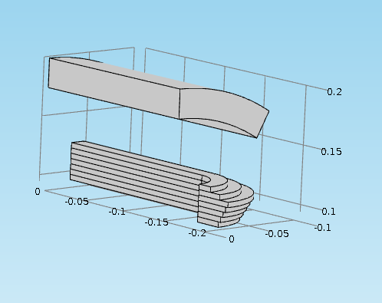
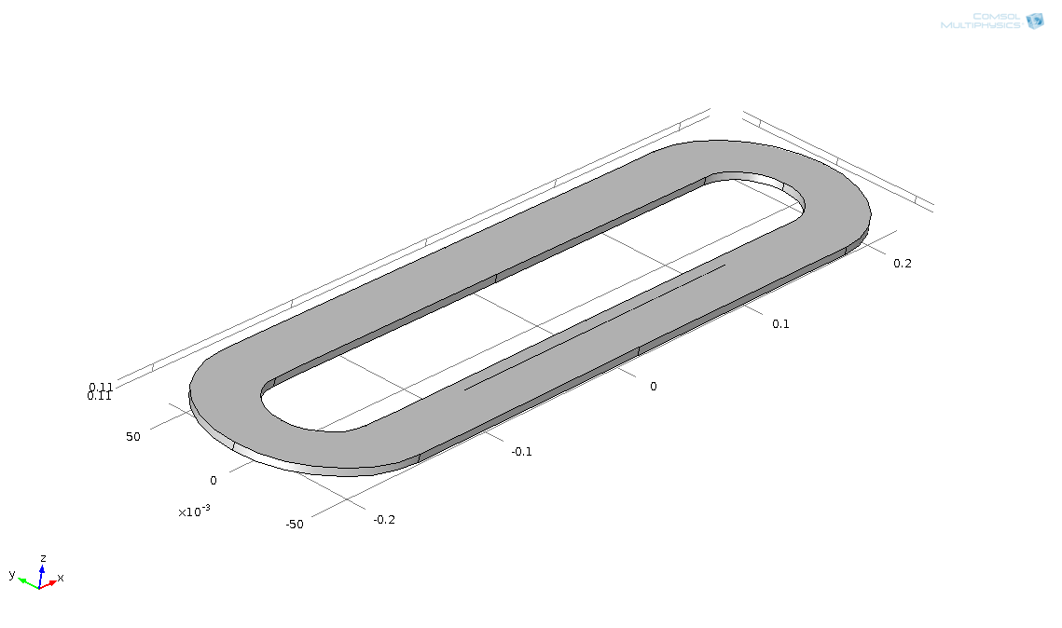
Winding Geometry
First step focuses on quench in the rotor winding
Objective is to evaluate the impact of quench protection on the machine design
Backiron
Rotor winding
Stator winding
Simulations performed on 1/4th of the geometry
Symmetry planes

Slide 7
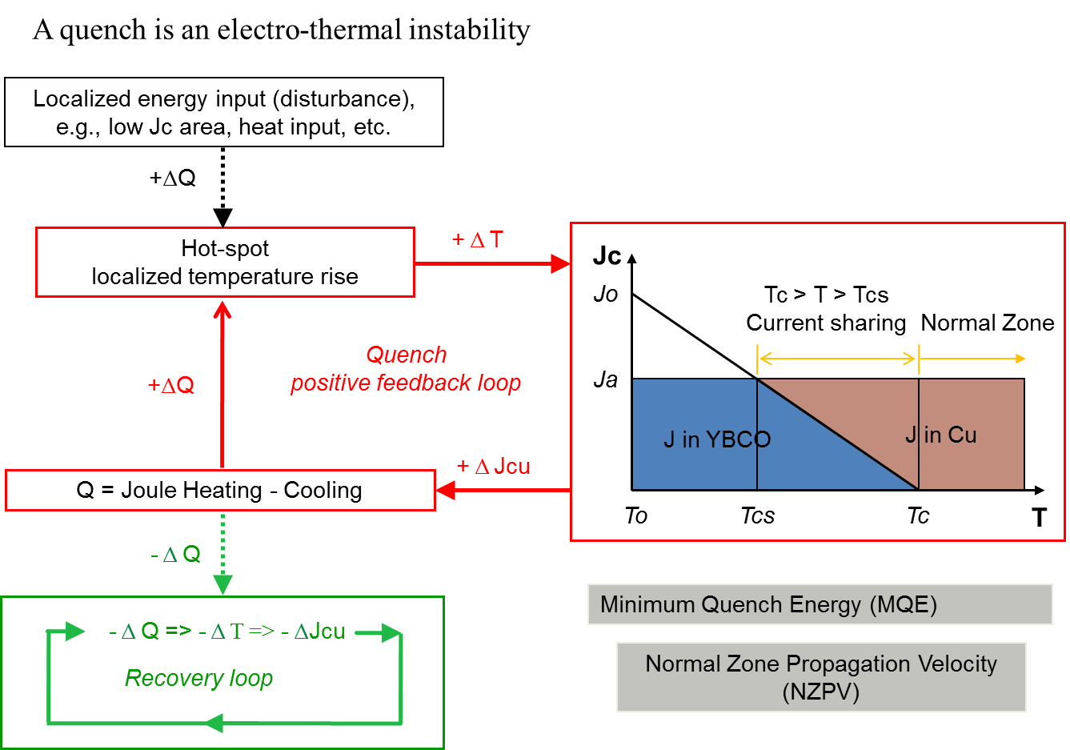
Quench in Superconductors
V
Stabilizer
I
*
Superconductor
Hot Spot
T

Slide 8
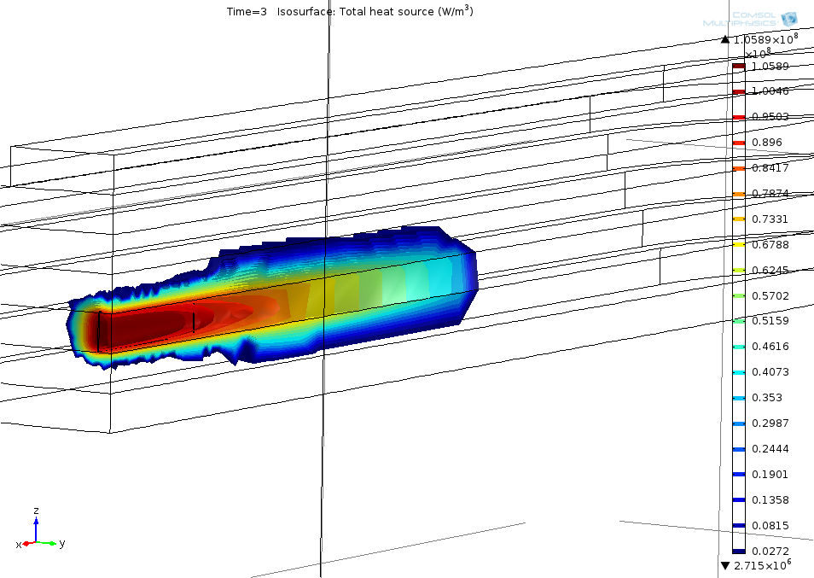
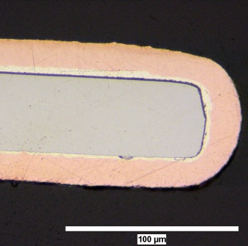
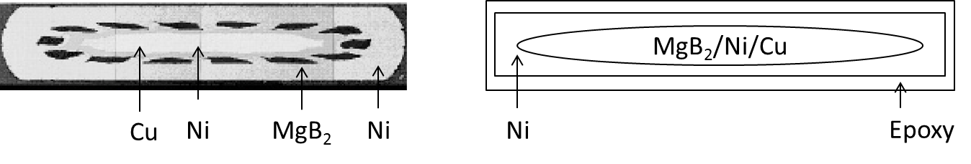
Quench model
Conductor
topology/materials
Model
NZPV
MQE
Winding geometry
Peak temperature
versus τ_{discharge}
Detection parameters (Voltage)
Protection parameters (τ_{discharge} )
YBCO Tapes
MgB2 conductors
YBCO
Cu
Hastelloy
Cu
NZPV: Normal zone propagation velocity
MQE: Minimum quench energy
τ_{discharge} : time constant of the discharge

Slide 9



YBCO Tape Configuration
Kapton Insulation
2 μm Ag
1 μm YBCO - HTS (epitaxial)
20μm Cu
~ 50 nm Buffer
20μm Cu
y
< 0.1 mm
50μm Hastelloy
50μm Nickel Hastelloy substrate
20μm Cu
20μm Cu
z
x

Slide 10
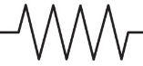

Electrical Properties
Anisotropic model
Infinite transversal equivalent resistivity (insulator)
  Resistivity on x-axis
  Infinite resistivity on y-axis and z axis (Use of Katpon)
L
R_{kapton}
R_{copper}
Kapton
R_{silver}
Cooper
e_{conductor}
Silver
e_{stack}
YBCO
R_{YBCO}
Nickel
R_{buffer}
Kapton
R_{nickel}
z
Current
R_{kapton}
x

Slide 11
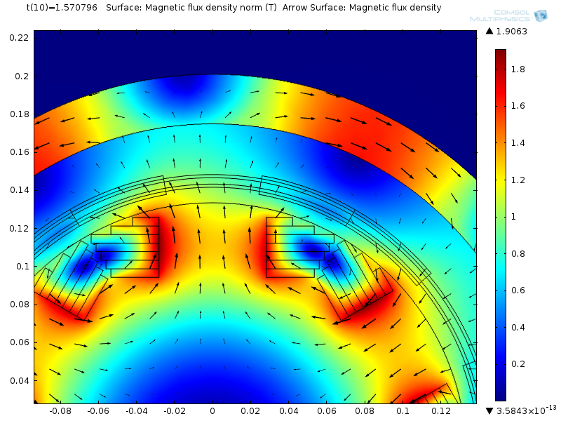
Flux and Temperature Distribution in Superconducting Machine
Need to consider field distribution and temperature gradient in winding for YBCO equivalent resistivity

Slide 12

YBCO Layer Critical Current
YBCO Jc(B,T) Scaling Law
${ J}_{c}\left(B,T\right)=\frac{C_{0}}{B}∙{B_{irr}\left(T\right)}_{}^{m}∙{\left(\frac{B}{B_{irr}\left(T\right)}\right)}^{p}∙{\left(1−\frac{B}{B_{irr}\left(T\right)}\right)}^{q}$A/m²
with $B_{irr}\left(T\right)=B_{irr0}∙{\left(1−\frac{T}{T_{c}}\right)}^{λ} T$
and $ρ_{sc}=\frac{E_{c}}{Jc(B,T)}∙{\frac{J}{J_{c}\left(B,T\right)}}^{n−1}Ω.m$
 | YBCO T<50K | YBCO T≥50K
Tc(K) | 92 | 92
p | 0.95 | 0.73
q | 2.568 | 1.69
m | 1.98 | 1.98
λ | 1.98 | 1.54
B_{irr0} (T) | 88 | 91
C₀ | 3.5e7 | 1e7
E_{c} (V/m) | 10⁻⁶ | 10⁻⁶
n | 30 | 30
Jc data from SuperPower – 2G HTS Tape w/ Advanced Pinning

Slide 13
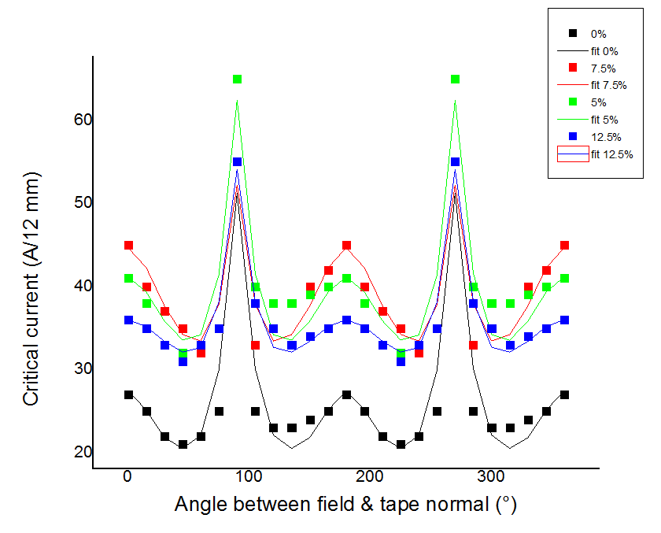
YBCO Jc Dependence on Field Direction
Anisotropic critical current, magnetic field dependency
Percentage of improved pinning by Zr in YBCO tape
Incidence magnetic field
y-axis
B_{i}
θ
J
$$J_{c}\left(θ\right)=J_{c}\left(90°\right).{(A.({\cos\left(θ\right)}^{2}+γ^{−2}.{\sin\left(θ\right)}^{2})}^{−\frac{1}{2}}+{B.({\cos\left(θ\right)}^{2}+β^{−2}.{\sin\left(θ\right)}^{2})}^{−\frac{1}{2}})$$
J_{c}: Critical current density (A/m²)
B_{i}: Incidence magnetic field (T)
Fit values for 0% Zr doping
A=5.97 γ=7
B=21.39 β=0.438

Slide 14
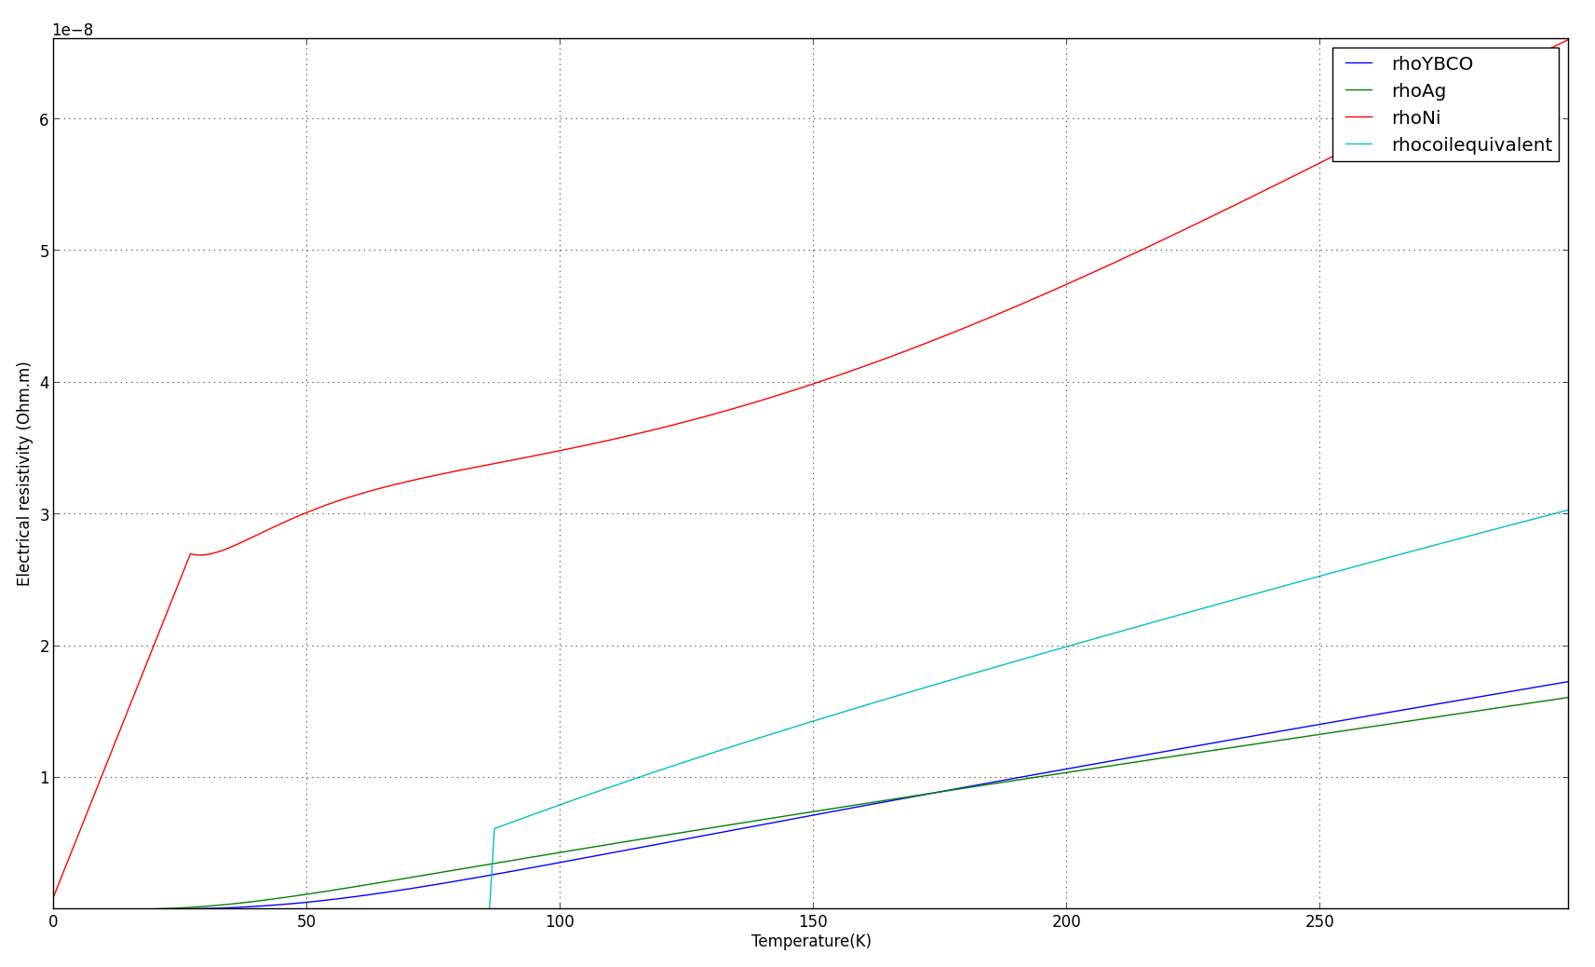
Electrical Equivalent Properties
Example of electrical resistivity of material and coil for J/Jc = 0.6, no field

Slide 15
Equivalent Thermal Properties
R_{thkapton}
R_{thcopper}
Kapton
R_{thsilver}
Cooper
Silver
x-axis
YBCO
R_{thYBCO}
Nickel
R_{thbuffer}
y
Kapton
R_{thnickel}
R_{thkapton}
x
R’_{thcopper}
R’_{thkapton}
R’_{thsilver}
R’_{thkapton}
R’_{thYBCO}
z-axis
R’_{thbuffer}
Kapton
Kapton
Kapton
R’_{thnickel}
y
Cooper
z
Silver
R2_{thkapton}
YBCO
Nickel
R’’_{thkapton}
Kapton
y-axis
R’’_{thkapton}
R’’_{thcopper}
R’’_{thsilver}
R’’_{thYBCO}
R’’_{thbuffer}
R’’_{thnickel}
R’’_{thkapton}

Slide 16
Thermal conductivities
Equivalent conductivities versus temperature

Slide 17

Equivalent Heat Capacity
Heat capacity:
C_{eq}: equivalent heat capacity (J/Kg/K)
C: heat capacity of layers (K/Kg/K)
m: mass of layers (Kg)
$$C_{eq}=\frac{\sum{m.C}}{\sum{m}}$$

Slide 18
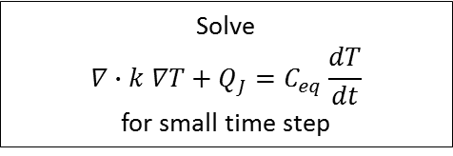
COMSOL Computational Model
Input
Parameterized model implemented in COMSOL
Winding properties are calculated in COMSOL
Geometry
Operation current
Compute magnetic flux density
Compute equivalent properties ρ_{eq}, k_{eq}, C_{eq} , Q_{j} at magnetic field and Temperatures
Affect equivalent properties ρ_{eq}, k_{eq}, C_{eq} to the windings
Use temperature distribution
Solve
$$∇∙k ∇T+Q_{J}=C_{eq}\frac{dT}{dt}$$
for small time step

Slide 19
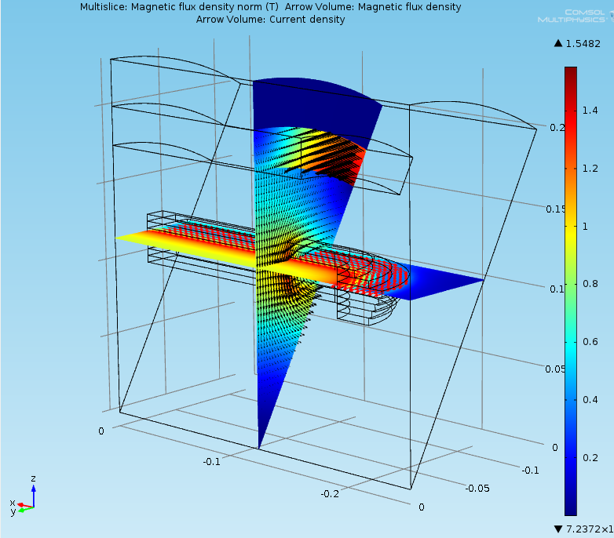
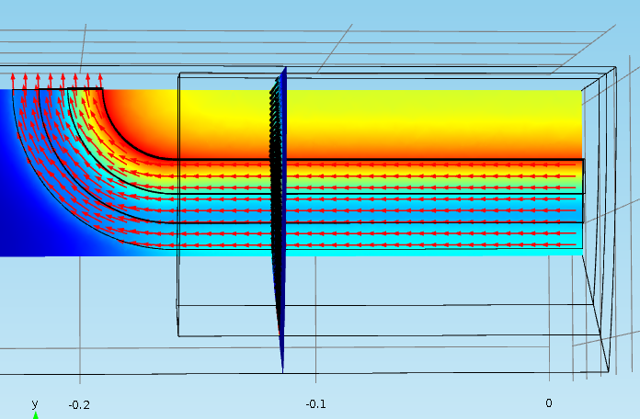
Magnetic Flux Density Distribution

Slide 20
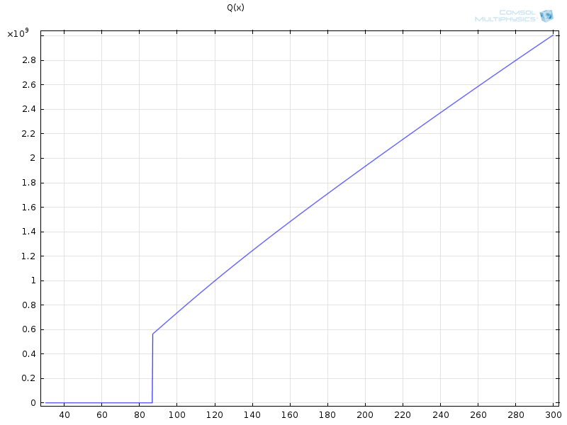
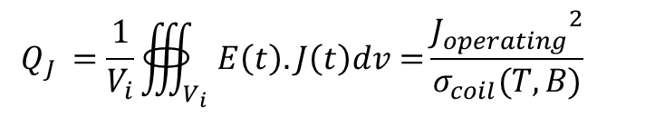
Coil heat source
$${ Q}_{J} =\frac{1}{V_{i}}∰_{V_{i}}{E\left(t\right).J\left(t\right)dv=}\frac{{J_{operating}}^{2}}{σ_{coil}(T,B)}$$
With:
- J_{operating}: operating current density (A/m²)
- σ_{coil}: equivalent conductivity of the coil (S/m)
- P_{j}: Joule losses in the coil (W/m³)
- V_{i}: specific volume (m³)
Superconducting state
Joule losses versus temperature at constant magnetic field (1T)

Slide 21
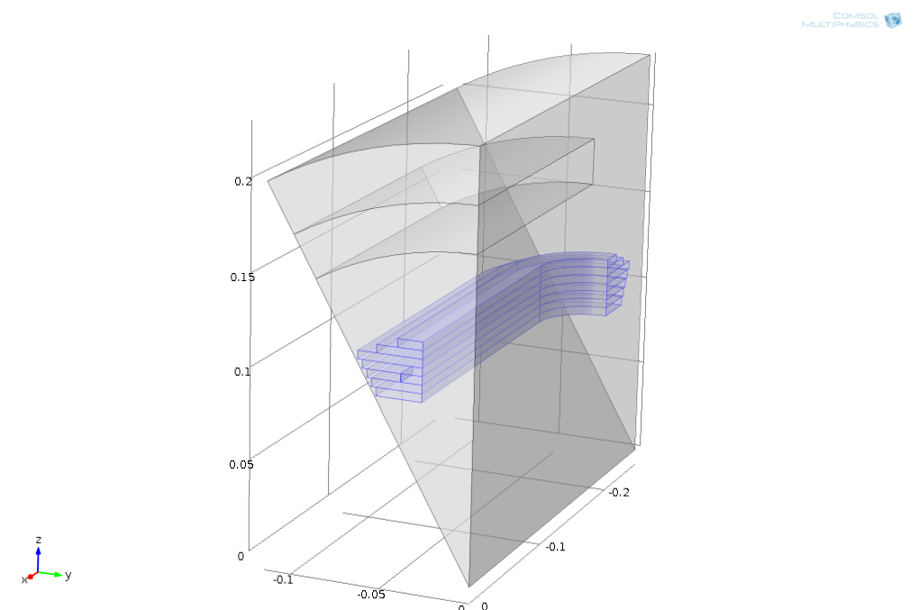
Thermal model
Cooling from inner pole surface (heat exchange coefficient)
Joule losses in the winding as Heat source
Heat source:
- Rectangle pulse
- Start time: 0.1s
- Duration 220 ms
- Value ≈ 5 W at 77K
Heat pulse
Power (W)
5
0
t(s)
0.1 0.32

Slide 22
Example of Quench Simulation at 77 K
Heat pulse (W)
Propagation mainly along x-axis
Heat pulse (W)

Slide 23
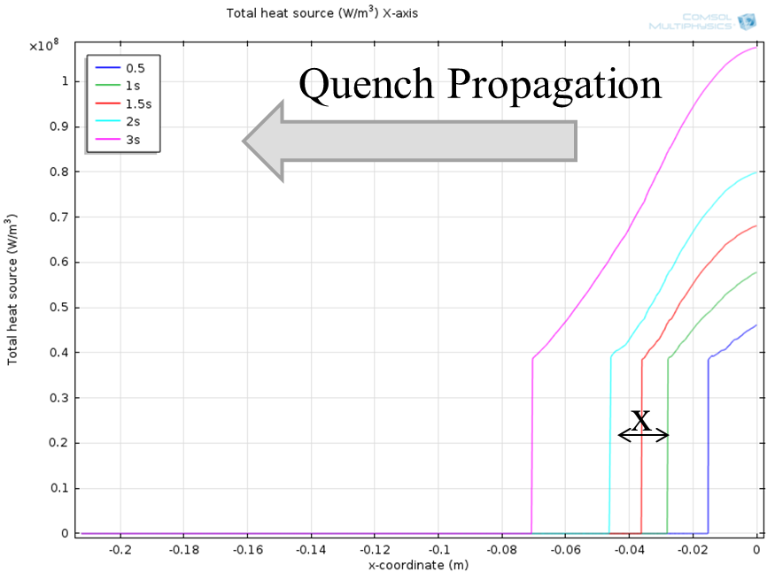
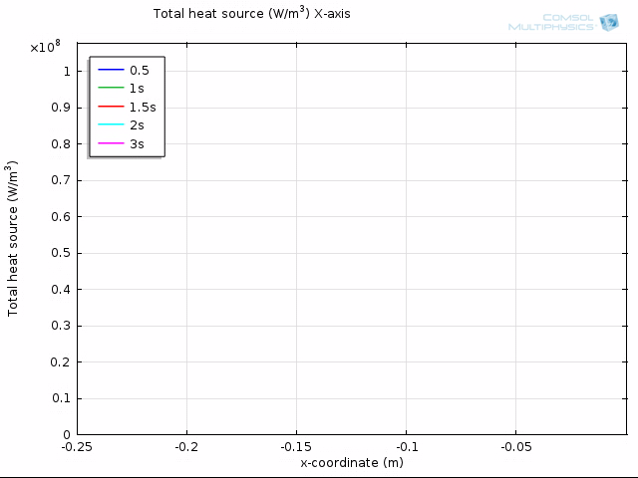
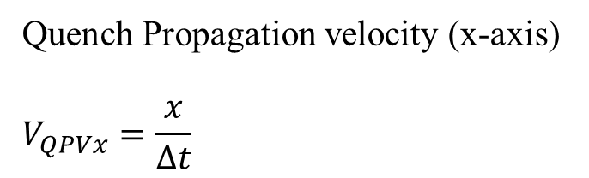
Normal Zone Propagation Velocity
Quench Propagation velocity (x-axis)
$$V_{QPVx}=\frac{x}{∆t}$$
Getting value during post processing

Slide 24
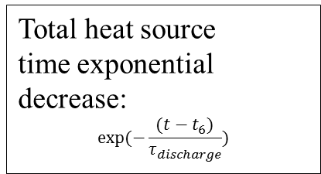
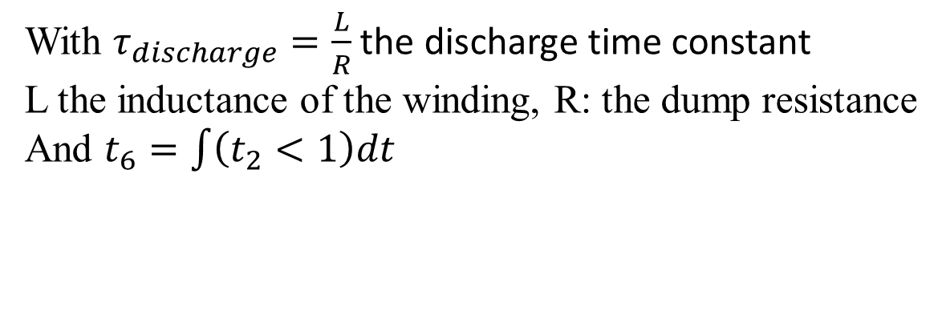
Quench detection
Voltage probe
if V< V_{threshold}
then 0
else
then 1
Total heat source
time exponential
decrease:
$$exp⁡(−\frac{(t−t_{6})}{τ_{discharge}})$$
Integration
of the voltage probe
Step to trigger coil discharge
Voltage probe
t₂
1
Voltage
during detection
a
t1
t(s)
t1+ε
t(s)
a
t₆
τ_{discharge}
t(s)
With $τ_{discharge}=\frac{L}{R}$ the discharge time constant
L the inductance of the winding, R: the dump resistance
And $t_{6}=\int{\left(t_{2}<1\right)dt}$

Slide 25
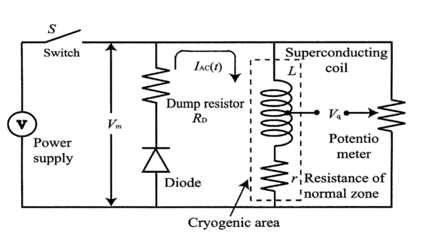
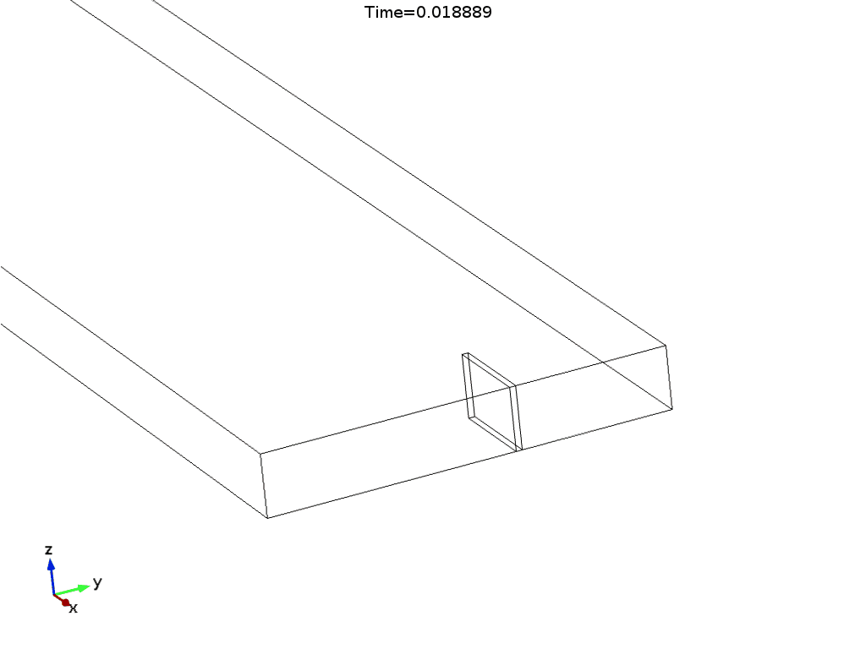
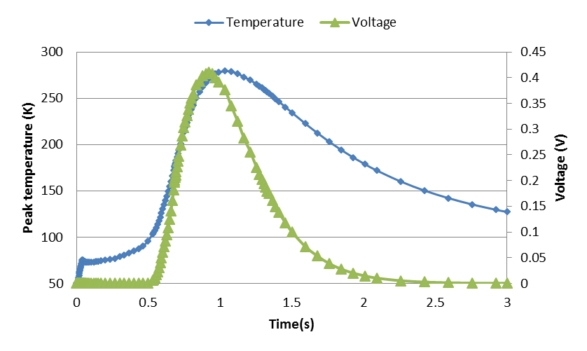
Example of Quench Simulations
*
Voltage detection
  Threshold: 400 mV
  Current discharge time constant: 0.5 s
Top: 50 K
I/Ic=0.7
Pulse of heat induces quench in winding

Slide 26
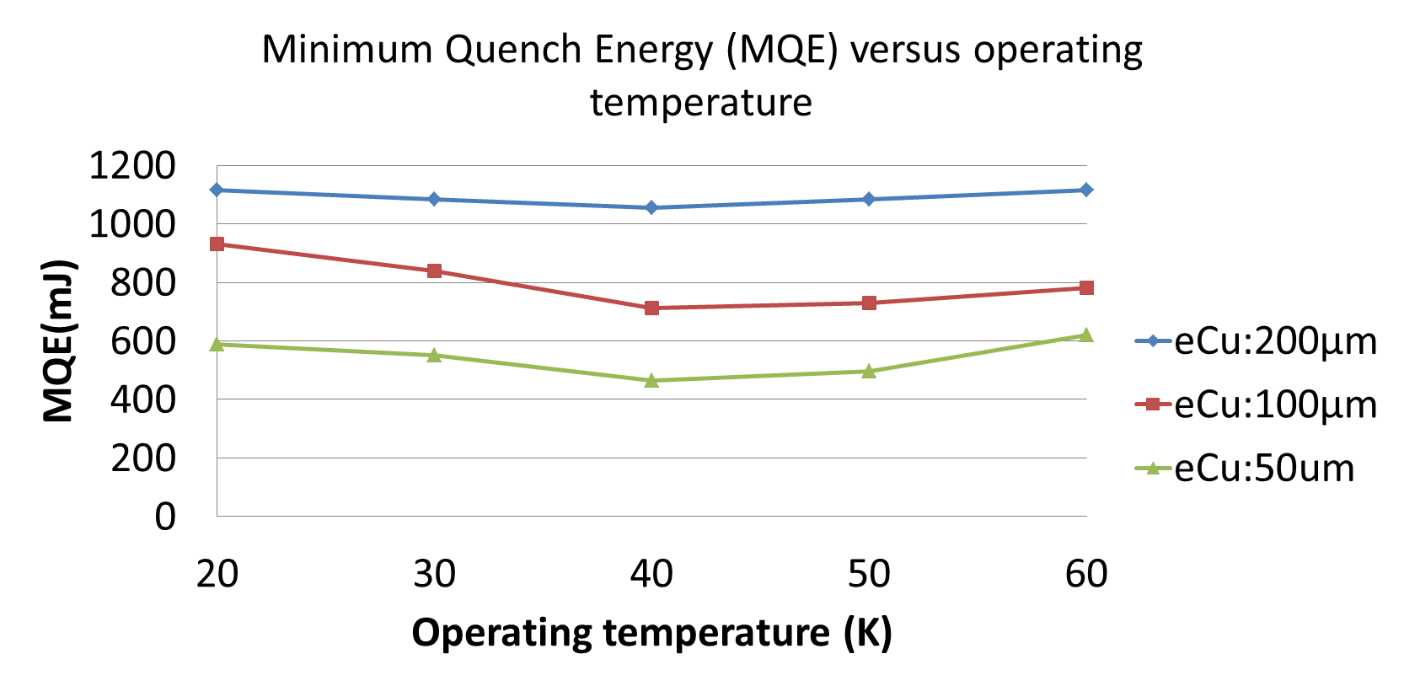
Minimum Quench Energy

Slide 27
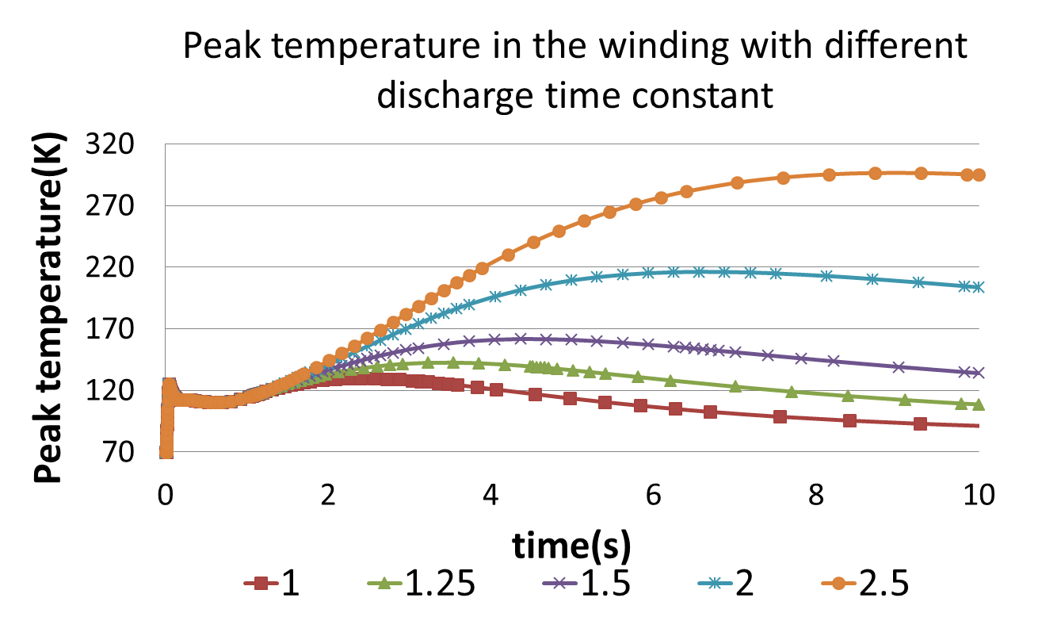
Temperature Profiles for Different Discharge τ

Slide 28
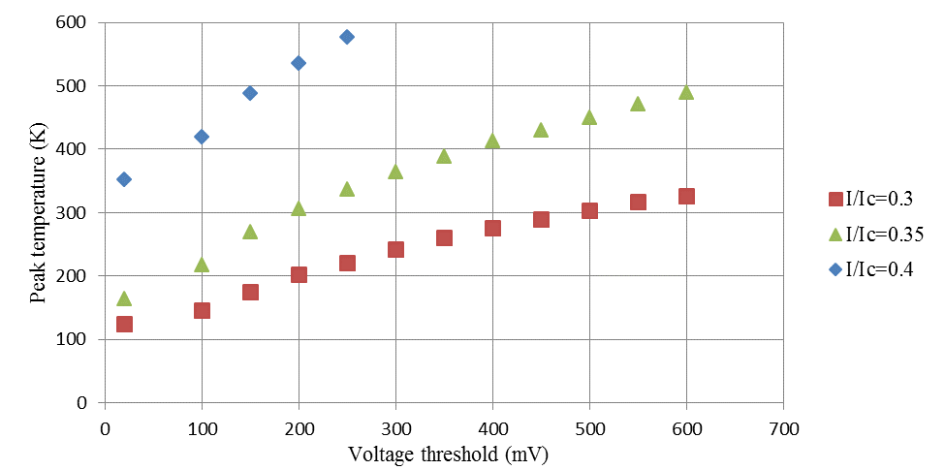
Impact of Detection Threshold on Peak Temp.

Slide 29
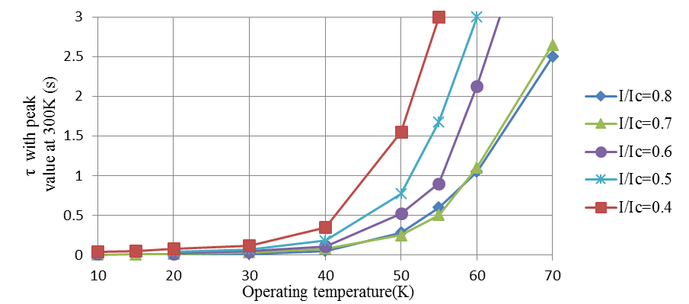
Impact of I/Ic on the Discharge Time Constant

Slide 30
Peak Temperature vs. Je

Slide 31
Influence of Copper Content on Coil Performance

Slide 32
Influence of Copper Content on Coil Performance (40K)
15 μm copper layer thickness leads to the highest engineering. current density in the winding

Slide 33
Summary and Perspectives
Parameterized model developed for YBCO
  Quench behavior can be estimated from
    Materials composing winding
    Jc(B,T) characteristic of the superconductor
    Voltage detection threshold
    Discharge time constant
Python code is being generated based on simulation results and will be implemented in Amber
    Quench protection will be used as additional constrains for the machine design
  More data needs to be generated to extract response surface
  Need coupling with external electric circuit model
    magnetic coupling, quench back
  Development of an in house flexible tool independent from FEA commercial packages is being considered

