Slide 1
Experiment Proposal to quantify the thermal response of superconducting cables to pulse heat loads
CHATS workshop 2013
Tiemo Winkler Rob van Weelderen Marcel ter Brake
CERN TE-CRG-CI CERN TE-CRG-CI University Twente

Slide 2
Content
Motivation: collimator setting are conservative
Limiting cases between enthalpy and heat transfer limits
Idea
Set-up
Proof of principle: results
Conclusions

Slide 3
Motivation
Collimation review this year at CERN revealed that settings for Beam Loss Monitors are conservative
With increasing beam energies the secondary particle showers will increase in intensity, thus trigger a beam dump earlier
Heat transfer of magnets to bath limits the beam dump trigger
Transient state heat transfer has to be determined

Slide 4
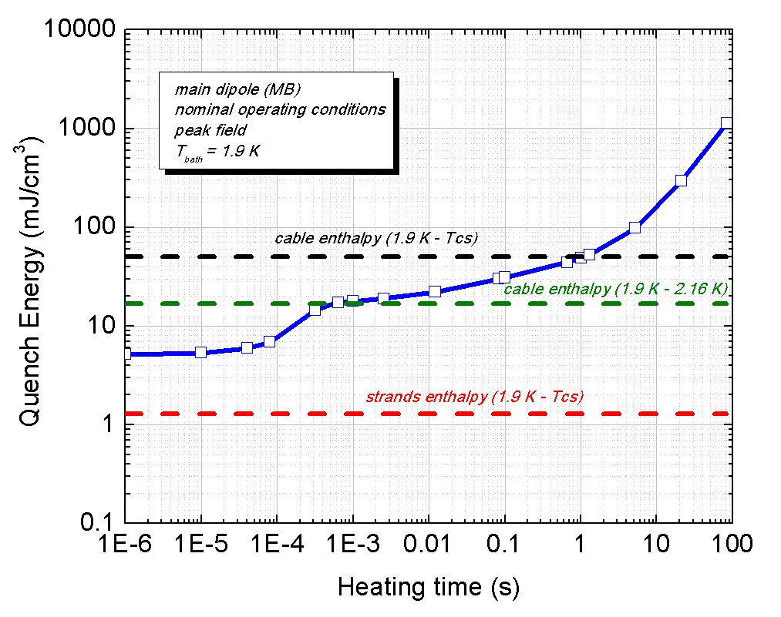
Limiting cases
Minimum quench energies (MQE) in steady-state are determined by heat transfer to the bath
  -> Heat transfer is fully developed
MQE for very short time scales is determined by the specific heat of cable
  -> Heat transfer is negligible
Between these two regions:
  Heat transfer is not fully established
  Specific heat plays an important role

Slide 5
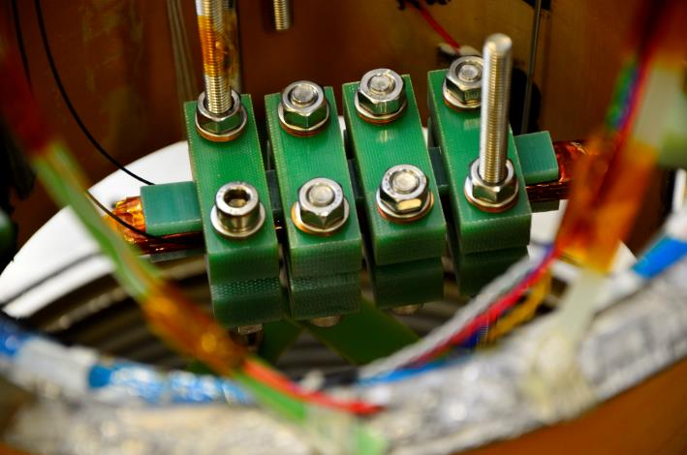
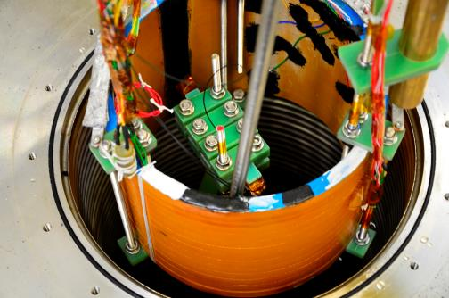
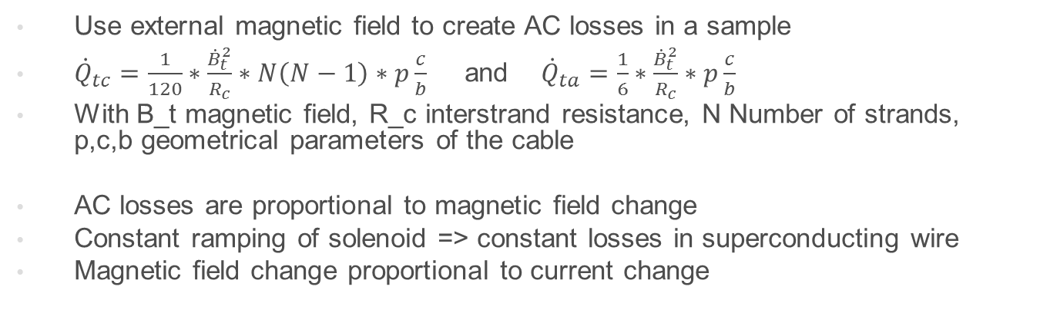
Idea
Use external magnetic field to create AC losses in a sample
${\dot{Q}}_{tc}=\frac{1}{120}∗\frac{{\dot{B}}_{t}^{2}}{R_{c}}∗N\left(N−1\right)∗p\frac{c}{b}$ and ${\dot{Q}}_{ta}=\frac{1}{6}∗\frac{{\dot{B}}_{t}^{2}}{R_{c}}∗p\frac{c}{b}$
With B_t magnetic field, R_c interstrand resistance, N Number of strands, p,c,b geometrical parameters of the cable
AC losses are proportional to magnetic field change
Constant ramping of solenoid => constant losses in superconducting wire
Magnetic field change proportional to current change

Slide 6
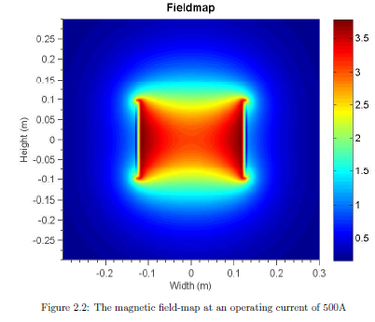
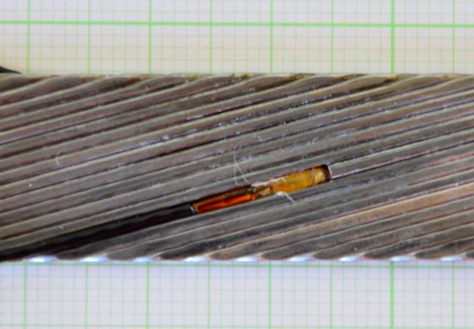
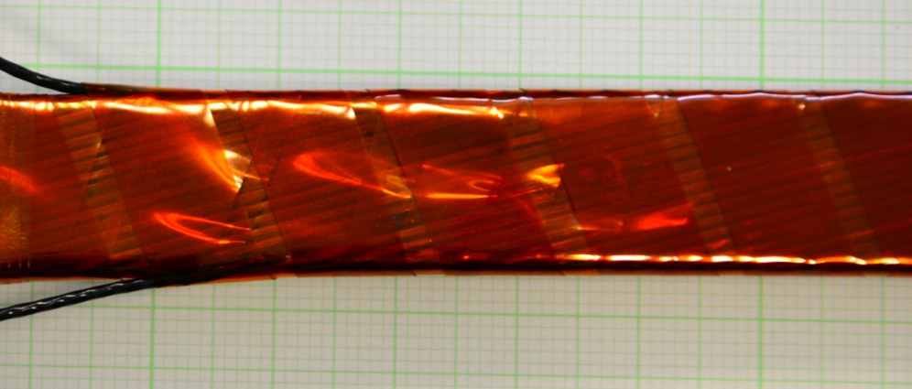
Set-up
Superconducting solenoid
2 bare chip CERNOX in sample
1 reference sensor in the bath

Slide 7
Proof of principle
Continuous ramping with 5 A/s
Sample temperature increases by 47 mK
10 sec characteristic time

Slide 8



Zoom
With T_0 start temperature,
t time,
tau as characteristic time,
T_eq equilibrium temperature
$$τ=10 sec$$
$T\left(t\right)=T_{0}\exp\left(−\frac{t}{τ}\right)+(1−\exp\left(−\frac{t}{τ}\right)T_{eq}$ ;
$$τ=\frac{C_{p}}{hA}$$

Slide 9

Generated heat
The generated heat can be roughly estimated.
Assuming the specific heat of the sample mostly consists of the Helium in the voids of the sample
Using the characteristic time tau, the specific heat of the Helium voids and the relation between the steady-state temperature
The generated heat can be calculated to be 0.1 mW/cm3
$$∆T=Q∗\frac{τ}{C_{p}}$$

Slide 10



Zoom
$$τ=10 sec$$
With T_0 start temperature,
t time,
tau as characteristic time,
T_eq equilibrium temperature
$$T\left(t\right)=T_{0}\exp\left(−\frac{t}{τ}\right)+(1−\exp\left(−\frac{t}{τ}\right)T_{eq}$$
;
$$τ=\frac{C_{p}}{hA}$$

Slide 11
Conclusions
Use a mass flow meter to determine deposited heat
Power supply
  change for a bipolar power supply to enable faster ramp rates
  Increase maximum output current for longer more homogenous ramps
Increase sample mass to increase sensitivity
Include strain gauge in setup to measure sample pressure during cool down

Slide 13
First results
Continuous ramping with 5 A/s
Sample temperature increases by 47 mK
10 sec characteristic time

Slide 14


Zoom
$$τ=10 sec$$
With T_0 start temperature,
t time,
tau as characteristic time,
T_eq equilibrium temperature
$$T\left(t\right)=T_{0}\exp\left(−\frac{t}{τ}\right)+(1−\exp\left(−\frac{t}{τ}\right)T_{eq}$$

Slide 15

Zoom
$$τ=10 sec$$
With T_0 start temperature,
t time,
tau as characteristic time,
T_eq equilibrium temperature
$$T\left(t\right)=T_{0}\exp\left(−\frac{t}{τ}\right)+(1−\exp\left(−\frac{t}{τ}\right)T_{eq}$$

Slide 16
Logarithmic plot

Slide 17
Logarithmic plot

