Slide 1



Advances in Numerical Coding of the Two Fluid HeII Model
Rob van Weelderen CERN
Cyprien Soulaine IMFT
Michel Quintard IMFT-CNRS
Bertrand Baudouy CEA-Saclay
Hervé Allain non-affiliated

Slide 2
Introduction (1/4)
The simulation of superfluid helium (HeII) behaviour is not always obvious, and gives rise to specific numerical problems. These problems often occur at the boundaries, in regions with heat sources, and due to thermal-acoustic waves.
In a joint effort between the Institut de Mécanique des Fluides de Toulouse (IMFT), CERN and CEA-Saclay we have embarked on a project to develop a HeII simulator. The aim of this project is to develop a code, able to simulate the superfluid flow motion and its thermal interactions with superconducting magnet coils.

Slide 3
Introduction (2/4)
In a near future this tool will provide a solid basis to develop the theory of superfluidity in porous media, with the hope that it could significantly enhance the design of new devices cooled by He II.
We report on the mathematical approach taken to numerically solve the 2-fluid model of HeII in laminar and turbulent regimes, the specific problems encountered and the solutions found so-far. We compare the results with relatively simple configurations for which analytical solutions exist and with data from an experiment on forced flow of HeII

Slide 4
Introduction (3/4)
Starting point is the two-fluid model by Landau, Khalatnikov, which form a set of strongly coupled equations.
Only few multi-dimensional codes reported in literature, most report numerical difficulties which led them to either go 1-D, or to simplify by dropping terms in the momentum equation (Kitamura et al, Roa et al, Zang et Al, Ramadan and Witt)
Others, assuming mutal friction and thermomechanical terms are approximately equal, derive simplified equations (Suekane et Al, Pietrowicz and Baudouy).

Slide 5
Introduction (4/4)
Tatsumoto et al. proposes a numerical segregated solution, Bottura and Rosso a coupled algorithm.
We propose an alternative segregated approach: and extension of the “Pressure Implicit Operator Splitting (PISO)” algorithm by Issa (1985) to “Super-PISO”
The Pressure equation is directly derived from total mass balance and both momentum equations. Its at the core of HeIIFOAM, the code developed using OpenFOAM®.

Slide 6

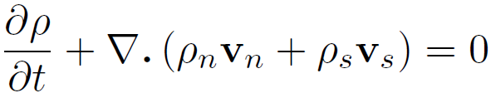
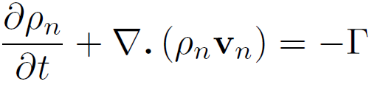
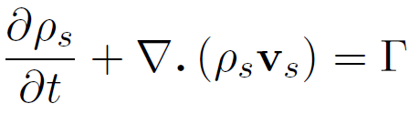
Mathematical model and assumptions 1/4
Mass conservation: Introducing the rate Γ at which superfluid transforms into normal, assuming the rate of normal to superfluid to be symmetric (r_{sn} = -r_{ns})
Γ is an unknown variable, to be solved

Slide 7


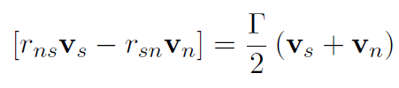
Mathematical model and assumptions 2/4
Momentum balance equations:
: Represents the thermo-mechanical force which occurs when a temperature gradient exists.
: Gorter-Mellink mutual friction term,
which is present in the equations only at high velocities.
: momentum transfer between the two fluids Landau and Lifchitz (1969) suggest that there is no momentum transfer while Woods (1975) who derived superfluid hydrodynamic equations from a thermodynamic point of view keeps it.

Slide 8
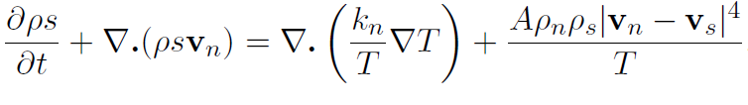
Mathematical model and assumptions 3/4
Energy balance equation:
To obtain a T equation we assume s and ρ independent of pressure →:

Slide 9




Mathematical model and assumptions 4/4
Boundary conditions for surfaces:
:normal component of the total mass flux must vanish at any surface at rest
:tangential component of the normal velocity v􀀀 must be zero at a solid surface
: In the absence of heat transfer between the solid surface and the fluid, neglecting k_{n} we get a no-slip boundary condition for the normal velocity
: at a heated surface
At the helium bath entrance, temperature and pressure are fixed values

Slide 10
Solutions and problems encountered (1/
Segregated approach: and extension of the Pressure Implicit Operator Splitting (PISO)” algorithm by Issa (1985) to “Super-PISO”. The Pressure equation is directly derived from total mass balance and both momentum equations. Its at the core of HeIIFOAM, the code developed using OpenFOAM®.
→ Details in “A PISO-like algorithm to simulate superfluid helium flow with the two-fluid model”, Computer Physics Communications, (Elsevier)

Slide 11

Solutions and problems encountered (1/
Heated wall gave many convergence issues, and we circumvented those by considering the heat source as a volume heat source in the energy equation that is distributed in some cells:
Where α is a phase indicator equal to 1 for the heated cells and 0 elsewhere
This trick allows the heat flux to be relaxed in several cells, which improves the stability of the calculation. In particular, the creation of normal fluid component is now spread over several cells instead of the singularity at the heated surface.

Slide 12
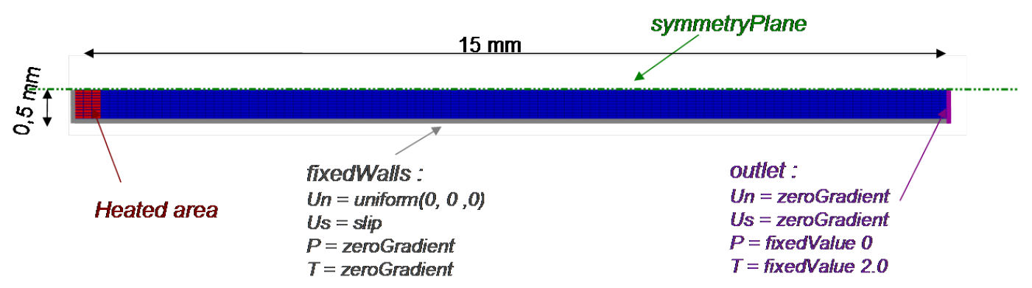
Solutions and problems encountered (2/
Capillary containing helium II in Landau’s regime:
This test consists in the simulation of a capillary (2h x L = 1 mm x 15 mm) tube filled with He II, heated at the left-hand side and connected to a He II bath at the right-hand side.
Initially, superfluid and normal components are at rest at bath temperature and pressure field is uniformly zero. The left-hand side is heated to q = 1000 W/m².

Slide 13
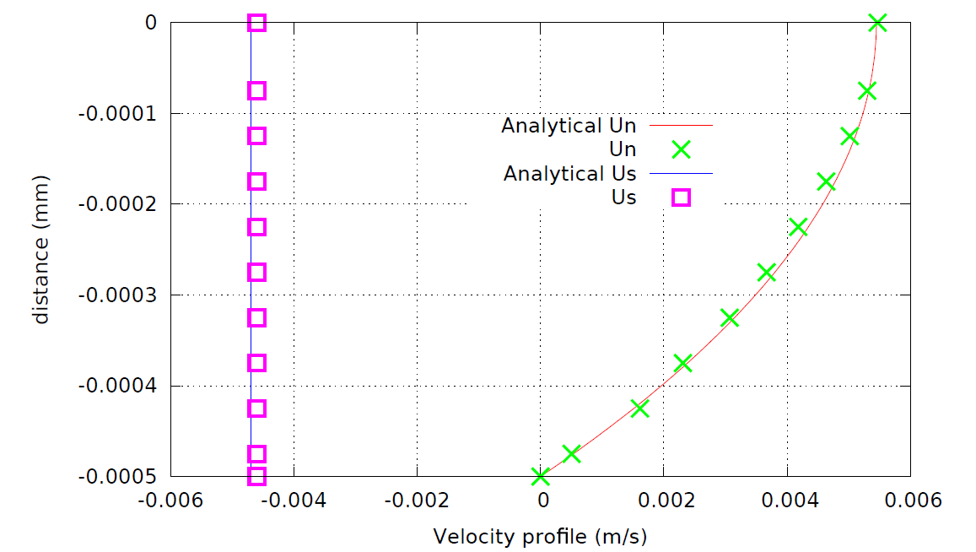
Solutions and problems encountered (3/
Capillary containing helium II in Landau’s regime: steady state
→ To avoid or limit the propagation of the heat waves the left-hand side is gradually heated with a relaxation time of 10⁻² s.
At steady state, this test-case has analytical solutions (Landau and Lifshitz (1969)), and the simulation agrees very well with it.

Slide 14
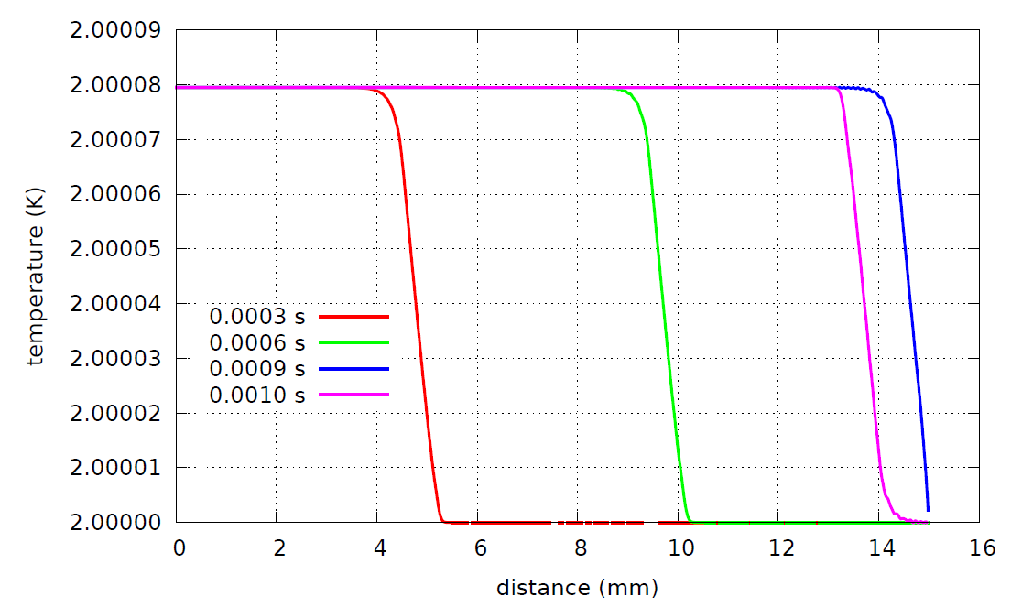
Solutions and problems encountered (4/
Capillary containing helium II in Landau’s regime: transient
Heat wave propagation speed in agreement with Landau & Lifshitz
However we have a strong, almost un-damped reflection from the open-bath end → need to develop alternative boundary conditions.

Slide 15
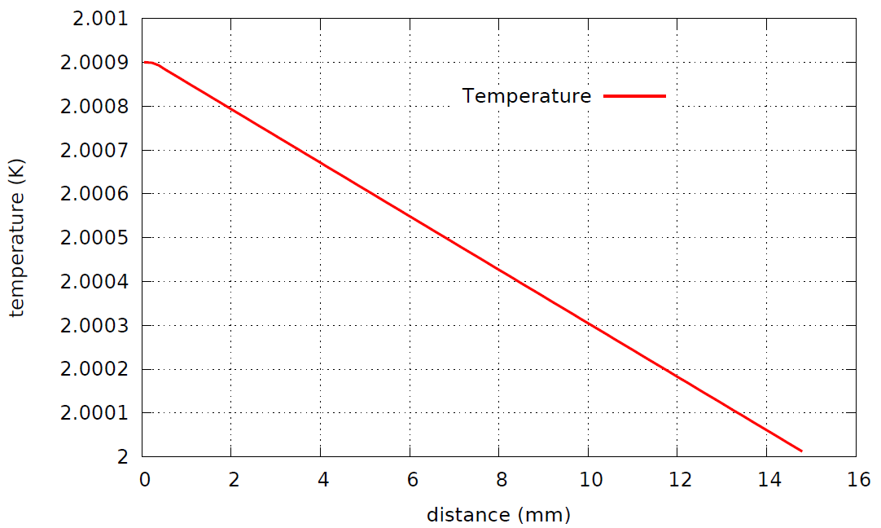
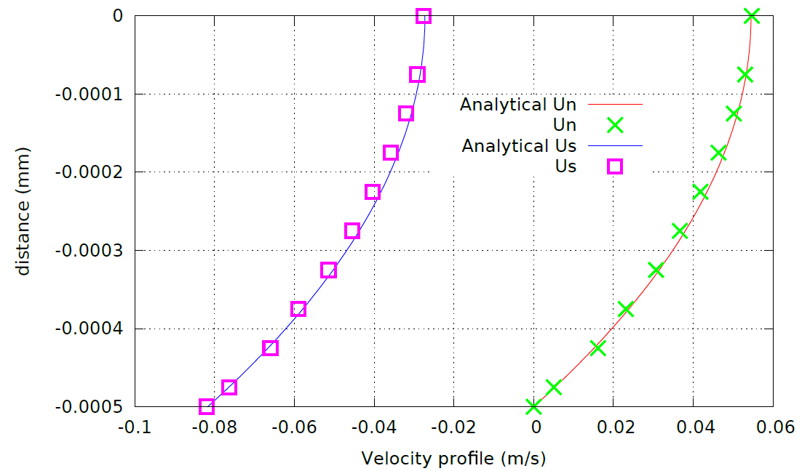
Solutions and problems encountered (5/
Capillary containing helium II in Gorter-Mellink’s regime:
No problems encountered in this case, theory and model agree perfectly (details skipped)
Temperature profile at steady state

Slide 16
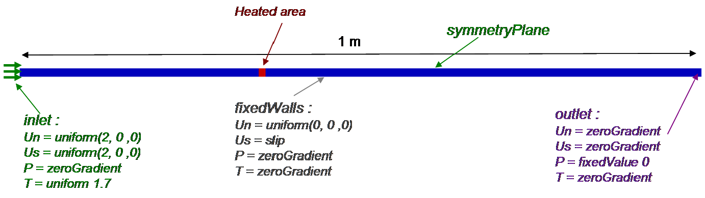
Solutions and problems encountered (6/
Fuzier and van Sciver’s experiments:
Transient heat transfer for a forced flow of He II at high Reynolds number following the setup of the experiments performed by Fuzier and Van Sciver (2008).
They measured temperature profiles in a forced flow of superfluid helium in a 1 m long, 9.8 mm inside diameter, smooth tube.

Slide 17
Solutions and problems encountered (7/
liquid is pushed from a bellows pump to reach a velocity up to 22 m/s.
A heater is placed between 0.30 m and 0.31 m from the left-hand side.
Liquid helium enters into the domain from the left-hand side at 2 m/s and flows out at the right hand side of the tube. Initially, we assume that the superfluid and normal velocities are equal to 2 m/s within the tube and the temperature is 1.7 K.
Several probes are placed along the tube. They correspond to the temperature measurements T3 to T8 of Fuzier and Van Sciver (2008). Simulations are performed with the full two-fluid model involving Gorter-Mellink mutual friction terms.

Slide 18
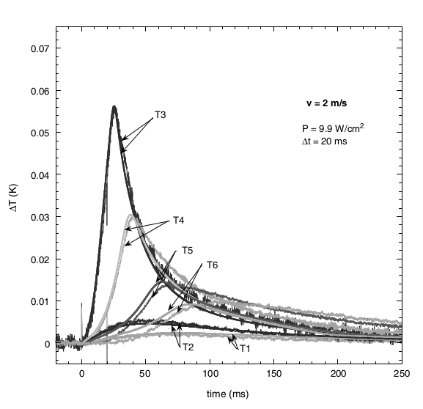
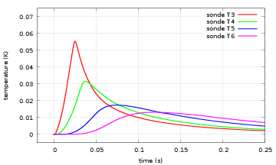
Solutions and problems encountered (7/
2 m/s
we start the heater at q = 9.9 W/cm² for 20 ms and we record the temperature evolution until 250 ms for the different probes. The results are in very good qualitative agreement with the experimental results shown in Fig. 5 of Fuzier and Van Sciver (2008) : the temperature peak for each probes are comparable both in amplitude and in time.

Slide 19
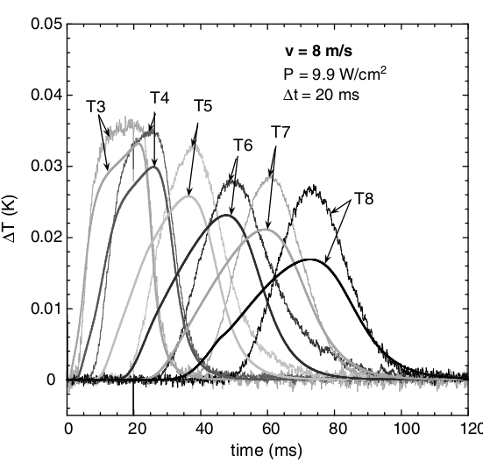
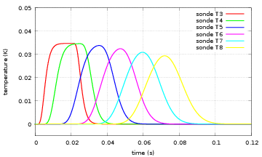
Solutions and problems encountered (8/
8 m/s

Slide 20
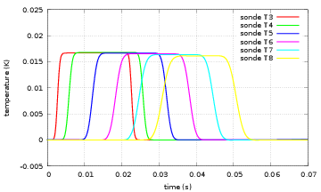
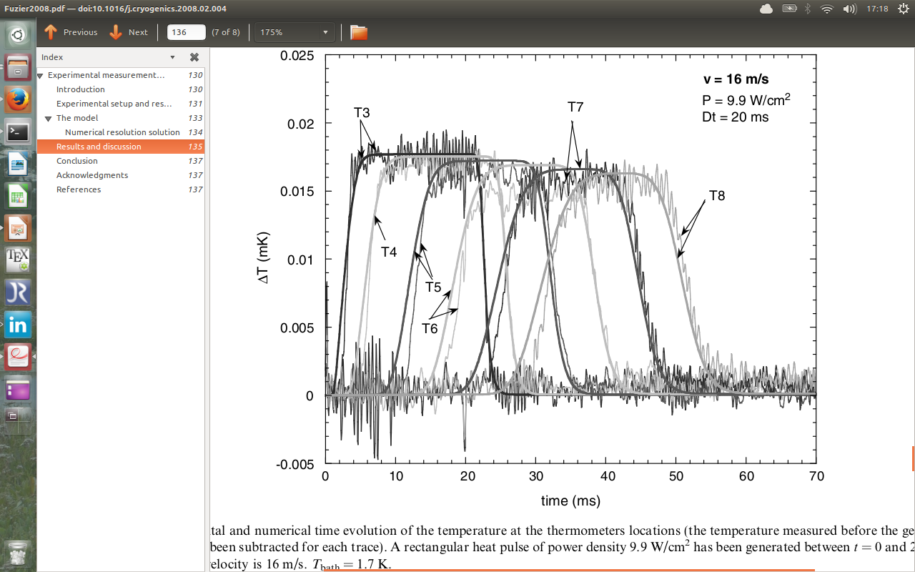
Solutions and problems encountered (9/
16 m/s

Slide 21
Superfluid flow through an area of beads
A capillary that contains 16 solid beads (0.5 mm diameter).
The heater is placed in a small extension of the capillary at the left-hand side of the array of beads.
The capillary is initially filled with He II at 2 K. The left-hand side is then warmed up to 10⁴ W/m², and the flow is simulated using the Gorter-Mellink model.

Slide 22

Superfluid flow through an area of beads
temperature profile at steady state in a capillary tube filled by 16 beads.
→ The presence of solid materials inside the capillary leads to an increase of the ∆T (30 x more than without).

Slide 23
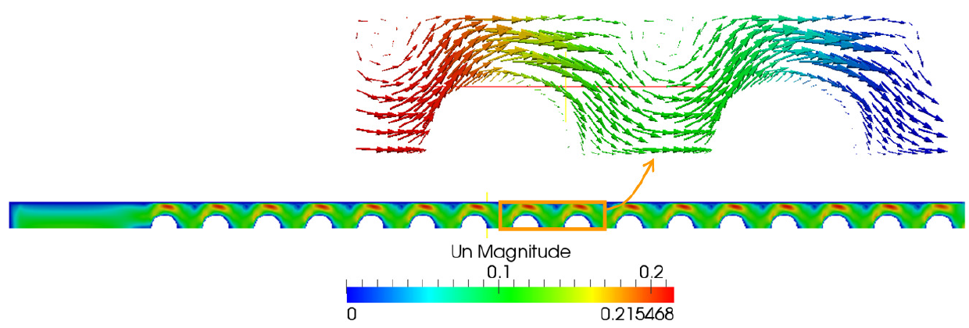
Superfluid flow through an area of beads
normal velocity magnitude and of the normal velocity vectors in two adjacent REV. We clearly notice cyclic flow patterns.
→ This suggests that one may define a Representative Elementary Volume (REV) of the pore-scale physics and then apply volume-averaging methodology in order to derive macro-scale equations

Slide 24
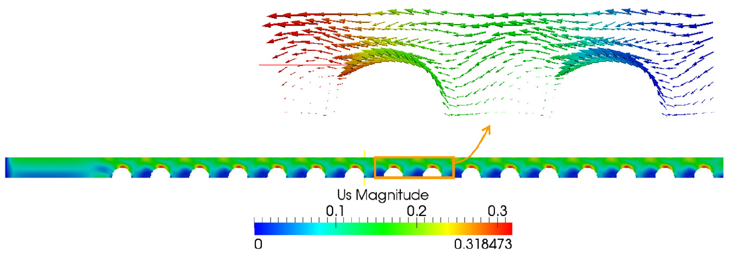
Superfluid flow through an area of beads
superfluid velocity magnitude and of the superfluid velocity vectors in two adjacent REV. We clearly notice cyclic flow patterns.
→This suggests that one may define a Representative Elementary Volume (REV) of the pore-scale physics and then apply volume-averaging methodology in order to derive macro-scale equations.

Slide 25
Conclusion
We’ve shown the first results, mostly of validations, of the use of a HeIIFOAM solver.
Some problems still need to be accounted for, especially on the open bath boundary.
Mostly, however, good agreement can be found
Aim to apply this to derive macro scale equations for superconducting, porous, cables.
Cross-check with dedicated tests to be foreseen

