Slide 1
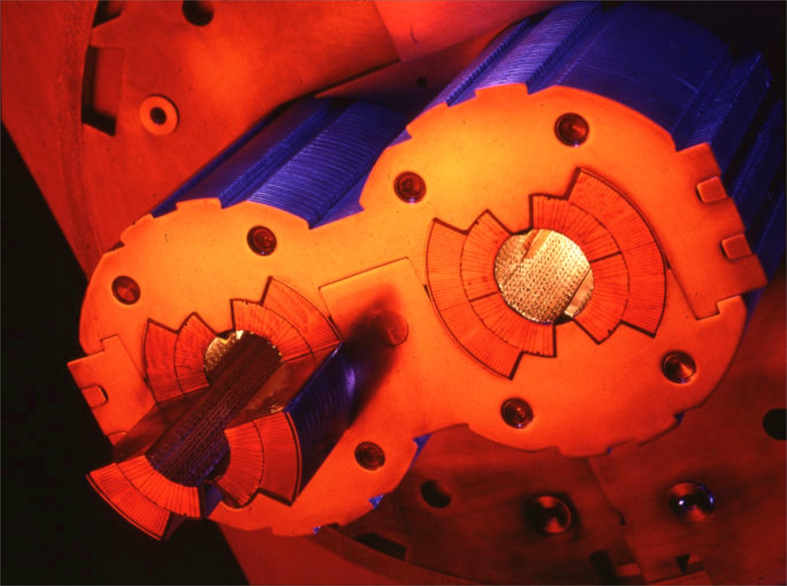

Quench modelling for accelerator magnets
A Case Study and Various Other Considerations relevant to
L. Bottura and S. Izquierdo Bermudez
CERN TE-MSC
Boston
October 9th-11th, 2013

Slide 2
Outline
Motivation
Scaling analysis
Quench modeling and issues
A “real-life” example
An attempt to transpose experience gained in quench modelling for fusion to the domain of accelerator magnets

Slide 3
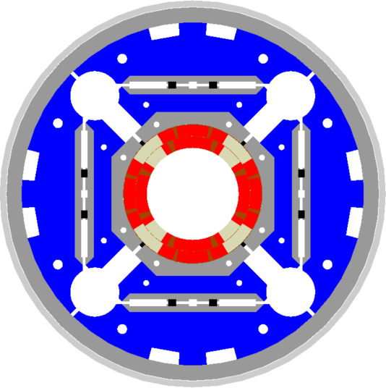
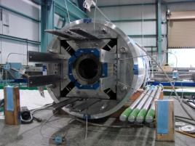




Motivation: MQXF for HL-LHC
Aperture | (mm) | 150
Gradient | (T/m) | 140
Current | (A) | 17500
Temperature | (K) | 1.9
Peak field | (T) | 12.1
Shell-based support structure (aka bladder-and-keys) developed at LBNL for strain sensitive material
HQ image by courtesy of H. Felice (LBNL)

Slide 4
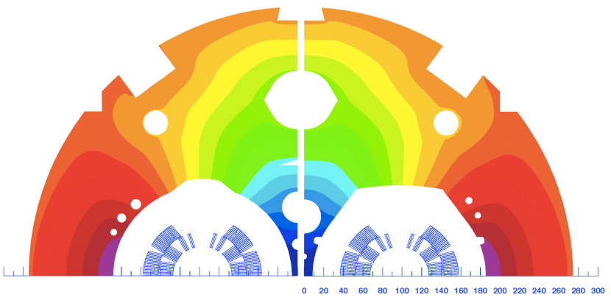
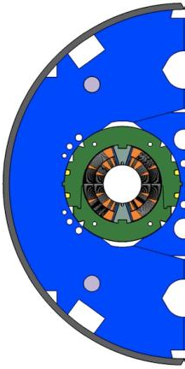
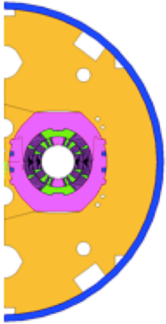

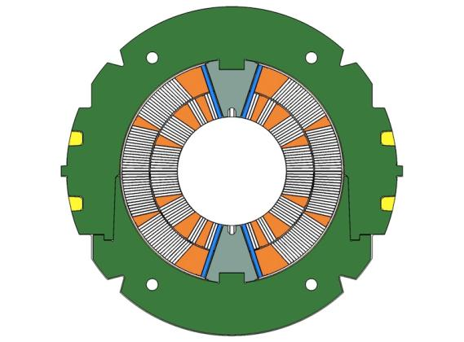
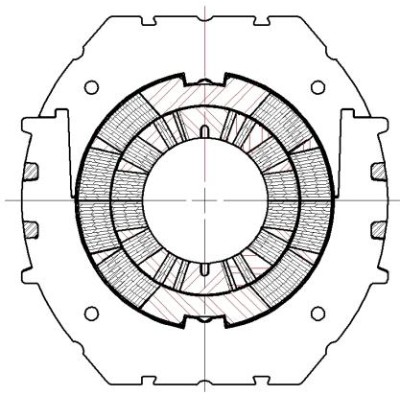
More motivation: 11 T dipole
Aperture | (mm) | 60
Field | (T) | 10.8
Current | (A) | 11850
Temperature | (K) | 1.9
Peak field | (T) | 11.3
Removable pole loading
Integrated pole loading
J_{op} ≈ 800 A/mm²
e_{m} ≈ 150 MJ/m³
By courtesy of A. Zlobin (FNAL) and M. Karppinen (CERN)

Slide 5
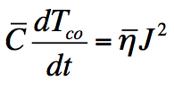
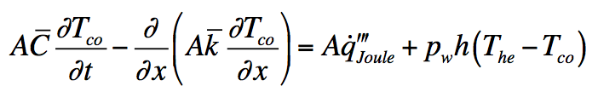
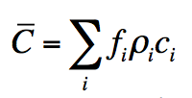
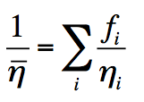
Scaling: adiabatic heat balance
The simplest (and conservative) approximation for the evolution of the maximum temperature during a quench is to assume adiabatic behavior at the location of the hot-spot:
Average heat capacity:
Average resistivity:

Slide 6
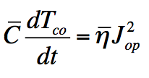
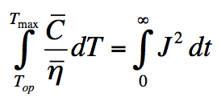
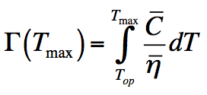
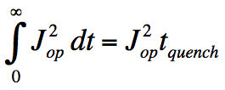
Scaling: hot spot temperature
adiabatic conditions at the hot spot :
can be integrated:
B.J. Maddock, G.B. James, Proc. IEE, 115 (4), 543, 1968
total volumetric heat capacity
cable operating current density
stabilizer resistivity
The function Γ(T_{max}) is a cable property quench capital
The integral of J depends on the circuit quench tax

Slide 7
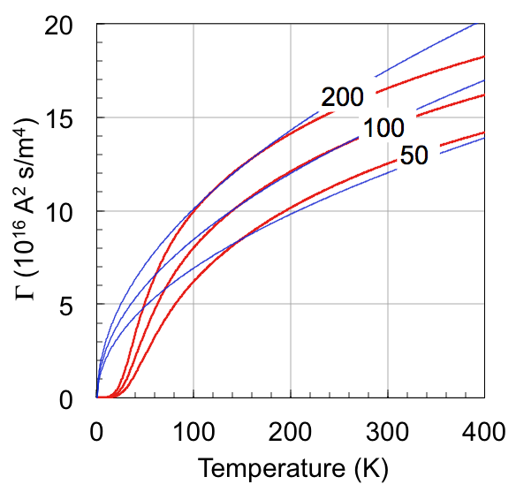
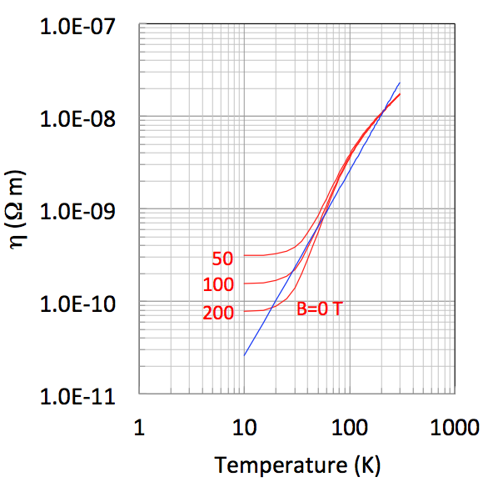
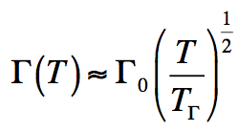
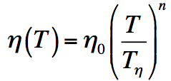
Material properties
copper Γ(T_{max})
copper resistivity
B=0 T
Wilson’s Gamma
Useful power approximation

Slide 8
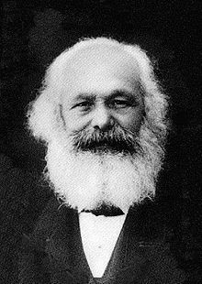
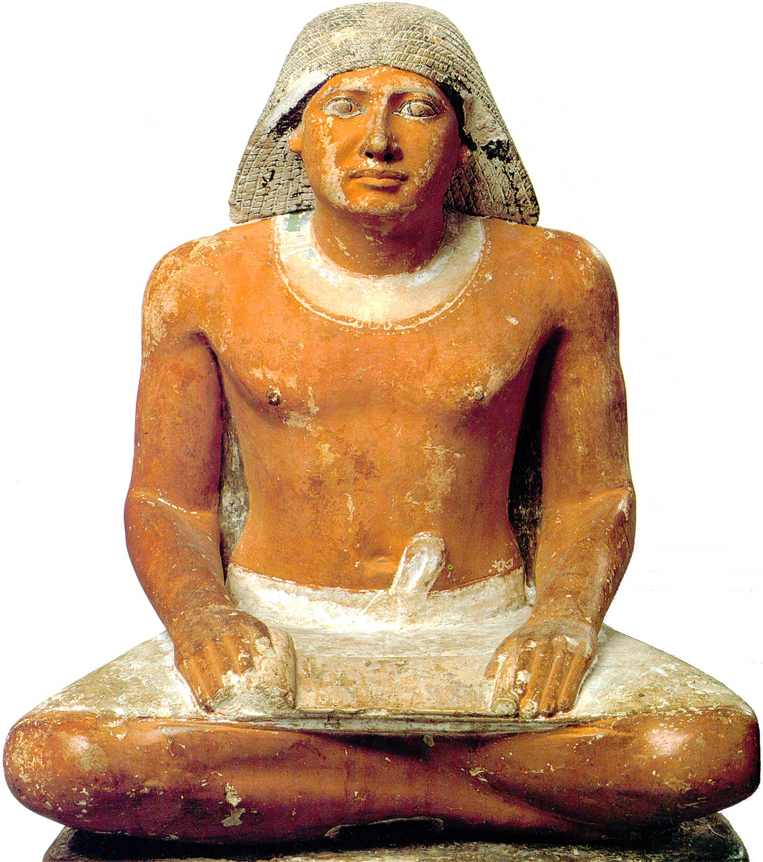
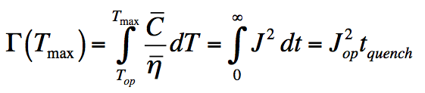
Quench Capital vs. Tax
The real problem is to determine the integral of the current waveform: how much is the quench time t_{quench} ?
Two limiting cases:
  External-dump: The magnet is dumped externally on a large resistance (R_{dump} >> R_{quench}) as soon as the quench is detected (e.g. ITER)
  Self-dump: The circuit is on a short circuit and is dumped on its internal resistance (R_{dump} = 0) (e.g. LHC)

Slide 9
“Self dump”
The magnetic energy is completely dissipated in the internal resistance, which depends on the temperature and volume of the normal zone
In this case it is not possible to separate the problem in quench capital and quench tax, but we can make approximations
Assume that:
  The whole magnet is normal at t_{discharge} (perfect heaters)
  The current is constant until t_{quench} then drops to zero
  Wilson’s Gamma and the power resistivity
S₁
L
D
R_{quench}
normal operation
quench

Slide 10
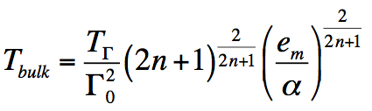
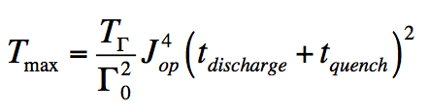
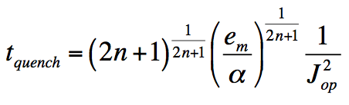
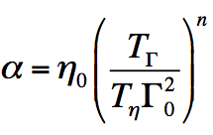
Scaling for “self dump”
Temperature
Quench time
magnet bulk
hot-spot
Details as from M. Wilson, Superconducting Magnets, Clarendon Press, 1986

Slide 11
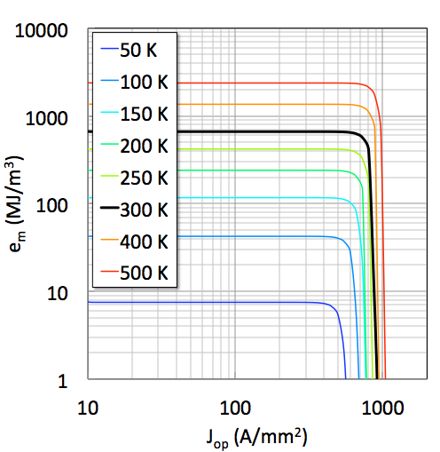
Scaling study for “self dump”
T_{max}
Cu/Nb₃Sn
f_{Cu} ≈ 0.55
f_{SC} ≈ 0.45
I_{op} ≈ 10 kA
t_{discharge} ≈ 0.1 s
e_{m} limited
ITER
11 T
LHC
Remember…
for the 11 T dipole:
J_{op} limited
J_{op} ≈ 800 A/mm²
e_{m} ≈ 150 MJ/m³

Slide 12
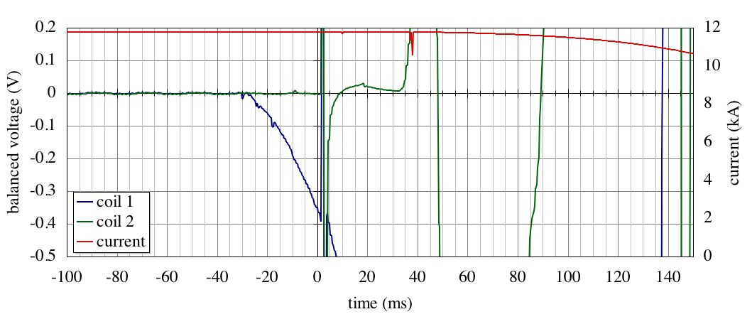
Detection, switch and dump
Example of an LHC dipole magnet training quench
magnet quenched
precursor
switch
propagation
detection threshold
detection
fire heaters
trigger (t=0)
t_{dump}
t_{detection}
t_{validation}
t_{heater}
t_{quench} ≈ t_{detection} + t_{validation} + t_{heater} +f t_{dump}
t_{discharge}
≈ 50…100 ms

Slide 13
Quench (modeling) issues
What is the time needed to detect a normal zone ? Longitudinal quench propagation speed
What is the time needed to induce a distributed quench, using quench heater or comparable mechanism ? Heater delay
What is the time needed for the quench to “invade” the whole magnet cross section (and the magnet tu dump) ? Transverse quench propagation speed

Slide 14

Quench model for a 11 T dipole
40 Nb₃Sn strands
14.7 mm x 1.25 mm
0.1 mm insulation
A_{Nb3Sn} = 7.2 mm²
A_{Cu} = 8.2 mm²
A_{epoxy-glass} = 5.5 mm²
6 blocks coil
2 layers/pole
56 turns
I_{op} = 11850 A
L/l = 6.8 mH/m
Turns 1…9
10…17
18..20
21,22
wedge
Inner layer
Outer layer
Heater
Turns 1…16
17…34

Slide 15
Quench modeling – unfolding
Identify in the winding the longitudinal and transverse (principal) directions
The longitudinal
cable is a continuum
“relatively easy” to solve
with accurate (high order) and
adaptive (front tracking) methods

Slide 16
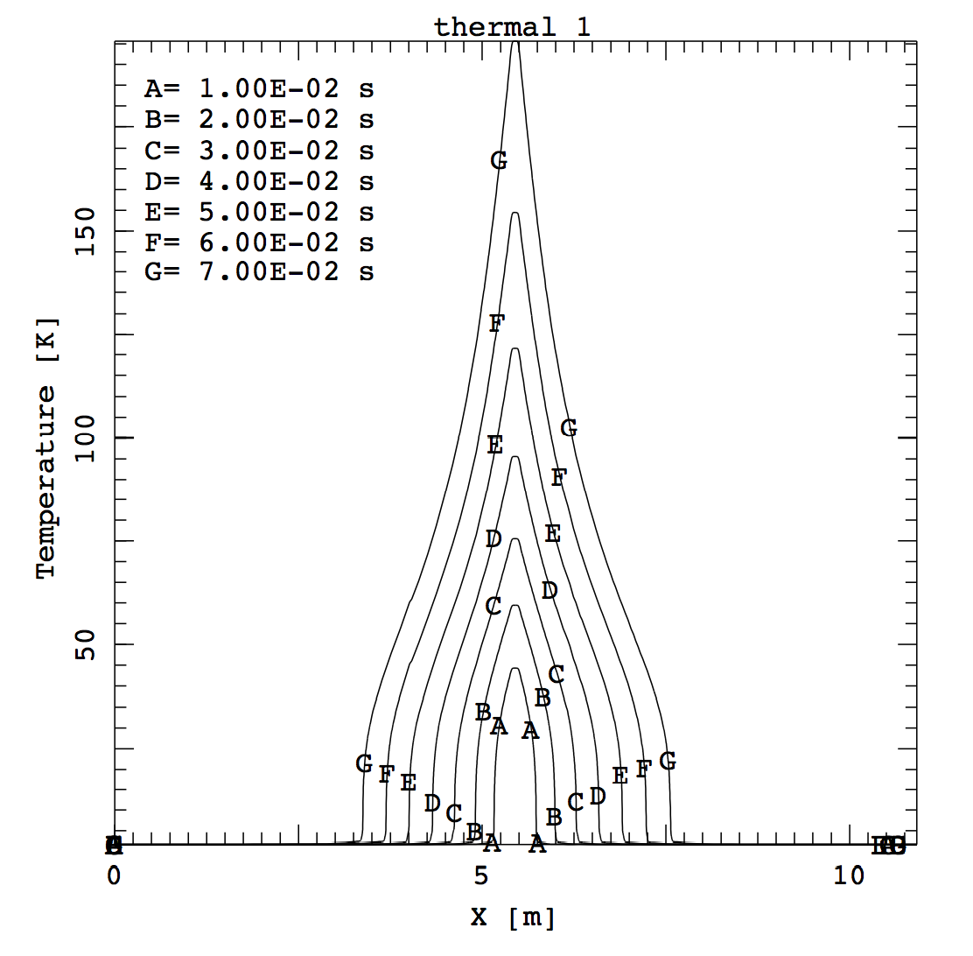
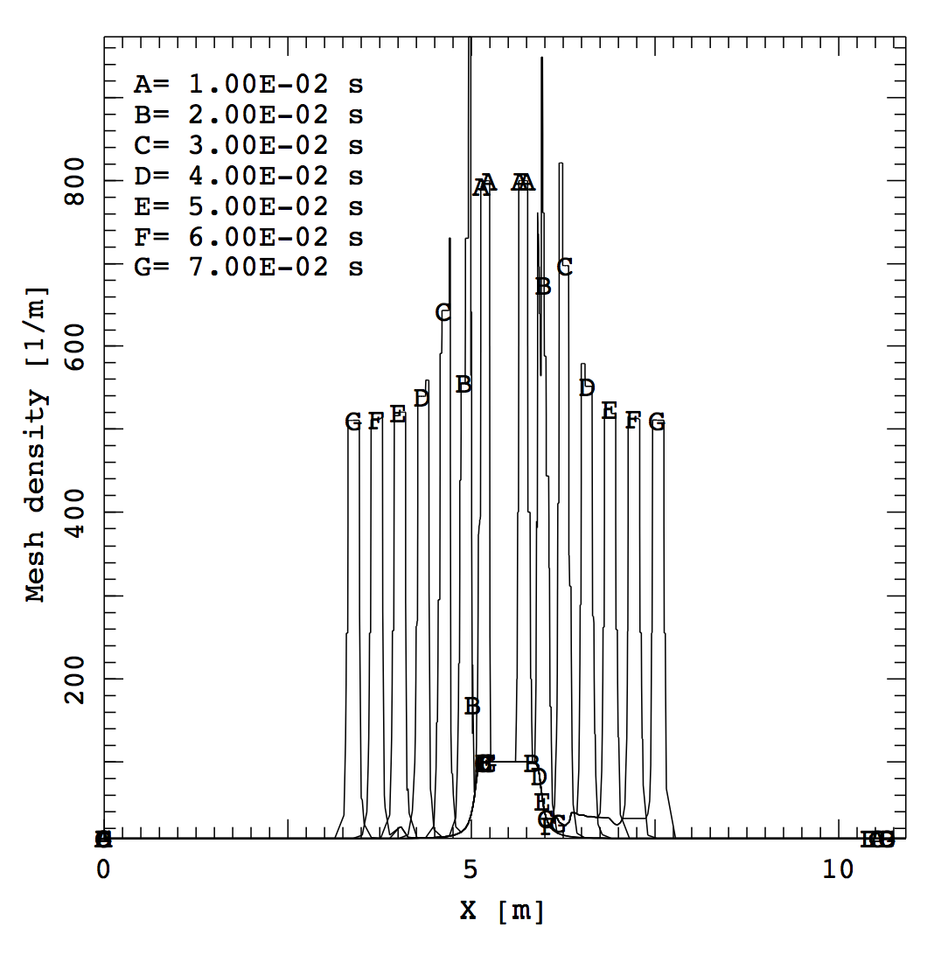
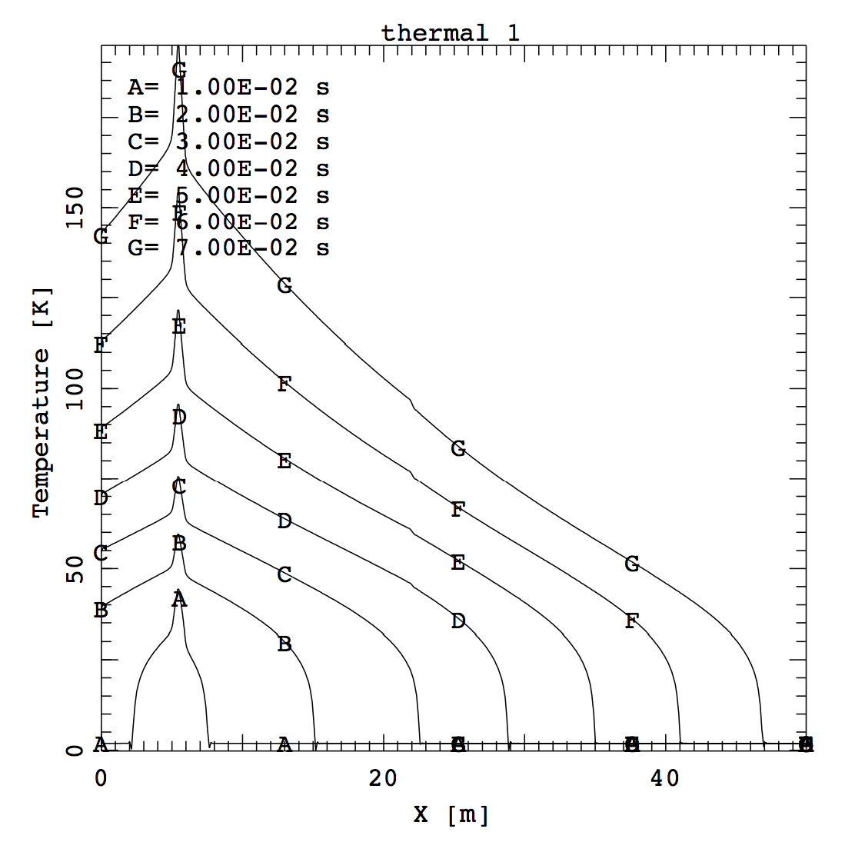
Longitudinal propagation speed
Adaptive mesh: minimum element size 1 mm
Adaptive mesh tracking fronts
≈30 m/s
Static mesh: 100 mm
Example of a quench in a Nb₃Sn 11 T cable triggered over 10 cm in a high field (11 T) zone (uniform field assumed)
Small mesh size and/or adaptive meshing are a must for quench analysis
≈600 m/s

Slide 17
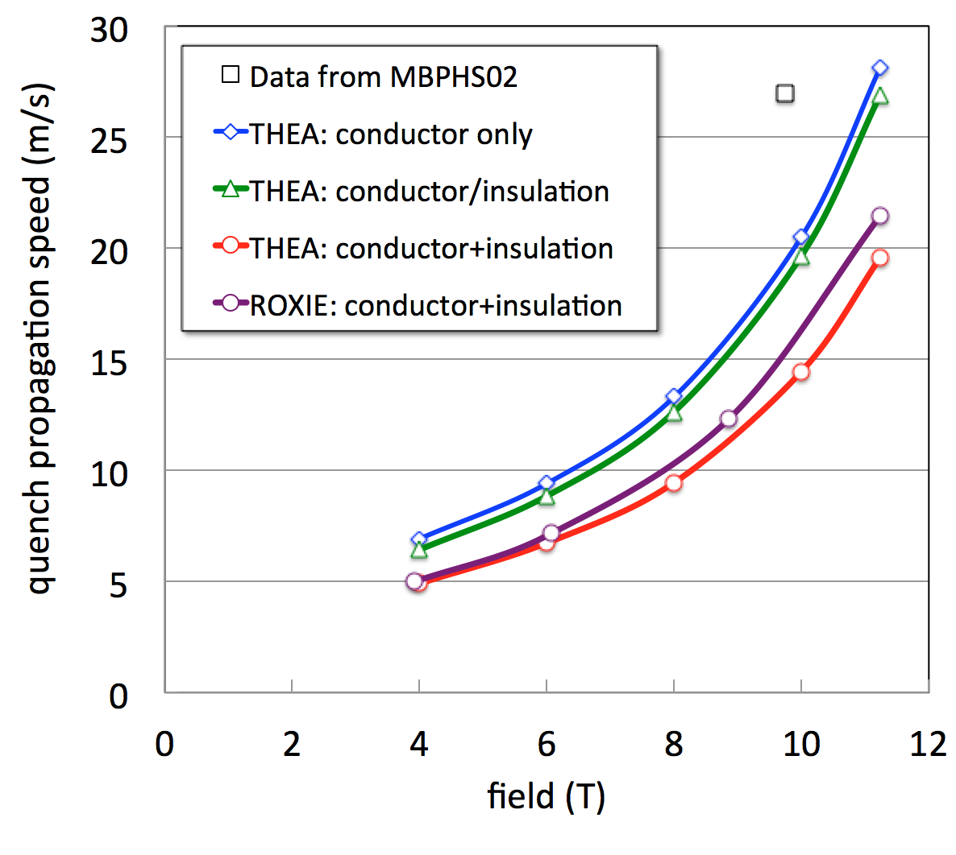
Longitudinal propagation
Conductor only
Conductor/insulation
Conductor+insulation
Appropriate subdivision is important to resolve relevant temperature gradients

Slide 18
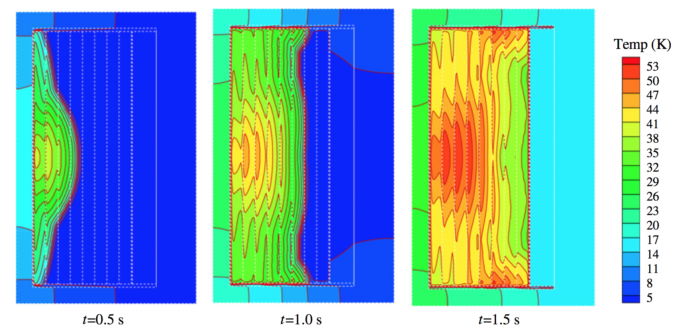
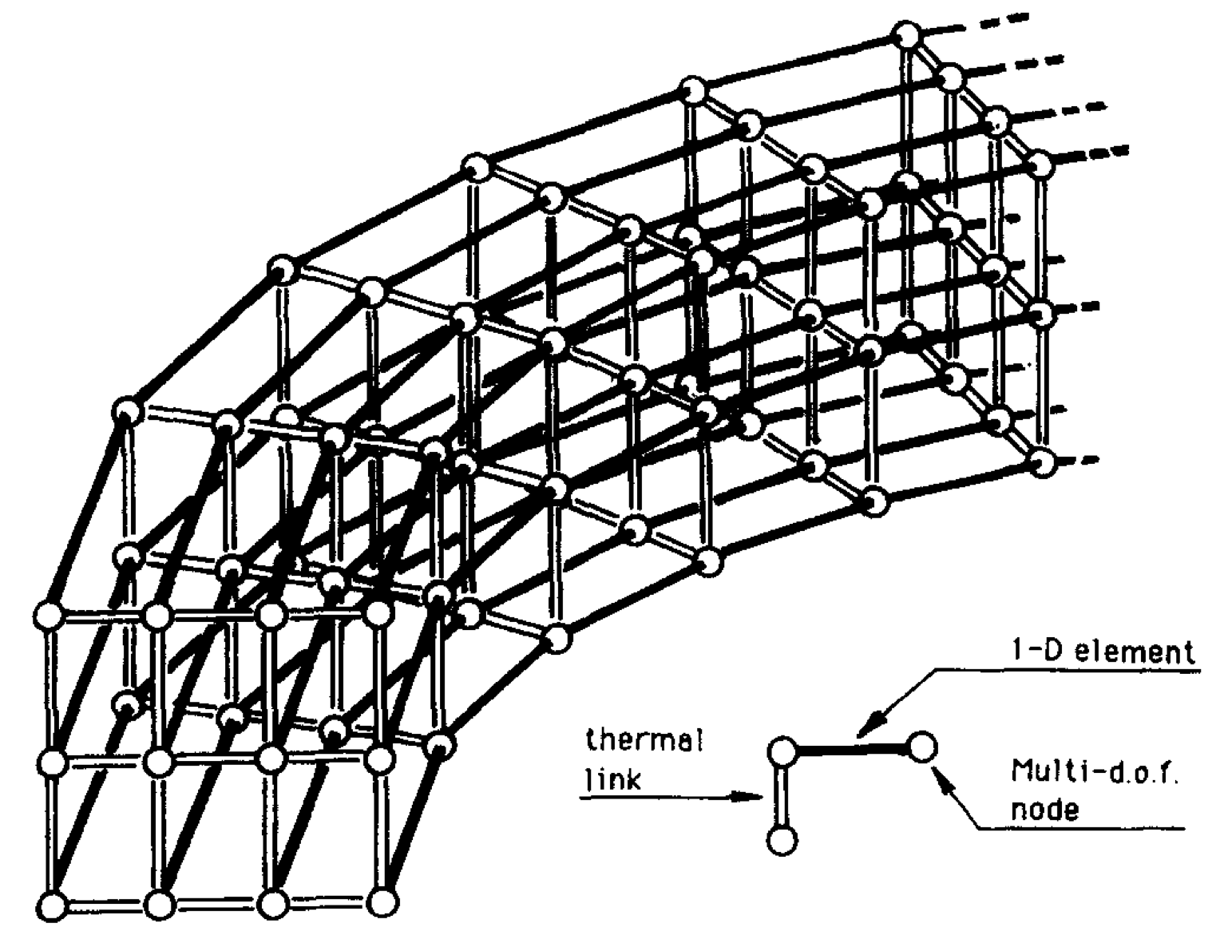
Quench model – thermal coupling
Continuum models
  3-D mesh of the magnet system allows for a natural treatment of geometry
  Examples:
    OPERA-quench (MICE)
    ANSYS (e.g. LBNL, FERMILAB)
    COMSOL (e.g. TUT)
X.L. Guo et al., Cryogenics 52 (2012) 420–427
Network models
  Simplified connectivity and thermal resistances
  Examples:
    SARUMAN and following (LB)
    Gavrilin, 1992
    ROXIE (S. Russenschuck, B. Auchmann, N. Schwerg)
    …
L. Bottura, O.C. Zienkiewicz, Cryogenics 32 (1992) 659-667

Slide 19
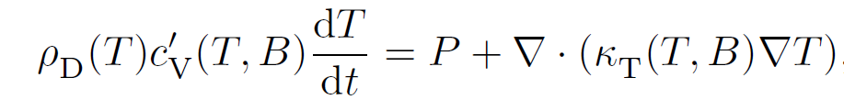
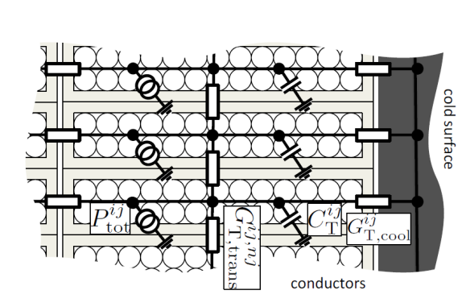
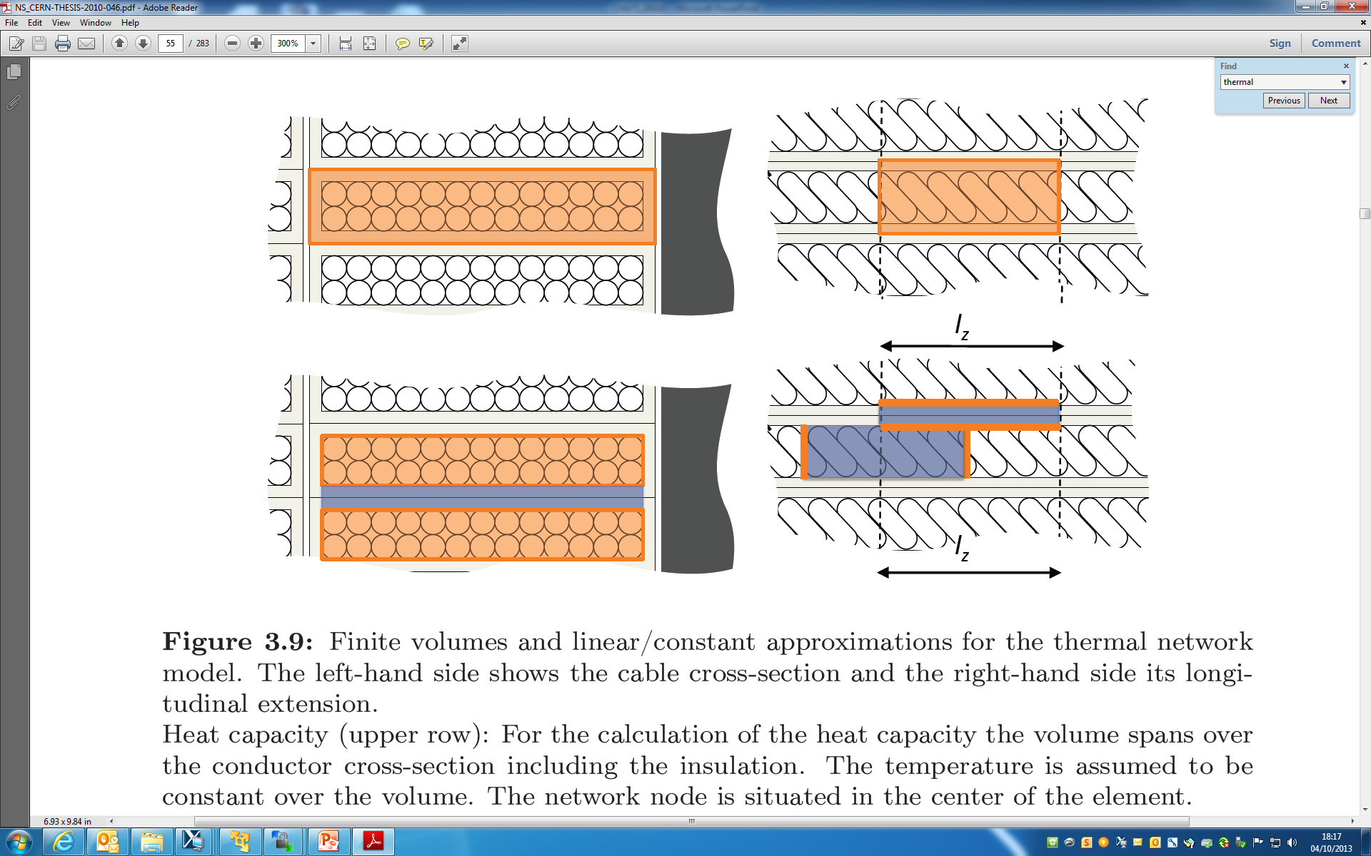

First order thermal coupling
Convection not considered -> cooling by helium mass flow can not be taken into account
Finite volumes and linear approximations:
Transverse direction
Heat capacity:
includes conductor + insulation
Thermal conductance and heat fluxes:
Conductor without insulation. Uniform temperature in the conductor and linear temperature distribution in between them
Longitudinal direction
Implementation in ROXIE, N. Schwerg, B. Auchmann, S. Russenschuck

Slide 20
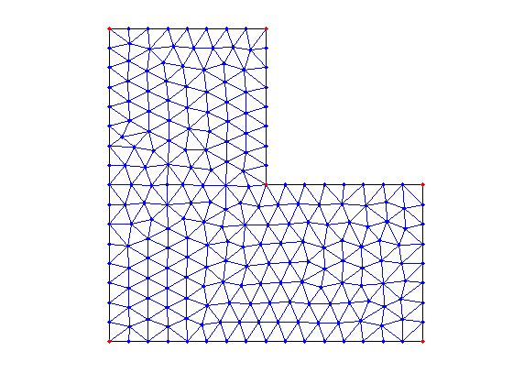
Higher order thermal coupling
Refine the 1-D thermal resistance
Heat capacity
cable
insulation
Thermal resistance
A. Gavrilin, Cryogenics, 32 (1992), 390-393
FE mesh
Hybrid model (DOF<->FEM)
Coupling
SUPERMAGNET
VINCENTA
4C
This would be great, but how to make it work in case of quench ?!?

Slide 21
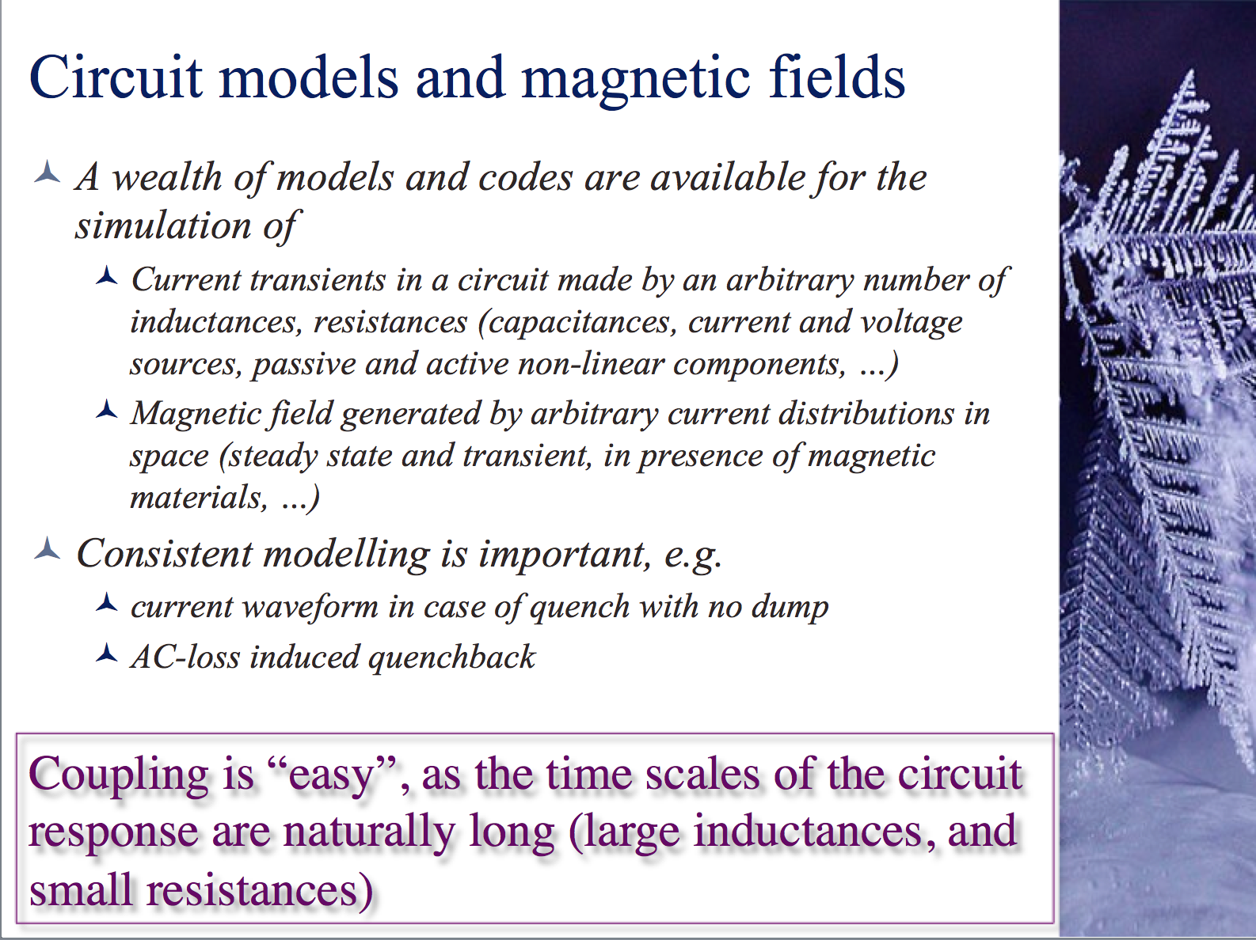
Coupling to circuit model
From MT-23 4OrCa-01

Slide 22
Case study: simulations performed
Quench of MBPS01, 1 m long, single aperture, 11 T dipole model
Magnet running at 11850 A, quench triggered by QH
ROXIE
  3-D slice simulation, scaled by the length
    1-D model of the cable
    2-D thermal network, first order thermal coupling
  Self-consistent current and field model
  Case 1: QH powered with nominal power (LF: 70.5 W/cm²; HF: 45.5 W/cm²)
  Case 2: OL temperature raised above Tcs after measured QH delay
SUPERMAGNET
  3-D model of the complete magnet
    1-D simulation of cable, adaptive mesh
    2-D thermal network, second order coupling
  Self-consistent current calculation, scaled field
  Quench triggered at the HF pole turn, detected (100 mv, 10 ms)
  QH modelled as power input to OL with 25 ms delay
case | IT t_{ins} (mm) | IL t_{ins} (mm) | QH power (W/m)
1 | 0.2 | 0.2 | 400
2 | 0.2 | 0.4 | 400
3 | 0.2 | 0.2 | 100
4 | 0.2 | 0.4 | 200

Slide 23
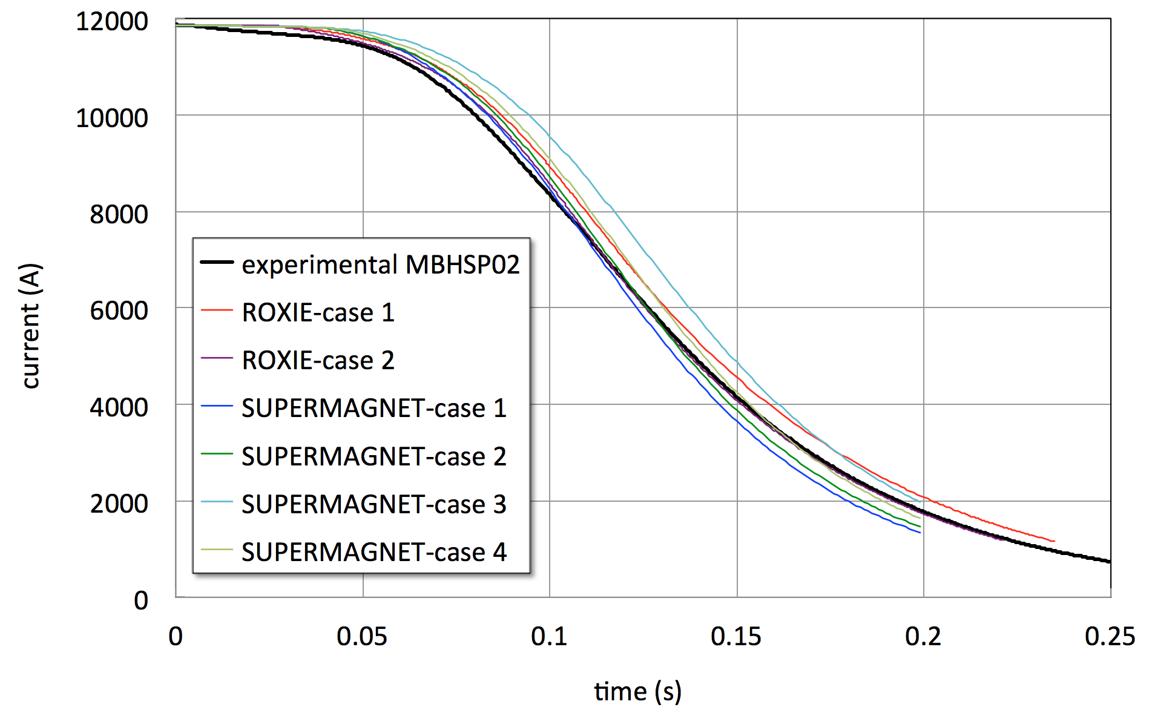
Quench simulation – 1
Current vs. time
The current waveform is reproduced fairly well within a relatively broad range of (quite uncertain) parameters

Slide 24
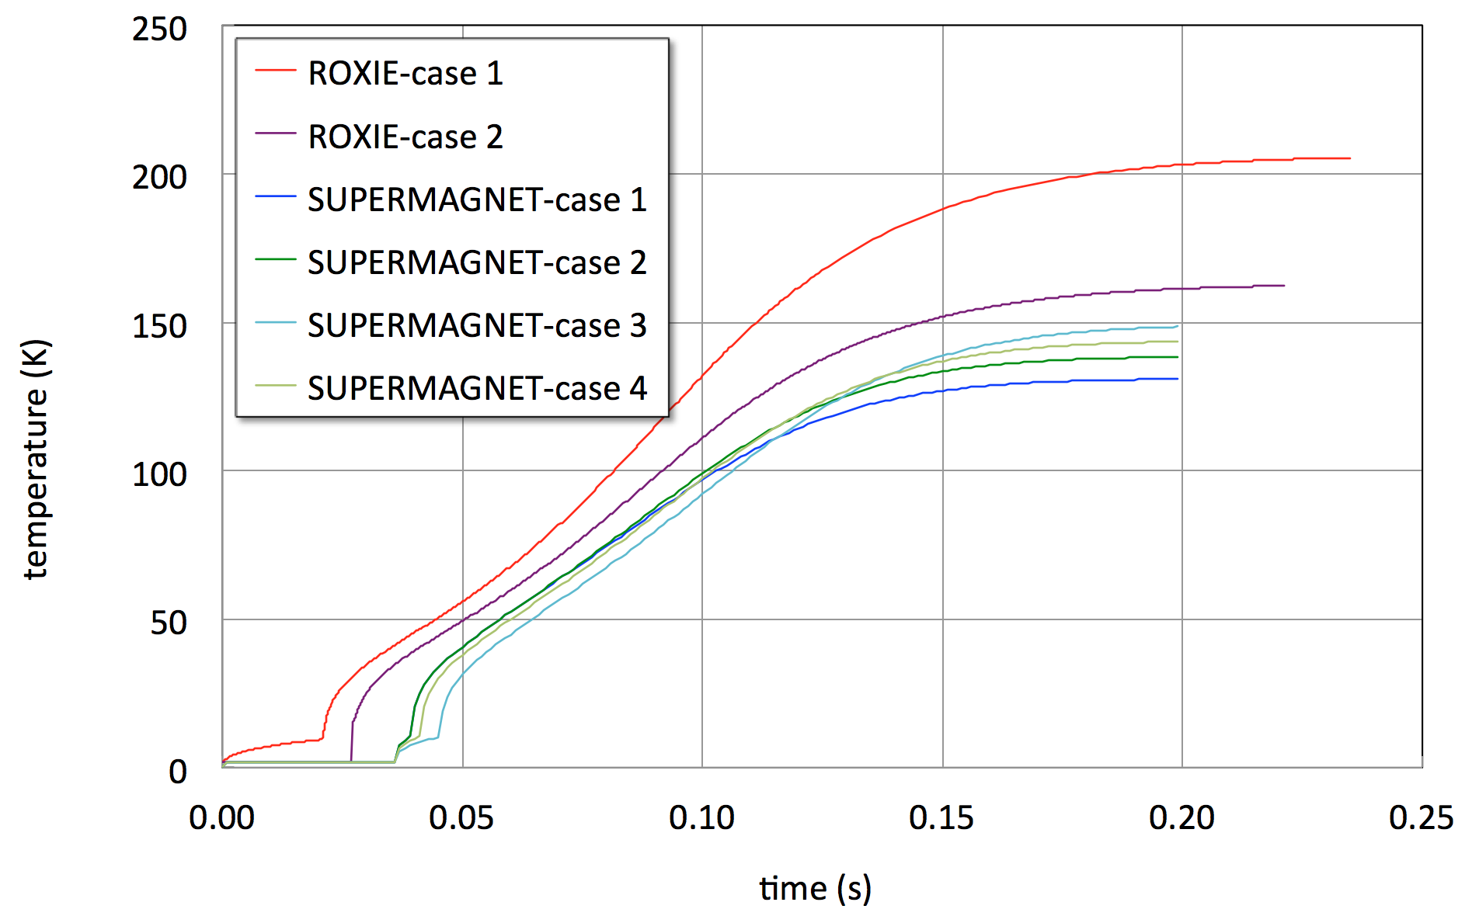
Quench simulation – 2
Temperature vs. time (at the QH)
Temperatures suffer from much greater uncertainty, but no data is available for direct comparison

Slide 25
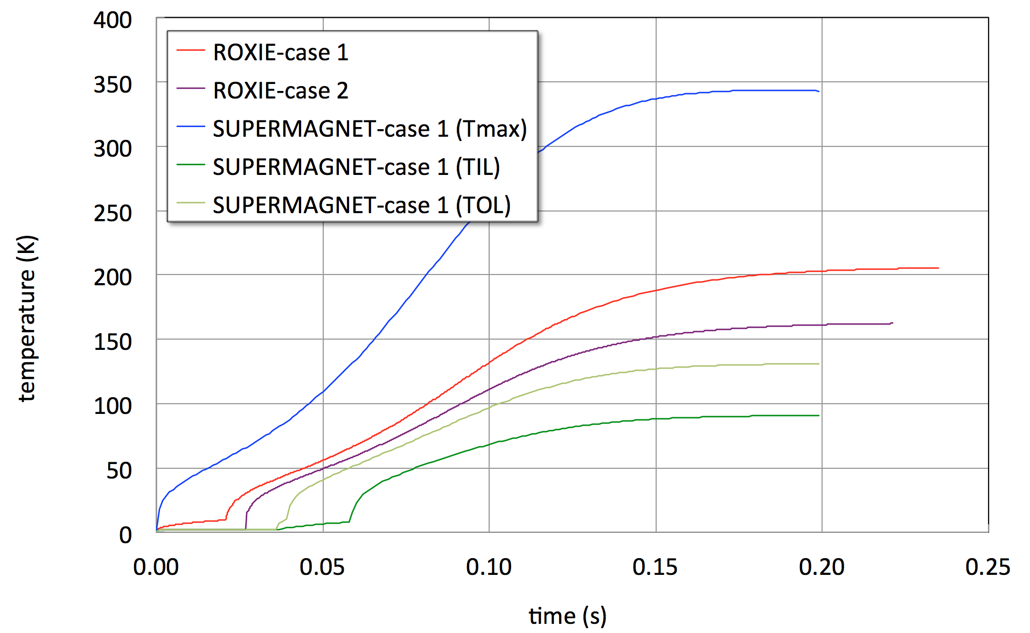
Quench simulation – 2
Temperature vs. time (at the QH)
≈ 350 K
Peak temperature hidden by overall behaviour !!!
150…200 K
IL-OL delay ≈25 ms vs. 13 ms measured

Slide 26
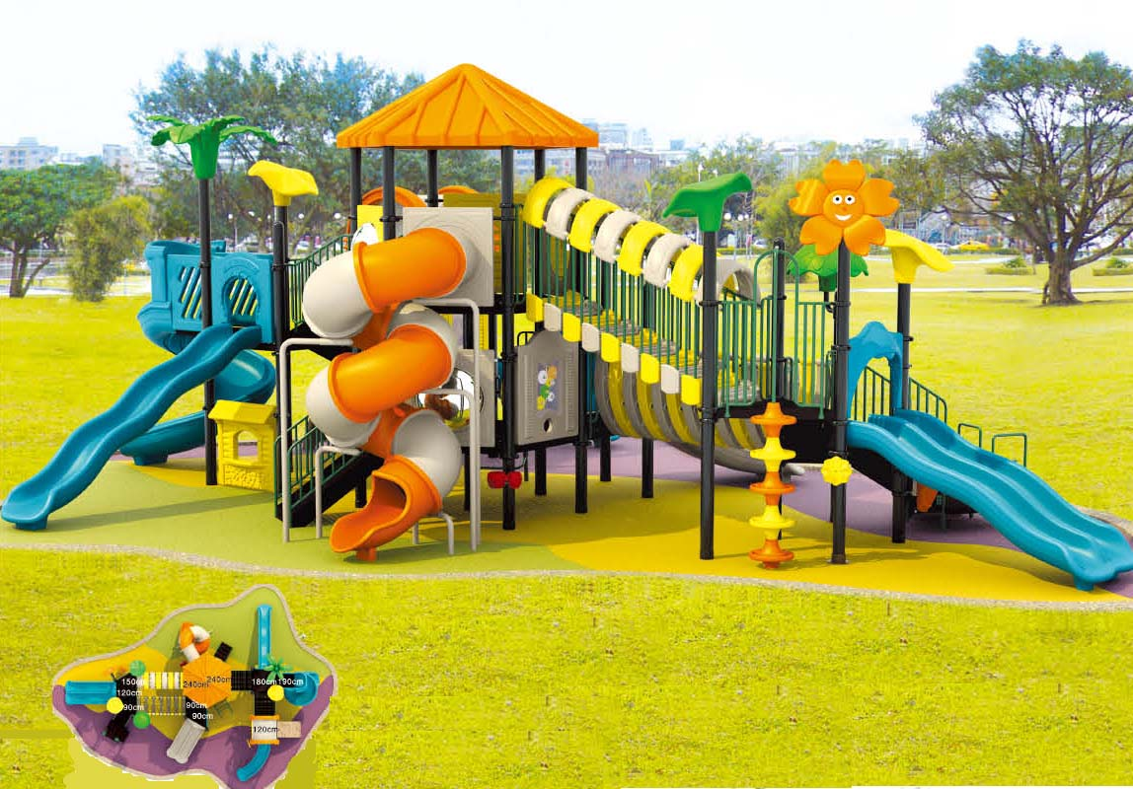
Lots of further details
Transverse heat transfer (geometry, properties, anysotropy) – measure !
Numerical stability, convergence, consistence
Quench heater efficiency (geometry, heat diffusion)
Effect of cooling (helium bath, superfluid, flows ?)
Quench-back (AC loss distribution in the coil and structure)
Resistive, inductive, capacitive effects in the circuit (non-linear components such as cold diodes, internal voltages)
A daunting problem ?
A wonderful playground

Slide 27
Conclusions
New accelerator magnets based on Nb₃Sn are pushing the boundary of protection
Accurate simulation of quench transients in these magnets is crucial to the design choices, definition of priority R&D and to prove that the magnets are fit for operation
We have today large uncertainties in the simulation results, depending on the hypotheses (inputs). It is essential to establish a good understanding of the dominating physics, and collect (new ?) data in well controlled and heavily instrumented experiments
This is a challenge for the CHATS community !!!

Slide 28
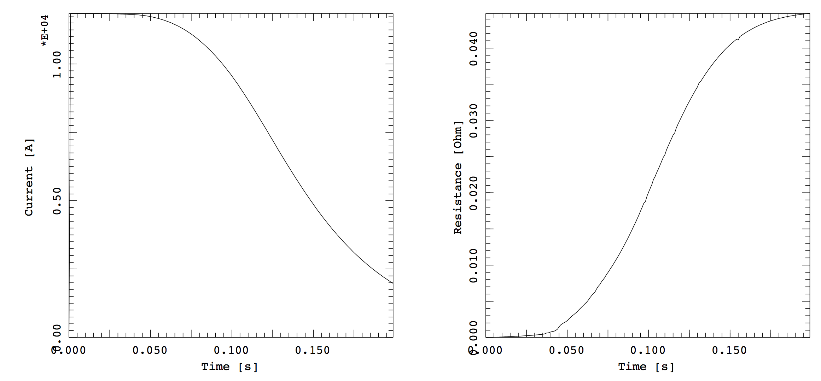
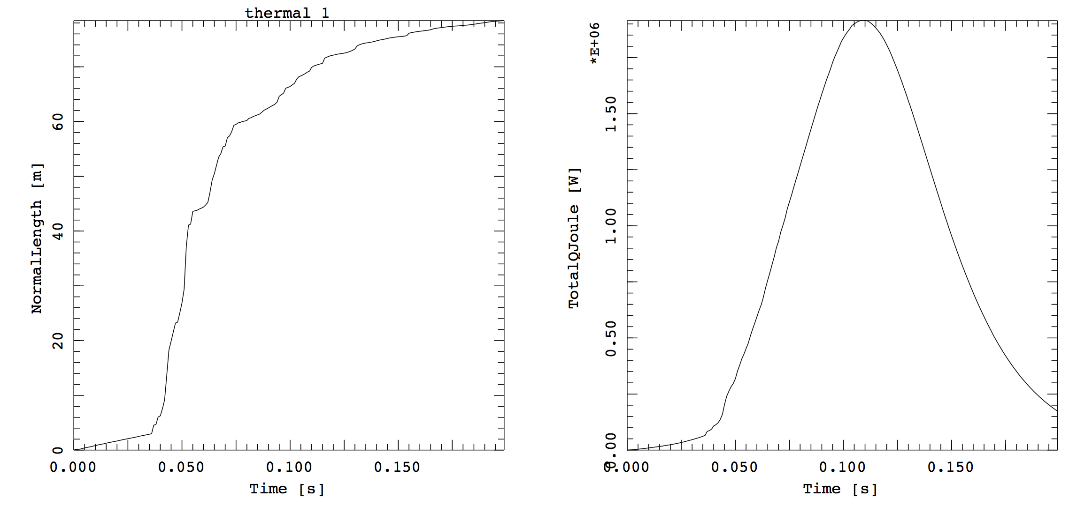
Typical quench sequence (case 4)

Slide 29
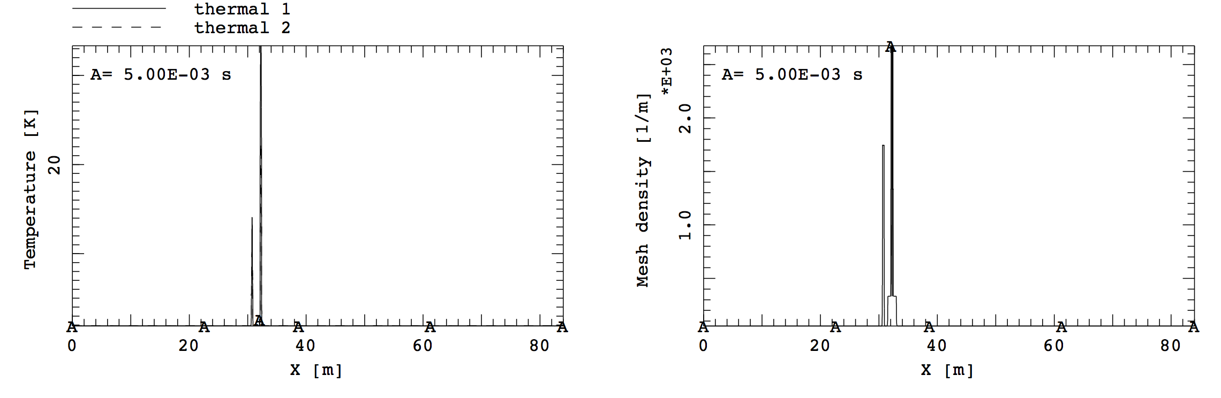
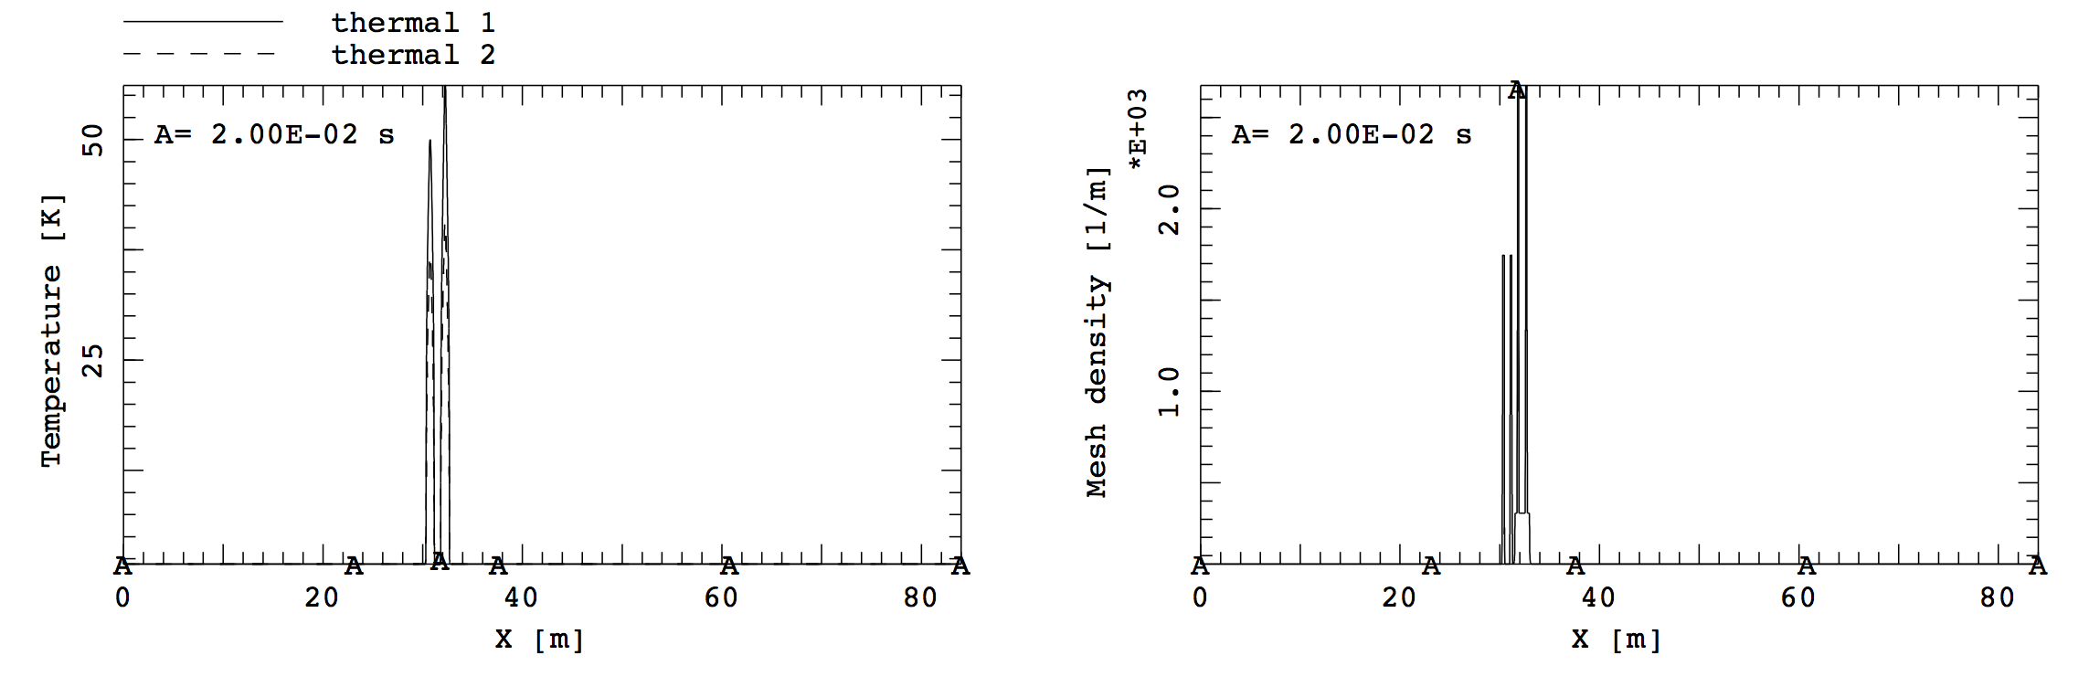
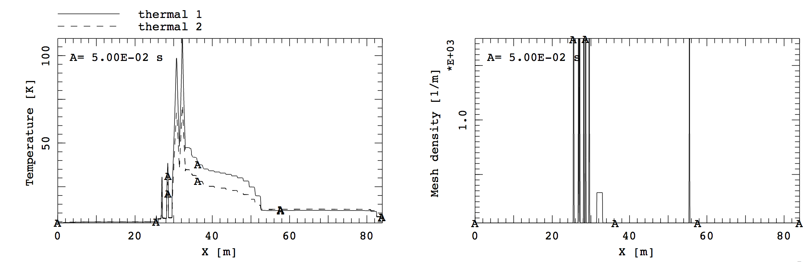
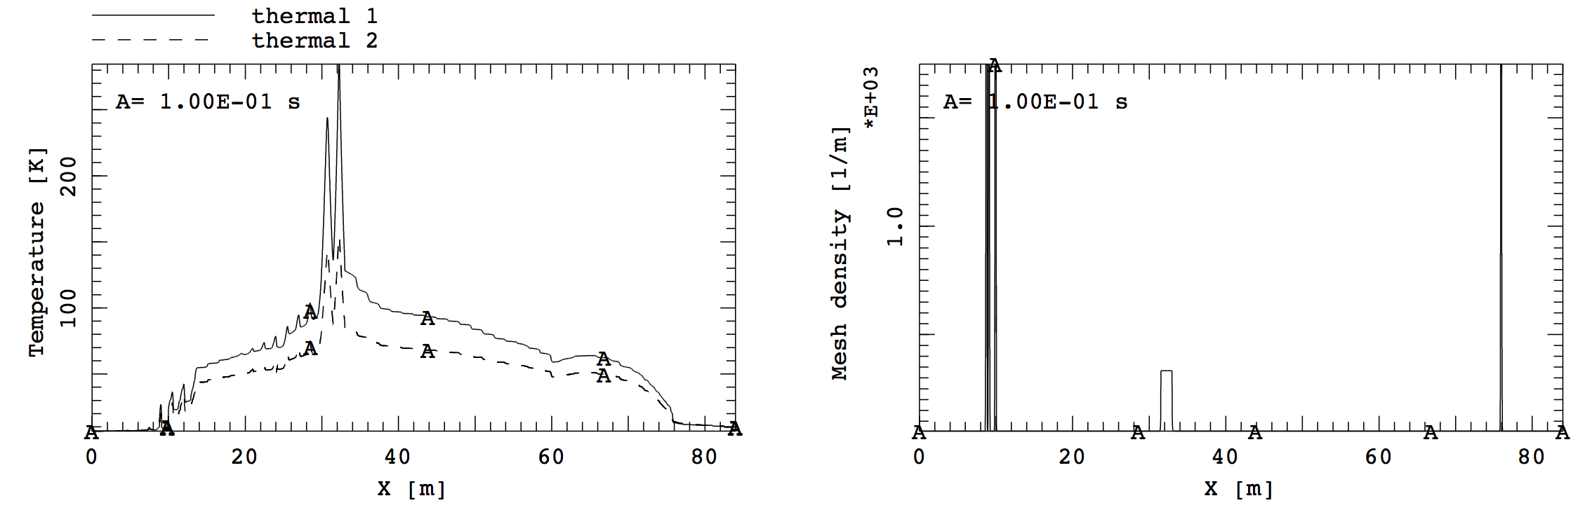

Typical quench sequence (case 4)

Slide 30
ROXIE Quench Module
Field computation
(computationally more demanding, weak coupling, magnetic field updated a number of times that can be defined by the user)
B
P_{loss}
L
I
Fourth-order Runge-Kutta algorithm.
Adaptive time stepping
Electrical network
P_{Ohm}
I
R
Thermal network
T
Critical surface model
Explicit Runge-Kutta solver: Conditionally stable
Adaptive time stepping: Necessary, high non-linear problem
Static mesh: computationally “expensive”

Slide 31



Simulation : Test bench conditions
Manual trips with the two operating protection heaters
  Dump delay 1000 ms → Self-dump (non-linear inductance and resistance)
  I₀ = 11850 A, T_{bath} = 1.9 K
 | MIITs after heater effective [MA²s] | MIITs from heater fired until effective [MA²s] | OL-IL delay [ms] | PH delay [ms]
Experimental data | 10.9 | 3.4 | 13.4 | ≈27
CASE1: OL heaters fired @ t=0 (computed heat transfer from heater to coil) | 12.3 | 2.9 | 42.5 | 21
CASE2: OL quenched @ PH measured delay (OL fully quenched at PH measured delay) | 11.4 | 3.8 | 33.8 | 27
Max. Temperature [K]
Heaters fired @ t=0
OL quenched @ measured delay

Slide 32
Heaters delay

