Slide 1

Losses Scaling Law for Superconducting Filaments Magnetized by an Elliptical Field.
Clement Lorin,
Denis Netter,
Philippe J. Masson.
University of Houston
Department of Mechanical Engineering
Texas Center for Superconductivity
October 11th, 2013

Slide 2
NASA’s Distributed Propulsion Aircraft

Slide 3
Project Objectives
Develop a high fidelity sizing tool for fully superconducting rotating machines.
  Accurate 3D geometry represented
    Electromagnetics, mechanical and
    thermal
  Portable code in Python and C
Develop model for quench propagation
  Address detection and protection
Develop new model for AC losses
for superconducting stators
  Based on FEA simulations
Validate AC losses model experimentally

Slide 4
Frequency Dependence of AC Losses
3 sources of AC losses in superconductors:
  Magnetization losses
  P_{mag}α B, f, J_{c}
  Coupling losses
  P_{coupl} α B², f²
  Eddy current losses
  P_{Eddy} α B², f²
Magnetization
losses are
dominating at
low frequency

Slide 5
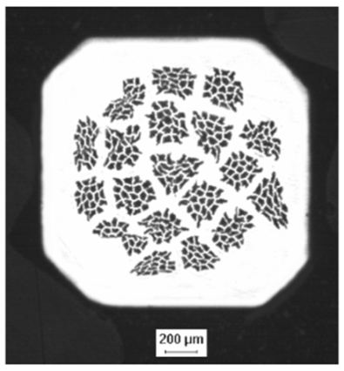
Magnetization (Hysteresis) Losses Calculation
Assumes AC field (alternating)
  Limited to self field
Transport current and applied field are in phase
J_{c}: filament critical current density
λ_{s}: fraction of superconductor
d: filament size
B₀: flux density variation
F: I/Ic

Slide 6
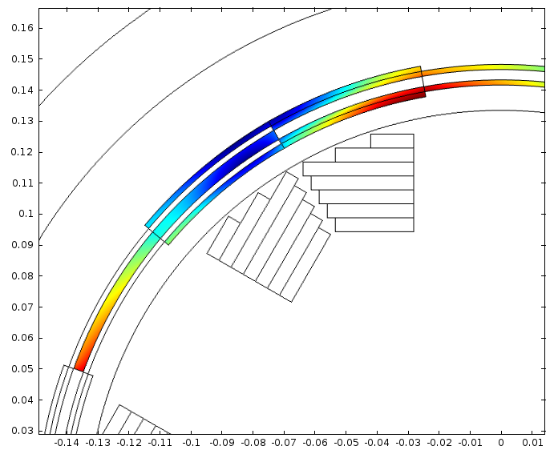
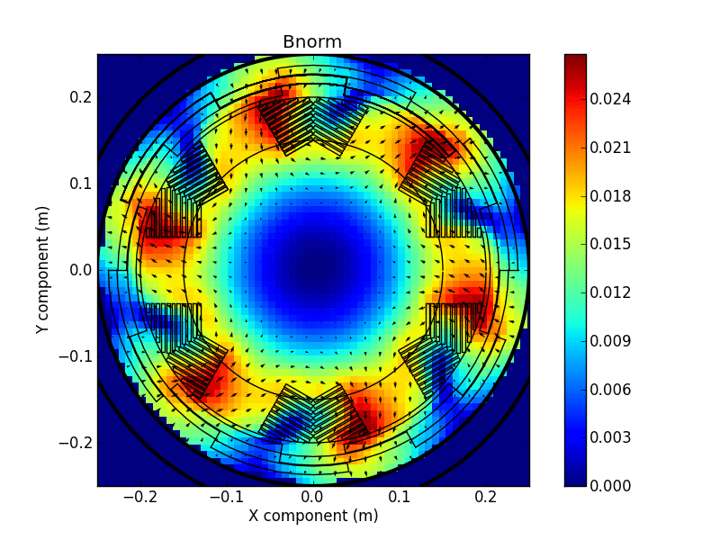
Stator Peak Field at Full Load
Flux density contribution from both rotor and stator
Non uniform flux density distribution

Slide 7
Introduction (1/3)
Magnetization losses in stator wires of rotating machines:
  Stator: Rotating field generated by temporal variation of currents inside the windings.
  Rotor: Rotating and Alternating field produced by rotation of the spatial distribution of the currents.
  → Local field = rotating field + alternating field

Slide 8
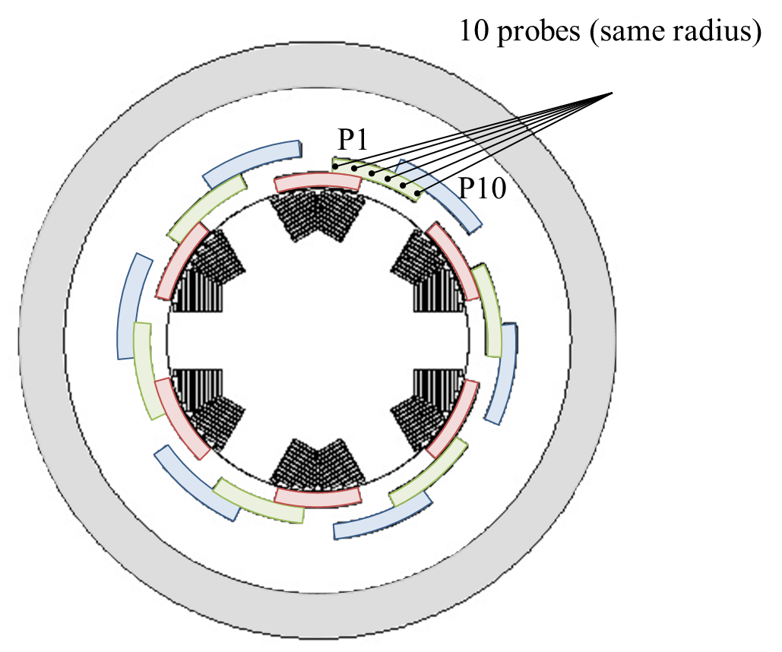
Introduction (2/3)
Peak field
Rotating/pulsating
In 1 pole, each stator conductor is in a unique magnetic configuration
Phase angle
rotating-pulsating
Probe #

Slide 9
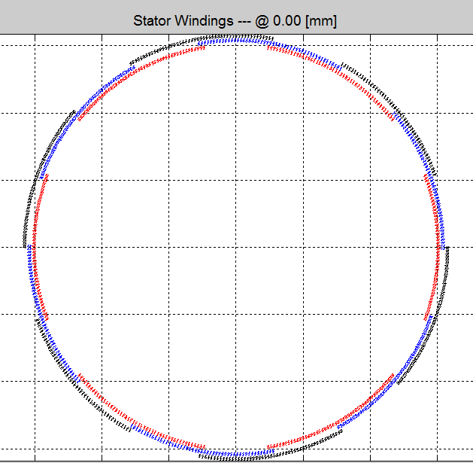
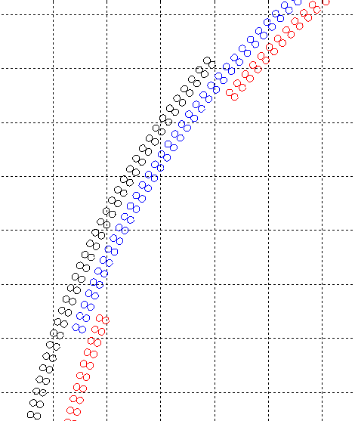
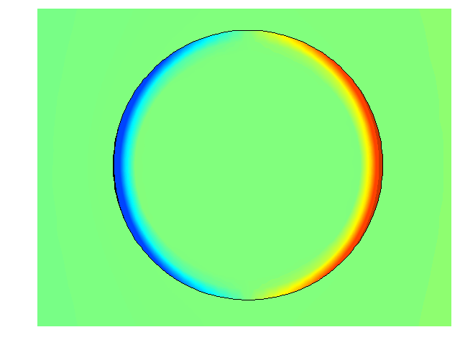
Introduction (3/3)
Armature
Cross-Section
Filaments are twisted and magnetically decoupled
  Analysis can be done on 1 filament
  Model implemented in COMSOL Multiphysics
  Sc. Modeled using a power law
  No current yet

Slide 10
Model description (1/2)
Geometry and model description:
r filament radius
H-Formulation:
Electrical behavior, power-law:
n n-value
J_{c} critical current @ E_{c} = 100 μV/m
Boundary conditions:
B₀ field amplitude
k = [0,1] → field configuration: “ellipticity”
f frequency
φ = [-π,π]
7 variables

Slide 11
Model description (2/2)
Loss [J/m/cycle]:
Over 1 cycle
Filament cross-section (πr²)

Slide 12
Dimensional Analysis (1/2)
Dimensional Analysis:
Variable | Usual unit | [kg] | [m] | [s] | [A]
J_{c} | A.m⁻² | 0 | -2 | 0 | 1 | n1
μ₀ | H.m⁻¹ | 1 | 1 | -2 | -2 | n2
r | m | 0 | 1 | 0 | 0 | n3
E_{c} | V.m⁻¹ | 1 | 1 | -3 | -1 | n4
Q (per cycle) | J.m⁻¹ | 1 | 1 | -2 | 0 | n5
B₀ | T | 1 | 0 | -2 | -1 | n6
f | Hz | 0 | 0 | -1 | 0 | n7
ϕ | rad | 0 | 0 | 0 | 0
k | adim | 0 | 0 | 0 | 0
n | adim | 0 | 0 | 0 | 0
3 dimensionless numbers
f* , b* , q*
Remark: adding a current I_{t} would lead to an additional dimensionless number.
This number must be dimensionless.

Slide 13
Dimensional Analysis (2/2)
Our parameters:
b*
f*
and n, k, φ
5 variables
instead of 7
with
with
Those parameters can be called invariants since the reduced losses q do not change if they do not change.
Reduced losses:
with
with

Slide 14
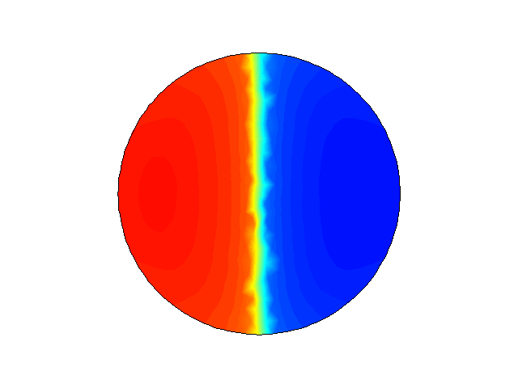
Alternating field losses – SL (1/5)
b*
f*
k=0
n

Slide 15
Alternating field losses – SL (1/5)
n = 20
b* = 20
b* = 1
q* versus f* for various b*
We need to reorder the charts to explain the thought process which led to a semi-analytical formula for AC losses under alternating field or rotating field
b* = 10
b* = 0.5
b* = 2
b* = 0.25

Slide 16
Alternating field losses – SL (2/5)
b* = 1
b* = 0.5
n = 20
b* = 2
b* = 0.25
b* = 10
b* = 20
A curve seems to be revealed.
→We try to scale the ordinate to get reduced losses values in the same order of magnitude, to do so we divide q* by b*²
q*/b*² versus f* for multiple b*
(b_{p} = b* former notation)
→ Then we try to adjust the abscissa values for each values of b* so as to create a curve with all the dots looking like the black curve above.

Slide 17
Alternating field losses (n=20) – SL (3/5)
If we divide the abscissa by b*² ⇒
If we divide the abscissa by b*⁴ ⇒
If we divide the abscissa by b*¹⁰ ⇒
If we divide the abscissa by b*¹⁹ ⇒

Slide 18
Alternating field losses (n=10) – SL (4/5)
If we divide the abscissa by b*² ⇒
If we divide the abscissa by b*⁴ ⇒
If we divide the abscissa by b*⁹ ⇒
We did the same for n = 2, n= 3, n = 5, n = 40, n = 50
Dividing by b*^{n-1} aligns the data points. Instead of an abscissa f*/b*^{n-1} we can use (f*/b*^{n-1})^{1/n}
to match Critical State Model (i.e. no frequency dependency when n→∝).
q
b*²
f*^{1/n}
b*^{(n-1)/n}

Slide 19
Alternating field losses – Scaling Law (5/5)
Data can be normalized with respect to a function of n
with
with
with

Slide 20
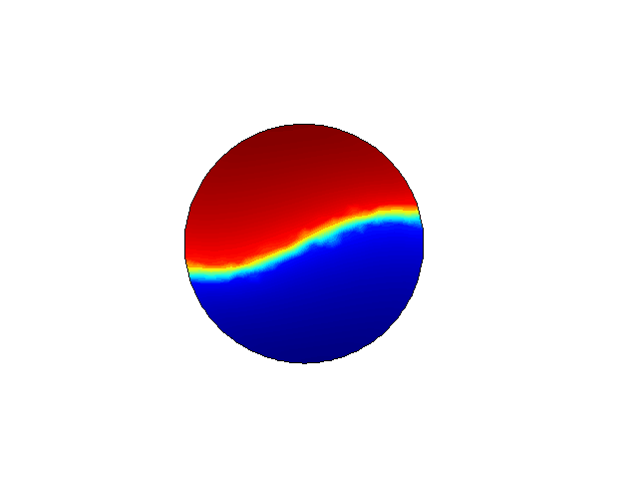
Losses in Rotating field Scaling Law
b*
f*
k=1
n

Slide 21
Losses in Rotating field Scaling Law
Rotating field: k = 1
Same method
with
Data can be normalized with respect to a function of n
with
with
Coefficients α₁ α₂ α₃ α₄ α₅ are different

Slide 22
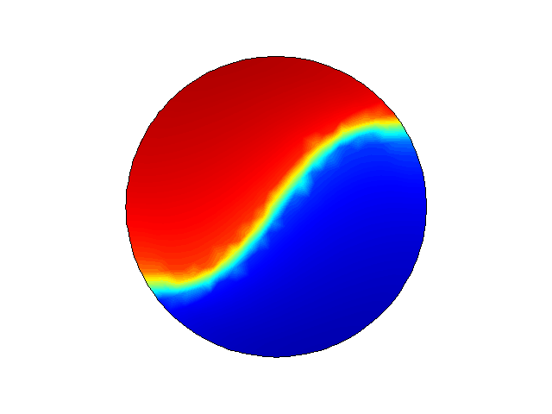
Elliptical field
b*
f*
k
n

Slide 23
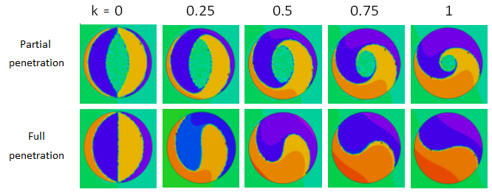
Elliptical field
alt
k = 0.25, 0.5, 0.75
1
0
ell
1
k
Same method
rot
1
Q*
1
X*

Slide 24
Fit(b*,f*,n,k) or fit (c_{n},n,k)
Fit curves
General expression:
Q*
X*
Error on data used to get the fit (~600):

Slide 25
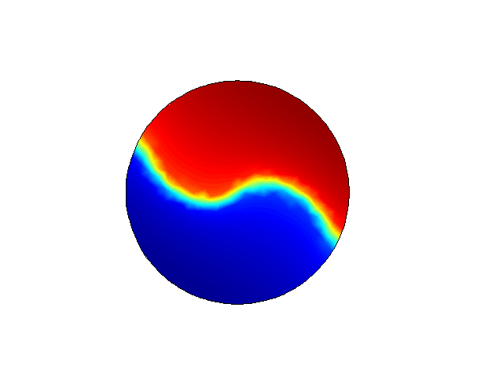
Elliptical field – with phase angle
b*
f*
k
n
ϕ

Slide 26
Elliptical field – with phase angle
Ratio between losses with and without phase angle can be approximate by:

Slide 27
Elliptical field – with phase angle
Transform☺ to
k₁ must be in [0,1] to use our previous fit.
Based on geometrical considerations on the applied field.
So is known.
☺ Lorin C. , Masson P.J., Numerical Analysis of the Impact of Elliptical Fields on Magnetization Losses, IEEE TAS, 23, 3, 8201405 (2013)

Slide 28
Random test
Results
60 simulations randomly taken in the whole domain

Slide 29
Conclusion
Investigation of elliptical field losses in smooth power-law electrical behavior round-shaped filaments:
  Reveal a fundamental variable:
  Semi-analytical formulae give fast and reliable magnetization losses values depending on:
B₀ field amplitude
r filament radius
k = [0,1] → field configuration: “ellipticity”
n n-value
f frequency
J_{c} critical current @ E_{c} = 100 μV/m
φ = [-π,π]

Slide 30
Next Steps (1/2)
H-Formulation:
Electrical behavior, power-law:
where
Transport current constrain:
where A = filament area
Boundary conditions:
bp penetration field ratio
k = [0,1] → field configuration
φ = [-π,π] → rotor load angle
ip = [0,1] → penetration current ratio
θ = [0,2π] → current/field phase angle

Slide 31
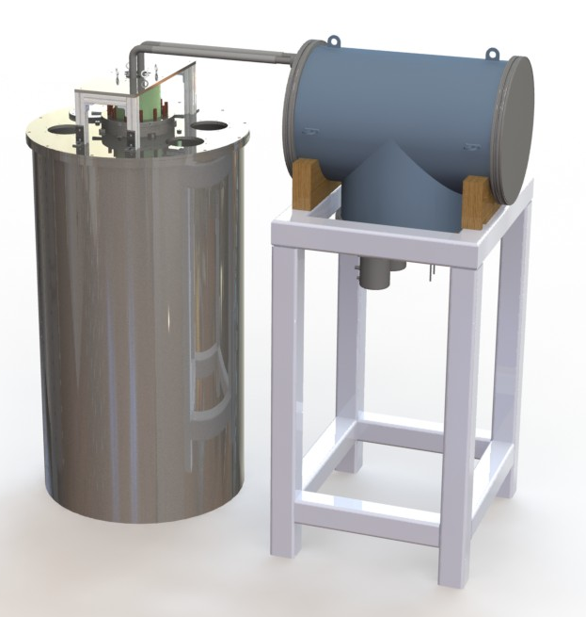
Next Steps (2/2)
Implement model in Amber HTS Machine Sizing Code
Perform experimental validation
  Tests will start in January 2014
    AC field
    Transport current
  Upgrade to include elliptical field
  scheduled for 2015
GHe Transfer Line
Cooling System
Sample Cryostat

