Slide 1
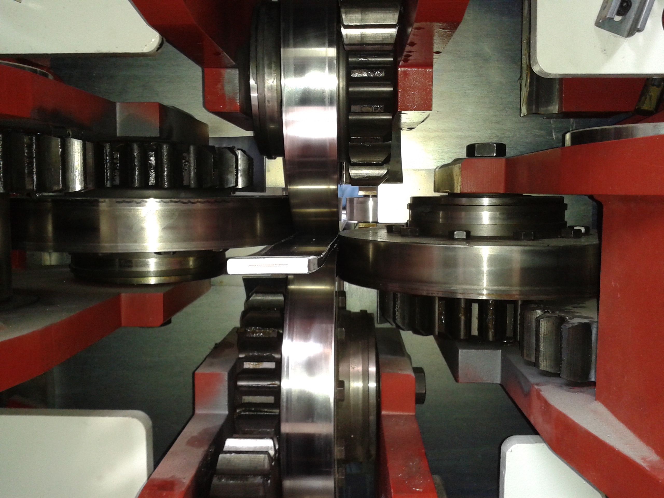
LCD solenoid al-stabilized superconductor Extruded Al-0.1wt.%Ni measurement status
Stefanie Langeslag
LCD Magnet Meeting
April 25th, 2013

Slide 2
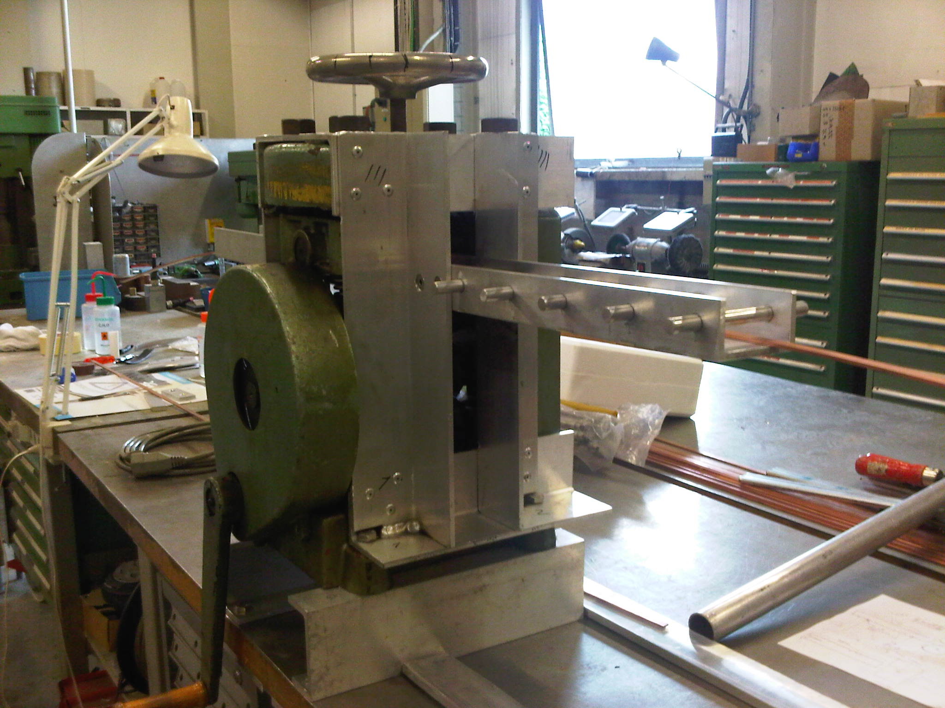
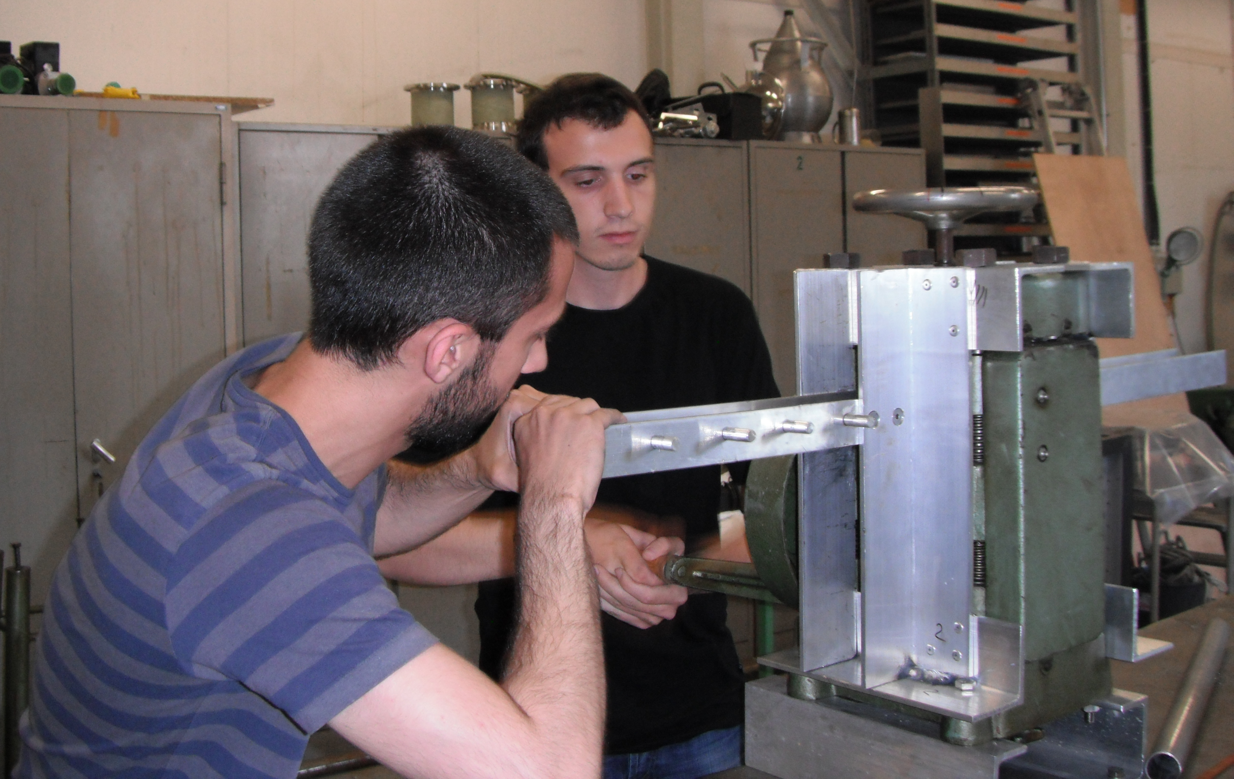
Lab-scaled work hardening here at CERN

Slide 3
Effect of lab-scaled work hardening on the mechanical and transport properties of Al and Al-0.1wt.%Ni.

Slide 4
Conclusion of the results
The Al-Ni alloy extruded with Rutherford cable exhibited in the highest cold worked state of 30% an R_{p0.2} of 58 and RRR of 673, which will result in an R_{p0.2} of 87 MPa at 4.2 K [1].
The obtained values are slightly lower than the gross of measurements conducted on Al-0.1wt%Ni extruded in smaller cross-sections in the development of the ATLAS and CMS solenoid conductor [1-4].
A cautious conclusion to be further verified is that increased cross-section extrusions result in decreased work hardening effects.
[1] S. Sgobba, D. Campi, B. Cure, P. El-Kallassi, P. Riboni, and A. Yamamoto, “Toward an improved high strength, high RRR CMS conductor,” in IEEE Transactions on Applied Superconductivity, pp. 521–524, ETH, CH-8092 Zurich, Switzerland, 2006.
[2] K. Wada, S. Meguro, H. Sakamoto, T. Shimada, Y. Nagasu, I. Inoue, K. Tsunoda, S. Endo, A. Yamamoto, Y. Makida, K. Tanaka, Y. Doi, and T. Kondo, “Development of high-strength and high-RRR aluminum- stabilized superconductor for the ATLAS thin solenoid,” IEEE Transactions on Applied Superconductivity, vol. 10, no. 1, pp. 373–376, 2000.
[3] K. Wada, S. Meguro, H. Sakamoto, A. Yamamoto, and Y. Makida, “High-strength and high-RRR Al-Ni alloy for aluminum-stabilized superconductor,” in IEEE Transactions on Applied Superconductivity, pp. 1012–1015, Furukawa Elect Co Ltd, Nikko, Japan, 2000.
[4] A.Yamamoto, Y.Makida, K.Tanaka,and Y.Doi, “Development towards ultra-thin superconducting solenoid magnets for high energy particle detectors,” Nuclear Physics B, vol. 78, pp. 565–570, 1999.

Slide 5
Conclusion of the measurements
For an initial determination of work hardening on the properties of the material the current work-hardening method proved to be sufficient.
  However, for a determination of bonding characteristics and critical current degradation with cold work, a more industrial scale work-hardening method should be found.
For a more satisfying specification of properties of the entire conductor, microstructure and hardness measurements along the entire cross-section should be made.
  Grain sizes should be determined in at least two planes in a highly cold-worked state.

Slide 6
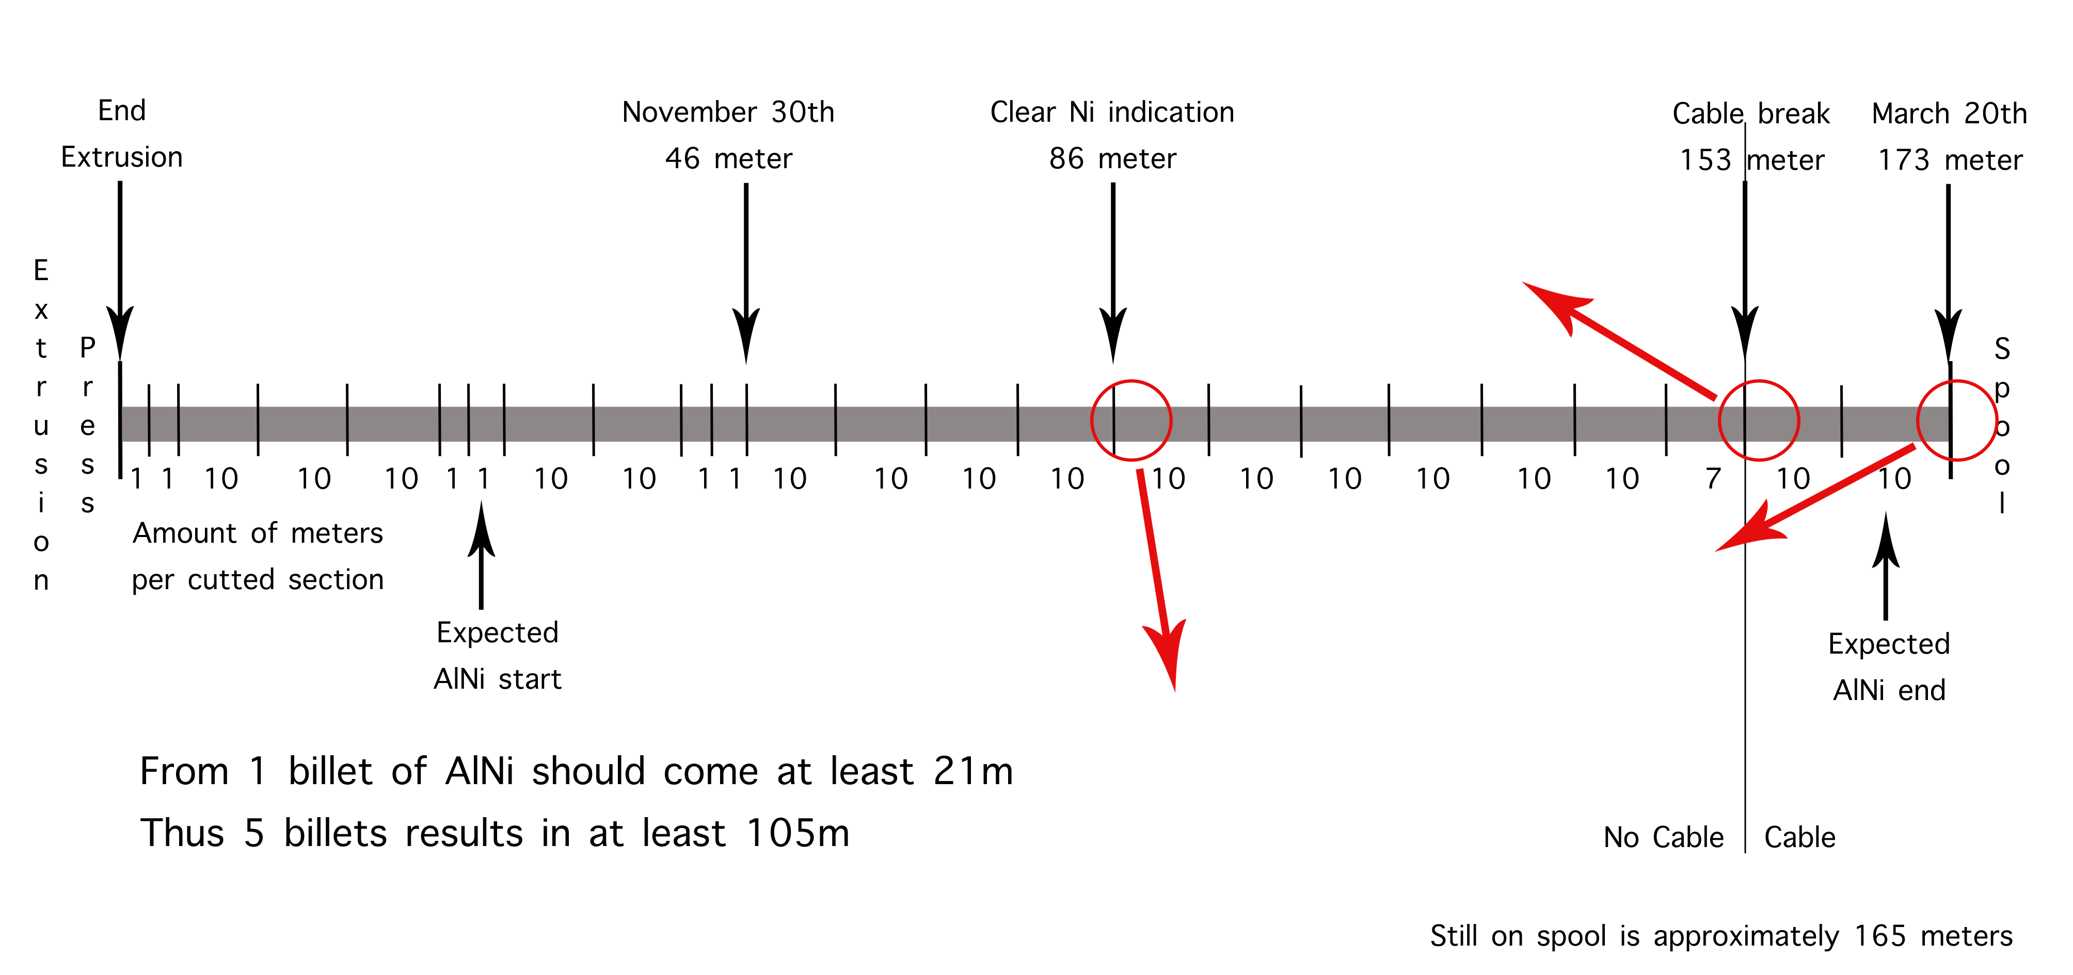


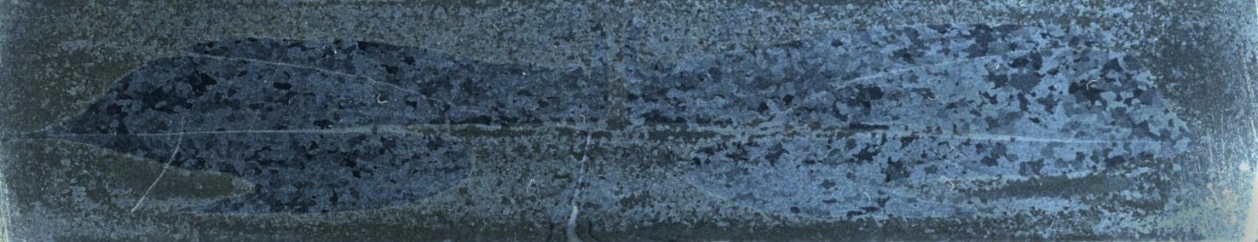
Notes:
6 meter further along we still see mainly AlNi

Slide 7
Notes:
6 meter further along we still see mainly AlNi

Slide 8
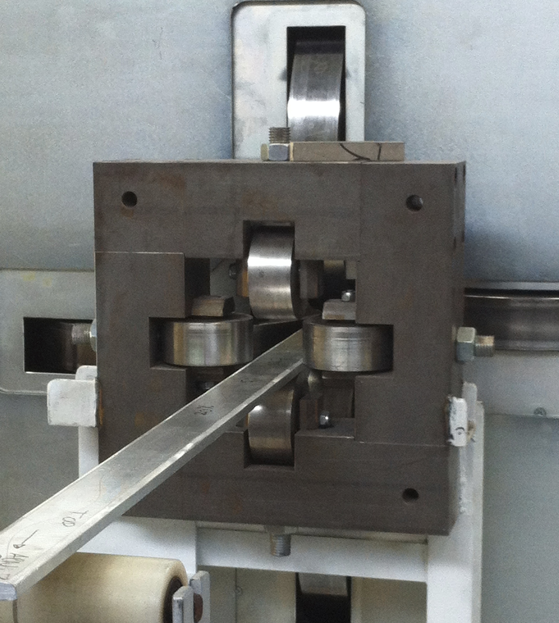
Cold work; Industrial scale
Cryotech, Chivasso (Italy)
ENEA; Antonio della Corte
11 samples (1,5 meter)
Inlet Turk-head rolling machine Cryotech, Chivasso (IT)

Slide 10
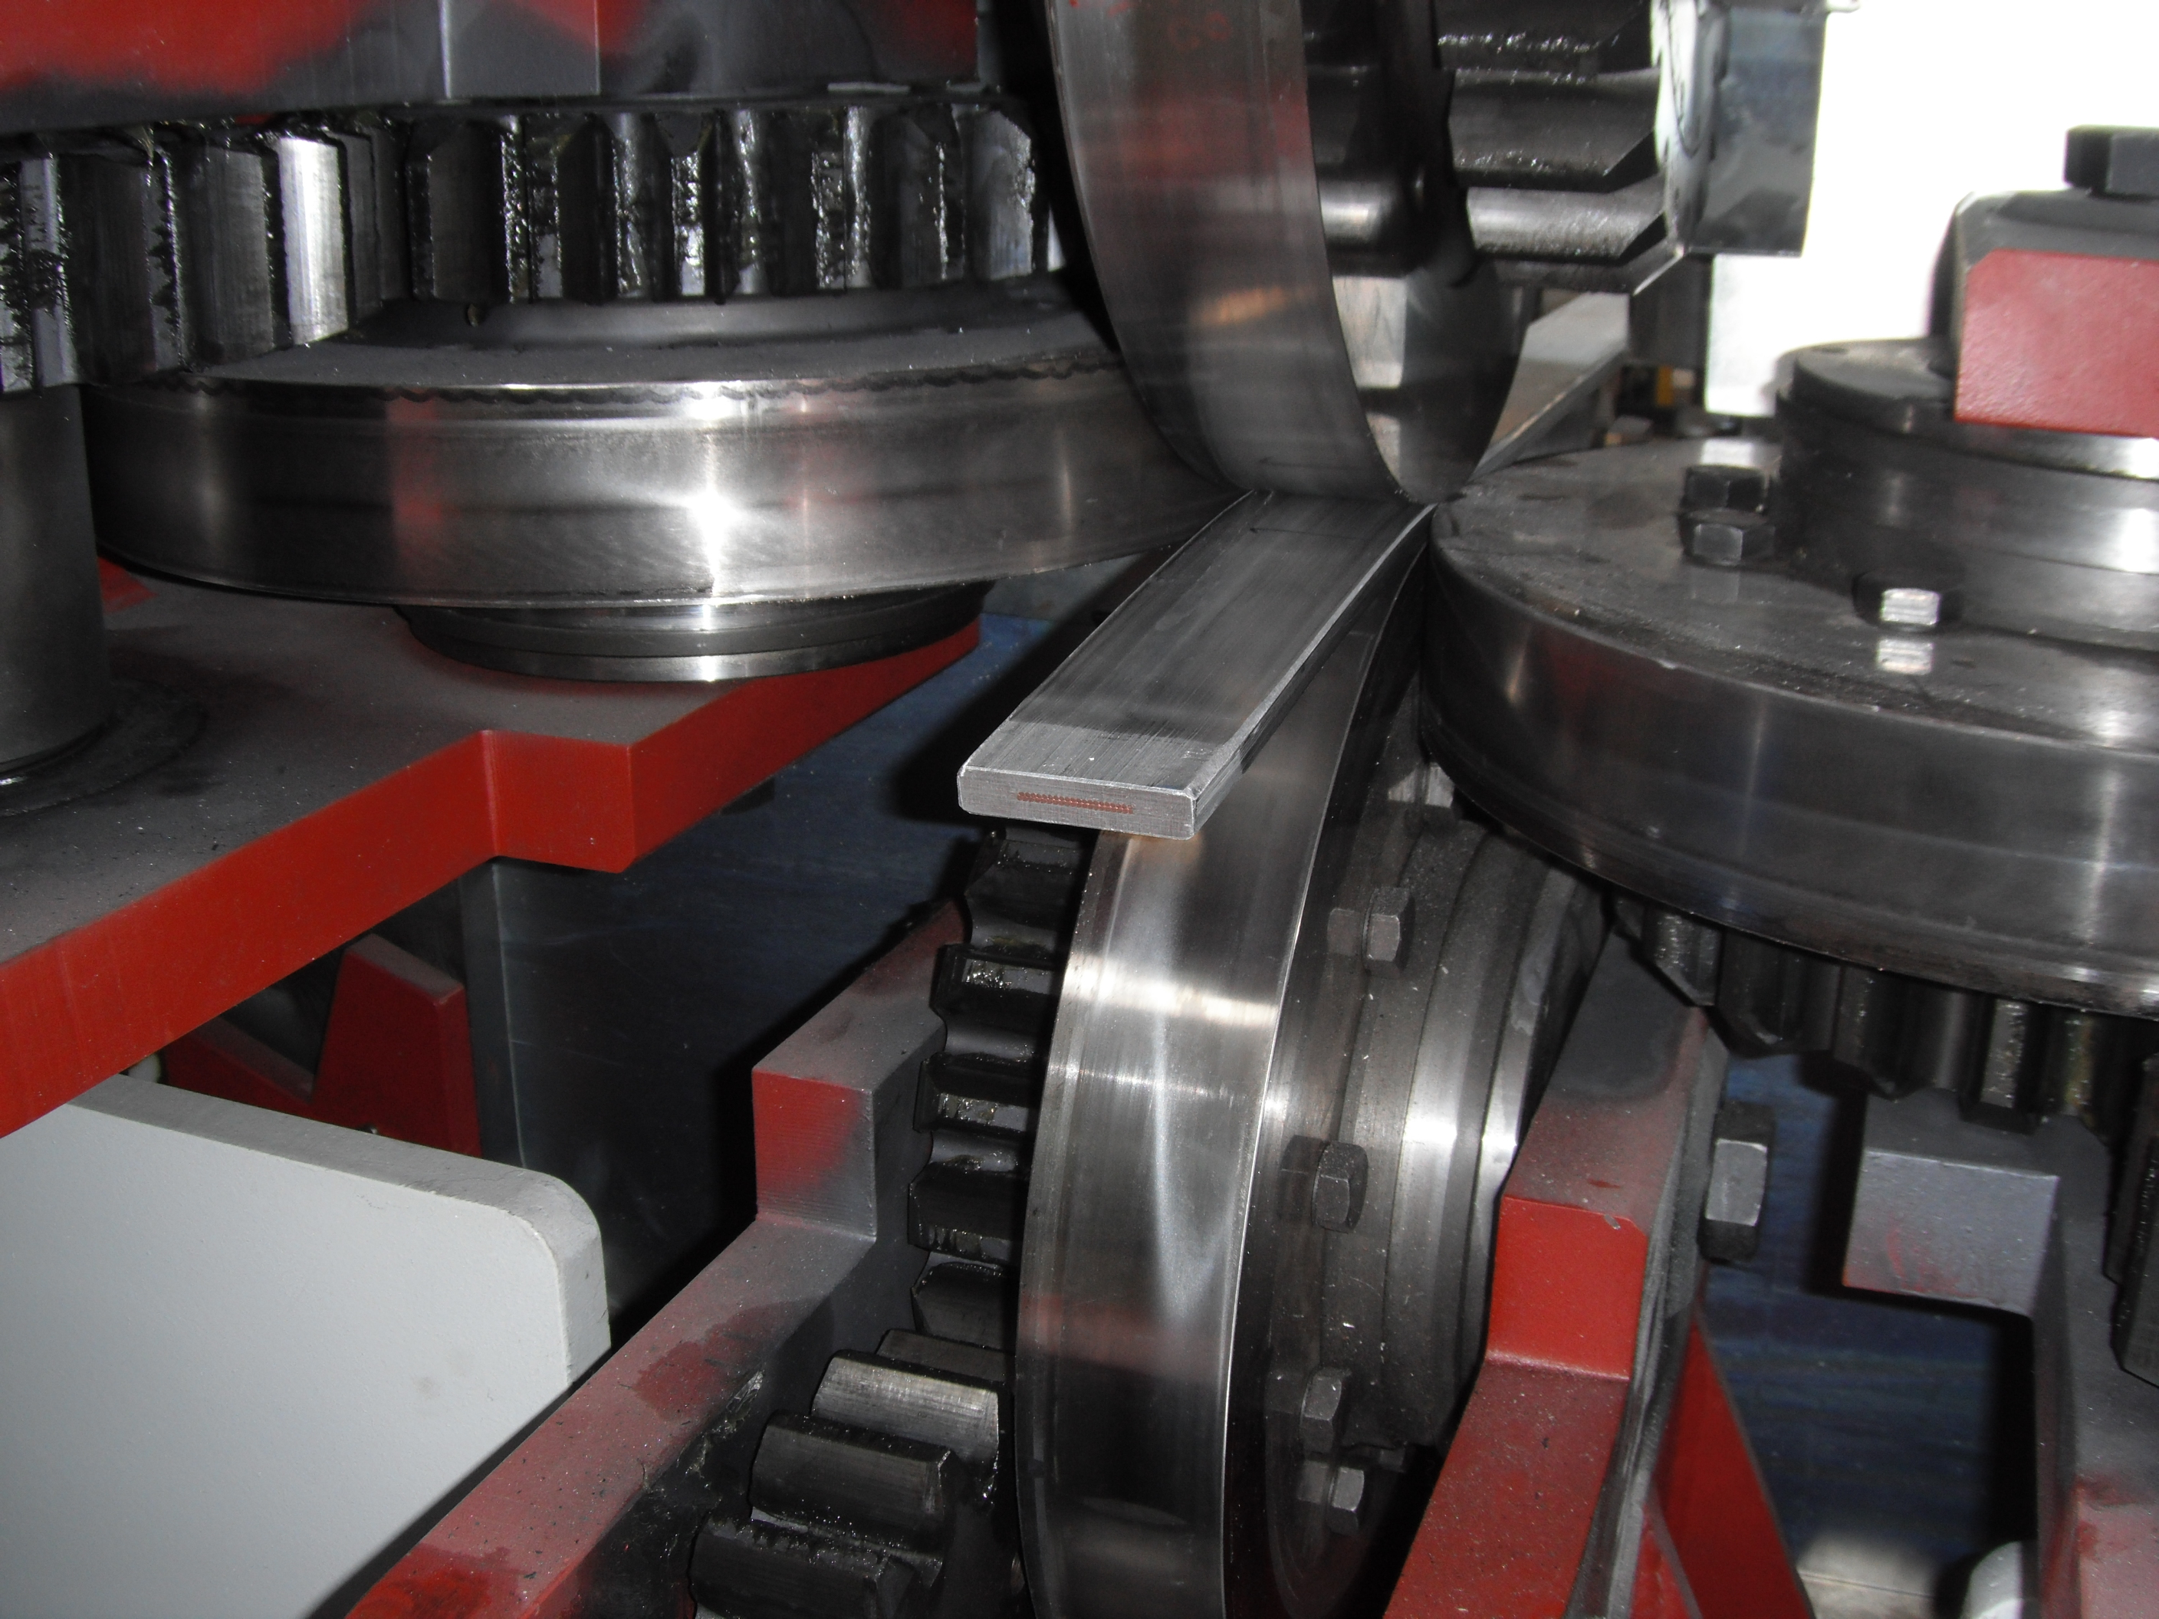

Slide 12
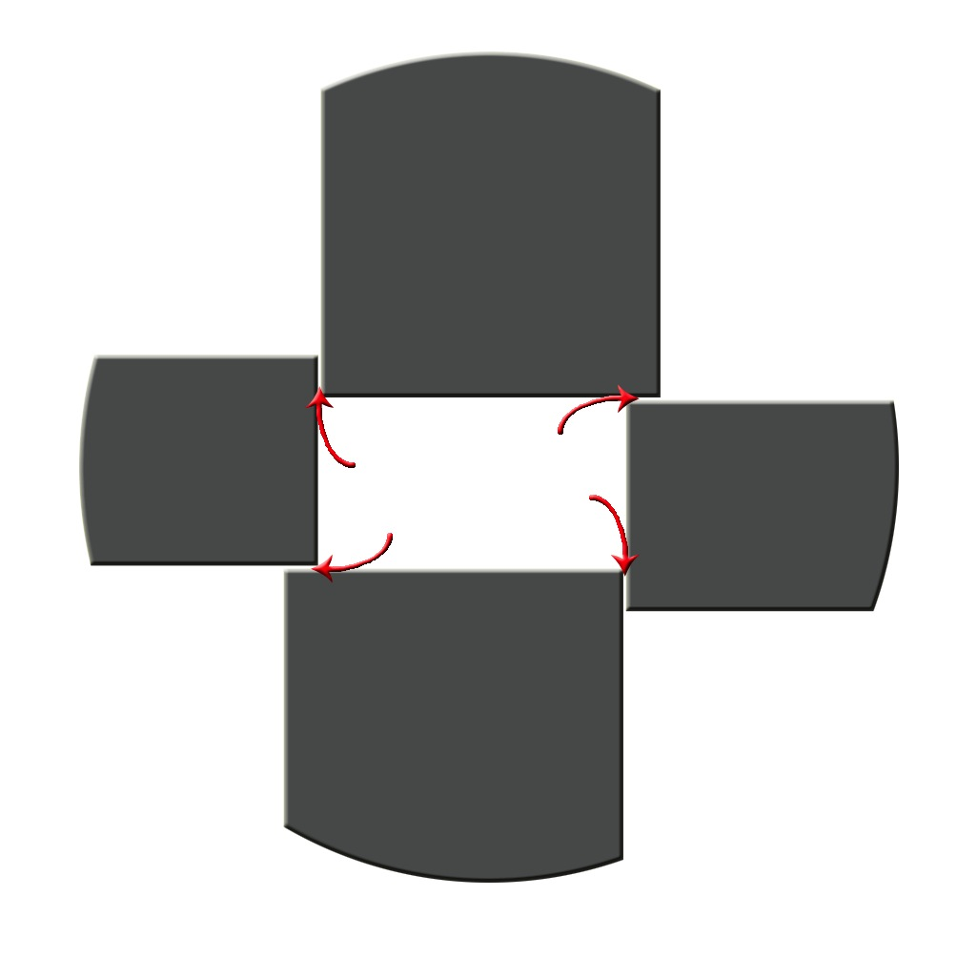

Schematic drawing of sample with burrs.
Roller configuration

Slide 13
Measurement goals
Verifying results lab-scaled work hardening
Effect of Turk-head rolling
Grain directionality with rolling direction
Bonding quality assessment with work hardening
  Empa; Jürg Neuenschwander
  Ultrasonic testing
Verifying enhancement mechanical properties at cryogenic temperature
Heat treatment effects
  Treatment below recovery temperature
  Solid solution heat treatment -> Quenching -> Precipitation hardening

Slide 14
TEST | WHAT TO ACHIEVE | SAMPLES |  |  |  |  |  | SPECIMEN total
RRR | Check results of lab-scaled CW | 15% (wc,1p) | 20% (wc,1p) | 25% (wc,1p) | 30% (wc,1p) |  |  | 14
 | RRR with amount of CW steps | 20% (wc,1p) | 20% (wc,2c) | 30% (wc,1p) | 30% (wc,3c)
 | RRR with CW at 35% | 35% (wc,1p)
 | RRR lapse with heat treatment | HT 100°C | HT 130°C | HT 160°C | HT 200°C | HT SS->PH |  | 10
TENSILE | Check results of lab-scaled CW | 15% (wc,1p) | 20% (wc,1p) | 25% (wc,1p) | 30% (wc,1p) |  |  | 18
 | Stress-strain with amount of CW steps | 30% (wc,1p) | 30% (wc,3c)
 | Stress-strain with CW at 35% | 35% (wc,1p)
 | Relation s-s warm vs. s-s cold | 0% | 20% (wc,1p) | 30% (wc,1p) |  |  |  | 15
 | Stress-strain with heat treatment | HT 100°C | HT 200°C |  |  |  |  | 6
BONDING | Bonding quality with CW | 0% | 15% (wc,1) | 20% (wc,1p) | 25% (wc,1p) | 30% (wc,1p) | 35% (wc,1p) | 16
 | Bonding quality with amount of CW steps | 20% (wc,1p) | 20% (wc,2c) | 30% (wc,1p) | 30% (wc,3c)
 | Bonding quality with application direction CW | 20% (wc,1p) | 20% (ho,1p)
OPTICAL | Check results of lab-scaled CW | Al 20% (wc,1p) | 20% (wc,1p) |  |  |  |  | 5
 | Microstructure with application direction CW | 20% (wc,1p) | 20% (ho,1p)
 | Microstructure with rolling direction | 20% (wc,1p) | 20% (wc,2c) | 20% (wc,2ce)
 | Microstructure with heat treatment | HT 100°C | HT 130°C | HT 160°C | HT 200°C | HT SS->PH |  | 5
VICKERS | Hardness mapping along cross-section | 0% | 20% (wc,1p) | Al 0% | Al 20% (wc,1p) |  |  | 5
HARDNESS | Hardness mapping with application direction CW | 20% (wc,1p) | 20% (ho,1p)
 | Hardness with heat treatment | HT 100°C | HT 130°C | HT 160°C | HT 200°C | HT SS->PH |  | 5

Slide 15
April | 22 |  | 23 |  | 24 |  | 25 |  | 26
Drop-off material first batch |  | Determine HT |  | Determine HT |  | Prepare material HT |  | Prepare material HT
 |  | Prepare LCD presentation |  | Prepare LCD presentation |  | Heat treatment |  | Heat treatment
 |  |  |  |  |  | LCD workgroup presentation
 | 29 |  | 30 | May | 1 |  | 2 |  | 3
 |  | Pick-up samples first batch |  | Labour | Day | Prepare material Empa |  | Send material Empa
Heat treatment |  | Heat treatment |  |  |  | Heat treatment |  | Heat treatment
 |  |  |  |  |  |  |  | Prepare second batch material
 | 6 |  | 7 |  | 8 |  | 9 |  | 10
Drop-off second batch material |  |  |  |  |  | Ascension | Day
RRR first batch |  | RRR first batch |  | RRR first batch |  |  |  | RRR first batch
Tensile tests RT first batch |  | Alex using tensile machine |  | Tensile tests RT first batch |  |  |  | Tensile tests RT first batch
 | 13 |  | 14 |  | 15 |  | 16 |  | 17
ESLM meeting |  | Alex using tensile machine |  | Alex using tensile machine |  | Cryogenic tensile tests |  | Cryogenic tensile tests
 |  | 1 dewar helium ordered |  |  |  | 1 dewar helium ordered
 | 20 |  | 21 |  | 22 |  | 23 |  | 24
Pentecost
Roparun |  | Roparun |  | Roparun |  | RRR second batch |  | RRR second batch
 |  |  |  |  |  | Tensile tests RT second batch |  | Tensile tests RT second batch
LC workshop | 27 | LC workshop | 28 | LC workshop | 29 | LC workshop | 30 | LC workshop | 31
 |  | Talk LC workshop
RRR second batch |  |  |  |  |  | RRR second batch |  | RRR second batch
Tensile tests RT second batch |  |  |  |  |  | Tensile tests RT second batch |  | Tensile tests RT second batch
June | 3 |  | 4 |  | 5 |  | 6 |  | 7
 | 10 |  | 11 |  | 12 |  | 13 |  | 14
CEC/ICMC | 17 | CEC/ICMC | 18 | CEC/ICMC | 19 | CEC/ICMC | 20 | CEC/ICMC | 21

