Slide 1

Beam Instrumentation Challenges
Dr. Rhodri Jones
Head of the CERN Beam Instrumentation Group
1st oPAC Topical Workshop
Grand Challenges in Accelerator Optimisation
CERN, Geneva, Switzerland - June 26th – 27th 2013

Slide 2
Introduction to Beam Instrumentation
Beam instrumentation provides “eyes” for machine operators
  The instruments that observe beam behaviour
  An accelerator can never be better than the instruments measuring its performance!
What does work in beam instrumentation entail?
  Design, construction & operation of instruments to observe particle beams
  R&D to innovate or improve existing techniques to fulfill new requirements
  A combination of many disciplines
    Applied & Accelerator Physics and a lot of Mechanical, Electronic & Software Engineering
  A fascinating field of work!
What are the main beam parameters measured?
  Beam Position to control location of the beam in the accelerator
  Beam Intensity to measure operational efficiency
  Beam Loss to ensure safe operation
  Transverse Beam profiles
  Longitudinal Beam profiles
to optimise operation

Slide 3
Trends in Accelerators
Bigger, Faster, Better!
  High energy machines for particle physics
    LHC, HL-LHC, HE-LHC (CERN)
    CLIC/ILC (R&D)
  High current machines
    Neutron sources – material science
      SNS (US), ESS (Sweden), CSNS (China), IFMIF (Japan), …
    Neutrino Production
      T2K (JPARC, Japan), NuMI/Nova (FNAL, US), CNGS (CERN), Project-X (FNAL, US), …
  High Brightness machines
    X-ray Free Electron Lasers – probing complex, ultra-small structures
      LCLS (SLAC, US), European XFEL (DESY, DE), …
Compact or Exotic!
  Rare radioactive isotope machines
    FAIR (GSI, DE), HIE-ISOLDE (CERN)
  Anti-matter machines
    ELENA (CERN), FAIR (GSI, DE)
  Medical proton/ion therapy machines

Slide 4
Challenges for Beam Instrumentation
Unprecedented request for precision
  Positioning down to well below the micron level
Treatment of increasingly more data
  Bunch by bunch measurements for all parameters
Dealing with high beam powers
  Non-invasive measurement techniques
  Robust and reliable machine protection systems
Dealing with the ultra-fast
  Measurements on the femto-second timescale
Dealing with the ultra-low
  Measurement of very small beam currents

Slide 5
Challenges for Beam Instrumentation
The Quest for Unprecedented Precision

Slide 6
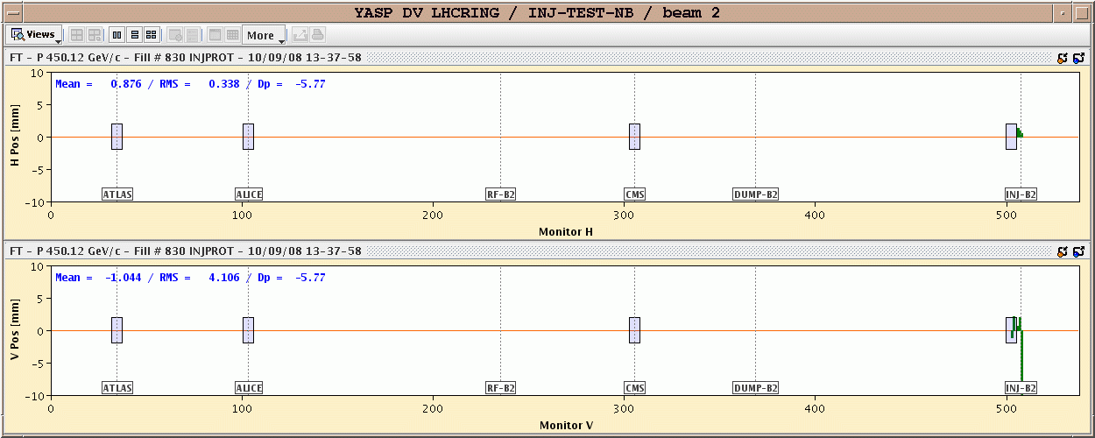
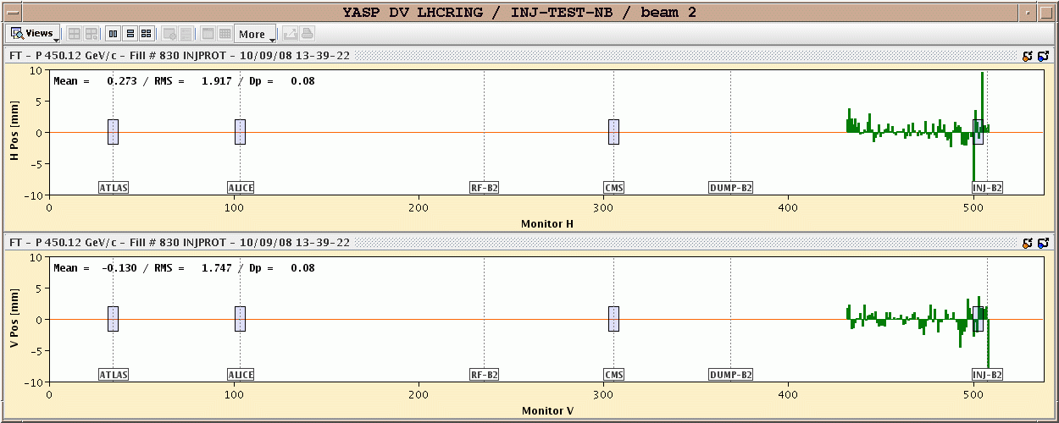
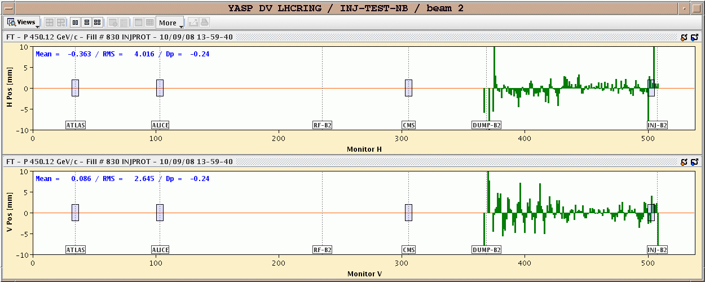
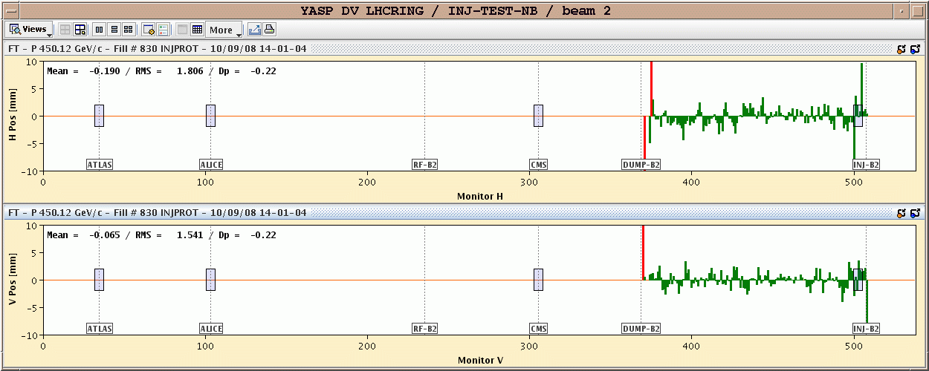
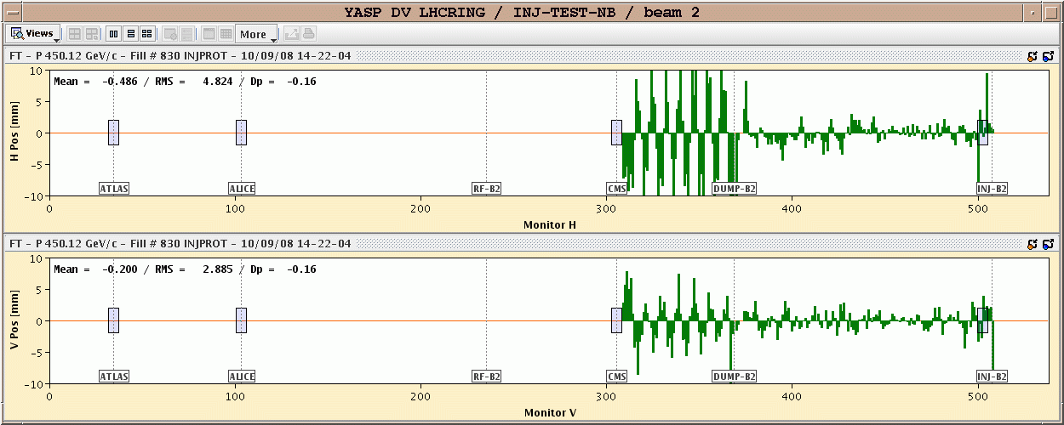
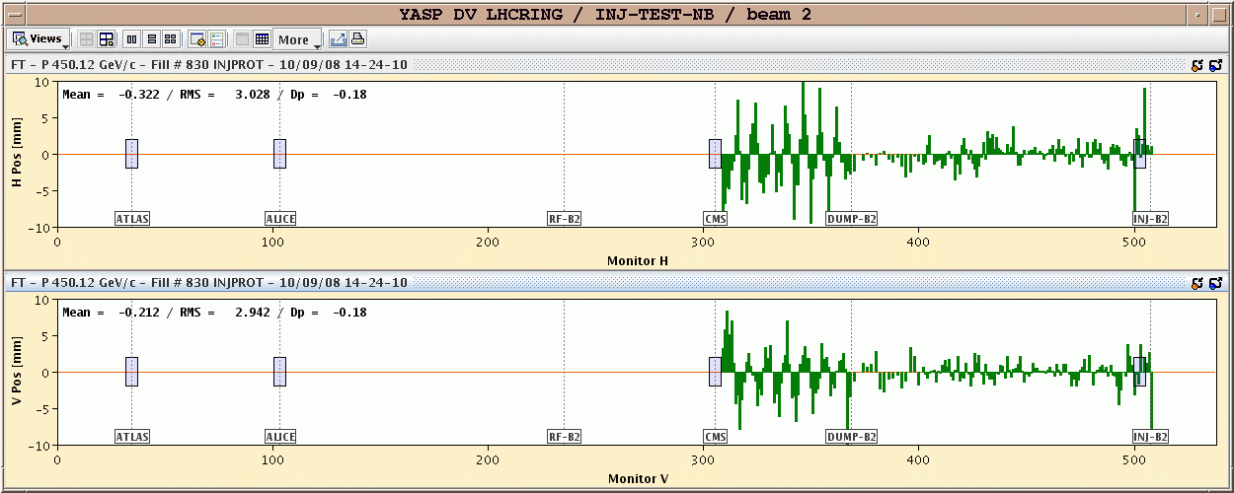
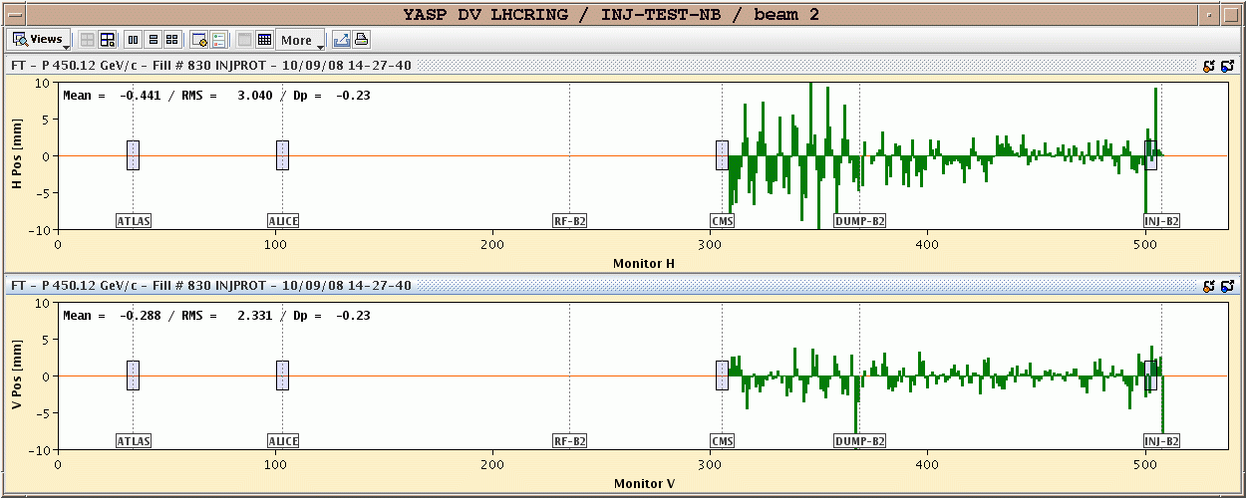
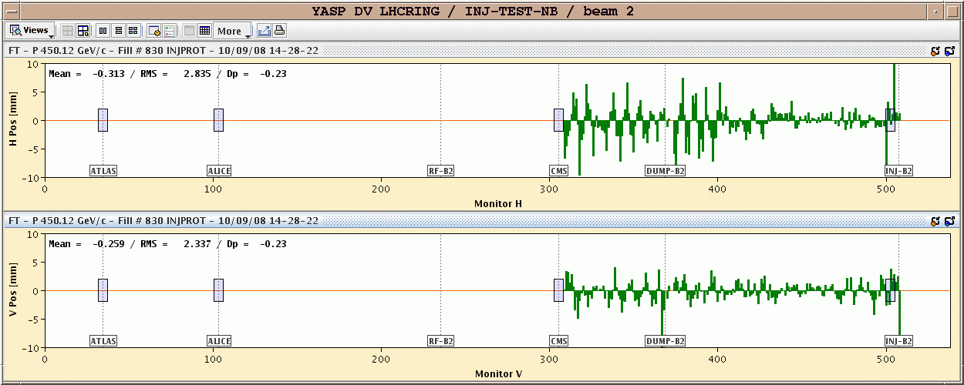
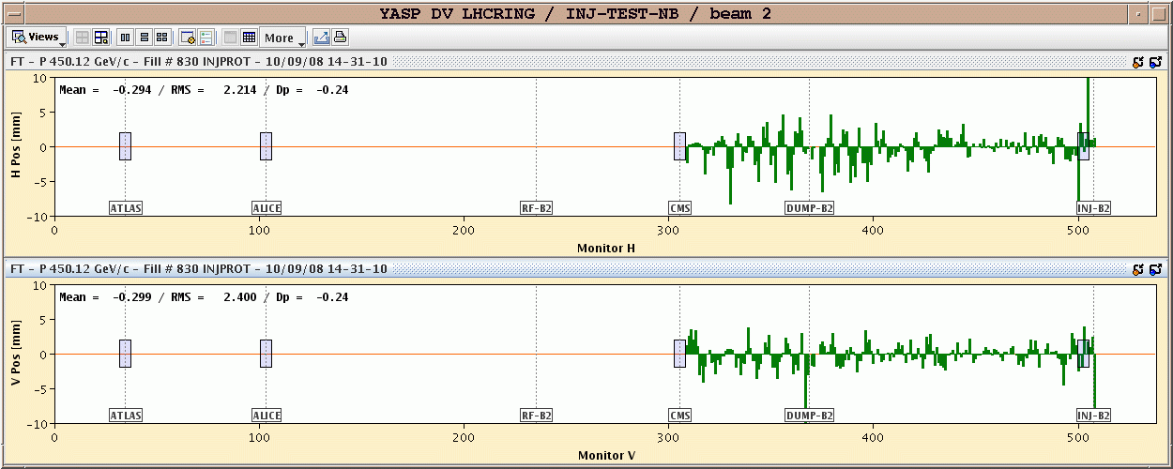
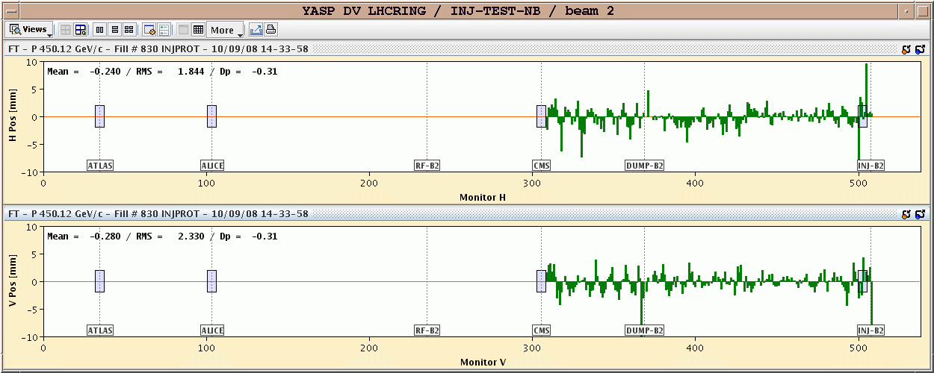
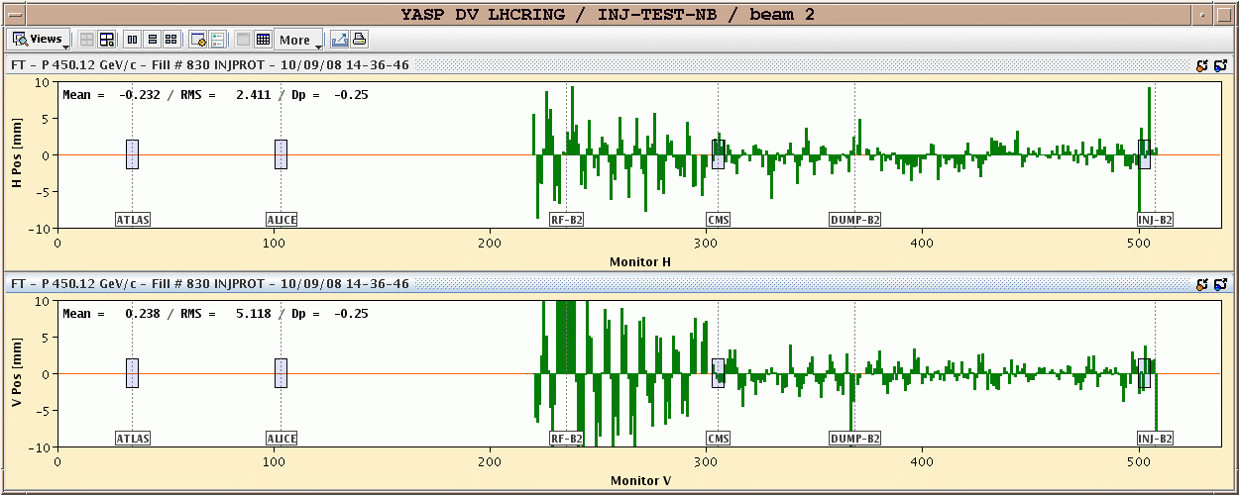
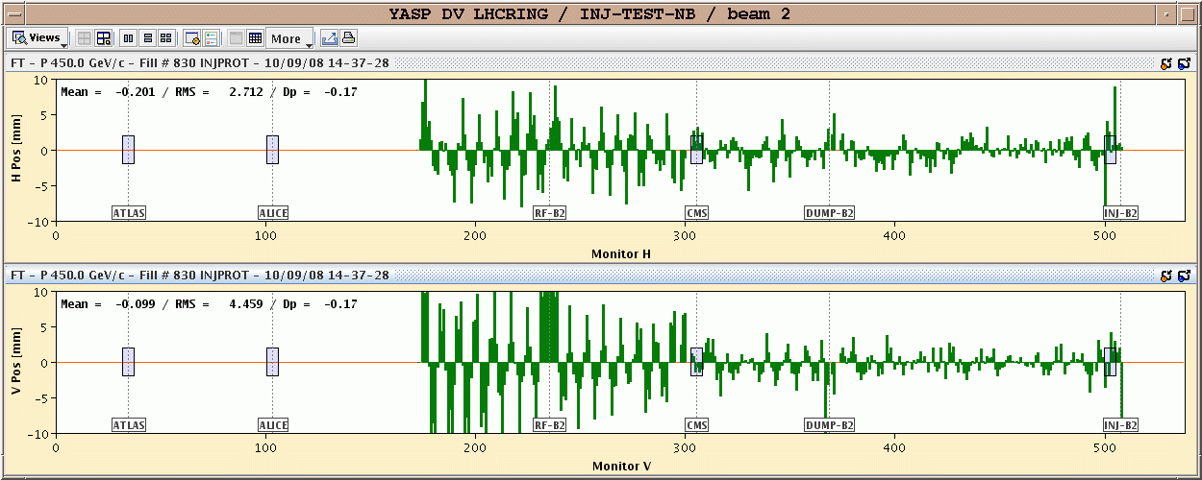
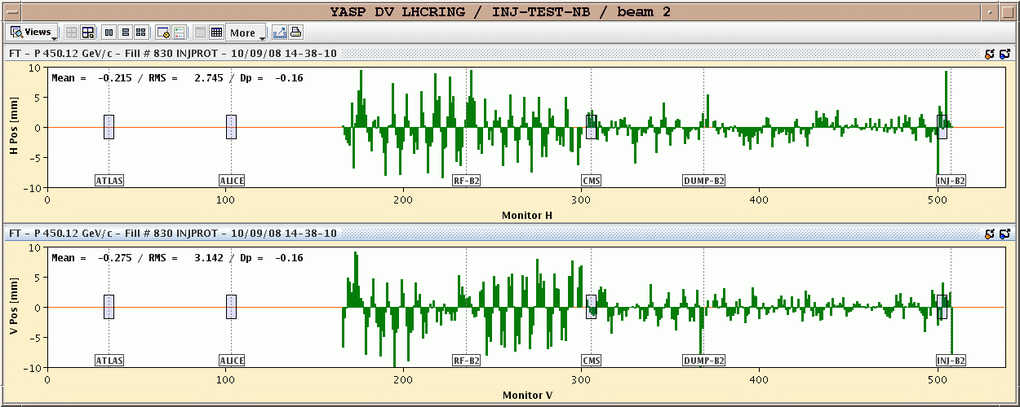
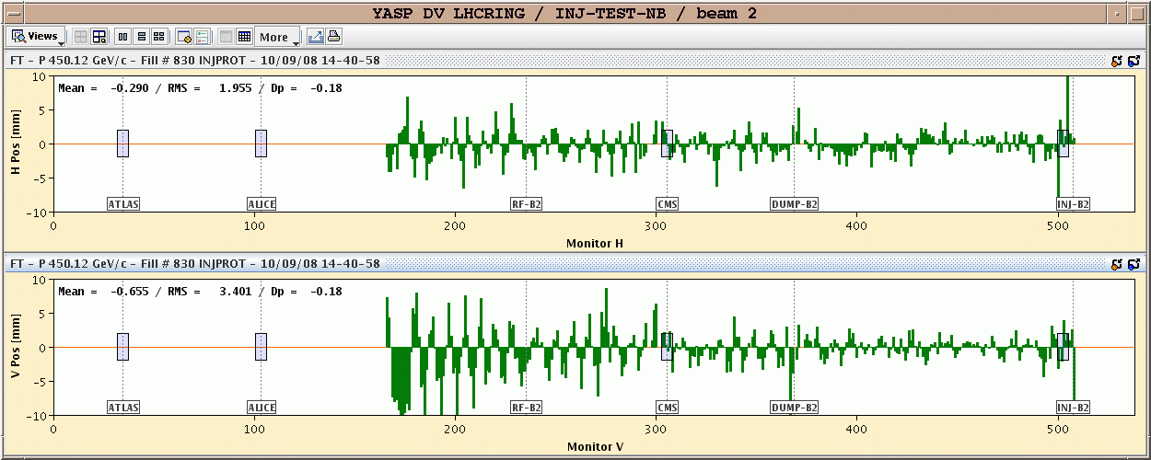
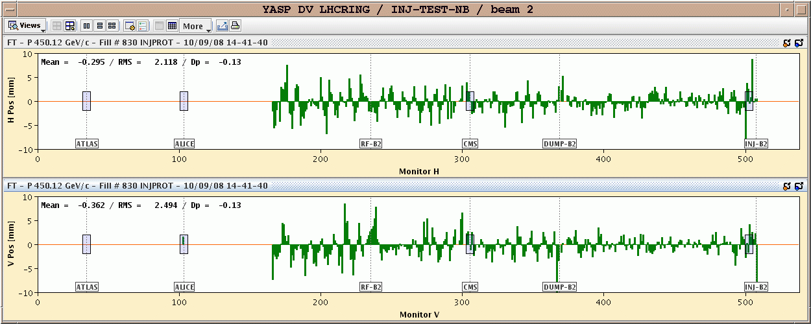
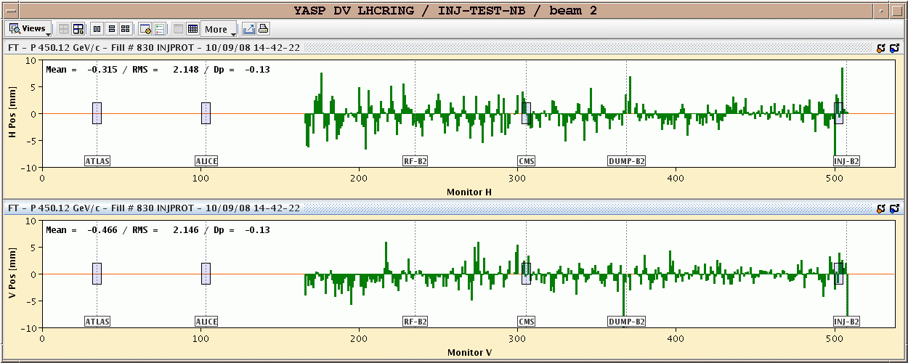
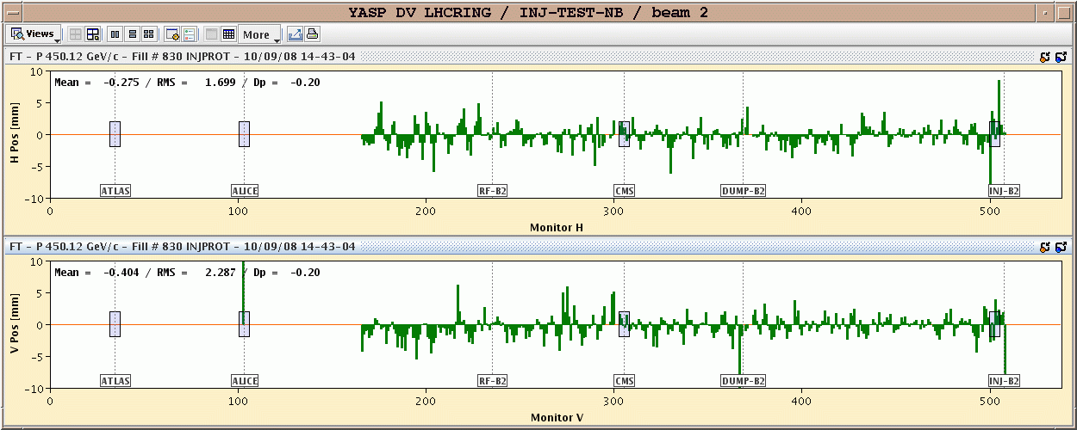
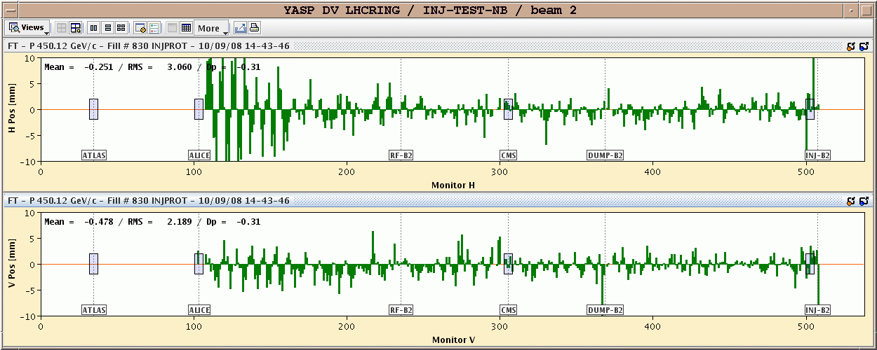
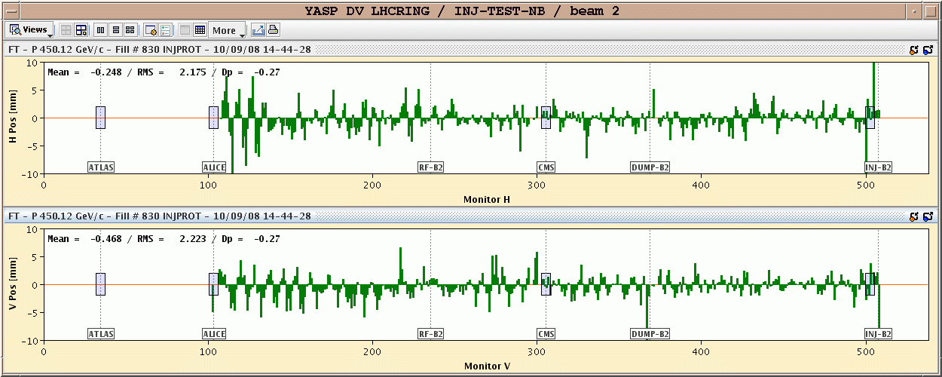
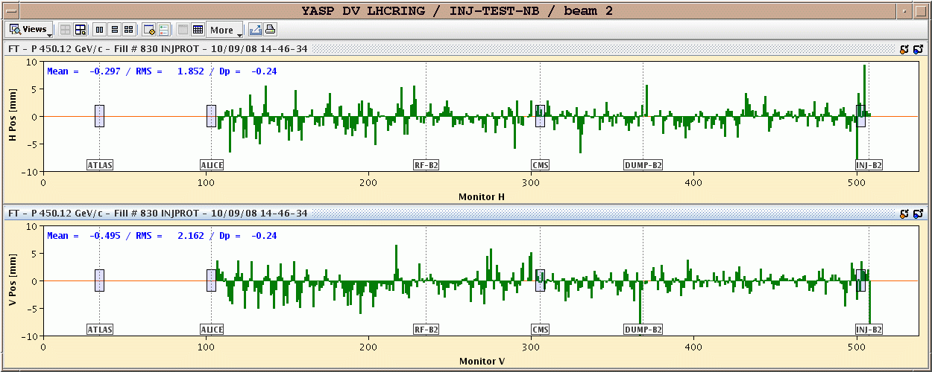
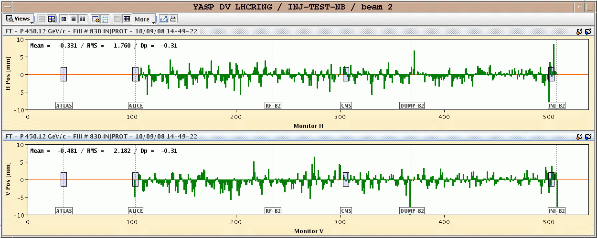
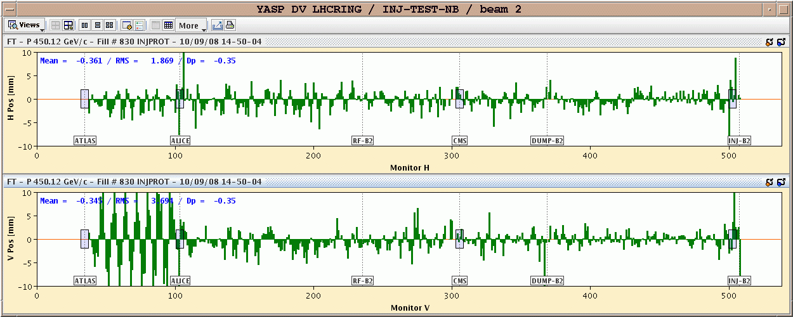
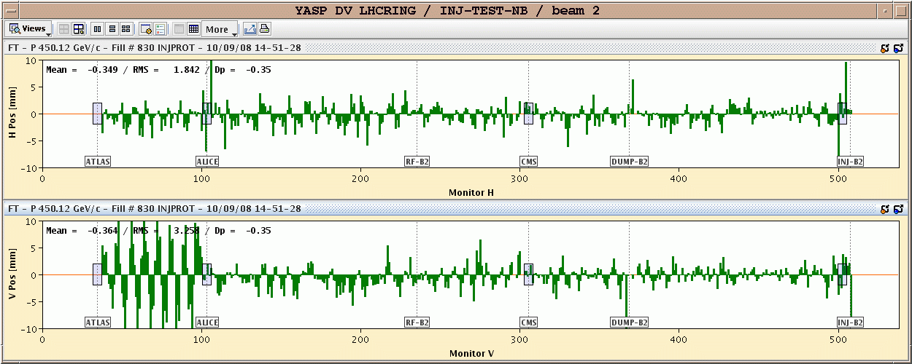
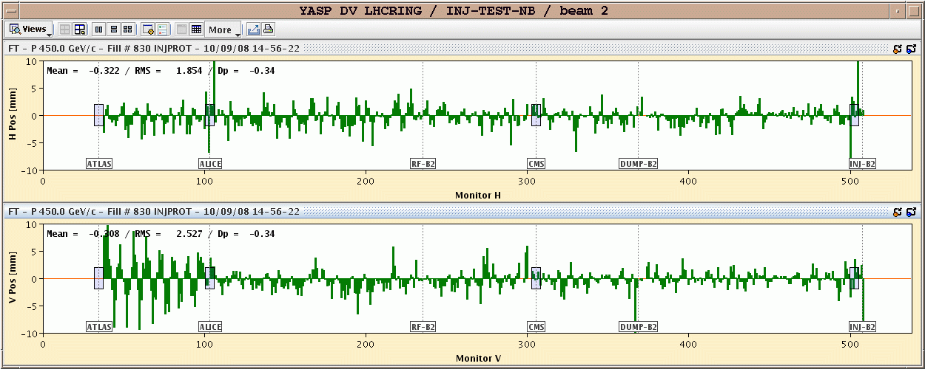
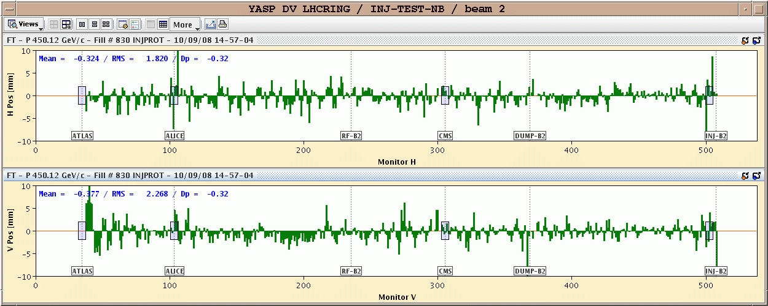
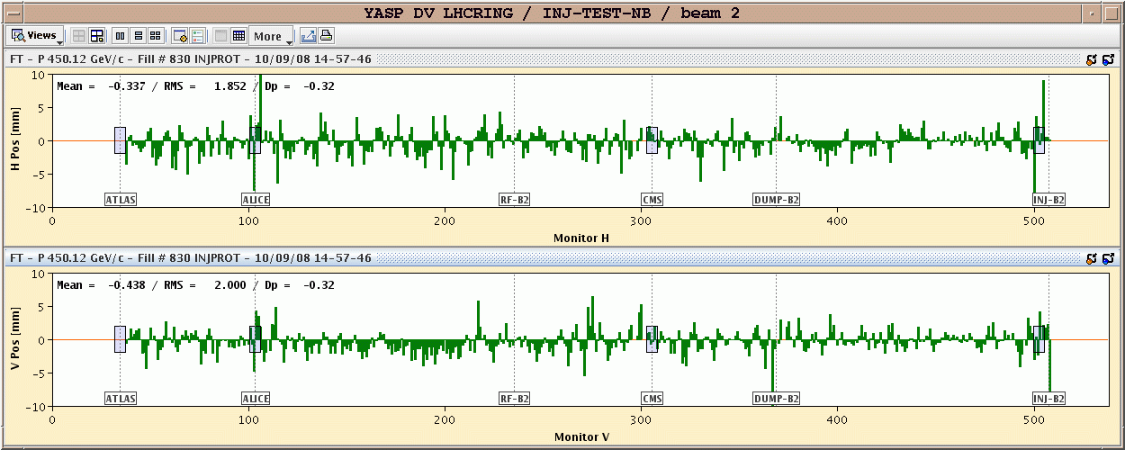
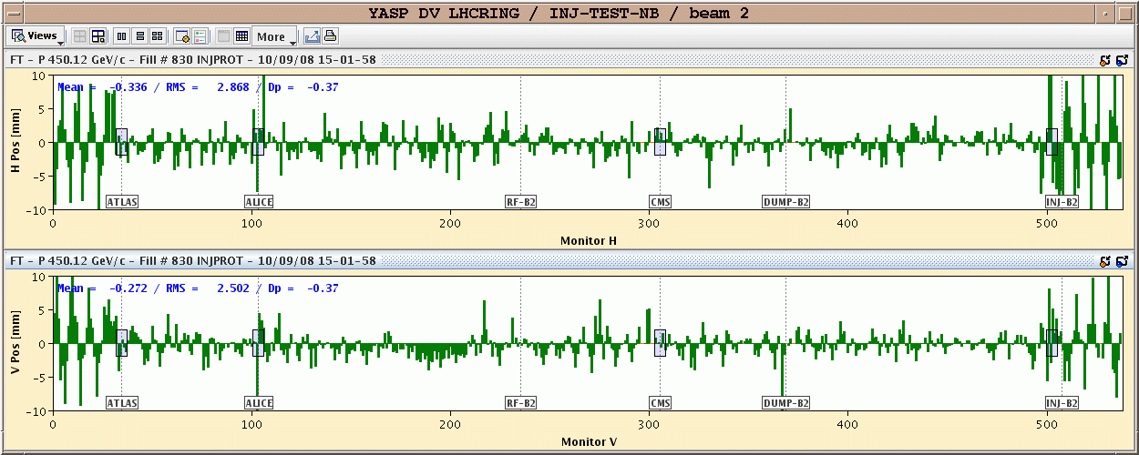
Beam Position Monitoring – The Challenges
Typically one of the largest BI systems
  LHC has 1100 BPMs – CLIC drive beam requires 40000! This implies:
    Precision engineering at low cost
    Simple, robust, yet very highly performing electronics
      Digitise as soon as possible (now doable with advances in ADCs & digital treatment systems)
      Radiation Tolerant (improves S/N, minimises expensive cabling BUT needs significant testing time)
  XFEL’s and Linear Colliders increasingly asking for very high resolution
    Well below 1μm for single pass

Slide 7
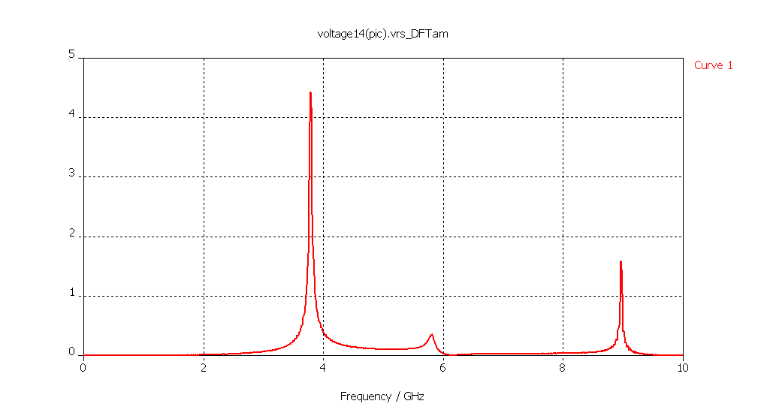
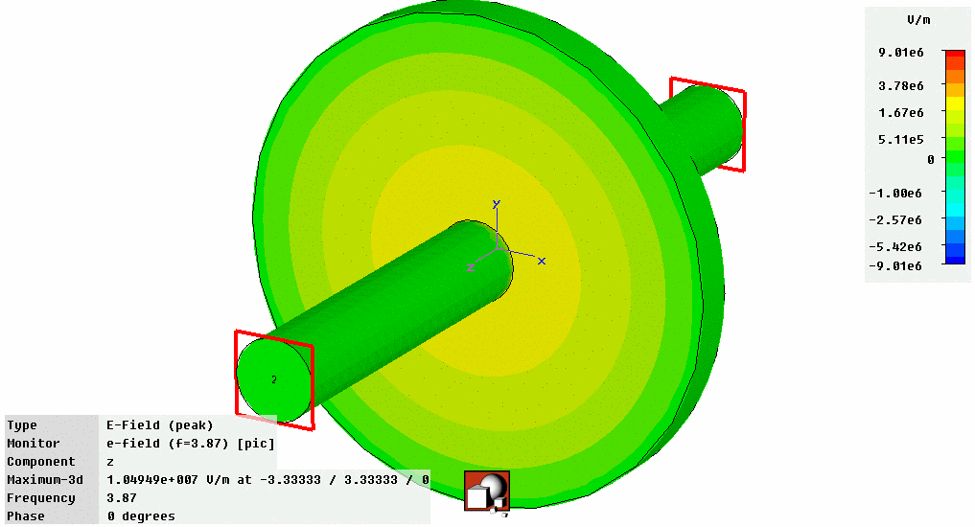
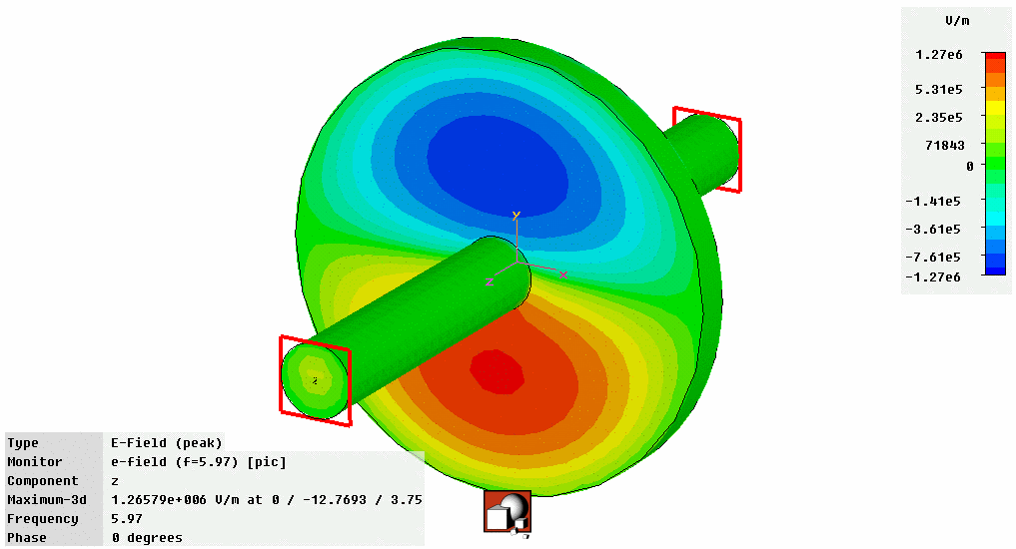
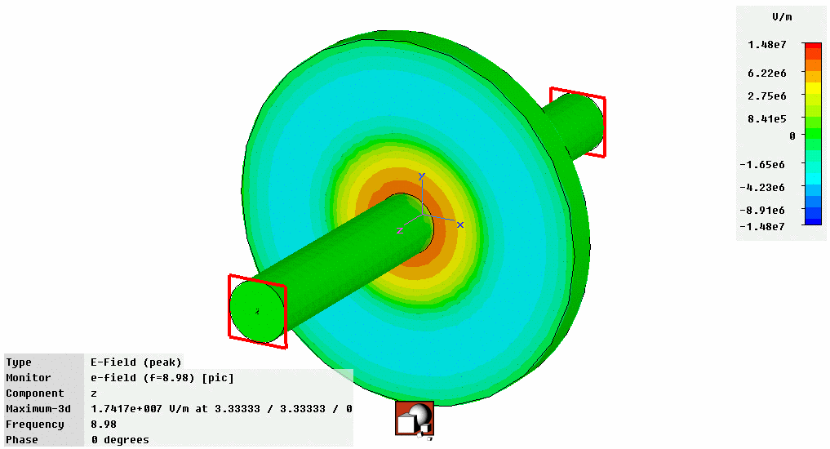
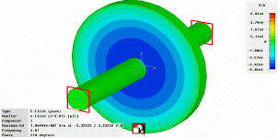
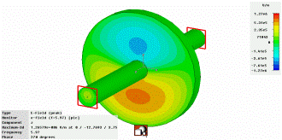
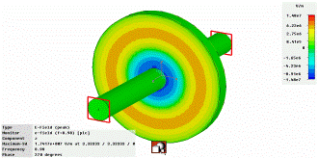
Improving the Precision for Next Generation Accelerators
Standard BPMs give intensity signals - need to subtract them to obtain a difference which is proportional to position
  Difficult to do electronically without some of the intensity information leaking through
    When looking for small differences this leakage can dominate the measurement
Solution – cavity BPMs allowing sub micron resolution
  Design the detector in such a way as to only collect only the difference signal
    Dipole Mode TM₁₁ proportional to position & shifted in frequency with respect to monopole mode
Frequency Domain
TM₀₁
TM₀₁
U / V
TM₀₂
TM₀₂
TM₁₁
TM₁₁
f / GHz
Courtesy of D. Lipka,
DESY, Hamburg
U~Q
U~Qr
U~Q

Slide 8
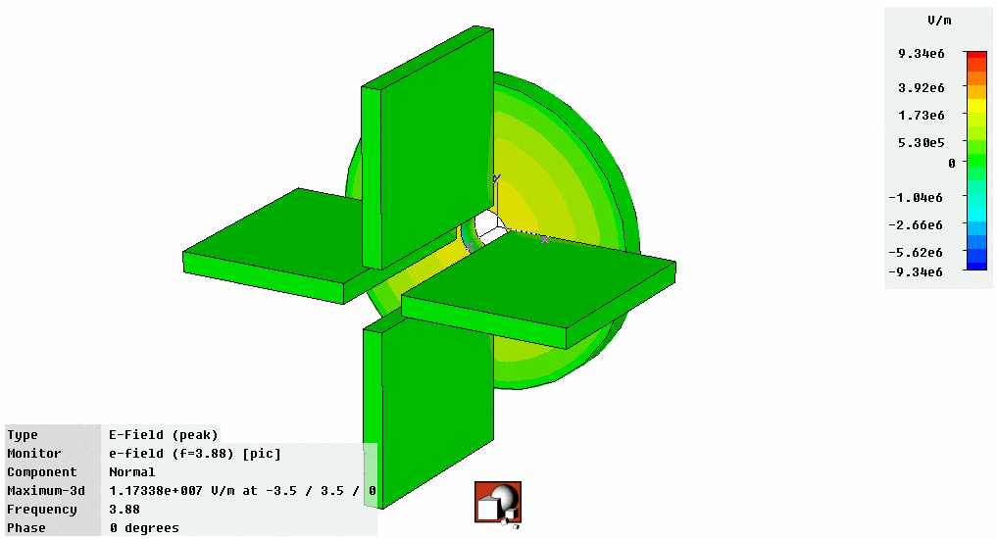
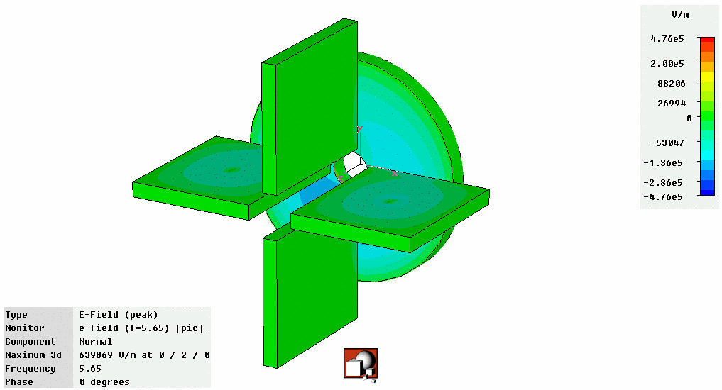
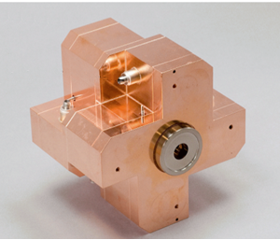
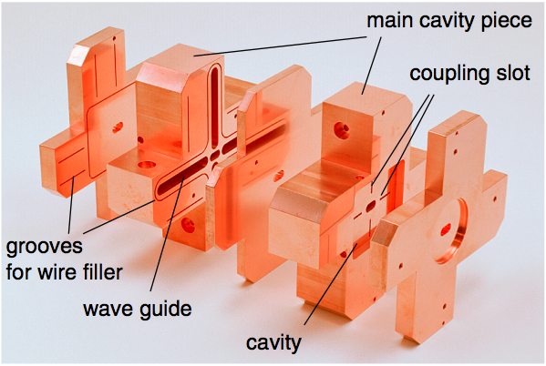
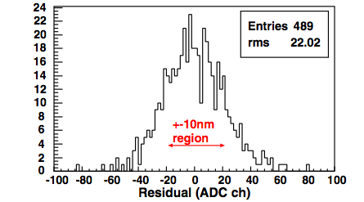
Today’s State of the Art BPMs
Obtain signal using waveguides that only couple to dipole mode
  Further suppression of monopole mode
Prototype BPM for ILC Final Focus
  Required resolution of 2nm (yes nano!) in a 6×12mm diameter beam pipe
  Achieved World Record (so far!) resolution of 8.7nm at ATF2 (KEK, Japan)
Monopole Mode
Dipole Mode
Courtesy of D. Lipka,
DESY, Hamburg
Courtesy of D. Lipka & Y. Honda

Slide 9
Challenges for Beam Instrumentation
Maximising the Available Data

Slide 10

Maximising the Available Data - Example
LHC Longitudinal Density Monitor
  Aims:
    Profile of the whole LHC ring with 50ps resolution
    High dynamic range for ghost charge measurement
  Method:
    Single photon counting with Synchrotron light
      Avalanche photodiode detector
      50ps resolution TDC
Longitudinal Bunch Shape
LHC turn clock
Arrival time
filter
TDC
APD
Electrical pulse
synchrotron light
Courtesy of A. Jeff

Slide 11
LDM On-line Correction
Satellites
Main bunch
Afterpulsing
Deadtime
Ghost bunches
Corrected for deadtime
Corrected for deadtime and afterpulsing

Slide 12
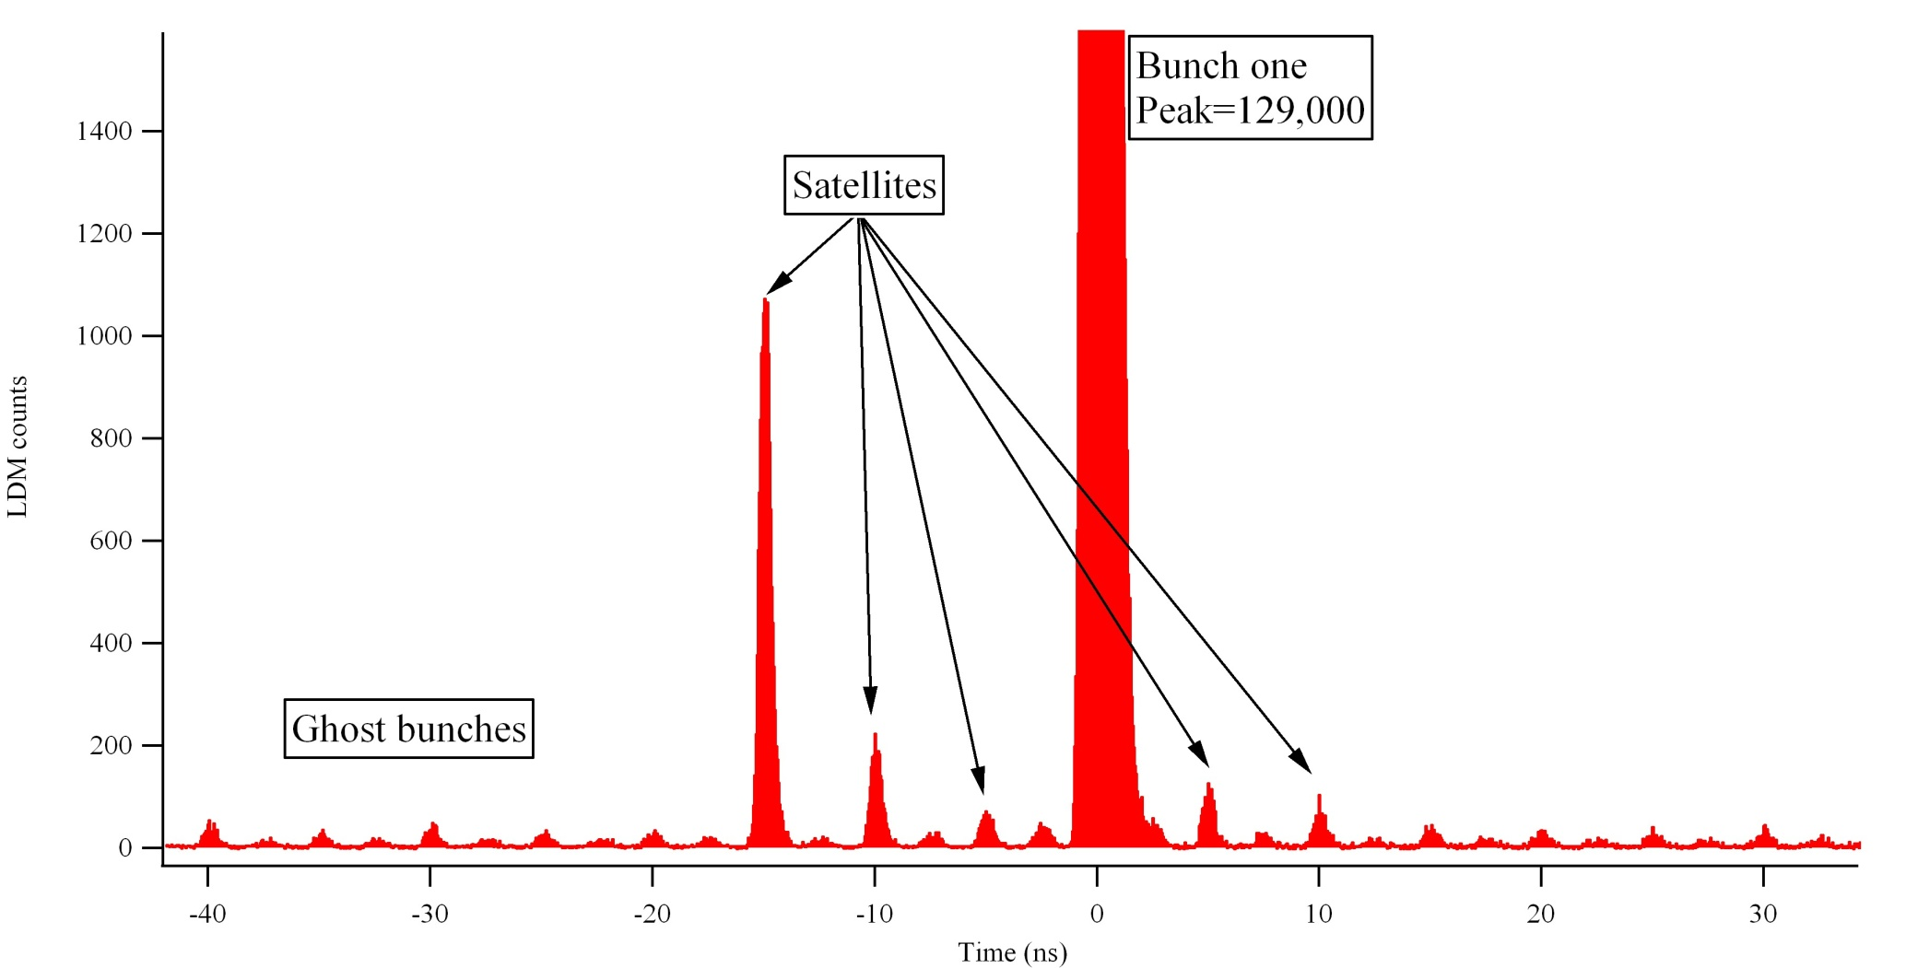
LDM Results
Results
  Able to profile the whole ring within a matter of minutes
  Critical input for accurate luminosity calibration of the experiments

Slide 13
Challenges for Beam Instrumentation
Dealing with high beam powers
  Non-invasive measurement techniques

Slide 14
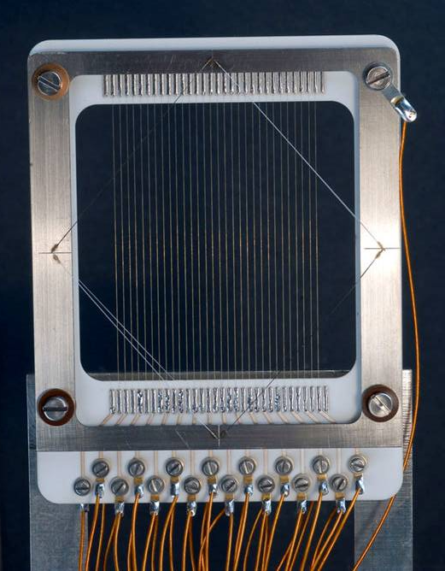
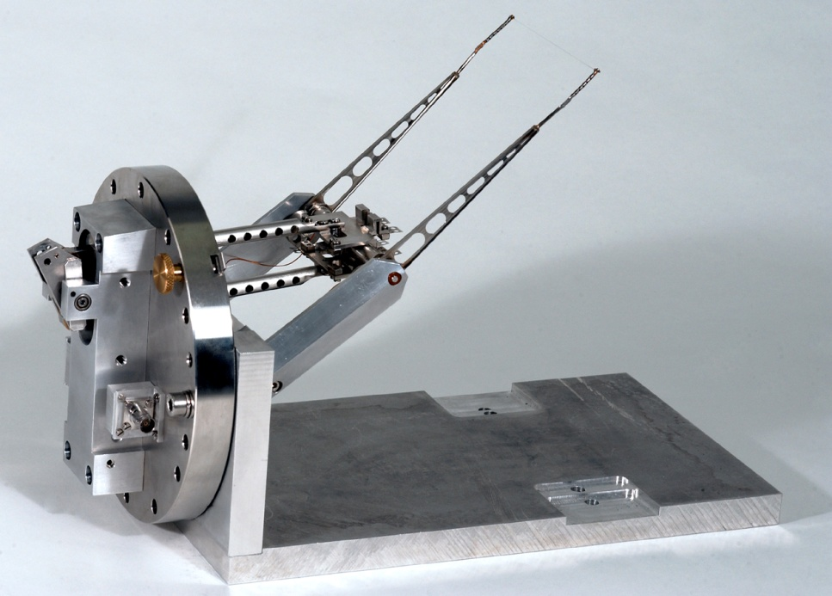
Dealing with High Beam Power - The Issues
Traditional invasive diagnostics no longer suitable
  Materials do not withstand energy deposition
    Burning of holes or breaking of wires
  Use of superconducting RF structures
    Risk of contamination on breakage or sputtering of the intercepted material

Slide 15
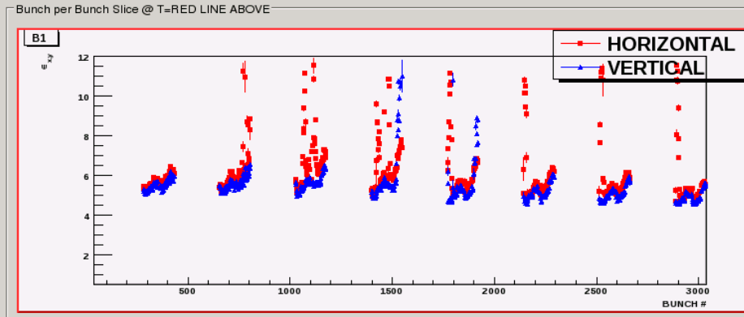
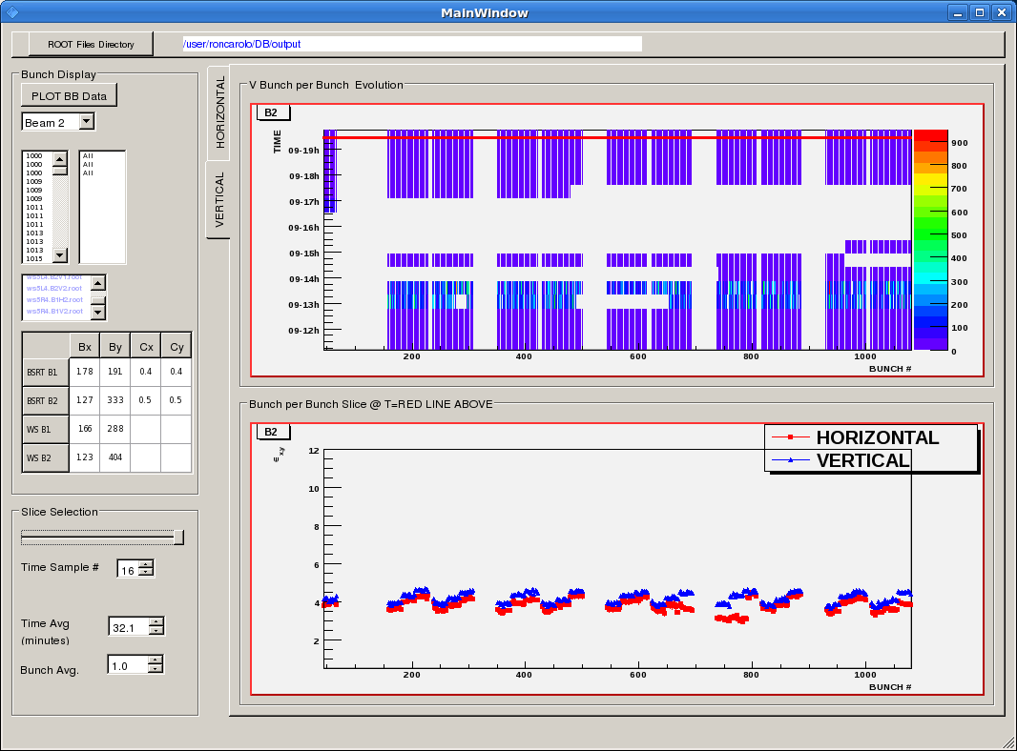
Measuring the Size of High Power Beams
Synchrotron Light Diagnostics
  Only for electron & very high energy proton/ion machines (LHC)
    Difficult to separate the light from the beam for linear accelerators
  Difficult to get absolute calibration
    Image correction factors typically bigger than the beam size!
  Additional challenges lie in fast cameras & signal treatment chains for bunch by bunch measurement
LHC Synchrotron Light Diagnostics

Slide 16
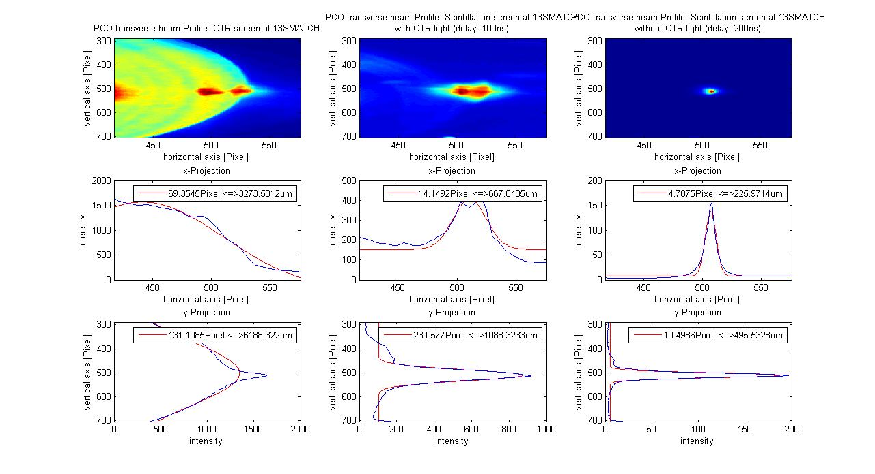
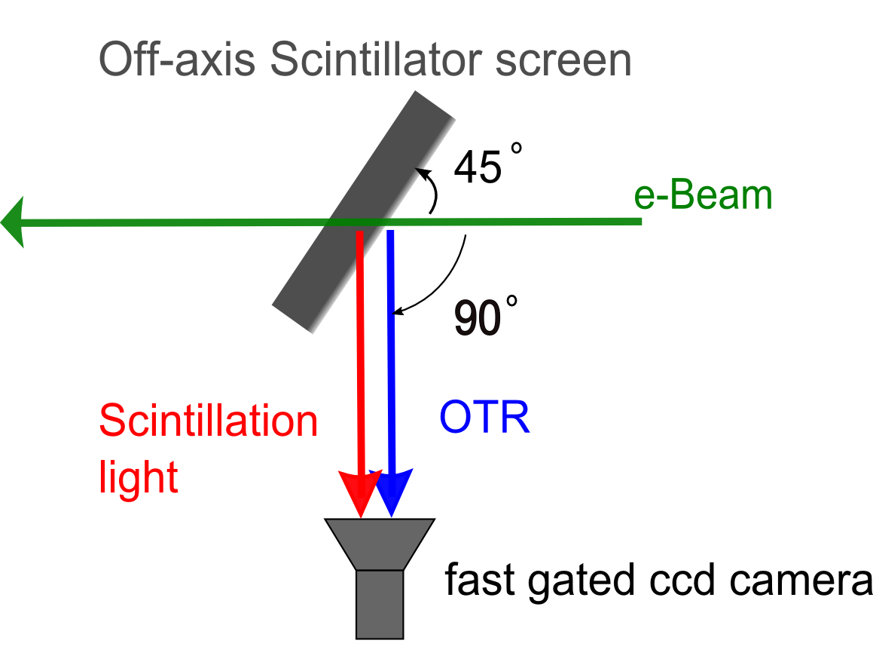
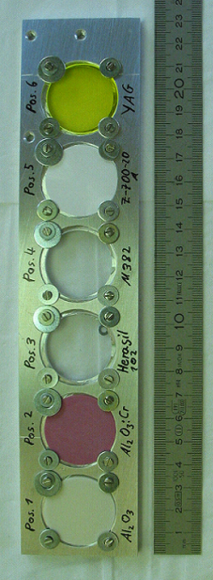
Measuring the Size of Intense Bunches
Standard OTR not an option for short intense bunches (main issue for LCLS)
  Signal swamped by Coherent OTR from micro-bunching within the main bunch
One proposal is to go to luminescent Screens
  There will still be COTR at polished surfaces
  Resolution might be a problem
Investigation of temporal suppression of COTR
  Scintillation screen + fast gated camera
  Proof-of-principle at FLASH, DESY
Resolution of scintillation screens needs study
  Synergy with ion beam diagnostics
  Similar studies ongoing for FAIR
Al coated Si OTR screen,
COTR light,
Coherent SR
LuAG screen,
COTR &
scintillation light
LuAG screen
+100ns delay
Only scintillation light
Courtesy of M. Yan
Courtesy of K. Wittenburg

Slide 17
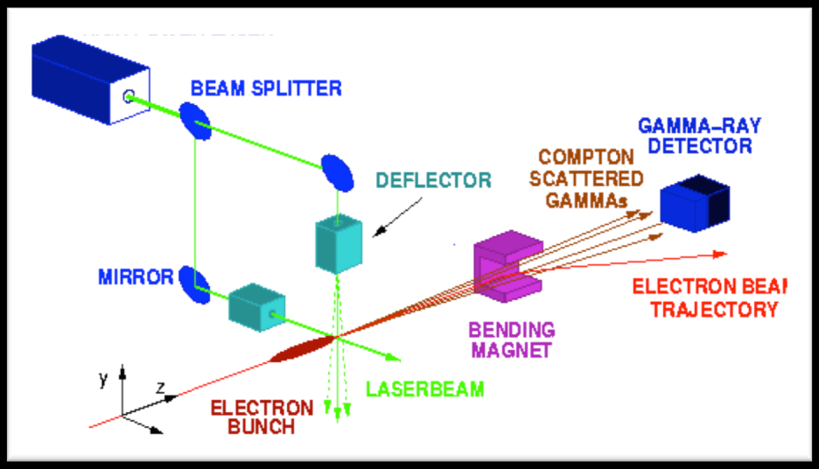
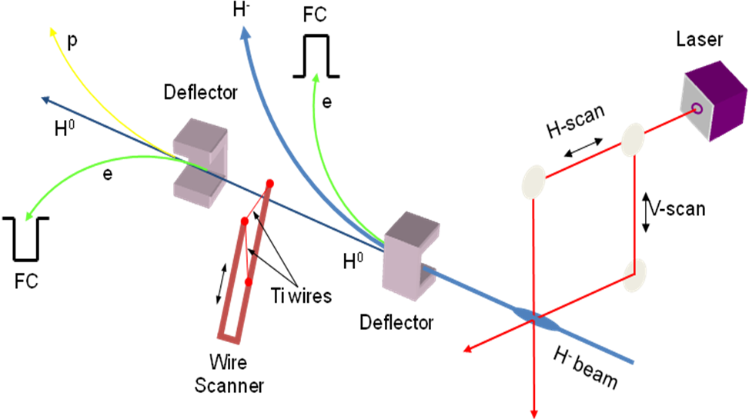
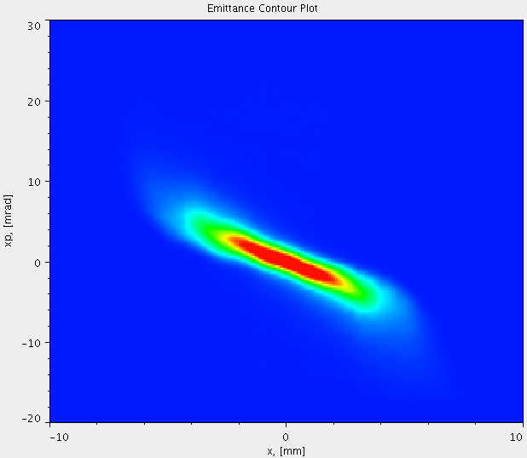

Non-Invasive Beam Size Measurement
Laser wire scanner
  Good candidate for H⁻ & electrons
    Can measure down to micron level
  Needs conversion to turn-key instrument
    Reliable laser system
    Laser distribution to multiple measurement stations
Courtesy of A. Alexandrov

Slide 18

Non-Invasive Beam Size Measurement
Beam Induced Fluorescence
N₂ excited state
Photon
emitted
Beam
e⁻
N₂ ground state

Slide 19

Non-Invasive Beam Size Measurement
Beam Induced Fluorescence
  Issues
    Sensitivity to radiation
    Low signal yield ⇒ vacuum bump
    Drift of excited gas molecules
    ⇒ broadening of profile
N₂-fluorescent gas
equally distributed
Vacuum gauge
Blackened walls
Valve
150mm flange
Ion beam
Viewport
Lens, Image-Intensifier
and CCD FireWire-Camera
Courtesy of M. Schwickert

Slide 20


Non-Invasive Beam Size Measurement
Residual Gas Ionisation
  Some 10 times more sensitive than BIF
  More complicated to build
    High voltage network
    Guiding magnetic field
  Image broadening due to space charge
  Ageing of detectors an issue
Courtesy of M. Schwickert

Slide 21

Non-Invasive Beam Size Measurement
Electron Beam Scanner
  Derive beam profile from deflection of low energy electron beam scanned across the high energy proton beam
Courtesy of W. Blokland

Slide 22


Non-Invasive Beam Size Measurement
Electron Beam Scanner – how it works
  Look at the deflected projection of a tilted sheet of electrons
Quadrupoles
Deflector
Electrons ➔
Multiple scans
dy
dx
take the derivative to get the profile
Courtesy of W. Blokland

Slide 23

Non-Invasive Beam Size Measurement
Electron Beam Scanner – the challenges
Courtesy of W. Blokland

Slide 24
Challenges for Beam Instrumentation
Dealing with high beam powers
  Robust and Reliable Machine Protection Systems

Slide 25



Beam Loss Monitors – New Materials
Diamond Detectors
  Fast & sensitive
  Used in LHC to distinguish bunch by bunch losses
  Investigations now ongoing to see if they can work in cryogenic conditions
Courtesy of E. Griesmayer

Slide 26
Cryogenic Beam Loss Monitors
Silicon
  Successfully used at 1 K at CERN in 1976
Diamond
  Successfully in use as LHC BLM at room temperature
  Better resistance to radiation than Si at room temperature
  Less leakage current than Si at room temperature
  Does it work in liquid helium?
Liquid helium ionisation chamber
  Advantage : no radiation hardness issue
  Disadvantage : slow (charge mobility of 0.02 cm2/V/s)

Slide 27

Cryogenic Beam Loss Monitors
Diamond results
  Single particle (response averaged from ~5000 pulses)

Slide 28
Challenges for Beam Instrumentation
Dealing with the ultra-fast
  Measurements on the femto-second timescale

Slide 29
Ultra-Short Bunch Length Diagnostics
Next Generation FELs & Linear Colliders
  Use ultra short bunches to increase brightness or improve luminosity
How do we currently measure such short bunches?
  Transverse deflecting cavity
p⁺ @ LHC | 250ps
H⁻ @ SNS | 100ps
e⁻ @ ILC | 500fs
e⁻ @ CLIC | 130fs
e⁻ @ XFEL | 80fs
e⁻ @ LCLS | 75fs
Destructive Measurement

Slide 30


Non Destructive – Electro-Optic Sampling
Limited to >250fs by laser bandwidth
Spectral Decoding
Limited to >30fs by sampling laser pulse &
response of electro-optic materials
Temporal decoding

Slide 31

Non Destructive – Electro-Optic Sampling
Shortest measured electron bunch profile
  79.3 ± 7.5 fs at DESY FLASH
  Using 65um thick GaP crystal
Courtesy of A. Gillespie

Slide 32
Challenges for Beam Instrumentation
  Dealing with the ultra-low
  Measurement of very small beam currents

Slide 33

Measuring very low Intensity Beams
Measuring rare ions and antiprotons
  Currents well below 1μA resolution of traditional Direct Current Beam Transformers
Superconducting QUantum Interference Devices
  Can overcome the limits of conventional systems
  Both low and high temperature versions have been developed
Challenges
  Shielding the detector from stray fields
    Earth’s magnetic field ~ 50µT
    Field produced by 100 nA beam at 10 cm ~ 0.2 pT !
  Making the system compact
Cryogenic Current Comparator (CCC)
  Charged particle beam induces screening currents
  Toroidal pick-up coil of niobium with ferromagnetic core is used to measure magnetic field
  Signal from coil is fed through a superconducting transformer for impedance matching to the input coil of the readout DC SQUID.

Slide 34








Conclusion
Particle Beam Diagnostic systems are continually evolving to meet the requirements of
  ever more powerful and sophisticated accelerators
  ever more demanding specifications
Many synergies between the developments required for all types of new accelerator facilities
  Ideal subject for collaboration on an international level
  Was already underway between the major accelerator laboratories worldwide
  Now strengthened and extended to universities and industry via European Networks

