Slide 1
X-band SLED type Pulse Compressor.
Made in CERN.
I. Syratchev
April 10 2013

Slide 2
Why do we need the pulse compression technology!?
There is a general knowledge, that for the similar average power, it is much easy to build RF power amplifier (like klystron) with moderate peak power and long RF pulses, than the device with short pulses and high peak power. The same true for the klystron modulator. From the other hand, NC accelerating structure normally needs relatively short RF pulses, factor 3-10 shorter then the convenient klystron pulse.
RF amplifier
RF energy storage element
The pulse compression is a technology which allows to increase the peak RF power in exchange for the RF pulse length reduction. The method has a limited efficiency. First due to the ohmic losses in the RF storage element and second, if the system parameters are kept constant during the pulse (passive method), because of the transient processes in a system.

Slide 3
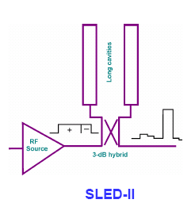
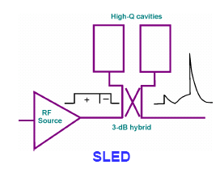
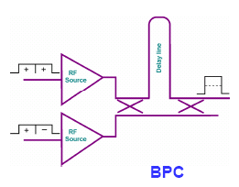

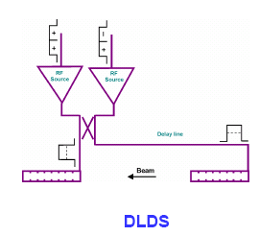
RF Pulse compressors
RF energy storage element (s):
Operational regime:
Active. The properties of the RF storage network (coupling/phase) can be controlled externally. It allows to increase efficiency.
Passive. The phase/amplitude modulation of the RF power source
Delay
Line (s)
Cavity (ies)
After decade of development, the powerful enough active elements are still not available.
The length of the delay line is proportional to the pulse length. At a low frequency/long pulse SLED II, BPC and DLDS become impractical!
BOC

Slide 4
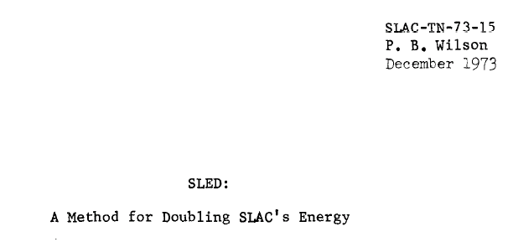
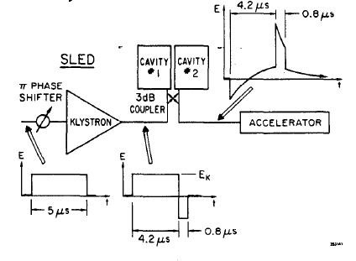

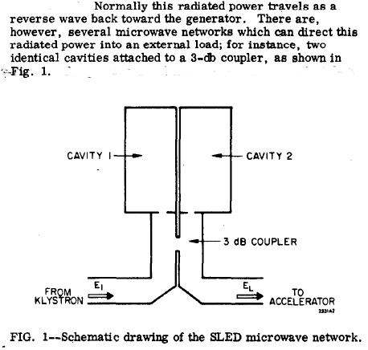
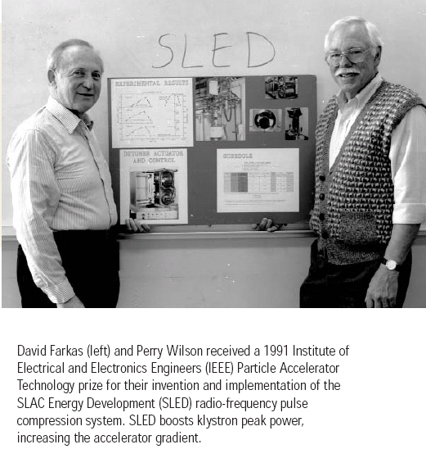
The story started at SLAC in 1973
1)
3) 180⁰ phase flip
2)
TE₀₁₅, Q₀~10⁵

Slide 5
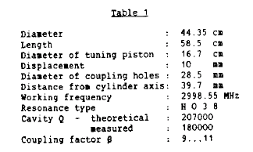
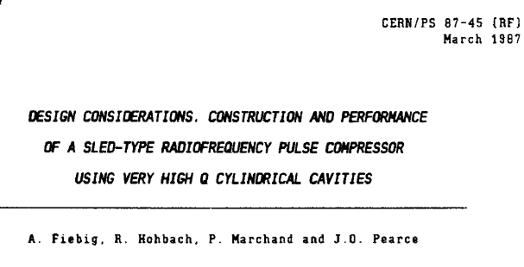
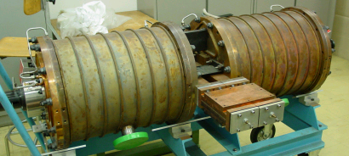
Later on…
CERN, 1985
Still in operation at CTF3

Slide 6
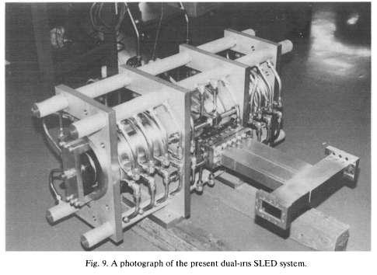
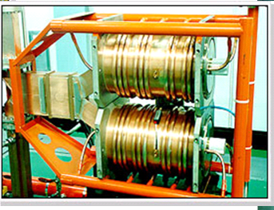
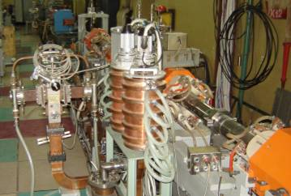
And continued…
KEK, ATF&KEKB, Japan 1992.
Pohang Accelerator Laboratory
Korea, 1994?
TE₀₁₅, Q₀~10⁵
TE₀₁₅, Q₀~10⁵
BINP, Novosibirsk, Russia, 2000?
TE₀₁₅, Q₀~10⁵
For almost 35 years more then hundred of S-band SLED type pulse compressors are successfully operated worldwide.

Slide 7
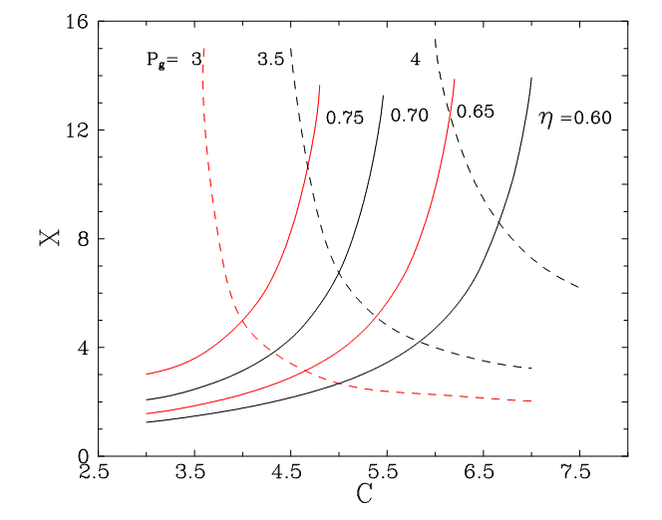
SLED type pulse compressor at higher frequencies
SLED power gain/efficiency plot
H_{01N} cavity performance
Q₀=2x10⁵
Q₀=1.65x10⁵
(Spring 8)
Longitudinal index (N)
Q₀=1.8x10⁵
(LIPS)
Q₀=3x10⁵ (6 GHz)
Q₀=1x10⁵
SLED
Frequency, GHz
To keep reasonable compression efficiency at a higher frequencies, it is necessary to increase the cavity longitudinal index N, thus the relative length of the cavity.
Exercise:
F=6 GHz, T_{KL}=2500 ns, T_{out} = 500 ns (C=5), target efficiency 70% (Pg=3.5)
X=6.7. To satisfy, the cavity unloaded Q-factor should be: 3.2x10⁵

Slide 8
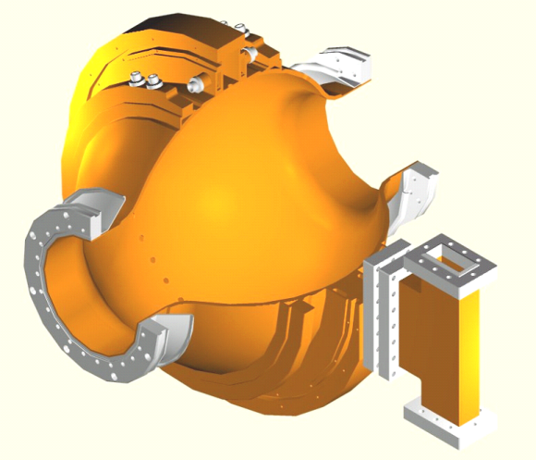
The second generation of the SLED type pulse compressor
Barrel
Open
Cavity RF pulse compressor

Slide 9
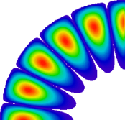
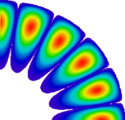
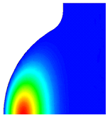
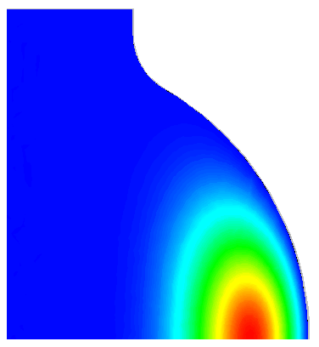
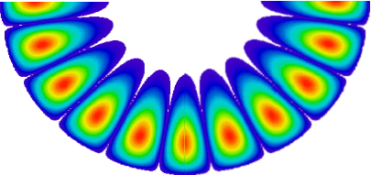
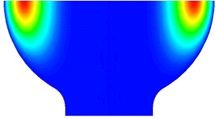
z
Barrel cavity short theory.
ρ = ρ
ξ = ξ
The eigen-frequency of the Barrel cavity with
E_{mnq} oscillation is the solution of:
-d
r₀
d
2h
r
ν_{mn} is a root of the Bessel function that for the
big m can be approximated as:
2a
Cavity profile:
The optimal radius r₀, when the external caustic
has the smallest height comes from:
where α and θ are derived from:
Whispering gallery mode
Finally the height of the external caustic and Q-factor
of the cavity are:
for Copper:

Slide 10
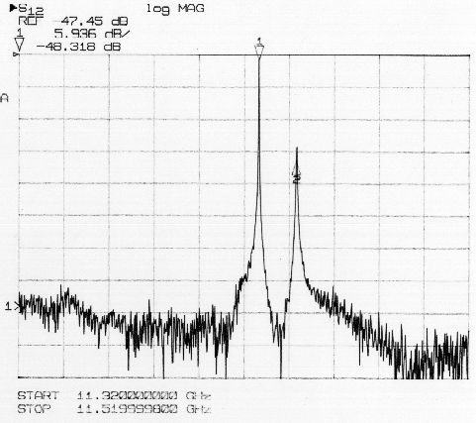
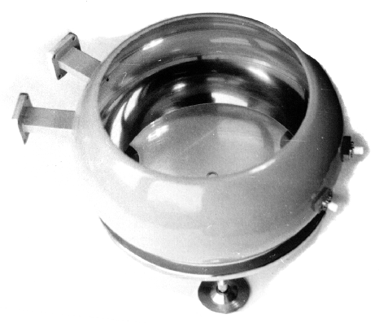
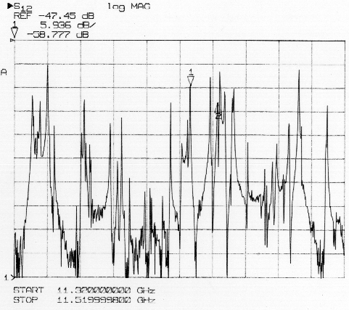
The concept of the BOC (originally VPM – VLEPP Power Multiplier) was proposed in 1990 (Balakin, Syratchev). In 1994 the fist X-band VPM was tested in KEK.
input
reflected
output
150MW
Test cavity (TM_{25,1,1})
Diameter 0.263 m
Open cavity
Q₀ = 1.9x10⁵
Closed cavity

Slide 11
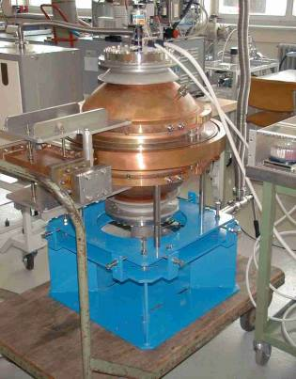
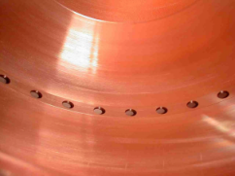
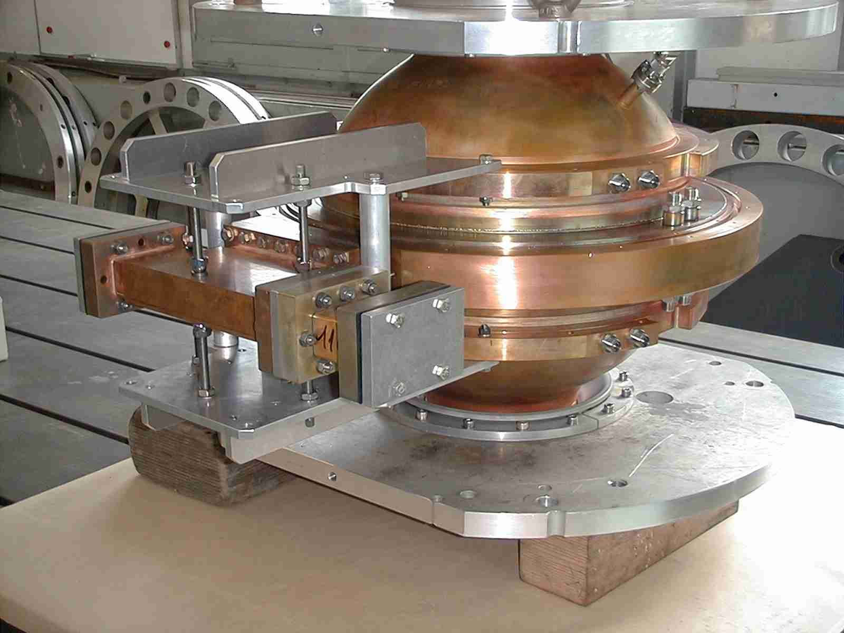
3 GHz BOC RF pulse compressor for CTF3 (2000)
XX century
Internal view
of coupling holes
XXI century

Slide 12
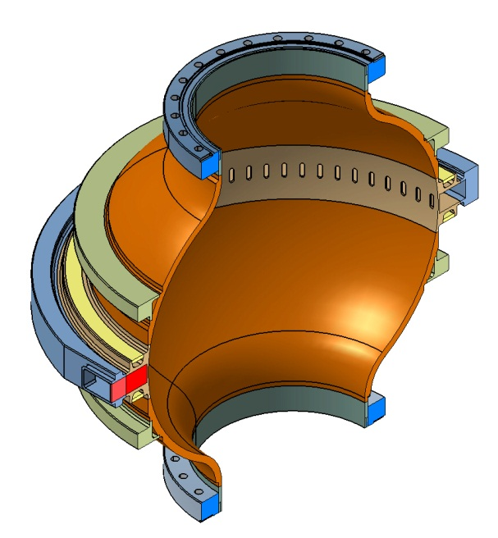
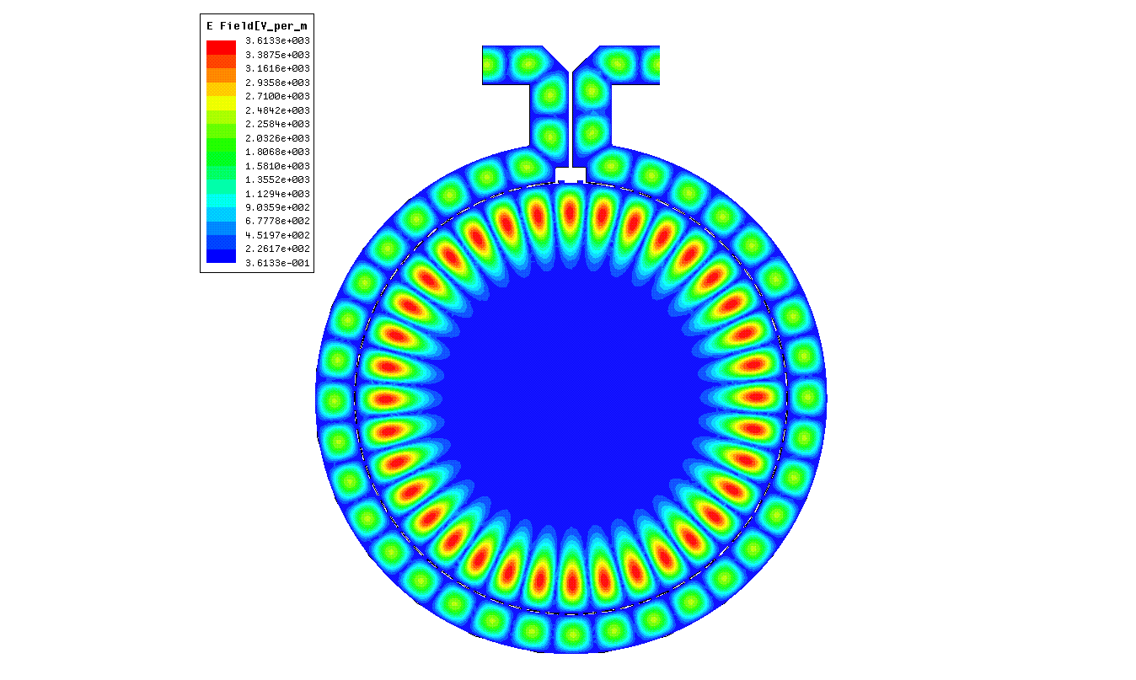
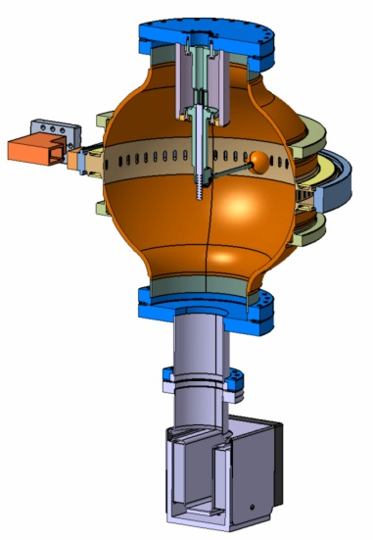
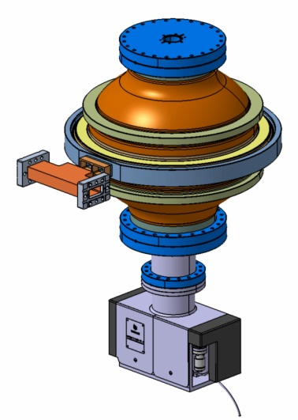
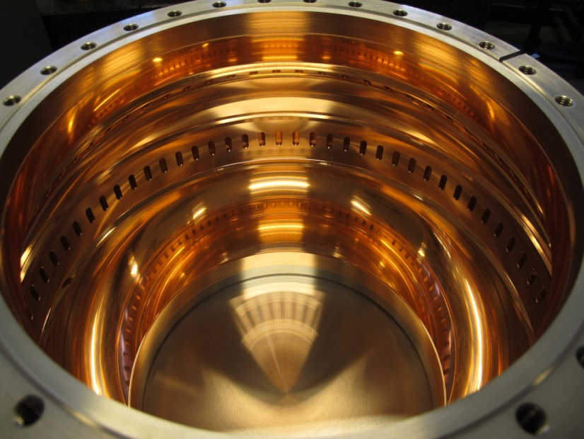
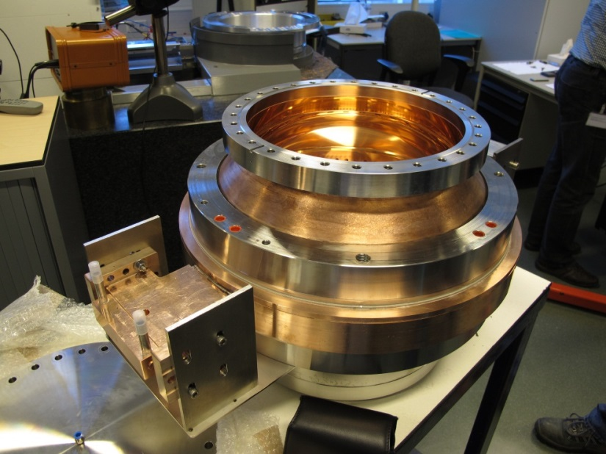
5.7 GHz BOC RF pulse compressor for PCI (2012)
BOC’s unloaded Quality factor
Goal: ≥ 190000
HFSS: 210000
Measured: 204000
Beta: 9.4

Slide 13
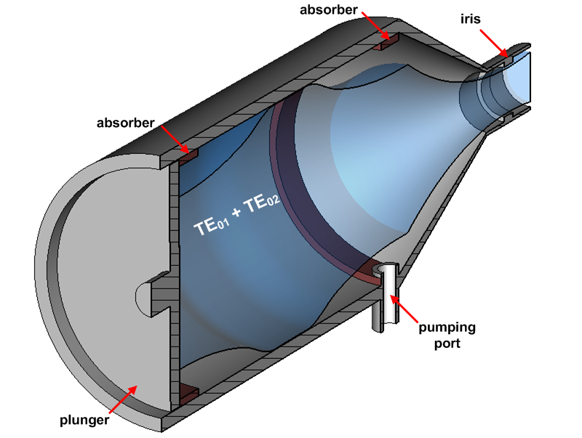
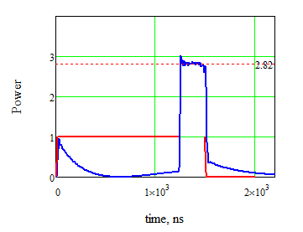
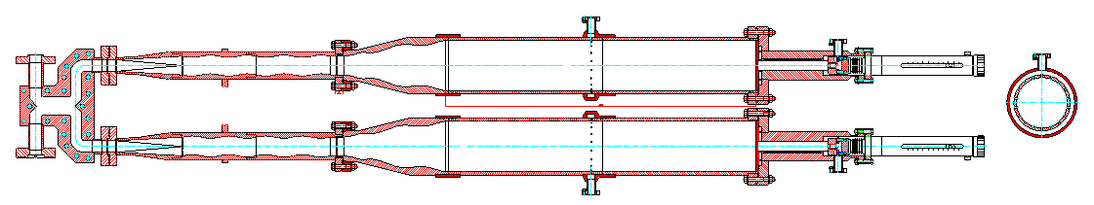
The third generation of the SLED type pulse compressor
with beating modes in a cavity (BMC). 2009 (GYCOM, Russia).
First BMC is now successfully operated at XBOX #1.
Measured Q₀ ~ 1.6x10⁵ (expected ~ 2x10⁵ )
Tuning plungers heating up problem.
Backlashes problem with plungers movement.
Q₀ ~ 2x10⁵
3-db hybrid
H10->H01 mode converter
Mode mixing taper
Beating wave cavity

Slide 14
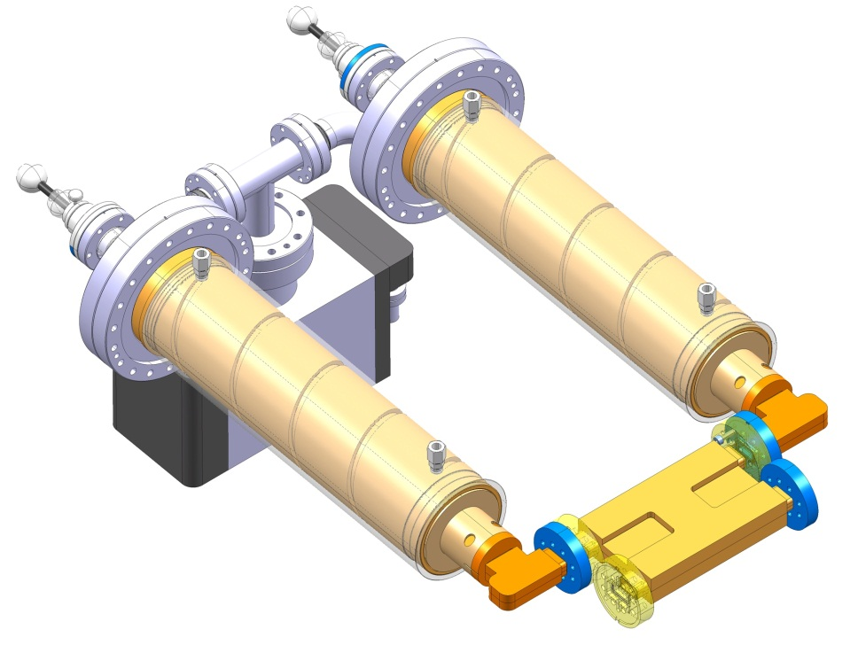
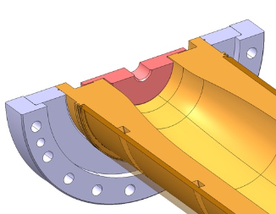
Manual resonant frequency de-tuners
X-band SLED pule compressor at 2013 (back to the roots)
Cavity operating mode H_{0,1,32}
Integrated cooling
Common vacuum circuit
Compact mode launcher
Fixed tuners
Double-height -3dB hybrid, made at CEA/CERN
Objectives:
Compact (inexpensive) RF design
Relaxed fabrication tolerances
Fixed frequency tuners (frequency control by temperature)
Detuning option.

Slide 15
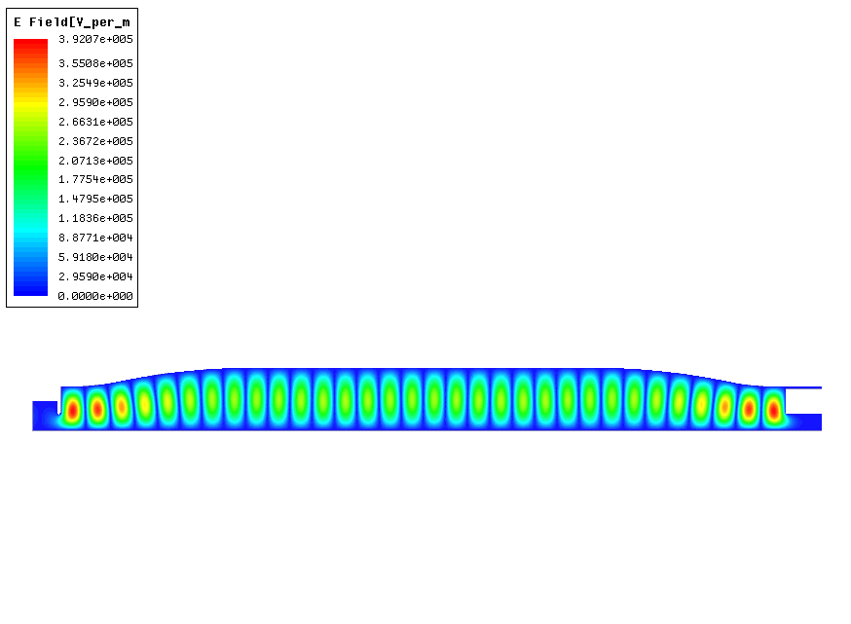
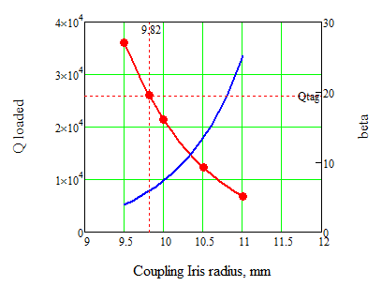
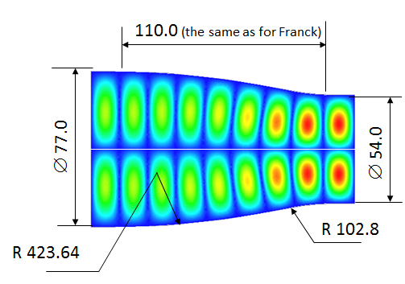
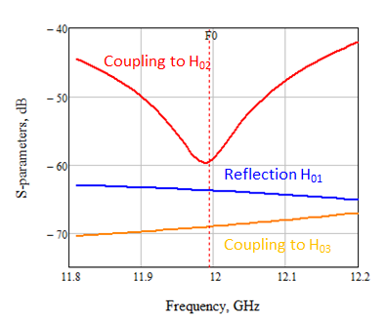
Storage cavity design
Cavity operating mode H_{0,1,32} , length 0.444 m, Q₀ (HFSS) = 1.78x10⁵
∅ 36.27
Coupling iris
Adiabatic taper
Iris thickness 2 mm with inner filler radius 1 mm
Q₀ = 1.78x10⁵
target
Q _{Loaded}
beta
5.85

Slide 16
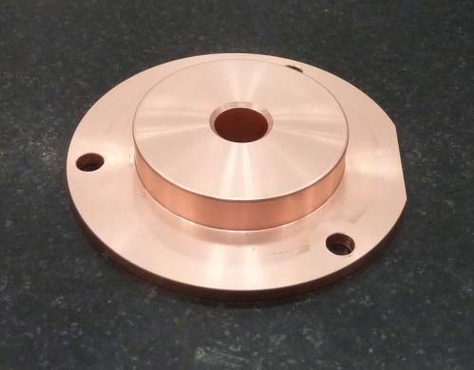
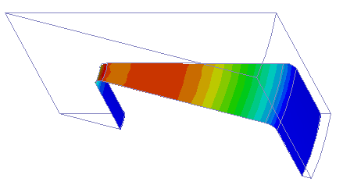

Coarse tuning
Cavity frequency tuning by re-machining piston surfaces
Fine tuning
Frequency down
Frequency up
To provide reliability and robustness of the cavity tuning, it is decided to make the position of the tuning piston fixed. That means that iterative re-machining process of the piston will be required. To reduce the sensitivity of the iterations, the area of the intervention is defined in a special way:
The frequency tuning sensitivity with the piston repositioning is 2 MHz/mm. To provide reflection in a steady state <-20 dB, the cavities need to be synchronized to the level better than 0.1 MHz, that will require mechanical repositioning or re-machining the piston surface in steps <4.5 microns.
Magnetic field on the piston surface
Re-machining direction
Re- machining of the 45⁰ chamfer at the piston inner diameter gives tuning sensitivity of 1.1 MHz/mm – about 20 times less than retouching the flat part.
45⁰

Slide 17
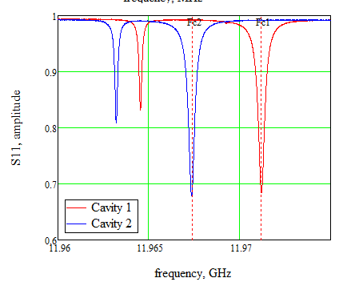
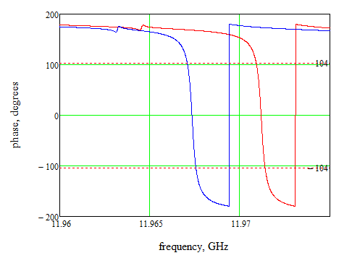
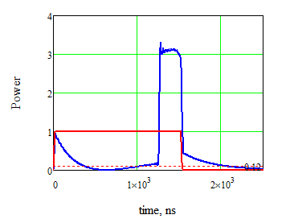
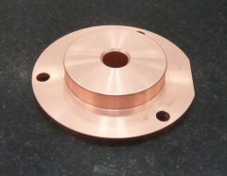
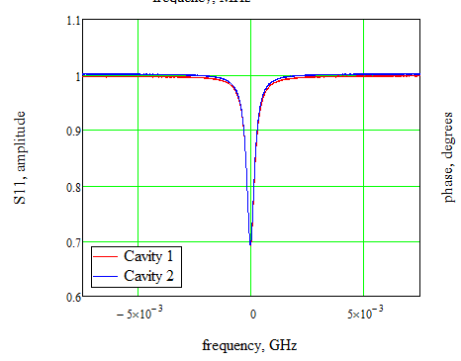


PC cavities tuning. 1-st step.
Measured at 30 ⁰C
Original:
Predicted compression:
11.9674
11.9712
250 ns
Re-machined pistons:
#1 -> +0.8^{-0.003/+0.009} mm
#2 -> +0.99^{+0.006/+0.007} mm
Expected: 11.9872 GHz
1st tuning:
11.98715
Zoom

Slide 18



PC cavities tuning; 2-nd step + final tuning with chamfer.
Fit to theory: beta=5.85 (expected 5.85); Q₀~2.0x10⁵!!! (expected 1.78x10⁵ )
F_{c}=11.990528 GHz
Operational temperature at vacuum (for 11.9942 GHz): 29.35 ⁰C
The pulse compressor performance is above expected!

Slide 19



Other issues
Cavity matching is about -30 dB
(to be confirmed after final assembly)
De-tuning cavity with a ‘small’ piston allows to make PC transparent (no compression)
+25 MHz

Slide 20


Simulations vs. measurements
HFSS simulations using file from Raphael, gave the frequency: 11.9994 GHz.
The only possible explanations for ~ 30 MHz discrepancy through fab. errors are:
Cavities diameter is bigger by ~ 1.5 mm, or
The cavity length is longer by ~ 1.5 mm, or
Some combinations of the two

