Slide 1
Pulse Compressor Testing

Slide 2
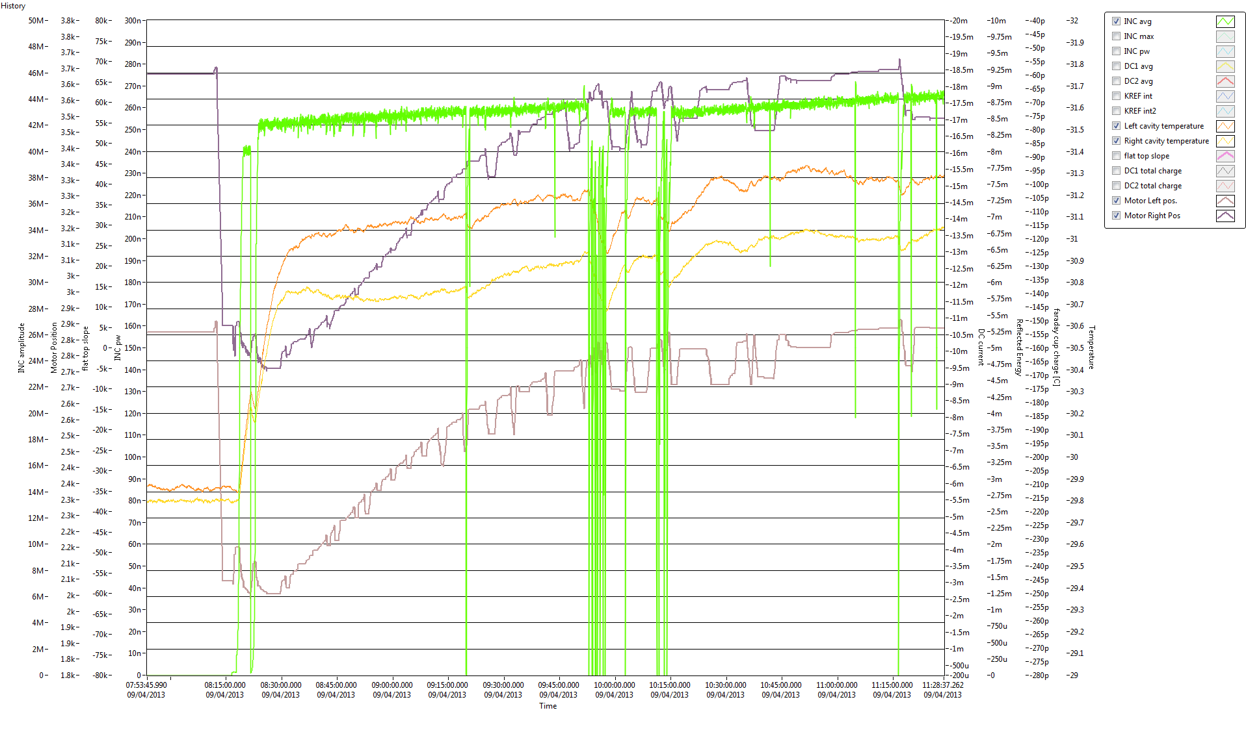
XBOX1 Pulse compressor ‘active tuning’

Slide 3
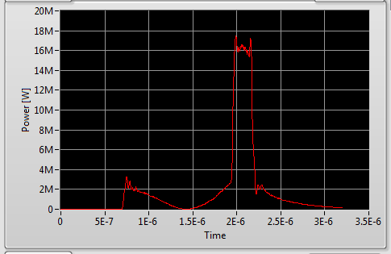
XBOX-1 Pulse
Pulse shape from output of accelerating structure

Slide 4
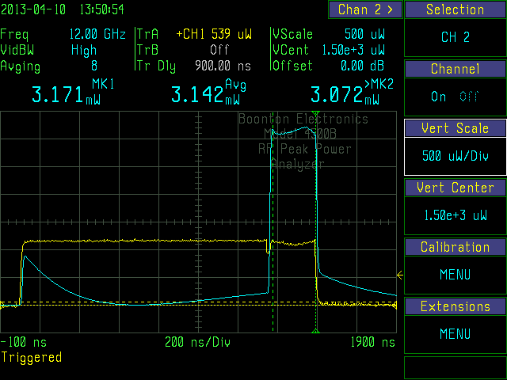
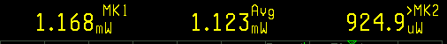
Pulse Compressor input/output pulse
Power Gain 2.8
(Cal. Not verified)

