Slide 1
Nuclear physics: the ISOLDE facility
Lecture 1: Nuclear physics
Magdalena Kowalska
CERN, PH-Dept.
kowalska@cern.ch
on behalf of the CERN ISOLDE team
www.cern.ch/isolde

Slide 2
Outline
Aimed at both physics and non-physics students
This lecture: Introduction to nuclear physics
  Key dates and terms
  Forces inside atomic nuclei
  Nuclear landscape
  Nuclear decay
  General properties of nuclei
  Nuclear models
  Open questions in nuclear physics
Lecture 2: CERN-ISOLDE facility
  Elements of a Radioactive Ion Beam Facility
Lecture 3: Physics of ISOLDE
  Examples of experimental setups and results

Slide 3
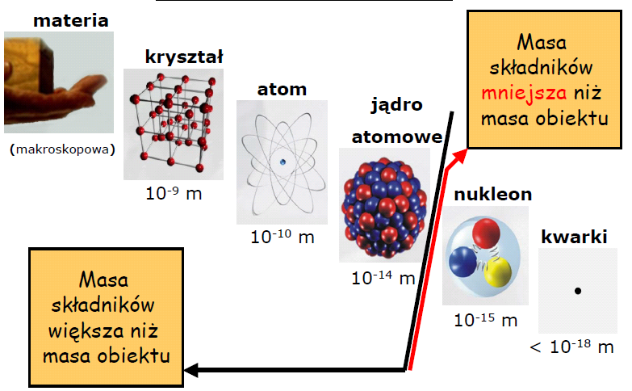
Nuclear scale
Matter
Crystal
Atom
Atomic
nucleus
Macroscopic
Nucleon
Quark
Nuclear physics:
studies the properties of nuclei and
the interactions inside and between them

Slide 4
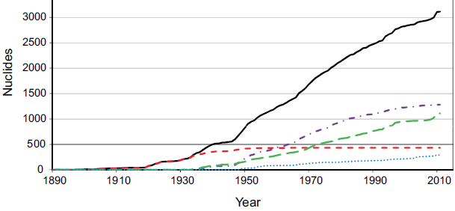

Key dates
1896: Becquerel, discovery of radioactivity
1898: M. Sklodowska-Curie and P. Curie, isolation of radium
1911: Rutherford, experiments with a particles, discovery of atomic nucleus
1932: Chadwick, neutron discovered
1934: Fermi, theory of β radioactivity
1935: Yukawa, nuclear force mediated via mesons
1949: Goeppert-Meyer, Jensen, Haxel, Suess, nuclear shell model
1964: Gell-Mann, Zweig, quark model of hadrons
1960’ties: first studies on short-lived nuclei
Since then:
Today: the exact form of the nuclear interaction is still not known, but we are getting to know it better and better with many dedicated facilities
Known nuclides

Slide 5
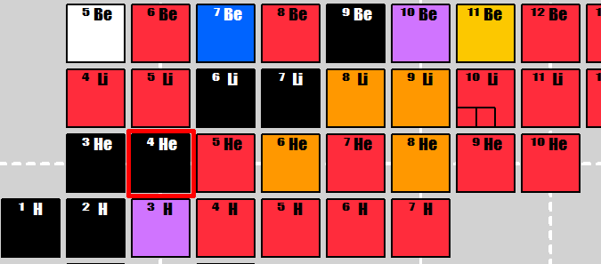
Terminology
Nucleus/nuclide:
Nucleons: protons and neutrons inside the nucleus
Isotopes: nuclides with the same number of protons, but not neutrons
Isotones: nuclides with the same number of neutrons, but not protons
Isobars: nuclides with the same atomic number (but different Z and N)
A
atomic number A
Z protons
N= A-Z neutrons
X
Z
N
Isomers = long-lived nuclear excited states

Slide 6


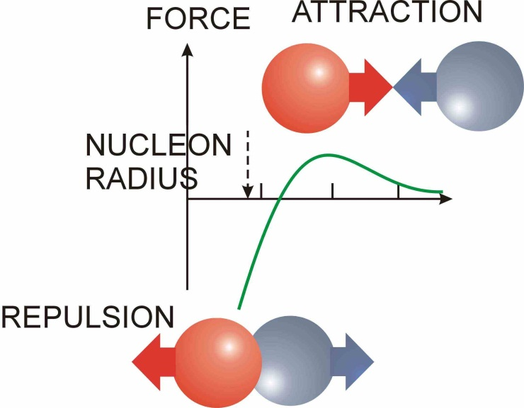


Forces acting in nuclei
Coulomb force repels protons
Strong interaction ("nuclear force") causes binding which is stronger for pn-systems than nn-systems
Neutrons alone form no bound states (exception: neutron stars (gravitation!)
Weak interaction causes β-decay
e
n
p
ν
-

Slide 7
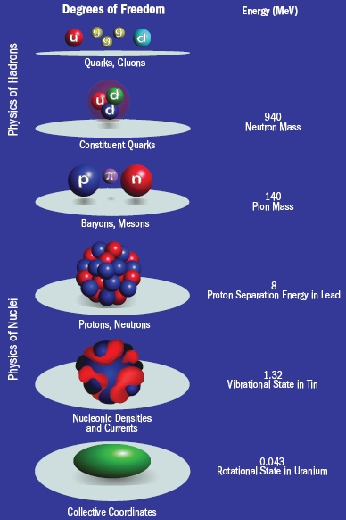
Nuclei and QCD
Different energy scales
In nuclei: non-perturbative QCD, so no easy way of calculating
Have to rely on nuclear models (shell model, mean-field approaches)
Recent progress: lattice QCD

Slide 8
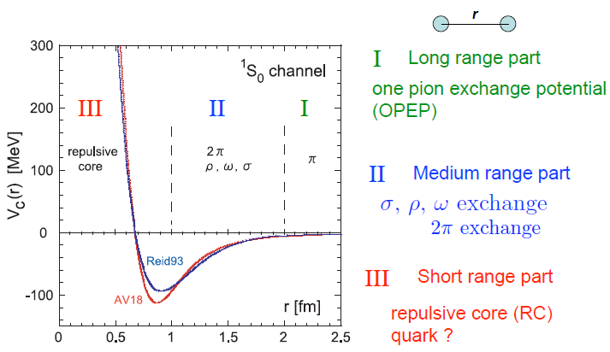
Properties of nuclear interaction
Has a very short range
Consists mostly of attractive central potential
Is strongly spin-dependent
Includes a non-central (tensor) term
Is charge symmetric
Is nearly charge independent
Becomes repulsive at short distances
Nuclear potential

Slide 9
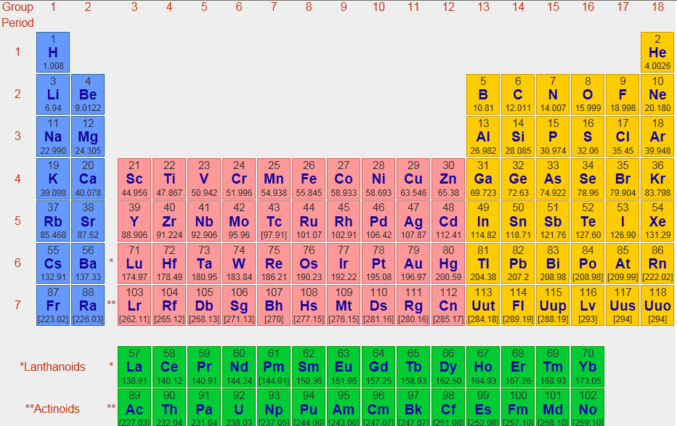
Chart of elements
Around 100 elements
Ordered by proton number Z
A few of them made only in a lab

Slide 10
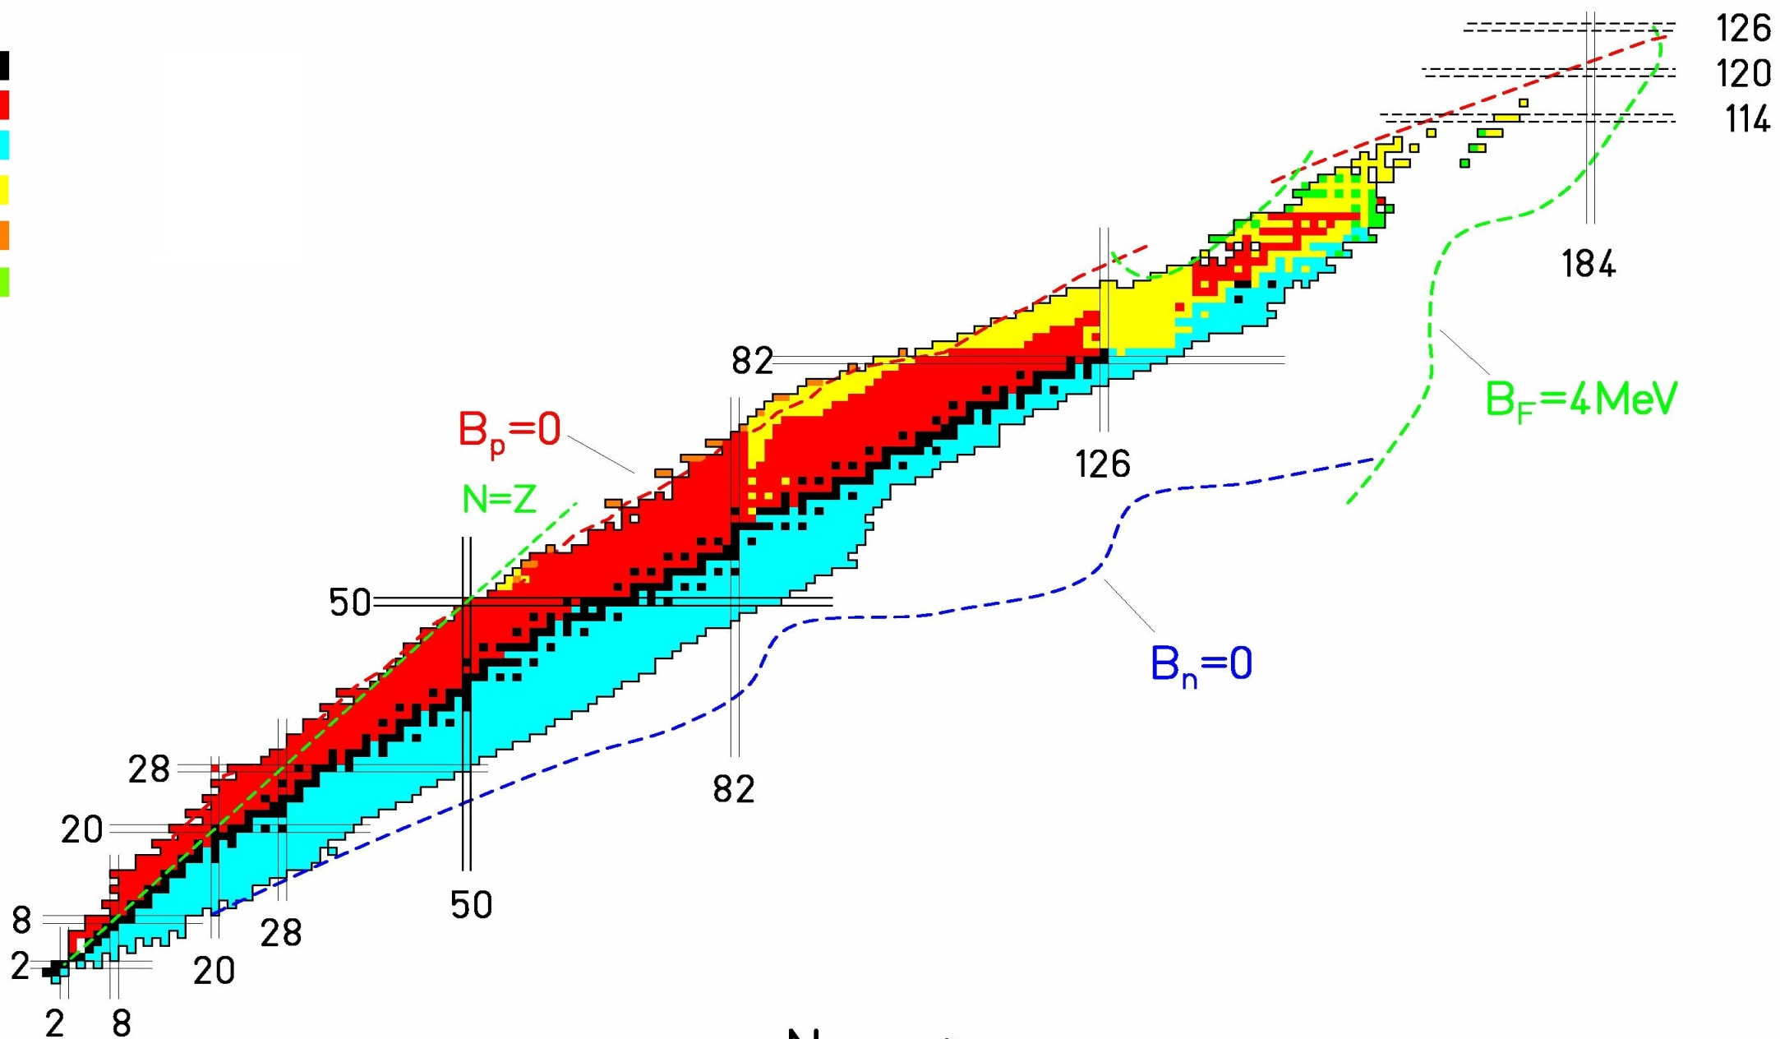
Chart of nuclei
stable
β⁺/EC decay
⁻ decay
α decay
p decay
spontaneous fission
Proton drip-line
neutron drip-line
protons
- About 300 stable isotopes: nuclear models developed for these systems
- 3000 radioactive isotopes discovered up to now (many of them made only in labs)
- Over 7000 nuclei predicted to exist
Magic numbers
neutrons

Slide 11
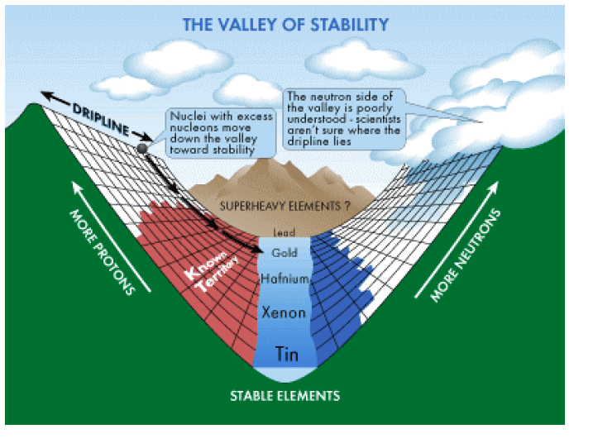
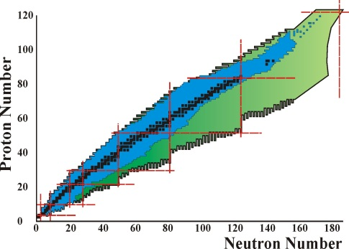
Valley of stability
β⁺
β⁻
β⁺ decay
β⁻ decay
N-Z

Slide 12
Nuclear decay
Mass of mother nucleus = mass of decay products + energy
protons
β⁻
n
β⁺,ε
p
α
neutrons

Slide 13
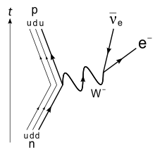
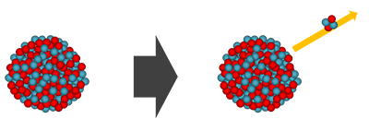
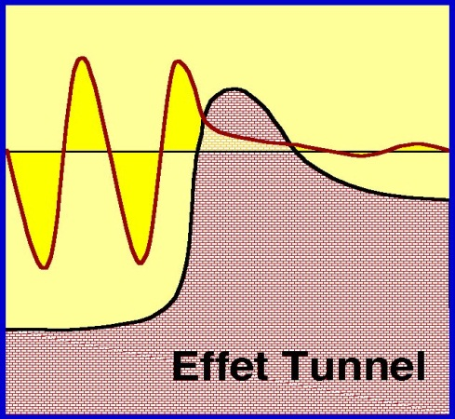
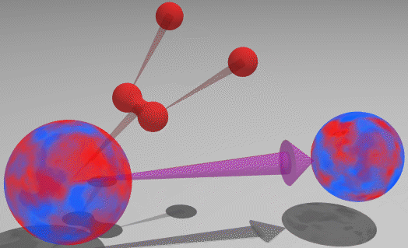
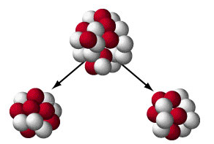
Nuclear decay
β+ decay – emission of positron: p -> n + e⁺ + ν_{e}
ε/EC – electron capture:
  nucleus captures an atomic electron: p + e- -> n + ν_{e}
β- decay – emission of electron
α decay – emission of alpha particle (4He nucleus)
p (or 2p) decay – emission of 1 or 2 protons
  in very proton-rich nuclei
spontaneous fission – spontaneous splitting into two smaller nuclei and some neutrons
  Observed in heavy nuclei
  Very long lifetimes
α particle in a nucleus
Tunneling

Slide 14
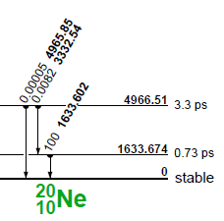
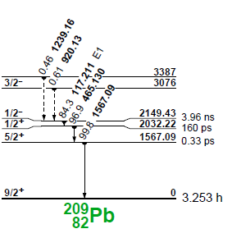
Gamma decay
Gamma radiation emitted when the nucleus goes to a lower energy state
No change in Z or N
Gamma ray relative intensities and energies (in keV)

Slide 15
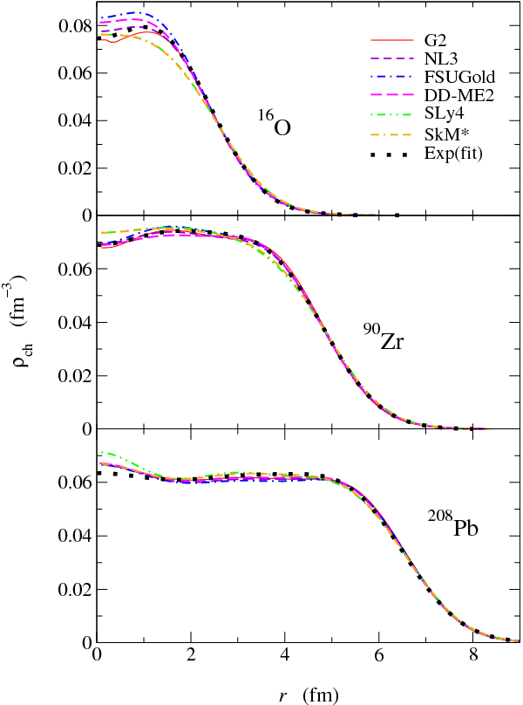
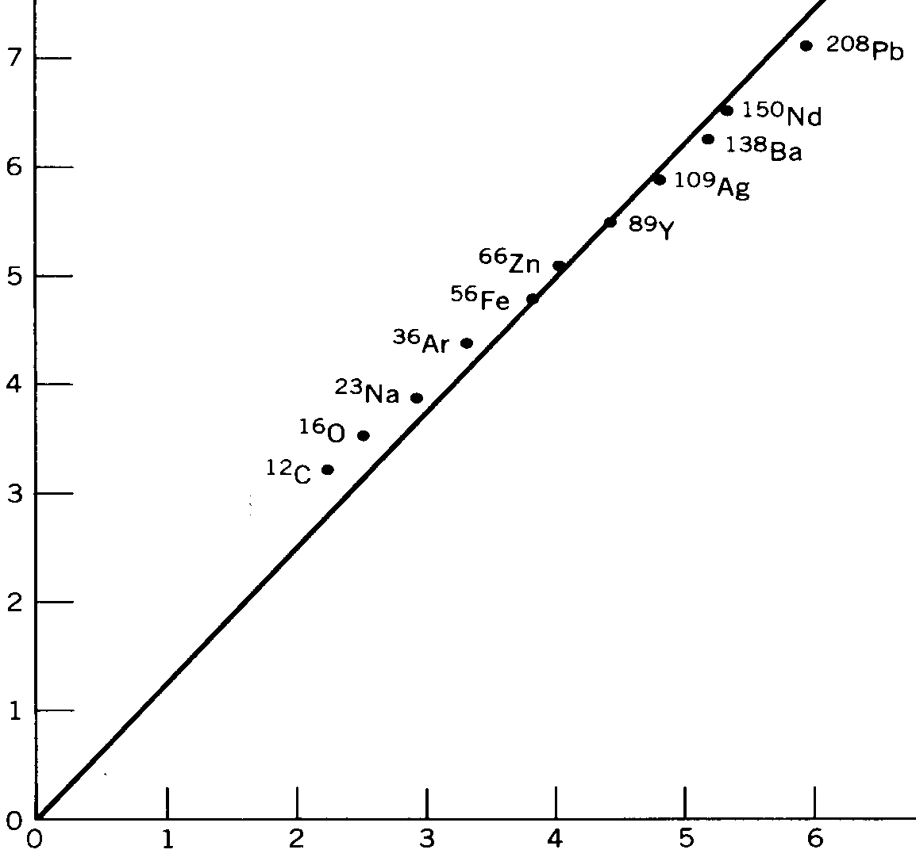
Radius
Charge distribution
Density of nucleons almost constant
Radius increases with A^{1/3}
Volume increases with number of particles
radius of nucleus (fm)
R = 1.25 x A^{1/3} (fm)
A^{1/3}

Slide 16
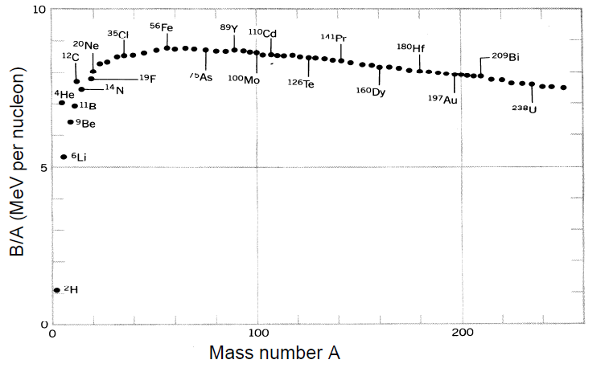
Mass and binding energy
Nuclei are bound systems, i.e. mass of nucleus < mass of constituents
Binding energy:
Binding energy/nucleon (B/A):
M(N,Z) = N M_{n} + Z M_{p} – B(N,Z)
fission
Direction of energy release
fusion

Slide 17
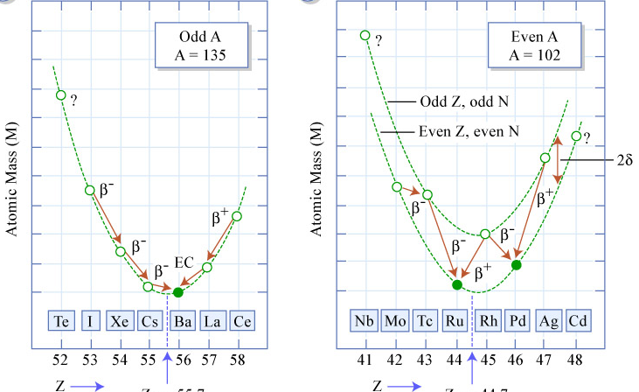
Mass parabola

Slide 18
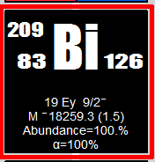
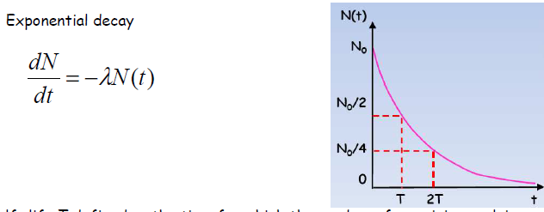
Lifetime
Some nuclei are stable (i.e. their lifetimes are comparable to that of a proton and we have not seen their decay)
  E.g. until recently 209Bi was thought to be stable
Others are unstable – they transform into more stable nuclei
Exponential decay: statistical process
  Half-life = time after which half of the initial nuclei have decayed
Examples of half-lives:
11Li: 9 ms
13Be: 0.5 ns
77Ge: 11h
173Lu: 74 us
208Pb: stable

Slide 19
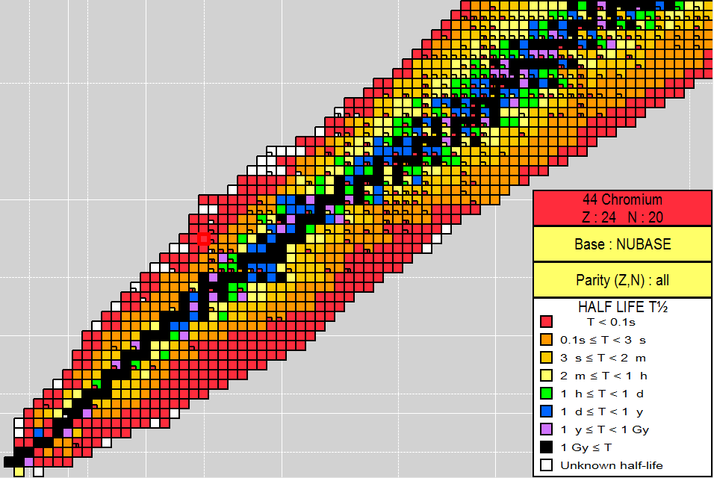
Lifetime
Elements with even Z have more stable isotopes
“valley of stability” bends towards N>Z
Nuclei further away from this valley are more exotic (i.e. shorter-lived)
protons
neutrons

Slide 20
Nuclear models
Nucleus = N nucleons in strong interaction
The many-body problem
(the behavior of each nucleon
influences the others)
Nucleon-Nucleon force
unknown
No complete derivation from the QCD
Can be solved exactly for N < 10
For N > 10 : approximations
Different forces used depending
on the method chosen to solve the
many-body problem
Shell model
only a small number of
particles are active
Approaches based
on the mean field
no inert core
but not all the correlations
between particles are taken
into account

Slide 21
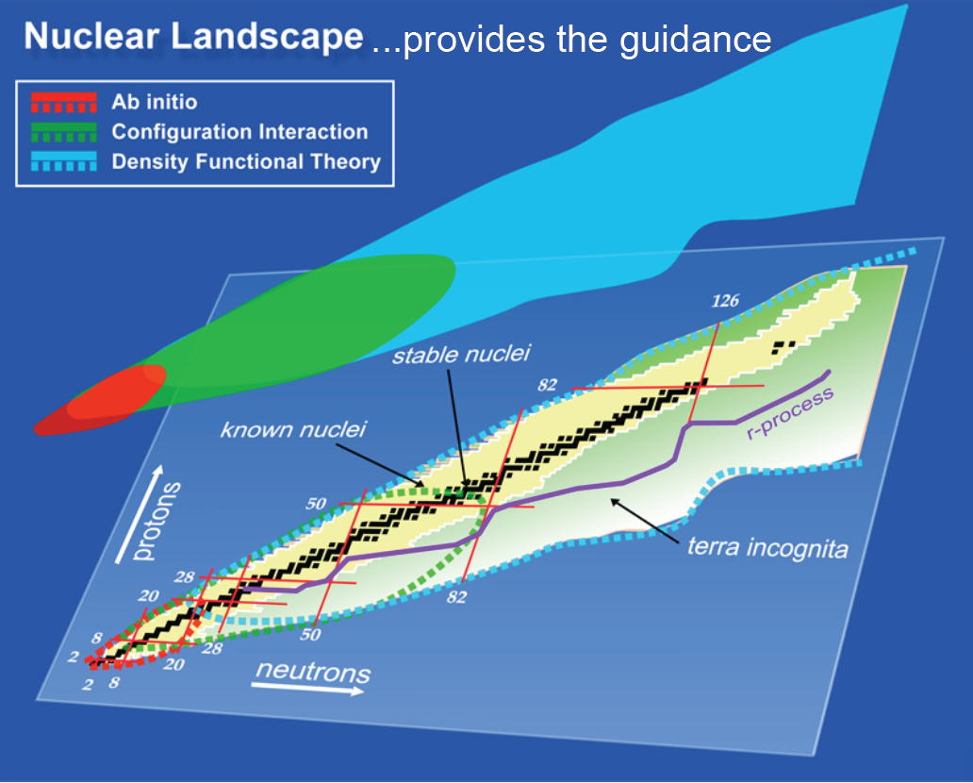
Nuclear models

Slide 22

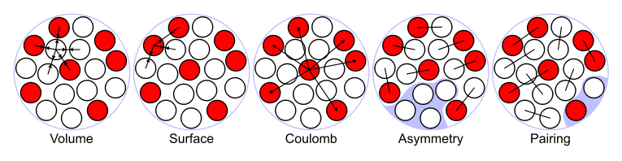
Liquid drop model
Based on the experimental binding energy per nucleon
Nuclei have nearly constant density => they behave like a drop of uniform (incompressible) liquid
Forces on the nucleons on the surface are different from those inside
Describes general features of nuclei, but not details
Terms:
Additional terms -> shell model

Slide 23
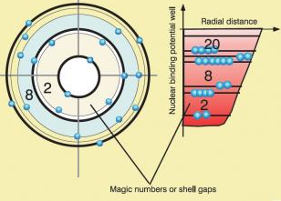
Nuclear shell model
Created in analogy to the atomic shell model (electrons orbiting a nucleus)
Based on the observation of higher stability of certain nuclei
  filled shell of neutrons or protons results in greater stability
  neutron and proton numbers corresponding to a closed shell are called ‘magic‘
First ionization energy in atoms
Challenge: created for stable nuclei,
is it valid for radionuclides?

Slide 24
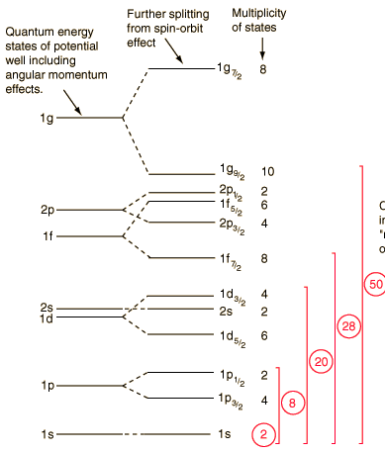
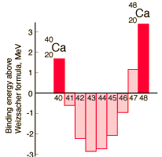
Nuclear shell model
Differences to atomic shell model
  No central potential but a self-created one
  Nucleon-nucleon interaction has tensor (non-central) components
  Two kinds of nucleons
  In ground state: all odd number of protons or neutrons couple to spin 0
  Strong spin-orbit coupling changes magic numbers: 8,20,28,50,…
  No analytic form of nucleon-nucleon interaction in nuclear medium

Slide 25
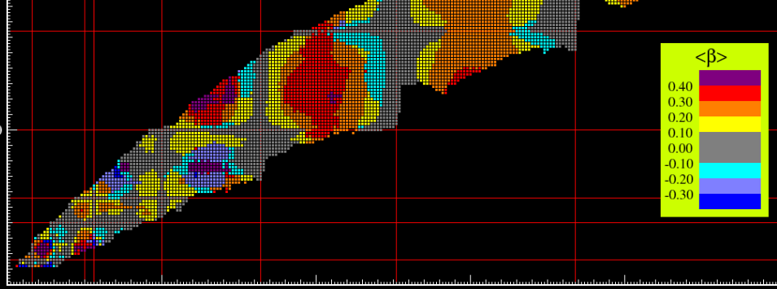
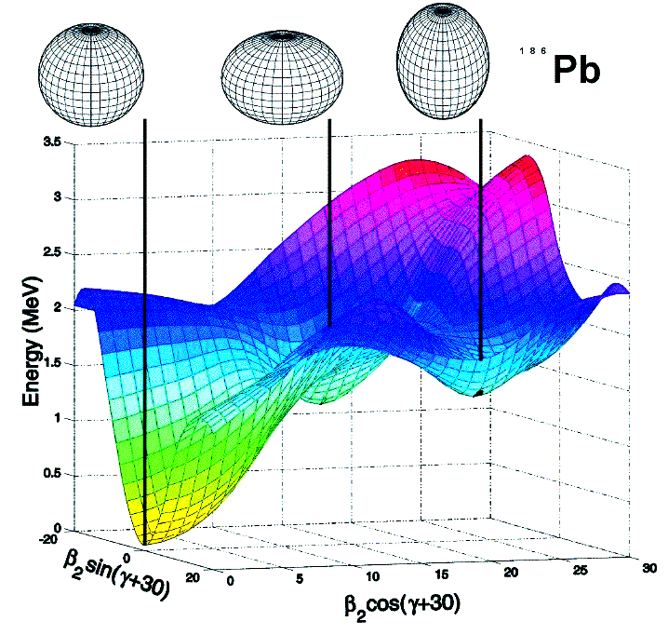
Mean-field models
Each particle interacts with an average field generated by all other particles: mean field
Mean field is built from individual excitations between nucleons
No inert core
Very good at describing deformations
Can predict properties of very exotic nuclei
Not so good at closed shells

Slide 26
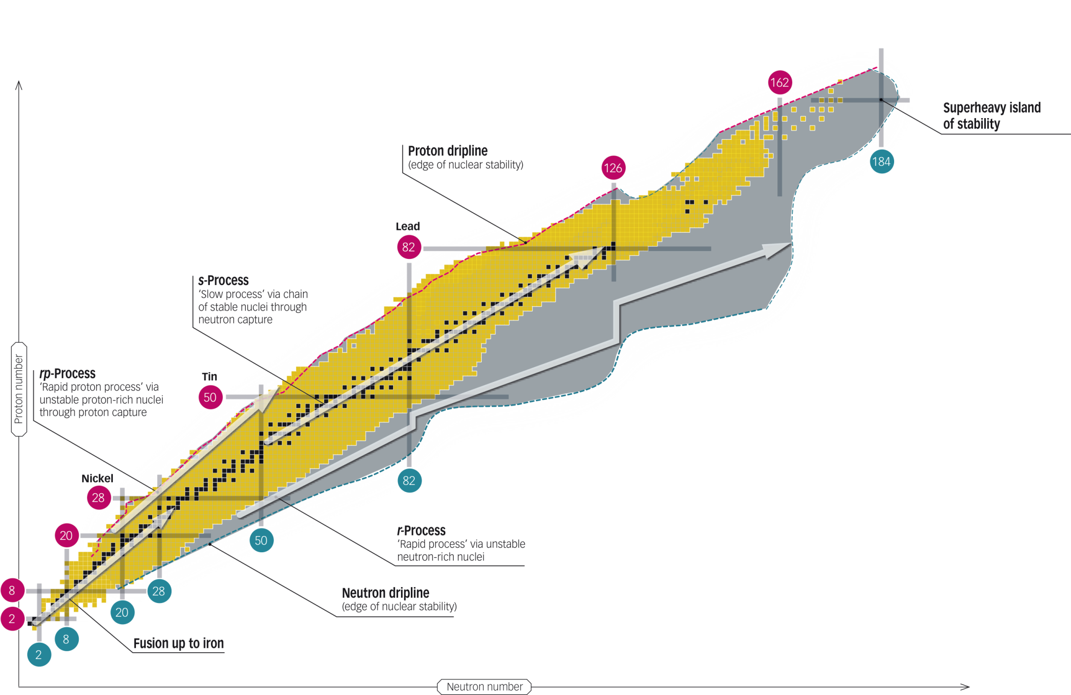
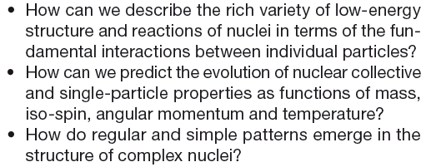
Open questions in nuclear physics
2 kinds of interacting fermions
Observables:
Ground-state properties: mass, radius, moments
Half-lives and decay modes
Transition probabilities
Main models:
Shell model (magic numbers)
Mean-field models (deformations)
Ab-initio approaches (light nuclei)
(NuPECC long-range plan 2010)

Slide 27
Summary
Nuclear physics investigates the properties of nuclei and of the underlying nucleon-nucleon interaction
Rich history and many nuclei discovered
All 4 fundamental interactions at play
  details of strong interaction are not known
Nuclear landscape – over 3000 known nuclei and even more predicted
Nuclear decays transform one nucleus into another
Nuclear properties – reveal features of nuclear interaction
Nuclear models
  Each is better in one respect and worse in another
  Aim: describe known properties and predict new ones
Open questions in nuclear physics
  How to describe various properties in with a fundamental interaction
  How to make predictions
  How do regular patterns emerge
We are getting closer to the answers with radioactive ion beam facilities, such as ISOLDE -> Lecture 2 and 3

Slide 29
Creation of nuclides
H, He, and some Li were created during the Big Bang
Heavier nuclei were produced in stars = stellar nucleosynthesis
Up to Fe – via fusion (see binding energy/A)
Above: via proton or neutron capture
  Stellar environment not yet known
  Several locations suggested by models (e.g. supernovae explosions, neutron star mergers)
  Need nuclear physics data to constrain models

Slide 30
Binding energy
Binding energy = mechanical energy required to disassemble a whole into separate parts
Bound system = interaction energy is less than the total energy of each separate particle
  Energy is needed to separate the constituents
  Mass of constituents = mass of bound system + binding energy (positive)
Atoms:
  Mass of electrons + mass of nucleus > mass of the atom
Nuclei:
  Mass of protons + mass of neutrons > mass of the nucleus
  E.g for 12C: 11.18 GeV > 11.27 GeV (difference of 90 MeV = binding energy)
Nucleons:
  It looks like mass of quarks < mass of nucleon (ca 10MeV < 1GeV)
  But quarks don’t exist as separate particles, thus 10MeV is a rest mass of quarks inside a nucleon. It would take an enormous energy to isolate quarks, so as separate particles they would be much heavier, so:
  mass of constituents > mass of nucleon

Slide 31
Atomic vs nuclear structure
Atoms
Nuclei
shell model: e⁻ fill quantized energy levels
Description
shell model (but not only): p and n separately fill quantized energy levels
n, l, m_{l}, s, parity (-1)^{l}
Quantum numbers
n, l, m_{l}, s, parity (-1)^{l}
max. S possible
(due to Coulomb force):
J= L+S= Σl_{i} + Σs_{i} or J= Σj_{i} = Σ(l_{i} +s_{i})
min. S possible
(due to strong force pairing):
J = Σj_{i} = Σ(l_{i} +s_{i})
Lowest en. levels
weak
Spin-orbit coupling
strong
for 3 electrons in a d orbital
for 3 nucleons
in a d orbital
d_{3/2}
d_{5/2}
calculated by solving Schrödinger equation with central potential dominated by nuclear Coulomb field
Energy levels
not easily calculated; nucleons move and interact within a self-created potential

Slide 32
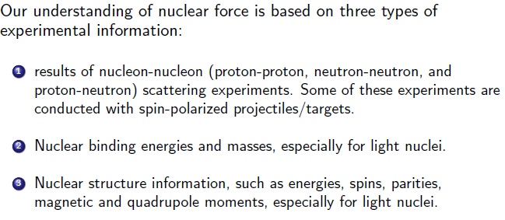
Nuclear force and experiments
After http://web-docs.gsi.de/~wolle/TELEKOLLEG/KERN/LECTURE/Fraser/L5.pdf

Slide 33
Does di-neutron exist?
If nuclear force is charge independent, why does system with 1n and 1p exist (deuteron), but that with 2n and 2p, etc don’t? And what binds neutrons in neutron stars?
Nuclear force is charge independent, but it depends on the spin, i.e.
  Spin-up to spin-up (↑ ↑) interaction of 2 protons is the same as for 2 neutrons
  But ↑↓ interaction of 2p is different than ↑ ↑ for 2p or 2n
And there is Pauli principle
As a result => A system of n and p can form either a singlet or triplet state. The triplet state is bound, but not the singlet (we know it from deuteron). A system of 2n or 2p can only form a singlet (due to Pauli principle), so no bound state of 2p or 2n, etc, exists.
Neutron stars exist thanks to gravity
bound
unbound
Not allowed
p
n
p
n
p
p
n
n
p
p
n
n
↑
↑
↑
↓
↑
↓
↑
↓
↑
↑
↑
↑
See more details in http://web-docs.gsi.de/~wolle/TELEKOLLEG/KERN/LECTURE/Fraser/L5.pdf

Slide 34
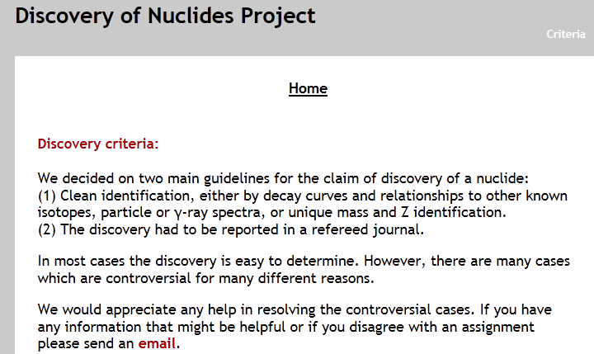
Discovery of nuclei
Discovery Project at MSU – documenting discoveries of nuclei
http://www.nscl.msu.edu/~thoennes/isotopes/criteria.html

Slide 35
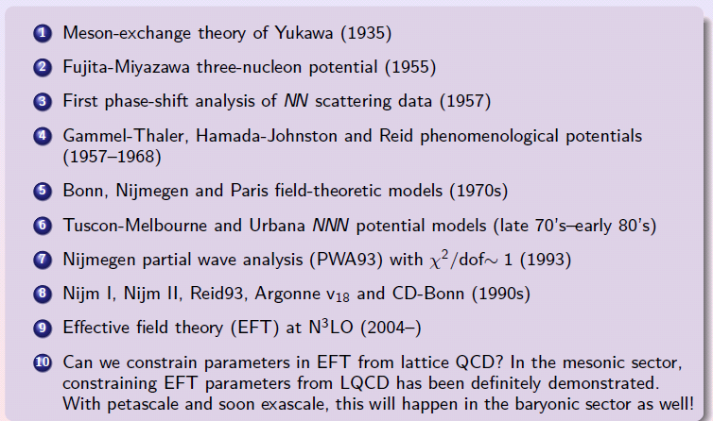
Modelling nuclear interaction

Slide 36
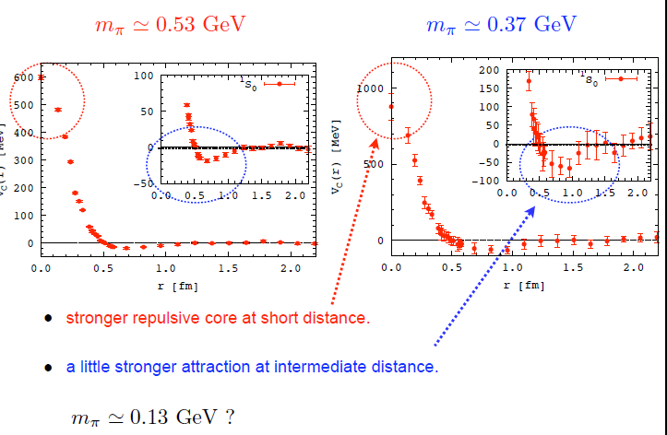
NN potential from QCD
Aoki, Ishii, Matsuda

Slide 37
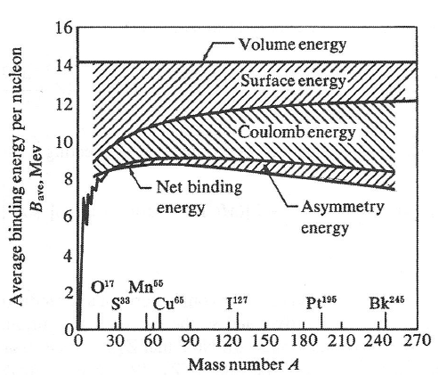
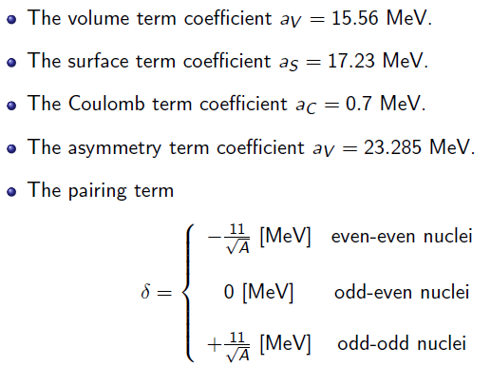
Liquid drop model

Slide 38
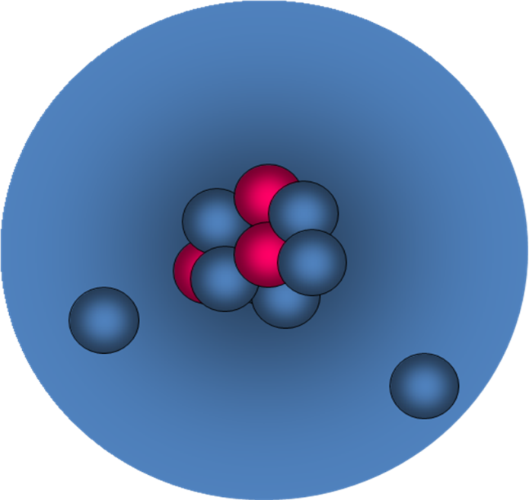
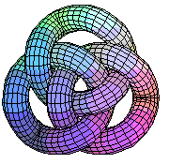
Properties of radio-nuclides
Different neutron-to-proton ratio than stable nuclei leads to:
  New structure properties
  New decay modes
=> Nuclear models have problems predicting and even explaining the observations
Example - halo nucleus ¹¹Li:
  Extended neutron wave functions make ¹¹Li the size of ²⁰⁸Pb
  When taking away 1 neutron, the other is not bound any more (10Li is not bound)

Slide 39
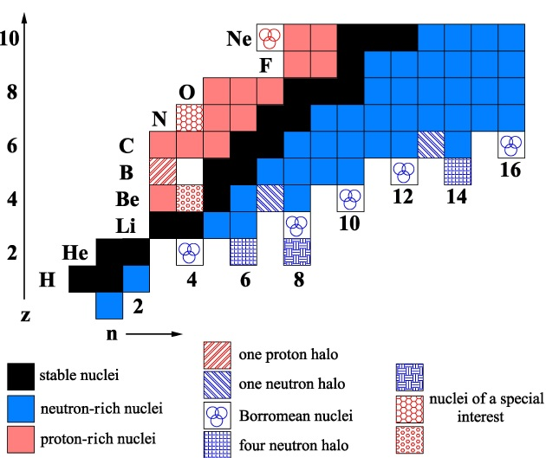
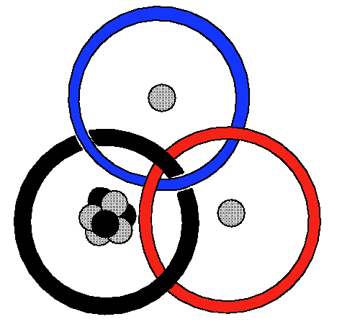
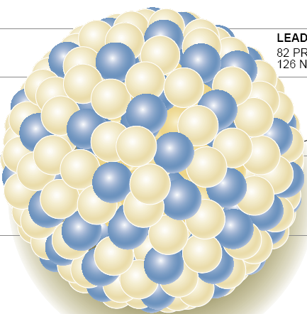
Halo nuclei
Halo: nucleus built from a core and at least one neutron/proton with spatial distribution much larger than that of the core
discussed
1985: first halo system identified: ¹¹Li
2013: half-dozen other halos known
Nuclear structure and core-halo interaction still not well understood
11
8
=> Crucial information:
Mass/binding energy
Spin-parity
Magnetic moment
Mass and charge radius
Quadrupole moment
Energy level scheme
8
11
8
¹¹Li:3p,8n
²⁰⁸Pb:82p,126n
Recent achievements: charge radii of ¹¹Li (Uni Mainz/GSI), ⁶He (Argonne)

Slide 40
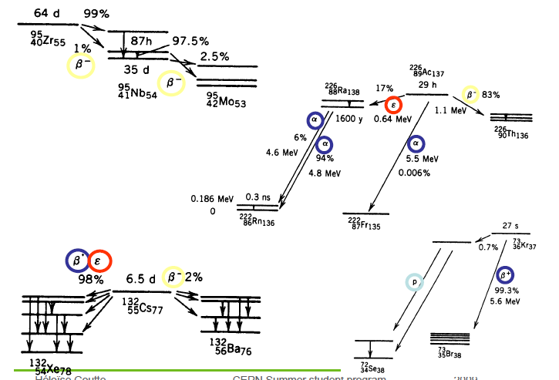
Examples of nuclear decays

