Slide 1

Standard Model @ Hadron Colliders
III. Top Quark
P.Mättig
Bergische Universität Wuppertal

Slide 2

Top quark
Basic facts

Slide 3
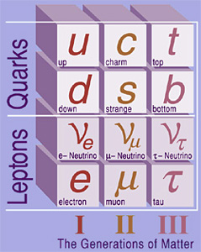
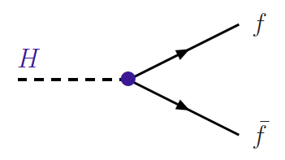
The mysterious top quark
Top quark: no internal structure
but heavy as a gold atom
i.e. coupling strength to
Standard Model Higgs Boson
➔ λ _{t} = 0.996±0.006
Is ‚ONE‘ like any other number?
Does the top quark have a special role in particle physics?

Slide 4
A brief history of the top quark
Known to exist since 1973
Phenomenological prejudice: around 15 GeV
(ss) = 1 GeV, (cc) = 3.1 GeV, (bb) = 9.4 GeV, ➔ (tt) = 30 GeV ??
(Partly) motivating aim for several accelerators:
e⁺e⁻: PETRA/PEP, TRISTAN, LEP, .... pp: SppS
No signature found!
Observed in 1995 at Tevatron, a few 1000 top‘s collected
Mass as expected from quantum fluctutions
LHC currently produces ~ 50000 tt events/day
When default energy/luminosity reached: close to 1M/day

Slide 5
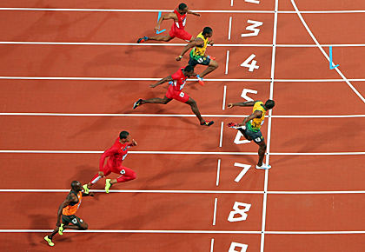
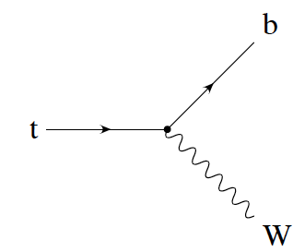
Phenomenology of heavy top
competing interactions:
who‘s faster?
t
t
g
b
b
For lighter quarks: strong interaction >> weak interactions
➔ colour neutral hadrons
For top quark: strong interaction < weak interactions
➔ no top hadrons! ‚free quark‘
top quarks decay before hadrons formed
99.1% of all top quarks decay into a bottom quark!

Slide 6
Phenomenology of heavy top
Decay properties of top quark unambigously predicted by SM
tt ➔ (only) 6 quarks
largest fraction, very high background
tt ➔ 4 quarks, charged lepton, neutrino
Some 30% ‚usable‘, low background
FAVOURED channel
tt ➔ 2 quarks, 2 charged l, 2 neutrinos
Only 5% ‚usable‘, very low
background, difficult to reconstruct
Decay fractions largely determined by fractions of W - decay

Slide 7
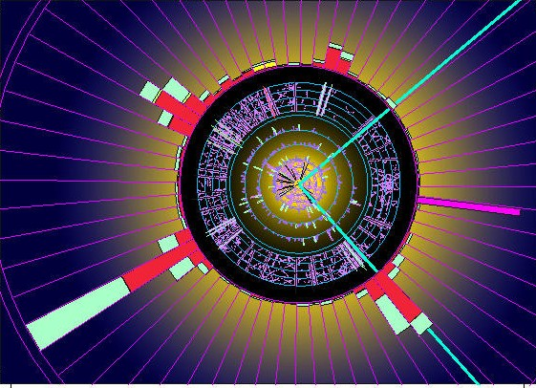
A semileptonic tt event

Slide 8

Surveying the top quark

Slide 9
Is the top quark a normal fermion?
Weak t coupling (V-A)
CKM – elements
Electric charge
Top mass
gtt couplings
spin correlations
tt - resonances

Slide 10
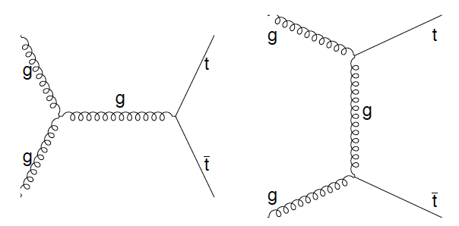
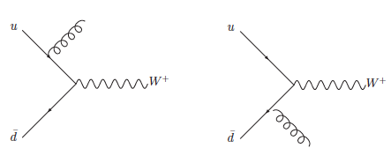
How to measure tt cross section
(Why should we?):
Sensitive to gluon –tt couplings
Test of QCD with massive quarks
Select events:
4 jets with p_{T}> 25 GeV
isolated electron,muon p_{T}>20 GeV
missing transverse energy > 20 GeV
Luminosity:
How many proton-collisions?
What fraction of tt events are retained after selection

Slide 11
Cross section determination
Experimental precision depends on how well
- background, efficiency, luminosity can be controlled
Key issue determine efficiency
Largest uncertainties:
Jet energy scale
bottom identification
Background yield
Jets from QCD
selection efficiency
e, μ, .....
Log σ
Selected p_{T} range
True jet p_{T}
Observed p_{T}
wrong energy scale
Jet pt
Experimental uncertainty ~ 9%
Luminosity uncertainty ~ 4.4 %

Slide 12
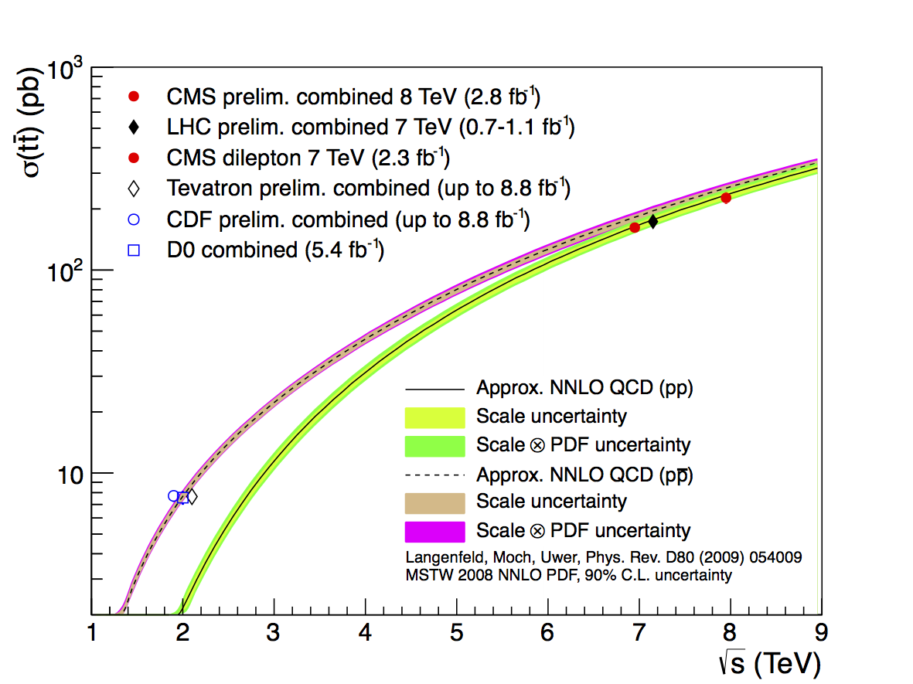
Cross section measuremnt
Theoretical uncertainty 7-10%
partly NNLO
Theory & experiment
uncertainty about
equal
Very good agreement between data and expectation

Slide 13

Weighting the top quark

Slide 14
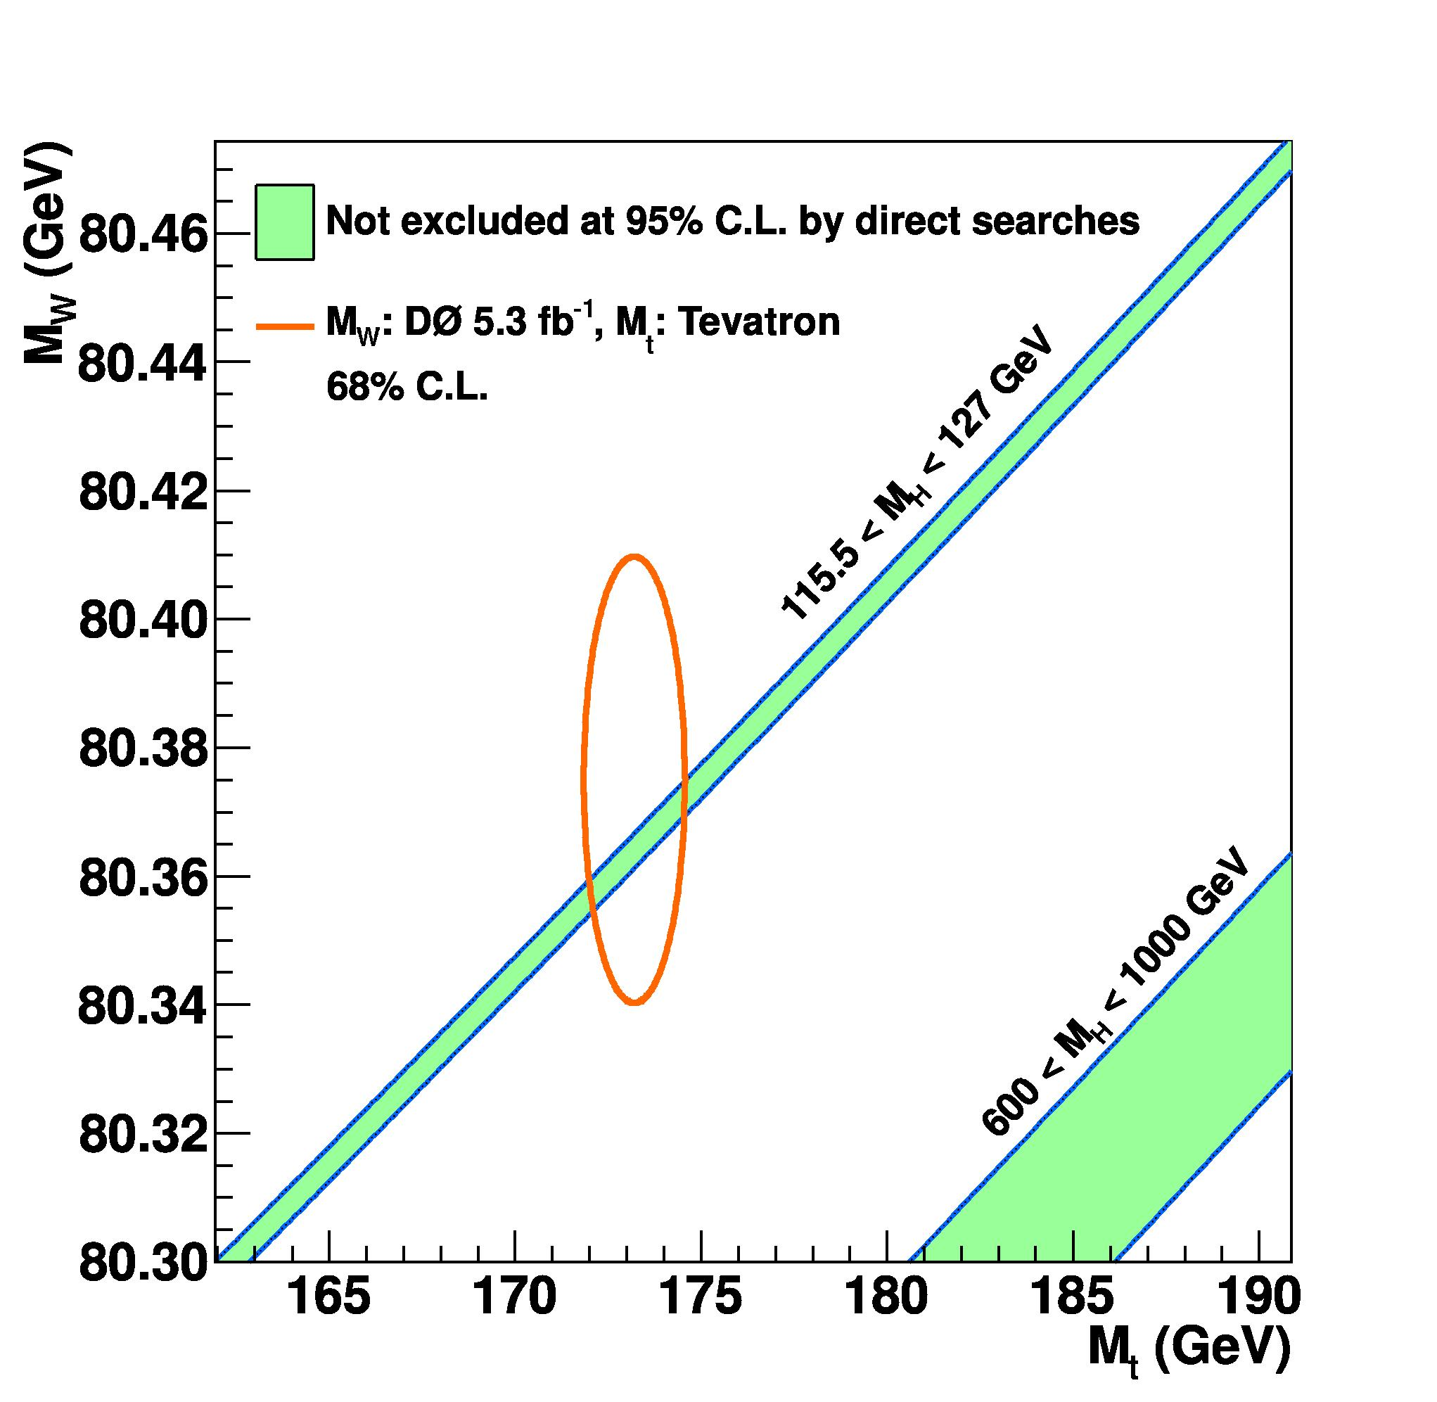
Mass of the top quark
A fundamental parameter of the Standard Model
A broad spectrum of decays and methods
Note: first time a quark mass can be
measured directly
(Lighter quarks to be inferred indirectly from hadron masses)

Slide 15
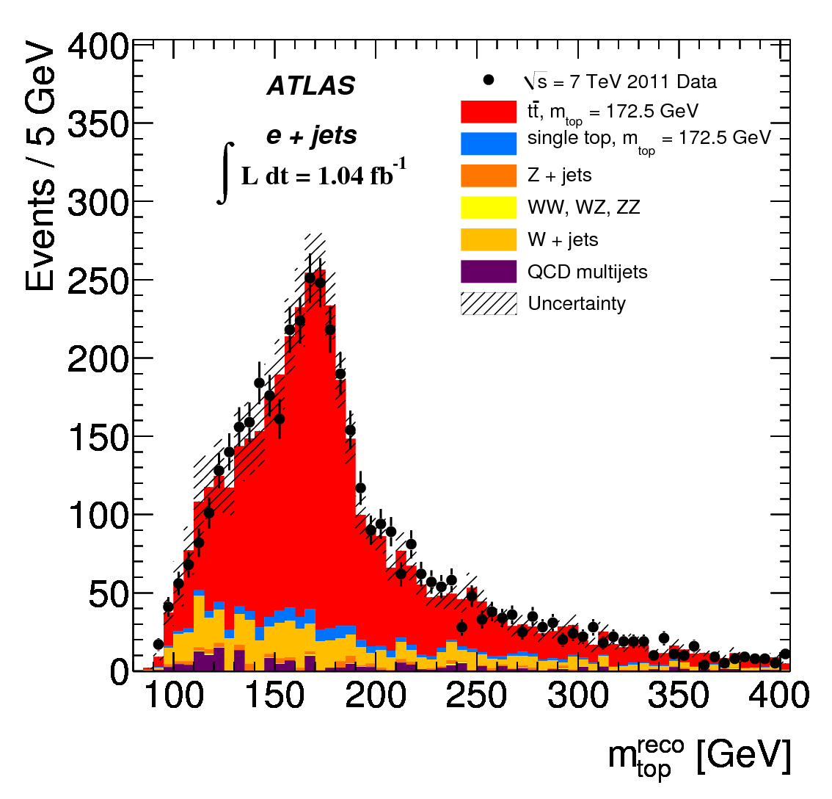
Top mass from l+jet decays
Favoured topology: tt ➔ 4 Jets (2 b –jets) + e/μ + ν
The problems:
How to get the z – component of ν
Out of 4 (or more) jets: which jet belongs to which top?
What is the energy scale of jets (and electrons)

Slide 16
Problem 1: p_{z}(ν)
Constraint from W - mass
Note: ν – mass completely negligible
Quadratic equation ➔ 2 solutions
physics: in 70% the solution with smaller p_{z} correct

Slide 17
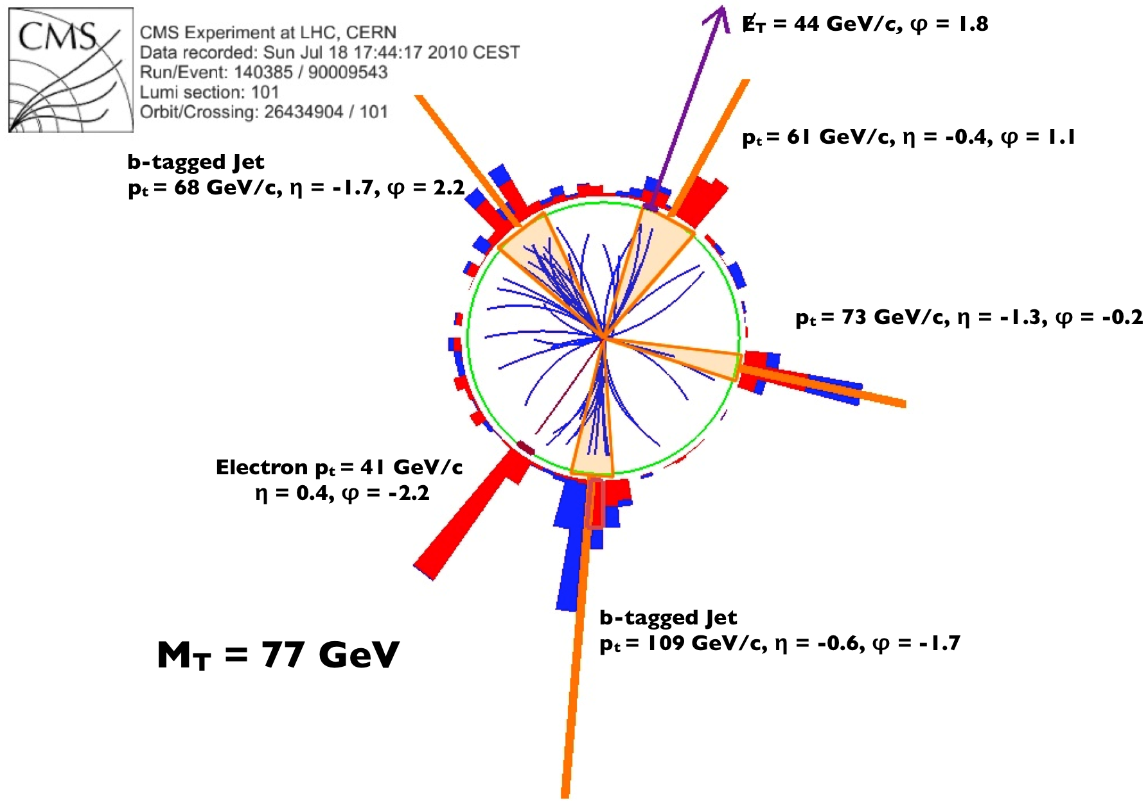
Problem 2: which jets?
Two facettes:
if more than 4 jets (initial state rad.)
mostly jets with highest p_{T}
if exactly 4 jets: which belongs to
which top quark?
4 jets ➔ 4 possible assigments
(j_{A}j_{B}J_{C}/j_{D}, j_{A}j_{B}j_{D}/j_{C,} ....)
Note: if b – jets identified, reduced to 2 possibilities
Important constraints
mass (jjj) = mass(jlν) (= M_{t})
mass (jj) = M_{W}

Slide 18
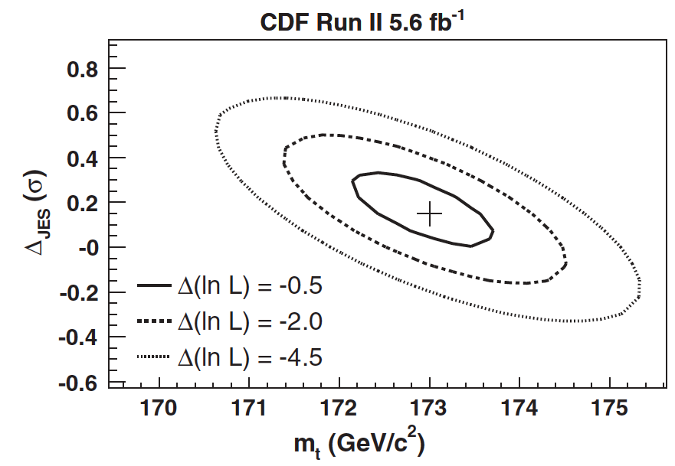
Problem 3: jet energy scale
Measure signals in calorimeter ➔ derive jet energy
Implies uncertainty!
➔ relates directly to top mass
Top – quarks offer ‚self calibration‘
M(jj) has to be equal M_{W}
➔ change JES such that fulfilled
Still the (slightly) dominant uncertainty of M_{t}

Slide 19
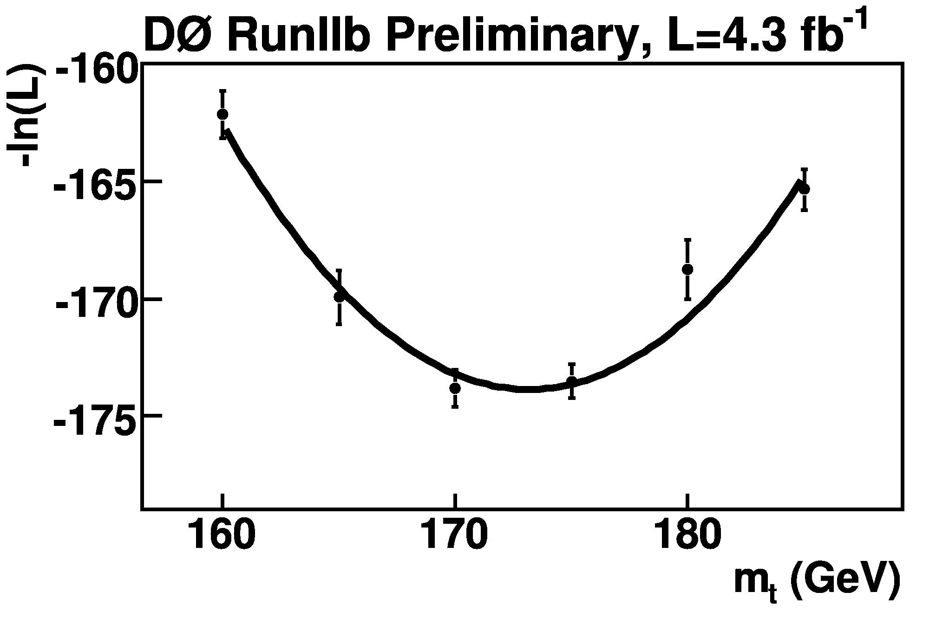
Use all information
Theoretical pred with
M₁(top)
Convolute with experimental effects
w₁
Theoretical pred with
M₂(top)
w₂
Sum over all events and find combine weights
......
Find M(top) with maximum weight

Slide 20
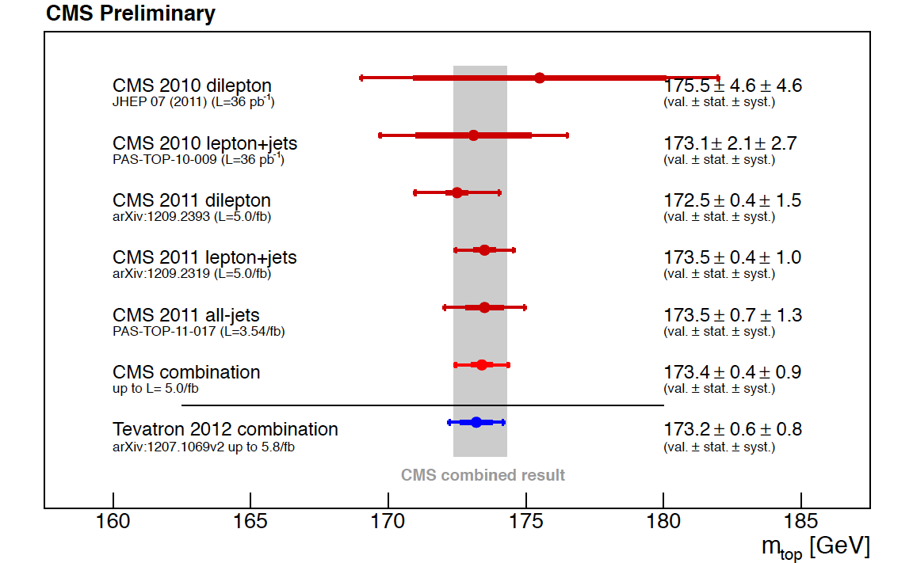
Measurements of M_{top}

Slide 21
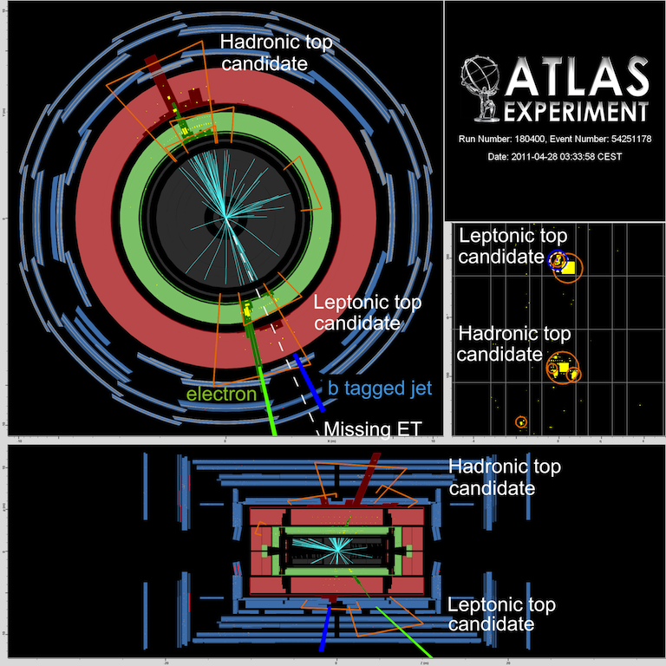
Production properties: e.g. M_{tt}
N.B. High p_{T} top quarks: jets merge! ‚Boosted Top Quarks‘
New algorithms required

Slide 22
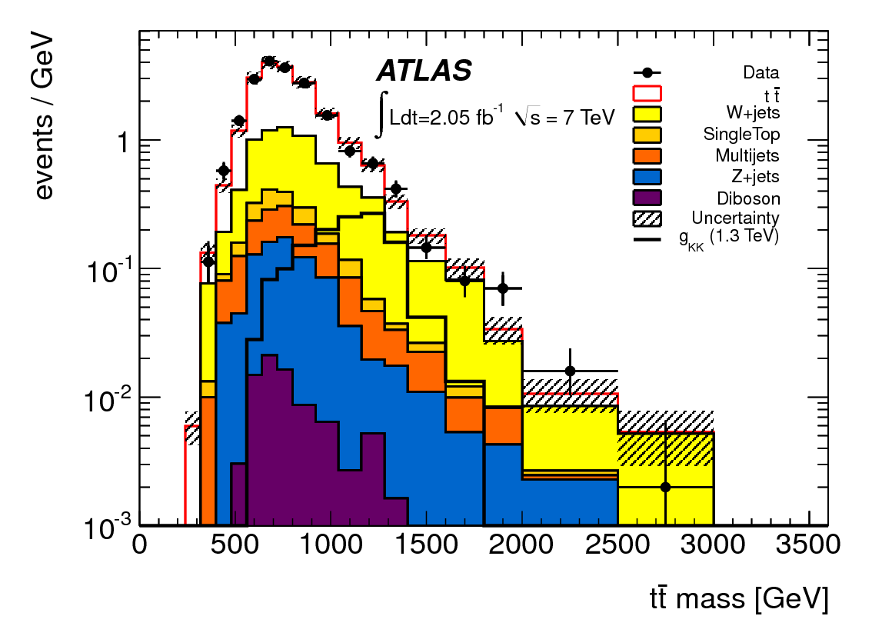
Searching for a tt - resonance
Postulated in many BSM scenarios
➔ at this stage no new particle observed

Slide 23
Standard Model @ Hadron Colliders
IV. Higgs Boson
P.Mättig
Bergische Universität Wuppertal

Slide 24
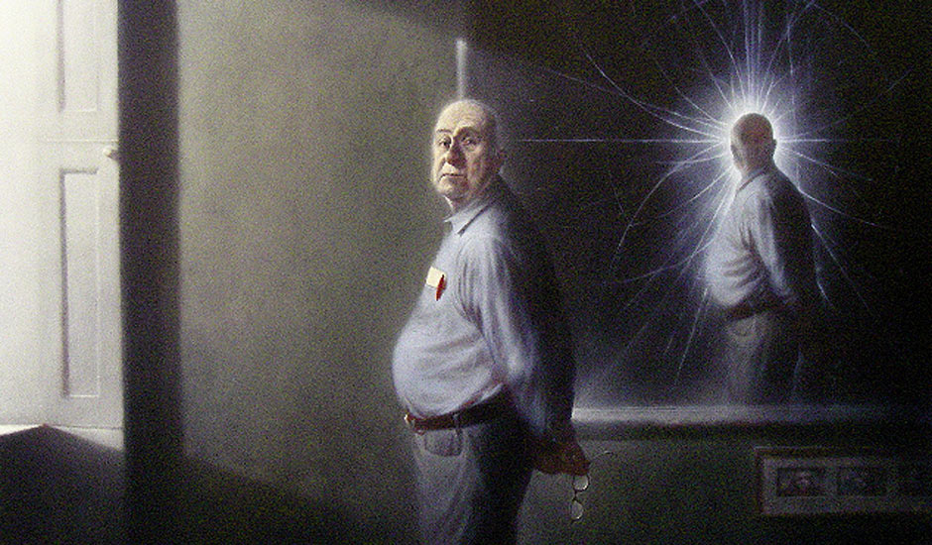
The Higgs mechanism - basics

Slide 25
Electroweak symmetry breaking
Masses of bosons and fermions break basics ingredients:
- fermion masses break local gauge invariance
boson masses lead either to
a. infinite cross sections
b. strongly coupled theory ➔ many W‘s, .....
c. a new particle with spin 0

Slide 26
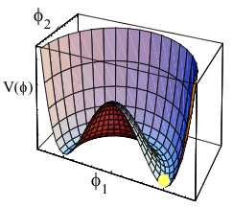
The solution ‚Higgs mechanism‘
The Standard Model answer:
Higgs fields
gives mass to bosons
provides means for fermion mass
implies elementary physical particle
gives mass to Higgs Boson
NOTE: no prediction of masses!
Introduce potential (by hand)
Two unknowns: λ, μ
Mass of W
Mass of Higgs
Mass of fermions
v: ‚vacuum expectation value‘
M_{W} ➔ v = 246 GeV

Slide 27
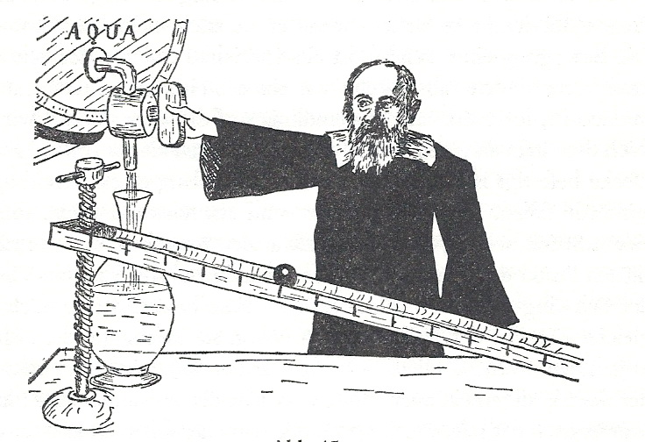

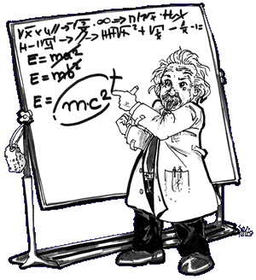
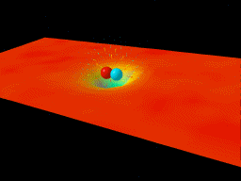
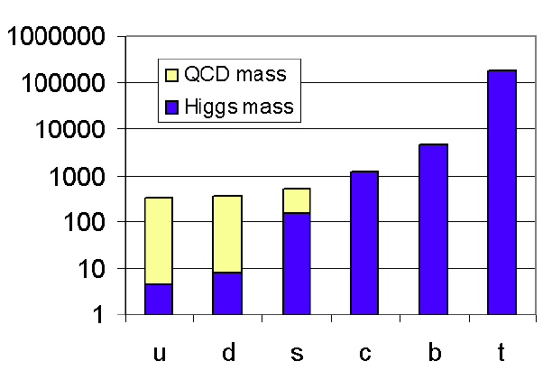
A few notes on mass
Mass always of basic importance
Derek Leinweber
B.Müller
➔
A dynamical generation of hadron masses ➔
99% of visible matter due to strong interaction
This principle does not work if particles are elementary!
Notes:
Derek Leinweber
B.Mueller nucl-th/0404015

Slide 28
The Higgs Boson: well known!
..... except its mass!
What is to be known to search for the Higgs boson:
how is it produced?
how strongly is it produced?
how does it decay?
Devise search strategy along this line

Slide 29
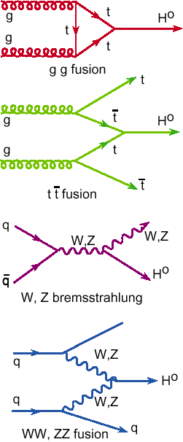
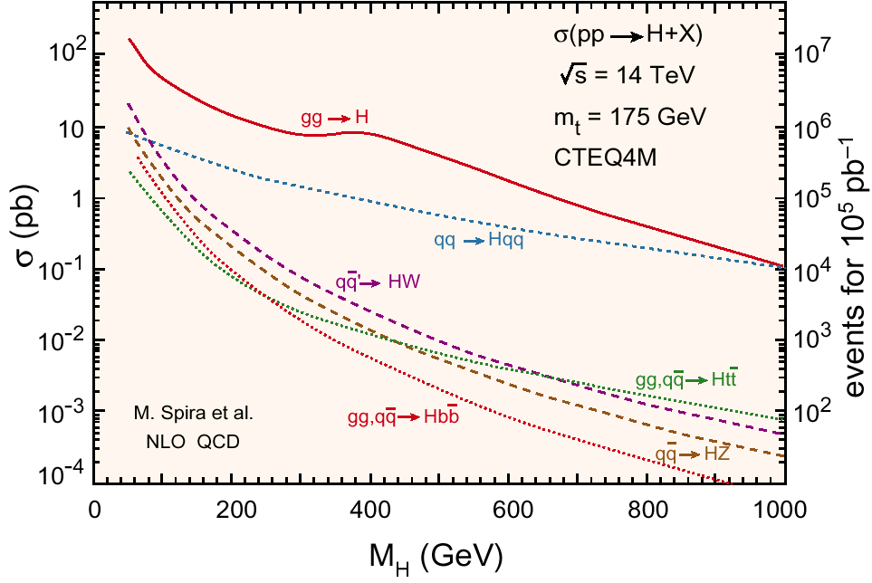
Higgs searches at Hadron Colliders

Slide 30
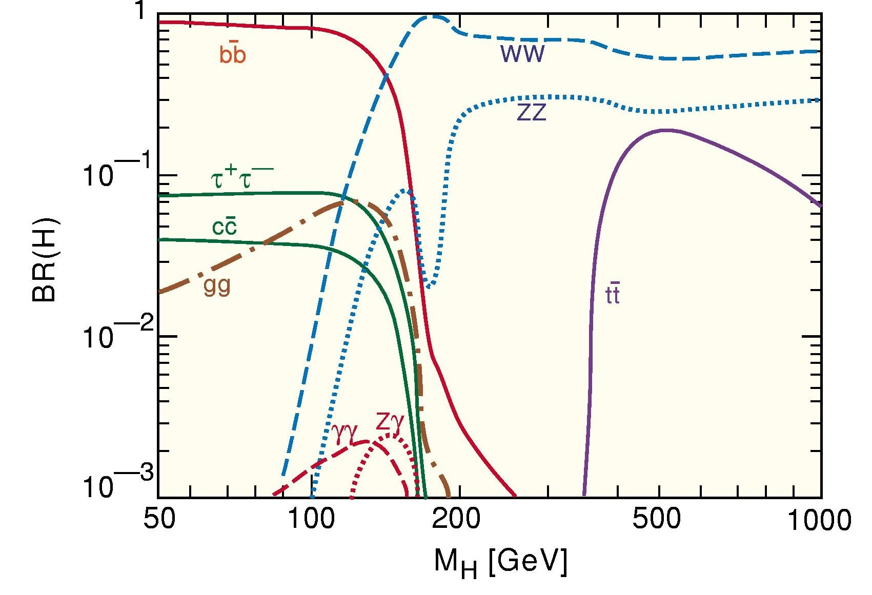
Favoured signatures @ LHC
No decays in jets! Background formidable➔ leptons
Special properties: mass peaks
High branching ratios
H→WW
H→ ZZ

Slide 31
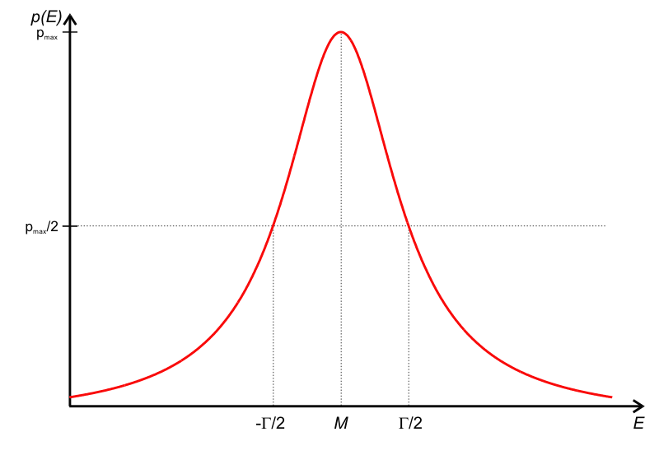
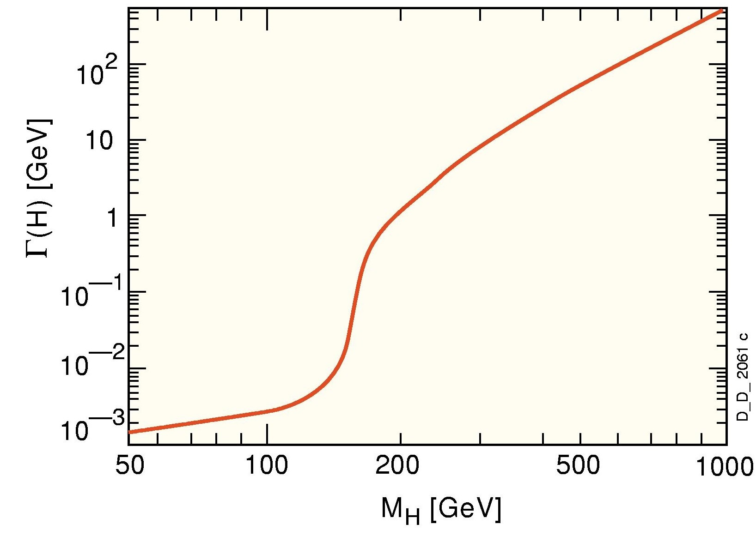
How strong is the coupling?
Width of higgs boson proportional to coupling
Γ(H) ~ M(H)
Threshold W/Z passed:
High coupling
Initial W/Z: high X-section
Very small width ...
Very small coupling!

Slide 32

How to interpret the measurements
Notes:
„Wir haben entdeckt, woraus das Nichts besteht!“
„...was immerhin Etwas ist.“

Slide 33
Test if data EXCLUDE hypothesis
Step 1: X-section at mass m_{H} that
can be excluded @ 95% CL
Step 2: Plot ratio
σ(exclusion)/
σ (Xsec of SM expectation)
If below 1:
Higgs excluded in mass range
If above 1:
Higgs cannot excluded since
either: ‚hint‘, ..... ‚signal‘
or: no sensitivity for exclusion
Compare to expectation (i.e. simulation assuming no signal)
IF expectation above SM Higgs X-section: no sensitivity to exclude
IF expectation below BUT data are high: a first hint

Slide 34
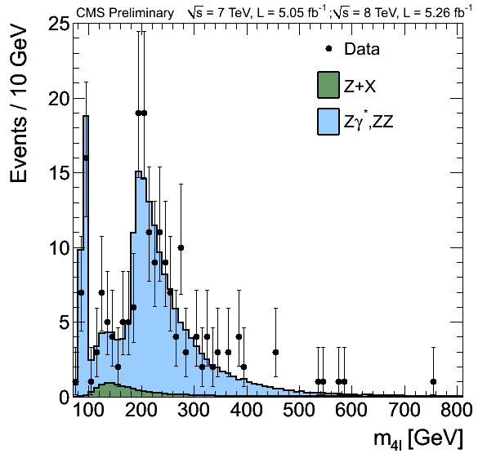
95% CL Limits ZZ → (l⁺l⁻) (l⁺l⁻)
Simulation with NO signal, but
luminosity, detector effects, ....
➔ EXPECTED limit
No sensitivity
Small σ*BR
Oscillations around
expectation:
more or less events
than background expectation
INTERESTING!
Data can exclude less than expected
by large margin
Regions of ratio < 1
EXCLUSION!

Slide 35
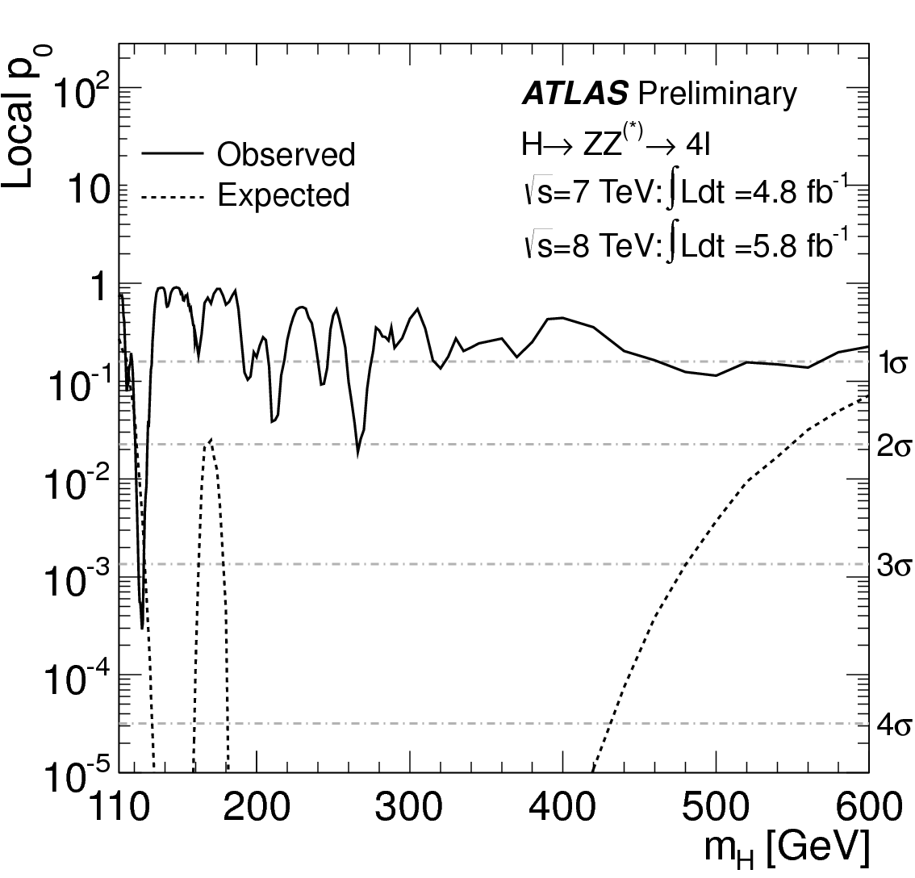
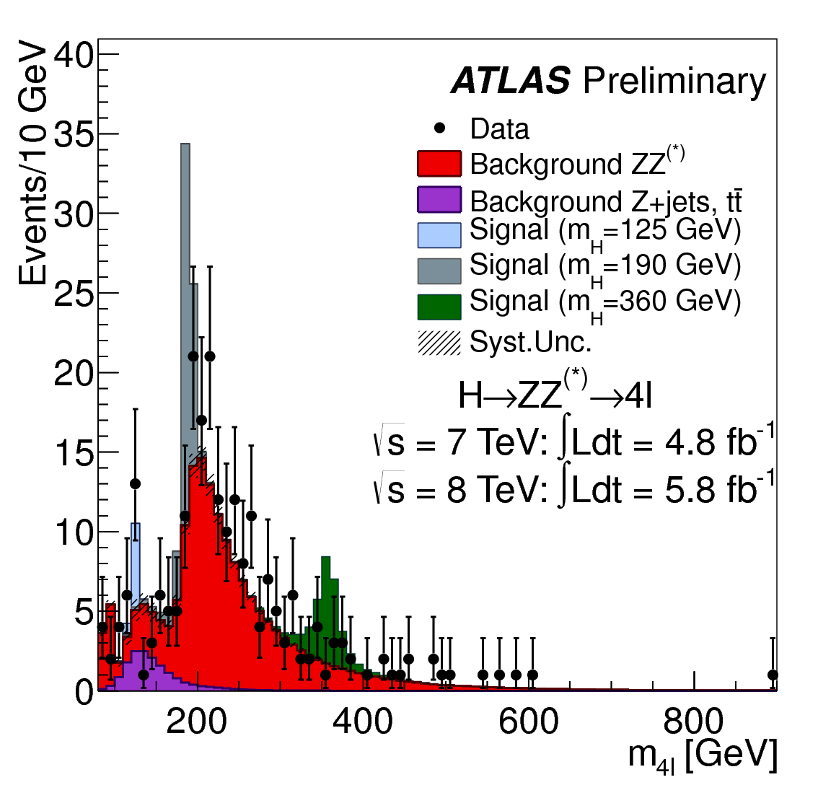
p - value probability of stat. fluctuation
‚p – value‘ : how likely is it that at a certain mass M_{H}
- the expected background fluctuates upward
- to produce at least the number of observed events
Observed dearth or excess
reflected in wiggles
Convention:
Signal observed if p > 5σ

Slide 36
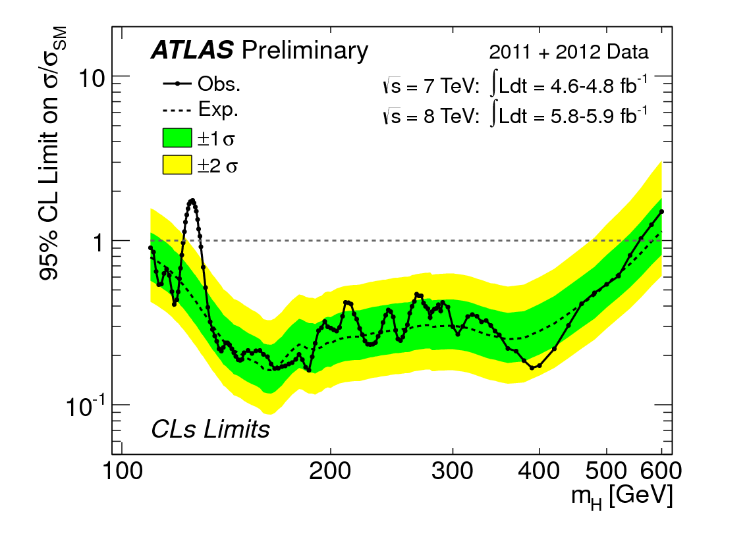
Combining all searches
High mass range:
ZZ ➔ l⁺l⁻l⁺l⁻
ZZ ➔ l⁺l⁻νν
ZZ ➔ l⁺l⁻qq
WW ➔ l⁺νl⁻ν
Higgs EXCLUDED 2·M_{W} < M_{H} < 558 GeV (CMS: 600GeV)
High mass Standard Model Higgs boson (almost) excluded

