Slide 1
Future Collider Technologies
D. Schulte

Slide 2
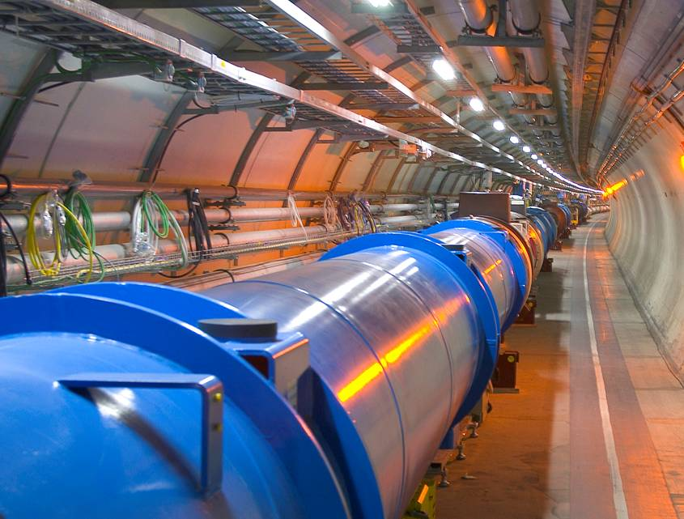
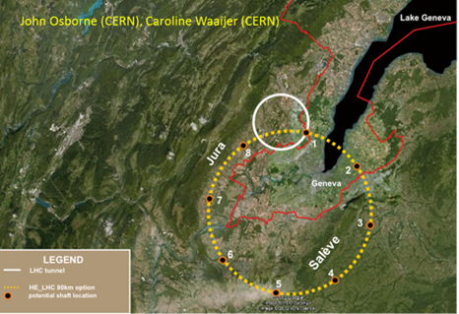
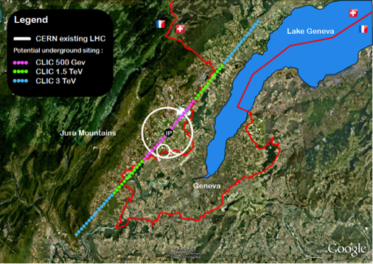
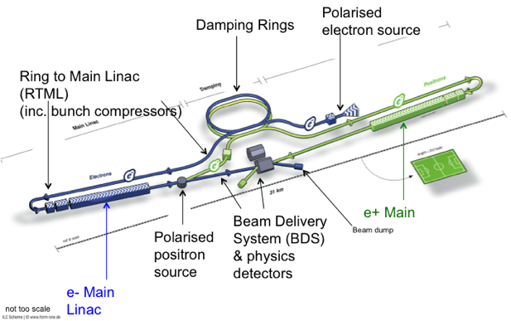
European Strategy for Particle Physics
A year-long process
  Will be repeated in about five years with more input from the LHC
  Received many inputs
  Similar processes are or have been ongoing in other regions
Identified four highest priorities
  Highest priority is exploitation of the LHC including luminosity upgrades
  Europe should be able to propose an ambitious project after the LHC
    Either high energy proton collider (HE-LHC, VHE-LHC)
    Or high energy linear collider (CLIC)
  Europe welcomes Japan to make a proposal to host ILC
  Long baseline neutrino facility (not covered here)
Projects that were not included in the highest priorities
  E.g. LHeC, LEP3, photon-photon colliders, and muon colliders.

Slide 3
Note: Hadron Colliders

Slide 4
High Energy Hadron Collider
Similar design as for the LHC
The LHC would serve as the largest test facility ever
Maximum proton energy is given by ring size and dipole field ρ x B
Maximise field of dipoles
  Technology and cost
Increase bending radius ρ/circumference C
  Mainly cost
parameter | LHC | HL-LHC | HE-LHC | VHE-LHC
E [TeV] | 14 | 14 | 33 | 100
C [km] | 26.7 | 26.7 | 26.7 | 80 (100)
B [T] | 8.33 | 8.33 | 20 | 20 (16)
P_{SR} [W/m] | 0.21 | 0.4 | 3.5 | 84
L [10³³cm⁻²s⁻¹] | 1 | 7.4 | 5 | 5
A number of other issues needs to be addressed
E.g. synchrotron radiation increases
Similar in nature to the ones that will be discussed in the LHC upgrades lecture

Slide 5
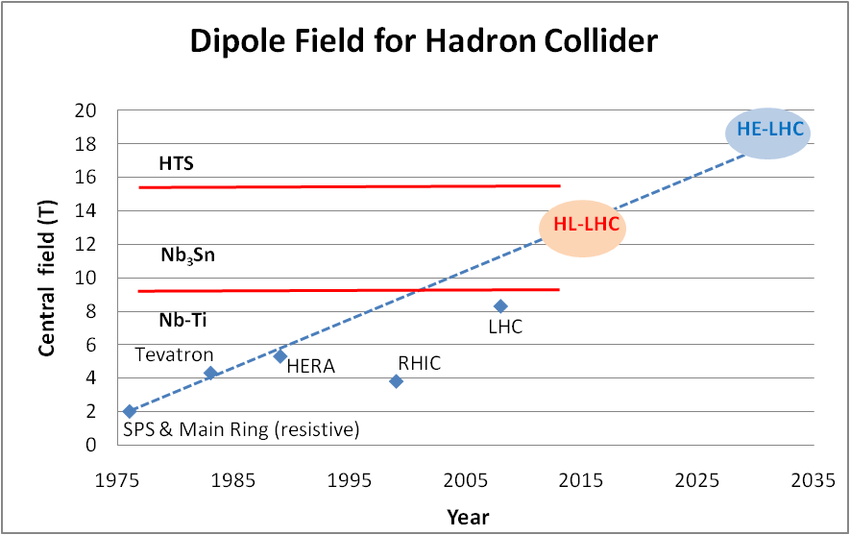
Development of Dipole Fields
Looking at performance offered by practical SC, considering tunnel size and basic engineering (forces, stresses, energy) the practical limits is around 20 T. Such a challenge is similar to a 40 T solenoid (μ-C)
LBNL, with large bore
Spring 2013
Nb-Ti operating dipoles;
Nb3Sn cosϑ test dipoles
Nb3Sn block test dipoles

Slide 6
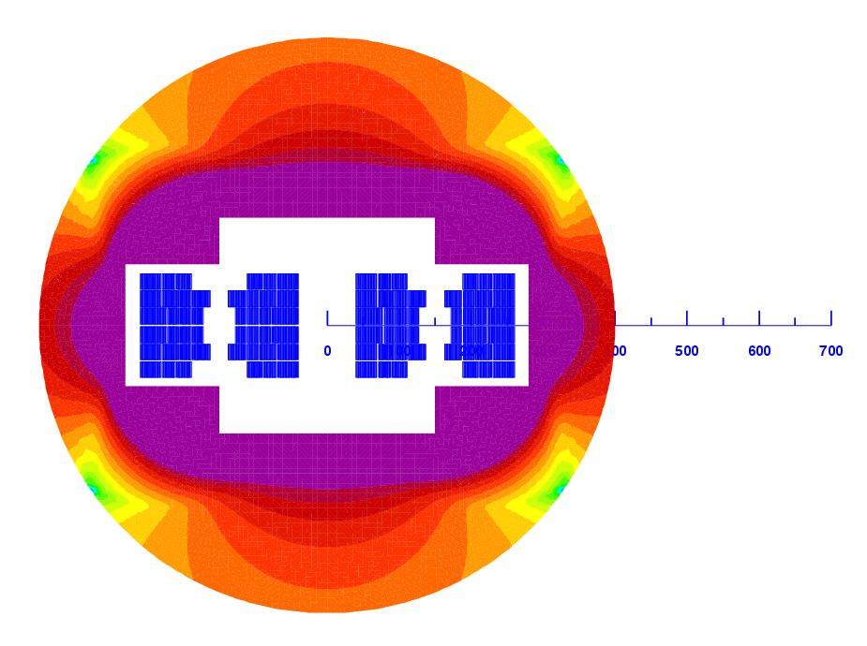
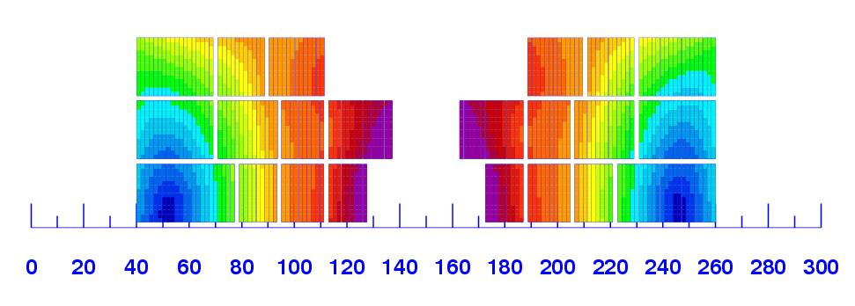
Example Magnet Design
L. Rossi and E. Todesco
Magnet design: 40 mm bore (depends on injection energy: > 1 Tev)
Very challenging but feasable: 300 mm inter-beam; anticoils to reduce flux
Approximately 2.5 times more SC than LHC: 3000 tonnes!
Multiple powering in the same magnet for FQ (and more sectioning for energy)
Certainly only a first attempt: cosϑ and other shapes will be also investigated

Slide 7
Challenges
The physics case of a high energy hadron collider vs. a high energy lepton collider has to be studied
A design needs to be developed to identify and address the challenges
The magnets are an obvious challenge
The cost is another challenge
  The magnets are most likely more expensive than the ones for LHC
  The size of the machine can be much larger than LHC (VHE-LHC)

Slide 8
Lepton Collider Choice

Slide 9
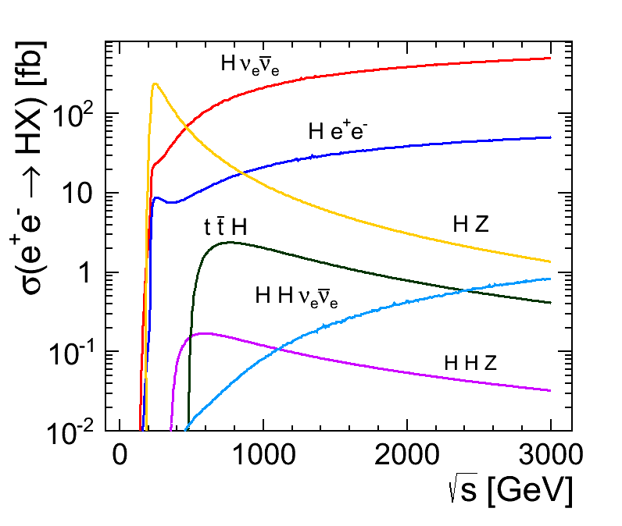
Higgs at 125GeV
~250GeV

Slide 10
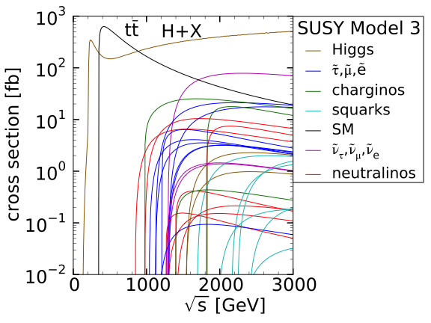
Example of Potential SUSY Scenario
Have to wait for further LHC results before a decision can be made
European strategy asks us to prepare proposals for facilities in 2018
350GeV
Consistent with current LHC results

Slide 11
Ring Collider Energy Limitation
Beam can be used many times
Lepton beam energy is below LHC
-> magnets are not a problem
accelerating cavities
N
N
But synchrotron radiation is:
At LEP2 lost 2.75GeV/turn for E=105GeV
Pay for installed voltage (ΔE) and size (R),
so scale as:
S
S
-> use heavier particles, e.g. muons
-> or linear collider
(-> or try to push a bit harder on cost)

Slide 12
Linear Collider Energy Limitation
source
main linac
Hardly any synchrotron radiation
Beam can only be used only once
-> strong beam-beam effects
Acceleration gradient is an important issue

Slide 13
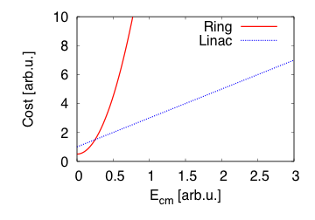
Simplified Cost Scaling Comparison
Linac:
Ring:
Power consumption behaves similar to cost for constant luminosity
There will always be an energy where linear colliders are better

Slide 14
Linear Collider

Slide 15

Generic Linear Collider

Slide 16
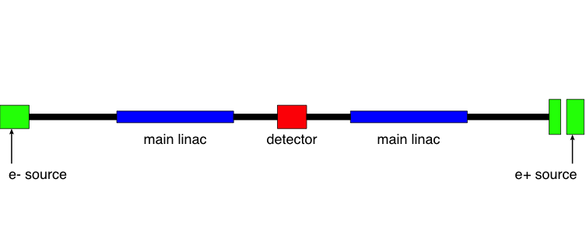
Generic Linear Collider
The main linac provides the energy of the beam
Issue 1: the gradient

Slide 17
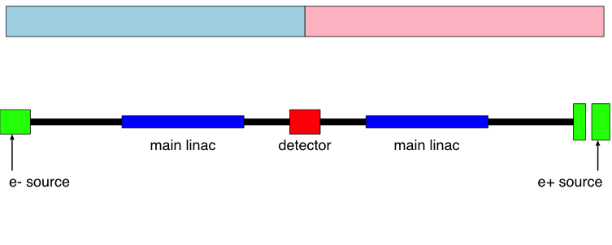
Generic Linear Collider
But little luminosity, since beams collider only once
Need very small σ_{x} and σ_{y}

Slide 18
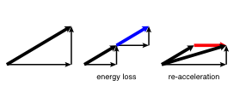
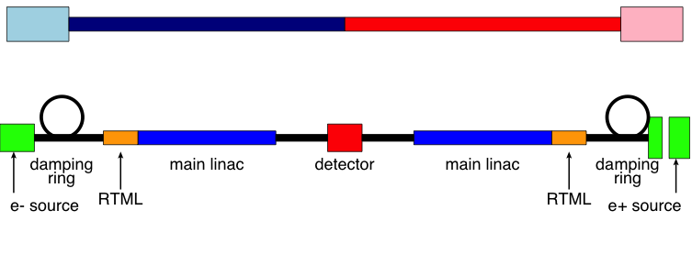
Generic Linear Collider
The damping rings reduce the phase space (emittance ε_{x,y}) of the beam
The RTML (ring-to-main linac transport) reduces the bunch length

Slide 19
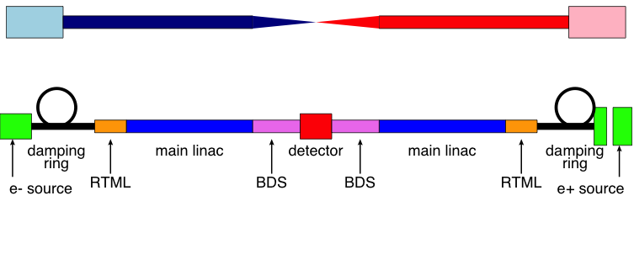
Generic Linear Collider
The beam delivery system (BDS) squeezes the beam as much as possible, i.e. reduces β_{x,y}

Slide 20
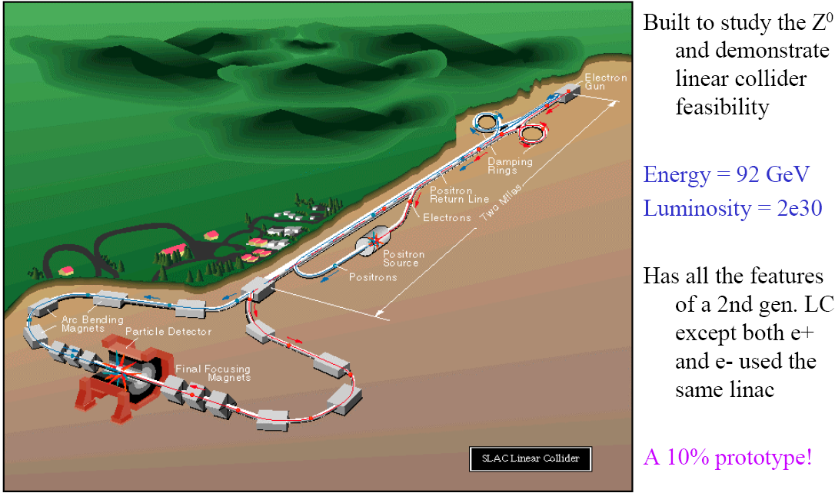
SLC: The only Linear Collider that existed

Slide 21
ILC Layout

Slide 22
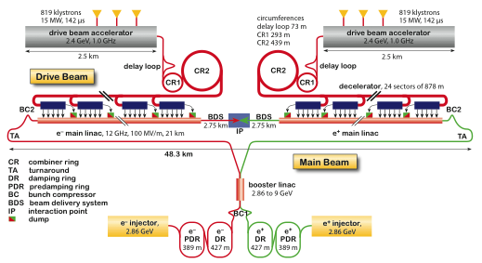
CLIC Layout at 3 TeV
Drive Beam Generation Complex
Main Beam Generation Complex

Slide 23
ILC and CLIC Main Parameters
Parameter | Symbol [unit] | SLC | ILC | CLIC
Centre of mass energy | E_{cm} [GeV] | 92 | 500 | 3000
Length | [km] | 3 | 31 | 48
luminosity | L [10³⁴cm⁻²s⁻¹] | 0.0003 | 1.8 | 6
Luminosity in peak | L_{0.01} [10³⁴cm⁻²s⁻¹] | 0.0003 | 1 | 2
Gradient | G [MV/m] | 20 | 31.5 | 100
Particles per bunch | N [10⁹] | 37 | 20 | 3.72
Bunch length | σ_{z} [μm] | 1000 | 300 | 44
Collision beam size | σ_{x,y} [nm/nm] | 1700/600 | 474/5.9 | 40/1
Vertical emittance | ε_{x,y} [nm] | 3000 | 35 | 20
Bunches per pulse | n_{b} | 1 | 1312 | 312
Distance between bunches | Δz [mm] | - | 554 | 0.5
Repetition rate | f_{r} [Hz] | 120 | 5 | 50
ILC has parameter sets from 250GeV to 1TeV
CLIC has parameter sets from 250GeV to 3TeV

Slide 24
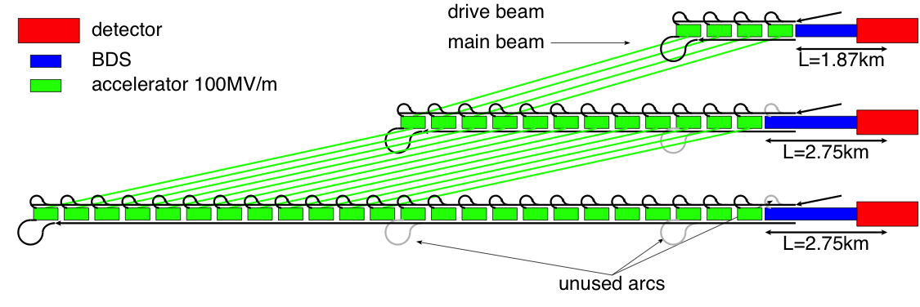
Note: Staging
ILC and CLIC can be staged (e.g. start at E_{cm}=250GeV)
But the Higgs studies can also be done at higher energy
  E.g. top threshold (350GeV)
They can go up in energy to 0.5-1GeV for ILC and 3TeV for CLIC
CLIC is planned to be constructed in stages (0.5, 1.5 and 3TeV)

Slide 25
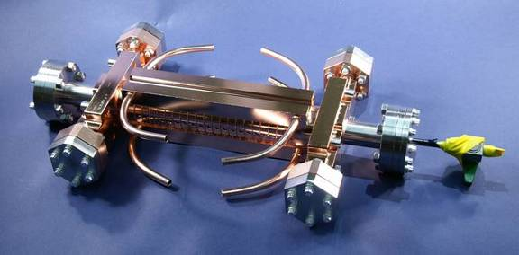
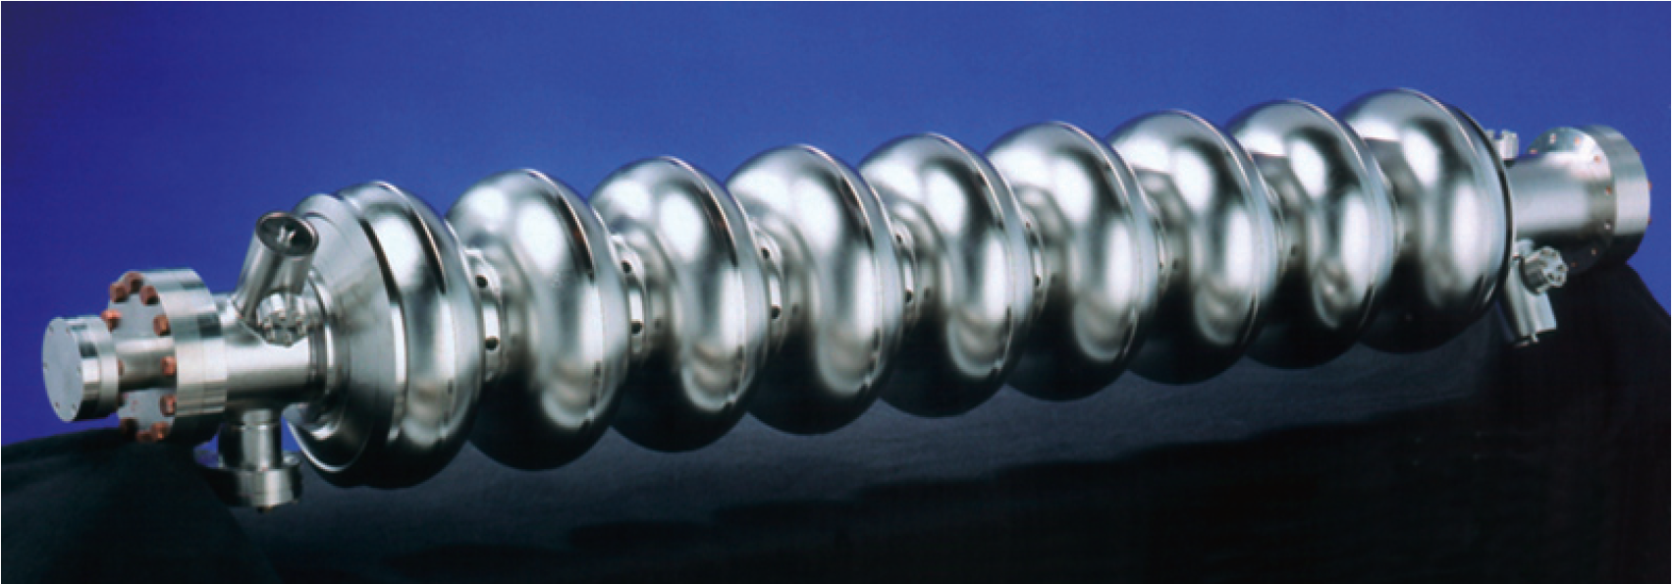
Cavity/Accelerating Structure
ILC cavity
1.3 GHz, superconducting
Target effective operational 31.5MV/m
Target gradient 35MV/m
Q₀≈10¹⁰
CLIC accelerating structure
12 GHz, normal conducting
Target loaded gradient 100MV/m
Target unloaded gradient 120MV/m
Q₀≈6 10³

Slide 26
ILC TDR
http://www.linearcollider.org/ILC/Publications/Technical-Design-Report

Slide 27
The CLIC CDR documents
In addition a shorter overview document was submitted as input to the European Strategy update, available at:
http://arxiv.org/pdf/1208.1402v1
An input document to Snowmass 2013 has also been submitted:
http://arxiv.org/abs/1305.5766

Slide 28
Circular Colliders

Slide 29
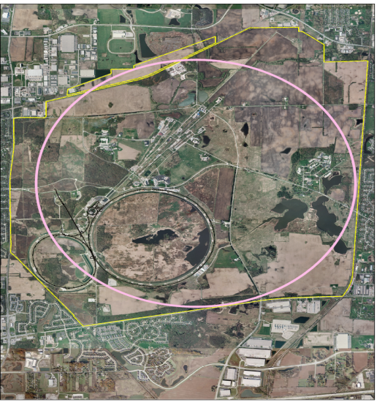
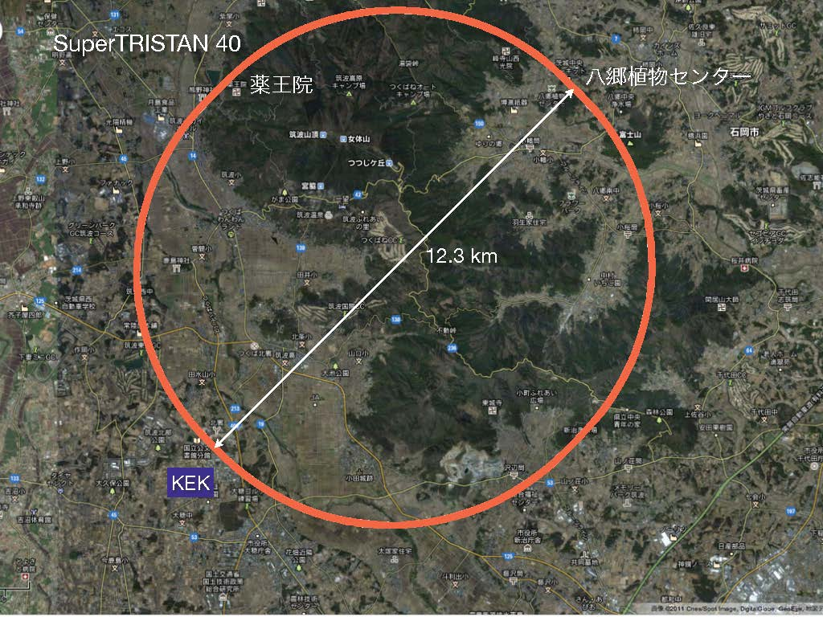
Some e⁺e⁻ Circulator Collider Suggestions
SuperTRISTAN (40/60km)
FNAL site filler (16km)
A number of ring proposals has been made recently
TLEP (80km)
pp collider
e⁻e⁺ Higgs Factory
Chinese Higgs Factory (50/70km)

Slide 30
Parameter Examples
 |  | IHEP-50km | Fermilab Site filler | TLEP
Centre-of-mass energy | E_{CM} [GeV] | 240 | 240 | 350
Luminosity/IP | L [10³⁴cm⁻²s⁻¹] | 2.5 | 0.52 | 0.65
IPs |  | 2 | 1 | 4
circumference | C [km] | 50 | 16 | 81
Charge per bunch | N [10¹⁰] | 70 | 80 | 75
Number of bunches | n | 26 | 2 | 12
Colliding beam size | σ_{x}/σ_{y} [μm] | 60/0.3 | 67.3/0.48 | 63/0.32
Energy loss/turn | ΔE [GeV] | 3 | 10.5 | 9.3
Synchrotron power (both beams) | P_{S} [MW] | 103.6 | 100 | 100

Slide 31
Challenges
No design report exists that can be reviewed
Beamstrahlung leads to short luminosity lifetime
Need top-up operation
Many technical challenges
high level of synchrotron radiation
lattice design
emittance control
RF system
…
The energy reach is limited
How does this affect the physics case?
Could be considered together with a hadron collider
But is a choice of the funding agencies

Slide 32
Muon Collider

Slide 33
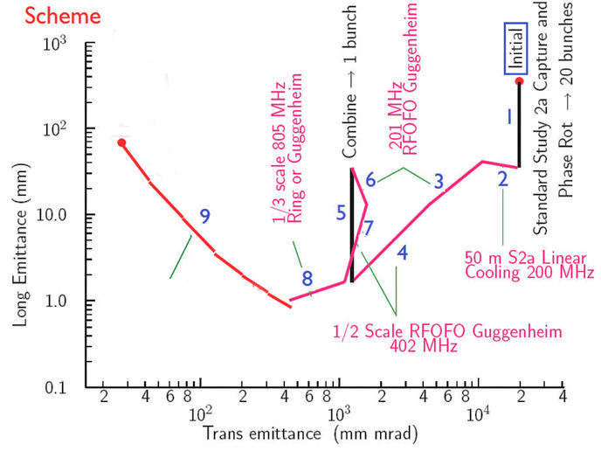
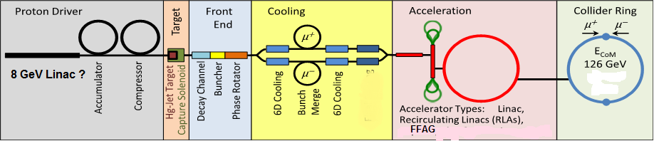
Muon Collider Overview
Muon are heavy so they emitt little synchrotron radiation
But they do not live very long
Produce them, cool them quickly and let them collide in a small ring

Slide 34

Muon Collider Parameters
http://www.fnal.gov/pub/muon_collider/collaboration-links.html

Slide 35
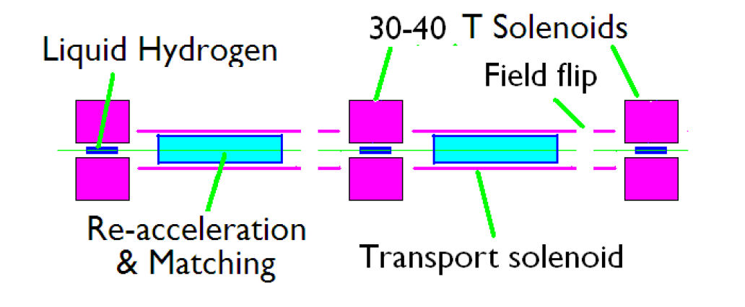
Final Transverse Cooling System

Slide 36
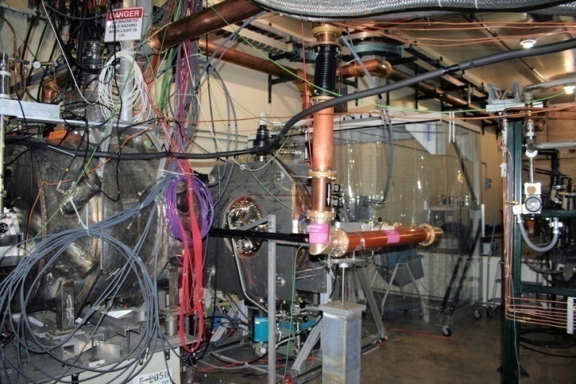
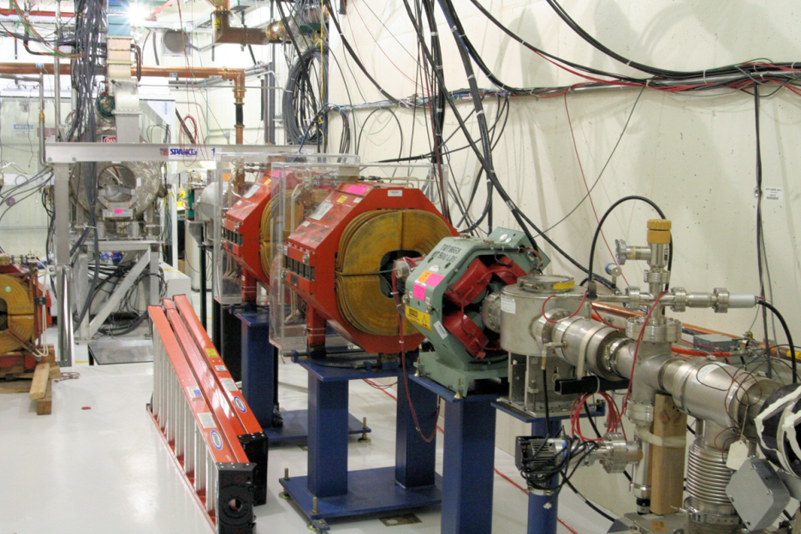
MuCool
Test of cooling components
  Cavity gradient in strong solenoid field (filled with hydrogen)
  Absorbers, windows, engineering
  Uncertainty in scattering model
  Eventually full beam test
Experiments are ongoing
http://www.fnal.gov/projects/muon_collider/cool/cool.html

Slide 37
Muon Collider Higgs Factory
PHYSICAL REVIEW SPECIAL TOPICS - ACCELERATORS AND BEAMS,VOLUME 6, 081001 (2003)
Parameter | Unit | Case1 | Case2
E_{cms} | GeV | 100 | 100
Power | MW | 81 | 81
RMS energy spread | % | 0.01 | 0.003
Luminosity | 10³¹ cm⁻² s⁻¹ | 2.2 | 1
Higgs/year | 10³ | 4 | 3.9
Cost to produce a muon is high (e.g. 1TeV proton beam/muon)
So use direct production
-> Very mall energy spread and energy stability required

Slide 38
LHeC

Slide 39
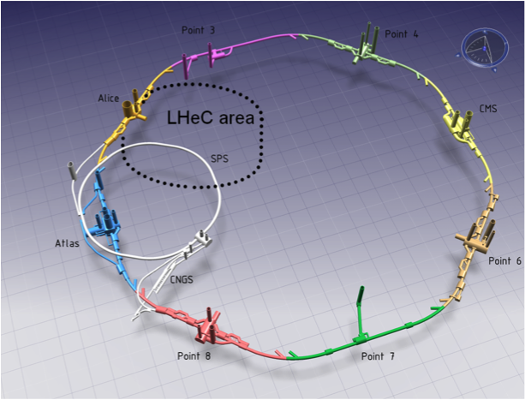
LHeC
Collide LHC beam with 60GeV polarised electrons (L=O(10³³cm⁻²s⁻¹))
Study provided CDR (http://arxiv.org/abs/1206.2913)
Requires electron beam power of 400MW
But are not allowed to use more than 100MW
wall plug power
 | p | e-
E [GeV] | 7000 | 60
L [cm⁻²s⁻¹] | 10³³
γε_{x,y} [μm] | 3.75 | 50
σ*_{x,y} [μm] | 7 / 7
Δt [ns] | 50 | 50
N [10¹⁰] | 17 | 0.2

Slide 40
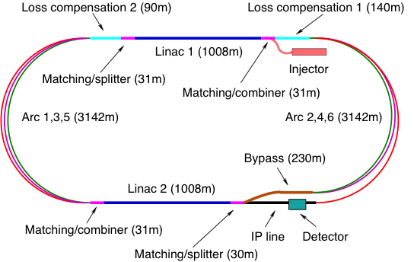
LHeC Linac-ring Option

Slide 41
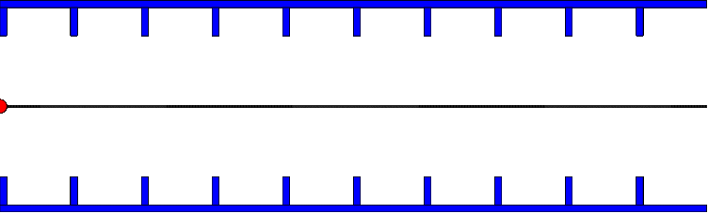
Energy Recovery Principle

Slide 42
Gamma-gamma Collider

Slide 43
Gamma-gamma Collider Concept
Based on e⁻e⁻ collider
But collide electron beam with laser beam just before the IP (at small angle α)
Hard backscattered photons move almost in direction of initial electron (angle ~1/γ)
Photons collide, electrons as well
α
ϑ
Backscattered photons form a spectrum with maximum energy given by
Practical maximum is 83% of electron energy
-> Typical laser wavelength O(μm), some J per pulse
Many photons are softer than maximum energy
-> Typical luminosity O(10%) of geometric e⁻e⁻ luminosity

Slide 44
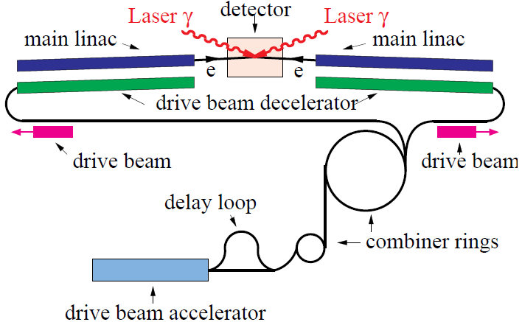
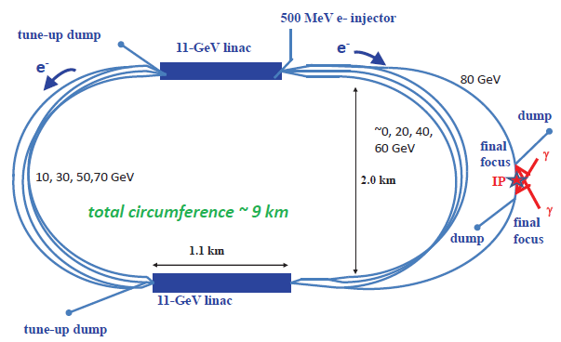
Gamma-gamma Collider Options
A linear collider can be upgraded to a gamma-gamma collider
CLICHÉ, a dedicated version of CLIC (exploration from 2003)
SAPPHIRE, based on re-circulating linac (2012)
Other flavours exist

Slide 45
Plasma Acceleration

Slide 46
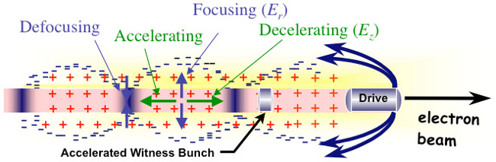
Principle Electron Driven Plasma

Slide 47
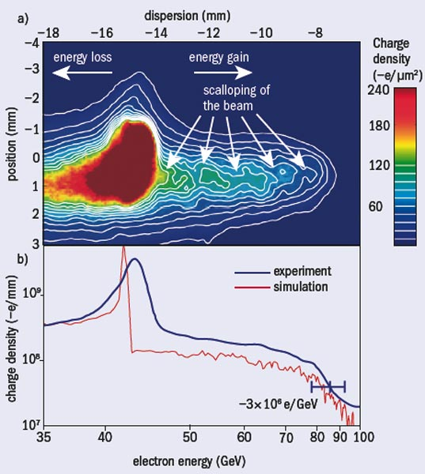
Record Acceleration: 42 GeV
Using SLC beam
L=0.85m
G=O(50GV/m)
E167 collaboration
SLAC, UCLA, USC
I. Blumenfeld et al, Nature 445, p. 741 (2007)

Slide 48
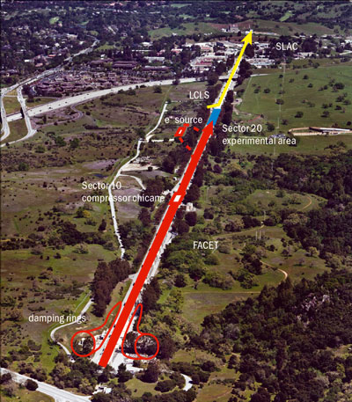
FACET at SLAC
Drive bunch: charge O(10¹⁰) particles, 23 GeV
  Can use electrons and positrons
Test of beam loading
  60%-90% efficiency of energy transfer
Test of positron acceleration
Test of plasma lenses
  Self-focusing of the beam
http://facet.slac.stanford.edu/
Image credit: SLAC

Slide 49
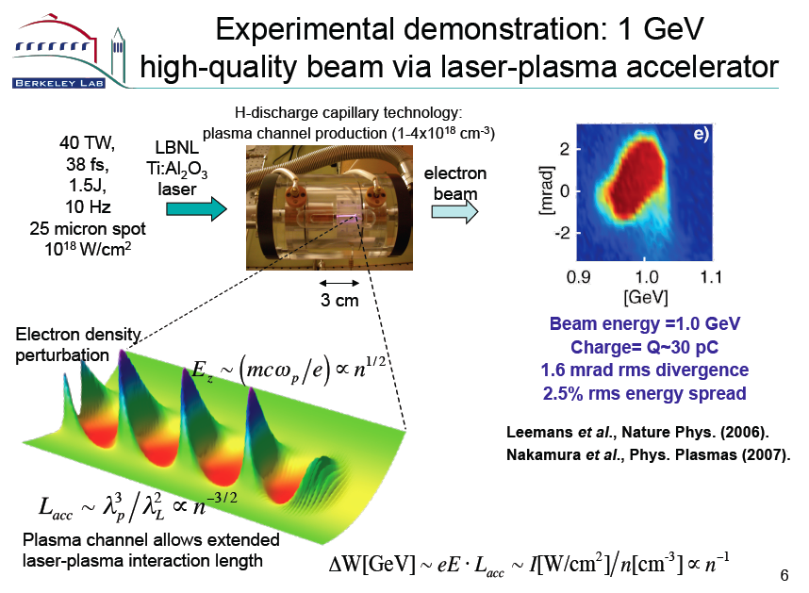
Laser Plasma Acceleration
E. Esarey

Slide 50
R&D
Further development of laser-plasma acceleration in ELI (extreme light infrastructure)
  http://extreme-light-infrastructure.eu
Use of proton beam to generate plasma
  Being explored at CERN

Slide 51
Summary
HE-LHC, VHE-LHC
  Given high priority by European strategy
  A conceptual design needs to be developed
CLIC
  Given high priority by European strategy
  Conceptual design for 3TeV (CDR exists), feasibility demonstrated, many components developed, staged approach exists, which will follow physics findings
  Technical proposal to be developed for 2018
  More tomorrow
ILC
  Japan might offer to be the host
  Quite mature (TDR exists) for 500GeV, 1TeV under discussion
  More tomorrow
Ring-based electron-positron collider
  Limited in energy but potential synergy with high energy hadron collider
  A conceptual design remains to be developed
LHeC
  Conceptual design report exists
  Much smaller scope than other projects
Muon collider
  Cooling technology is being explored, a long way to go
Gamma-gamma collider
  Being explored
Plasma acceleration
  Very interesting long-term development, a very long way to go

Slide 52
Reserve

Slide 53
LHeC IP Parameters
 | protons | electrons
beam energy, E [GeV] | 7000 | 60
Luminosity [cm⁻²s⁻¹] | 10³³
normalized emittance γε_{x,y} [μm] | 3.75 | 50
rms IP beam size σ*_{x,y} [μm] | 7 / 7
bunch spacing, Δt[ns] | 25 or 50 | 50
bunch population, N | 1.7x10¹¹ | 2x10⁹
Electron beam power
P=E x Ne /Δt ≈ 400MW >> 100MW consumption
-> energy recovery

