Slide 1
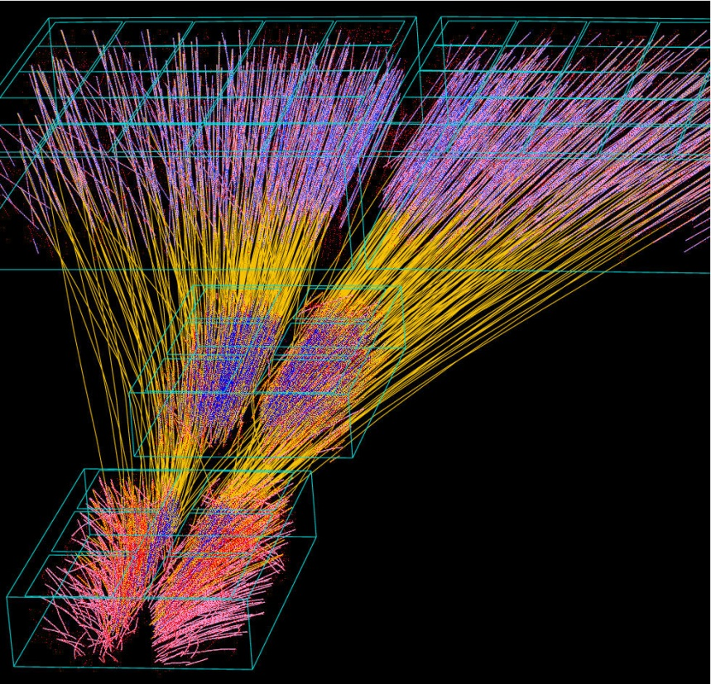
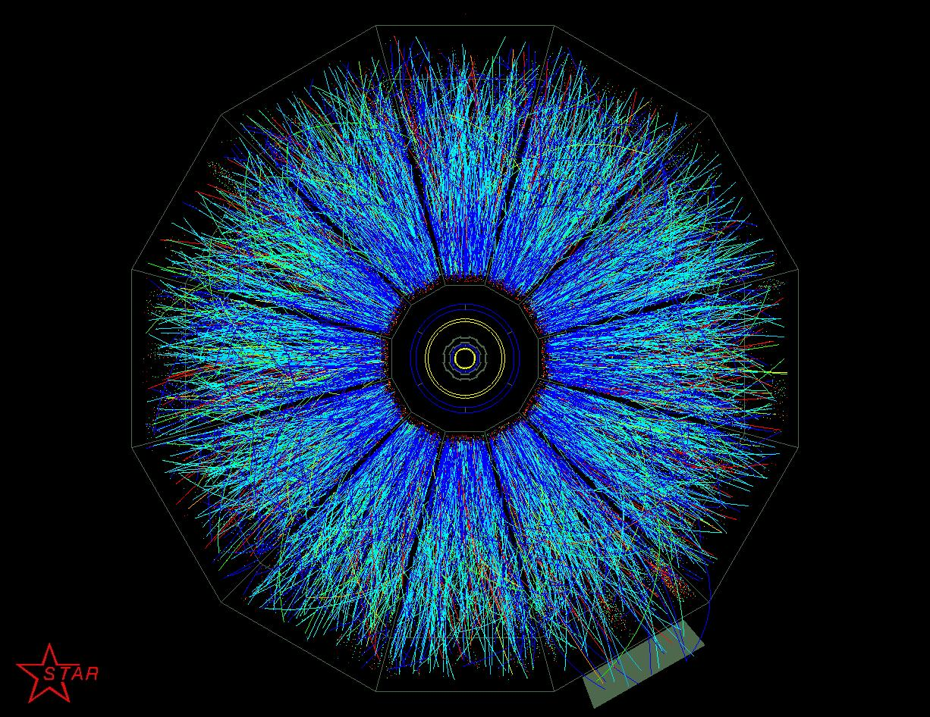
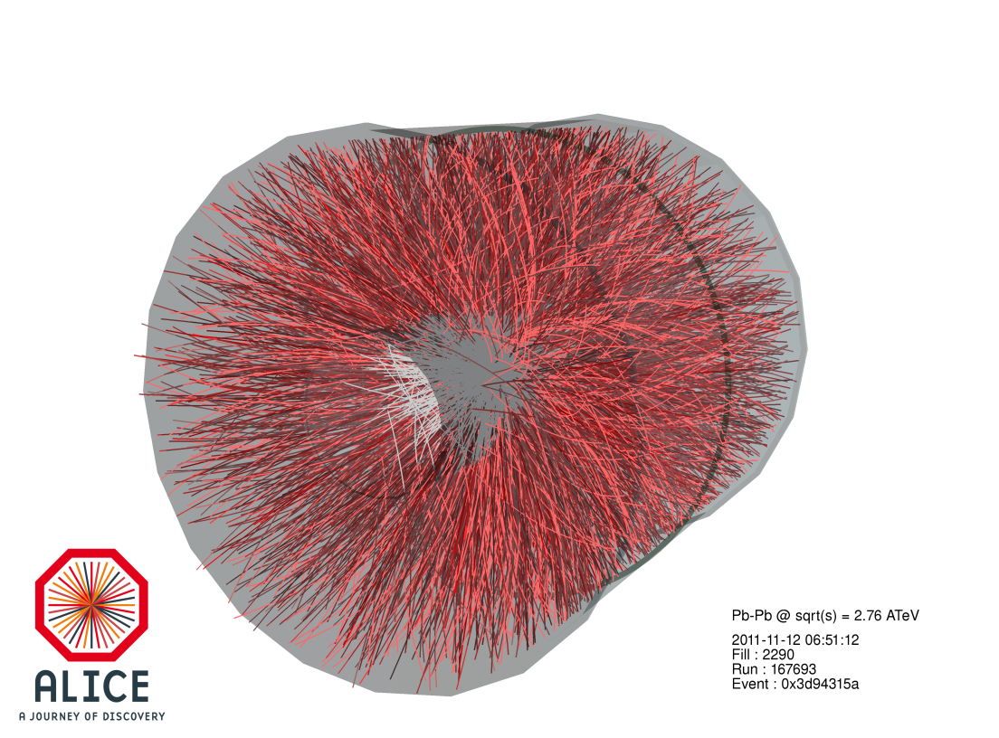
Heavy Ions and Quark-Gluon Plasma…
E. Scomparin – INFN Torino (Italy)
…to LHC!
From SPS…
…to RHIC…
Highlights from a
25 year-old story

Slide 2
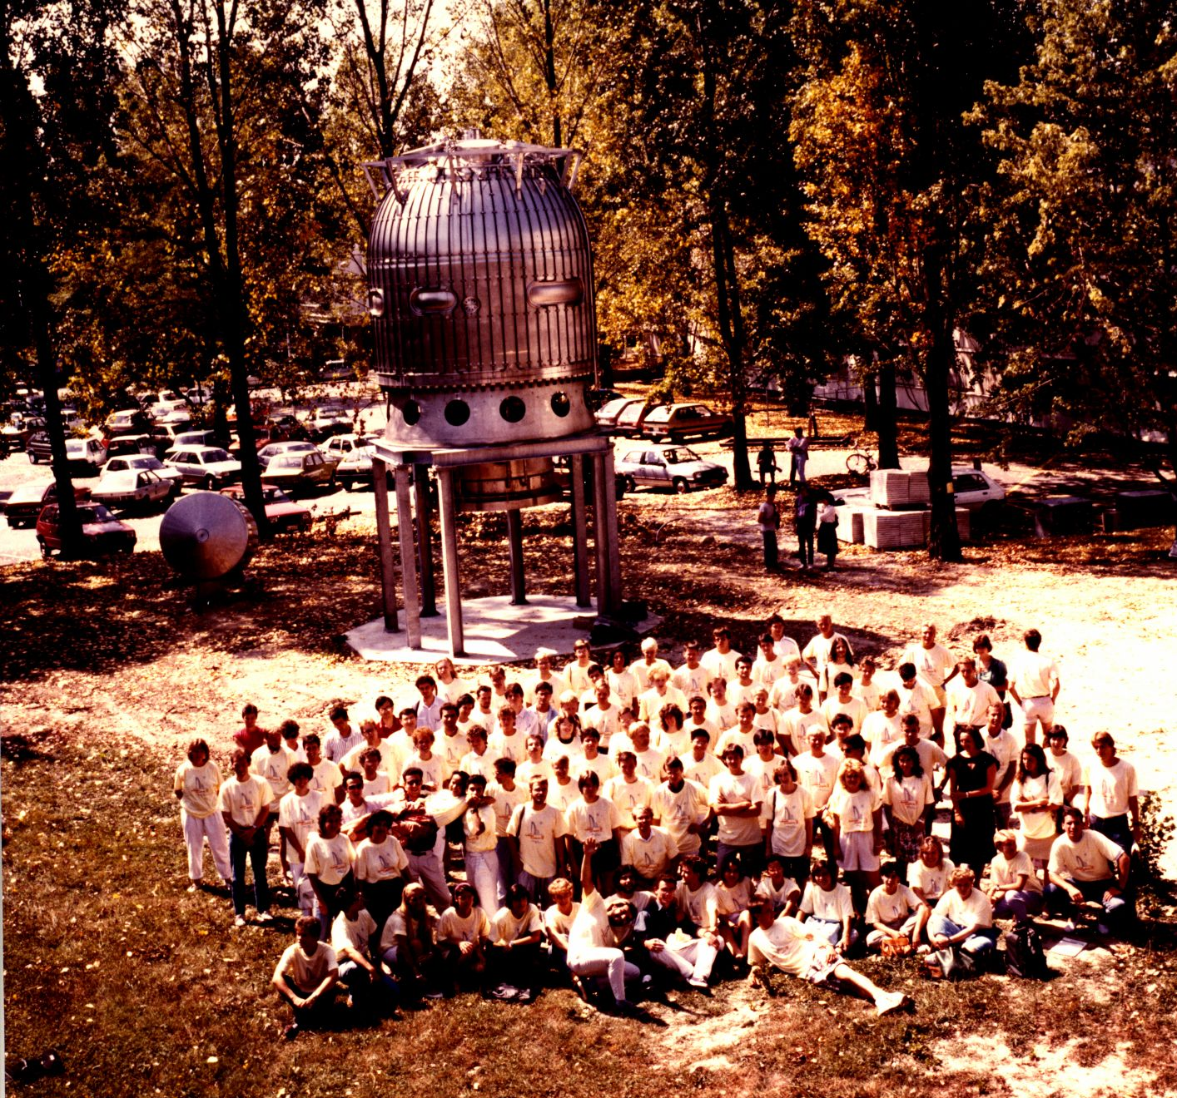
Before starting….
CERN Summer Student Official Photo
(1988!)

Slide 3

Before starting….
Many thanks to all of my colleagues who produced many of the
plots/slides I will show you in these three lectures…..
…and in particular to my Torino colleagues Massimo Masera
and Francesco Prino. We hold together a university course on these
topics and several slides come from there

Slide 4
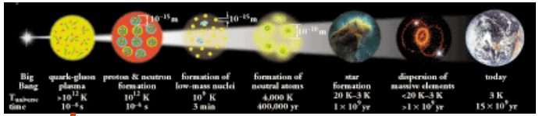
Why heavy ions ?
Heavy-ion interactions represent by far the most complex collision
system studied in particle physics labs around the world
So why people are attracted to the study of such a complex system ?
Because they can offer a unique view to understand
The nature of confinement
The Universe a few micro-seconds after the Big-Bang,
when the temperature was ~10¹² K
Let’s briefly recall the properties of strong interaction…..

Slide 5
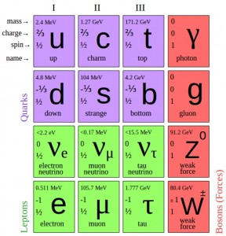
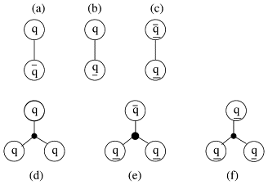
Strong interaction
Stable hadrons, and in particular protons and neutrons, which build up
our world, can be understood as composite objects, made of quarks
and gluons, bound by the strong interaction (colour charge)
3 colour charge states (R,B,G) are
postulated in order to explain the
composition of baryons (3 quarks or
antiquarks) and mesons (quark-antiquark pair)
as color singlets in SU(3) symmetry
Colour interaction through 8 massless vector
bosons →gluons
The theory describing the interactions of quarks and gluons was
formulated in analogy to QED and is called Quantum
Chromodynamics (QCD)

Slide 6
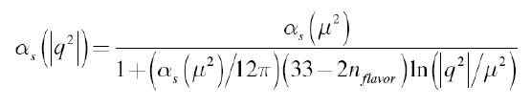
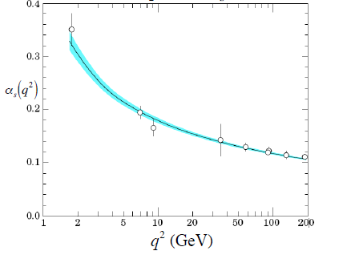
Coupling constant
Contrary to QED, in QCD the coupling constant decreases when
the momentum transferred in the interaction increases or, in other
words, at short distances
Express α_{S} as a function of
its value estimated at a certain
momentum transfer μ
Consequences
→ asymptotic freedom (i.e. perturbative calculations possible
mainly for hard processes)
→ interaction grows stronger as distance increases

Slide 7


From a confined world….
The increase of the interaction strength, when for example a quark and
an antiquark in a heavy meson are pulled apart can be approximately
expressed by the potential
where the confinement term Kr parametrizes the effects
of confinement
When r increases, the colour field can be seen as a tube connecting the quarks
At large r, it becomes energetically favourable to convert
the (increasing) energy stored in the color tube to a
new qq_{bar} pair
This kind of processes (and in general the phenomenology
of confinement) CANNOT be described by perturbative QCD,
but rather through lattice calculations or bag models, inspired to QCD

Slide 8
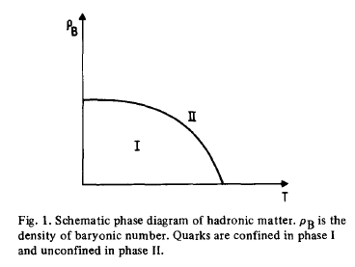
…to deconfinement
Since the interactions between quarks and gluons become weaker
at small distances, it might be possible, by creating a high
density/temperature extended system composed by a large number of
quarks and gluons, to create a “deconfined” phase of matter
First ideas in that sense date back to the ‘70s
”Experimental hadronic spectrum
and quark liberation”
Cabibbo and Parisi Phys. Lett. 59B, 67 (1975)
Phase transition at large T and/or ρ_{B}

Slide 9
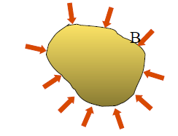

Becoming more quantitative…
MIT bag model: a simple, phenomenological approach which contains
a description of deconfinement
Quarks are considered as massless particles contained in a finite-size bag
Confinement comes from the balancing of the pression from the quark
kinetic energy and an ad-hoc external pressure
Kinetic term
Bag energy
Bag pressure can be estimated by considering the typical hadron size
If the pression inside the bag increases in such a way that it exceeds the
external pressure → deconfined phase, or Quark-Gluon Plasma (QGP)
How to increase pressure ?
  Temperature increase → increases kinetic energy associated to quarks
  Baryon density increase → compression

Slide 10
High-temperature QGP
Pressure of an ideal QGP is given by
with g_{tot} (total number of degrees of freedom relative to quark, antiquark
and gluons) given by g_{tot} = g_{g} + 7/8 × (g_{q} + g_{qbar}) = 37, since
g_{g} = 8 × 2 (eight gluons with two possible polarizations)
g_{q} = g_{qbar} = N_{color} × N_{spin} × N_{flavour} = 3 × 2 × 2
The critical temperature where QGP pressure is equal to the bag
pressure is given by
and the corresponding energy density ε=3P is given by

Slide 11
High-density QGP
Number of quarks with momenta between p and p+dp is (Fermi-Dirac)
where μ_{q} is the chemical potential, related
to the energy needed to add one quark to
the system
The pressure of a compressed system of quarks is
Imposing also in this case the bag pressure to be equal to the pressure
of the system of quarks, one has
which gives μ_{q} = 434 MeV
In terms of baryon density this corresponds to n_{B} = 0.72 fm⁻³, which is
about 5 times larger than the normal nuclear density!

Slide 12
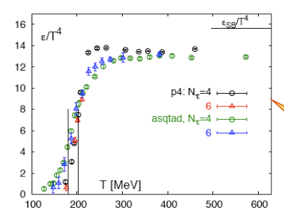
Lattice QCD approach
The approach of the previous slides can be considered useful only
for what concerns the order of magnitude of the estimated parameters
Lattice gauge theory is a non-perturbative QCD approach based on a
discretization of the space-time coordinates (lattice) and on the
evaluation of path integrals, which is able to give more quantitative
results on the occurrence of the phase transition
In the end one evaluates the partition function and consequently
  The thermodynamic quantities
  The “order parameters” sensitive to the phase transition
This computation technique requires intensive use of computing resources
“Jump” corresponding to the
increase in the number of degrees
of freedom in the QGP
(pion gas, just 3 degrees of freedom,
corresponding to π⁺, π⁻, π⁰)
Ideal (i.e., non-interacting) gas
limit not reached even at high
temperatures

Slide 13
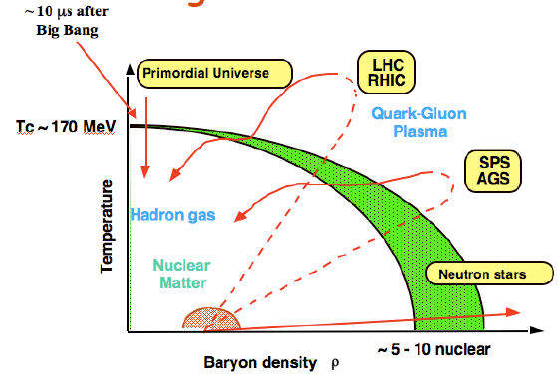
Phase diagram of strongly interacting matter
The present knowledge of the phase diagram of strongly interacting
matter can be qualitatively summarized by the following plot
How can one “explore” this phase diagram ?
By creating extended systems of quarks and gluons at
high temperature and/or baryon density → heavy-ion collisions!

Slide 14

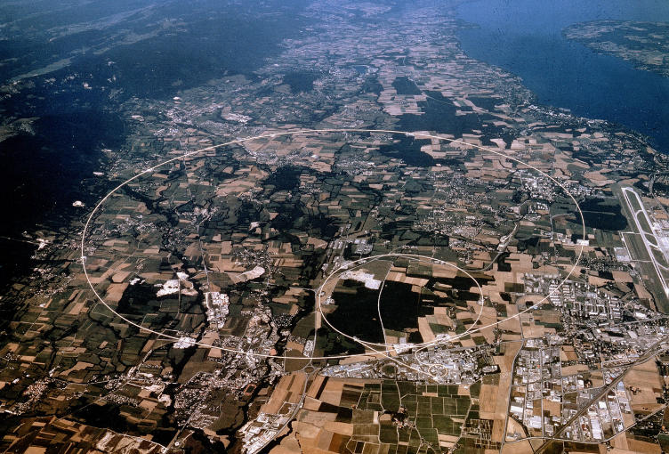
Facilities for HI collisions
The study of the phase transition requires center-of-mass energies of
the collision of several GeV/nucleon
First results date back to the 80’s when existing accelerators and
experiments at BNL and CERN were modified in order to be able to
accelerate ion beams and to detect the particles emitted in the collisions
BNL

Slide 15
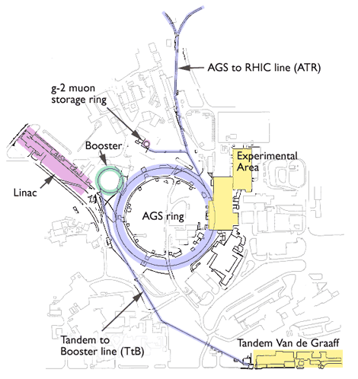
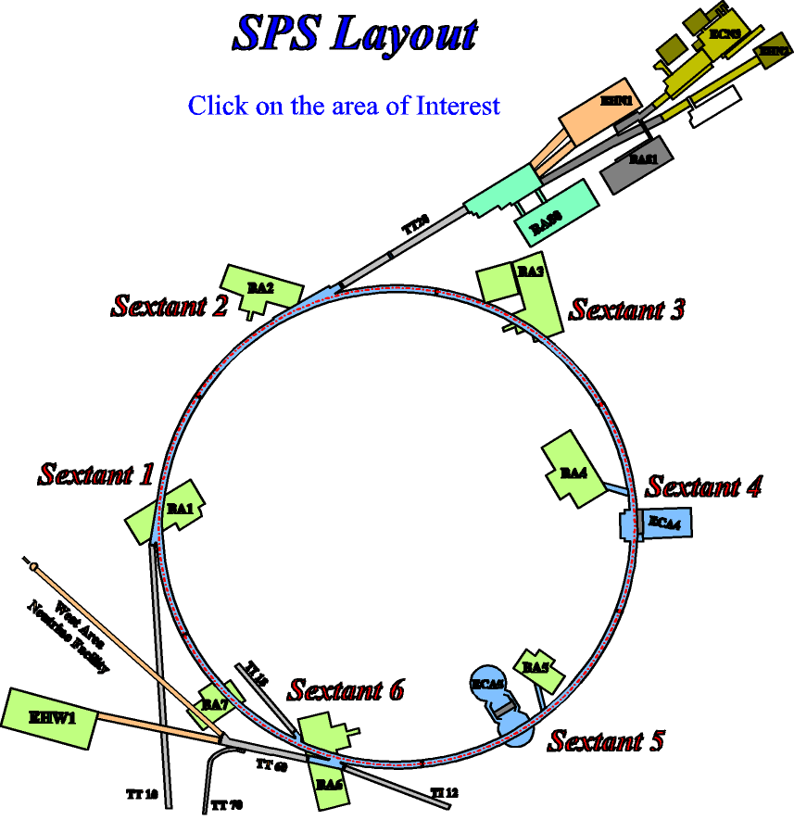
From fixed-target…
AGS at BNL
p beams up to 33 GeV
Si and Au beams up to 14.6 A GeV
SPS at CERN
p beams up to 450 GeV
O, S, In, Pb up to 200 A GeV
Remember Z/A rule !

Slide 16
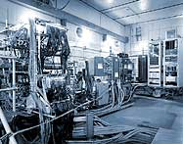
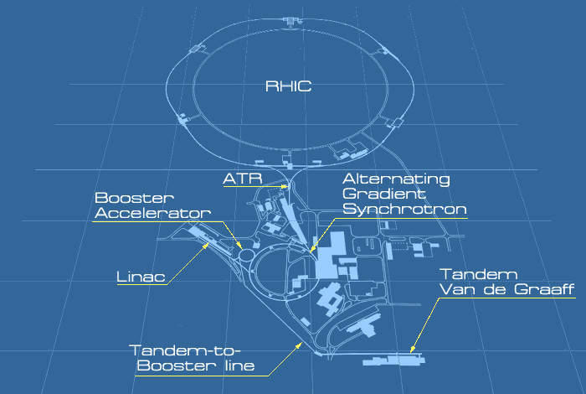

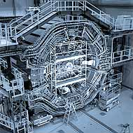
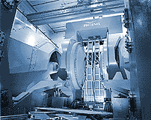
… to colliders!
RHIC: the first dedicated machine for HI collisions (Au-Au, Cu-Cu)
  Maximum √s_{NN} = 200 GeV
2 main experiments : STAR and PHENIX
2 small(er) experiments: PHOBOS and BRAHMS

Slide 17
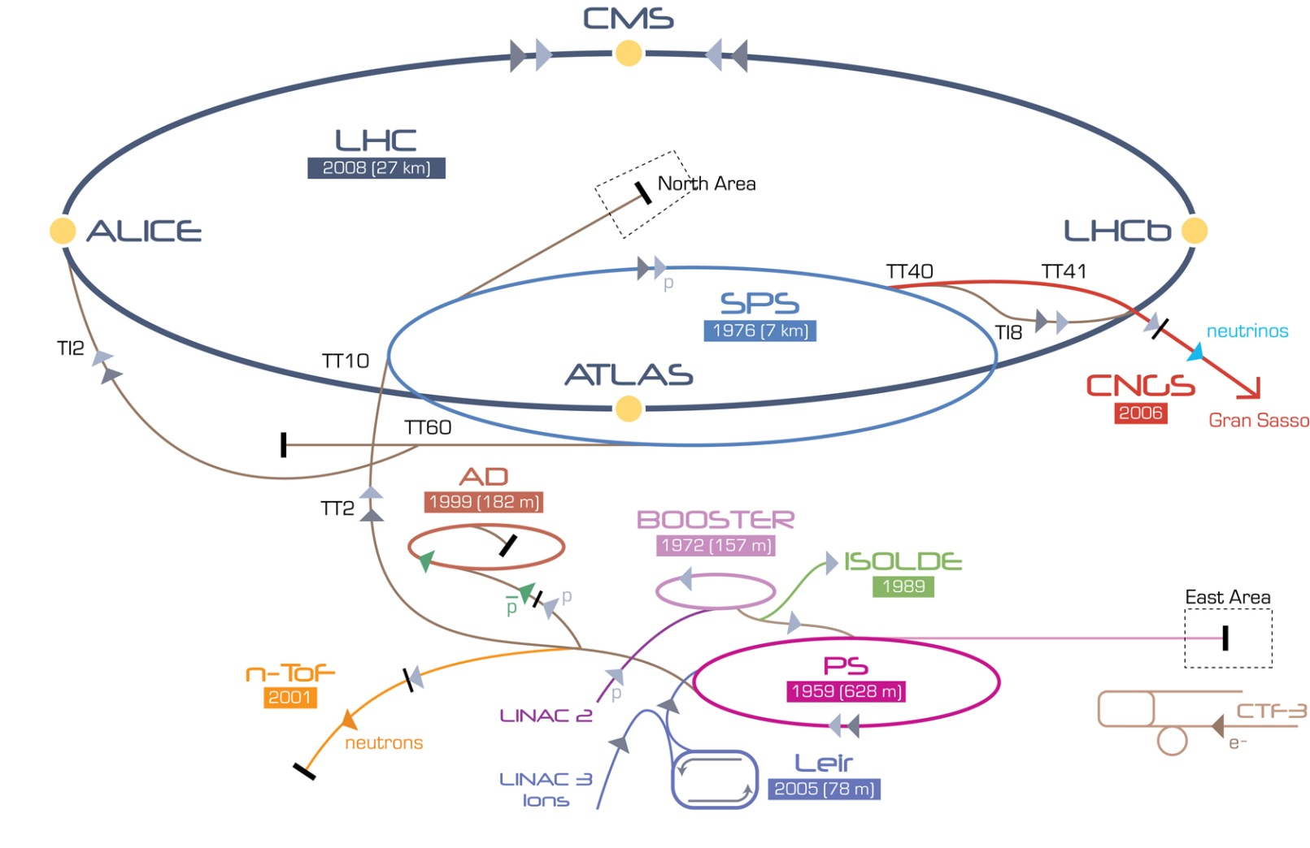
… to colliders!
LHC: the most powerful machine for HI collisions
  √s_{NN} = 2760 GeV (for the moment!)
3 experiments studying HI collisions: ALICE, ATLAS and CMS

Slide 18
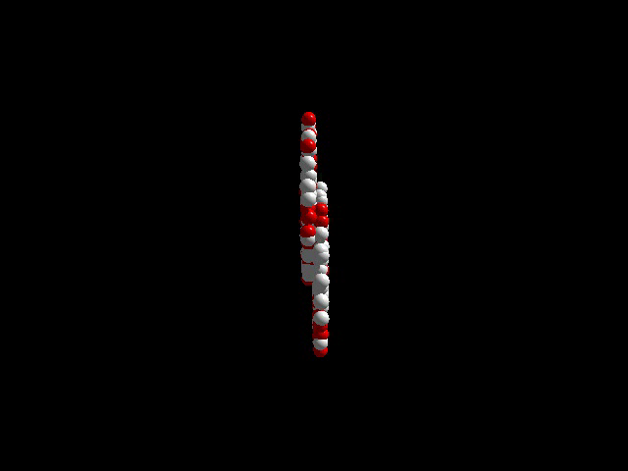
How does a collision look like ?
A very large number of secondary particles is produced
  How many ?
  Which is their kinematical distribution ?

Slide 19
Kinematical variables
The kinematical distribution of the produced particles are usually
expressed as a function of rapidity (y) and transverse momentum (p_{T})
p_{T}: Lorentz-invariant with respect to a boost in the beam direction
y: no Lorentz-invariant but additive transformation law → y’=y-y_{β}
(where y_{β} is the rapidity of the ref. system boosted by a velocity β)
y measurement needs particle ID (measure momentum and energy)
Practical alternative: pseudorapidity (η)
y~η for relativistic particles
Alternative variable to p_{T}: transverse mass m_{T}

Slide 20
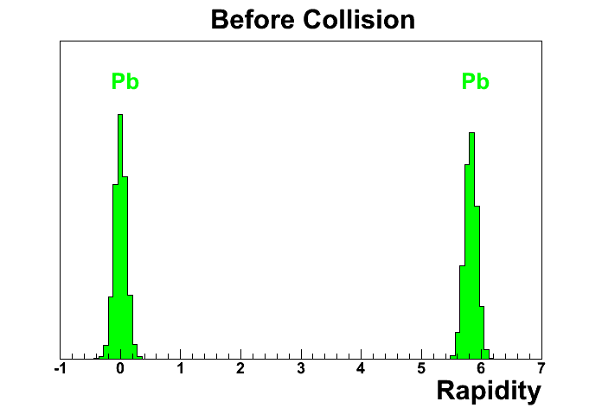
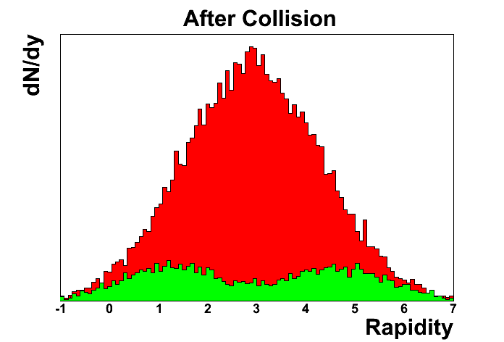
Typical rapidity distributions
Fixed target: SPS
  p_{BEAM}=158 GeV/c, β_{ΒΕΑΜ}=0.999982
  p_{TARGET}=0 , β_{TARGET}=0
Collider: RHIC
Midrapidity:
largest density of
produced particle
  p_{BEAM}=100 GeV/c
  β=0.999956, γ_{BEAM}≈100
20

Slide 21

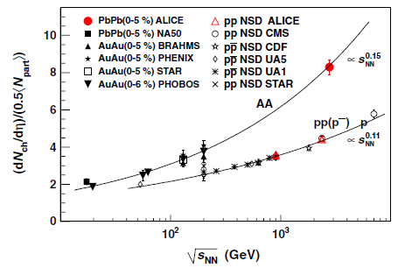
Multiplicity at midrapidity
SPS energy
RHIC energy
LHC energy (ALICE)
Strong increase in the number of produced particles with √s
In principle more favourable conditions at large √s for the creation of an
extended strongly interacting system

Slide 22


Multiplicity and energy density
Can we estimate the energy density reached in the collision ?
Important quantity: directly related to the possibility of observing
the deconfinement transition (foreseen for ε ≥ 1 GeV/fm³)
If we consider two colliding nuclei with Lorentz-factor γ, in the instant
of total superposition one could have
→ at RHIC energies →
(enormous!)
But the moment of total overlap is very short!
  → Need a more realistic approach
Consider colliding nuclei as thin pancakes (Lorentz-contraction)
which, after crossing, leave an initial volume with a limited longitudinal
extension, where the secondary particles are produced

Slide 23
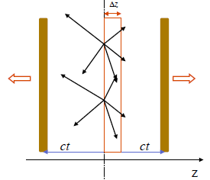


Multiplicity and energy density
Calculate energy density at the time τ_{f} (formation time) when the
secondary particles are produced
Let’s consider a slice of thickness Δz and transverse area A. It will
contain all particles with a velocity
The number of particles
will be given by
(y~β when
y is small)

Slide 24

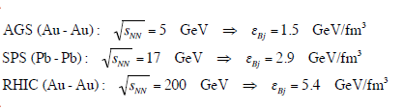
Multiplicity and energy density
The average energy of these particles is close to their average
transverse mass since E=m_{T}cosh y ~ m_{T} when y→0
Therefore the energy density at formation time can be obtained as
Bjorken
formula
Assuming τ_{f} ~ 1 fm/c one gets
values larger than 1 GeV/fm³ !
Compatible with phase transition
With LHC data one gets ε_{Bj} ~ 15 GeV/fm³
Warning: τ_{f} is expected to decrease when increasing √s
For example, at RHIC energies a more realistic value is τ_{f}~0.35-0.5 fm/c

Slide 25
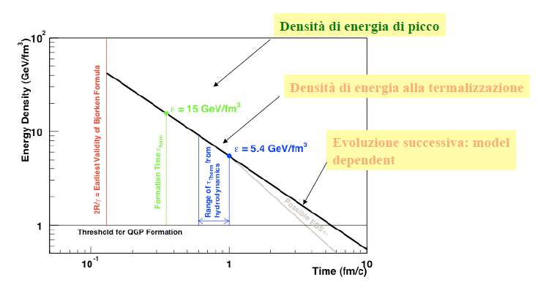
Time evolution of energy density
One should take into account that the system created in heavy-ion
collisions undergoes a fast evolution
This is a more realistic evaluation (RHIC energies)
Peak energy density
Energy density at
thermalization
Late evolution:
model dependent

Slide 26
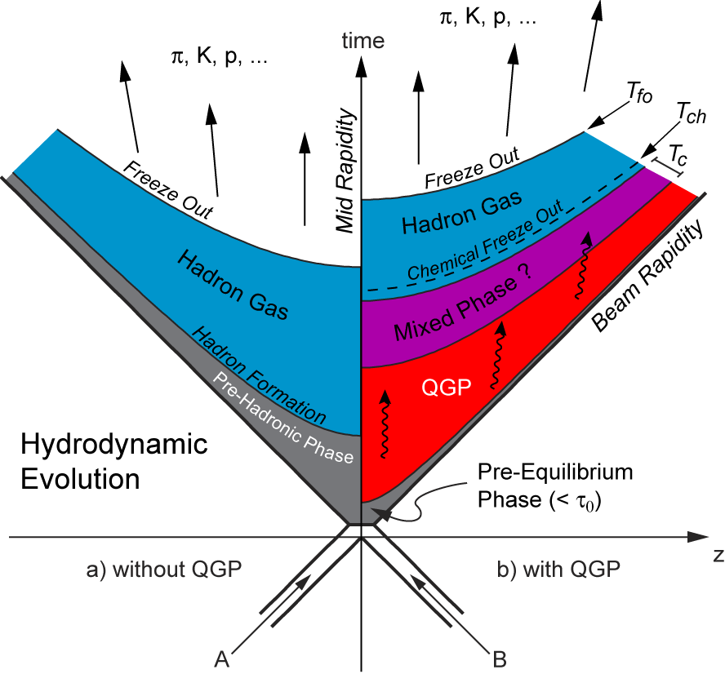
Time evolution of the collision
More in general, the space-time evolution of the collision is not trivial
In particular we will see that different observables can give us
information on different stages in the history of the collision
Soft processes:
High cross section
Decouple late
→ indirect signals for QGP
EM probes (real and virtual photons): insensitive to the hadronization phase
Hard processes:
Low cross section
Probe the whole
evolution of the collision

Slide 27
High- vs low-energy collisions
Clearly, high-energy collisions should create more favourable
conditions for the observation of the deconfinement transition
However, moderate-energy collisions have interesting features
Let’s compare the net baryon rapidity distributions at various √s
Starting at top SPS energy, we observe
a depletion in the rapidity distribution
of baryons (B-B_{bar} compensates for
baryon-antibaryon production)
Corresponds to two different regimes:
  baryon stopping at low √s
  nuclear transparency at high √s
Explore different regions
of the phase diagram

Slide 28
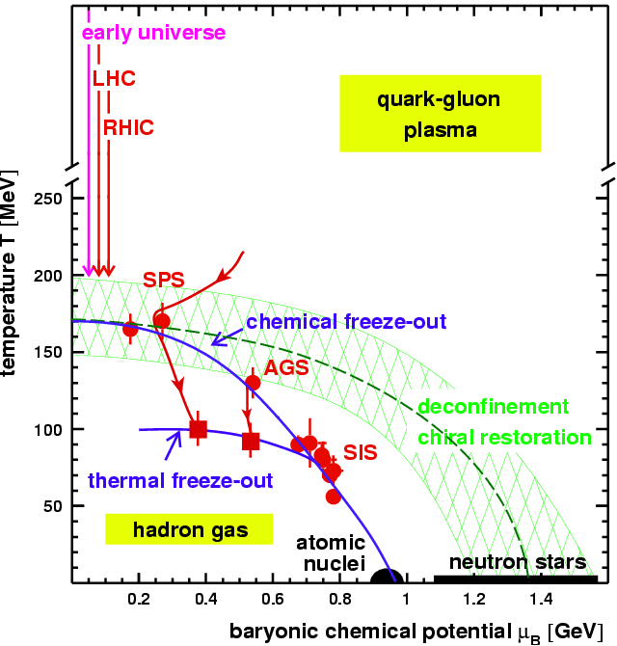
Mapping the phase diagram
High-energy
experiments
Low-energy
experiments
High-energy experiments → create conditions similar to Early Universe
Low-energy experiments → create dense baryonic system

Slide 29
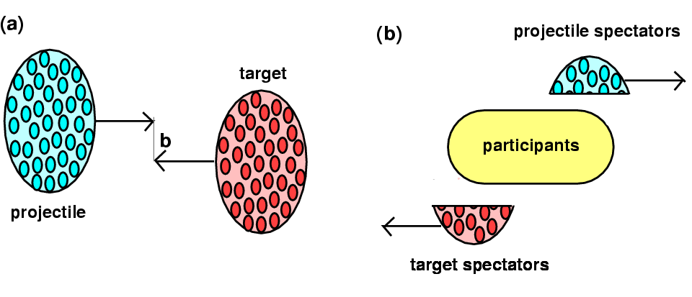
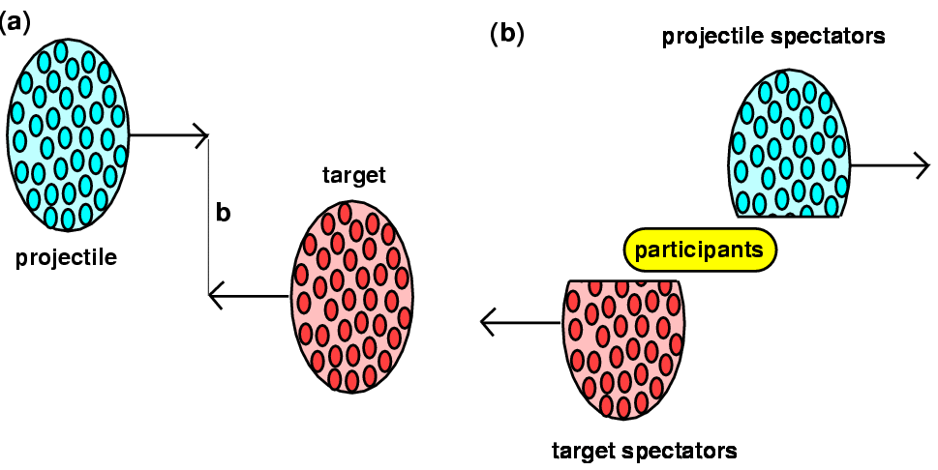
Characterizing heavy-ion collisions
The experimental characterization of the collisions is an essential
prerequisite for any detailed study
In particular, the centrality of the collision is one of the most important
parameters, and it can be quantified by the impact parameter (b)
Small b → central collisions
  Many nucleons involved
  Many nucleon-nucleon collisions
  Large interaction volume
  Many produced particles
Large b → peripheral collisions
  Few nucleons involved
  Few nucleon-nucleon collisions
  Small interaction volume
  Few produced particles
29

Slide 30
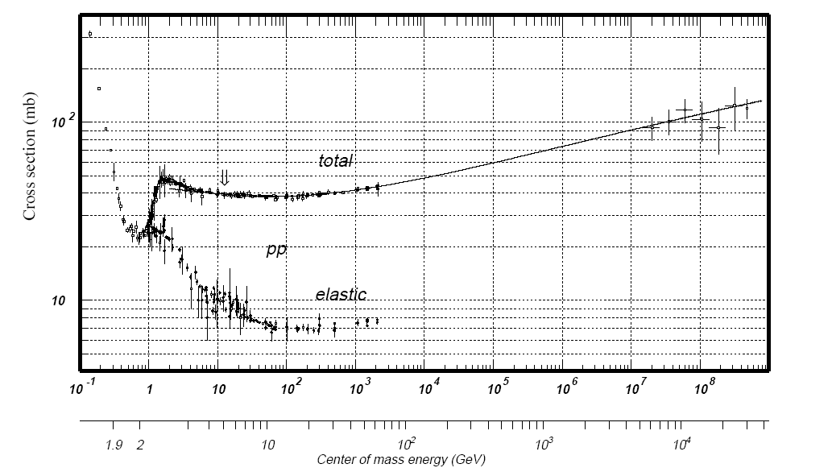
Hadronic cross section
Hadronic pp cross section grows logarithmically with √s
Mean free
path
RHIC (top)
LHC(p)
SPS
LHC(Pb)
ρ ~ 0.17 fm⁻³
~ 70 mb
= 7 fm²
λ ~ 1 fm
is small with
respect to
the nucleus size
→ opacity
Laboratory beam momentum (GeV/c)
Nucleus-nucleus hadronic cross section can be approximated
by the geometric cross section
σ_{had}^{PbPb} = 640 fm² = 6.4 barn
(r₀ = 1.35 fm, δ = 1.1 fm)

Slide 31
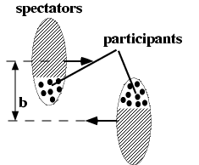
Glauber model
Geometrical features of the collision determines its global characteristics
Usually calculated using the Glauber model, a semiclassical approach
Nucleus-nucleus interaction → incoherent superposition of
nucleon-nucleon collisions calculated in a probabilistic approach
Quantities that can be calculated
  Interaction probability
  Number of elementary nucleon-nucleon
  collisions (N_{coll})
  Number of participant nucleons (N_{part})
  Number of spectator nucleons
  Size of the overlap region
  ….
Nucleons in nuclei considered as point-like and non-interacting
(good approx, already at SPS energy λ=h/2πp ~10⁻³ fm)
Nucleus (and nucleons) have straight-line trajectories (no deflection)
Physical inputs
  Nucleon-nucleon inelastic cross section (see previous slide)
  Nuclear density distribution

Slide 32
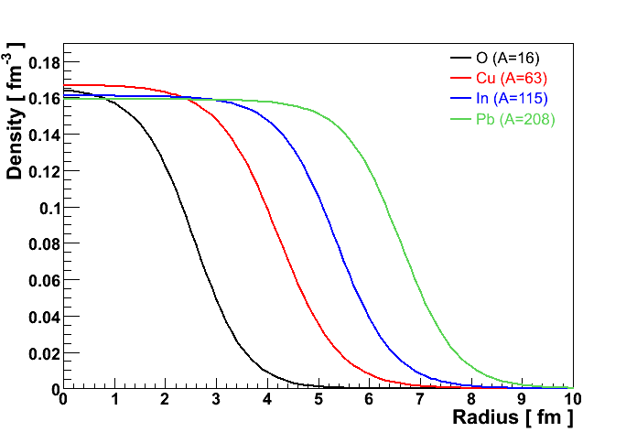
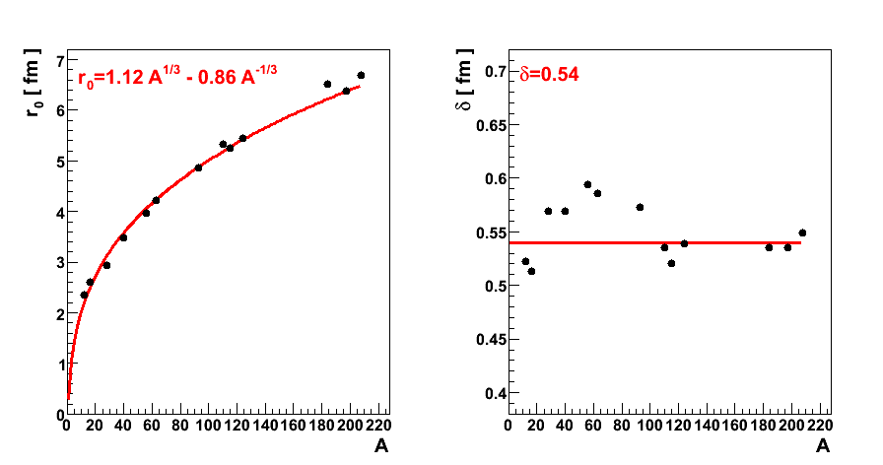
Nuclear densities
Core density
“skin depth”
Nuclear radius

Slide 33
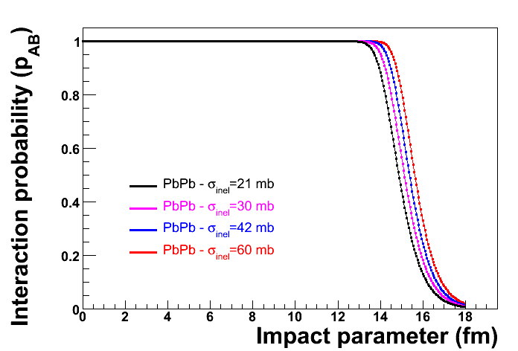
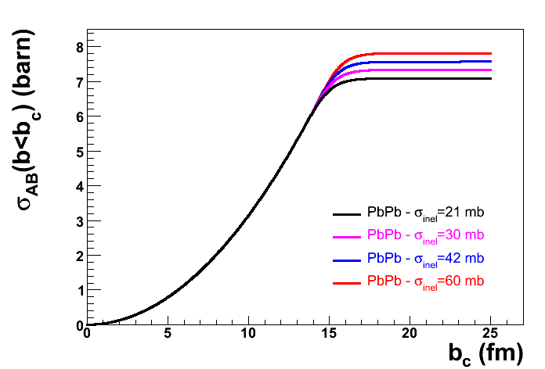
Interaction probability and hadronic cross sections
Glauber model results confirm the “opacity” of the interacting nuclei,
over a large range of input nucleon-nucleon cross sections
Only for very peripheral collisions (corona-corona) some transparency
can be seen

Slide 34
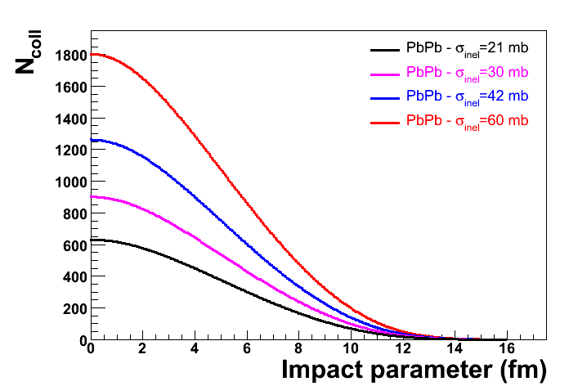
Nucleon-nucleon collisions vs b
Although the interaction probability practically does not depend on
the nucleon-nucleon cross section, the total number of nucleon-nucleon
collisions does
σ_{inel} corresponding to
the main ion-ion
facilities
Accel. | √s (GeV) | σ_{total} (mb) | σ_{inel} (mb)
AGS | 3-5 | 40 | 21
SPS | 17 | 40 | 33
RHIC | 200 | 50 | 42
LHC(Pb) | 5500 | 90 | 60

Slide 35
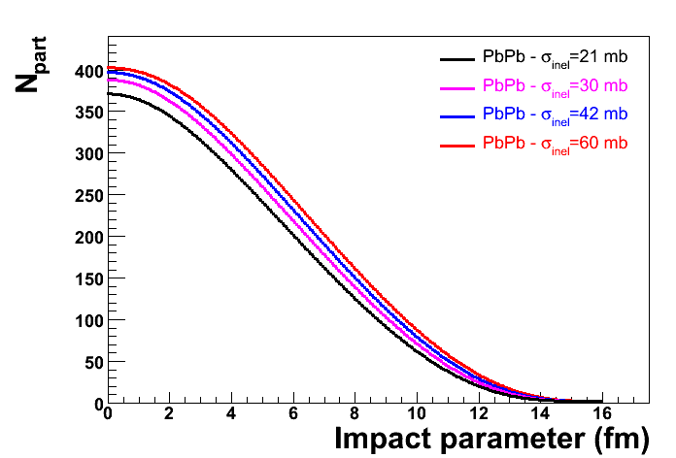
Number of participants vs b
With respect to N_{coll}, the dependence on the nucleon-nucleon cross
section is much weaker
When σ_{inel} > 30 mb, practically all the nucleons in the overlap region
have at least one interaction and therefore participate in the collisions
σ_{inel} corresponding to
the main ion-ion
facilities
Accel. | √s (GeV) | σ_{total} (mb) | σ_{inel} (mb)
AGS | 3-5 | 40 | 21
SPS | 17 | 40 | 33
RHIC | 200 | 50 | 42
LHC(Pb) | 5500 | 90 | 60
35

Slide 36
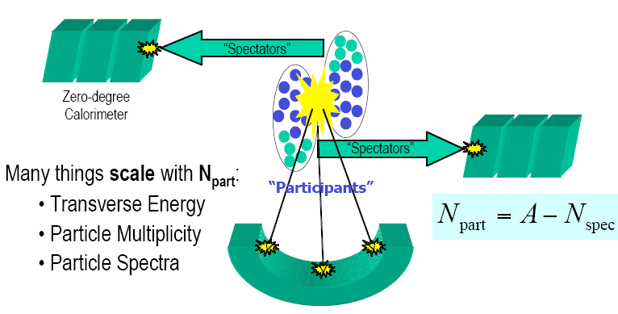
Centrality – how to access experimentally
Two main strategies to evaluate the impact parameter in
heavy-ion collisions
  Measure observables related to the energy deposited in the
  interaction region → charged particle multiplicity, transverse
  energy (∝ N_{part})
  Measure energy of hadrons emitted in the beam direction
  → zero degree energy (∝ N_{spect})

