Slide 1
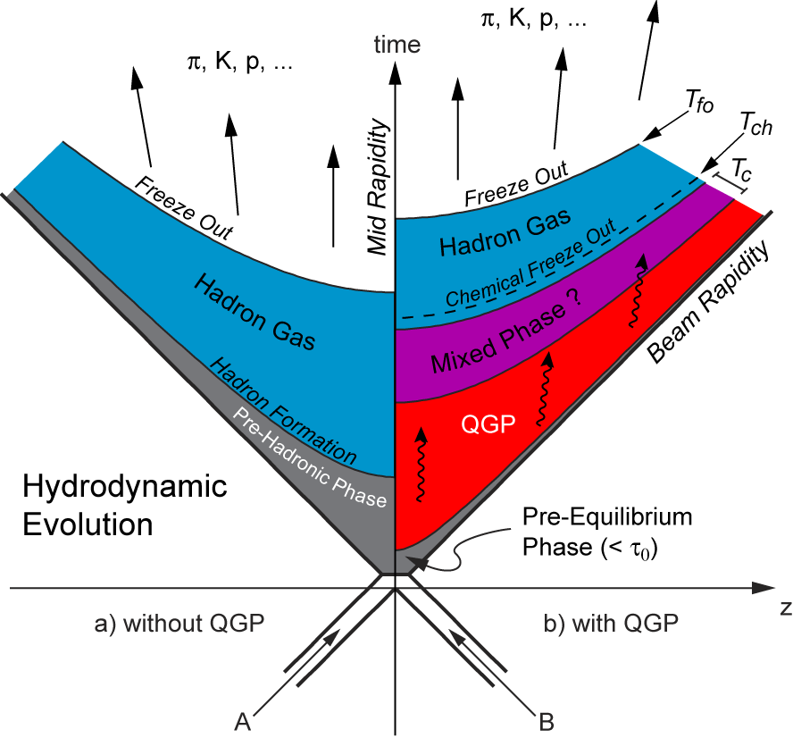
…and now to some results…
Can we understand quantitatively the evolution of the fireball ?

Slide 2
Chemical composition of the fireball
It is extremely interesting to measure the multiplicity of the various
particles produced in the collision → chemical composition
The chemical composition of the fireball is sensitive to
  Degree of equilibrium of the fireball at (chemical) freeze-out
  Temperature T_{ch} at chemical freeze-out
  Baryonic content of the fireball
This information is obtained through the use of statistical models
  Thermal and chemical equilibrium at chemical freeze-out assumed
  Write partition function and use statistical mechanics
(grand-canonical ensemble) → assume hadron production is a
statistical process
  System described as an ideal gas of hadrons and resonances
  Follows original ideas by Fermi (1950s) and Hagedorn (1960s)

Slide 3
Hadron multiplicities vs √s
Baryons from colliding
nuclei dominate at low √s
(stopping vs transparency)
Pions are the most
abundant mesons (low
mass and production
threshold)
Isospin effects at low √s
p_{bar}/p tends to 1 at
high √s
K⁺ and Λ more produced
than their anti-particles
(light quarks present in
colliding nuclei)

Slide 4
Statistical models
In statistical models of hadronization
  Hadron and resonance gas with baryons and mesons
  having m ≤ 2 GeV/c²
    Well known hadronic spectrum
    Well known decay chains
These models have in principle 5 free parameters:
  T : temperature
  μ_{B} : baryochemical potential
  μ_{S} : strangeness chemical potential
  μ_{I3} : isospin chemical potential
  V : fireball volume
  But three relations based on the knowledge of the initial state
  (N_{S} neutrons and Z_{S} “stopped” protons) allow us to reduce the
  number of free parameters to 2
Only 2 free parameters remain: T and μ_{B}

Slide 5
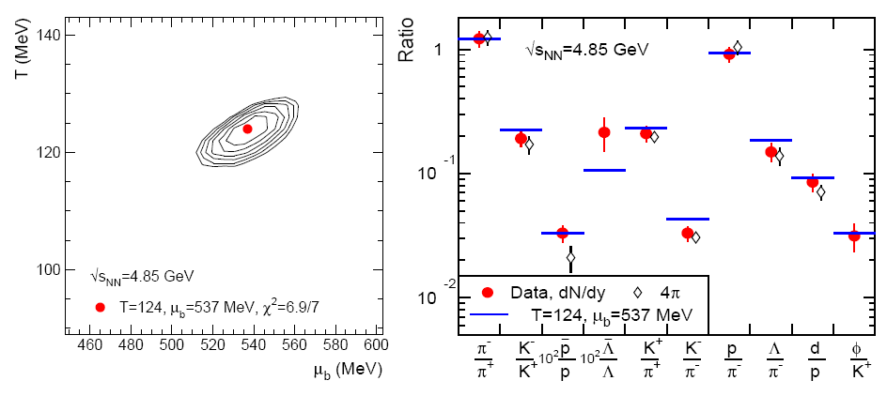
Particle ratios at AGS
Results on ratios: cancel a significant fraction of systematic uncertainties
AuAu - E_{beam}=10.7 GeV/nucleon - √s=4.85 GeV
Minimum χ² for: T=124±3 MeV μ_{B}=537±10 MeV
χ² contour lines

Slide 6
Particle ratios at SPS
PbPb - E_{beam}=40 GeV/ nucleon - √s=8.77 GeV
Minimum χ² for: T=156±3 MeV μ_{B}=403±18 MeV
χ² contour lines

Slide 7
Particle ratios at RHIC
AuAu - √s=130 GeV
Valore minimo di χ² per: T=166±5 MeV μ_{B}=38±11 MeV
χ² contour lines

Slide 8
Thermal model parameters vs. √s
The temperature T_{ch} quickly
increases with √s up to ~170 MeV
(close to critical temperature for the
phase transition!) at √s ~ 7-8 GeV
and then stays constant
The chemical potential μ_{B} decreases
with √s in all the energy range
explored from AGS to RHIC

Slide 9
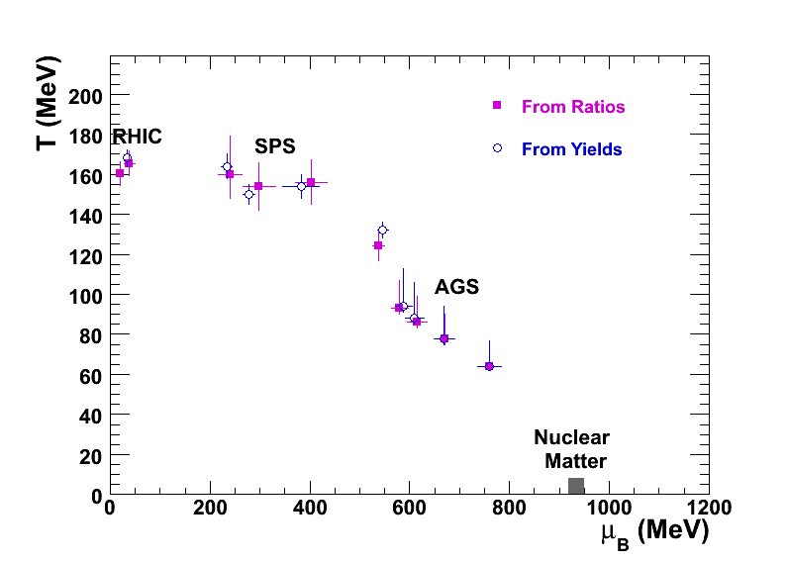
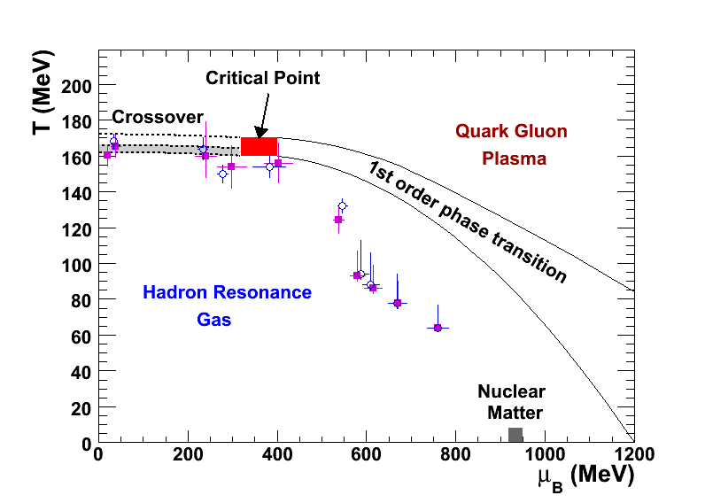
Chemical freeze-out and phase diagram
Compare the evolution vs √s of the (T,μ_{B}) pairs with the QCD phase
diagram
The points approach the phase transition region already at SPS energy
The hadronic system reaches chemical equilibrium immediately after
the transition QGP→hadrons takes place

Slide 10
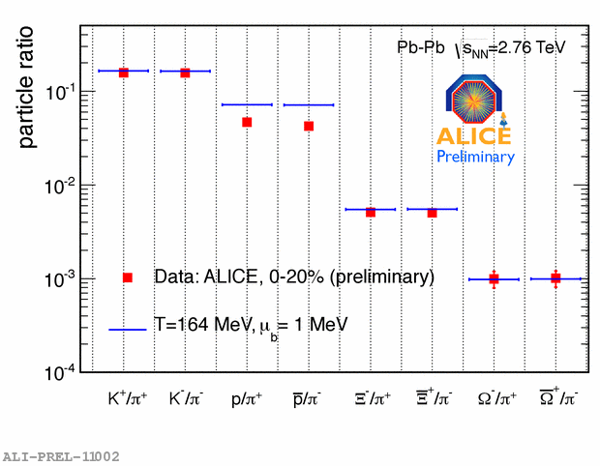
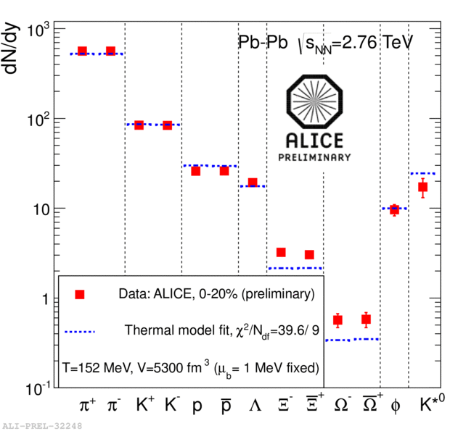
News from LHC
Thermal model fits for yields
and particle ratios
T=164 MeV, excluding protons
Unexpected results for protons: abundances below thermal model
predictions → work in progress to understand this new feature!

Slide 11
Chemical freeze-out
Fits to particle abundances
or particle ratios in
thermal models
These models assume
chemical and thermal
equilibrium and describe
very well the data
The chemical freeze-out
temperature saturates
at around 170 MeV, while
μ_{B} approaches zero at
high energy
New LHC data still
challenging

Slide 12
Collective motion in heavy-ion collisions (FLOW)
Radial flow → connection with thermal freeze-out
Elliptic flow → connection with thermalization of the system
Let’s start from p_{T} distributions in pp and AA collisions

Slide 13
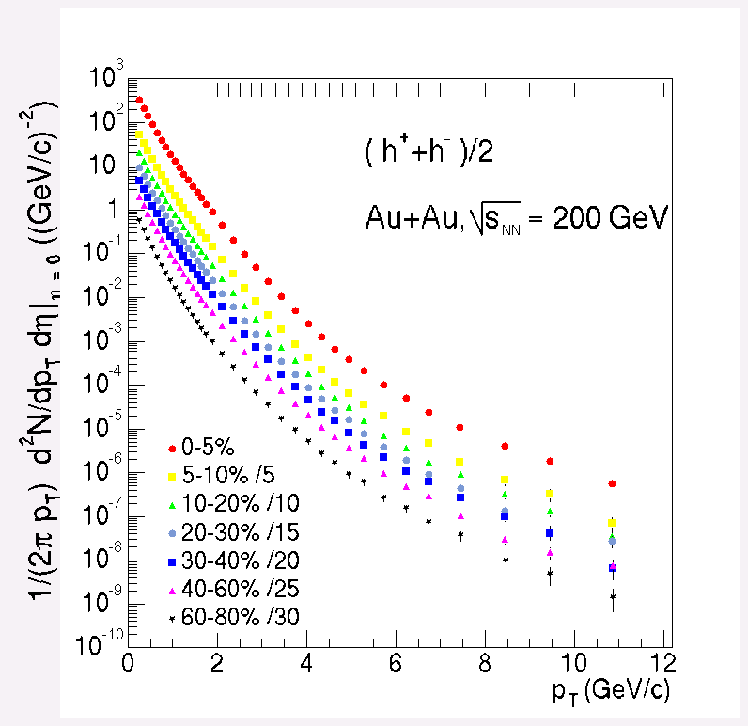
p_{T} distributions
Transverse momentum distributions of produced particles can provide important information on the system created in the collisions
Low p_{T} (<~1 GeV/c)
Soft production
mechanisms
1/p_{T} dN/dp_{T} ~exponential,
Boltzmann-like and almost
independent on √s
High p_{T} (>>1 GeV/c)
Hard production
mechanisms
Deviation from exponential
behaviour towards
power-law

Slide 14
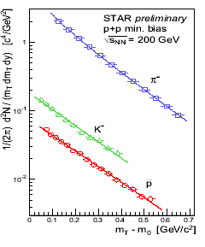
Let’s concentrate on low p_{T}
In pp collisions at low p_{T}
  Exponential behaviour, identical for
  all hadrons (m_{T} scaling)
T_{slope} ~ 167 MeV for all particles
These distribution look like thermal spectra and T_{slope} can be seen as
the temperature corresponding to the emission of the particles, when
interactions between particles stop (freeze-out temperature, T_{fo})
14

Slide 15
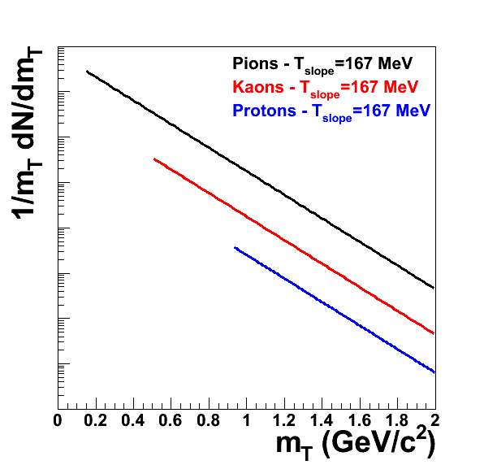
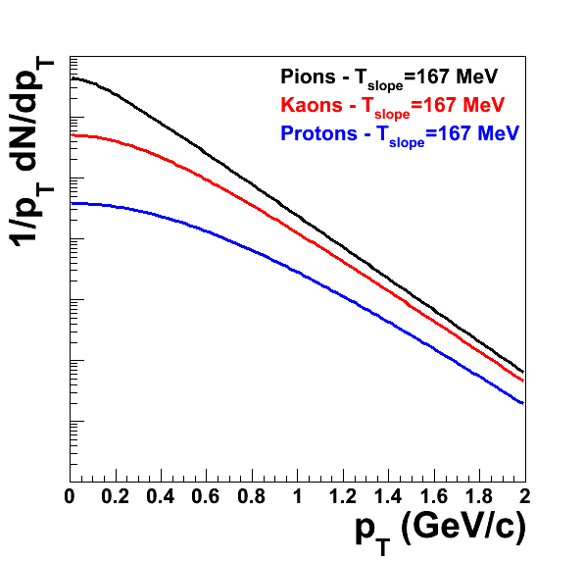
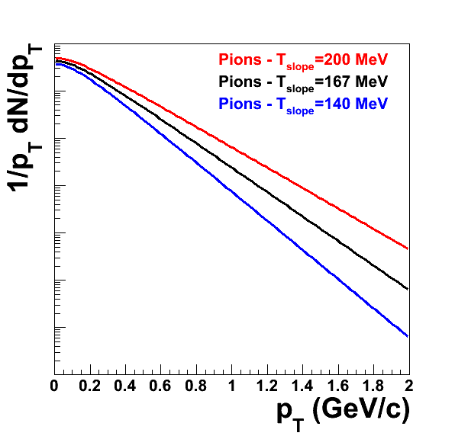
p_{T} and m_{T} spectra
Slightly different shape of spectra,
when plotted as a function of p_{T} or m_{T}
Evolution of p_{T} spectra vs T_{slope},
higher T implies “flatter” spectra

Slide 16
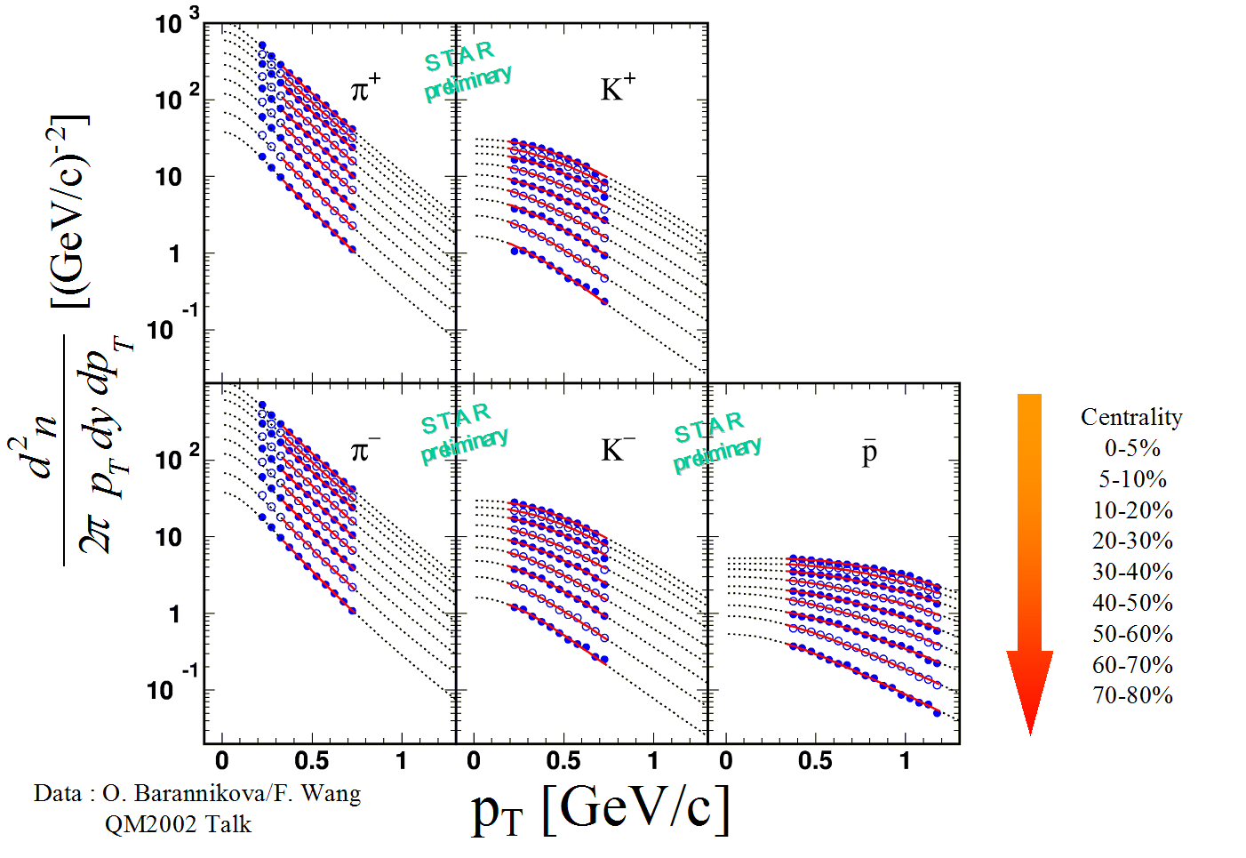
Breaking of m_{T} scaling in AA
Harder spectra (i.e. larger T_{slope})
for larger mass particles
Consistent with a shift towards
larger p_{T} of heavier particles

Slide 17
Breaking of m_{T} scaling in AA
T_{slope} depends linearly
on particle mass
Interpretation:
there is a collective
motion of all particles
in the transverse plane
with velocity v⊥ ,
superimposed to
thermal motion,
which gives
Such a collective transverse expansion is called radial flow
(also known as “Little Bang”!)

Slide 18
Flow in heavy-ion collisions
Flow: collective motion of particles superimposed to thermal motion
Due to the high pressures generated when nuclear matter is heated
and compressed
Flux velocity of an element of the system is given by the sum of the
velocities of the particles in that element
Collective flow is a correlation between the velocity v of a volume
element and its space-time position
y
v⊥
x
v⊥

Slide 19
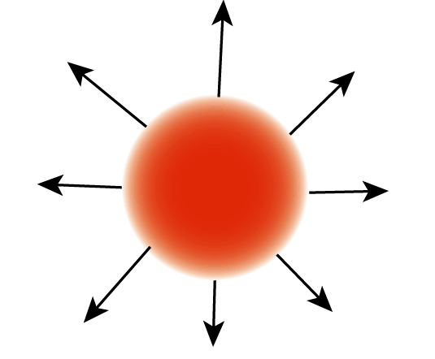
Radial flow at SPS
y
x
Radial flow breaks m_{T}
scaling at low p_{T}
With a fit to identified
particle spectra one can
separate thermal and
collective components
At top SPS energy
(√s=17 GeV):
T_{fo}= 120 MeV
β⊥ = 0.50
19

Slide 20
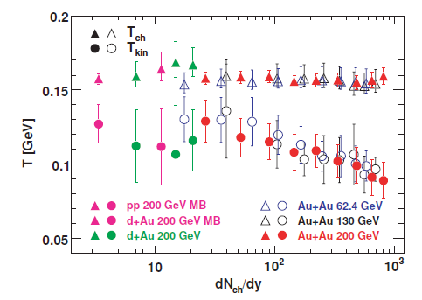
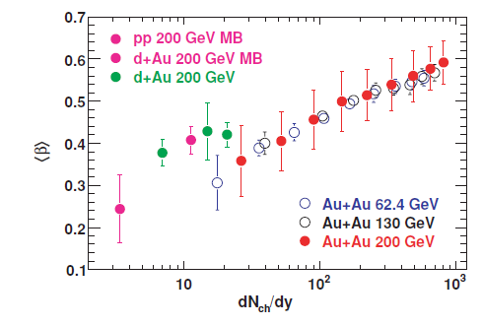
Radial flow at RHIC
y
x
Radial flow breaks m_{T}
scaling at low p_{T}
With a fit to identified
particle spectra one can
separate thermal and
collective components
At RHIC energy
(√s=200 GeV):
T_{fo}~ 100 MeV
β⊥ ~ 0.6
20

Slide 21
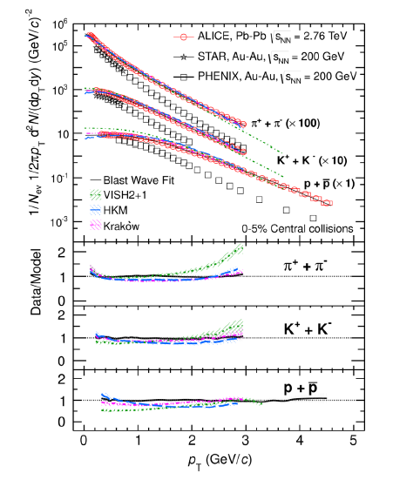
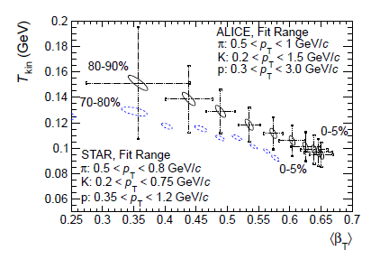
Radial flow at LHC
Pion, proton and kaon spectra
for central events (0-5%)
LHC spectra are harder than
those measured at RHIC
T_{fo}= 95 ± 10 MeV
β⊥ = 0.65 ± 0.02
Clear increase of radial flow at LHC,
compared to RHIC (same centrality)
21

Slide 22
Thermal freeze-out
Fits to p_{T} spectra allow
us to extract the
temperature T_{fo} and the
radial expansion velocity
at the thermal freeze-out
The fireball created in
heavy-ion collisions
crosses thermal
freeze-out at 90-130
MeV, depending on
centrality and √s
At thermal freeze-out the
fireball has a collective
radial expansion, with a
velocity 0.5-0.7 c

Slide 23
Anisotropic transverse flow
y
Ψ_{RP}
x
In heavy-ion collisions the impact parameter creates a “preferred”
direction in the transverse plane
The “reaction plane” is the plane defined by the impact parameter and
the beam direction
23

Slide 24
Anisotropic transverse flow
In collisions with b ≠ 0 (non central) the fireball has a geometric
anisotropy, with the overlap region being an ellipsoid
Macroscopically (hydrodynamic description)
  The pressure gradients, i.e. the forces “pushing” the particles are
anisotropic (ϕ-dependent), and larger in the x-z plane
  ϕ-dependent velocity → anisotropic azimuthal distribution of particles
Microscopically
Interactions between produced
particles (if strong enough!) can
convert the initial geometric
anisotropy in an anisotropy in
the momentum distributions
of particles, which can be
measured
y
z
x
Reaction plane

Slide 25
Anisotropic transverse flow
Starting from the azimuthal distributions of the produced particles with
respect to the reaction plane Ψ_{RP}, one can use a Fourier decomposition
and write
The terms in sin(ϕ-Ψ_{RP}) are not present since the particle distributions
need to be symmetric with respect to Ψ_{RP}
The coefficients of the various harmonics describe the deviations with
respect to an isotropic distribution
From the properties of Fourier’s series one has

Slide 26
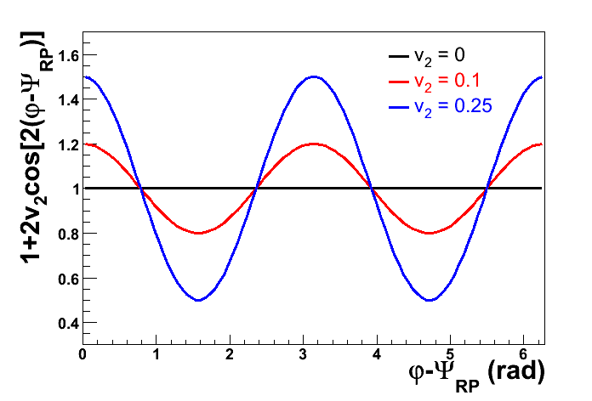
v₂ coefficient: elliptic flow
Elliptic flow
v₂ ≠ 0 means that there is a
difference between the
number of particles directed
parallel (0⁰ and 180⁰) and
perpendicular (90⁰ and 270⁰)
to the impact parameter
It is the effect that one may
expect from a difference of
pressure gradients parallel
and orthogonal to the impact
parameter
IN PLANE
v₂ > 0 → in-plane flow, v₂ < 0 out-of-plane flow
OUT OF PLANE

Slide 27
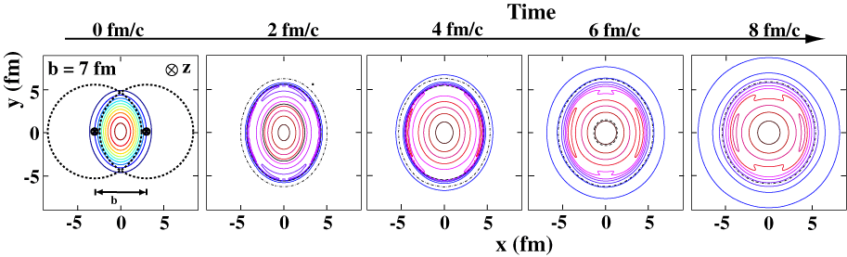
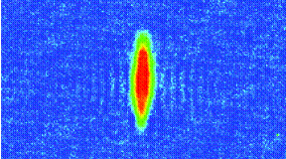
Elliptic flow - characteristics
The geometrical anisotropy which
gives rise to the elliptic flow
becomes weaker with the evolution
of the system
Pressure gradients are stronger in
the first stages of the collision
Elliptic flow is therefore an observable
particularly sensitive to the first stages
(QGP)

Slide 28
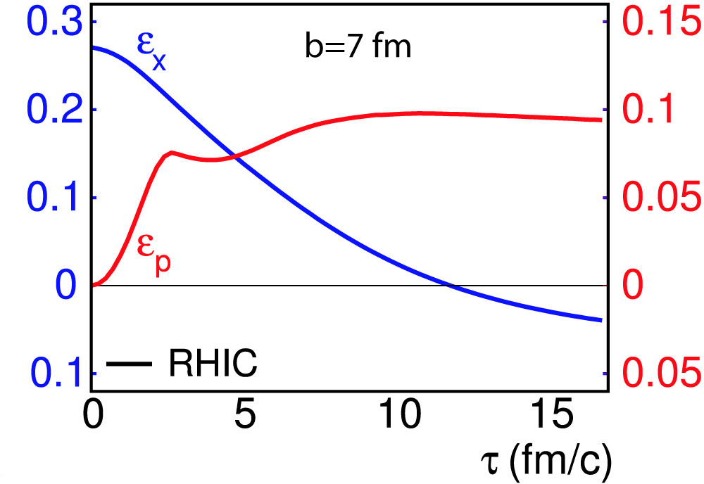
Elliptic flow - characteristics
The geometric anisotropy (ε_{X}= elliptic deformation of the fireball)
decreases with time
The momentum anisotropy (ε_{p} , which is the real observable), according
to hydrodynamic models:
  grows quickly in the QGP state (τ < 2-3 fm/c)
  remains constant during the phase transition (2<τ<5 fm/c), which in
  the models is assumed to be first-order
Increases slightly in the hadronic phase (τ > 5 fm/c)

Slide 29
Results on elliptic flow: RHIC
Elliptic flow depends on
  Eccentricity of the overlap region, which decreases for central events
  Number of interactions suffered by particles, which increases for
  central events
Very peripheral collisions:
  large eccentricity
  few re-interactions
  small v₂
Semi-peripheral collisions:
  large eccentricity
  several re-interactions
  large v₂
Semi-central collisions:
  no eccentricity
  many re-interactions
  v₂ small (=0 for b=0)
29

Slide 30
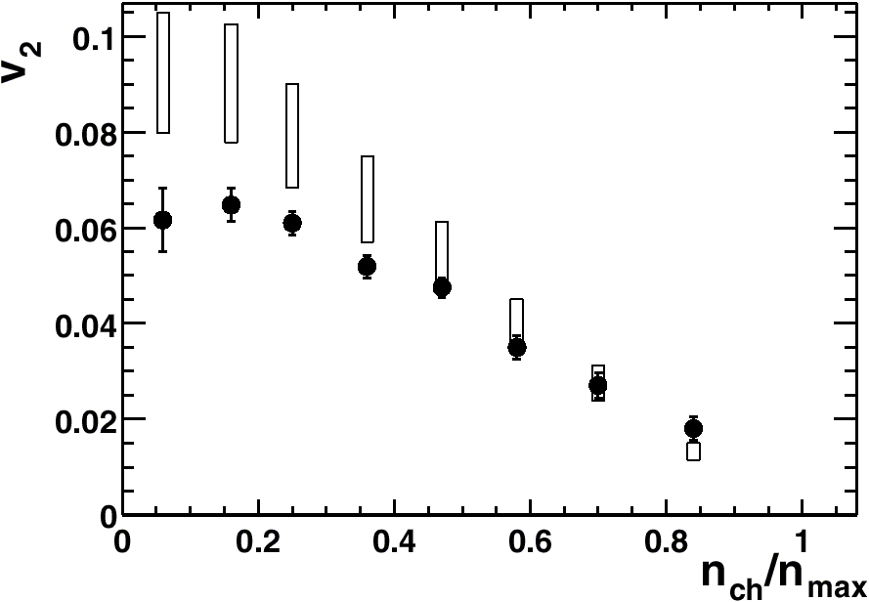
v₂ vs centrality at RHIC
Hydrodynamic limit
STAR
PHOBOS
RQMD
Measured v₂ values are in good agreement with ideal hydrodynamics
(no viscosity) for central and semi-central collisions, using parameters
(e.g. τ_{fo}) extracted from p_{T} spectra
Models, such as RQMD, based on a hadronic cascade, do not
reproduce the observed elliptic flow, which is therefore likely
to come from a partonic (i.e. deconfined) phase
Notes:
Parameters for hydro: initial state via Glauber equilibration time, freeze-out time

Slide 31
v₂ vs centrality at RHIC
Hydrodynamic limit
STAR
PHOBOS
RQMD
Interpretation
  In semi-central collisions there is a fast thermalization and the
  produced system is an ideal fluid
  When collisions become peripheral thermalization is incomplete
  or slower
Hydro limit corresponds to a perfect fluid, the effect of viscosity is
to reduce the elliptic flow

Slide 32
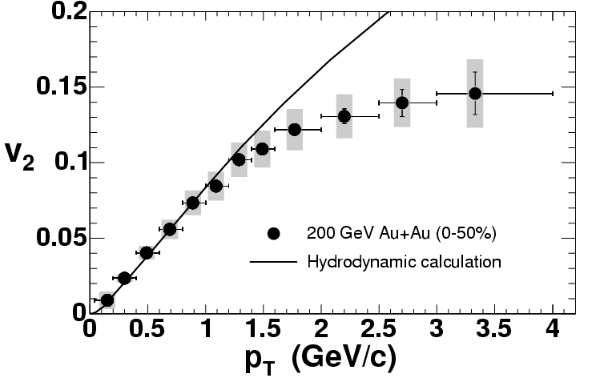
v₂ vs transverse momentum
At low p_{T} hydrodynamics reproduces data
At high p_{T} significant deviations are observed
Natural explanation: high-p_{T} particles quickly escape the fireball
without enough rescattering → no thermalization, hydrodynamics
not applicable
Notes:
Increase of v2 with pT: larger pT is generated by more rescattering so it is naturally connected to a larger v2

Slide 33
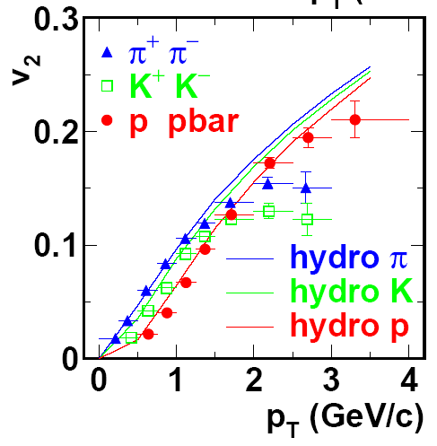

v₂ vs p_{T} for identified particles
Hydrodynamics can reproduce rather well also the dependence of
v₂ on particle mass, at low p_{T}
Notes:
Consequence of radial flow which pushes proton at higher pT

Slide 34
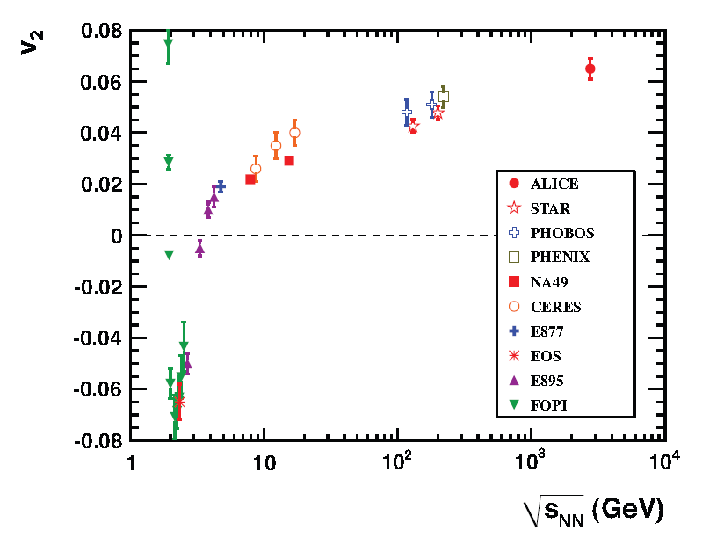
Elliptic flow, from RHIC to LHC
Elliptic flow, integrated over p_{T}, increases by 30% from RHIC to LHC
In-plane v₂ (>0) for very low √s: projectile and target form a rotating system
In-plane v₂ (>0) at relativistic energies (AGS and above) driven by pressure gradients (collective hydrodynamics)
Out-of-plane v₂ (<0) for low √s, due to absorption by spectator nucleons

Slide 35
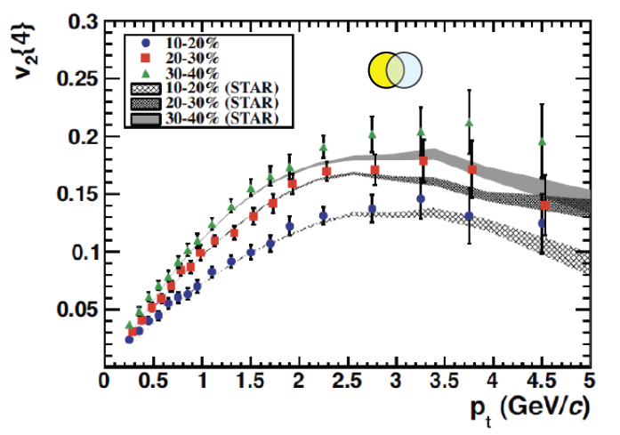
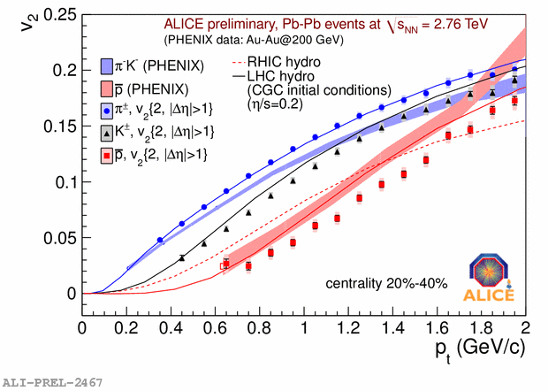
Elliptic flow at LHC
v₂ as a function of p_{T} does not
change between RHIC and LHC
The difference in the p_{T}
dependence of v₂ between
kaons, protons and pions (mass
splitting) is larger at LHC
The 30% increase of integrated
elliptic flow is then due to the
larger ⟨p_{T}⟩ at LHC coming from
the larger radial flow
This is another consequence of
the larger radial flow which
pushes protons (comparatively)
to larger p_{T}

Slide 36
Conclusions on elliptic flow
In heavy-ion collisions at RHIC and LHC one observes
  Strong elliptic flow
  Hydrodynamic evolution of an ideal fluid (including a QGP phase)
  reproduces the observed values of the elliptic flow and their
  dependence on the particle masses
  Main characteristics
    Fireball quickly reaches thermal equilibrium (τ_{equ} ~ 0.6 – 1 fm/c)
    The system behaves as a perfect fluid (viscosity ~0)
Increase of the elliptic flow at LHC by ~30%, mainly due to larger
transverse momenta of the particles

