Slide 1
Update on ν yields at CENF, including off-axis positions for Laguna
28th March 2013
M. Calviani, A. Ferrari, W.S. Kozlowska, P.R. Sala*
*INFN Milan

Slide 2
Outline
Again many new configurations tested, … further progress!
Variation of rates with lateral offset investigated in order to help in determining the Laguna prototype optimal position

Slide 3
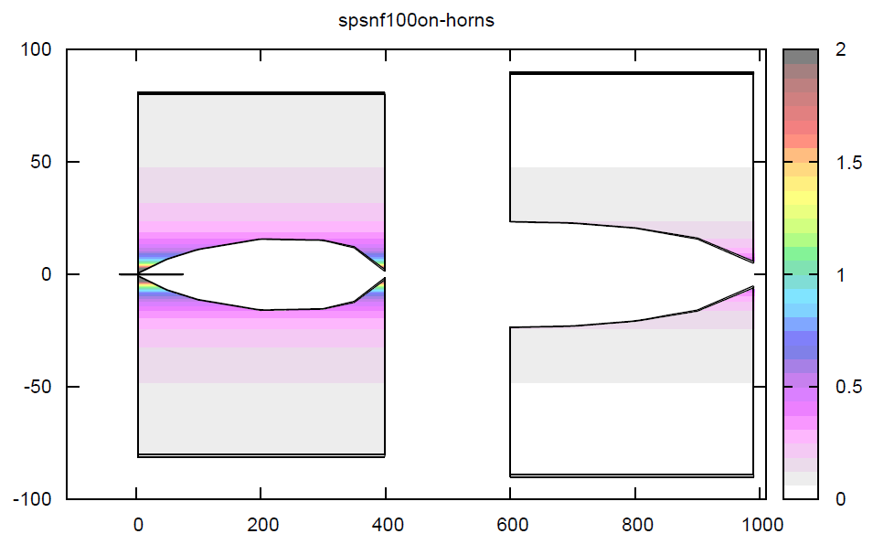
Reference, LoI, layout
Field (Tesla)
R (cm)
HORN
4 m length
300 kA
REFLECTOR
4 m length
150 kA
TARGET
1 m graphite, r=2.5 mm
Partially inside horn
At 6 m from target
Z (cm)

Slide 4
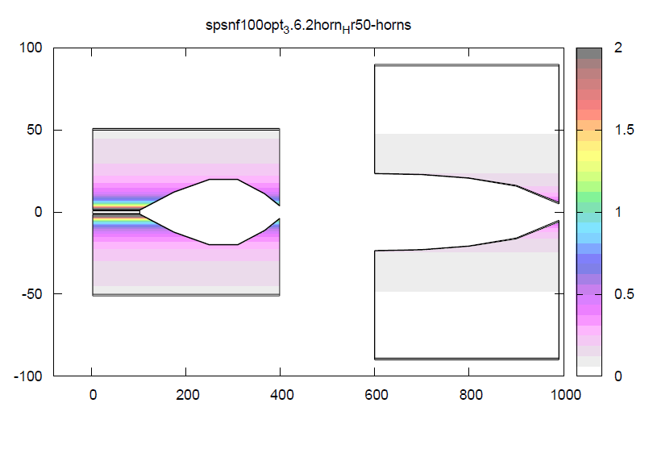
Old-New “best” layout
Field (Tesla)
R (cm)
REFLECTOR
4 m length
150 kA
HORN
4 m length
280-(240) kA
TARGET
1 m graphite , r=8 mm
Fully inside horn
Z (cm)

Slide 5
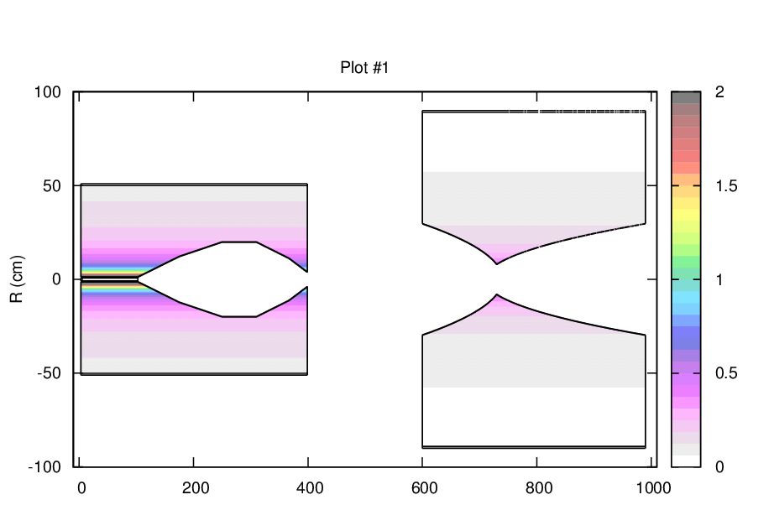
New-new “best” layout
Field (Tesla)
R (cm)
DOUBLE PARABOLIC REFLECTOR
4 m length
180 kA
HORN
4 m length
260-(240) kA
TARGET
1 m graphite , r=8 mm
Fully inside horn
Z (cm)

Slide 6
ν_{μ} fluxes comparison
ν_{μ} fluence @ Near Detector
Blue: LoI
Red: Old-new
Green: New-new

Slide 7
ν_{μ} fluxes comparison
ν_{μ} fluence @ Near Detector
Blue: LoI
Red: Old-new
Green: New-new

Slide 8
ν_{μ} CC rate comparison
ν_{μ} CC rate @ Far Detector
Blue: LoI
Red: Old-new
Green: New-new
ν_{μ} CC (< 4 GeV) (evt/kT/10¹⁹pot):
2.70 10⁵ 3.79 10⁵ 3.98 10⁵
1.00 1.40 1.47
ν_{μ} NC (0-oo) (evt/kT/10¹⁹pot):
1.74 10⁵ 2.30 10⁵ 2.13 10⁵
1.00 1.32 1.22
ν_{e} CC (< 4 GeV) (evt/kT/10¹⁹pot):
1.80 10³ 2.25 10³ 2.28 10³
1.00 1.25 1.27

Slide 9
ν_{μ} fluxes as a function of R
ν_{μ} fluence @ Near Detector (New-New)
Green: R=0-2.4 m
Blue: R=6-12 m
Red: R=12-18
Purple: R=18-24 m

Slide 10
ν_{μ} rates as a function of R
R=0-2.4 m
Laguna prototype*:
ν_{μ} CC: 3.54 /spill
ν_{μ} NC: 1.23 /spill
ν_{μ} CC rates @ Near Detector (New-New)
Purple: Total
Green: QE
Blue: RES
Red: DIS
* 216 m³ LAr
1.75 10¹³ pot/spill
rates over 0-80 GeV

Slide 11
ν_{μ} rates as a function of R
R=6-12 m
Laguna prototype*:
ν_{μ} CC: 1.72 /spill
ν_{μ} NC: 0.609 /spill
ν_{μ} CC rates @ Near Detector (New-New)
Purple: Total
Green: QE
Blue: RES
Red: DIS
* 216 m³ LAr
1.75 10¹³ pot/spill
rates over 0-80 GeV

Slide 12
ν_{μ} rates as a function of R
R=12-18 m
Laguna prototype*:
ν_{μ} CC: 0.702 /spill
ν_{μ} NC: 0.255 /spill
ν_{μ} CC rates @ Near Detector (New-New)
Purple: Total
Green: QE
Blue: RES
Red: DIS
* 216 m³ LAr
1.75 10¹³ pot/spill
rates over 0-80 GeV

Slide 13
ν_{μ} rates as a function of R
R=18-24 m
Laguna prototype*:
ν_{μ} CC: 0.346 /spill
ν_{μ} NC: 0.128 /spill
ν_{μ} CC rates @ Near Detector (New-New)
Purple: Total
Green: QE
Blue: RES
Red: DIS
* 216 m³ LAr
1.75 10¹³ pot/spill
rates over 0-80 GeV

Slide 14
Conclusions
Reflector improvements → further (small) gains in the “signal” region, significant reductions in the “background” region (still better S/N)!
As expected a lateral offset ∼15 m is needed to bring the number of events/spill in the Laguna prototype down to ≤ 1
Weak dependence on horn current!
Future
Further optimization for the reflector
Injections of engineering constraints (room for target cooling, neck thicknesses…) → some rate reduction anticipated

