Slide 1




High Rep Rate Circuits 2 and 3 specification/Wish List
Nick Shipman 02.04.2013

Slide 2
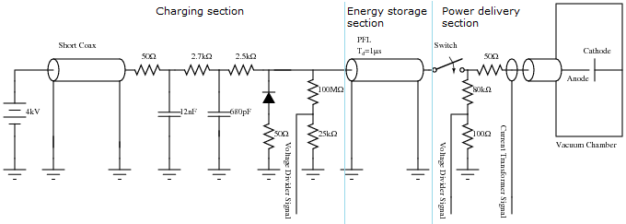
The present High-Rep-Rate Circuit
The power supply charges the PFL to the set voltage, 4kV in this case. When the switch is closed the vacuum gap is charged and in the case of a breakdown a large current flows and the energy which is stored on the PFL is discharged (mainly in the external circuit) during twice the delay time of the PFL.

Slide 3
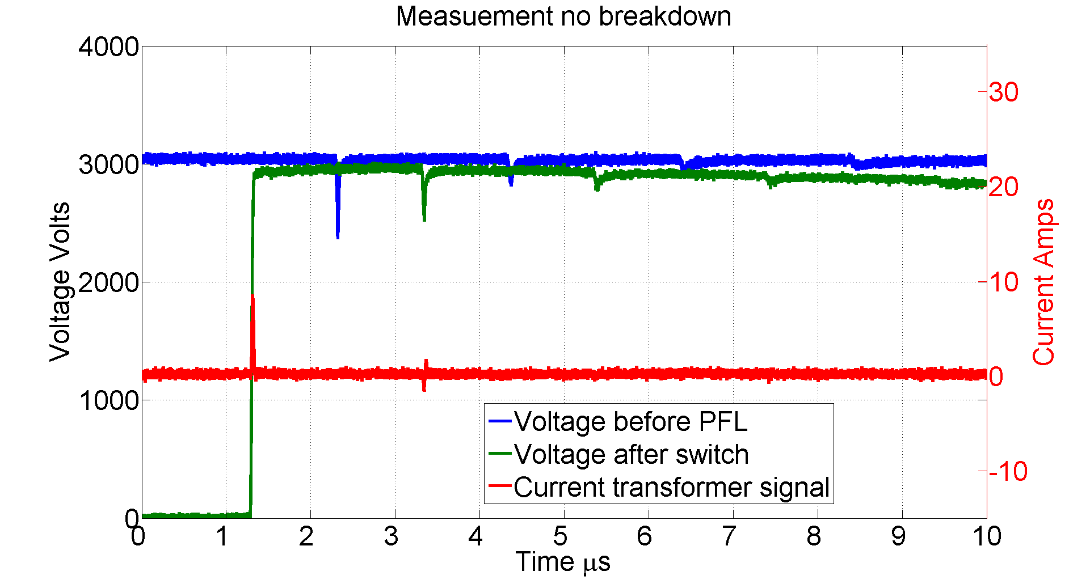
Voltage and Current Traces – no BD
In the no BD case you can see that even after the switch closes (at ~4.3us). The voltage after the switch (green, also ~equal to the voltage seen by the gap in this case) only starts to decay very slowly.
V after switch
V b4 PFL

Slide 4
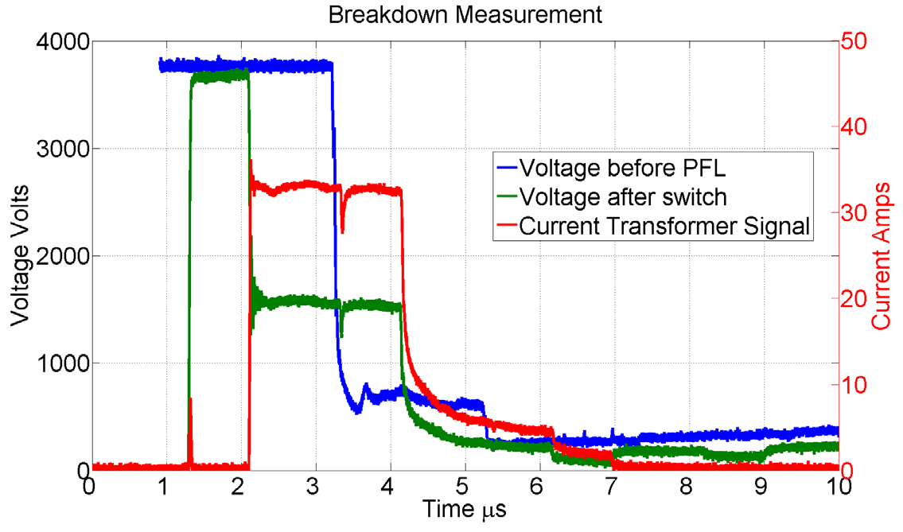
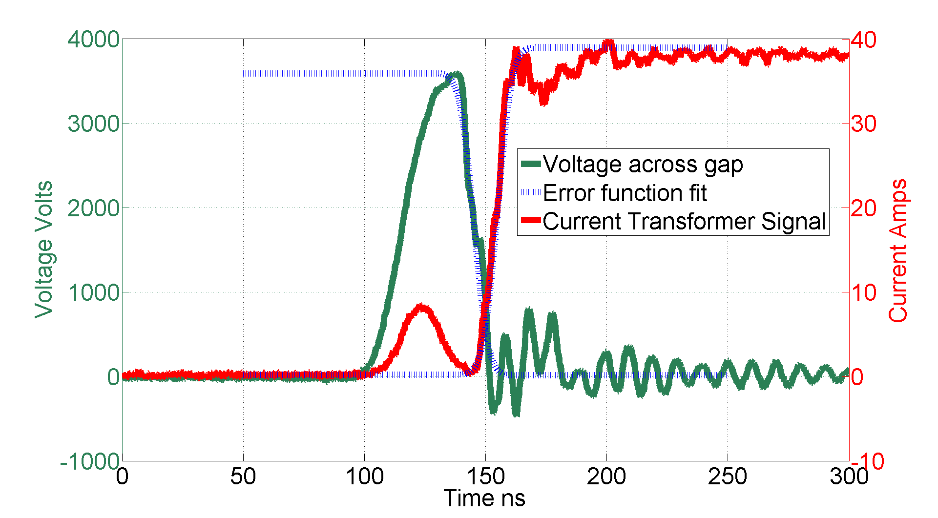
Voltage and Current Traces – BD
V after switch
V b4 PFL

Slide 5
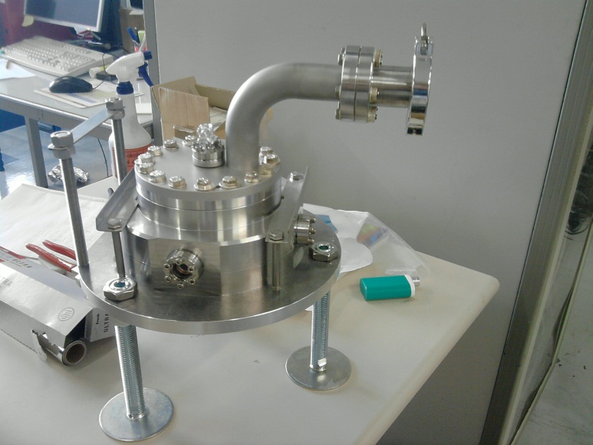
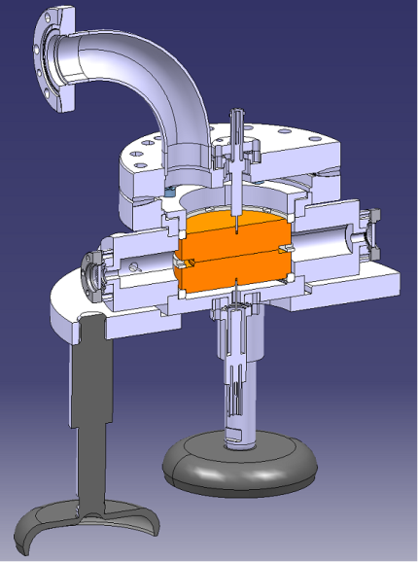
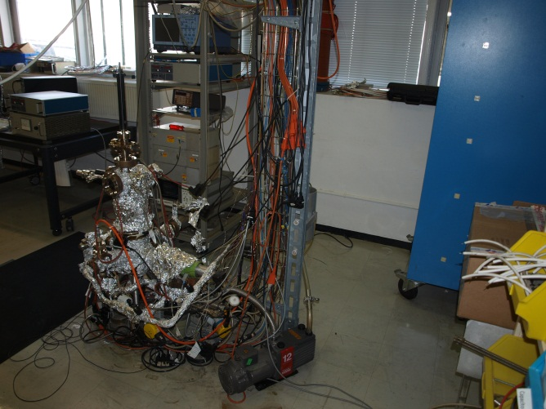
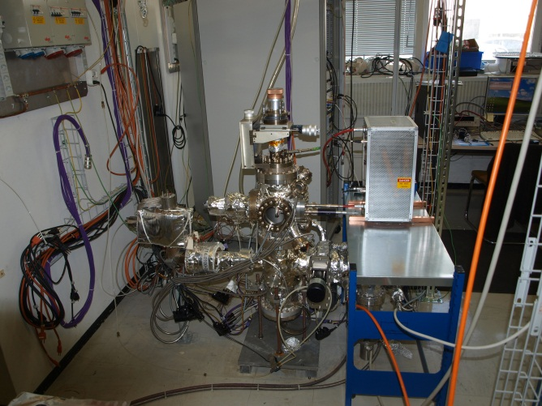
Fixed Gap System
The High Rep Rate circuit is currently installed on system I. We need two additional HRR circuits and controllers one for the Fixed Gap System and one for System II.
Due to the different types of electrodes the Fixed Gap System has a much higher capacitance than System I and II, ~2nF instead of ~100pF.
System I
System II

Slide 6
Specifications/Wish List – for discussion
We would like a circuit which can supply high voltage square pulses to a 10-100um vacuum gap. Usually the gap would act just as a capacitance but occasionally an electrical breakdown would occur and the impedance of the gap would become very small.
The voltage of the pulse should be adjustable.
The repetition rate should be adjustable.
Should the pulse width be adjustable. (yes?)/Should the pulse have a fast fall time as well as a fast rise time. (yes?)
Should the stored energy be adjustable?(no?)/Allowed to vary with voltage?(yes?)
Should the rise time of the pulse be adjustable?(no?)
The maximum voltage available should be - 10kV?
In the no breakdown case the maximum repetition rate should be - 1kHz?
In the breakdown case there is no minimum repetition rate (the pulsing can be stopped for a short time to allow the switch to recover.)
Square Pulse shape
  Rise times fall times - <20ns?
  Pulse Length – 0.1us – 10us?
  Flat top - ?
External circuit resistance during breakdown – 100 Ohms?

Slide 7
Controller
Who is building the controller?
What will it look like?
What should it be able to do?
Co-ax switch boxes
With a suitable co-axial switch box it should be possible for the systems we are building to be able to calculate Beta by measuring the emission current and the size of the gap (in the case of System I and II) and to calculate the size of the gap by measuring the gap capacitance.
Should this be incorporated form the start?
Other ideas?
E.g. Is it possible to have two or more PFL’s charged to different voltages and to expose the gap to the voltage stored on each of them in turn? This would be useful for studying any memory effects of a BD. Are there other ways to do this?

