Slide 1
Are there some evidences of structure responses alterations during the pulses just before a BD ?
X-box1 experiments and data processing
(Jan Kovermann, Ben Wolley, Joseph Tagg, Wilfrid Farabolini)

Slide 2
Scope of the study
BD signals (RF, Faraday Cup, Vacuum…) are data logged.
But also some signals previous to the BD (20 ms and 40 ms before).
Otherwise signals are data logged every 60 seconds.
Research for some differences in the immediate signals previous to a BD.

Slide 3
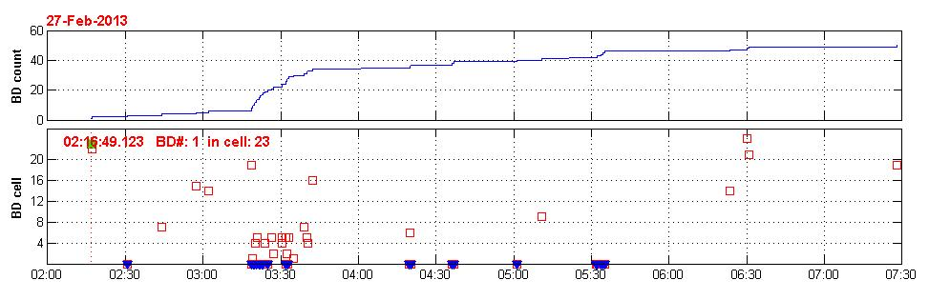
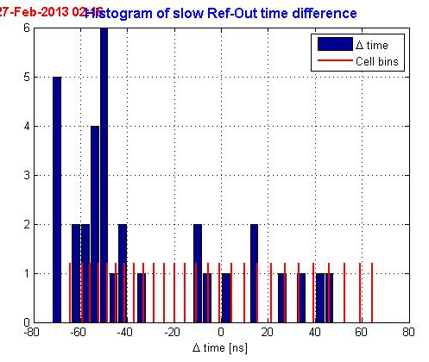
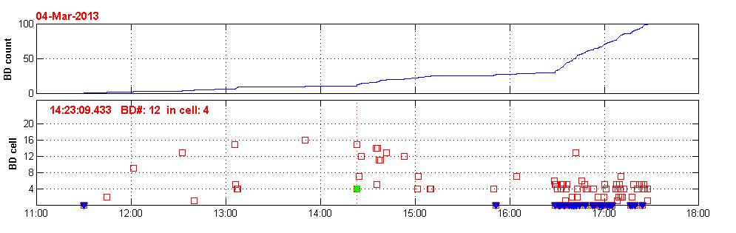
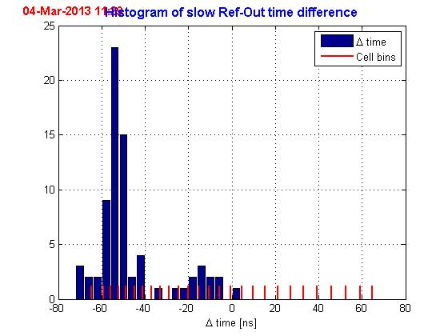
2 examples of 8 hours sequences
During BD cluster a hot cell (# 4 or # 5) appears
Blue marks show failures in BD location (delta time out of range)

Slide 4
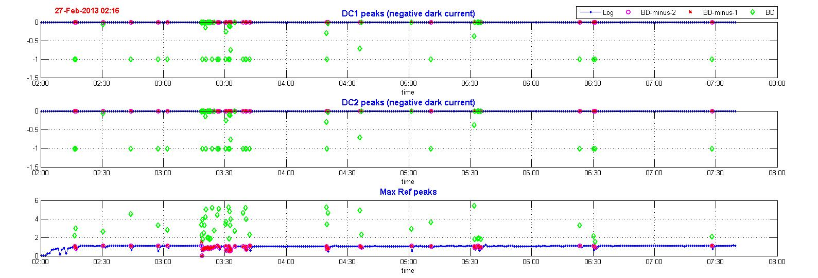
Research in FCU and Reflected RF peak values
Uncalibrated data
Faraday cup (DC1 and DC2) current are negative (dark current or BD burst). Very often saturated at -1 during BD.
Reflected RF power are positive.
Background levels (offset) are suppressed.
All these signals are used to detect BDs and the 2 previous pulses are also data logged.

Slide 5
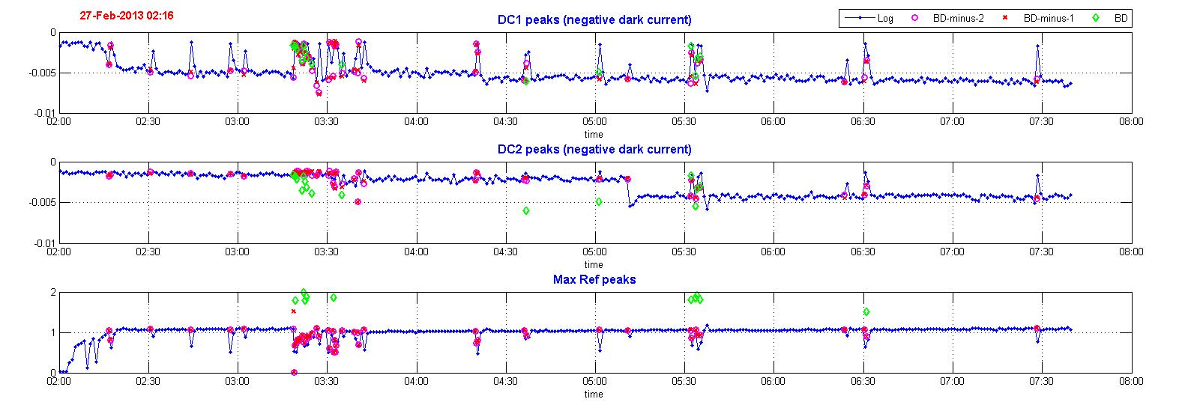
Zoomed data of the previous slide
Klystron interruption and RF ramping after a BD detection
FCU and FCU peak values of the pulses just before a BD are identical to the continuous data logged signals.

Slide 6
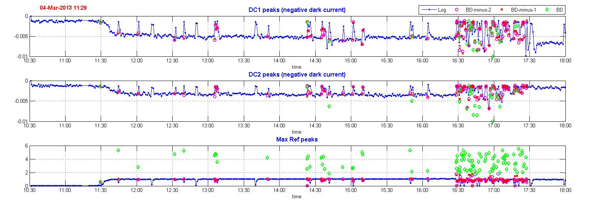
Zoomed data from the 4th March
Still no evidence of any precursor.
During cluster FCU signals are frequently weak.
Can be due to BD when RF power is still ramping on.

Slide 7
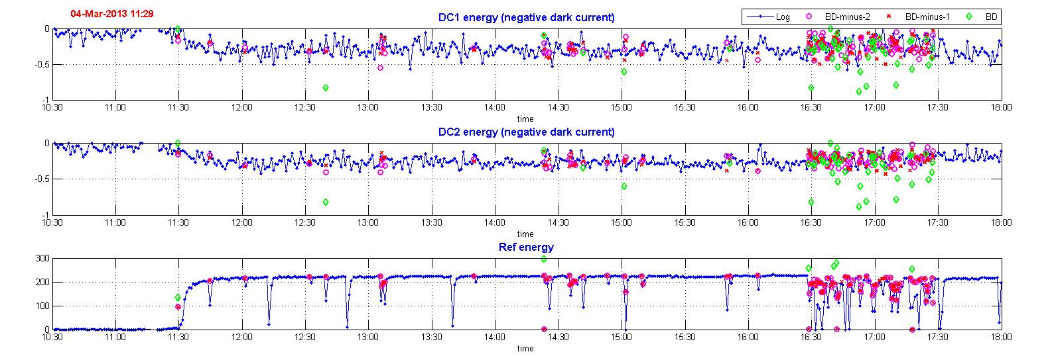
Same research in the integral of the previous signal (FCU total charge and Reflected energy)
Still nothing

Slide 8
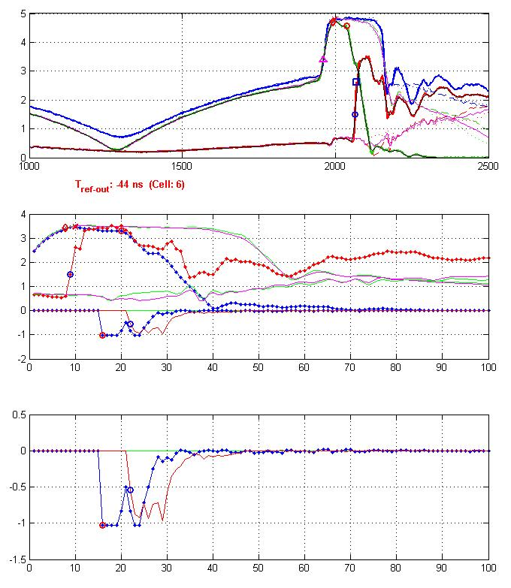
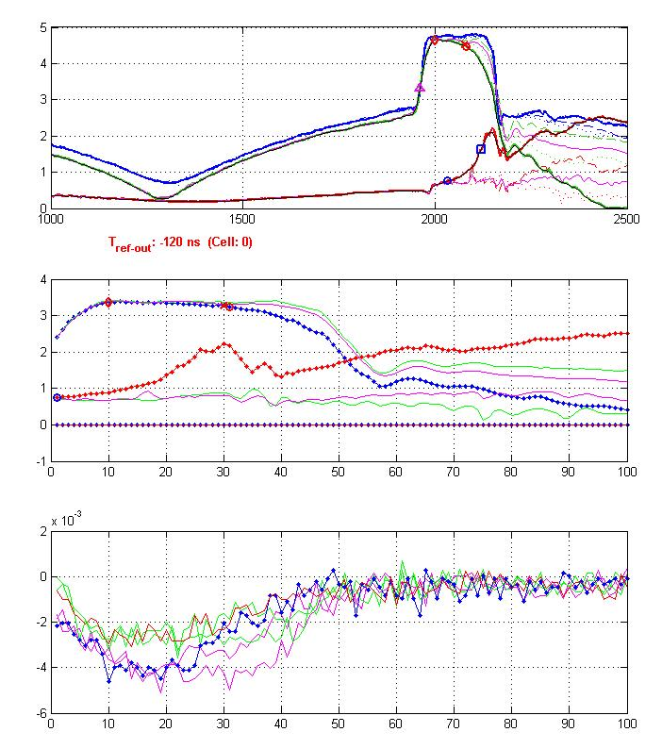
Signals
RF input
RF transmitted
RF Reflected
zoom
Before BD
DC1 and DC2 (saturated)
DC1 and DC2
(dark current only despite BD)

Slide 9
Conclusion
We have found no evidence of any precursor to a BD in the immediate pulses before the this BD.
It seems that the BD occurs suddenly without signs of progressive degradation of the structure (or at least not yet visible)

