Slide 2
Computing: a view of the future
Markus Schulz IT
markus.schulz@cern.ch

Slide 3
Predictions.... are.... risky.....
“I think there is a world market for maybe five computers”
  Thomas J. Watson, IBM 1943
“There is no reason anyone would want a computer in their home.”
  Ken Olson, founder of Digital Equipment Corporation, 1977
“There's no chance that the iPhone is going to get any significant market share.”
  Steve Ballmer, Microsoft, 2007
“There is no money to be made with the WWW”
  Markus Schulz, 1995

Slide 4

And our crystal ball ?
The High Energy Physics Community predicted the computing and storage needs for the LHC.
  Based on:
    technology trends, needs
    budget assumptions (which remained valid)

Slide 5
1996
2001
2006
2009/10
CPU
[10⁷ MIPS]
1
7
55
61
20
Installed at
CERN
[10⁷ MIPS]
0.005
4

Slide 6

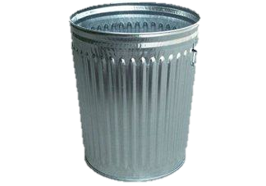
300
CPU
10⁷ MIPS
?
Provided (and used) in 2012 by WLCG

Slide 7
What about disk storage?
?
1996 100 TB
2001 1900 TB
2006 70000 TB
2010 83000 TB
2012 131000 TB provided by WLCG

Slide 8
Observations:
A 5 Euro music birthday card has more computing power than the Allied Forces during WW-II
A 2013 smart phone is faster than CERN’s computing centre from the mid 90s
Intuition breaks down → structured approach is needed

Slide 9
Building a Crystal Ball:
The future of computing is determined by:
  Physics
  Technology
  Markets
  Paradigm shifts
Now
Then
5
10
20
50
5
10
20
50
5
10
20
50
5
10
20
50
known
not so clear

Slide 10
Links lead to complexity...
Phys
Tech
Paradigms
Market/Cost

Slide 11
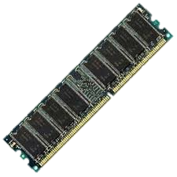
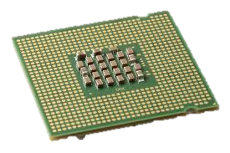
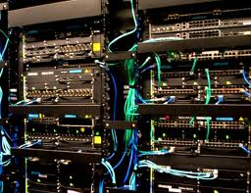
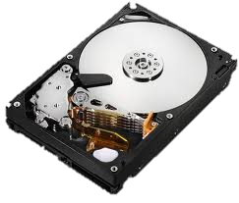
Building Blocks of Computers
Central Processing Units (CPUs)
  processing information
Memory
  storing information
Storage
  keeping information
Networks
  moving information
All need to improve to get faster systems
  Impossible to cover all in detail, will focus on CPUs
    all follow similar principles, with slightly different rates of improvement

Slide 12
Moore’s “Law”
“Transistor density on integrated circuits doubles about every two years”
  Gordon Moore, co founder of Intel
This means at the same cost you get:
  twice as many logical components
  and higher speed (or less power consumption)

Slide 13
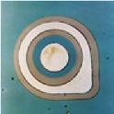
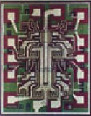
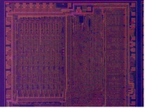
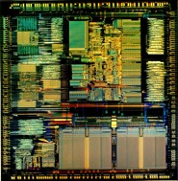

Without Moore’s Law: 1 Transistor = 1mm²
1959
60s
70s
85
Planar Transistor 1mm²
1
TTL Quad Gate
16
8bit Processor
4500
32bit Processor
275.000

Slide 14
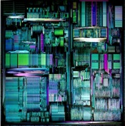
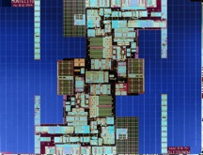
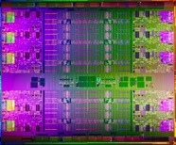
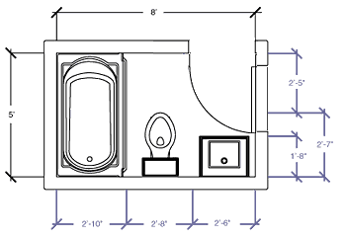
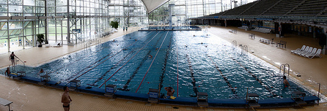
Without Moore’s Law: 1 Transistor = 1mm²
95
2000s
2010s
32bit Processor
5.500.000
64bit Processor
221.000.000
Multi Core Processor
3.000.000.000
Two of those, plus a bit
This Room
(- a bit)

Slide 15
Frequency
Smaller structures, less electrons need to be pushed around → faster transistors
  1970-1990 1→50 MHz (as expected)
  and then things got interesting....

Slide 16
Levelling out at 3.X GHz
Reducing energy consumption
Heat management
Dealing with variations in the production

Slide 17
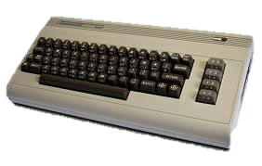
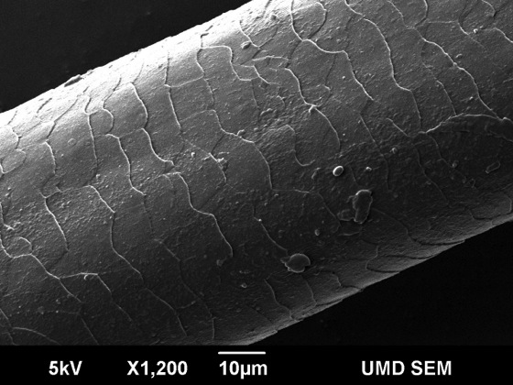
Moore’s Law’s Future
Current structures are 22 nm
  Intel’s roadmap:
    14nm 2014
    10nm 2016
    7nm 2018
    5nm 2020
    3nm 2022
Smallest transistor 2012
  1.5 nm using 1 atom
Quantum Effects
4500 Transistors

Slide 18
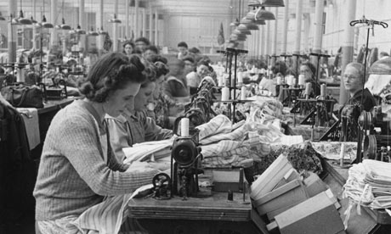
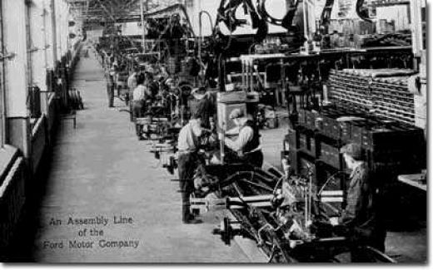
What to do with 3.000.000.000 Transistors?
Two core concepts have been used to speed up computer architectures
  Pipelining (working like an assembly line)
  Parallel processing(working concurrently)
Many additional smart tricks have been invented
  Caching, branch prediction, etc.....
Now: CPUs use all tricks combined
  Difficult to make full use of the hardware
    Facing sometimes fundamental limits (Amdahl’s Law)

Slide 19
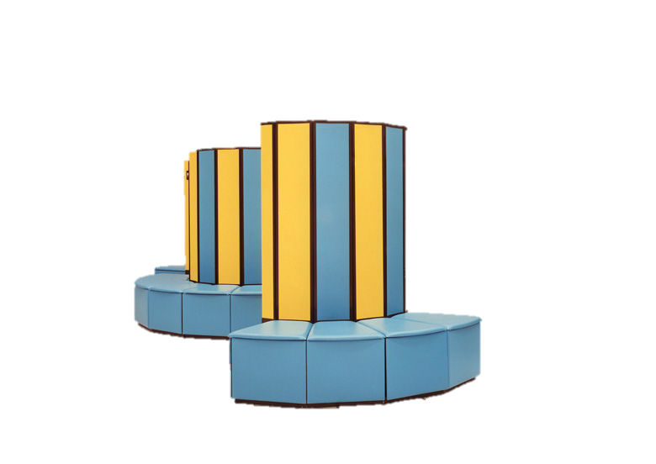
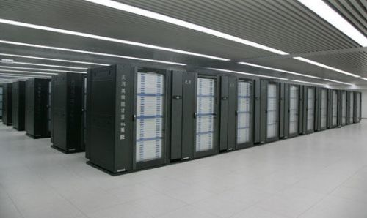
Super Computers?
Current Super Computers are build from commodity components (3.120.000 cores)
  adding a high speed, low latency interconnect
  adding accelerator cards ( graphic cards, etc. )
Tianhe-2
2013
CRAY
1980s

Slide 20
Pipelining
Break down operations into small steps
  which can be done very fast
Line up the work and finished, complex operations will drop out at the end at a high rate
  as long as the assembly line is full
Limits:
  Computers are flexible and “react” to results
    Conditional instructions can break the pipeline
    In average programs about every 6th instruction
Works well for many problems, but not for all
Pipelines got longer, with diminishing returns

Slide 21
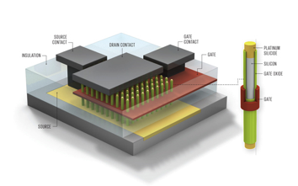
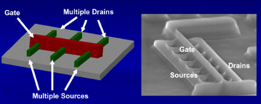
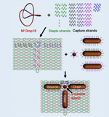
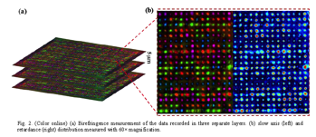

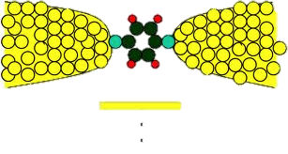
Alternative Technologies
Nanotubes, Molecular transistors, DNA, Graphen, ......
  proof of concepts (1-1000 components)
  many challenges ahead, but promising
3D Structures
  difficult to handle the heat
  on the surface already widely used
Memristors, high density, first products soon, but minuscule compared to discs
Laser nanostructures in glass → 360 TB glass disk
DNA for storage
  proof of concept ( 1cm³ == 1000 TB)
  very, very expensive, slow

Slide 22
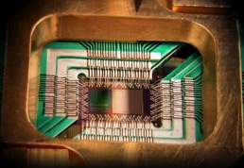
Quantum Computing
Two main branches
Using the phenomenon of quantum state superposition and entanglement to form qubits
    potential to revolutionize computing
    systems have to be insulated
    very early stages, very experimental, many paths are followed
D-Wave Systems offers a system based on quantum annealing
  Google and Lockheed are customers
  system can be used for solving optimization problems
  most likely to be used as a co-processor

Slide 23

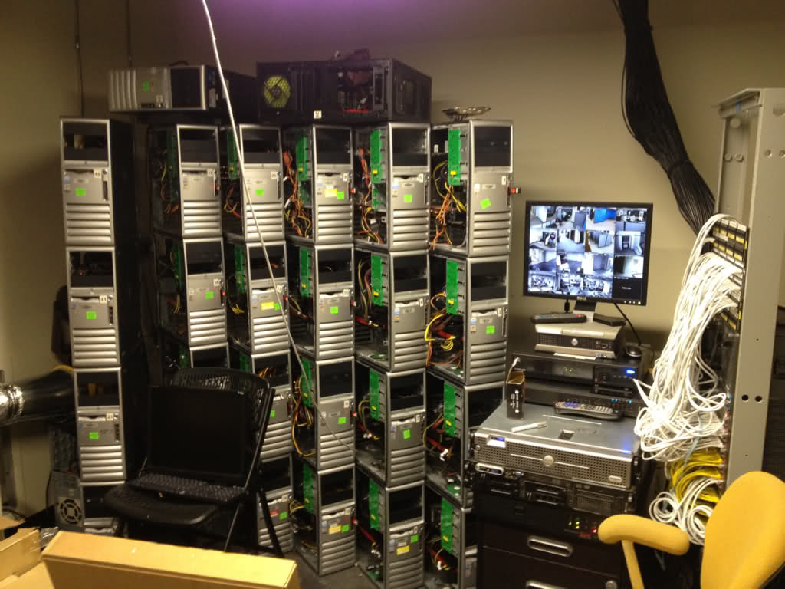
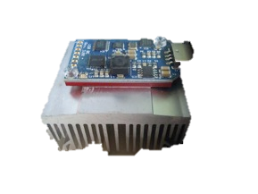
Market ←→ Technology
bitcoin a virtual currency based on cryptography (2009)
  created by bitcoin mining
    computing a specific algorithm
      which gets harder with time
  computing power == money
Desktops→ Botnets → Servers with GPUs (video cards) →2011 FPGAs (configurable chips)→ 2013 ASICs (custom chips)

Slide 24
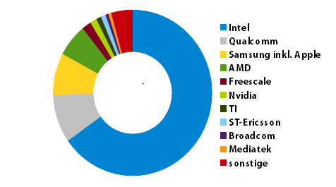
Market: Producer
Moore’s 2nd Law (Rock’s Law)
  “Cost of a semiconductor chip fabrication plant doubles every four years”
Cost of a 14nm fab is about 5B $
  Intel plans to build three
  Very few companies can afford this
Limited competition → higher prices, less research
2012 Processor Revenues 37B$

Slide 25
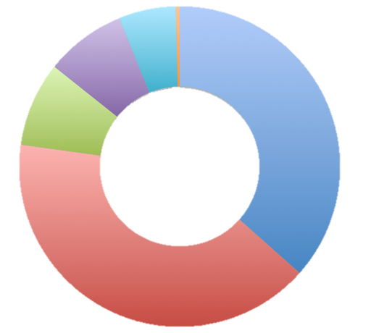
Market: Consumer
Performance
oriented
Units shipped [M] 2012 → 2013
Simple Phones 750 → 900
Smartphones 722 → 1000
Tablets 128 → 210
Notebooks 202 → 200
Desktops 148 → 142
Server 10 → 9.5
HPC 0.1 → 0.1
Price and power oriented

Slide 26
Consequences
Consumers move to lightweight mobile devices
  data storage and processing hosted by cloud services → less demand for desktops
  server machines are better utilized → less demand for server machines
  data and services are accessed via networks
Producers follow the consumers
  integration of components in single packages → price point!
    graphic units, network, sensors, memory,....
  focus on low power consumption
    slower CPUs
  price for servers is less critical → prices high, progress slower
    total costs are not dominated by hardware
    system, electricity, people

Slide 27
Putting it all together....
Don’t expect me to be better than Bill Gates...

Slide 28
Computing in 5-10years
Moore’s law will continue
  harder and harder, more diversity, complex solutions can gain an edge ( see bitcoin )
  first quantum computers ( for special purposes, Super Computers )
Computers will change shape
  most computing and storage is provided by Cloud services
  network access at high bandwidth from everywhere
Assistance systems will consume significant computing
  driving, work, augmented reality, translation, etc.
  first integration between humans and computer systems ( systems to help disabled people)
Slight slowdown of progress, software will require huge investments to catch up
  squeezing the lemon, using larger fraction of the silicon real estate
5 years: CPUs with 10 Billion transistors, running at 5 GHz, disks with 10TByte, 100 Gb networks common
10 years: CPUs with 30 Billion transistor, 6 GHz, 30TByte disks, (100 times the performance at the same cost!)

Slide 29
Computing in 20 Years
Systems reach molecular level (Moore’s Law has brought us to the scale of single atoms)
  high end systems will reach the complexity of the human brain (doesn’t mean intelligence)
    current super computer reach roughly 2%
  1st world will store everyone’s DNA
Quantum computers and/or biology inspired systems (all computers will have to deal with quantum effects)
  for research and large scale services
    medical applications
End user devices will not be perceived as computers anymore
  Collecting and serving data on everything to everything
  Network interruptions will be seen as major disasters
  Many people will use direct connections to their brains to enhance sensory and intellectual capabilities
20years: processing and storage power will be 5000 times higher than 2013 (at the same cost)

Slide 30
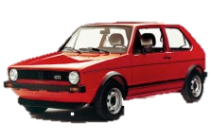
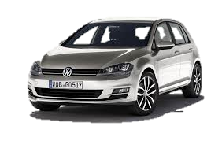
Computing in 50 years
Naive extrapolation: 33.500.000 fold improvement !
  happened before.......
Information processing will be fighting hard limits (Physics)
Scenarios:
  the digital age continues
    like the development of cars
    gradual improvements, but nothing dramatic over 30 years
      compare a 1983 Golf with a 2013 model....
  paradigm shift → magic
    if I could predict this no one would believe it (including me)
    probably a better job for Sci-Fi authors

Slide 31
Thanks a lot
And enjoy the (next) paradigm shift !!!! ☺

