Slide 1
LS1 Status @ Injectors
S Baird on behalf of N. Gilbert, S. Mataguez, D. Hay & D. McFarlane
LSC 5th April 2013

Slide 2
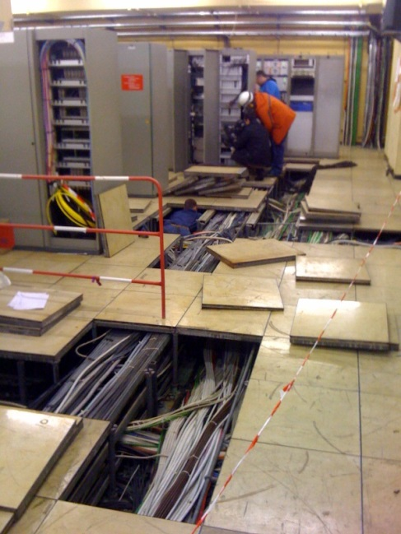
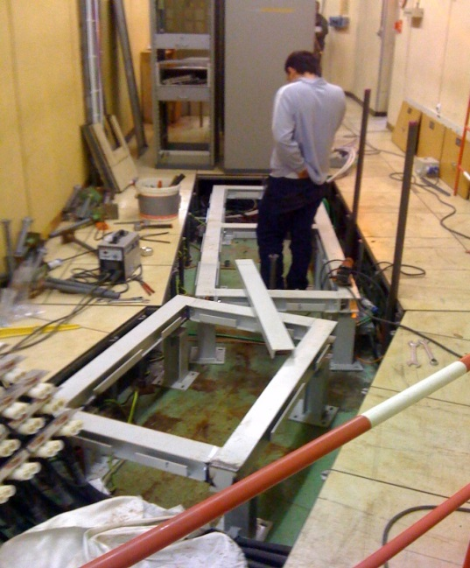
PSB
PSB Hall
PSB Tunnel
Dec.
Dec.
2013
Jan.
Beam Off : 11/02/2013
Jan.
2013
Feb.
No major changes in last 2 weeks
All lifting and handling HSE inspections completed.
Multipole converter project and rack installations ongoing.
  De-cabling in the surface building completed
  Underground cabling in progress
Cabling: 8 PSB campaigns are in preparation
  SEMgrids, RF Finemet cavity, BI BLMs, Vacuum equipment, Kickers, BE-BI, Interlocks (WIC) and the BIW safety system.
MAD installation is being prepared
  Co-activity issues with the replacement of PSB lift AS-45 to be resolved
Feb.
MAGNET TESTS
Mar.
CV
ACCESS
MULTIP. CONV.
CV
General maintenance
Mar.
BE-BI & CO
Apr.
Cables
Survey
TE-ABT
  Cables
Apr.
May
VACUUM
May
Jun.
LIFT REPLACEMENT
EN-STI
Jun.
Jul.
Jul.
Aug.
Magnets
BE-BI & CO
Aug.
Sep.
Sep.
Oct.
RF
Oct.
Nov.
General maintenance
Nov.
Dec.
Dec.
2014
Jan.
Survey
Jan.
2014
Feb.
COMMISSIONING NEW ACCESS SYSTEM
Feb.
Mar.
Mar.
Apr.
TESTS MULTIP. CONV.
Apr.
May
Hardware commissioning and cold check out
May
Jun.
              SETUP WITH BEAM
Jun.
Jul.
Jul.
Aug.
Aug.
Sep.
Beam back from L2 to PSB 30/05/2014
Beam back from PSB to PS 20/06/2014
Sep.
Oct.
Oct.
Nov.
Nov.
Dec.
Dec.
Survey
Magnets
Cable
Lift & crane
CV
Vacuum
RF
Kickers
Septa
Collimation (STI)
BI & CO
Access
EPC
Powering
Tests

Slide 3
CPS
Opening : 11/03/13
End LS1 : 01/05/14
Access
  Doors mechanically locked 19h00 and unlocked 07h30 (Thomas’s talk)
  Blind access 08h00 to 11h00 each morning
  Door 101 is not in use until 1st June due to civil engineering work for the new access system
Route Goward shielding work started
  Access restrictions to the “centre anneau” (Simon’s talk)
Dismantling of the existing ventilation system
  Work in Sectors 6 & 8 and Galleries 1 & 3
  Galleries 1 & 3 are closed until 10th May
In the PS Inflector zone certain auxiliary magnets (Linac3 to LEIR transfer line) are NOT CONDEMNED
  LEIR remains in HW test mode until mid-April
CE
CE
CE
CE
16/02
Powering tests
EPC
Lift B269
11/03
Magnet tests
R.Goward
HVAC
HVAC
HVAC
HVAC
EL
HVAC
HVAC
Maintenance Sealing
RF
RF
HVAC
HVAC
RF
HVAC
HVAC
SMH16
SMH42
RF
CV water
Control
HVAC
RF
HVAC
STP
RF
HVAC
STP
STP
RF
SS15 Liberate
STP
SMH57
RF
MU14
MU55\57
STP
MU75
Sept.16
SEH23
Dummy
RF
PS PSS complex new access system commissioning
Vacuum bake-outs
01/05
Magnet tests
DSO tests
PS Operations Cold Check-out
10/07
PS Setup with Beam
Physics
Ready for extraction 10/07/14
Powering
Tests
EPC
Magnet
Civil engineering
Lift & crane
Access
CV
Ventil
CV water
Septa (SE)
Kickers
Collimation (STI)
Vacuum
Cable
EL (pow.)
RF
Beam instrumentation
Survey
Control
Fire detection

Slide 4
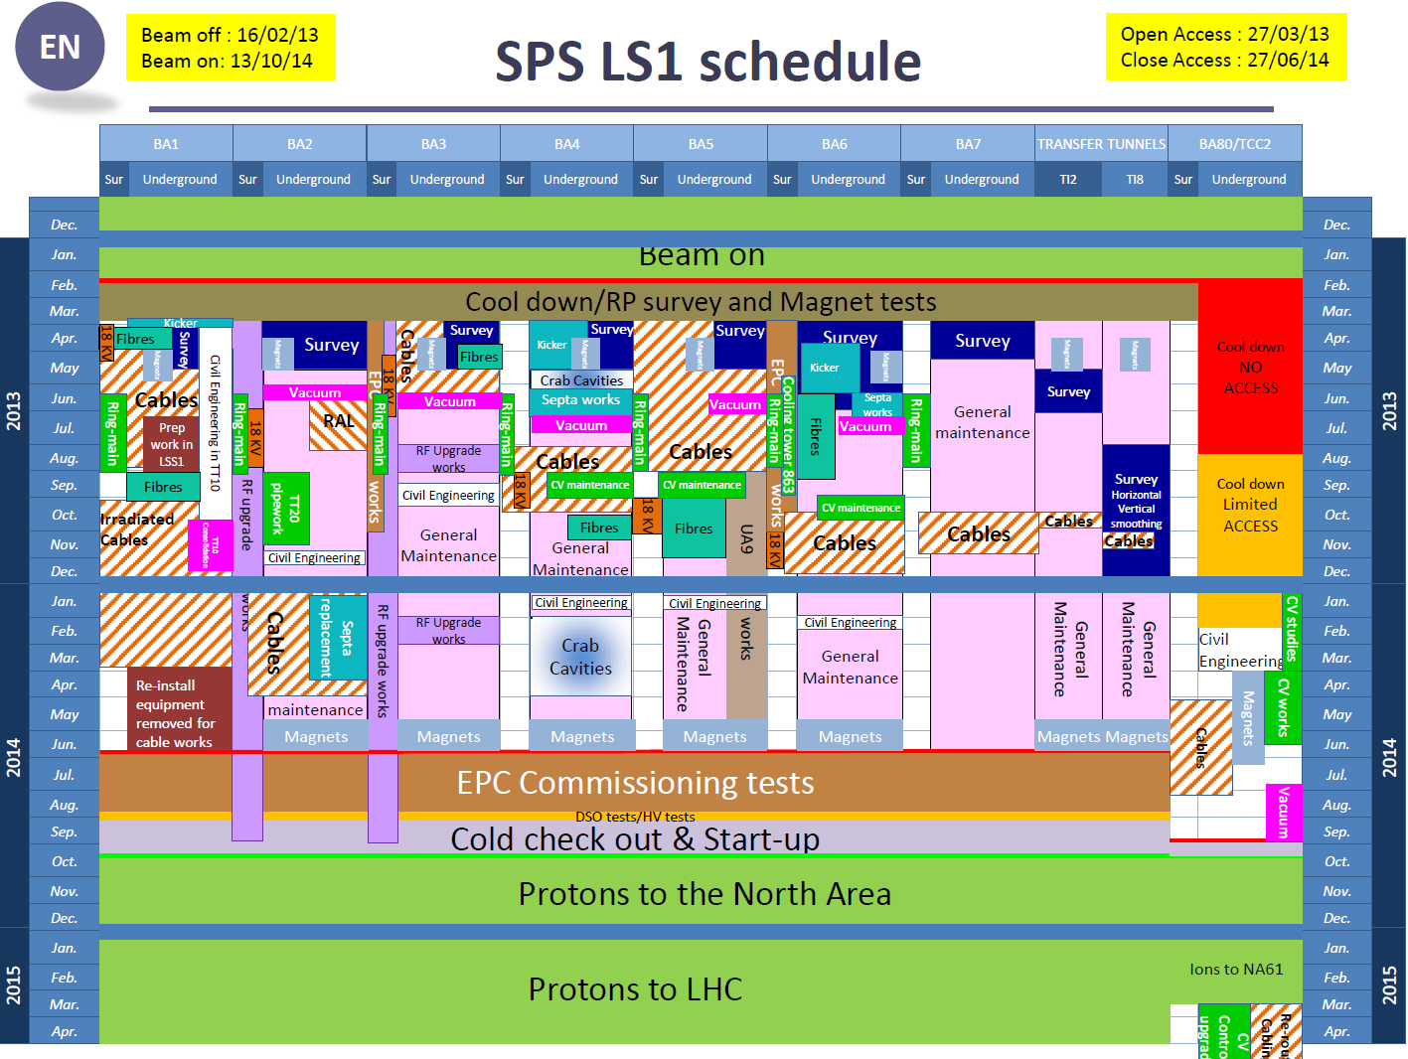
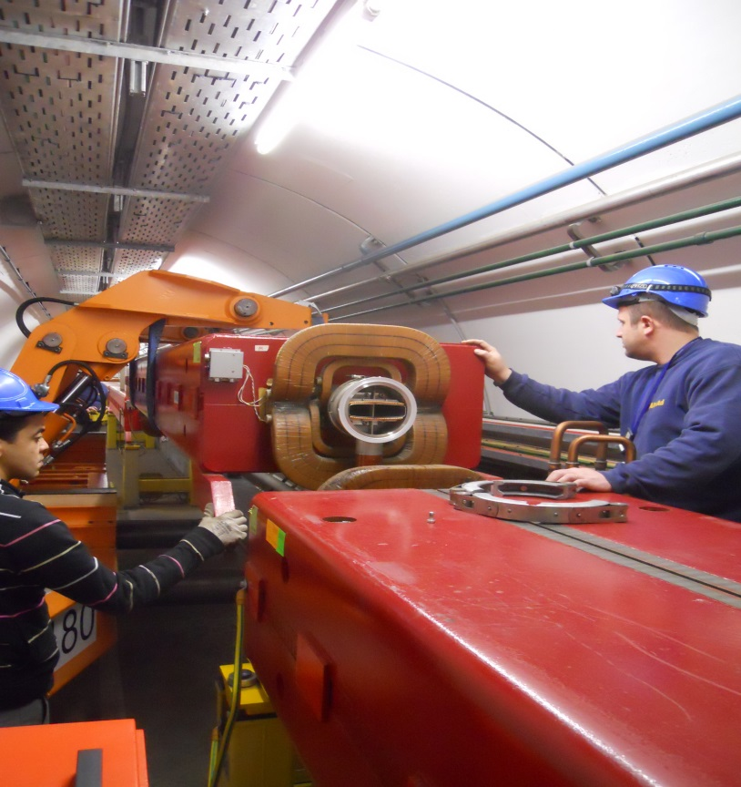
Magnet test are now complete
SPS was opened for “General” access on Wednesday the 27th March (as planned)
Test AUGs at each point have now started and will continue next week.
16 magnets have been identified during the magnet test as needing to be changed (planning for this is on-going)
16 magnets in BA5- will be removed for new coated vacuum chambers. This will start today and continue until the end of next week (4 magnets per day)
Survey have started their survey and re-alignment of the entire SPS.
All works proceeding as planned.

Slide 5
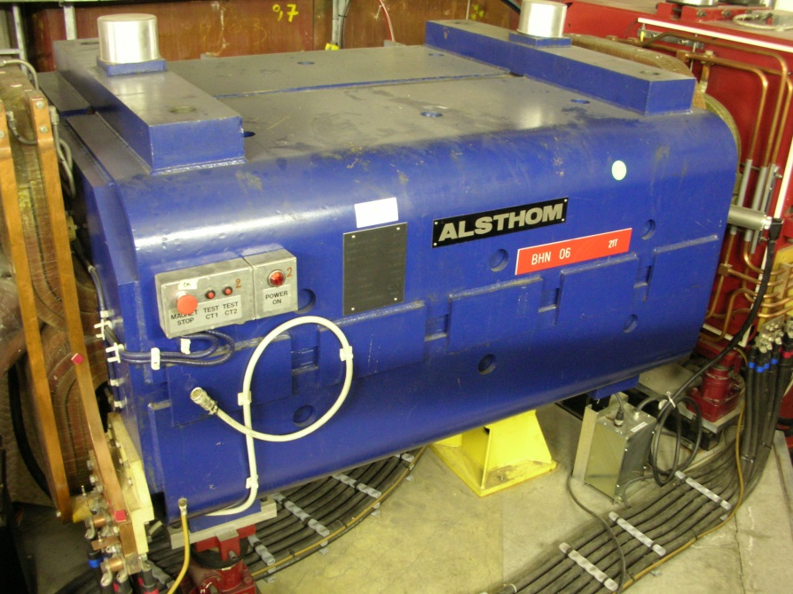
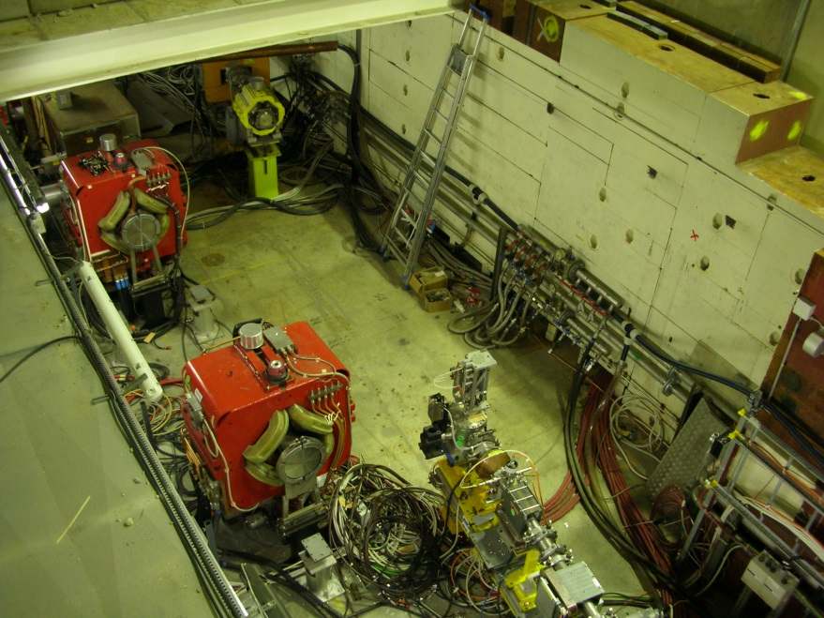
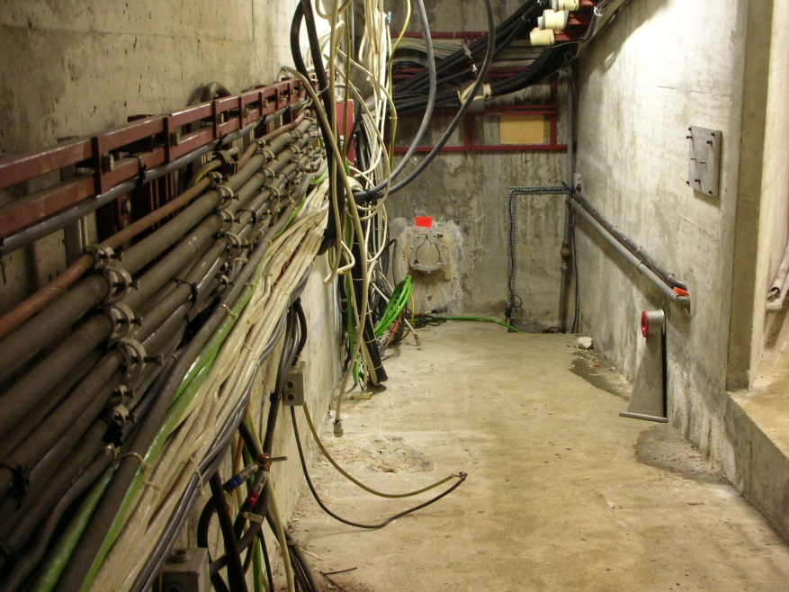
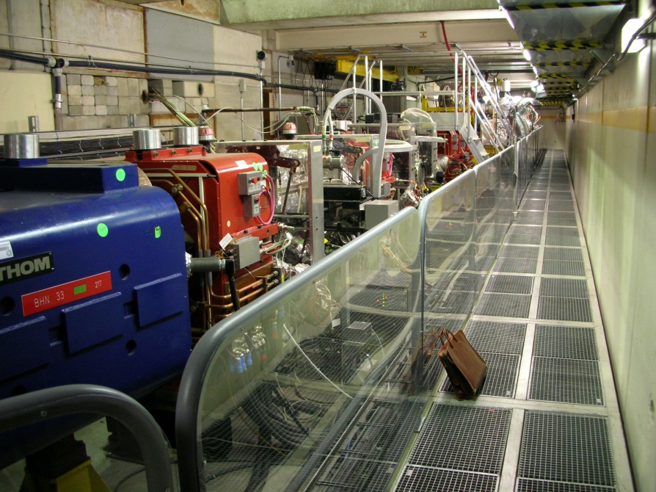
AD
Main AD-ring access point:
  shielding blocks reorganized.
  ready for new access system installation in August
Improved protection barriers for visitors
Preparation for the new building 393 (Civil engineering starts on 1st May)
  Removal of DC cables completed on 3/04
  Removal of control cables started on 4/04 until 26/04
Old line 8000 almost totally dismantled
  Completed this summer
BHZ8000 definitely removed from AD machine
SMH53 changed
KFI 55/56 tanks : repair in progress (lab)
Awaiting successful coil test results before dismantling ATRAP and removing BHN06

Slide 6
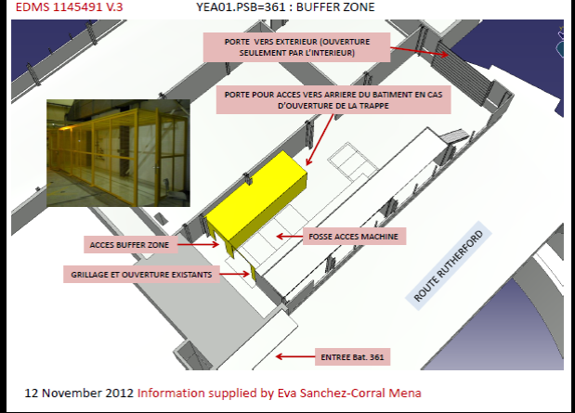
RP Buffer zones
PSB zone is created but not operational
  Not equipped
LEIR zone
  Shared with Linac2
AD zone is created but cannot be locked.
  Not used
PS zone is not ready
  Space by door 121 is used temporarily

