Slide 1
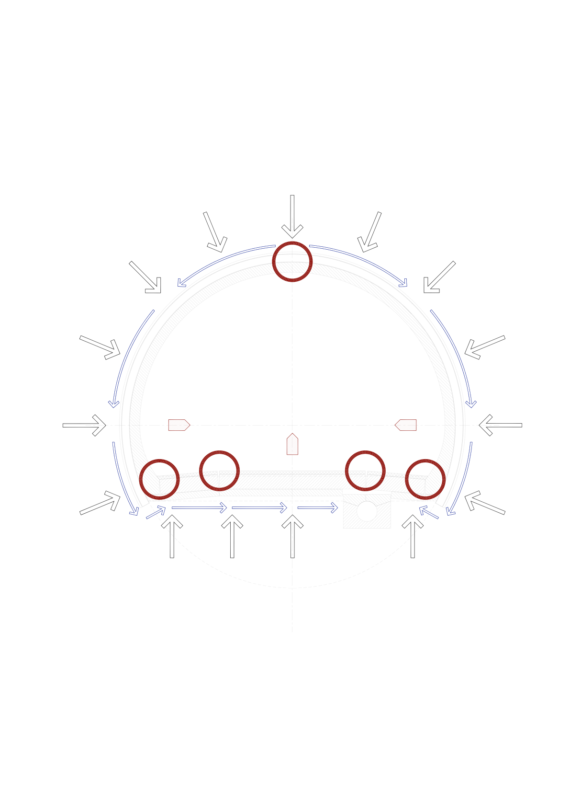
TT10 Remedial works
What is happening

Slide 2
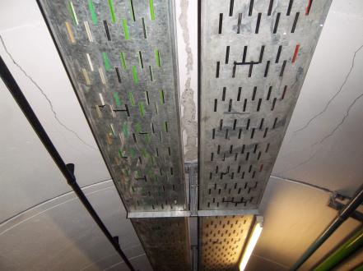
Compression
Tension
Compression failure in crown (some cases)
Tension/Shear failure in shoulders (typical)

Slide 3
Failure of Primary and Secondary due to poor ground in crown, or squeezing ground conditions
Failure of Primary and Secondary due to void in crown above secondary
Failure of Secondary due to void or poor concrete in crown (primary fails subsequently due to load increase)
Evidence:
No void found
Concrete thickness and quality ok
Not delineated by secondary lining pour length
Evidence:
Concrete thickness and quality ok
Not delineated by secondary lining pour length
Void found
Evidence:
Poor concrete thickness and quality
Delineated by secondary lining pour length

Slide 5
Stage 1
Remove shoulder and knee pipework
Remove beam
Slide top cable tray away from wall if possible

Slide 6
Stage 2
Place invert channel section
  152 x 152 x 37 section
  1m Centres

Slide 7
Stage 4
Place axis steel bar sections
  40 x 150 section
  1m Centres
Shear connection with invert channel

Slide 8
Stage 5
Place Shoulder I Beam
  152 x 152 x 37 section
  1m Centres
Shear connection with axis channels
Pre-stress I beam

Slide 9
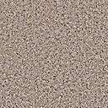
Potential Void
Existing Lining (Cracked and displaced)
Formwork (steel plate)
Cementitious Grout
Stage 6
Place Crown I Beam
  127 x 76 x 13 section
  4no. in crown
Connect crown fill formwork to I beam
Cementitious grout behind former

Slide 10
Stage 6
Drill through grout and old linings and low pressure grout to fill voids above crown

Slide 11
Stage 7
Install false floor over inert channel

Slide 12
Stage 8
Reinstate Beam and pipework

Slide 13
Planning

