Slide 1
Status and main challenges for detectors in Synchrotron Applications.
Heinz Graafsma
Head of FS-DS; DESY-Hamburg
and University of Mid-Sweden; Sundsvall

Slide 2
The Detector Challenge:
PETRA-3
ESRF (2000)
brilliance
ESRF (1994)
Synchrotron Sources
Second generation
First generation
X-ray
tubes
1900 1960 1980 2000

Slide 3
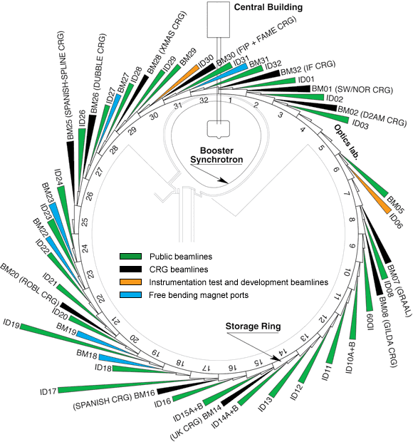
The Detector Challenge:

Slide 4
But is there hope ?
Europe has a long tradition in developing detectors for science; at least in part thanks to CERN
Europe has a large number of Storage Ring and FEL sources; which are centrally run ➔ this allows for centralized and larger scale instrumentation development
There is a surprisingly large number of Hybrid Pixel Array Detector systems; mostly photon-counting
PSI/SLS and CPPM-Marseille over 10 years ago started to use HEP HPAD detector technologies for dedicated photon science systems.

Slide 5
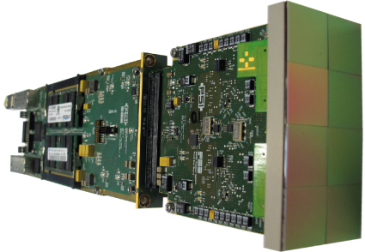
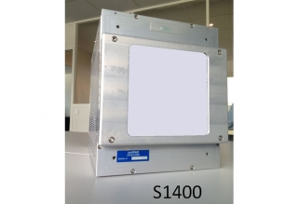
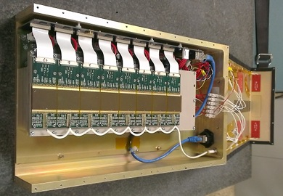
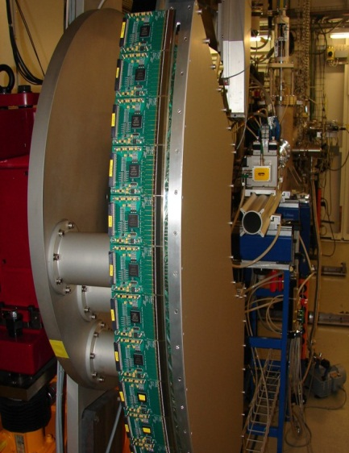
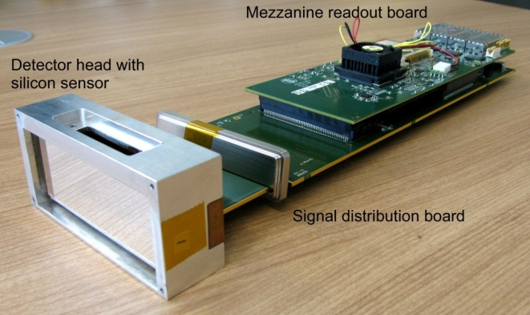
(some) major running systems:
PILATUS + EIGER
XPAD
MYTHEN + GOTTHARD
PIXIRAD
pnCCD
MEDIPIX
….

Slide 6
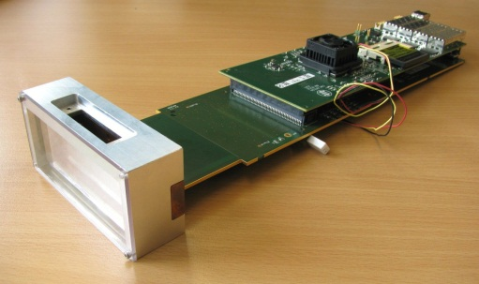
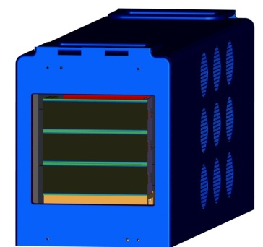
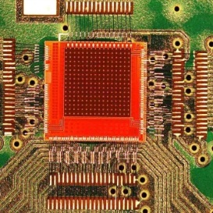
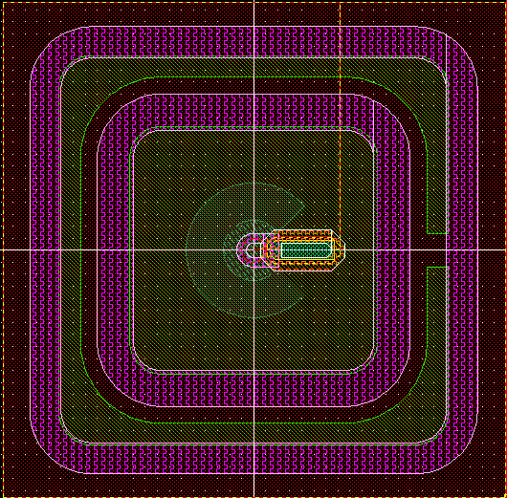
(some) major systems under development
MEDIPIX
  LAMBDA (DESY)
  EXCALIBUR (DIAMOND)
AGIPD (for EXFEL) (3 German + 1 Swiss partner)
LPD (for EXFEL) (2 British partners)
DSSC (for EXFEL) (7 German + Italian partners)
JUNGFRAU (for SWISSFEL) (PSI)
PERCIVAL (for low-E FEL applications) (DESY, STFC, Elettra, Diamond)
…

Slide 7
(some) major systems under development
MEDIPIX
  LAMBDA (DESY)
  EXCALIBUR (DIAMOND)
AGIPD (for EXFEL) (3 German + 1 Swiss partner)
LPD (for EXFEL) (2 British partners)
DSSC (for EXFEL) (7 German + Italian partners)
JUNGFRAU (for SWISSFEL) (PSI)
PERCIVAL (for low-E FEL applications) (DESY, STFC, Elettra, Diamond)
…

Slide 8
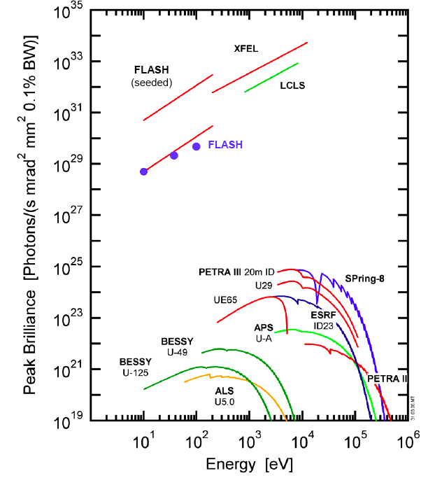
The FEL-Challenge: Different Science
Completely new science
Fast science 100 fsec
“Single shot” science
x10⁹

Slide 9
What is the Goal ?
K. J. Gaffney and H. N. Chapman, Science 8 June 2007

Slide 10
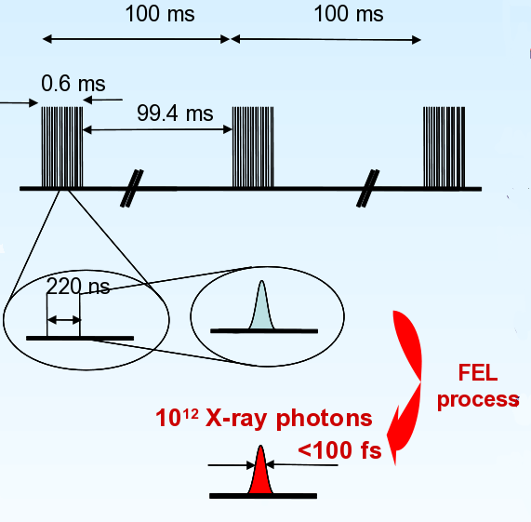
The European Free Electron Laser

Slide 11
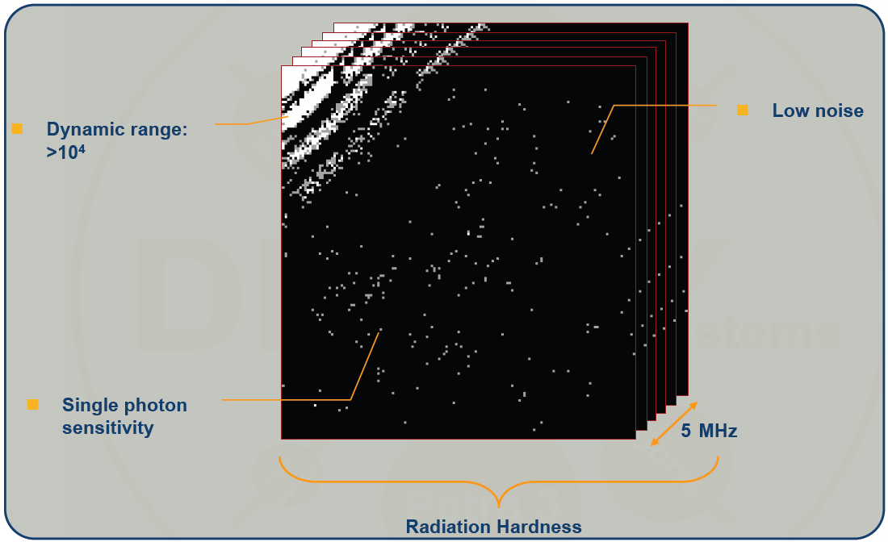
What are the Challenges ?
4.5 MHz

Slide 12
The Adaptive Gain Integrating Pixel Detector
High dynamic range:
Dynamically gain switching system
Extremely fast readout (200ns):
Analogue pipeline storage
C3
C2
Control logic
Analogue encoding
C1
Normal Charge sensitive amplifier
V_{thr} ≅ V_{ADCmax}
Discr.
Trim
DAC
Leakage comp.

Slide 13
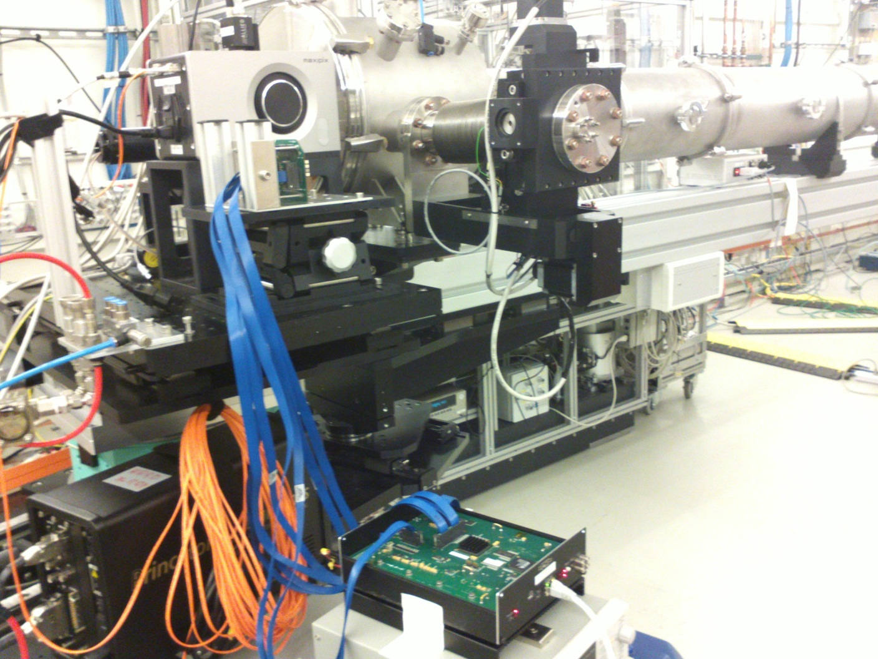
At the P10 beamline
Beam direction (coming from sample)
AGIPD sensor
It took about 1 ½ hours to set up, after about 2 hours we saw the first image
Chip tester box
Not in the picture: Sample, Alexanders PC, people, …

Slide 14
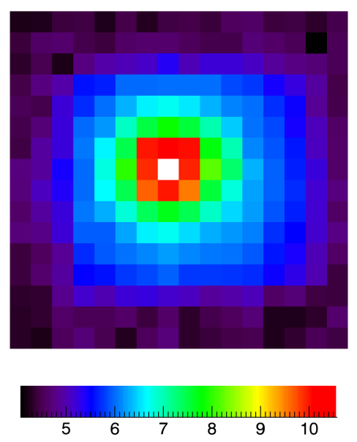
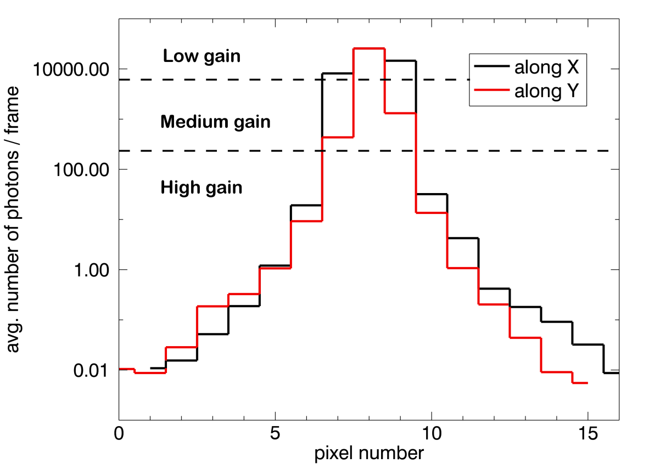
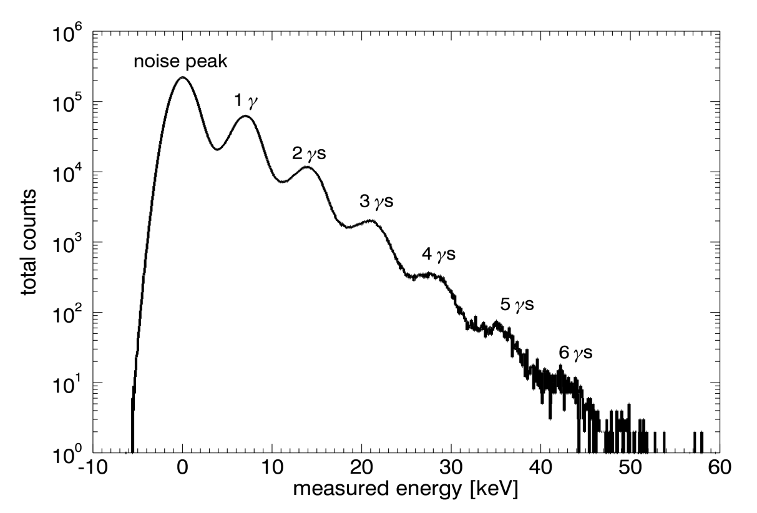
Looking at the direct beam
photons/second
Logarithmic color scale
Gain switching experimentally proven
10⁴ photons / pulse
Single photon sensitivity
4.5 MHz frame rate

Slide 15
The Analogue Storage
Sensor
ASIC per pixel
Pixel matrix
…
HV
Analog Mem
CDS
RO bus (per column)
+
SW
RO Amp
…
-
CTRL
DAC
Analog Mem
THR
Calibration circuitry
ASIC periphery
Chip output driver
Mux
Adaptive gain amplifier
352 analog memory cells
Notes:
Mention random vetoing possibility.

Slide 16
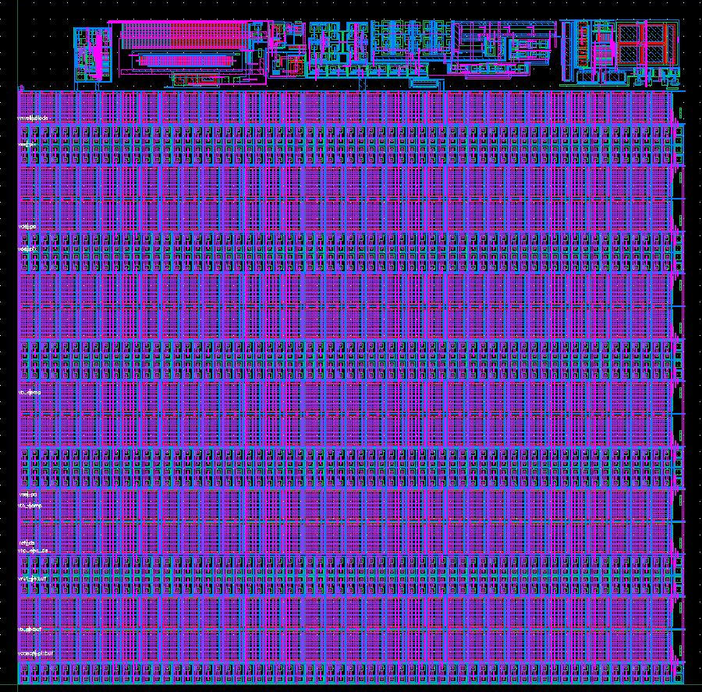
AGIPD 1.0 Pixel electronics
200 x 200 micron² pixels
352 storage cells + veto possibilities.
Minumum signal (noise) = 330 electrons = 0.1 photon of 12 keV
Maximum signal = 33 10⁶ electrons = 10⁴ photons of 12 keV
4.5 MHz frame rate
64 x 64 pixels per ASIC
2 x 8 ASICs per module (128x512 pixels, no dead area)
4 modules per quadrant

Slide 17

Soft is really hard
Synchrotron Free Electron Laser
PETRA III beamline(s)
250-3000 eV
up to 5x10¹² photons/s delivered to the sample
FLASH
15-300 eV
(in future possibly up to ~550 eV)
Higher energies in harmonics
10¹²-10¹⁴ photons/pulse delivered to the sample
Pulse duration 10-200 fs
(up to 800x)10 pulses/s

Slide 18
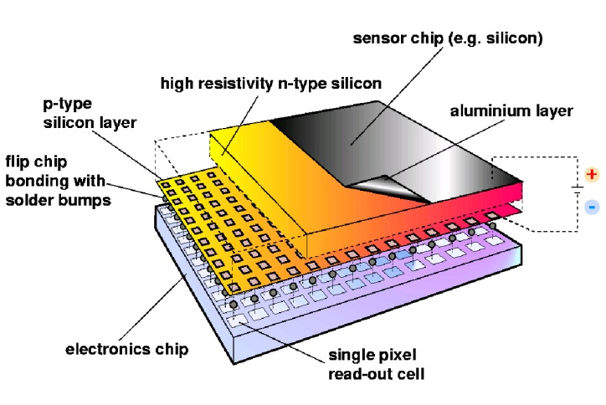
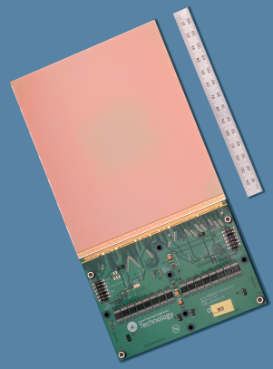
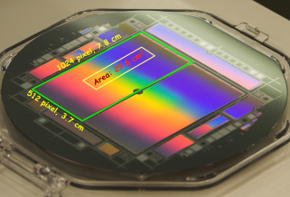
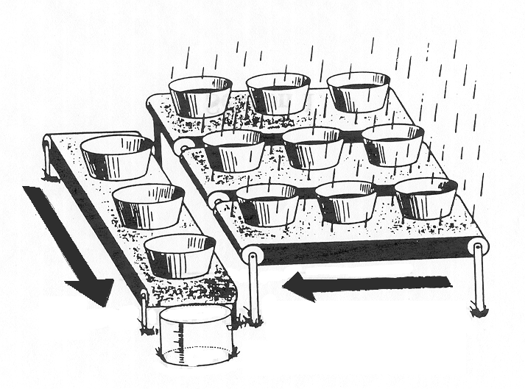
Technology Options Include
CCD
Limited maximum full-well capacity
Limited frame rates
Blooming
In our “region of interest” (single-photon at 250eV to 10⁵⁺ photons):
lower dynamic range than CMOS sensors
Hybrid Detector
Optimize sensor and electronics separately
Pitch limited by feasible bump bond size
Added complexity of bump bonding
CMOS Sensor
Profit from industry developments
Depleted region is the epilayer, currently limited to ~ 20μm
In-pixel conversion to voltage/amplification
On-chip digital conversion possible
credit: HLL MPG
credit: RAL-STFC
credit: Medipix Collaboration
from Turchetta 2010
credit: Jim Janesick, Pixelvision Inc.

Slide 19
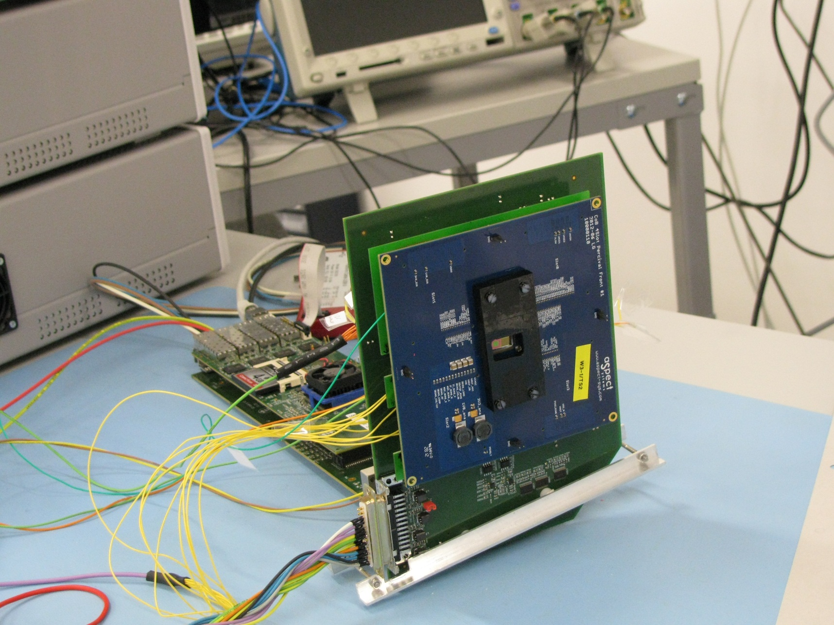
Tests chip at DESY

Slide 20

Percival in a nutshell
Ongoing development project between DESY, RAL / STFC, and Elettra; Diamond in the process of joining
Aim: develop X-ray imager for FLASH & FERMI, soft X-ray beams at PETRA III, ELETTRA, and DIAMOND, and for the use of CFEL scientists at other facilities
250eV-1keV, 16Mpixel, 120Hz frame rate, 1-10⁵ photons/pixel
Sensor developed at RAL, Readout developed at DESY (with Elettra), Diamond provides the DAQ
  Only digital information coming off the chip
  Readout development build upon / re-use XFEL and AGIPD developments already done on-site
Project underway, first test circuits produced first images
Project timeline
  First small backthinned test sensors in hand ~summer 2013
  First full backthinned system ~ end 2014

Slide 21
What could be next?
Smaller HPAD pixels with
  Reduced dynamic range (no gain switching);
  Reduced number of frames?
New Technologies including:
  3D CMOS: second layer (more functionality)

Slide 22
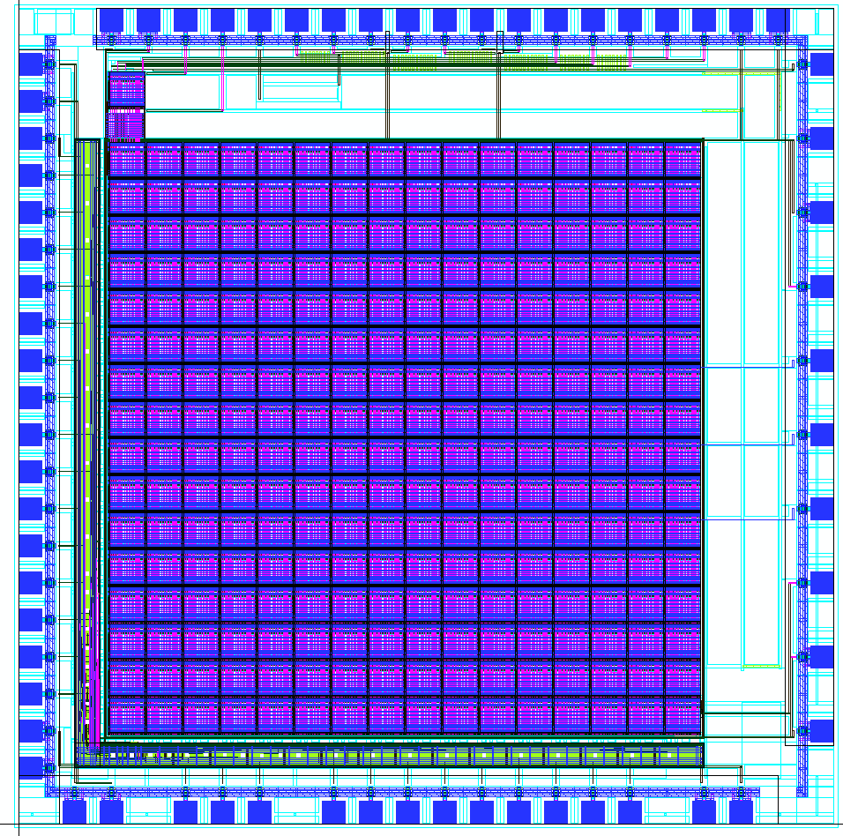
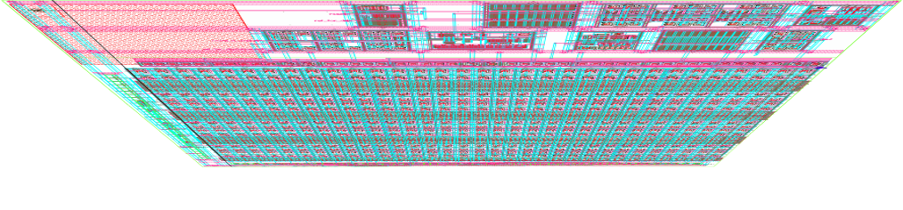
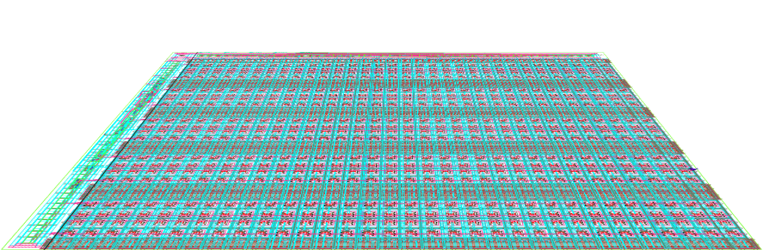
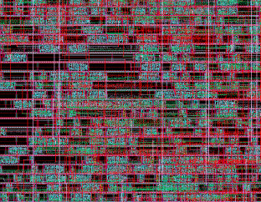
3D-CMOS
1) bump-bond to the detector (TSV)
2) amplification & double sampling
4) signal readout
3) store the analog signal in a memory cell in 1st/2nd layer
(544 memory depth)
5x5 mm2 double-tier dice
MPW, via CMP
submitted 2011
to be delivered early 2013
Standard Cells

Slide 23
What could be next?
Smaller pixels with
  Reduced dynamic range (no gain switching);
  Reduced number of frames?
New Technologies including:
  3D CMOS: second layer (more functionality)
  65 nm CMOS technology (more functionality)
  3D CMOS + 65 nm CMOS
Notes:
HGF Portfolio activity

Slide 24
HGF-Detector Program; Pillar-1 : The “Helmholtz-Cube”
What we have today
Replace standard sensor with: 3D and edgeless sensors, as well as High-Z
Replace standard bump-bonds with new interconnect techniques
Replace standard ASIC and wire bonds with thinned ASICs and TSV as well as ball-grid arrays
Replace standard ASIC with 3D-ASICs
Develop new high speed IO’s
Employ innovative materials

Slide 25
HGF-Detector Program; Pillar-1 : The “Helmholtz-Cube”
What we want tomorrow
new sensors
Thinned and 3D ASICs
Innovative materials
Advanced interconnect
High-speed I/O

Slide 26
Summary
With DEDICATED detector developments it is possible to solve the X-ray detection challenge.
It is a long and expensive process; needs persistence and good goals.
Collaborative approach is most effective; provided each partner is a real added value
Europe is still ahead and should make sure it stays.

