Slide 1
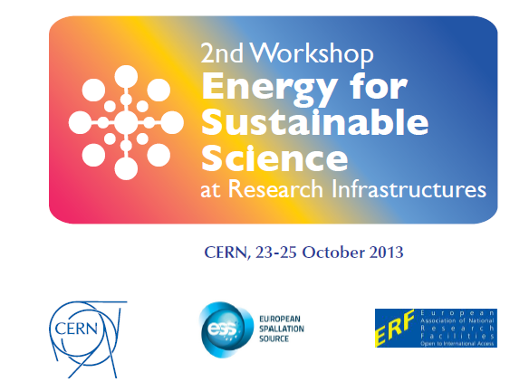

Slide 2
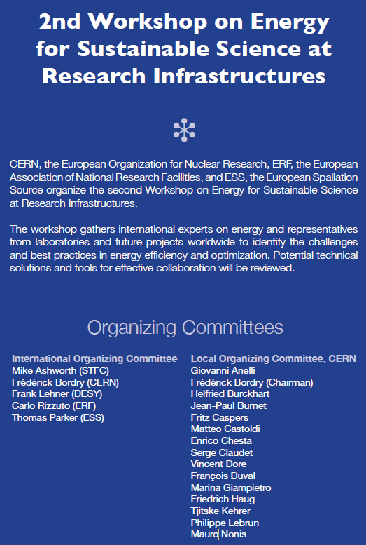
Organisation:
Tjitske Kehrer
Evelyne Delucinge
Industrial Exhibition:
Matteo Castoldi

Slide 3
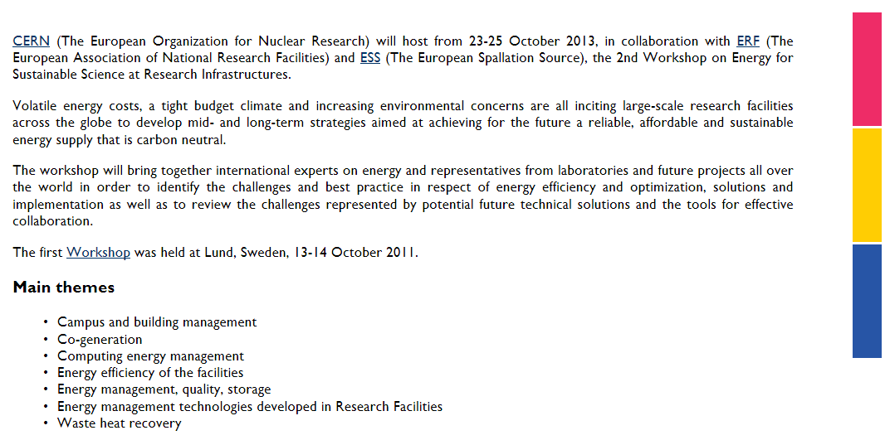


Slide 4
Energy Management at Research Infrastructures
In this session representatives from various research laboratories from Europe, Americas and Asia are asked to present in overview talks their strategies, goals and institutional practice to advance environmental sustainability at their research facilities and research campus with particular emphasis on energy savings and energy efficiency measures.
Energy Efficiency, Energy recovery and Energy quality
Practical examples in different domains: computer centre, buildings, accelerators operation, waste energy…
Green Technologies developed at Research Infrastructures
What are the technologies which are developed a RI and can be transferred in the domain of energy saving and renewable energy

Slide 5
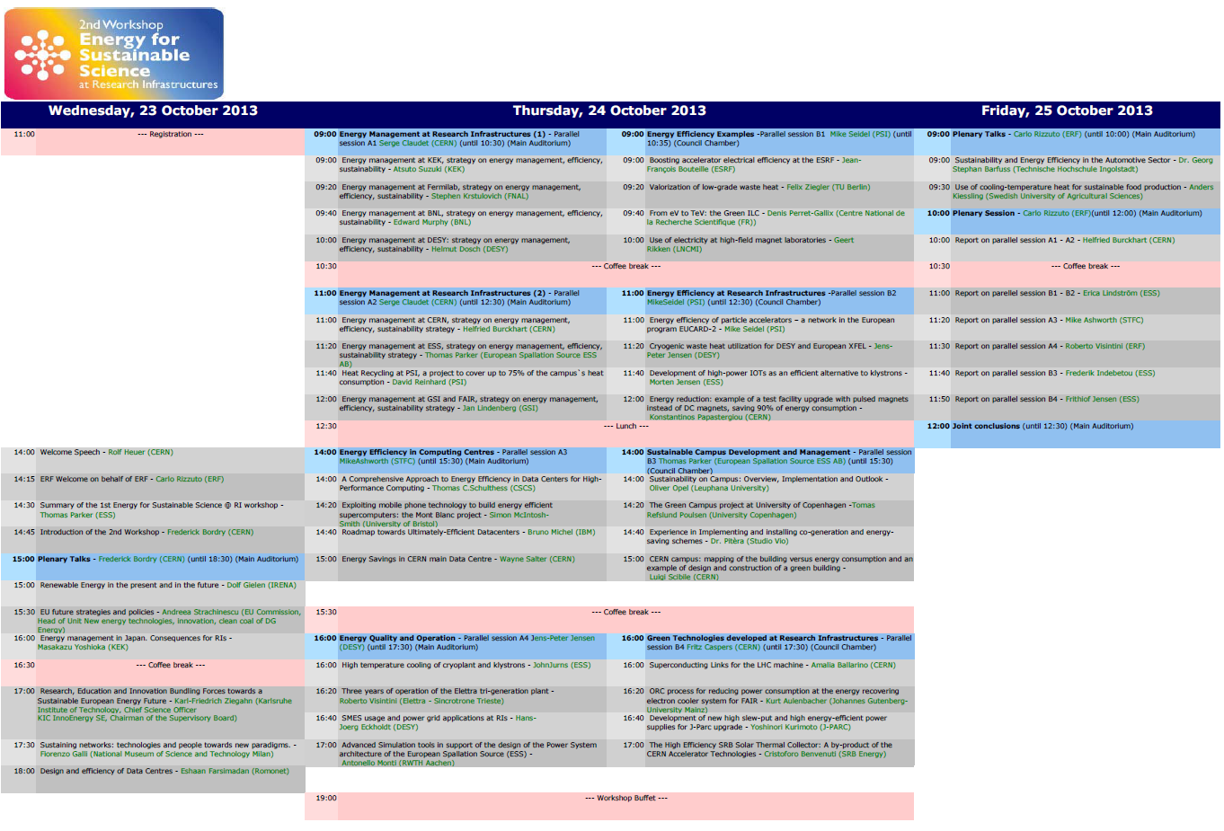
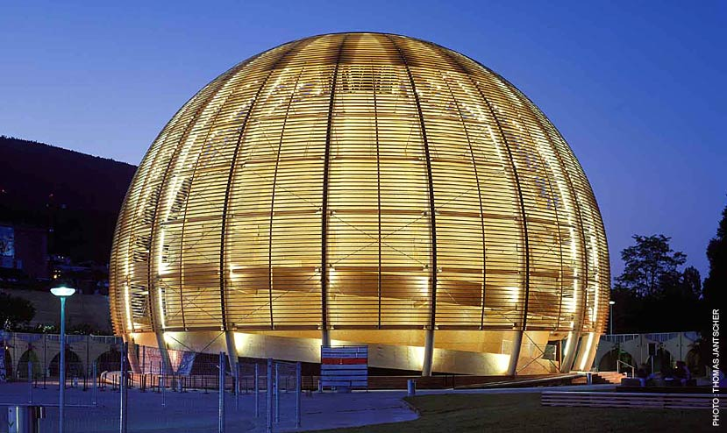
Buffet organized at the Globe of Science and Innovation on Thursday evening from 19h

Slide 6
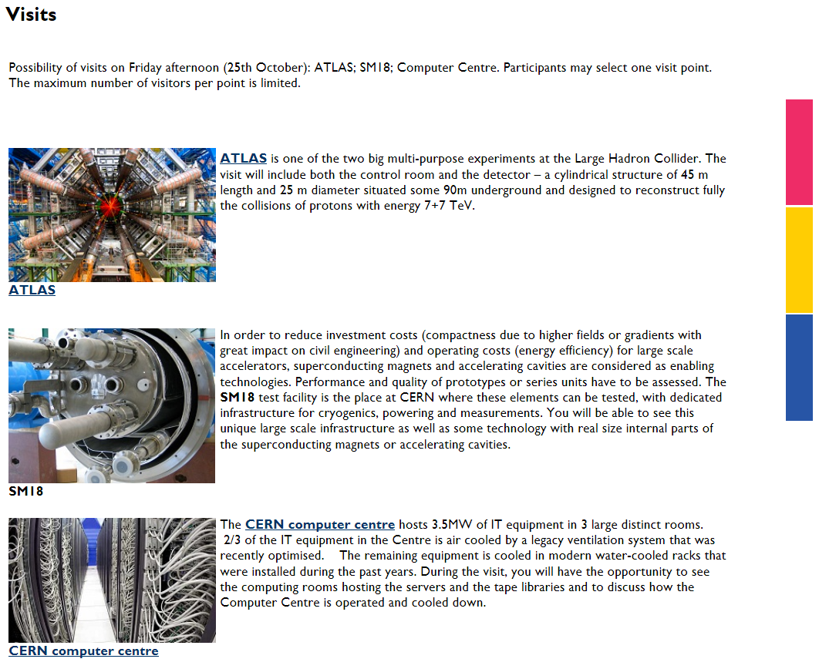

Slide 7
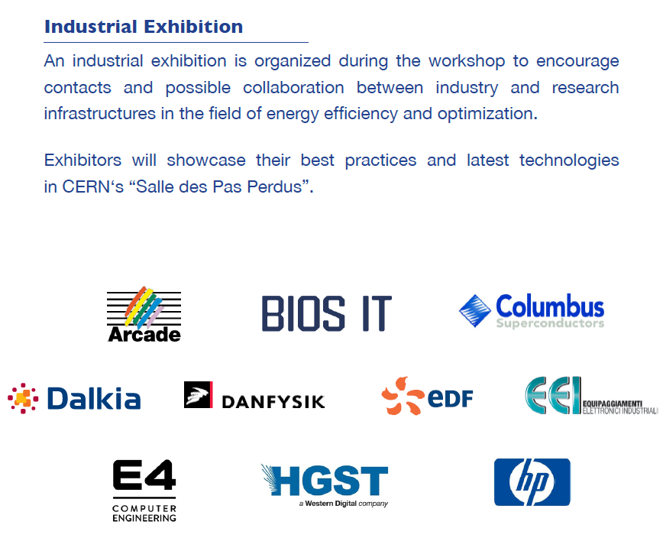

Slide 8
First plenary session
15:00 Renewable Energy in the present and in the future
Speaker: Mr. Dolf Gielen (International Renewable Energy Agency - IRENA)
15:30 EU future strategies and policies
Speaker: Andreea Strachinescu (EU Commission, Head of Unit New energy technologies, innovation, clean coal of DG Energy)
16:00 Energy management in Japan. Consequences for RIs
Speaker: Dr. Masakazu Yoshioka (KEK)
16:30 Coffee break 30' ( 61-1-201 - Pas perdus - Not a meeting room - )
17:00 Research, Education and Innovation Bundling Forces towards a Sustainable European Energy Future
Speaker: Dr. Karl-Friedrich Ziegahn (Karlsruhe Institute of Technology, Chief Science Officer KIC InnoEnergy SE, Chairman of the Supervisory Board)
17:30 Sustaining networks: technologies and people towards new paradigms.
Speaker: Prof. Fiorenzo Galli (National Museum of Science and Technology Milan)
18:00 Design and efficiency of Data Centres
Speaker: Dr. Ehsaan Farsimadan (Romonet)

