Slide 1
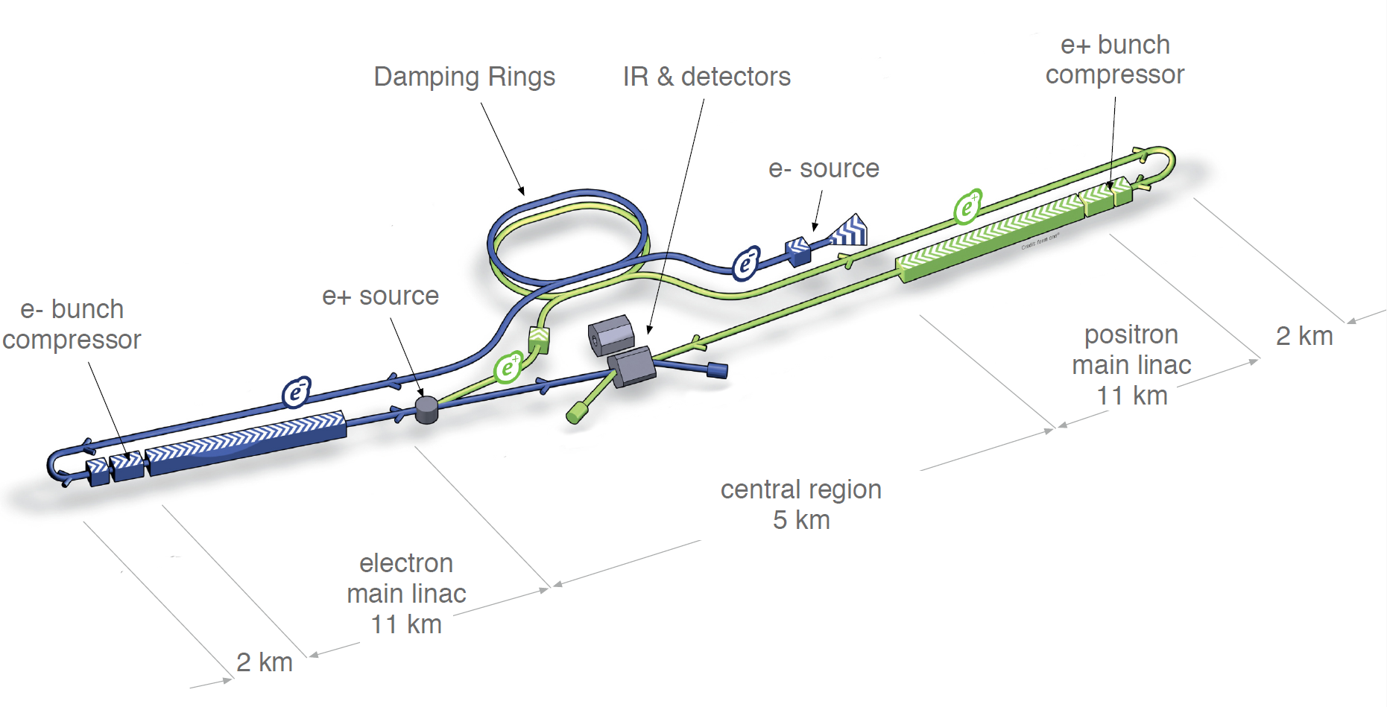
ILC: an amazing energy transformer
From eV to TeV:
the Green
ILC

Slide 2
Overview
ILC and the society
ILC Energy Budget requirement
Green Energies for ILC
Global organization for a Green ILC
Conclusions

Slide 3
ILC and the society
  ILC: the first Global Fundamental Science project, as such it will:
    Attract worldwide attention: a unique showroom for physics and basic research
    Host a large number of experts from various fields in an open science framework
  ILC: a large power consumer
    1.2 TWh (500 GeV) 20% of a nuclear reactor
    “Only” for fundamental science
    In an energy/global warming/financial crisis in the world and in Japan

Slide 4
Colliders energy budget
CERN at peak 180 MW, total one year 1.2 TWh ~ 140 MW average
“82% accelerators, 12% experiments,
3% computer center, 3% campus infrastructure.
About 1 TWh gets dissipated in cooling towers (H.J.Burckhart et al. IPAC2013)”
Compared to Geneva canton (500,000 residents):
Total energy 11.4 TWh/year, 25% goes to electricity (2009)
CERN is 10% of Geneva total energy
40% of Geneva electrical power, equivalent to consumption of 200,000 r
30 M$ (23 M€) … 20€/MWh 6-7 times cheaper that my bill…. ☹

Slide 5
ILC center (rough estimates)
e+e- Linac RF, Magnets, Cryo plants: 164MW @500GeV–300MW@1TeV (TDR)
Experiment ~ 5 MW (one of the LHC experiments)
Computing ~ 4 MW (estimated from CERN)
Buildings ~ 4 MW (estimated from CERN)
Very similar to CERN consumption let’s take 180 MW (peak) and 1.2 TWh/year
“A primary voltage of 275 kV was assumed for the site.”
“The power capacity is designed to be 300MW and space is reserved for
an additional 200MW for the future 1TeV upgrade.” ILC TDR Vol. 3-1 → 500 MW
180 - 320 MW 1.2-2.2% of Tohoku region (15 GW) ~ Morioka (300,000)
500 Gev BL 1 TeV 18-32% of Iwate prefecture
135€/MWh 2011 in Japan for industry (OECD 2013 report)
Yearly electricity running cost ~ 160 M€ (500 GeV BL)
Even if 50% rebate for very large users → 80 M€/year

Slide 6
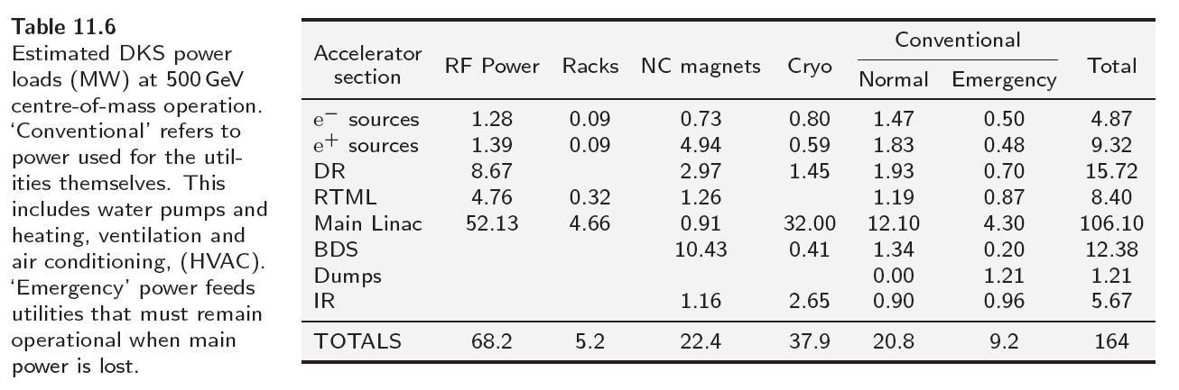
ILC baseline energy budget
MW
Rank: 1 6 3 2 4 5
% : 42 3 15 23 13 5

Slide 7
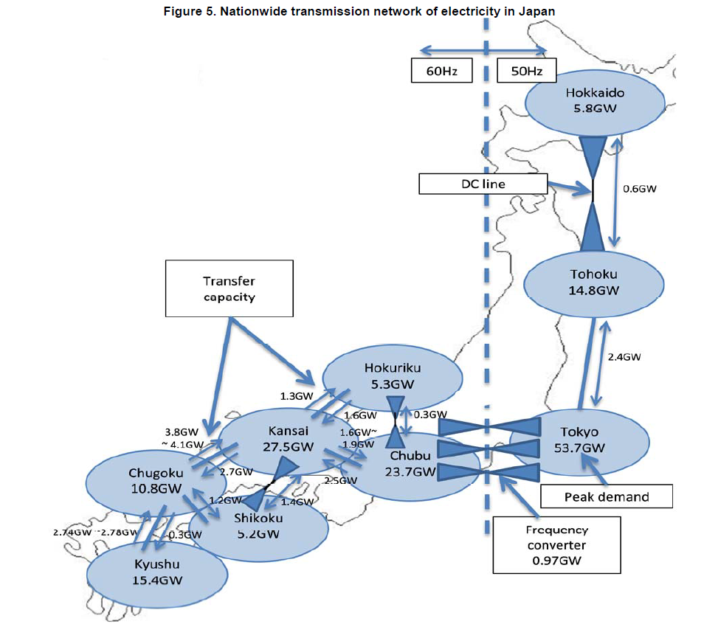
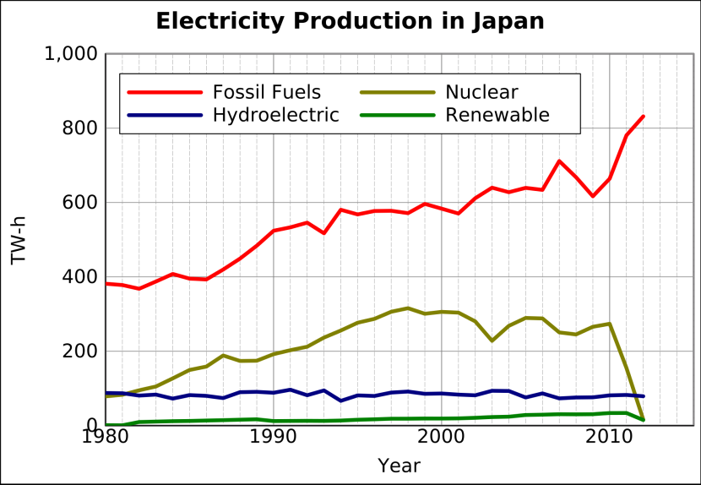
Jones, R. S. and M. Kim (2013), “Restructuring the Electricity
Sector and Promoting Green Growth in Japan”, OECD
Economics Department Working Papers, No. 1069, OECD
Publishing.
http://dx.doi.org/10.1787/5k43nxrhfjtd-en
Peak demand
Total 162.2 GW
~ 10 M people
ILC = Morioka

Slide 8
Should ILC turn to Green Energy ?
ILC being the size of a city, is a real scale workbench to develop, maintain and manage a mix of sustainable energy sources.
ILC is a (very) long term effort, investing in green energies makes sense.
It is the “fundamental research” contribution to the global warming and the energy crisis.
Energy research is a strong motivation to the society and the decision makers.
A substantial contribution to the ILC running cost.

Slide 9
ILC: an amazing energy transformer
Assuming an ILC powered by photovoltaic energy:
Energy at the particle level:
from 1 eV to 1 TeV:
12 orders of magnitude, a Tera scaling
Energy concentration:
Surface to collect 82 MW(one beam) to the beam size:
20 orders of magnitude, almost Zetta scaling
Energy transformation efficiency:
Beam power/AC power: 6-7%

Slide 10
ILC site

Slide 11
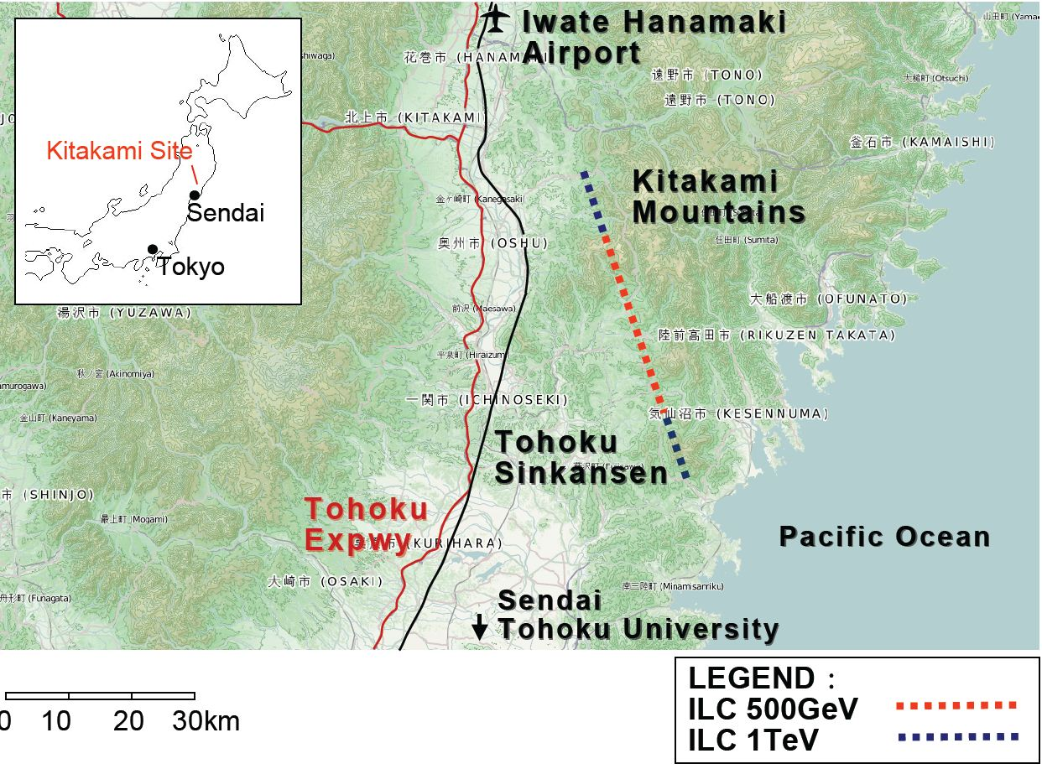

Slide 12
Check the ILC site
  Good environment for many different renewable energies
    Photovoltaic and thermal sun energies (~1800 h/year)
    Wind and marine power, many possible spots on sea shore and off-shore
    Local hot springs, geothermic (shallow drill)
    Biomass/biofuel energy: rural
  Power plants integration in the country landscape: need working with the citizens
  Extra production may support local people

Slide 13
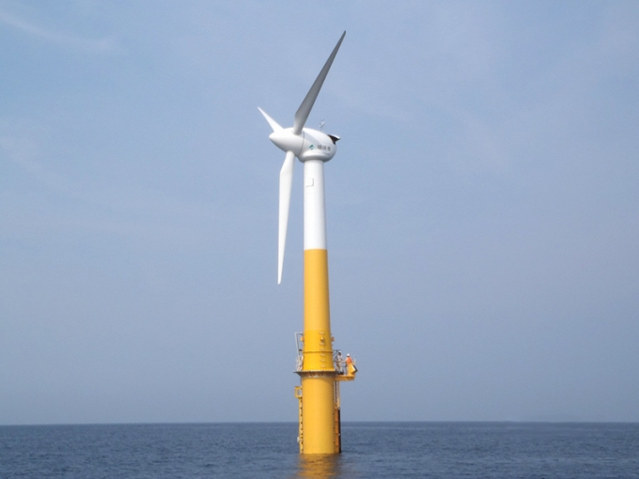
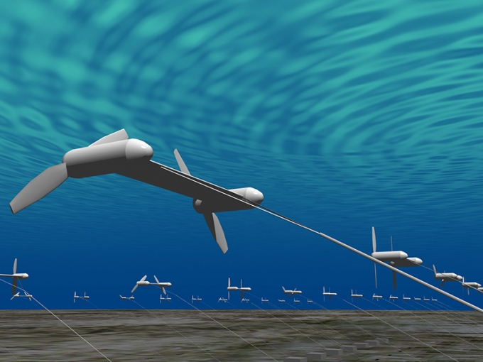
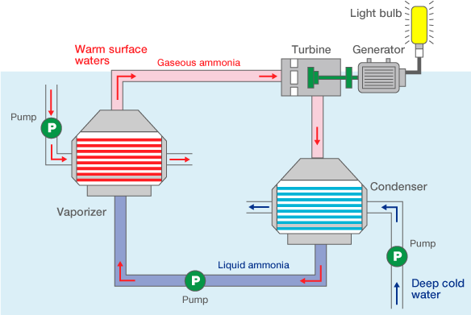
Wind/Marine Energy
2 MW Goto island prototype
Tidal and marine stream
2.3 GW installed, none failed after 3/11
Wind Projects
6 floating 2MW wind turbines off Fukushima
up to 80 in 2020
Sea temperature gradient

Slide 14
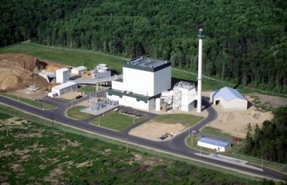
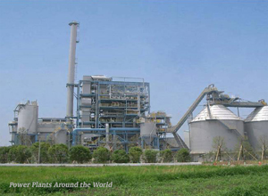
Biomass/biofuels Energy
Idemitsu Kosan Co. 5 MW
Miyasaki, Nishinippon Env. Energy co. 11.7 MW
Installed 2.3 GW (2011)
very little progress since 2011
Many sources including:
Rice, fishery and agricultural wastes
Algae
Other cattle and human wastes
Co-generations heat and electricity

Slide 15
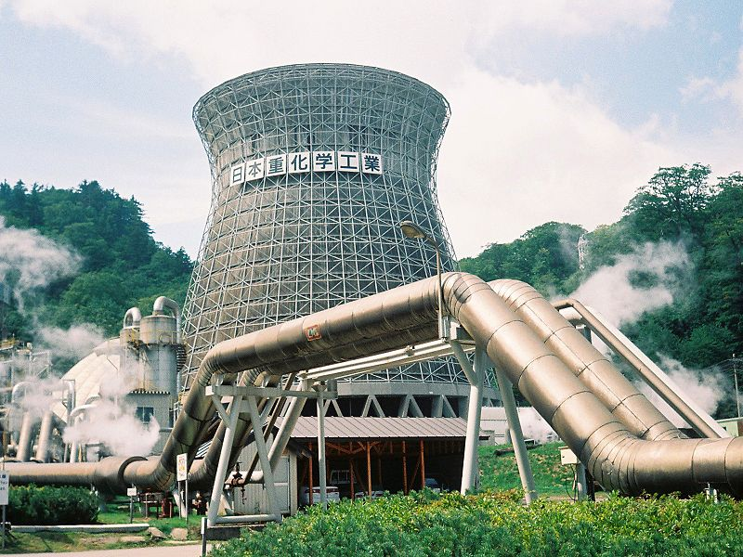
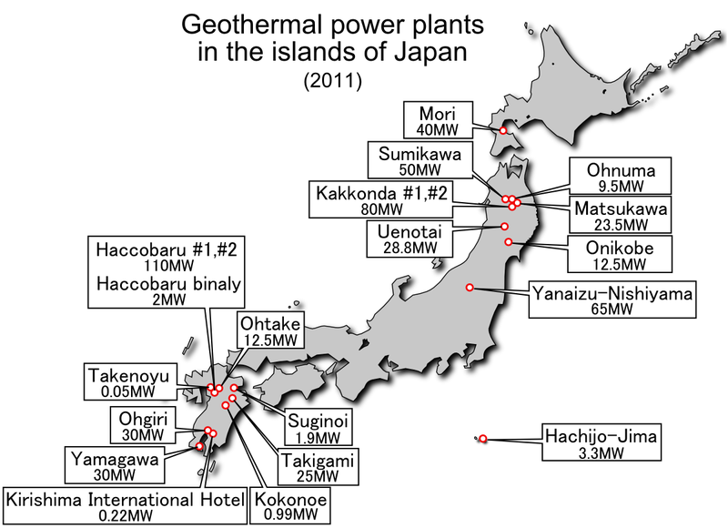
Geothermal Energy
9.5MW 1967 Matsukawa
Installed 2011 : 0.5 GW.
Geothermal potential sources : ~ 20 GW
No substantial progress since 2011
But:
Avoid National Parks
Get agreement with the onsen industry
Gov. support
No-Fracking

Slide 16
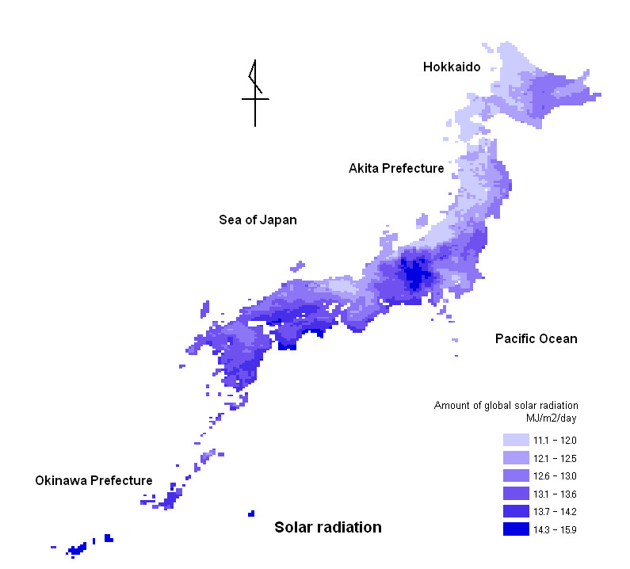
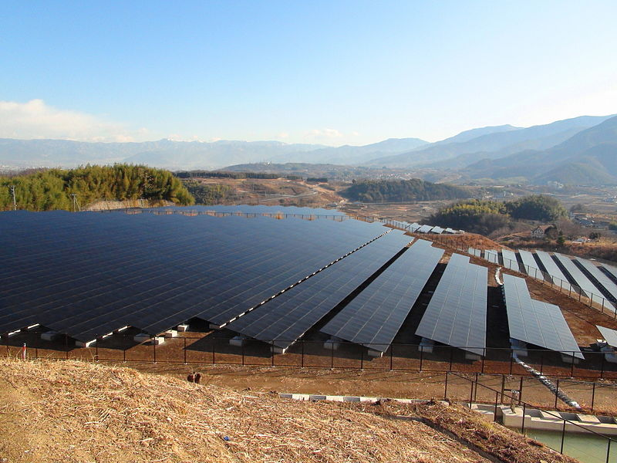
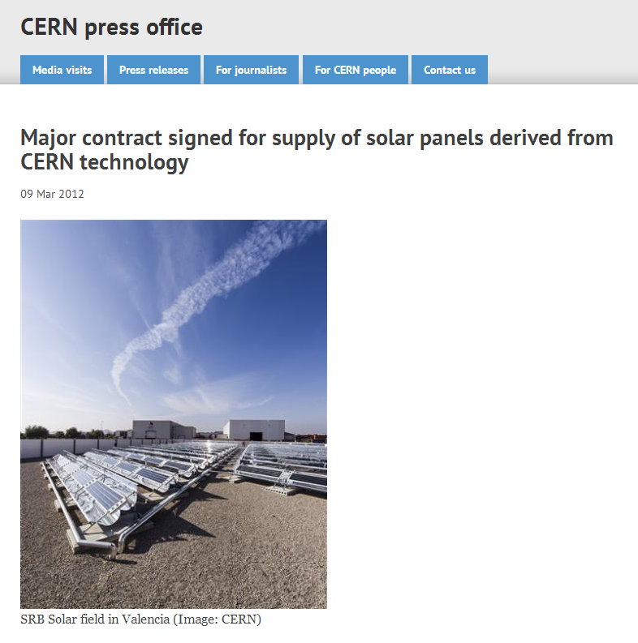
Photovoltaic and Thermal Solar energy
10 MW Komekurayama 30 km Fuji-san (TEPCO)
Installed: 8.5 GW
Projects:
341 MW in Hokaido
100 MW Minami Soma
2009 Target Japanese gov.
28 GW of solar PV capacity by 2020
53 GW of solar PV capacity by 2030
10% of total domestic primary energy demand
met with solar PV by 2050
Solar thermal Energy
C. Benvenuti
CERN Physicist

Slide 17
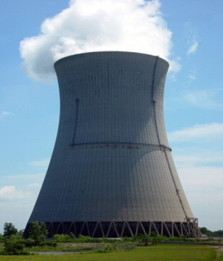
Green ILC Energy Issues
Energy saving and efficiency
  Better component efficiency: klystron, cryocooler (see M. Yoshioka’s talk)
  Beam energy and beam dump heat recovery (See A. Suzuki’s Talk)
  Cooling water heat recovery (Sterling engines and heat pumps, thermoelectrics, osmosis, …)
Production: Developing Sustainable energies for ILC
  How to adapt the ILC component power requirements to the various energy sources distinctive features (DC (PV) supply for cryo and RF, variability, …)
  How to build energy storage to cope with ILC running conditions (batteries, liquid helium, nitrogen, hydrogen, hydro, compressed air, ….
  What is the best mix to cover ILC specific needs ? 24/7, long shutdowns
Distribution: Smart (Local) GRID: Full scale multi-sourced GRID management and control
  Smooth and rapid switching between energy sources, including conventional supply
  Energy Management and forecast: production, storage and backup

Slide 18
Global organization for Green ILC
Creating the “ILC Sustainable Energy Research Center” aside of
the “ILC High-Energy Research Center”
Two main objectives:
  R&D on Sustainable Energies, attracting the best experts.
  Powering ILC
Industry participation
  Energy issues relate to most of the industry (much more than HEP)
  Twofold interest: part of a global research endeavor and ILC market
  ILC achievements: a showcase for the companies
Institutes and organizations over the world can be involved:
  In Japan JCRE Japan council on renewable energies, JREF, ..
  In the world: IEA, NREL (US), CREST, Narec(UK), CENER(SP), ..
To run parallel to ILC, no impact on ILC construction timeline
Own specific budget: substantial supports can be made available from:
  public programs, governmental and regional (EU) plans (US-EU energy council, …)
  Industry participation and contribution

Slide 19
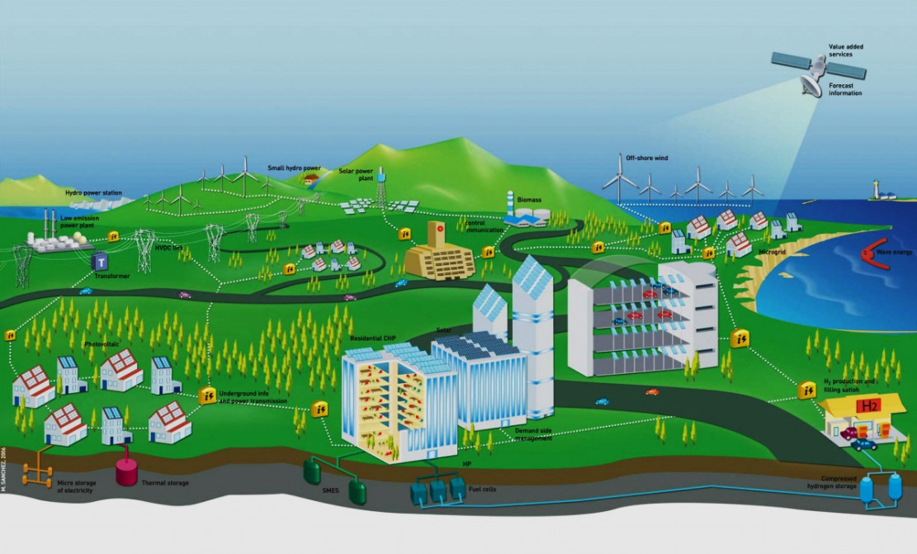

ILC Energy Center
ILC Energy Center
ILC High-Energy
Research Center
ILC Sustainable Energy Research Center
Fundamental Research
Basic Research
HEP Applications
Application R&D
Pilot Power plant for ILC
Electrons, photons, neutrons factories
HPC/GRID Computing

Slide 20

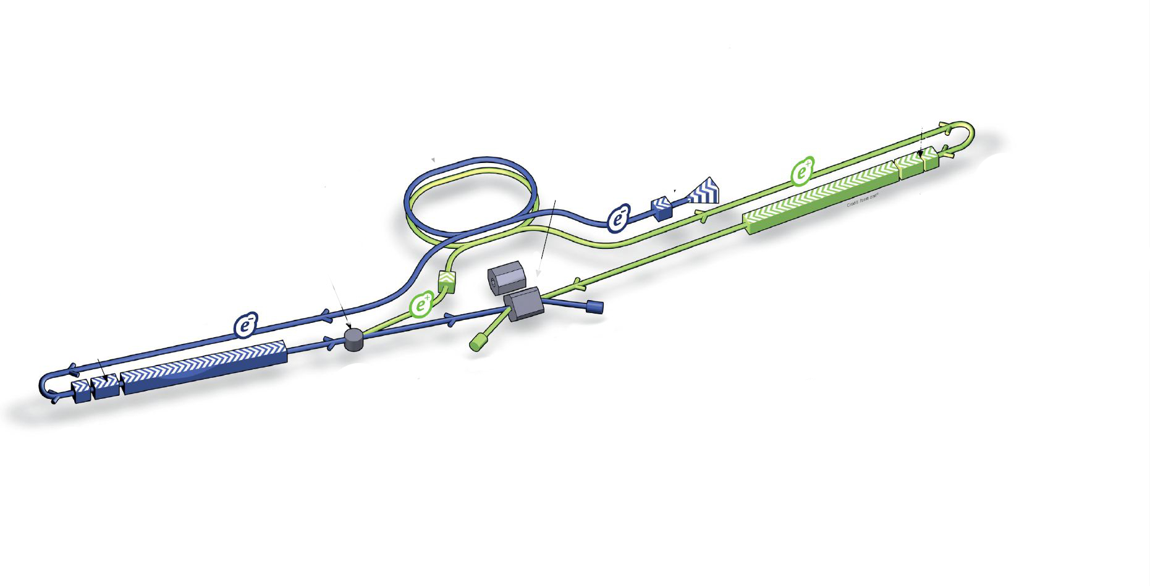

ILC center futuristic view
Forecast and data management
Hydro storage
Wind turbine
Off-shore wind
Solar Power Plant
Biomass
Geothermal Plant
Smart GRID
Wave/stream energy
Photovoltaic and thermal
Photovoltaic
He, H2 storage
Courtesy of:

Slide 21
ILC Sustainable energy institute missions
Get involved in the most advanced and promising researches:
  Basic research … is the most needed and less funded
    Nanotech for energy production and storage, for lighting, …: graphene, nanotubes, quantum dots, …
    Biomimetic research (artificial photosynthesis) and quantum effects in solid states
    New materials for catalysts, fuel cell membranes, high-Tc materials, solar cells high efficiency
    Low energy harvesting devices, STEG (thermo-electricity), stirling engines
    Characterization tools and computer modeling
  Technology and engineering (devices and systems)
    Hybrid systems, best mix, energy transformation, matching energy source and accelerator components
    Specific equipment like: Solar Powered Cryocooler (DC compressor, Thermoacoustic Stirling Heat Engine Pulse Tube), solar energy to RF, fuel cells for computing systems
    R&D on biomass, geothermal, wind/stream turbines
    Smart GRID
Power ILC:
  Identify locations with low environmental impacts.
  Design and build pilot power plants (a few 10 MW each) from various energy sources for complementarity for real scale studies and substantial ILC power supply.
  Connect to ILC, to the GRID
Can the ILC project reach energy self-sufficiency? How and when ?

Slide 22
Gradual Multi-Staged Implementation
As a backup of the conventional power supply (~ 7 MW current diesel engines)
To cover buildings energy (electricity and heating) ( ~ 10 MW) (zero energy )
To power some parts of the ILC components: some of the cryo plants, computers, …. (10-20 MW)
To be scaled up to all previous components (30-40 MW)
To power some of the klystrons (100 MW)
All 500 GeV ILC electrical supply (170 MW)
  Conventional power supply is now in backup mode
Get ready for the 1 TeV (additional 150 MW)
ILC Energy Research Center Location
Most genuinely close to ILC, in Kitakami vicinity
But not necessarily, through special agreements between electrical power utility companies
  could be anywhere in Japan or even with plants disseminated at the most favorable locations
  Anywhere in the world, could be part of the country running costs contributions, but should be sustainable energy… reinventing the Data GRID model

Slide 23
Energy research benefits
Research in a cross-disciplinary and global center.
“Scientific work is still too fragmented and specialized, with a focus on incremental change rather than on transformation.” OECD Sustainable Energy Forum 2013
Focus on basic research, rarely done in other frameworks
  Innovation and Industry target short term returns
  “Science can be perceived as working too much for vested corporate interests and not enough for the public interest” OECD Sustainable Energy Forum 2013
Complete path from basic research to pilot plants
Synergies with HEP:
  Material analysis (photon factories, FEL, XFEL, neutron sources, …)
  Large computing centers (GRID), Geant4 simulations, turbulences,
  Expertise in advanced electronics, large electronics and computing system management,
  Expertise in very high vacuum, surface treatment and cleaning, …
  Expertise in industrialization of manufacturing (cavities and magnets), design, quality control, organization and management,..

Slide 24
Next steps
Energy session at the LCWS in Tokyo (Nov. 11, 2013)
Setup an ILC Energy working group as part of the LC collaboration
  Energy and accelerators Scientists and Experts + Industry
  Green ILC Feasibility report by 2014-2015
Maybe the third “Energy for sustainable sciences” workshop in Sendai or Kitakami ?

Slide 25
Conclusions
HEP a driver for innovation: a unique opportunity to link HEP and Energy R&D in an ambitious but rewarding endeavor:
  Societal impacts:
    Tackle one of the most important world-wide issue: Energy, boost basic research which is most needed today
    ILC visibility and fundamental research public appreciation
    Local region good appraisal by providing instead of consuming resources
  Great saving in running cost particularly if R&D/infrastructures are supported by a separate additional budget.
  Better flexibility for the ILC operations (less GRID dependence)
Additional motivations for the decision makers: ILC goes beyond basic science
  In Japan:
    Revitalization of the economics (Abenomics), Re-industrialization after Tsunami in Tohoku, Global cities (Japan Policy Council), industry (AAA) and internationalization
  Elsewhere: fewer incentives. But energy is a big and motivating issue for everyone

Slide 26
Additional slides

Slide 27
Renewable energy Japan (METI)
Energy Source | Total capacity before FY2011 | Total capacity starting operation in FY2012 | Total capacity starting operation in FY2013 (as of May 31, 2013)
Photovoltaic power (for households) | 4.4 GW | 1.269 GW | 0.279 GW
Photovoltaic power (non-household) | 0.9 GW | 0.706 GW | 0.961 GW
Wind power | 2.6 GW | 0.063 GW | 0.002 GW
Small and medium hydropower (1,000 kW or more) | 9.4 GW | 0.001 GW | 0 GW
Small and medium hydropower (less than 1,000 kW) | 0.2 GW | 0.003 GW | 0 GW
Biomass power | 2.3 GW | 0.036 GW* | 0.038 GW
Geothermal power | 0.5 GW | 0.001 GW | 0 GW
Total | 20.3 GW | 2.079 GW | 1.280 GW

