Slide 1

CERN campus: mapping of the building versus energy consumption and an example of design and construction of a green building.
Luigi Scibile
CERN, General Services and Infrastructure Department
Head of the Site Engineering Group
Main contributors: F. Audinet, H. Burckhart, M-L. Gabassi, M. Gansser,
F. Magnin, C. Martel, M. Poehler

Slide 2


Slide 3
Content
The CERN campus: situation and outlook
Mapping heating space energy consumption
Models, simulations and estimates
Example of application of energy concepts

Slide 4
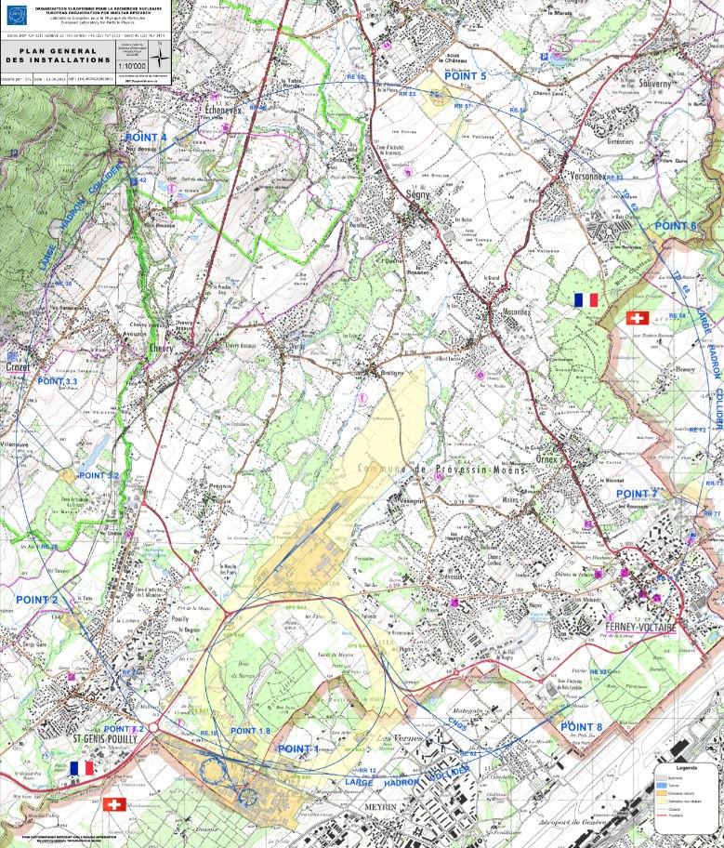
The CERN site
590 hectares of available land
2 main sites
  Meyrin (CH)
  Prévessin (FR)
15 satellite sites
650 buildings - 10m² up to 20.000m²
60% of the buildings are 30+ years old
2 Heating plants (3 x 15 MW + 3 x 5 MW)
22km + 7km of district heating network
80 km of tunnels
250 km of roads
10.000 professionals on site daily
100.000 tourist visitors annually

Slide 5
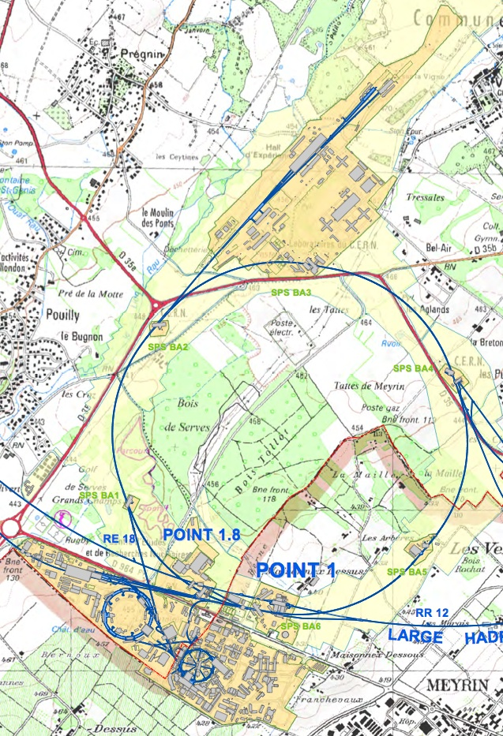
The CERN campus:
Meyrin and Prévessin sites
Work facilities
  (offices, labs, workshops, etc.)
Social facilities
  (restaurants, hostels, banking services, post office, clubs and a kinder garden)
Visitor facilities
Prévessin site
Meyrin site

Slide 6
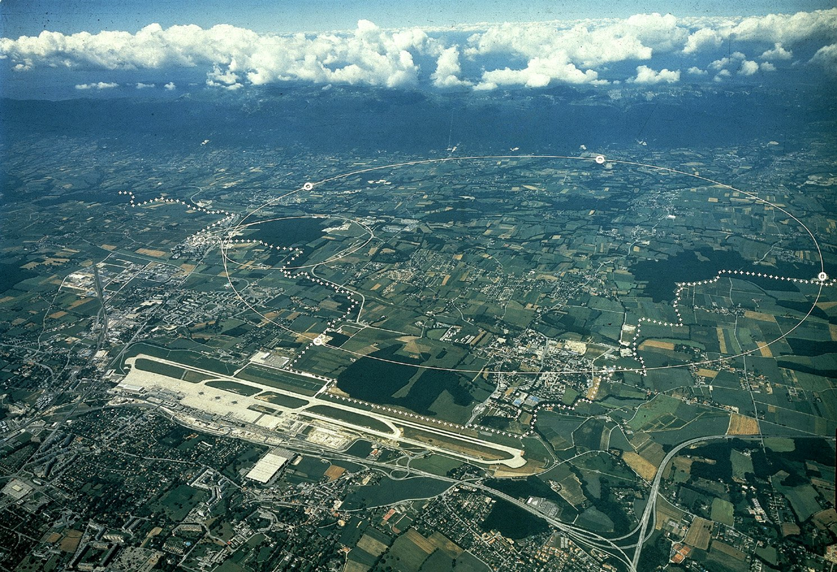
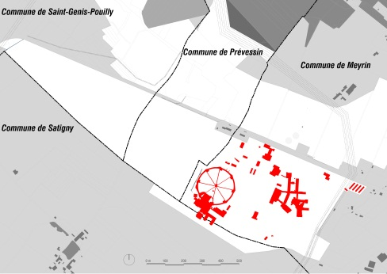
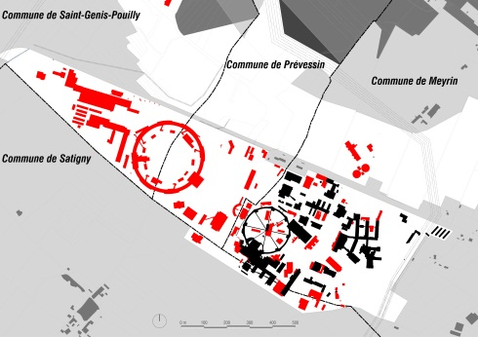
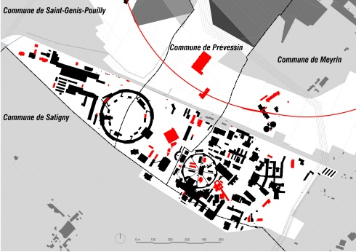
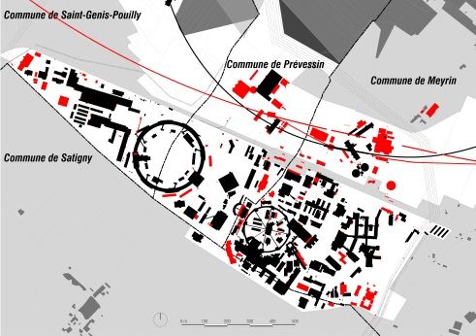
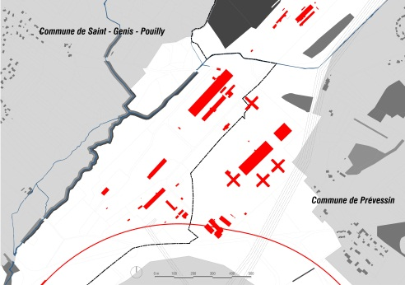
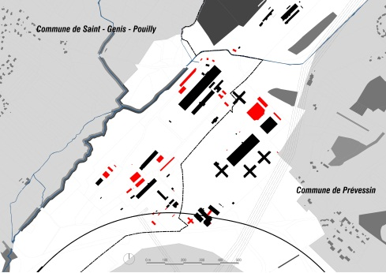
Two sites with a history
MEYRIN
1950-60
1960-75
1975-85
1985-10
PREVESSIN
1970-80
1980-10

Slide 7
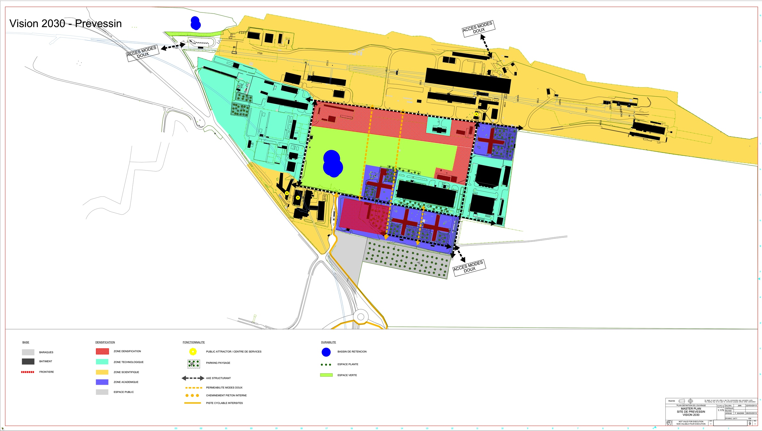
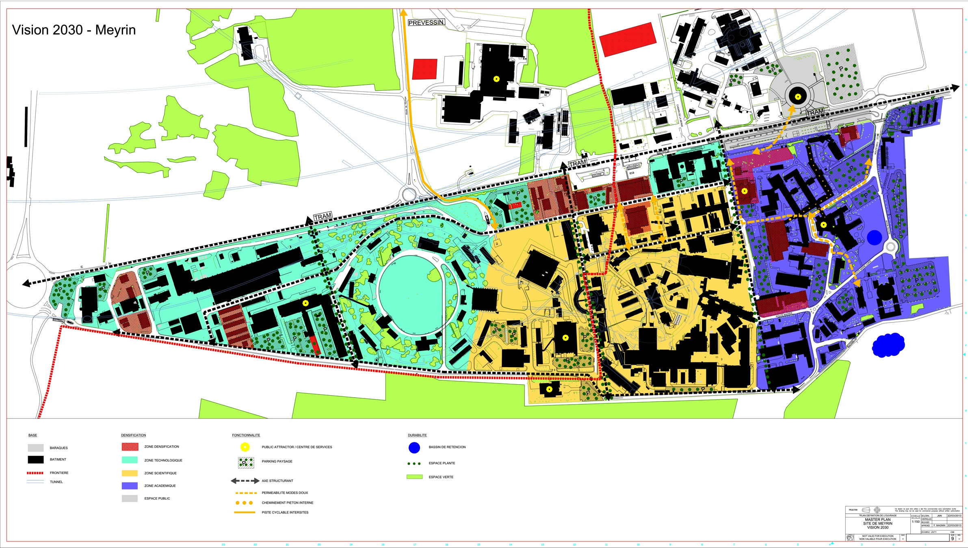
Two sites with a future
MEYRIN
PREVESSIN

Slide 8
The CERN campus: situation and outlook
Buildings:
  Renovation of building envelop, lighting systems, HVAC systems (safety and energy efficiency).
  New buildings energy concept (RT2012, SIA380).
Energy efficiency:
  Renovation of the heating process regulation at all levels (district heating plants and local control, -gas -NOx).
  Implementation of local energy measurements (today only available at high aggregation level).

Slide 9
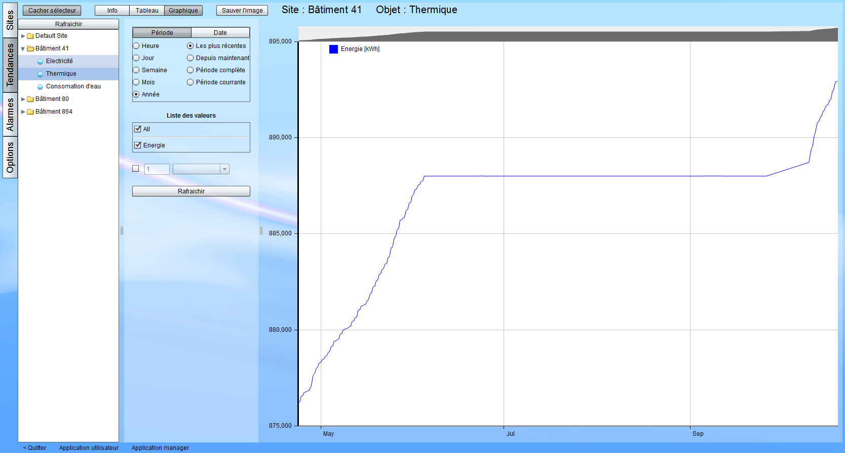
The CERN campus: situation and outlook
Example: local energy measurement.

Slide 10
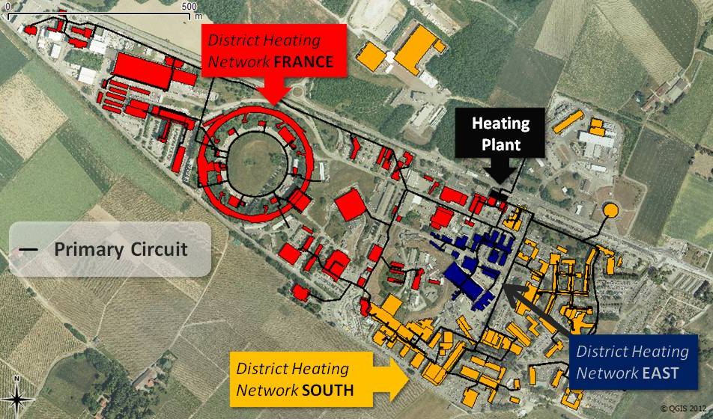
Mapping heat energy consumption/usage
Given the limitation of the energy measurements
Meyrin Site

Slide 11
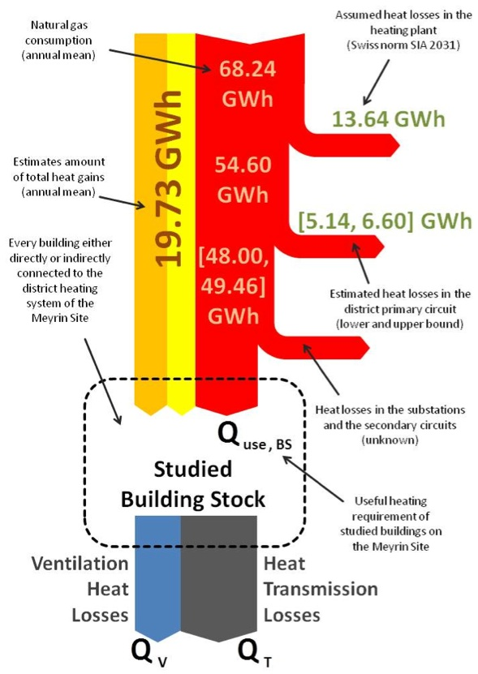
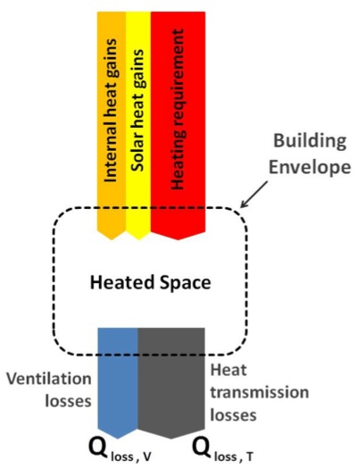
Mapping heat energy consumption/usage
Model where heat energy is used (requirements)
Model where/how energy is dissipated
Overall
Simulation results
46.2
GWh
65.9
GWh

Slide 12
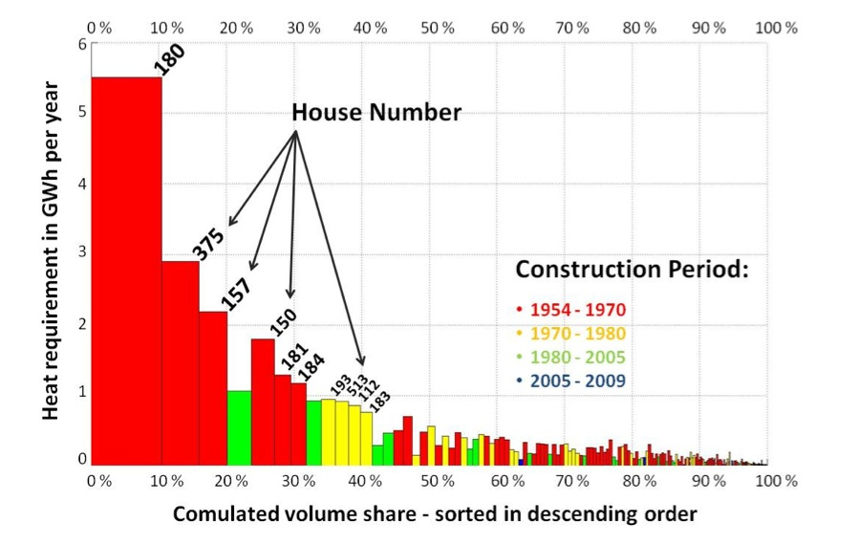
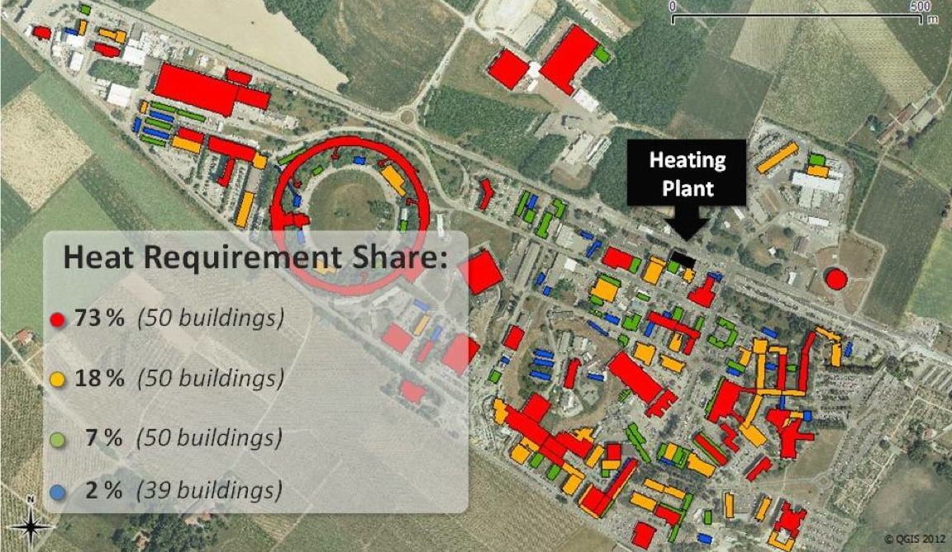
Mapping heat energy consumption/usage
Consolidation benefits
Planning tool
Identify synergies for waste heat recovery

Slide 13
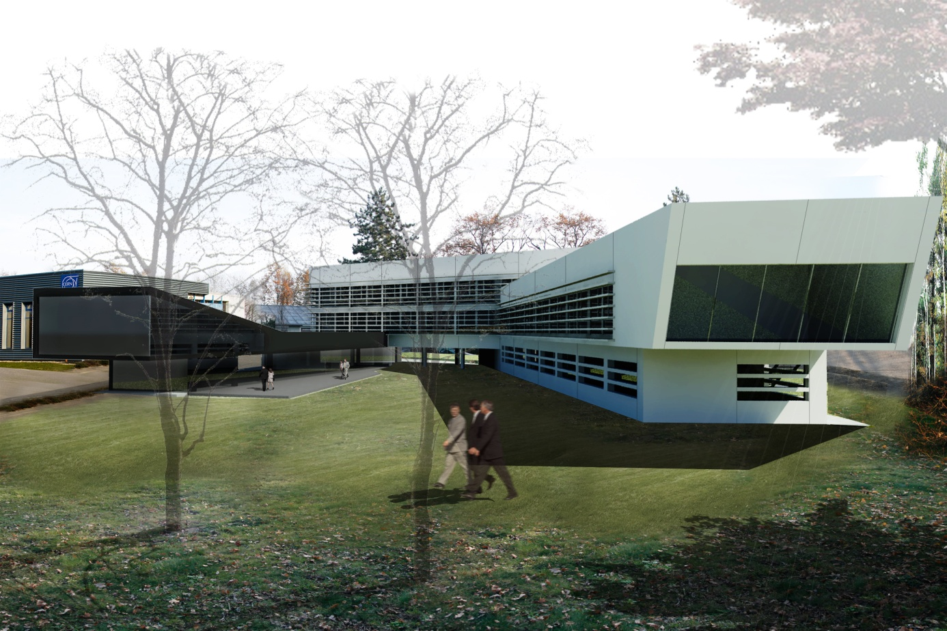
Example of application of energy concepts
Building 774
RT2012 standard
Renewable energy and energy recovery
Designed to interact with other sources

Slide 14
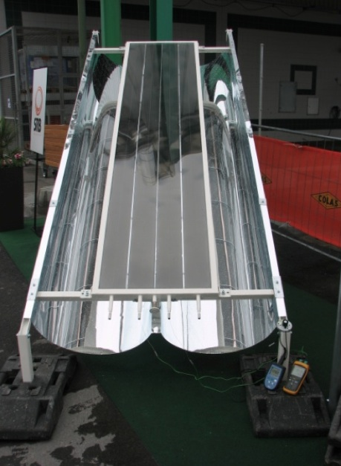
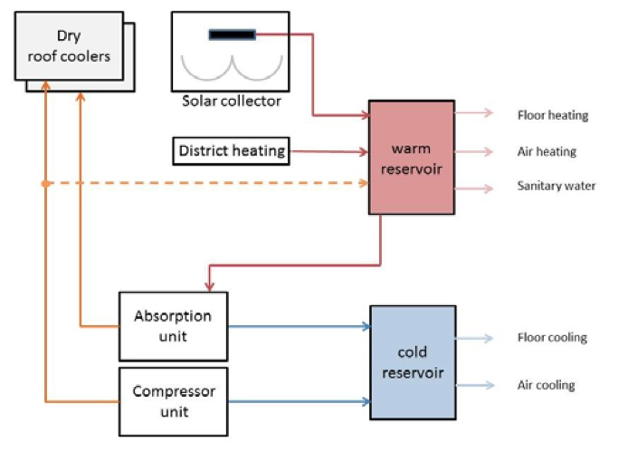
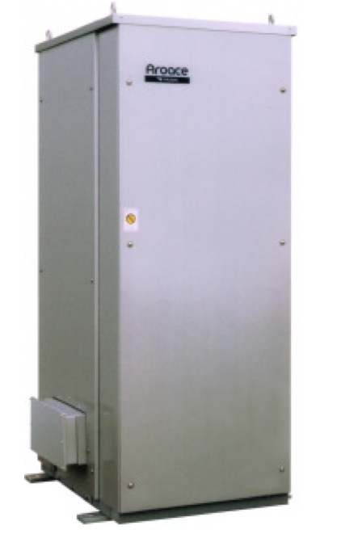
Example of application of energy concepts
Building design
Systems design
SRB panels
Excellent insulation
Triple-glazed windows
Fixed shading structure
Offices
Meeting rooms
Absorption
unit
Laboratories
Conference rooms
Cafeteria

Slide 15
Conclusions and outlook
Energy is a key aspect in the renovation of old infrastructures and in new building designs.
The model of the heat consumption/usage of the sites provides us an invaluable tool to target interventions and plan for future developments and synergies (energy recuperation).
New infrastructures are designed with built-in capability to have synergies with eventual energy recuperation.

Slide 16
Questions and answers
Thank you for your attention
QUESTIONS?
For additional material and contacts:
http://gs-dep.web.cern.ch/en/content/gs-se

