Slide 1
Materion Brush Inc.
Beryllium
Health and Safety Update
08 April 2013
Presented by:
Edward Hefter and Gordon Simmons

Slide 2
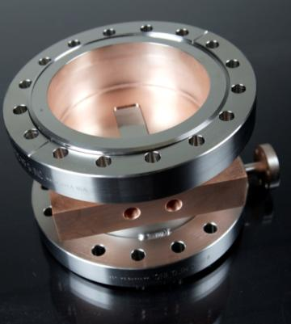
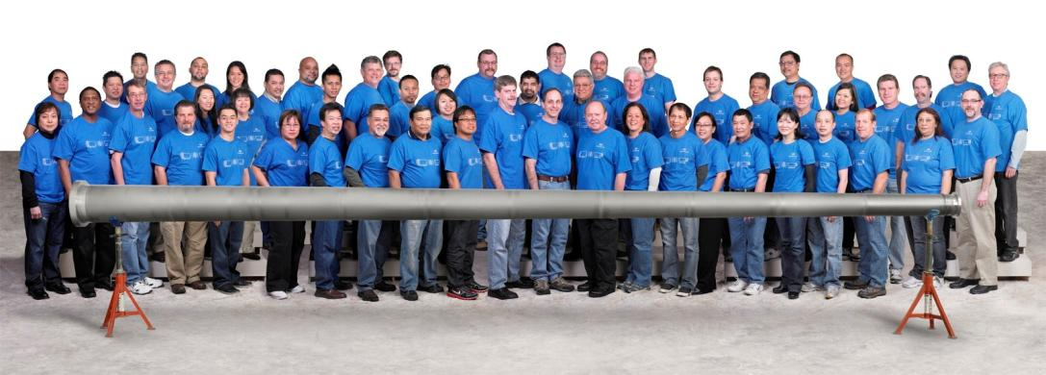
Materion Brush Inc.
Fully integrated producer of beryllium and
beryllium-containing materials
Primary beryllium-containing Products
      Metallic Beryllium (Be)
      AlBeMet® and Beryllium Oxide Ceramic (BeO)
      Alloys Containing small amounts of Beryllium
      (CuBe, NiBe, AlBe)
    This presentation relates to pure beryllium used at CERN
      Beampipes
      Support structures
      X-Ray Windows
Beryllium LHCb Beampipe
Notes:
14

Slide 3
Beryllium in the Environment
Beryllium is naturally occurring in the environment, with an average concentration in the Earth’s crust of 2.6ppm, the 44th most abundant element in the Earth’s crust¹
Typical concentration in topsoil is 0.6mg Be per kg soil²
Median air concentration of Be in US cities is 0.2ng/m³, and greater than 0.1ng/m³ in 50 US cities³
Beryllium in foods➔
In other words,
beryllium is found
everywhere!
Footnotes:
1 = IARC 1993, 2 = WHO 1990
3=ATSDR 1993, 4=HSDB 1997
Foods⁴ | Value
Rice | 0.08 mg/kg
Potatoes | 0.17 mg/kg
Tomatoes | 0.24 mg/kg
Head Lettuce | 0.33 mg/kg
Mushrooms | 0.12 mg/kg
Nuts | 0.01-0.47 mg/kg
Cigarettes² | 0.74 µg / Cigarette
Notes:
1=IARC. (1993). Beryllium, cadmium, mercury and exposures in the glass manufacturing industry. IARC Monographs on the Evaluation of Carcinogenic Risks to Humans. Lyon, France, World Health Organization 444 pp.
2=WHO. (1990). Environmental Health Criteria 106: Beryllium. Geneva, World Health Organization.
3=ATSDR. (1993). Toxicological profile for beryllium: Update. U.S. Department of Health and Human Services., Public Health Service., Agency for Toxic Substances and Disease Registry, Atlanta., GA., Division of Toxicology, Toxicology Information Branch.
4=HSDB. (1997). Hazardous Substance Data Bank. National Library of Medicine Specialized Information Services. http://tomescps.com/assm.asp?HS6899

Slide 4
The Real Risk with Beryllium
Chronic Beryllium Disease (CBD) Conditions
      Individual must be sensitive or allergic to beryllium
      Respirable particulate less than 10 microns in size, roughly 1/10th the diameter of a human hair
      Exposure to beryllium particulate in the form of a dust, fume or mist
        All three conditions are required!
CBD is primarily a disease affecting the lung – not ingestion or skin contact
CBD is treatable but not curable
      No special health risks with Be in solid form
Most end users, such as the engineers and technicians at CERN, will never handle beryllium in ways which generate dust, mist or fume. Beryllium is not a fire hazard since it has no flashpoint, melts at 1,285ºC, and evaporates at 2,970ºC
Notes:
9

Slide 5
How does an individual get CBD?
Individual born susceptible
From 1940-1990, studies indicate that <2% exposed population developed CBD. It is believed that genetics plays a role in sensitization and CBD
Exposure
Individuals exposed to airborne beryllium and inhales particulate <10µm in size
Sensitization
Individual becomes sensitized to beryllium, autoimmune system will react after additional exposures
Subclinical CBD
Diagnosis based on detection of sensitization and presence of granulomas (nodules) in lungs. No noticeable impact on health
CBD
Individual loses noticeable lung capacity
Treatable, not curable, potentially fatal
Inflammation
Immune response causes inflammation and damage to lungs

Slide 6
Migration Pathways

Slide 7
Recommended Maximum Exposure to Airborne Beryllium Guideline
Materion Brush Inc. recommends 0.2 µg/m³ airborne Be as an 8-hr time weighted average – this means that an individual is exposed to an average of no more than 0.2 µg/m³ in 8 hours, or no more than 0.4 µg/m³ in 4 hours, or no more than 0.8 µg/m³ in 2 hours.
At Materion facilities, where people might work around airborne Be for an entire shift, our goal is less than 0.2 µg/m³ at all times
Basis for Recommended Exposure Guideline (REG)
        The Johnson study demonstrates the Cardiff preventive model, using a TLV of 2.0 µg/m³ prevents clinical chronic beryllium disease.
        Studies by Cummings, Thomas, Madl, Schuler and Johnson all support the adoption of an OEL of no lower than 0.2 µg/m³ from a risk assessment perspective

Slide 8
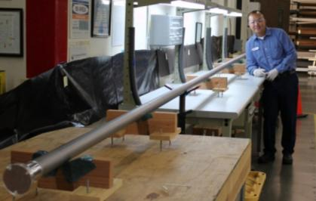
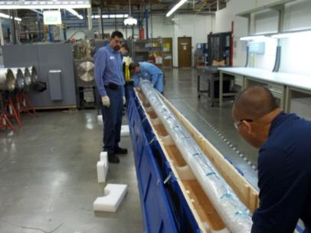
Skin Contact with Beryllium
No effect on contact or temporary embedding
Like iron, aluminum, and zinc, granuloma possible if left embedded in skin (a granuloma is a nodule produced in response to a foreign body or other causes – it can be removed, but should be avoided)
Solvents will not generate small beryllium particles, but some
acids will. In general, don’t use acid with beryllium.
Wear clean gloves to protect the skin and, most importantly, to protect the beryllium (verify gloves are clean before touching beryllium!)
Product shipped to CERN is cleaned
inside and outside prior to delivery to
remove dust or particulate
Notes:
16

Slide 9
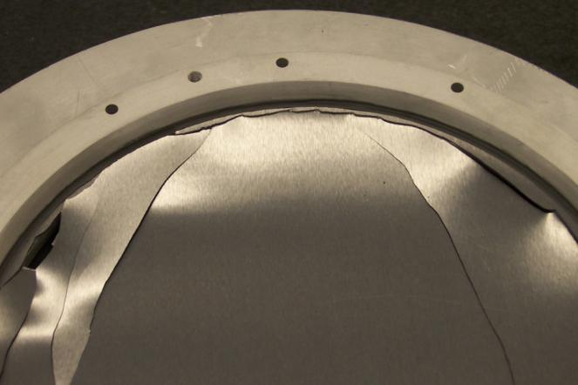
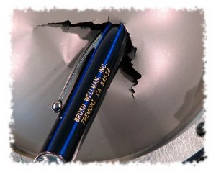
Broken Beryllium?
If beryllium breaks, it does not shatter
Long cracks
Large pieces
No respirable particles
Broken X-Ray Window,
0.5mm thick x Ø170mm
Intentionally broken 50µm thick
Be speaker dome

Slide 10
Materion’s Best Practices in Case of Broken Beryllium
Pieces are generally much larger than 10µm and therefore not a respirable danger
Wash skin if contacted with beryllium
Limit access to the area until the beryllium has been removed
Put large pieces in a sealed plastic bag and put bag in designated area
Remove smaller loose pieces with a HEPA vacuum and put HEPA filter in designated area
  HEPA = High Efficiency Particulate Air; filters out 99.97% of particulate larger than 0.3µm in diameter
Wipe the area with a damp cloth and properly dispose of the cloth in designated area
If needed, perform a wipe sample on the affected area and compare to a wipe sample on a non-affected area to validate the cleaning process
Notes:
10

Slide 11
Beryllium: The Cancer Question
Beryllium is listed by IARC (International Agency for Research of Cancer) and NTP (National Toxicology Program) as a carcinogen by inhalation; and, by the European Union as a Carcinogen Category 1B – "Presumed to have carcinogenic potential for humans," under Regulation 1272/2008 (Classification, Labeling and Packaging)
The only studies that conclude beryllium causes cancer were carried out on the same group of beryllium production workers in the United States when exposures were 100 to 1000 times the US OSHA PEL (United States Occupational Safety and Health Administration Permissible Exposure Limit)
Cancer risk varied depending on study and authors. Studies that suggest beryllium metal is linked with cancer are flawed and have very serious methodological errors in data analysis, according to scientists with a high level of expertise in cancer studies. The studies did not factor in smoking as a risk factor and did not correctly and they did not adjust for year of birth or year of hire
Notes:
13

Slide 12
Other Resources for Best Practices:
Materion Interactive Guide
The Interactive Guide to Working Safely with Beryllium and Beryllium-containing Material (Interactive Guide)
Primarily intended for users who will be performing operations that may generate dust, mist, or fumes
The purpose of the Interactive Guide is to provide users with important information about beryllium health and safety and to help users learn how to safely work with beryllium and beryllium-containing materials
Available online at www.berylliumsafety.com
Upon completion of the Interactive Guide, users are provided with a printable action plan and information to address most types of operations and tasks performed on beryllium-containing materials in an industrial environment.
Also available on CD and operates from most personal computers

Slide 13
Available Resources
Publications
      Material Safety Data Sheets
      Safety Facts
      Frequently Asked Questions
      Health and Safety updates
Product Stewardship Hotline at +1 216.383.4019
Terence Civic, Director, Health, Safety and Regulatory Affairs, Terence.Civic@Materion.com
www.materion.com
beryllium.eu
beryllium.com
Patricia Murphy
+44 118.945.2670
Patricia.Murphy@Materion.com
Edward Hefter
+1 510.661.9714
Edward.Hefter@Materion.com
Notes:
39

Slide 14
Backup Slides only after this point

Slide 15
Update on Current Product Stewardship Issues
REACH
      Registration of Beryllium and Beryllia was completed in December, 2010.
      Beryllium is not on the Candidate List issued by the European Chemical Agency (ECHA).
      Materion continues to advocate for the cancer reclassification of beryllium.
RoHS Recast
      RoHS Recast in the EU was completed in 2011 and does not include restrictions on beryllium.
      Beryllium was considered along with many other substances but ultimately excluded.
      Materion advocated to exclude Beryllium.

Slide 16
Materion Control Strategies When Fabricating with Beryllium
Beryllium Worker Protection Model (BWPM)
      Technical interventions for the effective control of beryllium focus on achieving 8 operational goals:
      Keep Beryllium:
out of the lungs
off of the skin
off of the clothing
at the source
in the work area
on the plant site
work areas & processes clean
workers prepared
Notes:
72
72

Slide 17
Supportive assessments Be does not cause cancer
Depending on the study and the authors, the risk of cancer varied. The studies that suggest beryllium metal is linked with cancer (Ward, Sanderson, Schubauer-Berigan), have been found to be flawed and have very serious methodological errors according to scientists with a high level of expertise in cancer studies.
Properties of BeST 2011 ®

Slide 18
Supportive assessments Be does not cause cancer
Recent studies by experts in epidemiology support the need to reclassify beryllium:
(Rothman K.J., Mosquin P.L. Confounding after Risk-set Sampling in the Beryllium Study of Sanderson et al. Ann Epidemiol 21(10): 773-779 2011)
This study concluded that “Simulations and reanalysis show that much of the reported association with lagged exposure is attributable to confounding by year of birth and year of hire. Lagging changes the exposure variable and can thus lead to changes in the amount of confounding.”
The study suggests that the previous studies that indicated a cancer risk did not account for factors that could influence the study conclusions
Properties of BeST 2011 ®

Slide 19
Supportive assessments Be does not cause cancer
Recent studies by experts in epidemiology support the need to reclassify beryllium:
(Levy, P.S., Roth H.D., Deubner D.C. Exposure to Beryllium and Occurrence of Lung Cancer: Findings from a Cox Proportional Hazards Analysis of Data from a Retrospective Cohort Mortality Study. J Occup Environ Med 51: 480-486 2009).
This study concluded “ The patterns observed provide little support for an association of lung cancer with beryllium work factors. This result is likely due to the absence in the original study of a significant overall excess of lung cancer after smoking adjustment.”
Properties of BeST 2011 ®

Slide 20
Supportive assessments Be does not cause cancer
Recent studies by experts in epidemiology support the need to reclassify beryllium:
(Boffetta P. International Prevention Research Institute, Lyon, France, Occupational exposure to beryllium and cancer risk: a review of the epidemiologic evidence. Critical Reviews in Toxicology 42(2): 107-118 2012)
“The studies of beryllium disease patients do not provide independent evidence and the results from other studies do not support the hypothesis of an increased risk of lung cancer or any other cancer. Overall, the available evidence does not support a conclusion that a causal association has been established between occupational exposure to beryllium and the risk of cancer.”
Properties of BeST 2011 ®

