Slide 1
SRS : doing more with less
RD51 Miniweek, WG5 meeting Tue 23 April 2013

Slide 2
SRS main activities
Selected topics for this talk
SRS production /sales via CERN store: ➔ ongoing, new productions, new devices
Timepix SRS ➔ ongoing at by Bonn Univ. 8 timepix array readout ➔ Talk by Michael
New FEC V6 card design & proto production ➔ ongoing with Bari and Valencia ➔ talk by Curro
New Digital SRS card ( VFAT –like chips) ➔ ongoing PCB mounting and tests ➔ talk by Mihai
VMMx longterm successor of APV hybrid ➔ started BNL and IFIN-HH ➔ talk by Sorin
SRS integration into ATLAS ➔ continuing ➔ talk by Andre
DTCC links 4 wire and 2 wire / fiber versions, ➔ being finalized
10Gbit readout architectures ➔ ongoing with ALICE, LMU, BARI, LUND, ATLAS, CERN
ADV active HV divider for GEMs ➔ prototype test ongoing
Trigger pickup box for Mesh self-trigger and gain measurement➔ prototypes in use, PCB revision needed
Quad Preamplifier for MPGD signal monitoring ➔ started 1st board tested , revision required
SRS-ATCA pilot systems ➔ ongoing, 3 systems to be delivered in Mai (ATLAS, ALICE, NEXT) ➔ talk y EicSys
Planned
let’s talk about these in the next WG5 meeting
GEMROC chip adapter ➔ under discussion, potentially no export problem
SRS shaper-Discriminator card ➔ planned
HV generator card for MicroMegas with HV control via SRS and pA readout ➔ schematics started

Slide 3
SRS user status 2013
ALICE EMCal Calorimeter upgrade, ORNL, SRS readout backend via DTCC links and 24 SRU’s , DATE Online system, being installed
ATLAS upgrade CERN, MAMMA project NSW , µMEGAS , APV frontend SRS Eurocrates-SRU, MMDAQ Online, installed
ATLAS upgrade Mainz, µMEGAS for MBTS, APV frontend- SRS Eurocrate, MMDAQ Online, waiting delivery
ATLAS Muon upgrade R&D, INFN Rome, APV frontend SRS Eurocrate, MMDAQ Online, delivered
ATLAS Saclay, µMEGAS R&D, APV frontend SRS Minicrate, MMDAQ Online, delivered
NA62 CERN straw tracker upgrade with µMEGAS, APV frontend with SRS Minicrate, MMDAQ Online, delivered
CMS upgrade CMS GEM collaboration CERN, Muon Endcaps, design of VFAT frontend digital readout SRS, ongoing with IFIN-HH
TOTEM upgrade GEMs Baris testlab, OPTO-Rx card design, Minicrate,Eurocrate, SRU, DATE Online, delivered
BNL GEM detectors, APV frontend-SRS Minicrate, RCDAQ Online, delivered
Stony Brook GEM detector R&D, APV frontend SRS Minicrate, RCDAQ Online, delivered
Bonn Phys. Inst. R&D for ILC, T24 DESY testbeam, Timepix Array Ingrid Module adapter for SRS , Eurocrate, Online unknown, ongoing
Florida Inst Tech GEMs, Muon Tomografy for Homeland security, 15k channel SRS prototype Eurocrate, DATE Online, delivered
Géosciences Azur-CNRS-UNSA, Muon Tomography w.µMEGAS for geology, APV frontend SRS Eurocrate, Date Online, delivered
GDD lab RD51, CERN, R&D for GEM and µMEGAS, APV frontend SRS Euro and Minicrates, DATE, Labview MMDAQ, delivered
HIP, HELSINKI, characterization MPGAD detactors, APV frontend SRS Eurocrate, DATE and Labview, delivered
INFN Napoli, ATLAS. Development of SRS Hardware and Firmware, Labview, delivered
Jefferson Lab, Virginia UVa upgrade GEM readout system, APV frontend SRS Eurocrate, DATE online, partially delivered
Yale University , GEM development ALICE, APV frontend SRS Eurocrate, DATE Online, delivered
NEXT Coll. small Xenon TPC with PM and Si PMs, SRS readout electronics co-development, SRS Eurocrate and SRU, DATE, delivered
UNAM, MEXICO, MX , R&D on THGEM, APV frontend SRS Minicrate, DATE Online, delivered
Radiation Laboratory, Nishina Center, RIKEN , APV frontend SRS Eurocrate, Online unknown, delivered
J-PARC /E16 experiment, GEM based tracking, APV frontend SRS Minicrate, Online Unknown, partially delivered
Jefferson Lab SHM spectrometer triple GEM, APV frontend SRS Eurocrate, DATE Online, waiting
Harward Univ. Physics, APV frontend SRS Minicrate, Online unknown, waiting
Tokyo Univ. ATLAS, APV frontend SRS Eurocrate, Online unknown, waiting
WIS and Aveiro Univ. GEM validation, APV Frontend SRS Eurocrate, MMDAQ and Labview, being delivered
East Carolina University, Health Physics, APV frontend, SRS Eurocrate, Labview, waiting
Munich LMU / ATLAS µMEGAS, APV frontend SRS Eurocrate –SRU, MMDAQ Online, partially delivered
NCSR Democritos ATHENS, APV frontend SRS Minicrate, Online unknown, waiting
IFIN-HH-Bucharest new Detector lab, APV and VFAT frontend, SRS Eurocrate and SRU, Labview, delivered
ATLAS NSW CERN, SRS-ATCA pilot system, MMDAQ Online, waiting
ALICE FOCAL ORNL, SRS-ATCA pilot system, DATE Online, waiting
NEXT Collaboration, SRS-ATCA pilot system, DATE Online, waiting
Lunds Univ, ILC TPC, SRU for 24 channel DTCC link readout, Online unknown, delivered

Slide 4
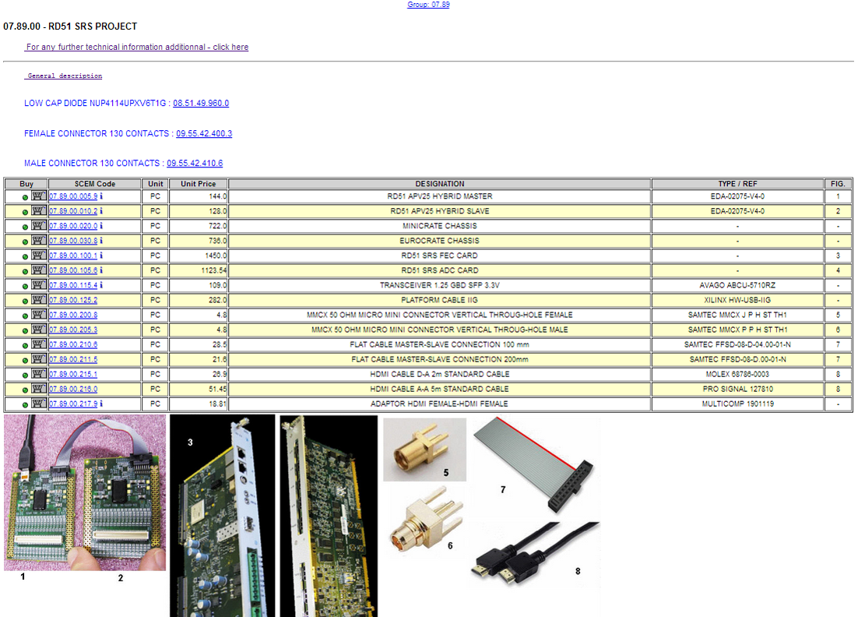
SRS @ CERN store
You need a CERN team account and access to edh.cern.ch
Goods will only be delivered to CERN addresses
In order to pick up
APV hybrids you need
to bring a signed
“letter of compliance”
and comply to the US
export country list

Slide 5
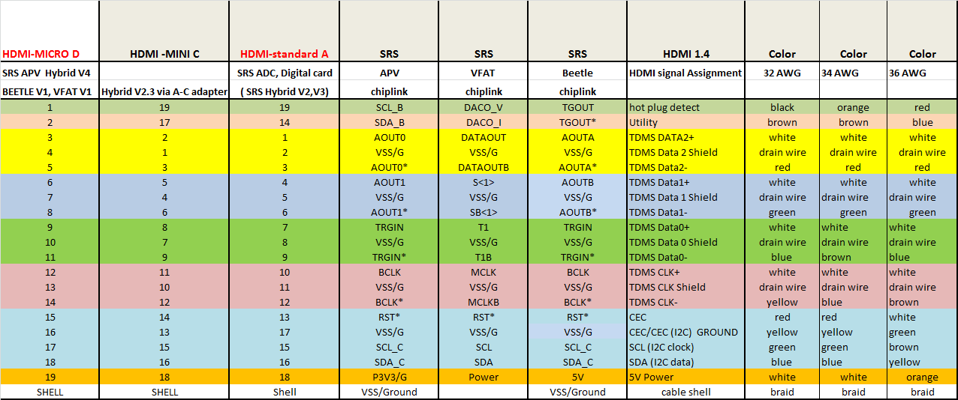
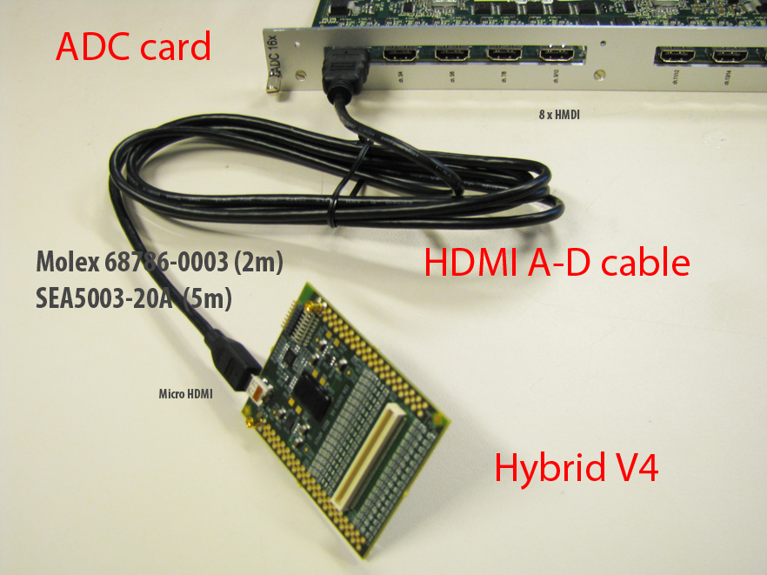
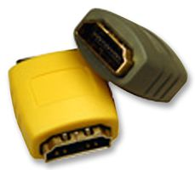
SRS frontend readout via HDMI
APV hybrids get
powered via HDMI
More distance than 5 me needed ?
Prolongator plugs
For extension with
standard HDMI
A-A cables

Slide 6
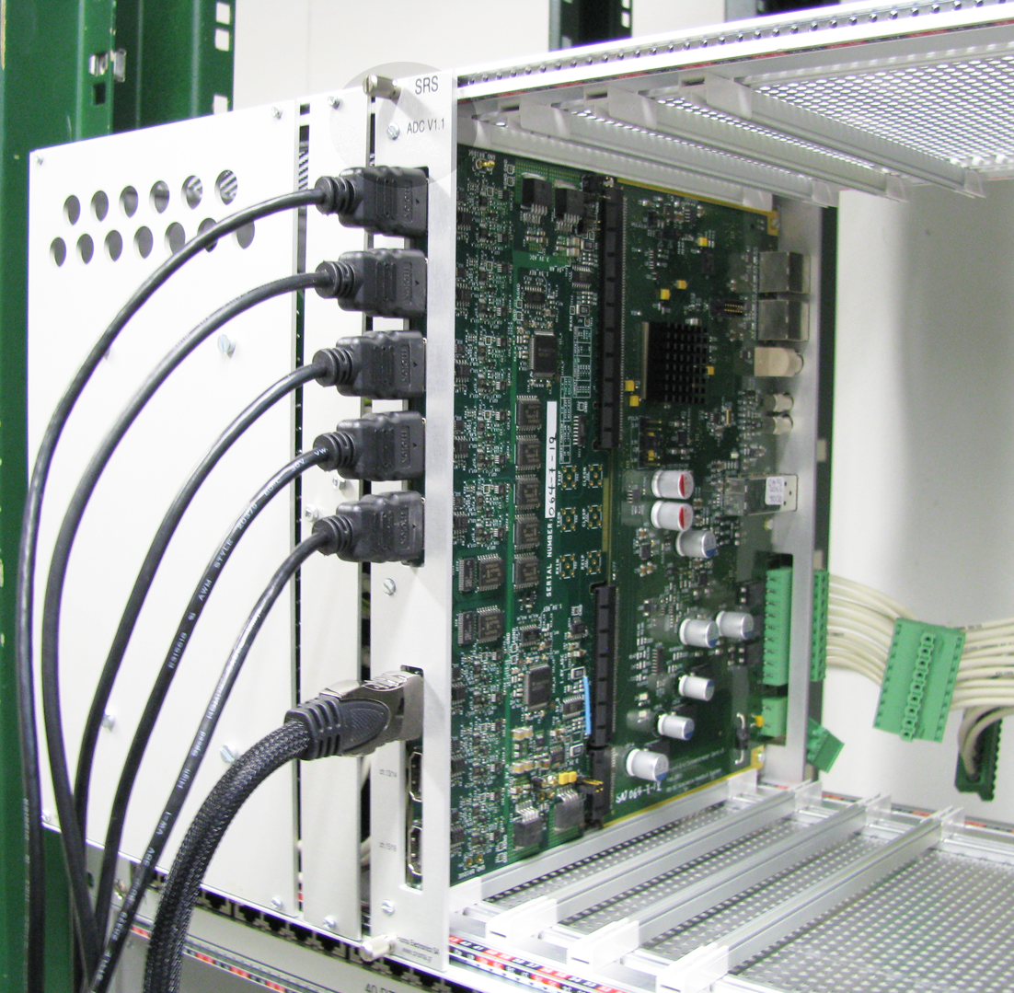
Backside of SRS Eurocrate adapter cards and chiplinks
FEC
Up to 8 HDMI
chiplinks per
Adapter card
ADC adapter

Slide 7
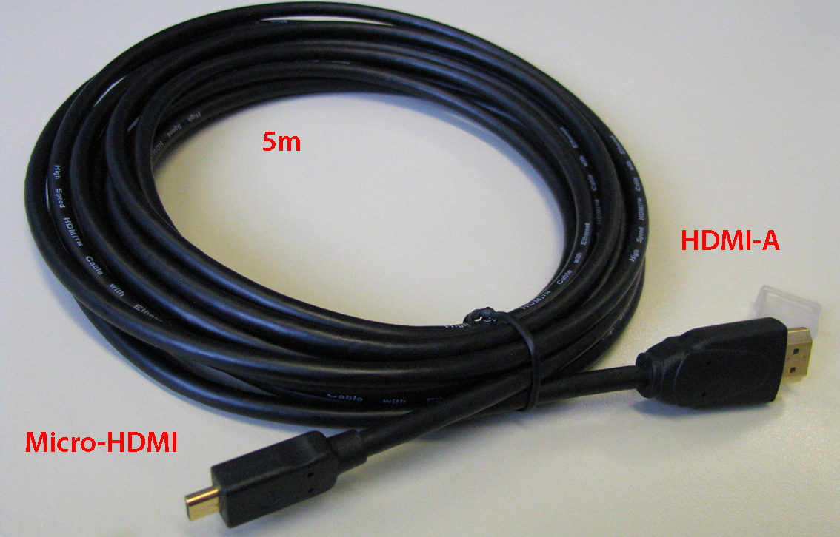
New 5m HDMI cables
(SEA 5003-20A)
Should become a CERN store SRS item soon

Slide 8
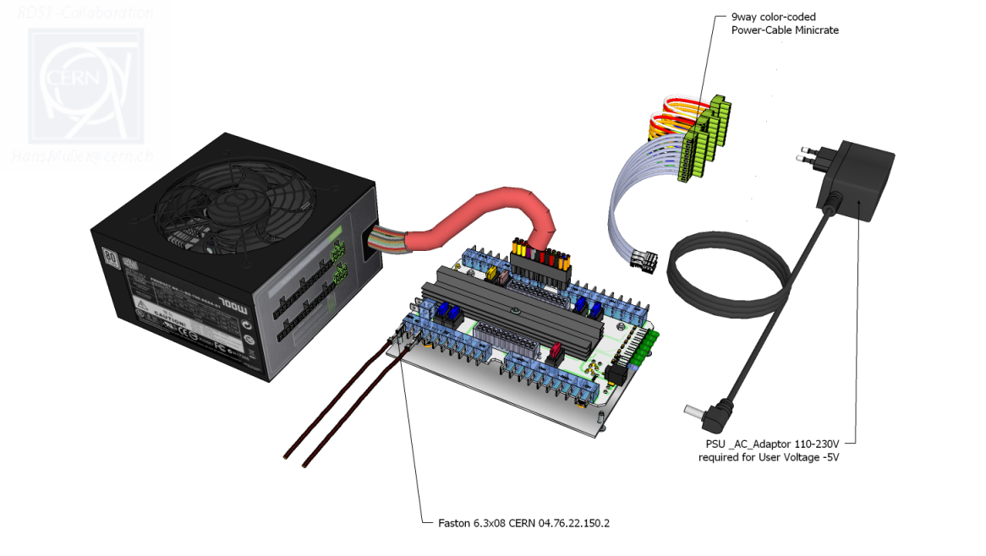
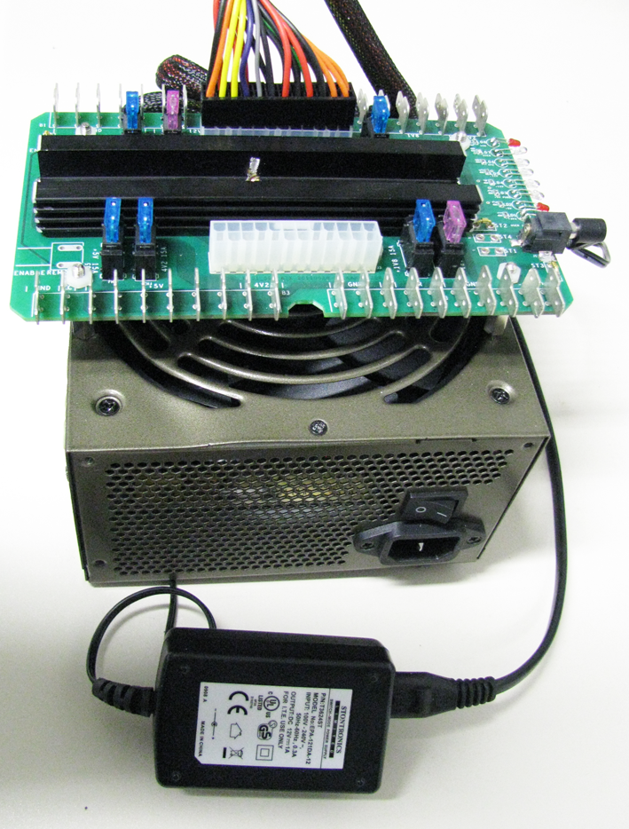
Desktop ATX power for SRS
SRS ATX adapter/filter board
fused , Faston connectors 6.3 x0.8
We have asked
the
CERN store
to add these
parts
ATX Power Supply Thermaltake TR2
450 Watt, 24 pin power connector
115-230VAC
PSU 5V, 2.6 A (-5V for ADC card)
110-240VAC Stontronics T3586ST 0
9pin power connector for FEC
PHOENIX MSTB 2,5 HC/9-ST-5,08

Slide 9
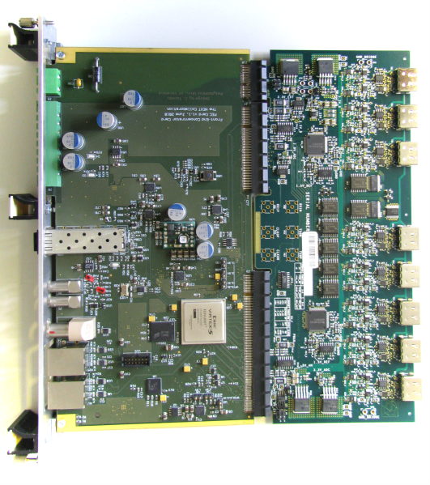
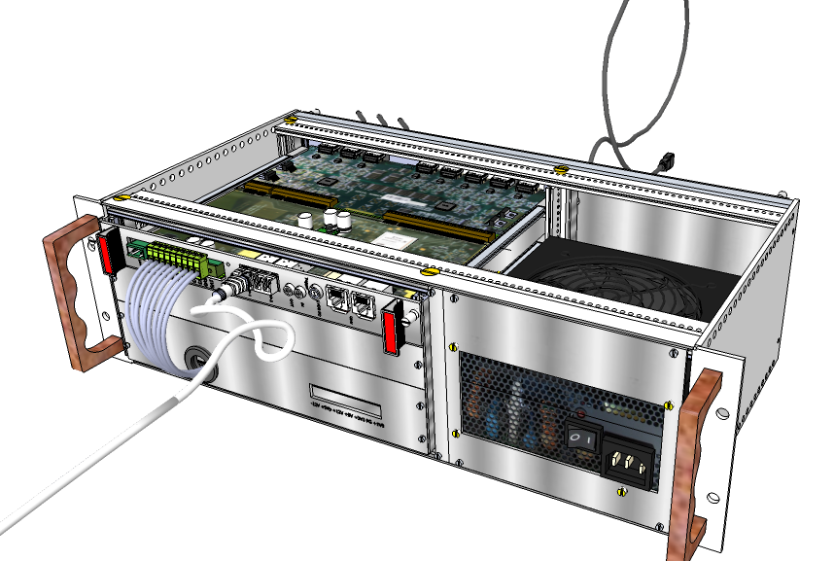
SRS Minicrate AB a portable solution for up to 4k gas channels
`
1 x FEC -ADC card Combo
CERN store items
SCEM 07.89.00.100.1 (FEC)
SCEM 07.89.00.105.6 (ADC)
2nd Combo can be inserted
in new Minicrate AB
Minicrate
CERN store SCEM 07.89.00.020.0
15 new ones to be produced

Slide 10
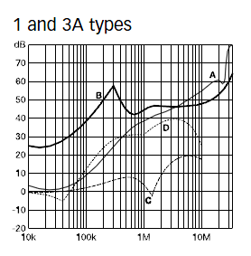
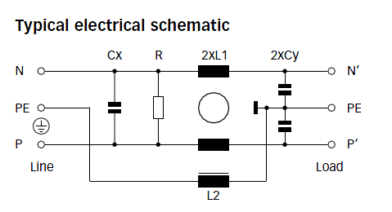
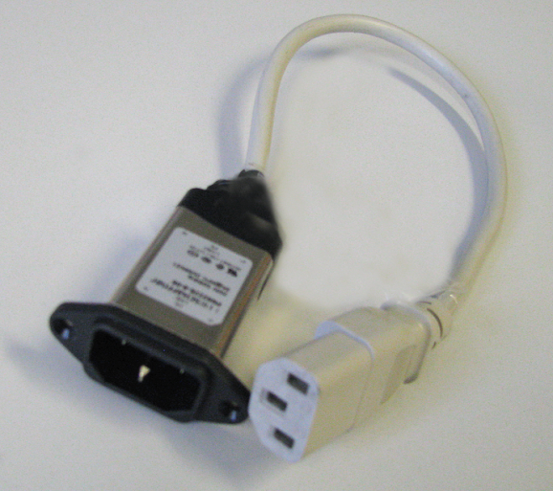
Noise/Ground loop filter
All new SRS crates are grounded via the earth pin of the AC mains plug
We recommend to insert AC + Earth filters ( as shown) into the power cable
Schaffner FN9222E inlet filters
SRS users: if you want one for test, contact us

Slide 11
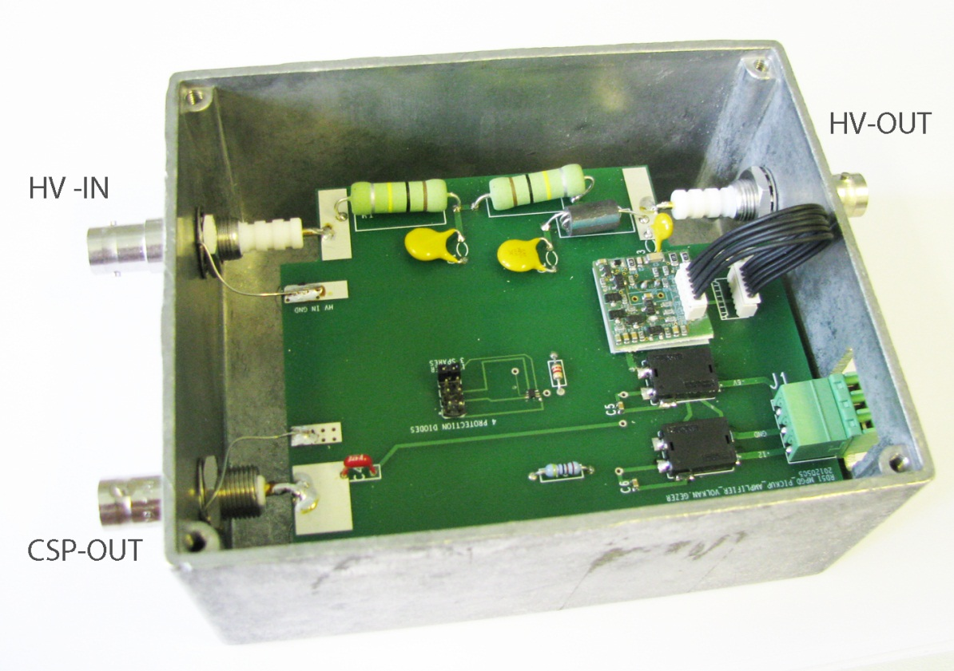
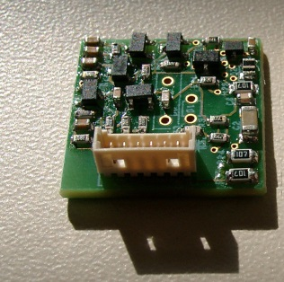
Trigger pickup box
Designed to pick up induced charge on grid or mesh
Converts charge to voltage via our proprietary CSP amplifier
50 OHM fast signal for external shaper /discriminator
HV-in
Detector
mesh
100k
100pF
grid
10nF
1pF, 1M
1mV/fC
1 us decay
10uF
10nF
J-FET
based CSP
CSP out to 50 OHM
CSP
1mV/fC
1 us discharge

Slide 12
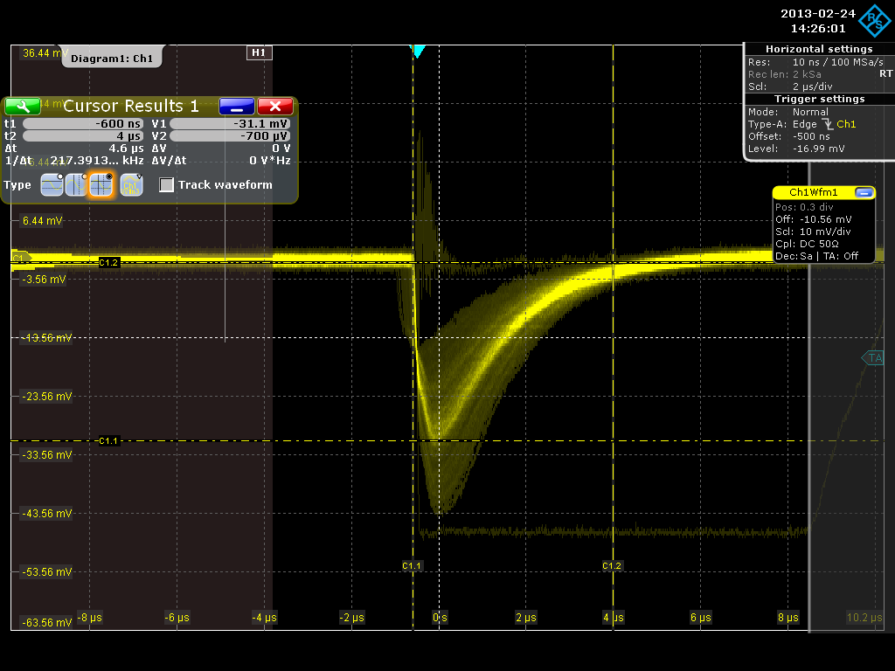
10x10 chamber grid trigger (400V)
a.) rate corresponds to the expected cosmic rate
b.) much larger discharge rate starts above working voltage
Total charge
31 mV over 1pF
31 fC
192.000 e-
30 pairs average (Strontium Beta source)
single electron amplification 6400

Slide 13
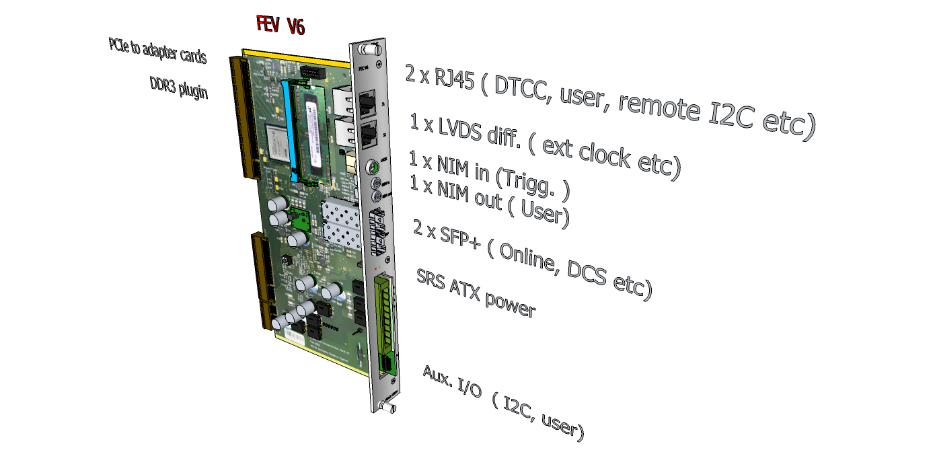
New FEC card
(Virtex 6 Lx130T)
See talk by Curro

Slide 14
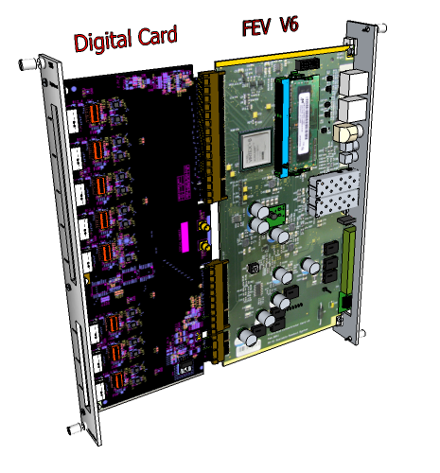
New digital Combo
See talk by Mihai
8 x HDMI
4 proto cards in production by Univ. Bonn

Slide 15
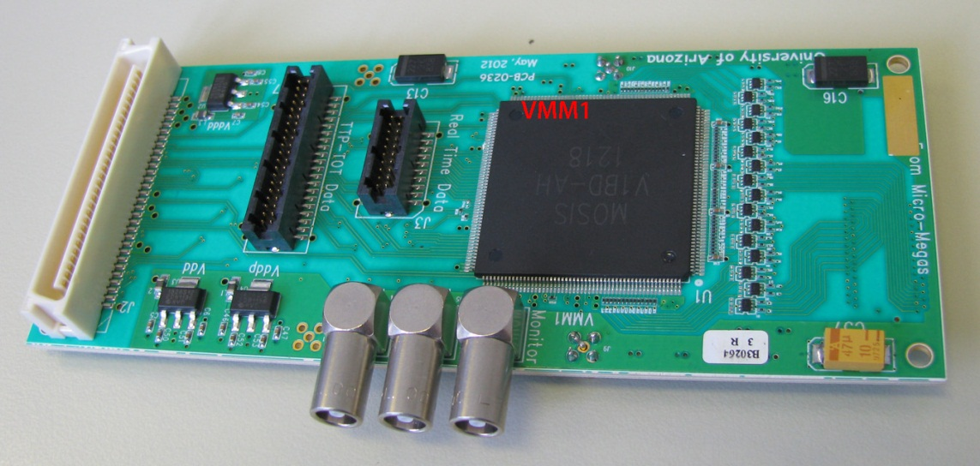
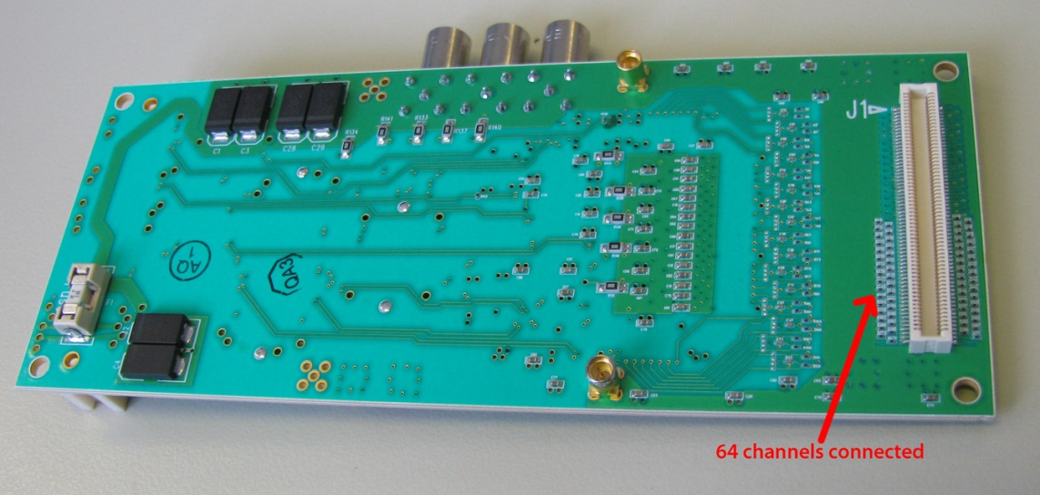
VMMx based frontend
See talk by Sorin

Slide 16

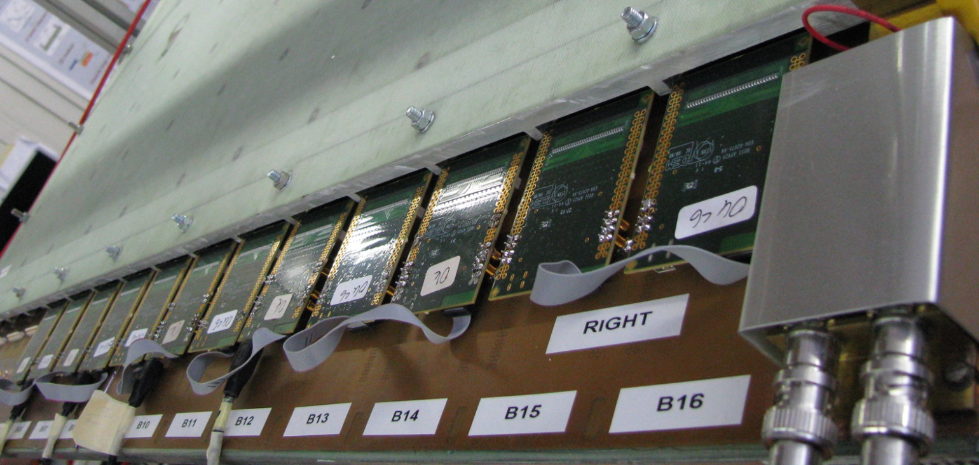
SRS integration into ATLAS NSW
Large uMegas chambers
for New Small Wheel
APV hybrids
HDMI cables to SRS readout system

Slide 17
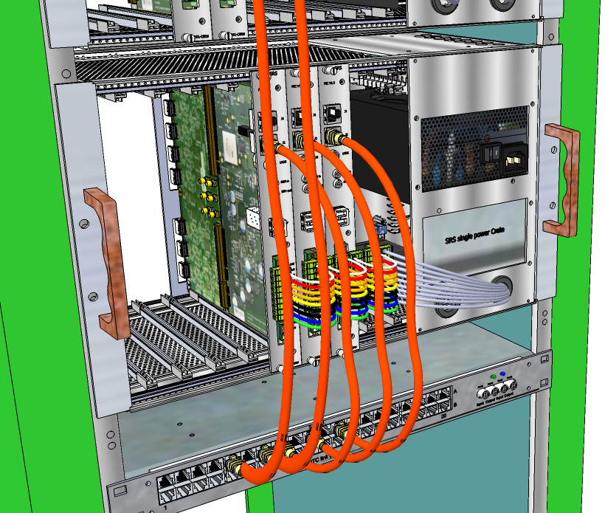
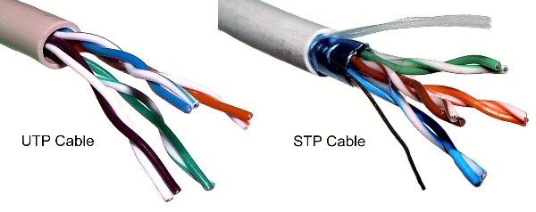
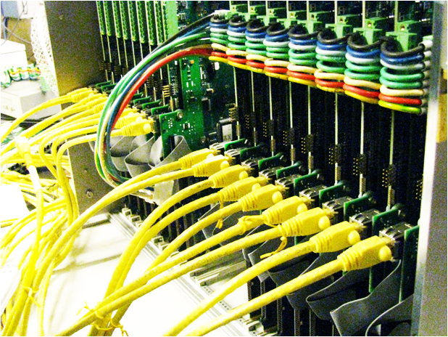
DTCC links
First version DTC already
used by EMCal with SRU, photo

Slide 18
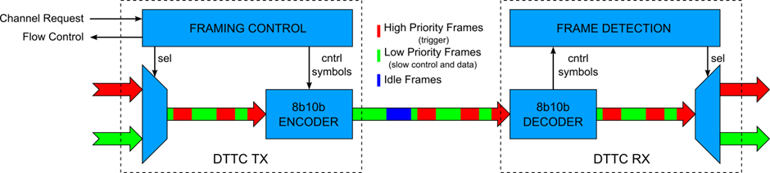
DTCC links *
Transmit Data, Trigger, Controls and Clock via 2 or 4 wires/fibers
DTCC-4 : 2 downlinks and 2 uplinks ( CAT6 cables)
DTCC-2 : 1 downlink and one uplink ( Micro-twinax, fiber optics)
Mixed datatypes via 8b/10b frames of different priority
*Alfonso Tarazona Martinez

Slide 19
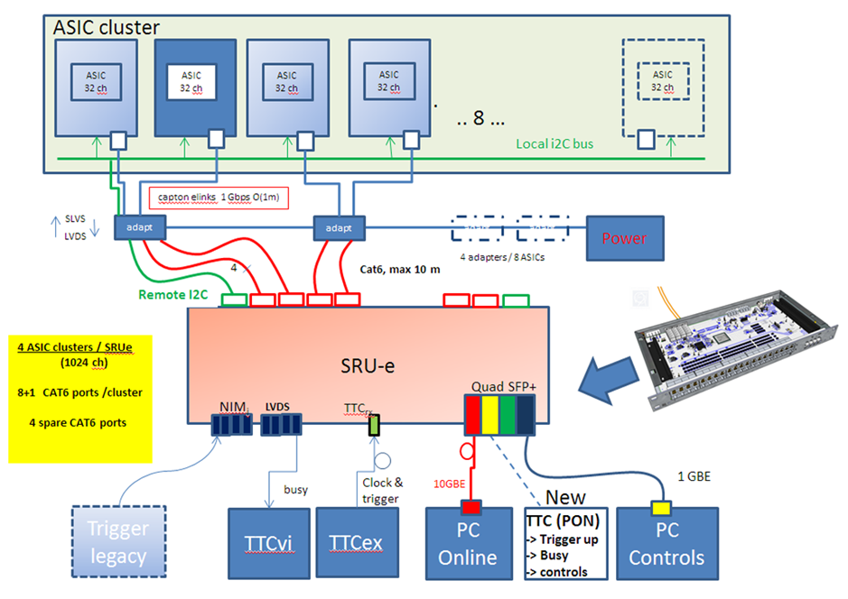
Emulation of 10 Gbit Readout Unit using the SRU

Slide 20
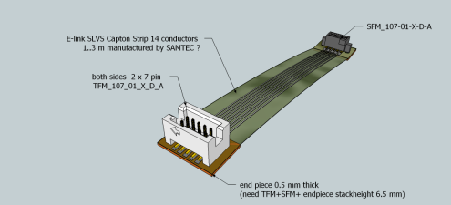
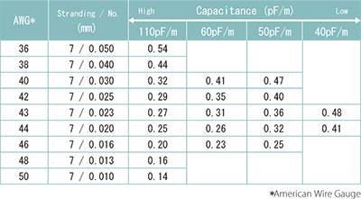
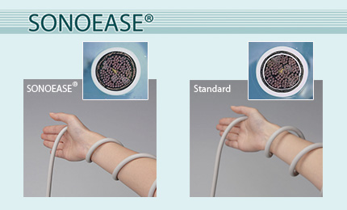
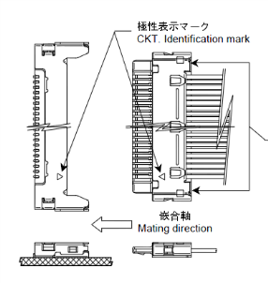
Micro copper frontend links
(0.4 mm typ.)
Kaptons ( may break! )
Hitachi Sonoease
Molex Micro IDT ( non standard)
3M Micro SAS
Samtec ECUE

Slide 21
Active Voltage Divider for GEMs
Overcome efficiency and protection issues of purely resistive HV dividers
-HV ~ (-5 kV)
Particle trajectory
GEM1_Top
HV
Drift_HV
Primary Electron drift gap
GEM1_Top
GEM foil 1 top/bottom
AVD
GEM1_Bott
GEM2_Top
GEM foil 2 top/bottom
GEM2_Bott
GEM3_Top
GEM foil 3 top/bottom
GEM3_Bott
Readout hybrid

Slide 22
AVD principle
low impedance output voltage at emittors
U_{hv} = -5kV, I_{max} = 1mA
I_{resistor} _{divider} = const
High-ohmic resistor divider is still
used
but only for bias voltages
I_{load} = variable
U_{out} = const

Slide 23
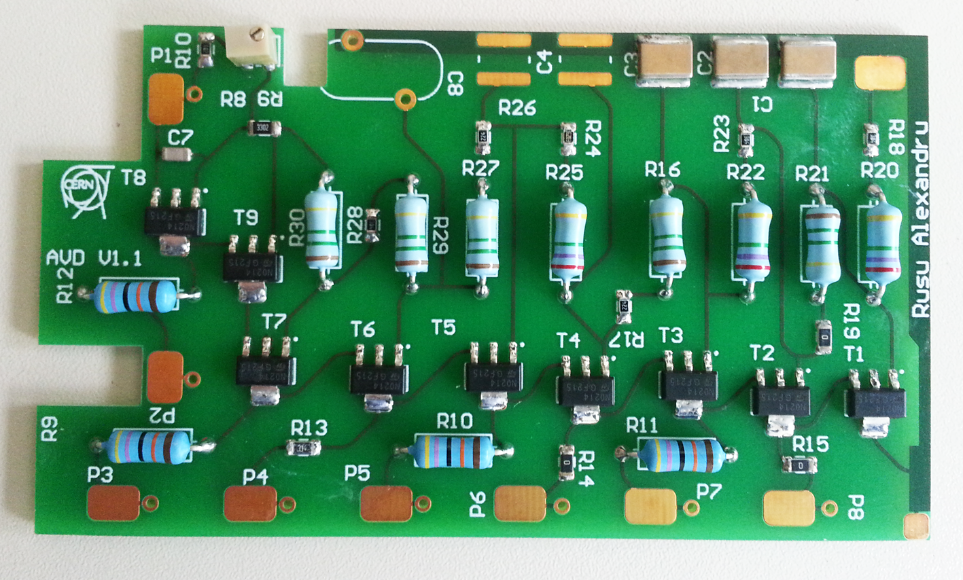
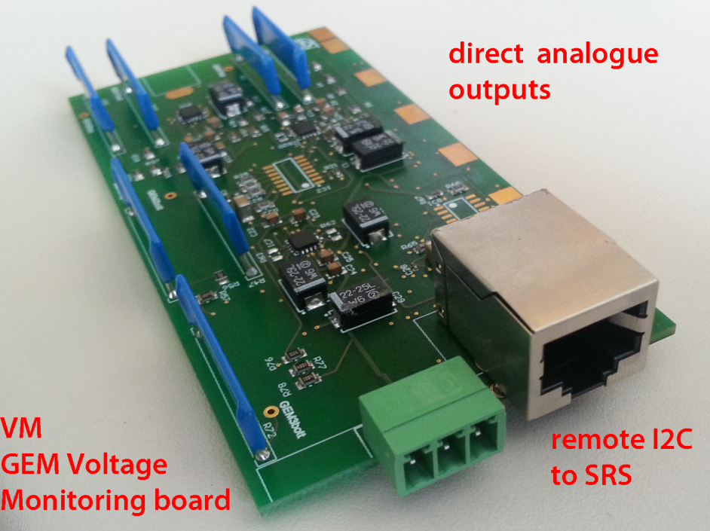
Implementation*
AVD
VM
AVD first tests at 5kV
All Voltages OK
cable shock tests OK
Long duration tests OK , but HV tripped
to be tested these days
Altium designer: trainee Alexandru Rusu

Slide 24
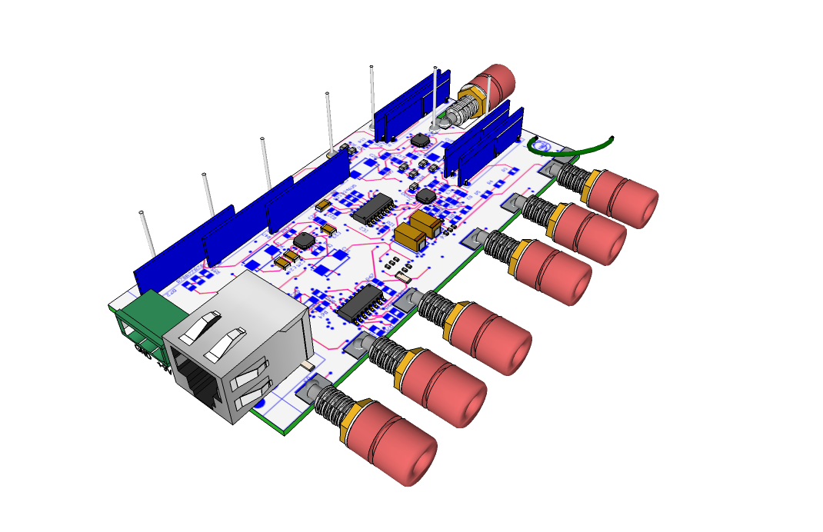
HV monitoring board
(installed below active divider board)
Pickup wires from AVD
12 bit ADC
Temperature probe
Instrumentation amplifiers
5 pA leakage
Giga-OHM divider resistors
Power connector
Humidity sensor below
Analogue Outputs
U_{HV} /1000
I2C readout via remote
LVDS cable to FEC card SRS

Slide 25
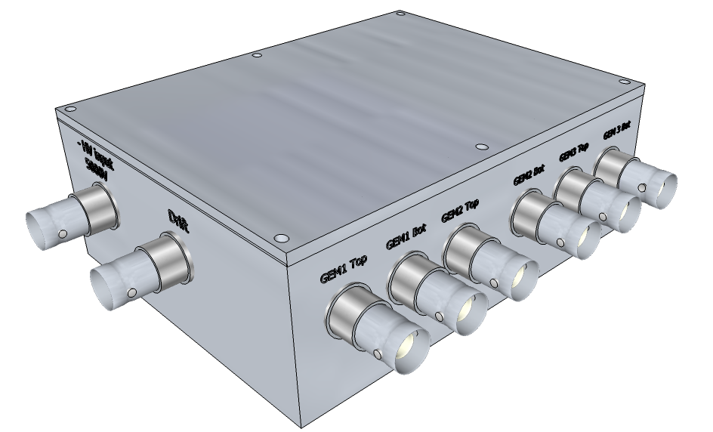
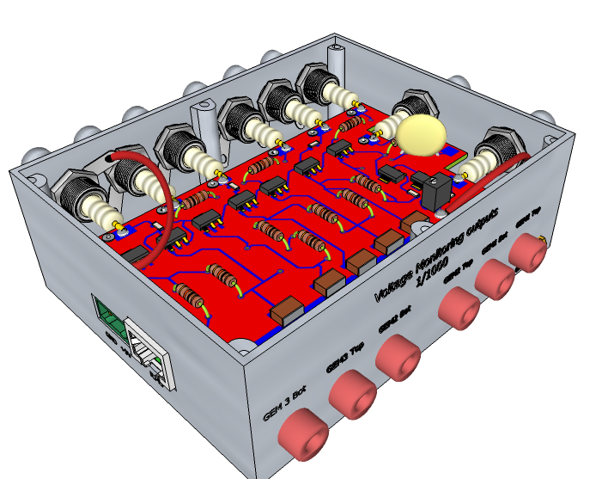
AVD box
- HV input
3 x TOP-Bottom GEM
HV output
Drift output
SRS readout cable connector
Monitoring outputs HV/1000

Slide 26
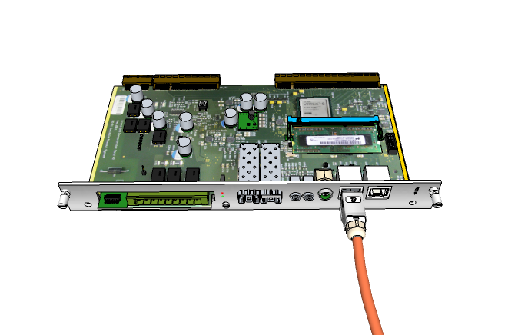
kVolt and pA readout via SRS
a.) special daisy chain cable between FEC and AVD’s (see below)
OR
b.) special cable router box ( not shown)
AVD_box
7x HV
1 x T
1 x H
SCL_{in}
SCL_{out}
SDA_{in}
SDA_{out}
CM_1 box
SCL_{out}_LVDS
1x I _{gem}
1 x I_{mon}
SCL_{in}
SCL_{out}
SDA_{in}
SDA_{in}_LVDS
SCL_{in}_LVDS
.
.
SDA_{out}
SDA_{out}_LVDS
CM_7 box
1x I _{gem}
1 x I_{mon}
SCL_{in}
SCL_{out}
SDA_{in}
SDA_{out}

Slide 27
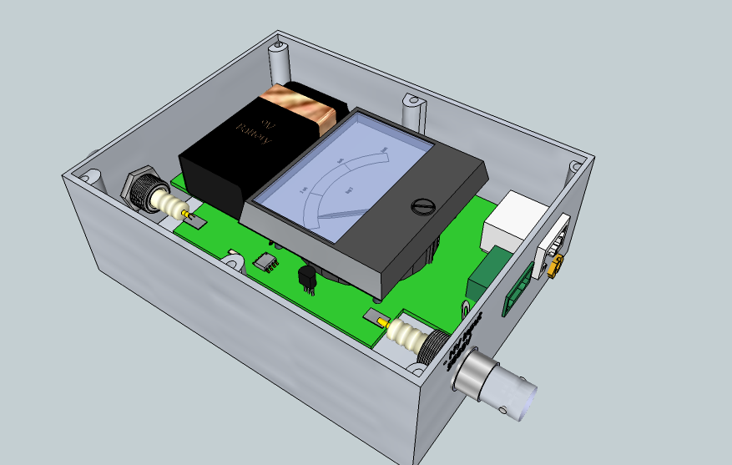
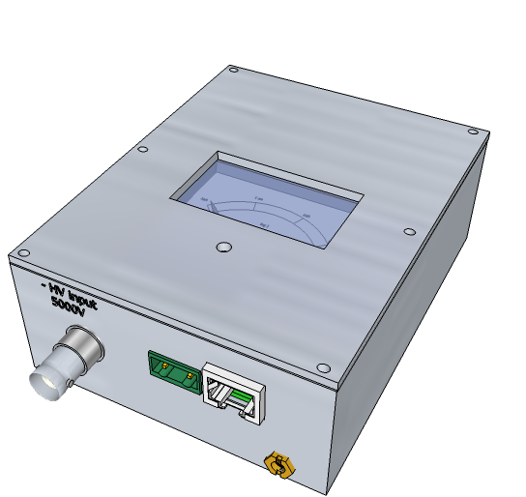
PicoAmp box (planned)
HV out
Log range 10 pA .. 100 uA
HV in
SRS readout cable connector

Slide 28
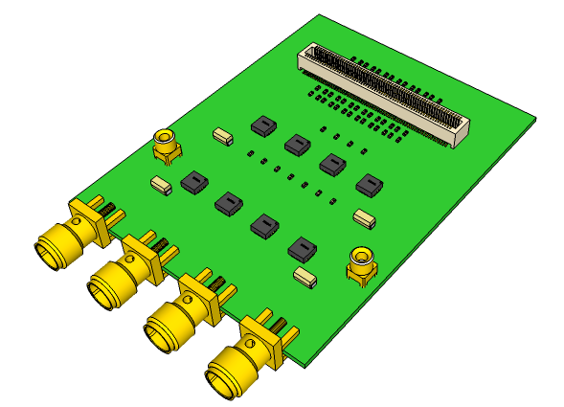
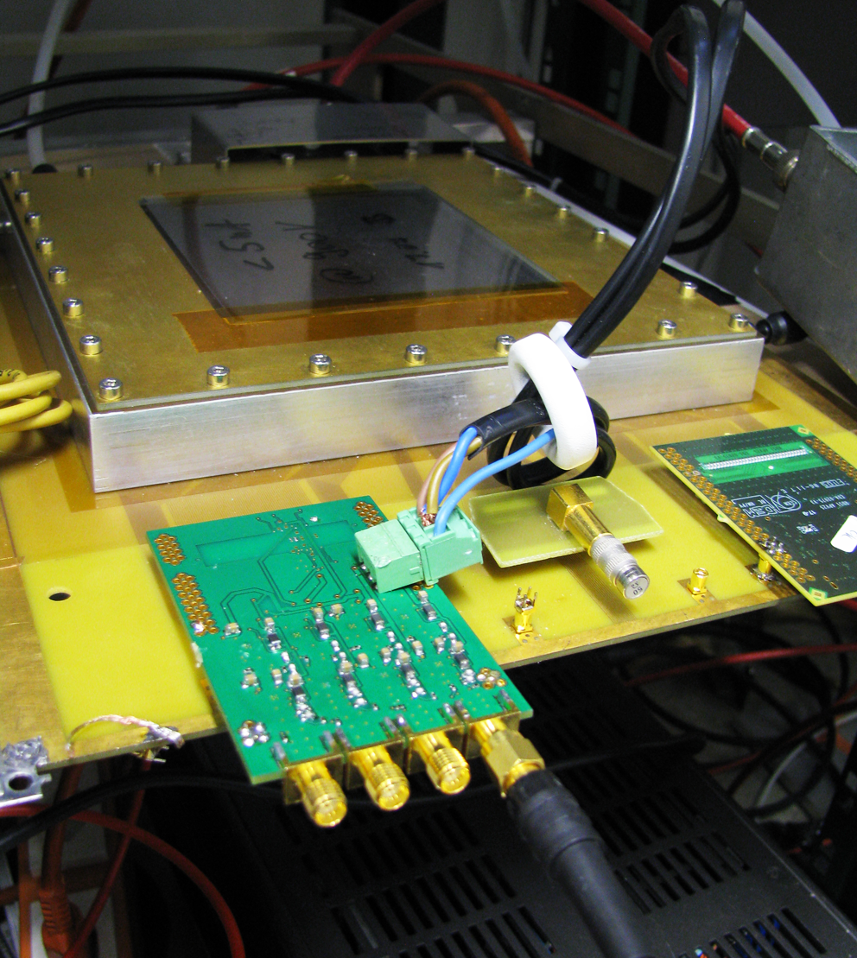
QSP Quad Signal Preamplifier
Prototype
2.4 GHz preamplifiers
4 neighboring detector channels.
Gain Vout/Vin = 20
Monitor detector signal dynamics
below the millivolt level
at full BW

Slide 29
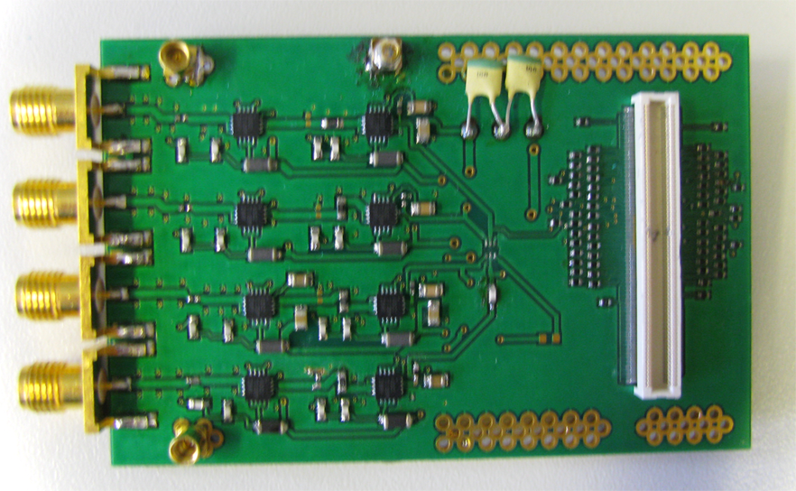
Photo QSP prototype
to GHz
Oscillocope,
also DRS4
PCB revision needed => tendency to ringing must be suppressed

Slide 30
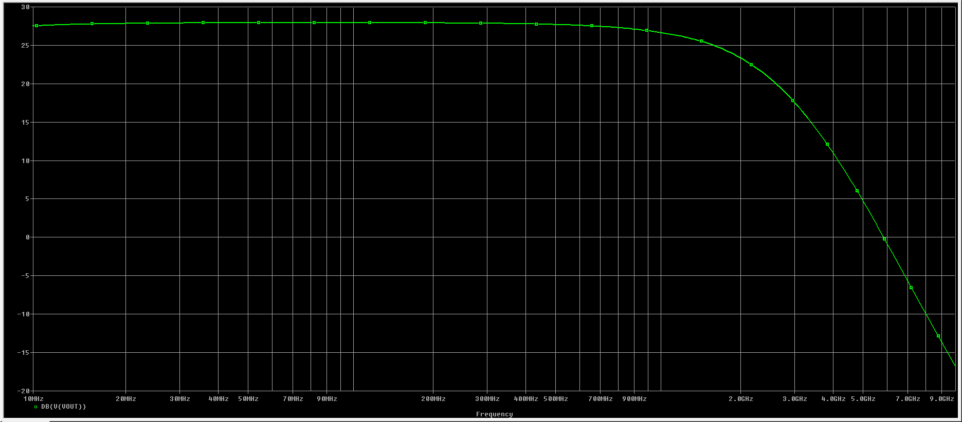
Frequency simulation*
* A.Tarazona

Slide 31
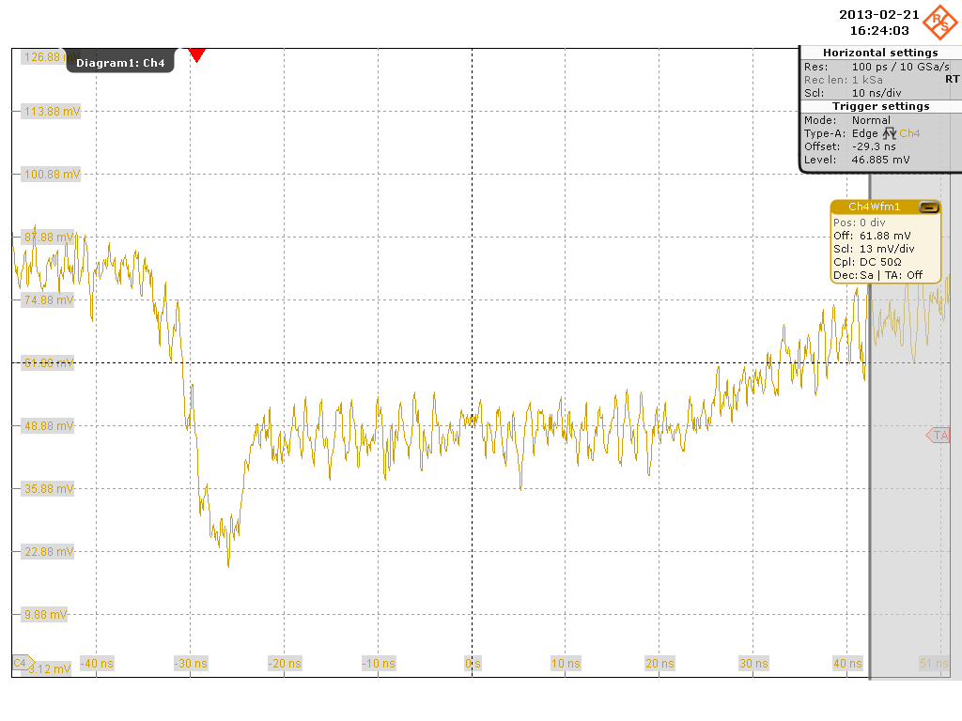
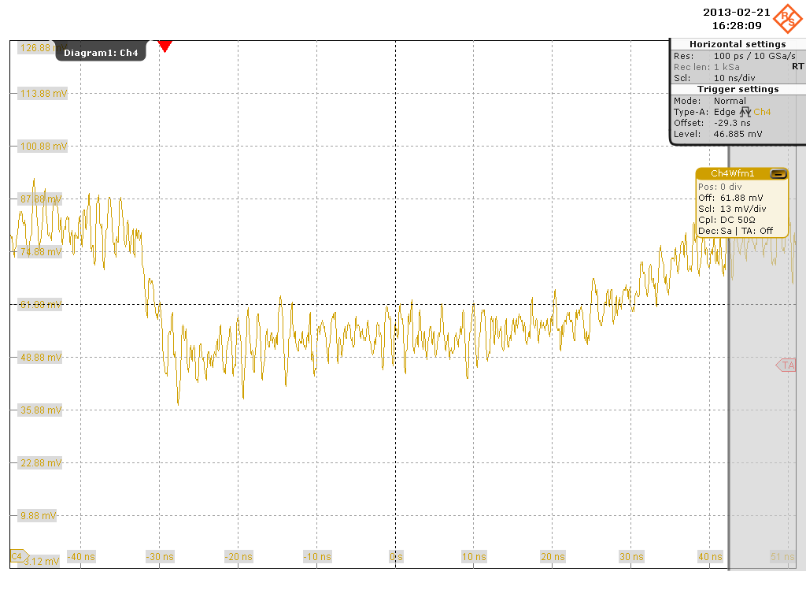
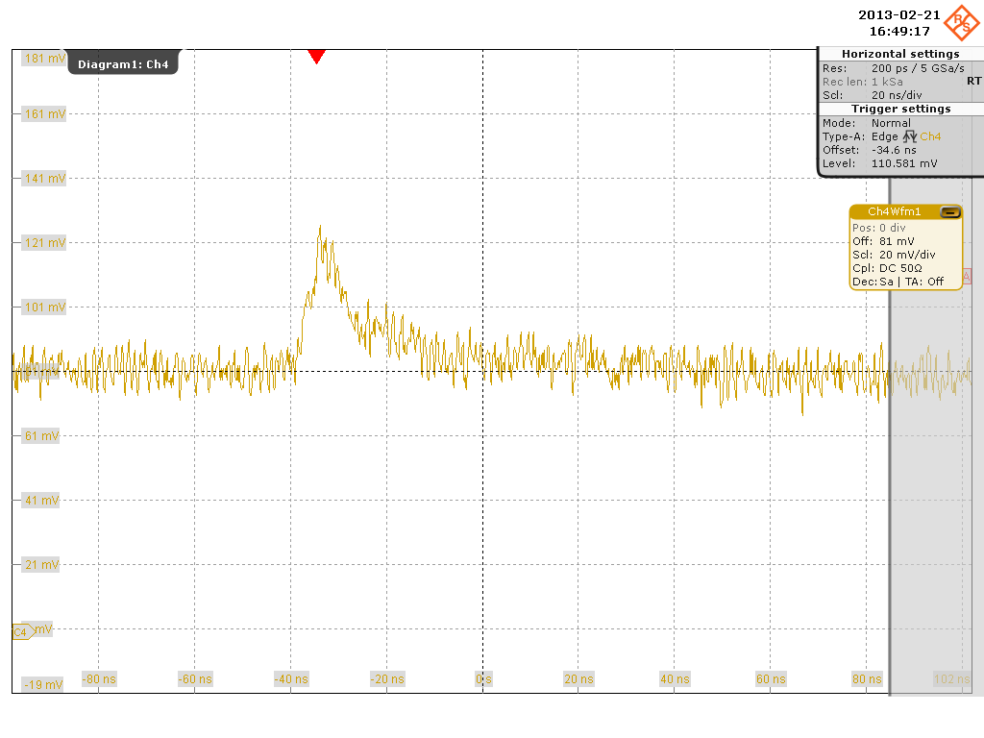
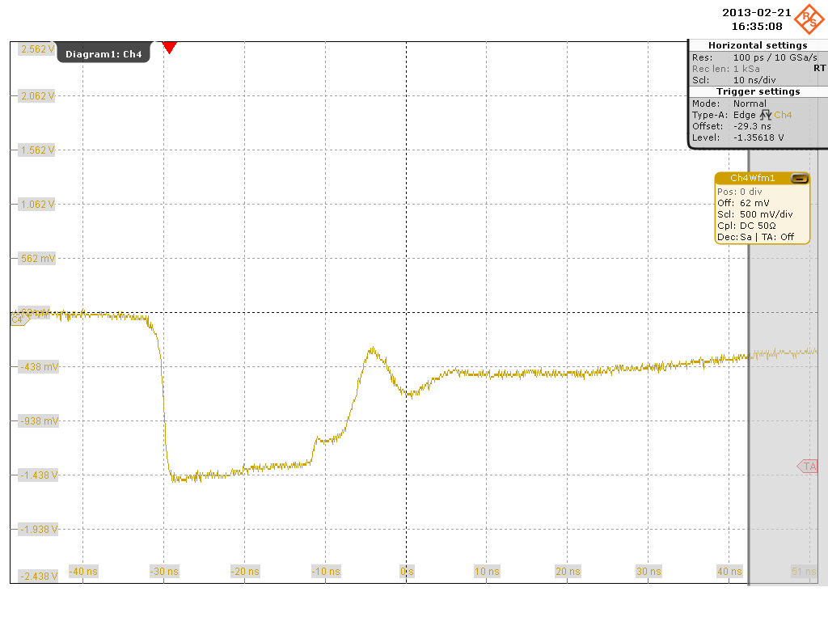
QSP signals on MM strip detector
Typical electron –ion tail signal
Typical ion tail signal, electrons suppresed
13mV/div 50 OHM 10ns/div
Typical positively induced strip signal
Typical discharge ( large vertical scale)
500 mV/div

Slide 32
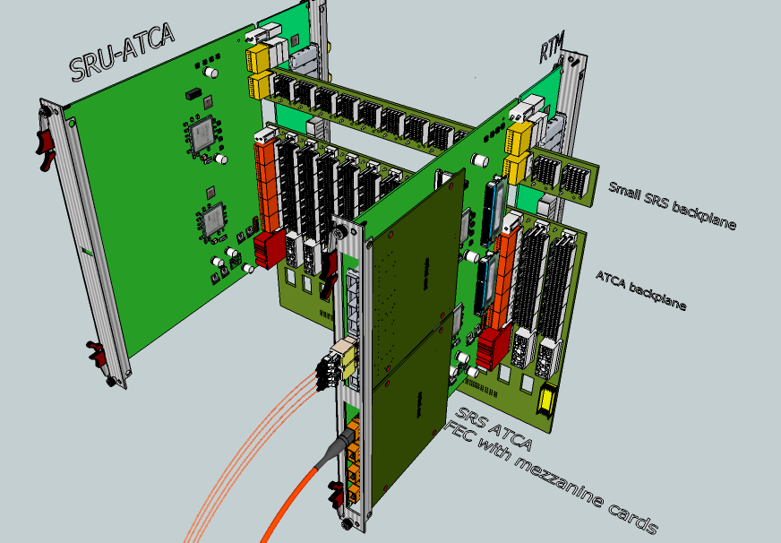
SRS ATCA* fully commercial SRS in certified ATCA Crates
talk Wojciech Jalmuzna
*AdvancedTCA ( Advanced Telecommunication Computing Architecture)
an open industry standard developed by PICMG 3.0

Slide 33
Summary
More than 34 SRS user teams, more waiting
CERN store new SRS production, new SRS utilities
New, fully commercial SRS_ATCA awaited
New FECV6, Digital card, ASIC hybrid being worked on
Timepix array readout first data
SRS integrated in LHC experiment upgrades
DTCC link: Data, Trigger Clock Control over 4 wires/ 2 wires,fibres
SRU 10 Gbit emulation platform for 10 Gbit readout of ASICs
Active HV Divider for improved efficiency and safety of GEMs
Remote I2C readout of kV, pA, T and P via FEC
Quad Oscilloscope probe for 2 GHz MPGD signals in preparation

