Slide 1
High-power and high-gradient developments for the CLIC project

Slide 2
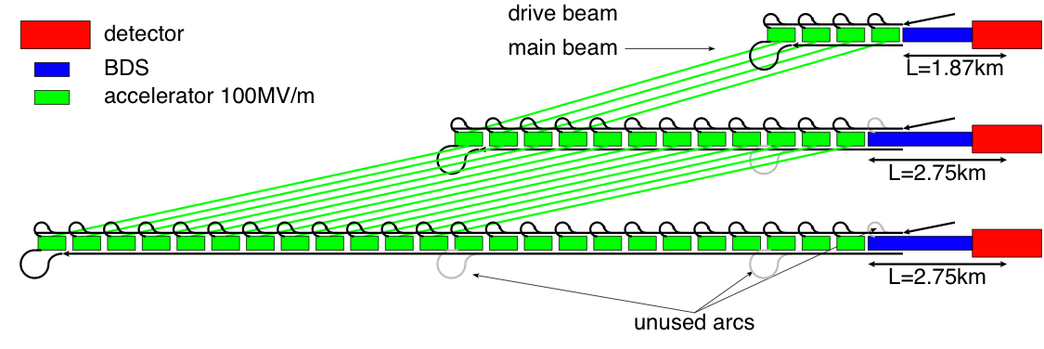
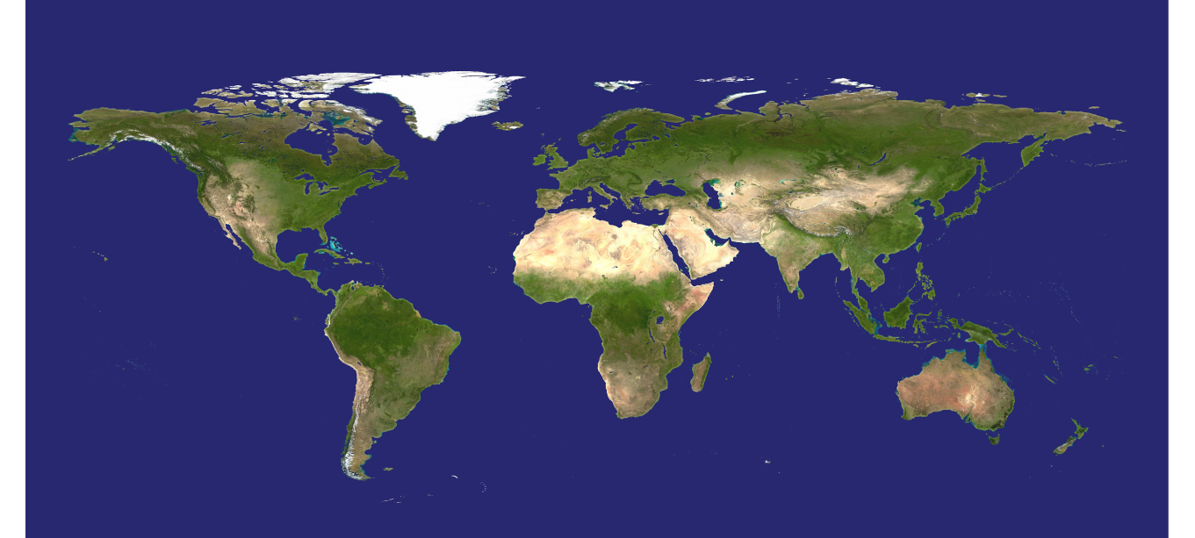

























What is CLIC?
A highly developed concept, design and hardware study for a collider capable of delivering e⁺e⁻ physics in the energy decade of 0.3 to 3 TeV – the lepton physics compliment to the LHC.
500 GeV c.m.
1.5 TeV c.m.
3TeV c.m.
CLIC multi-lateral collaboration - 48 Institutes from 25 countries

Slide 3
Primary accelerator features
Reach the high end of the energy range through high, 100 MV/m, accelerating gradient by using short-pulse, around 200 ns, normal-conducting rf.
Deal with the resulting high peak power requirement by going to high rf frequency, X-band, produced by the so-called drive beam scheme. At the lowest energies it is also possible to use klystron/rf pulse compressor units. Accelerating structure input powers are around 60 MW.
Deal with the luminosity and resulting high average power requirement by producing, transporting and colliding low-emittance, multi-bunch beams. This requires high-performance damping rings, micron-level main-linac precision and alignment, accelerating structure higher-order-mode damping, nanometer-level main-linac quadrupole stabilization and a sub-nm stabilized final focus etc.

Slide 4
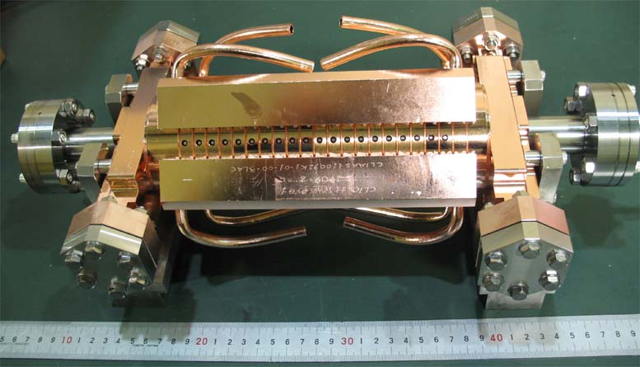
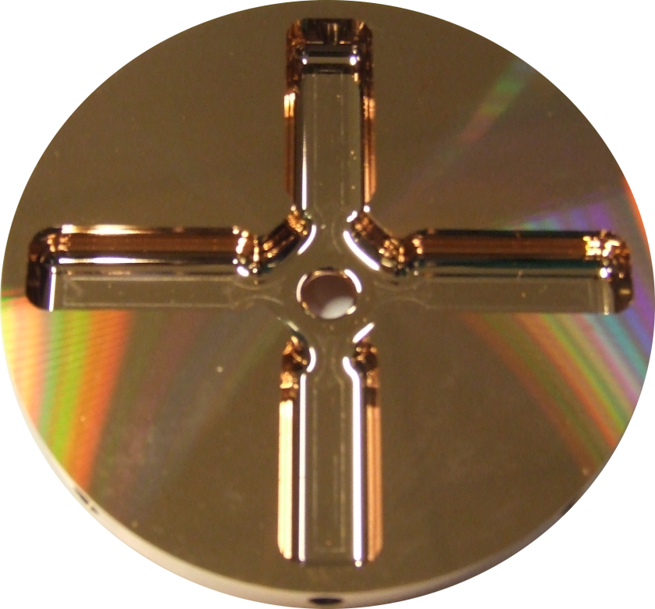
CLIC accelerating structure development
In order to reach 3 TeV with a facility which, for example, could be built in the area around CERN, so < 40 km, an accelerating gradient of around 100 MV/m is required.
In order to maintain low beam emittance along the main linac, accelerating structures must be built with a few micron tolerances and aligned along 10s of meters with roughly 10 micron tolerances.
In addition, in order to provide sufficient luminosity in an energy efficient way, trains of bunches are accelerated. This means that accelerating structures must be equipped with higher order mode in order to suppress .

Slide 5
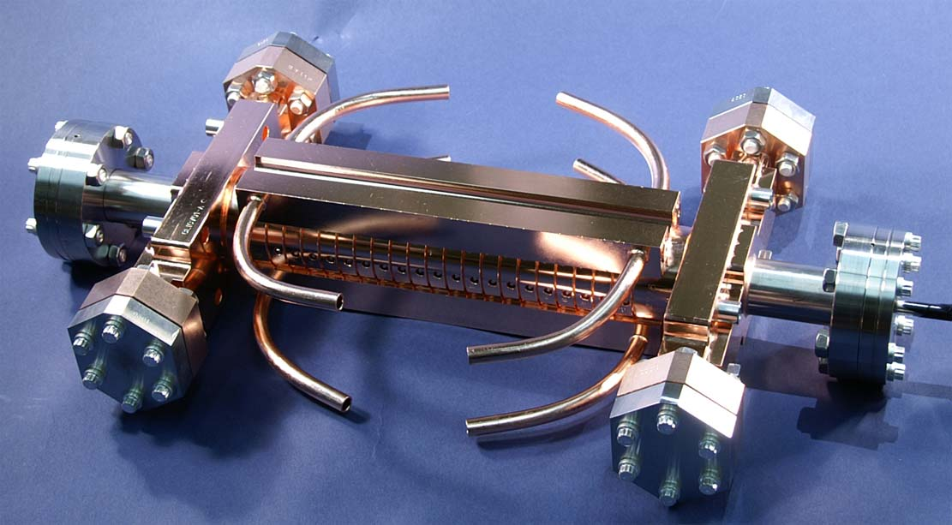
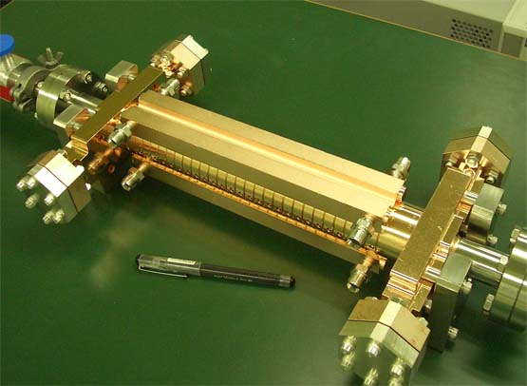
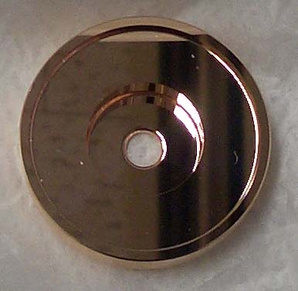
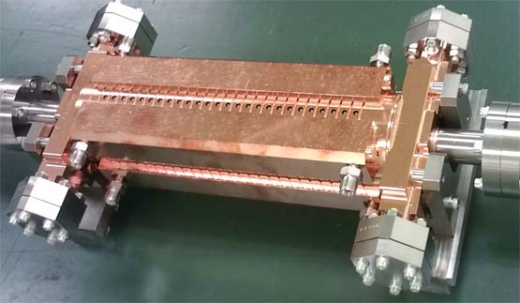
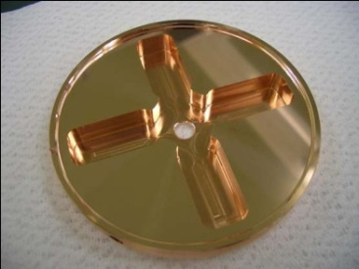
CLIC test structures; fabrication and test T18 →TD18→T24→TD24→TD24R05
1. T18_Disk_#2
undamped
3. T24_Disk_#3
damped
2. TD18_Disk_#2
4. TD24_Disk_#4
5. TD24R05 under test now

Slide 6
1st generation of CLIC X-band test structure prototypes T18/TD18 Parameters at tp=100 ns, <Ea>=100 MV/m
2007
T18_vg2.6_disk:
TD18_vg2.4_disk:
Very strong tapering inspired by the idea of having constant P/C along the structure
In TD18, all quantities are close to T18 at the same average gradient, except for the pulsed surface heating temperature rise which is factor 5 higher in the last cell.
A. Grudiev, IWLC2010

Slide 7
2nd generation of CLIC X-band test structure prototypes T24/TD24 Parameters at tp=100 ns, <Ea>=100 MV/m
2007
T24_vg1.8_disk:
TD24_vg1.8_disk:
Weaker tapering (quasi const gradient) together with smaller aperture (11% instead of 12.8%) reduce surface fields significantly compared to T18/TD18.
In TD24, all quantities are lower than in TD18 at the same average gradient. In particular pulsed surface heating temperature rise reduced by factor 2.

Slide 8
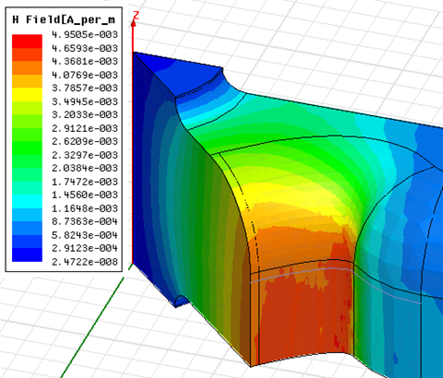
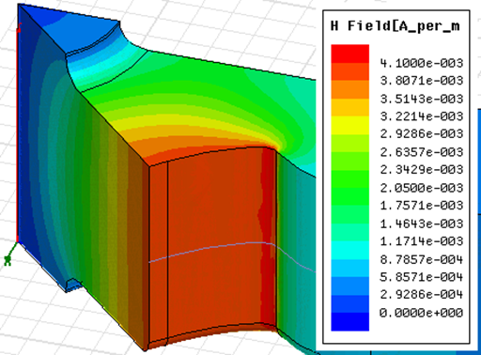
Reduce Hp/Ea and DT by reducing corner radius in the cell
Alexej Grudiev
TD24
TD24R05

Slide 9
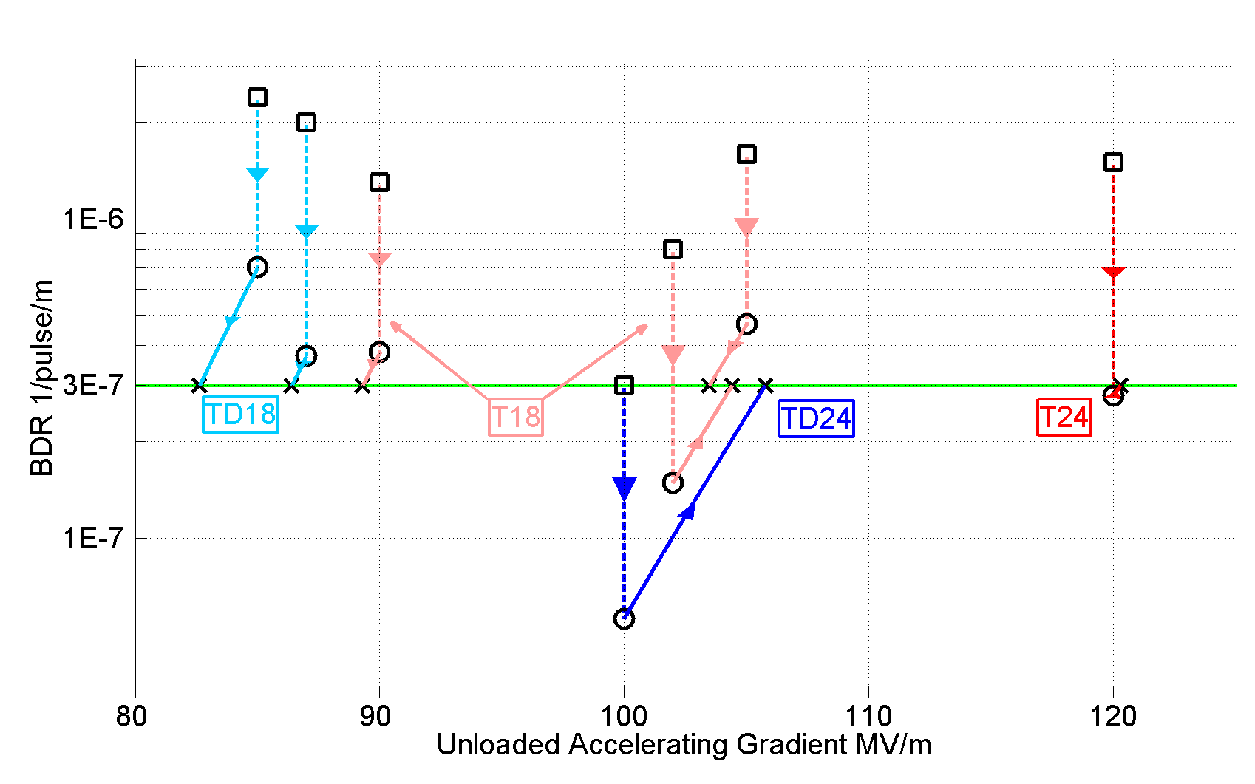
Accelerating gradients achieved in tests.
Status: 4-9-2012
HOM damped

Slide 10
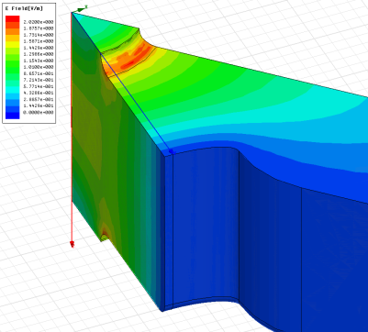
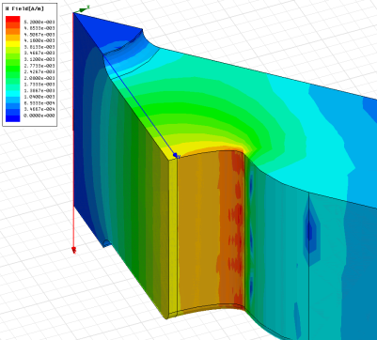
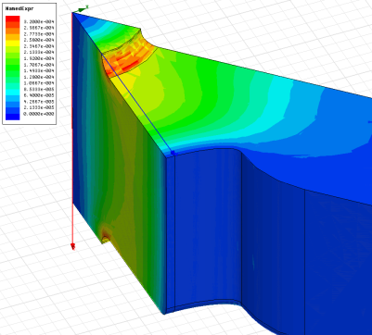
How we got there: High-power design laws
The functions which, along with surface electric and magnetic field (pulsed surface heating), give the high-gradient performance of the structures are:
E_{s}/E_{a}
global power flow
local complex power flow
New local field quantity describing the high gradient limit of accelerating structures.
A. Grudiev, S. Calatroni, W. Wuensch (CERN). 2009. 9 pp.
Published in Phys.Rev.ST Accel.Beams 12 (2009) 102001
H_{s}/E_{a}
S_{c}/E_{a}²

Slide 11
Simplified Parameter Diagram
Parameter Routine
Luminosity, …
Variable | Meaning | Current value
I_{drive} | Drive beam current | 101A
E_{drive} | Drive beam energy | 2.37GeV
τ_{RF} | Main linac RF pulse length | 244ns
N_{sector} | Number of drive beam sectors per linac | 4
N_{combine} | Combination number | 24
f_{r} | Repetition rate | 50Hz
N | Main beam bunch charge in linac | 3.72e9
n_{b} | MB bunches per pulse | 312
n_{cycle} | Spacing between MB bunches | 6 cycles
E₀ | MB energy at linac entrance | 9GeV
E_{cms} | Centre-of-mass energy | 500GeV
G | Main linac gradient | 100MV/m
I_{drive}
E_{drive}
τ_{RF}
N_{sector}
N_{combine}
f_{r}
N
n_{b}
n_{cycle}
E₀
f_{r}
E_{cms,} G, L_{structure}
Two-Beam Acceleration Complex
L_{module}, Δ_{structure}, …
Drive Beam Generation Complex
P_{klystron}, N_{klystron}, L_{DBA}, …
Main Beam Generation Complex
P_{klystron}, …

Slide 12
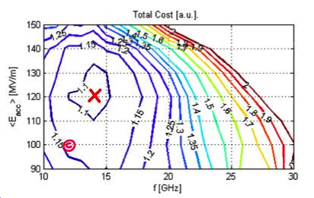
Optimization Ingredients
Define a figure of merit (FoM) to evaluate one given CLIC design/parameter set
e.g. FoM=-cost
Define a few free parameters to fully describe the design/parameter set
The other parameters are unambiguously defined by the free parameters
Currently: gradient G and a few structure parameters (f_{RF}, Δφ, a, Δa, L_{S}, …)
Use optimisation algorithm to find maximum
FoM(free parameters)
Currently: a simple full search
Allow some human intervention

Slide 13
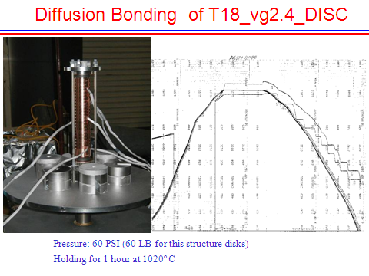
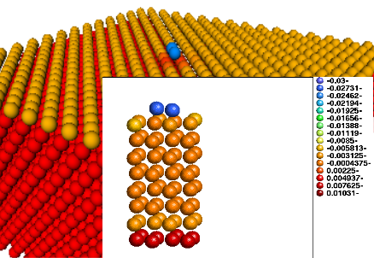
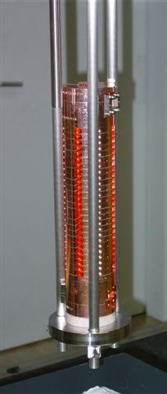
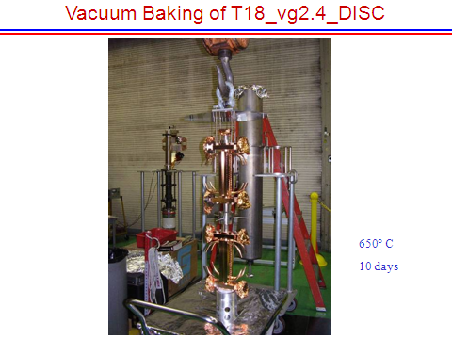
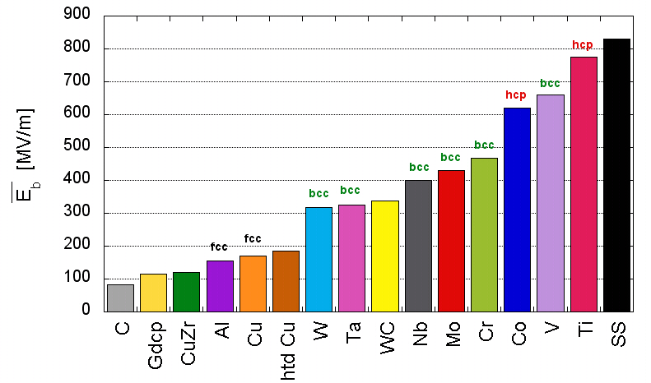
How we got there: heat treatment and material structure
TD18#3 at SLAC
TD18#2 at KEK
Stacking disks
Attempting to understand why it works.
Temperature treatment for high-gradient developed by NLC/JLC

Slide 14
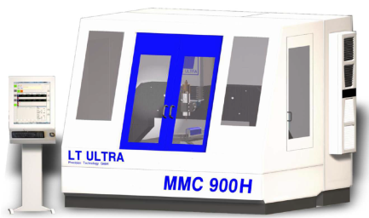
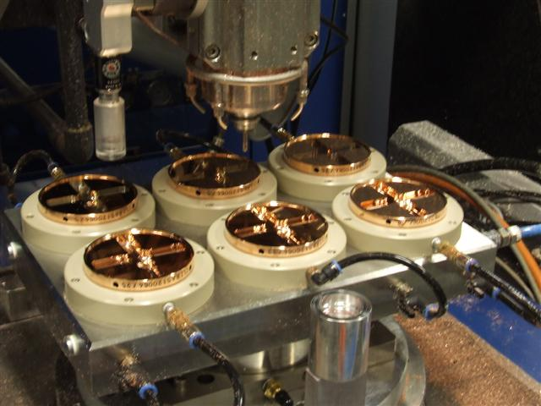
Micron precision turning and milling
Accelerating structure tolerances drive transverse wakefields and off-axis rf induced kicks which in turn leads to emittance growth – micron tolerances required.
Multi-bunch trains require higher-order-mode wakefield suppression – cells require milled features.
High-speed diamond machining also seems to be beneficial for high-gradient performance through minimizing induced surface stresses.
Development done “in industry”

Slide 15
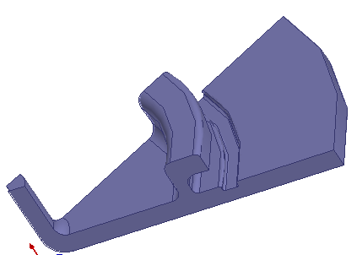
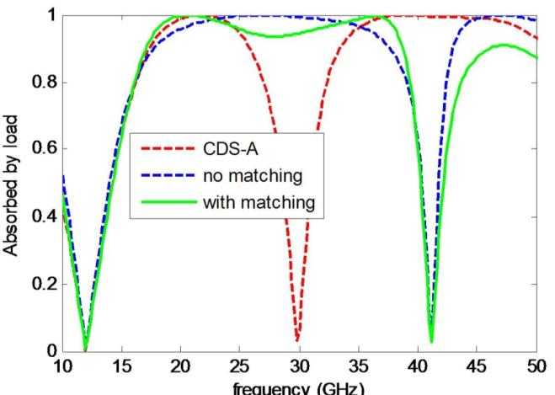
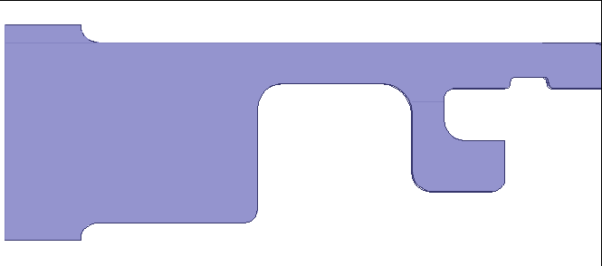
New choke design CDS-C
Features include “two-section”, “impedance matching”, “detuning”
2.0mm
1.2mm
1.6mm

Slide 16
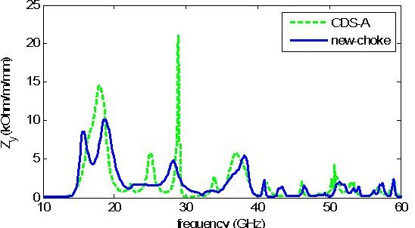
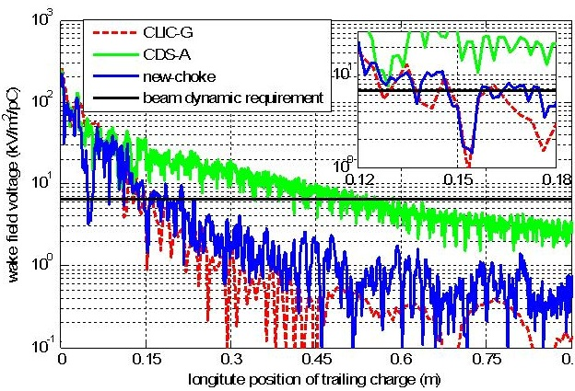
Damping result
 | W⊥ (s=0.15m) V/m/mm/pC
WDS | 5
CDS-A | ~30
CDS-C | 4~5
Freq(GHz) | Q | (R/Q)⊥
15.7 | 5.4 | 80.3
18.6 | 6.9 | 63.2
23.7 | 3.8 | 14.8
28.4 | 12.4 | 10.9
38.2 | 11.6 | 9.9
s | CDS | WDS
Fc | 1 | 1
Frms | 4 | 5
Fworst | 25 | 20

Slide 17
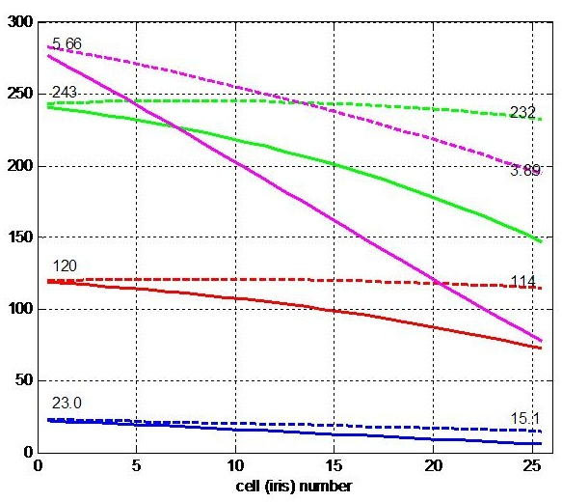
Full structure optimization CDS-C Parameter
 | CDS-C | CLIC-G
a(mm) | 3.15, 2.35 | 3.15, 2.35
Q(Cu) | 4895, 5385 | 5538, 5738
Zs(MΩ/m) | 59, 83 | 81, 103
vg(%c) | 1.38, 0.73 | 1.65, 0.83
Esurf(MV/m) | 245 | 235
Sc (MW/mm^2) | 5.66 | 5.39
Delta T(K) | 23.0 | 47.5
Pin (MW) | 67.5 | 60.5
Filling time(ns) | 75.4 | 64.8
RF-beam eff. | 23.8% | 27.5%

Slide 18
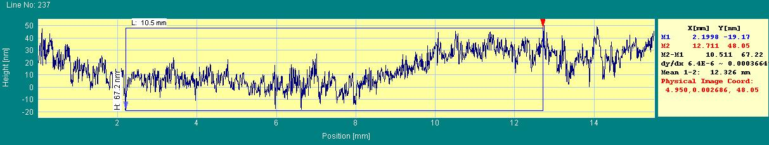
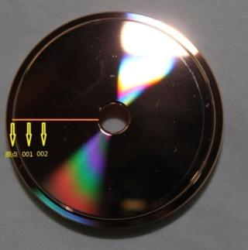
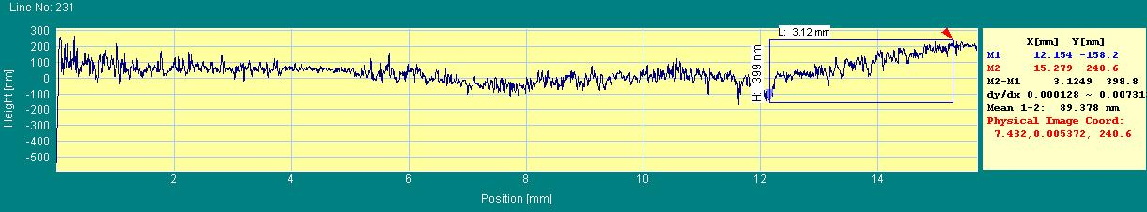
Flatness measurement before and after Etching
65nm
400nm
Note: different scale

Slide 19
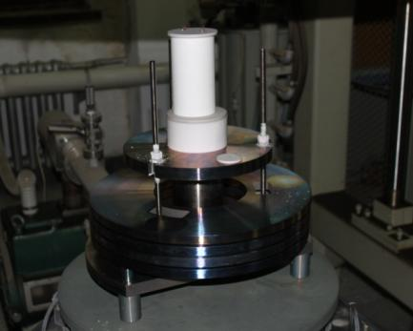
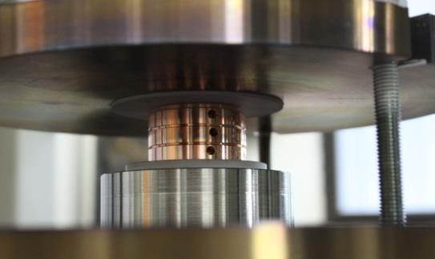
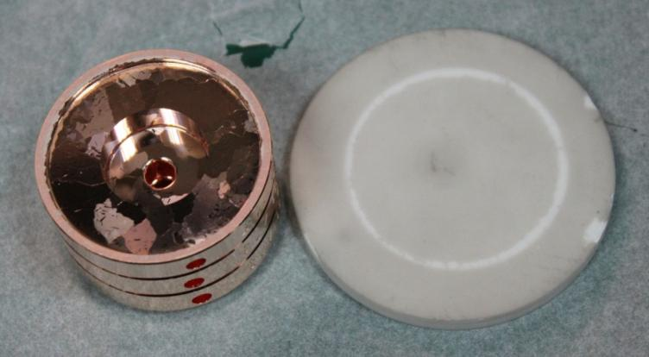
Bonding
Already cut into halves
One piece at CERN

Slide 20
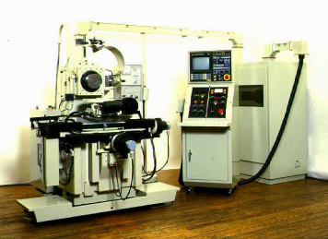
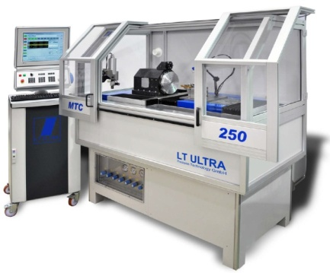
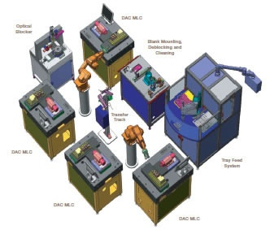
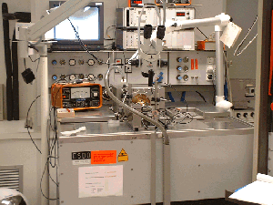
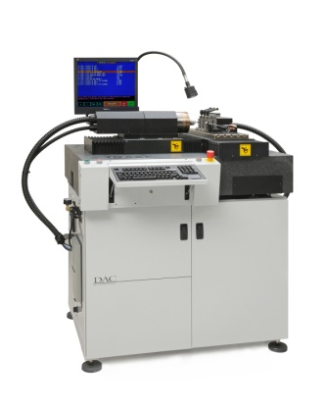
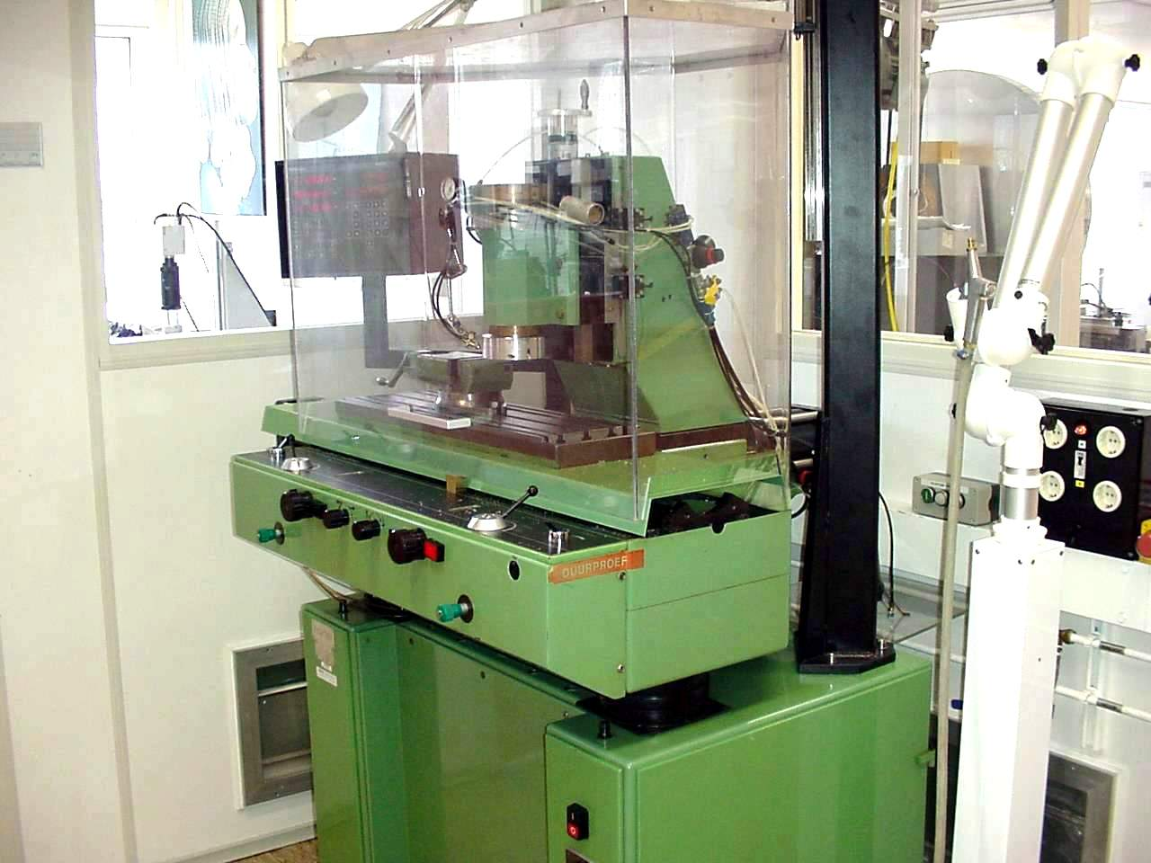
Evolution of machining capability
Single point diamond turning
Up to the 1980’s
1980’s - 1990’s
2000’s - 2010’s
Future ?
First machines at research institutes and universities
Start of industrialization
Optical recording
contact lenses
Larger machines
Multiple axis ( X/Y/Z and C)
Intelligent machines ?
Robotisation ?
Ultra precision diamond milling (lagging more than a decade behind on turning)
Up to the 1990’s
1990’s - 2000’s
2010’s
Future ?
Limited to fly cutting
mirror optics
Laser scanner mirrors
Milling as add-on on lathes
Lens arrays
Intra ocular lenses
First proto type machines
Micro fluidics
Accelerator parts
Pallet machining?
Robotisation ?

Slide 21
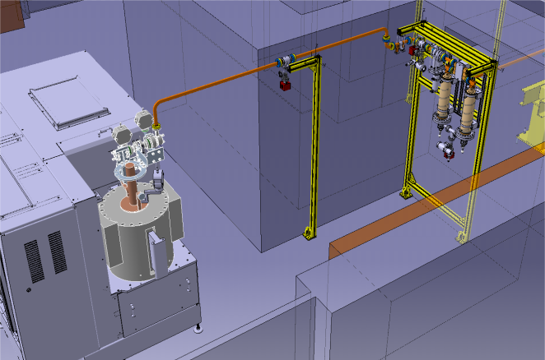
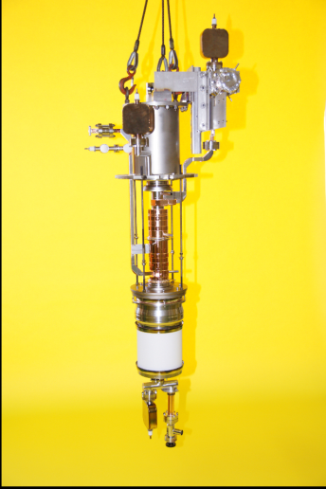
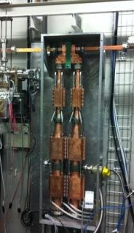
High-gradient testing using klystrons
In order to test enough accelerating structures we have an on-going campaign to establish a number of klystron-based test stands.
We have received an XL-5 klystron from SLAC from a batch order from SLAC and have an order out with CPI for two more.
A side benefit is that these test stands, with accelerating structures, turn out to be very close to the rf units one could use for:
an entry energy CLIC
a normal conducting FEL linac
a Compton-source linac
a medical linac
We wish to advance mutually beneficial work with these types of projects, and we hope today helps.

Slide 22
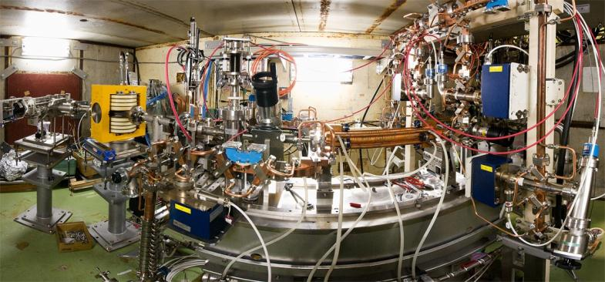
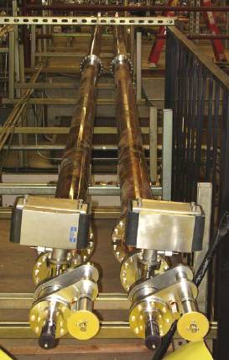
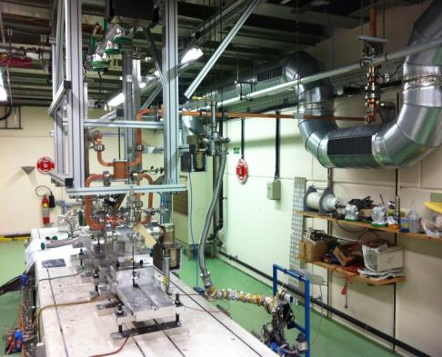
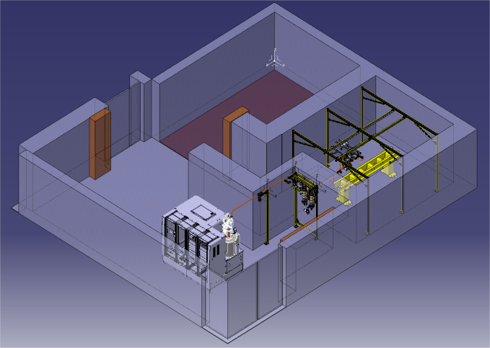
Klystron-based test stands for CLIC
NEXTEF at KEK
XBox1 at CERN
ASTA at SLAC?
XBox2 at CERN

Slide 23
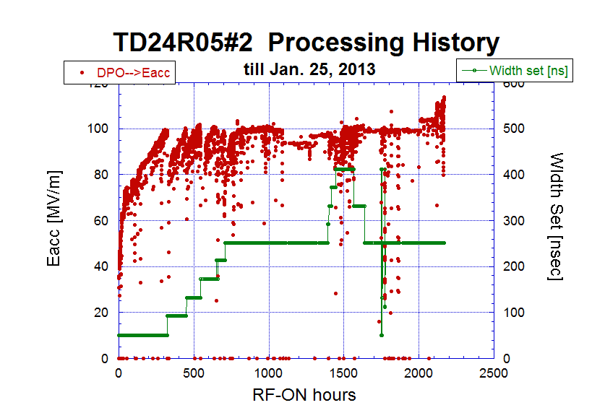
TD24R05#2 Processing history

Slide 24
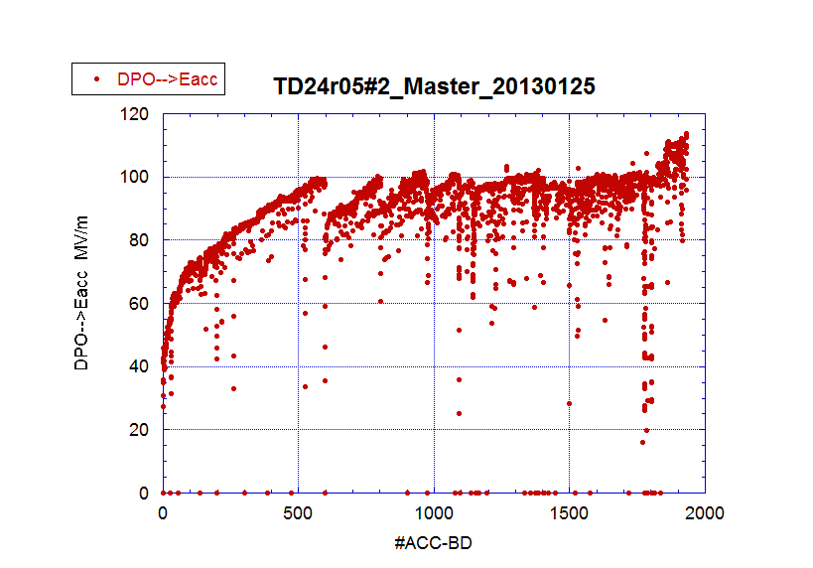
TD24R05 Eacc versus #ACC-BD

Slide 25

Difference in processing speed among 5 disk-stack-type CLIC-prototype structures
Number if ACC-BD’s until reaching the same level in (Tp, Eacc)
Speed
→1. T24
→ 2. TD24R05
→ 3. T18
→ 4. TD24
→ 5. TD18
TD24R05
T24
T18
91ns
132ns
51ns
TD24
TD18
Still to be revised for better comparison (130126)

Slide 26


The final X-box1 RF layout
Due to the delays caused by the klystron repairs, the conditioning software based on the CERN control system could not be finished ➔ Urgent need for control, interlock and feedback systems!
➔ Decision to use a National Instruments PXI based system for all Xbox-1 controls and DAQ
8ch 250MSps/s 14 bit ADCs for RF (log detectors) and DC sampling, one FPGA for 4chs used for interlocking on reflected power and DC spikes
I/Os for temp. gauges and interlock signals
Stepper motor control and encoder read back
Ion pump current readout for all pumps

Slide 27



Layout of the CERN x-band test stand
(X-box 1)
Clockwise from top-left:
Modulator
Pulse compressor
DUT + connections
Accelerating structure
Gallery
Bunker

Slide 28



Full conditioning history TD24R05

Slide 29

100ns-150ns history TD24R05

Slide 30



X-Box#2 – under prepration.
Bld. 150
D. Gudkov, CERN

Slide 31


Site preparation
21.02.2013
08.05.2013
Pre-approved by safety for radiation and seismic risks (more to come)
Shielding reinforced, area cleared,
Utilities to be deployed during summer
Modulator in place. Walls to be closed now.
Continuous work

Slide 32



Two paths for test stands and linac power units
50-75 MW tubes
NEXTEF, Xboxes 1 and 2
Potentially 100 Hz range linacs in the 8-9 GeV range.
7-10 MW tubes combined
Xbox3
Potentially kHz range linacs in the 1-2 GeV range.
Industrial supply is crucial!

Slide 33




Power production using PETS and two-beam acceleration
Drive beam ON
CLIC Nominal, unloaded
CLIC Nominal, loaded
Drive beam OFF

Slide 34


Slide 35


Slide 36


Introduction
Unloaded
CLIC nominal
Increasing current
Loaded (CLIC)
Gradient along the structure
Unloaded
Testing of accelerating structure with nominal beam loading was a missing block in our testing program. Such a test will be done using CTF3 (1.2 A) drive beam and RF power delivered from X-box1 (90 MW) via modified 30 GHz low loss transfer line (60MW).
The main target of this experiment is to compare loaded and unloaded accelerating structure breakdown trip rate.

Slide 37
Accelerating gradients achieved in tests.
Status: 4-9-2012
loaded

Slide 38




Complete Dog-leg test RF network layout (calculated RF transfer efficiency ~0.75)
Mode converter type#2
RF
∅ 50 mm circular waveguide
Beam
The number of 12 GHz new RF components were fabricated by CERN and CEA to re-adjust ‘old’ 30 GHz low losses transfer line to the new frequency.

Slide 39
Another option for low energies, e.g. 350 GeV:
X-band klystron driven

Slide 40




KMD and X-Band Overview, January 5, 2011 Erik Jongewaard
X-band klystrons (industrialized)
Klystron XL4 series
design
Klystron XL5 series
5 tubes have been fabricated at SLAC (1.5 are in operation). The first tube is ordered from industry (CPI)
Efficiency
32.5%
performance
18 tubes built to date (not counting rebuilds)
CLIC’k target
CLIC’k klystron:
59 MW
418 kV, 324 A (µK=1.2)
Efficiency 0.436
CLIC’k klystron:
59 MW
404 kV, 308 A (µK=1.2)
Efficiency 0.474

Slide 41




PPM focusing vs. Superconducting Solenoids
PPM, KEK
1994
…A superconducting focusing solenoid system for an X band klystron has been developed. The system consists of a conduction cooled superconducting solenoid, a GM refrigerator and high Tc material current leads. The system cools down to the operation temperature of about 4 K by 4 days just by turning on the refrigerator….
In the past 2 decades, the SC technology has progressed a lot. It is worth revising the use of SC (cryogen-free) solenoids for the klystrons again. If cost effective, such an approach will bring benefits for the technology as a whole.

Slide 42




Designing the linac
Klystron peak power for the fixed layout: 2 x Kl(PPM)+PC -> 6 x structures
Scaled (244 ns) 12 GHz DM SLED II performance
XL5 klystron measured
CLIC_G
_502
_1
_2
RF transport efficiency 0.9 is included
50 Hz
Case | CLIC_G | CLIC_502 | #1 | #2
Gradient, MV/m | 100 | 80 | 67 | 57
Length, m | 0.23 | 0.23 | 0.48 | 0.48
P peak, MW | 61.3 | 74.2 | 84 | 76
Efficiency, % | 28.5 | 39.6 | 41.9 | 49.5
F. Merit [a.u.] | 3.81 | 3.3 | 2.79 | 3.41
Used input: Klystron efficiency 0.55 (measured). Modulator efficiency 0.7 (expected)

Slide 43


CLIC’k RF unit layout
The alternative PC schemes certainly must be considered (especially for the low energy machine), but for our evaluation, we will keep DM SLED II as a base line option, as its performance was confirmed through the high RF power testing.
2-pack solid state modulator
PPM klystrons
460 kV, 2 μs flat top
59 MW
1.95 μs
118 MW
1.95 μs
x 4.64
~17.7 m, ∅16.3 cm
TE01 transfer line (? m)
TE01 90⁰ bend
Inline RF distribution network
492 MW
244 ns
Common vacuum network
x 8 accelerating structures,
100 MV/m loaded gradient
2 m, 1.83 active
Compared to NLC, the energy gain per unit in CLIC’k case is 26% lower (need more klystrons per meter), but the unit active length is ~ 2 time shorter.

Slide 44





Alternative#1. One channel design.
Mode launcher
E _{surf} = 180 MV/m at 490 MW
Such a pulse compressor is under construction at KEK
Potentially, the factor >2 cost reduction compared to DM SLED II can be anticipated – one channel and much less sophisticated RF network. Indirect savings will come from halving the number of pipes needed to be installed in a tunnel.
Compared to DM SLED II, OC SLED is 8% less efficient.
High RF power capability is the biggest issue.
Another design of the mode launcher may solve this problem
E _{surf} = 90 MV/m at 490 MW
30 MW/channel
490 MW

Slide 45

Modulator & Space reservation issues
Because of the high accelerating gradient and thus the need for high RF power density (245 MW/m), there is a very severe demand on space reservation (~ 1 klystron/m) in the service tunnel to insure a high enough technical gradient. As a first approximation, the DFM2 modulator can be fitted. More studies (which should include space reservation for all the other systems) will be needed to prove such a concept.
2.5 m
1.5 m
Power supply for
2 x modulator
DFM2
4.0 m

Slide 46
Not the main line but a growing theme – applying CLIC technology to other projects.
I will now show a few slides on a proton cancer therapy application.
But we try to work more and more with XFELs, Compton sources etc.

Slide 47

Design project B: cyclinac for single-room proton facility

Slide 48

TULIP 24 – baseline design
230 MeV
24 MeV

Slide 49





Backward wave high-gradient accelerating structure for proton acceleration based on CLIC technology

Slide 50

Optimization plots - fields

Slide 51
Physical processes of breakdown

Slide 52

Relevant data points of BDR vs Eacc
TD18
Steep rise as Eacc, 10 times per 10 MV/m, less steep than T18
T. Higo, KEK

Slide 53

TD18_#2 BDR versus width at 100MV/m around 2800hr and at 90MV/m around 3500hr
TD18
Similar dependence at 90 and 100 if take usual single pulse?
T. Higo, KEK

Slide 54






Diffusion bonding of structure under H₂ at 1 bar
Also done at TED with degreasing and etching at CERN before bonding
Applied weight: 33.7 kg equivalent to ~ 0.08 – 0.12 MPa;
Same thermal cycle as couplers but with flat top at 1010°C
No deformations observed on the external diameter after bonding
Disks after etching
Coupler
Structure n°1
Structure n°2
Assembly of disks in the furnace
Geometrical measurements on external diameter after bonding
Alignment = 9µm for ACS#1 and 12.6 µm for ACS#2
Angle = 90.0514° for ACS#1 and 90.0087° for ACS#2

Slide 55

TD24R05 conditioning in Xbox-1

Slide 56



T24#3 BDR evolution at 252ns normalized 100MV/m
Assuming the same exponential slope as that at 400hr
We understand the BDR has been kept decreasing.
From T. Higo

Slide 57

What are the field emitters? Why do we look for dislocations?
The dislocation motion is strongly bound to the atomic structure of metals. In FCC (face-centered cubic) the dislocation are the most mobile and HCP (hexagonal close-packed) are the hardest for dislocation mobility.
A. Descoeudres, F. Djurabekova, and K. Nordlund, DC Breakdown experiments with
cobalt electrodes, CLIC-Note XXX, 1 (2010).

Slide 58


Dislocation-based model for electric field dependence
Now to test the relevance of this, we fit the experimental data
The result is:
Power law fit
Stress model fit
[W. Wuensch, public presentation at the CTF3, available online at http://indico.cern.ch/conferenceDisplay.py?confId=8831.] with the model.]

Slide 59

Electron emission
Fowler Nordheim Law (RF fields):
I_{FN}
(β, φ₀, A_{e}, E₀)
High field enhancements (β) can field emission.
Low work function (φ₀) in small areas can cause field emission.
typical picture ➔
geometric perturbations (β)
alternate picture ➔
material perturbations (φ₀)
grain
boundaries
peaks
oxides
cracks
Copper surface
inclusions
(suggested by Wuensch and colleagues)

Slide 60
Schottky Enabled Photo-electron Emission Measurements
ICT
Data 2010-10-04
First results
from Tsinghua
e-
γ
Should not get
photoemission
Experimental parameters
work function of copper = φ₀ = 4.65 eV
energy of λ=400nm photon = hν= 3.1 eV
Laser pulse length
Long = 3 ps
Short = 0.1 ps
Laser energy ~1 mJ (measured before laser input window)
Field (55 – 70 MV/m)

Slide 61
→Long Laser Pulse (~ 3ps) →E=55 MV/m@ injection phase=80 ➔ 55sin(80)=54
First results
from Tsinghua
Data 2010-10-04
Q I
single photon emission
Q(pC)
laser energy (mJ)
photocathode input window

Slide 62


Slide 63


Modelling DC discharges
~ 4-6 kV
r=1 mm
d=20 μm
e.g. Cu
First we have to understand breakdowns in DC, before we can generalise to RF
Simple and cost-efficient testing of breakdown behaviour with two DC setups at CERN
We adjusted also out theoretical model to the DC experimental conditions
However, results are completely general!

Slide 64



Evolution of β & E_{b} during conditioning experiments
Measurements of β after each sparks (Cu electrodes)
β · E_{b} = cst
β ↔ next E_{b}
correlation
β ↔ previous E_{b}
no correlation
Antoine Descoeudres

Slide 65

Evolution of β during BDR measurements (Cu)
β·E = 10.8 GV/m
spark
breakdown as soon as β > 48 ( ↔ β · 225 MV/m > 10.8 GV/m)
consecutive breakdowns as long as β > β_{threshold}
length and occurence of breakdown clusters ↔ evolution of β
Antoine Descoeudres

Slide 66



Simulated system
Fully coupled electric field – mechanical interaction
Electric field deforms sample
Deformed sample causes local field enhancement
Dc El. field ramped from 0 … 10 000 MV/m
Comsol Multiphysics 4.3
Nonlinear Structural Materials Module
AC/DC module
3D-simulations, 2D-snapshots
Simulated materials:
Soft copper
Single crystal copper
Stainless steel

Slide 67


Deformation at realistic electric field strength
Void formation starts at fields > 400 MV/m
Material is plastic only in the vicinity of the defect
Thin slit may be formed by combination of voids or by a layer of fragile impurities
Field enhancement factor ~2.4
Thin material layer over the void acts like a lever, decreasing the pressure needed for protrusion formation

Slide 68


Slide 69


Slide 70



DC Spark System Turn on Time
Sample size = 50
The spread in voltage fall times (and current rise times) is extremely small compared to the RF case.
The measured current rise time always shorter than voltage fall time due to initial charging current overlap.

Slide 71
Summary of turn on times
Test | Frequency | Measurement | Result
Simulation |  |  | 0.25ns
New DC System | DC | Voltage Fall Time | 12-13ns
Swiss FEL (C-Band) | 5.7GHz | Transmitted Power Fall Time | 110 - 140ns
KEK T24 (X-Band) | 12GHz | Transmitted Power Fall Time | 20-40ns
CTF/TBTS TD24 (X-Band) | 12GHz | Transmitted Power Fall Time | 20-40ns
CTF SICA (S-Band) | 3GHz | Transmitted Power | 60-140ns
The turn on time does not seem to be related to the bandwidth of the structures but to the frequency or possibly the intrinsic size.

Slide 72
Pulsed surface heating limit
TD24
Last
regular
cell: 19
Cell # (cell #1 is a input matching cell):
4
?16?
5
6
7
8
9
10
11
12
13
14
15
17
18
It seems that cell #10 (regular cell #9 ~ middle cell) exhibits the level of damage which could be considered as a limit.
A. Grudiev
Images courtesy of M. Aicheler: http://indico.cern.ch/getFile.py/access?contribId=0&resId=1&materialId=slides&confId=106251

Slide 73

Features in high current region of TD18
Current density around 2x10⁸A/cm² during test
Damping waveguide
Inner cell

Slide 74

Electromigration
Our current(!) explaination is that these features are due to electromigration. Electromigration is the transport of atoms in a conductor due to momentum transfer from the current.
This can cause the formation of voids and breakup of the material.
The effect has been a problem in semiconductor interconnects – at current densities of

Slide 75


Slide 76

An effect of surface tension plus electromigration?
So does this evolve…
…into this?
If the such localized flow features exist, the surface currents will preferentially flow though them.
We get a current enhancement, increasing pulsed surface heating and electromigration.
These combined effects could then have a positive feedback and produce an instability.

Slide 77


Forming a community
HG2012 at KEK
https://indico.cern.ch/conferenceDisplay.py?ovw=True&confId=208932
Now in our seventh year. Focus steadily expanding to include broad high-gradient normal-conducting rf community.
http://indico.cern.ch/conferenceDisplay.py?confId=231116

Slide 78



MeVArc – Multidisciplinary and multi-application workshop dedicated to breakdown physics
http://www.regonline.com/builder/site/default.aspx?EventID=1065351
This year 5-7 November – hosted by CERN. More information soon.

Slide 79


Last slide
…with CLIC technology!
Your project…

